Slide 1
TB 2022
Potentially problematic channels

Slide 2
Some initial notes
In the next slides I’ll state the channel’s location in the form of (Row, Column) as well as the channel number.
For example – (3, 16) ch 120
Noisy channels will be bolded on the images for ease of identification.
Sometimes a channel will be noisy in one run and completely blank in another. In such case it is written as noisy but is anyway considered defected.
Please feel free to comment and express your opinion on the selected channels.

Slide 3
CALICE

Slide 4
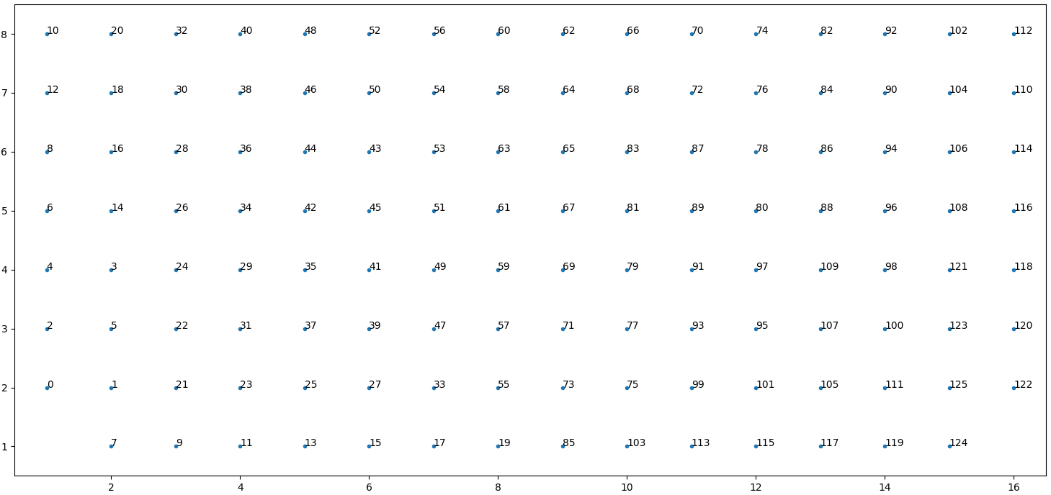
First, Sensor Layout
Numbers presented are (Jakub) channel numbers.
CALICE – bottom left and right corners are not connected.
Row #
Column #

Slide 5
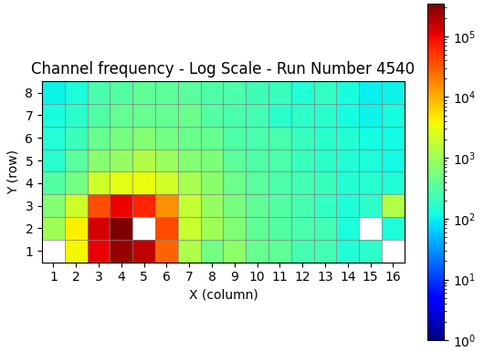
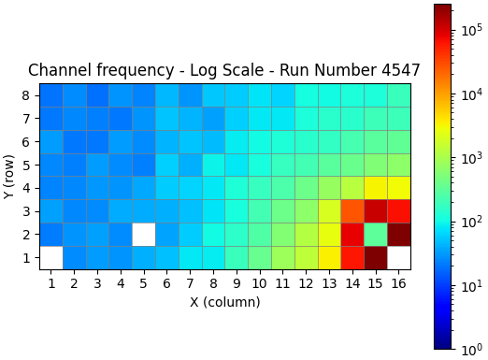
C74
Slightly noisy – (3, 16) ch 120
Weak or dead – (2, 5) ch 25, (2, 15) ch 125
Weak or dead are bolded below as well as the noisy channel.

Slide 6
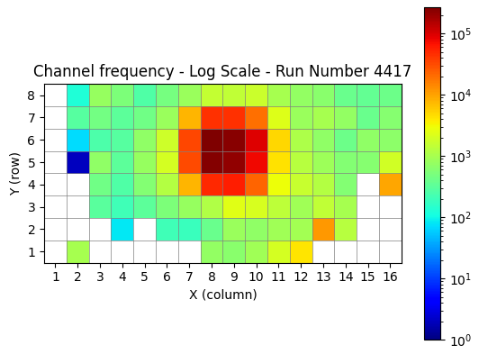
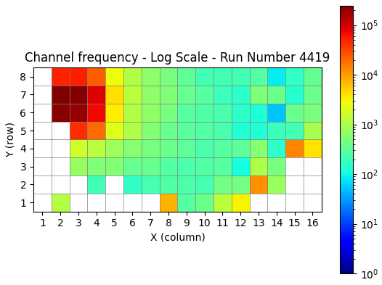
C75
Noisy – (4,15) ch 121, (4,16) ch 118, (2,13) ch 105
Slightly noisy – (1,8) ch 19, (1,12) ch 115
Weak or dead (not bolded, too many) – column 1, column 2 rows 2-5, (1,3), (2,3), (1,4), (1,5), (2,5), (1,6), (1,7), (1,13), (1,14), (1,15), (2,15), (3,15), (1,16), (2,16), (3,16)

Slide 7
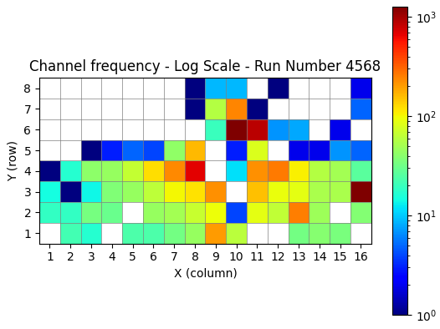
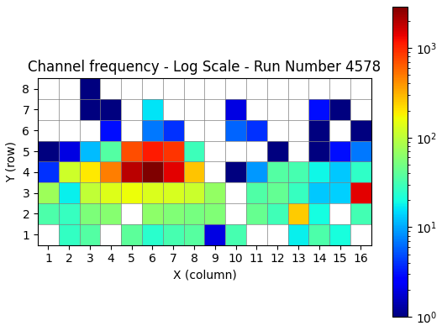
C72 (new glue)
Noisy – (2,13) ch 105, (3,16) ch 120
Weak or dead – most…

Slide 8
GaAs

Slide 9
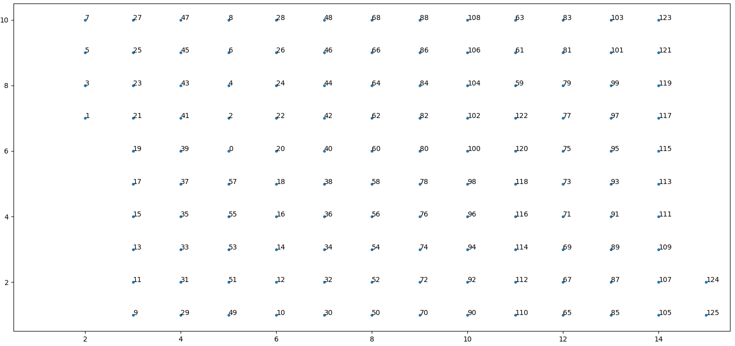
Again, Sensor Layout
GaAs – left column not connected, as well as 6 bottom pads in second column and top 8 pads of most right column.
Row #
Column #

Slide 10
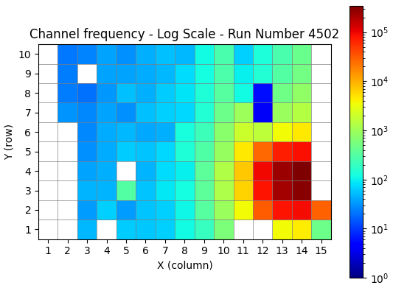
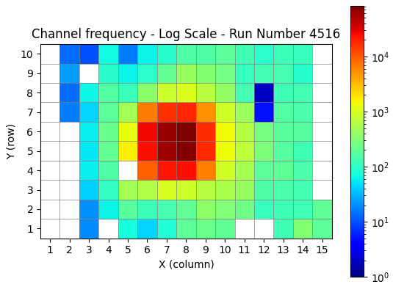
Yan1
Slightly noisy – (3,5) ch 53
Weak or dead – (9,3), (1,4), (4,5), (7,12), (8,12), (1,11), (1,12)
(1,15) sometimes seems weak, but in general not ideal anyway
I’ve blackened non-connected pads to avoid confusion
Weak?
Not weak?

Slide 11
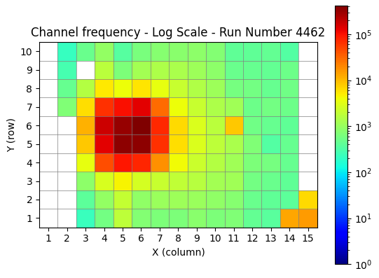
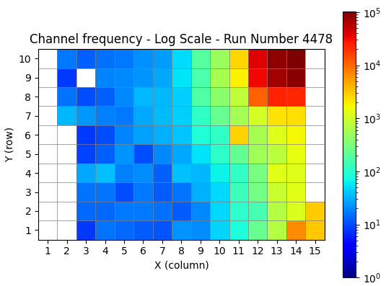
Anton1
Noisy – (6,11) ch 120, (1,14) ch 105, (1,15) ch 125, (2,15) ch 124
Weak or dead – (9,3) ch 25.
I believe (9,3) was cancelled due to large noise (relevant to Yan1 as well)
I’ve blackened non-connected pads to avoid confusion

