Slide 1
ARES Operation Meeting
Summary of week 47 / 2022
Max Kellermeier, on behalf of the ARES crew

Slide 2
Summary of week 47
Mon. 21st November | Tue. 22nd November | Wed. 23rd November | Thu. 24th November | Fri. 25th November
 |  | Laser auto-alignment works again (exposure and gain adjusted) Prepared machine state for high charge, low DC WP Transportable Charge range tested for MDI shift (with high DC) → up to ~70 pC MDI shift: intensity measurements for proper calibration Pulse shot mode tests | Auto Acc. Shift Continuing BO vs. RL studies | Bunch duration measurement with Three-phase method MMG phases determined and set to on-crest Momentum and Pointing jitter measurements for arrival time stability
 |  | Local modulator reset of TWS2 necessary Pulse shot mode requires further investigations; No. pulses not reliable yet |  | Severe reference phase drift of TWS2 (no live correction applied) Periodic vertical oscillations in pointing stability measurements
Tunnel open | Tunnel open for cabling work |  |  | Tunnel opened for the weekend
Achievements
Difficulties
Notes

Slide 3
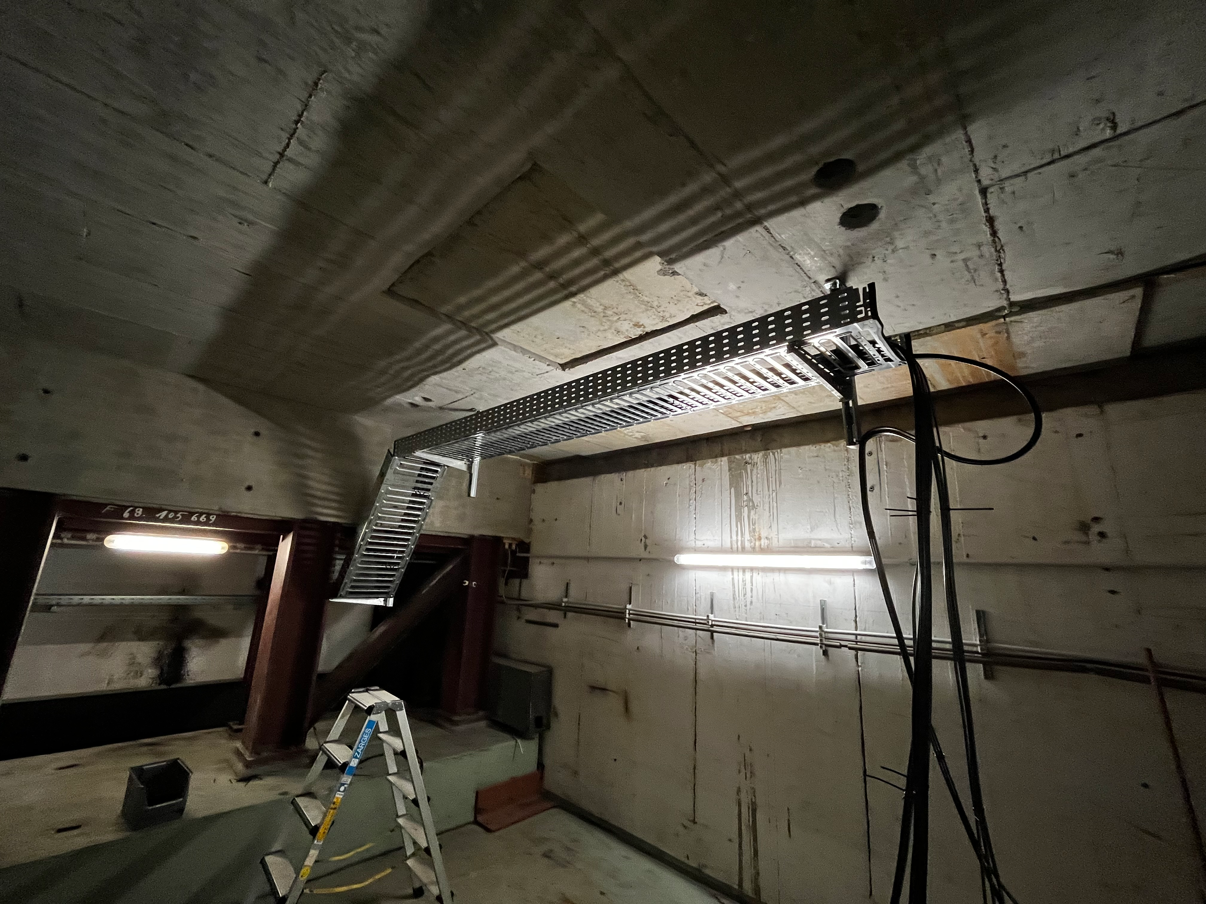
MIN X-Band cabling
+ floor painting works in the Xband Modulator room.

Slide 4
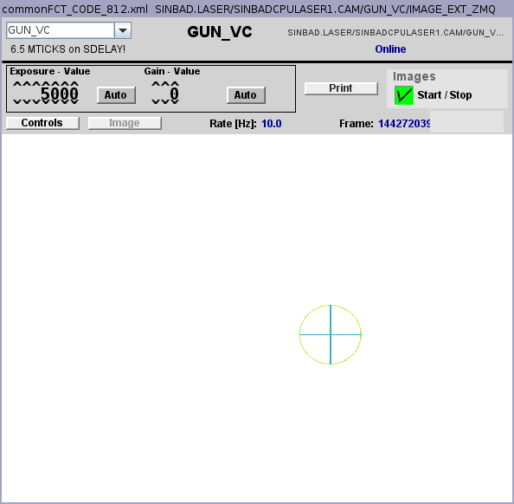
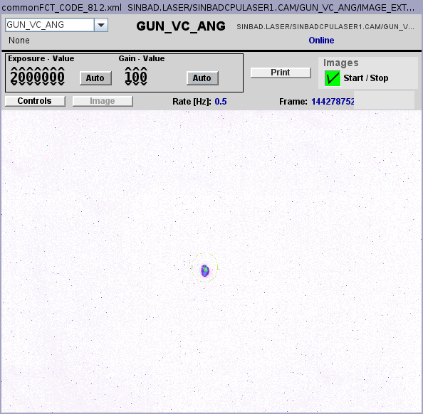
Laser Auto-alignment
Works again, but slow (0.5 Hz)

Slide 5
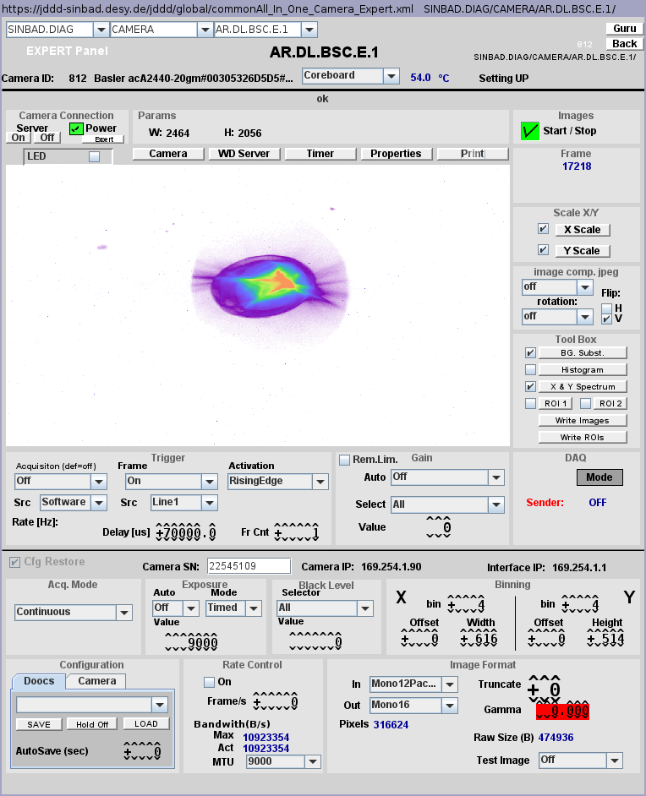
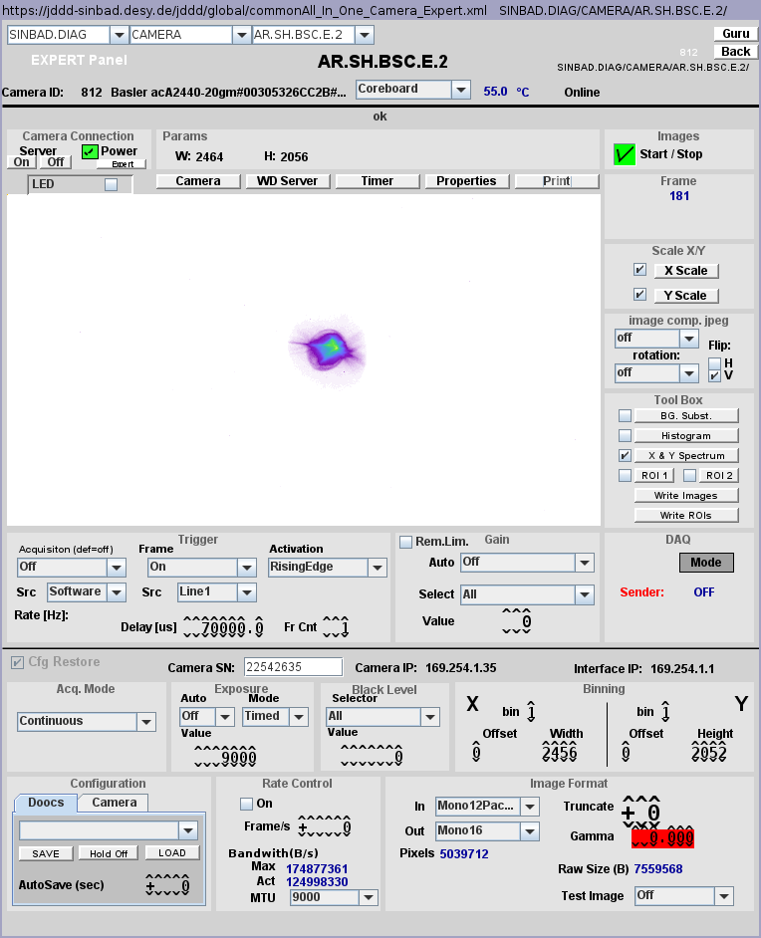
High Charge settings for MDI shift
Transport up to SH.E2
62pC (FC1), 71pC (DaMon 1 coarse)
PHAROS 28%,
aperture 320um,
user attenuator 8000
  FC1: 70pC
  Damon 1 coarse: 80pC

Slide 6
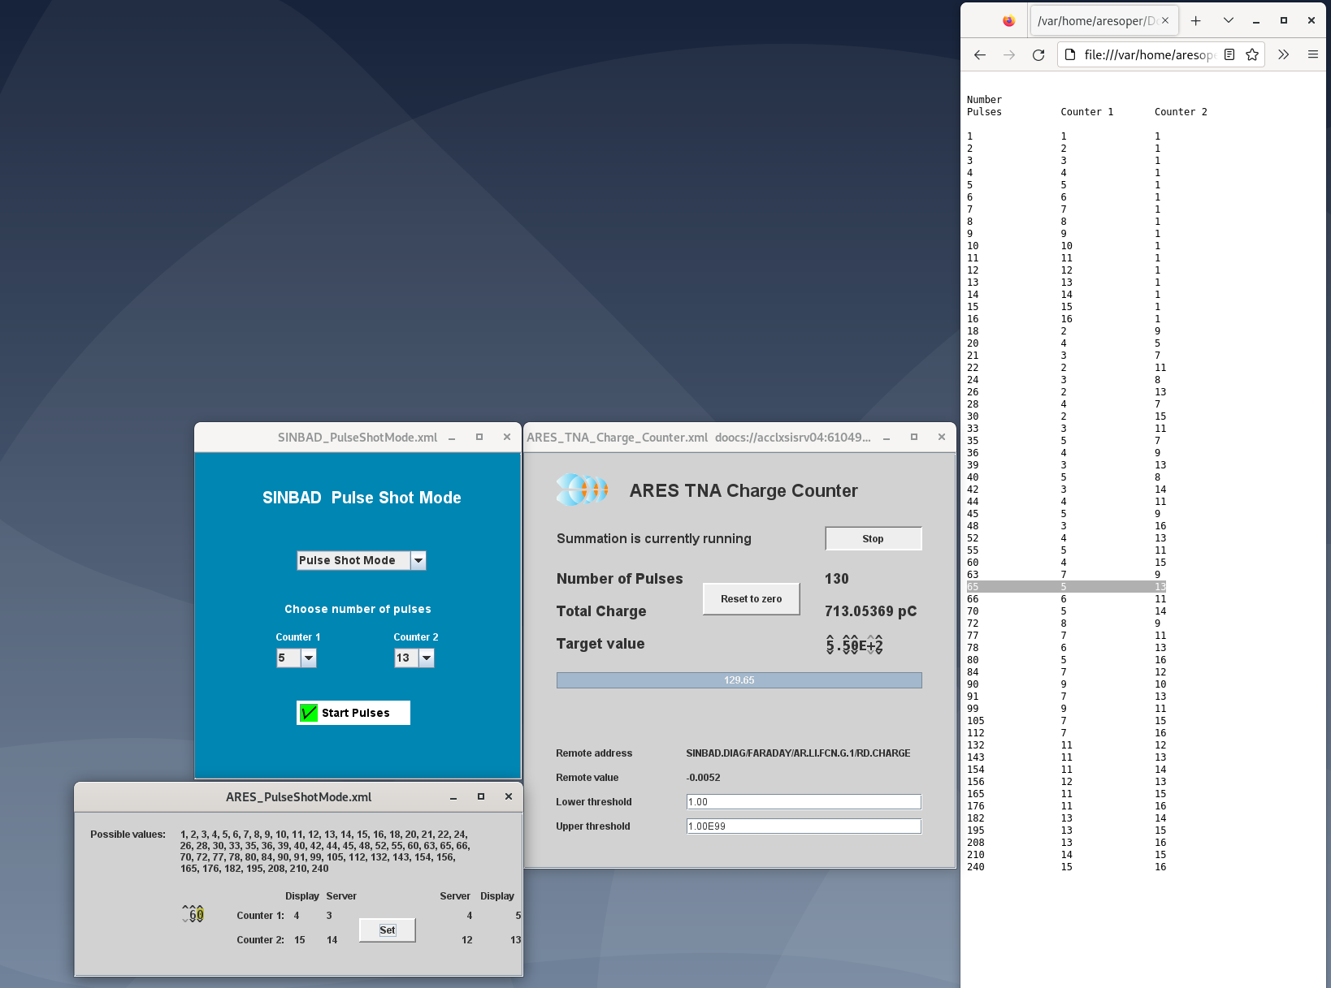
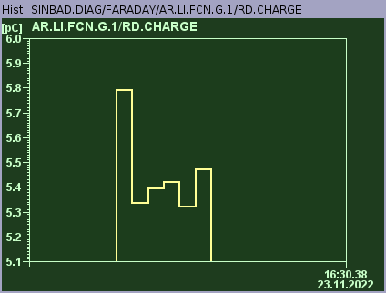
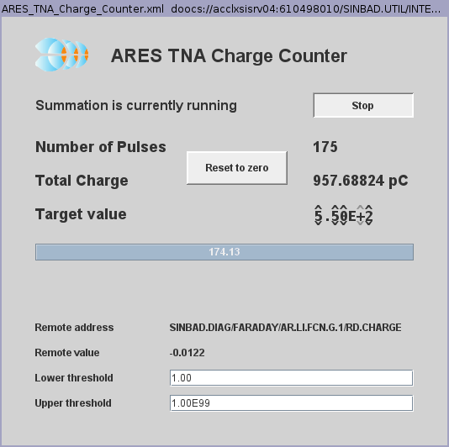
Laser pulse shot mode
Further investigations needed
Sent 5 shots:
Example:
Counters at 9 and 11 → 99 shots
Sometimes only 98 were counted
-1 Bug fixed by Hannes
Tests continued with panel from MCS and test panel
Charge counter panel extended with pulse counter

Slide 7
Autonomous Acc Shift
Comparison of RL and BO: Results in good agreement with results from week before

Slide 8
Measurements for arrival time stability
MMG phase of all three structures measured and set to nominal zero (on-crest), low charge (0.12 pC at FC1)
Momentum and pointing stability measurements for:
  TWS1 on-crest + TWS2 off
  TWS1 on-crest + TWS2 on-crest
  TWS1 on-crest + TWS2 -90° off-crest
  TWS1 on-crest + TWS2 +90° off-crest

Slide 9
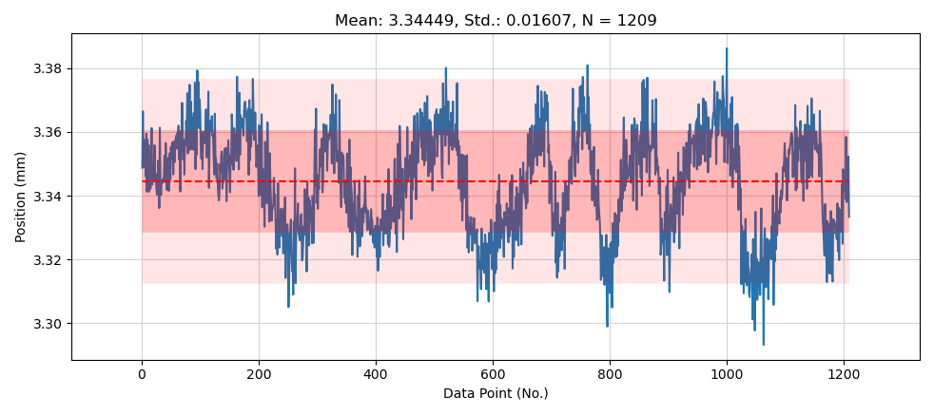
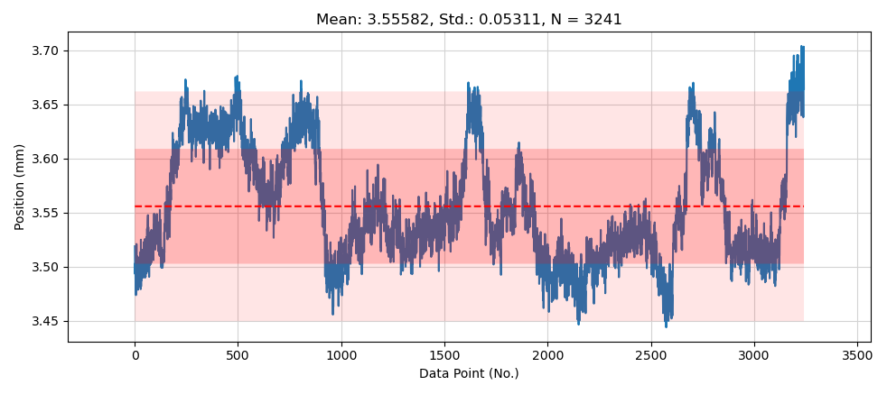
Stability of vertical beam position
TWS2 on-crest vs. off-crest
70µm Peak-to-peak
200µm Peak-to-peak
On SH.E2
Similar with TWS2 off-crest

Slide 10
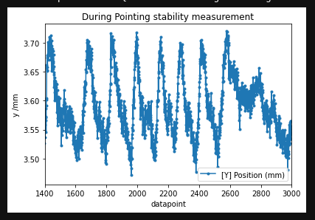
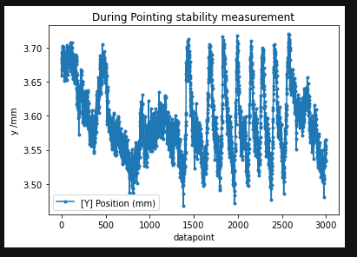
Periodic Vertical osc. in pointing stability measurements
TWS2 off
Vertical beam variation of about 200µm peak-to-peak verified at end of shift
No periodic features observed anymore

Slide 11
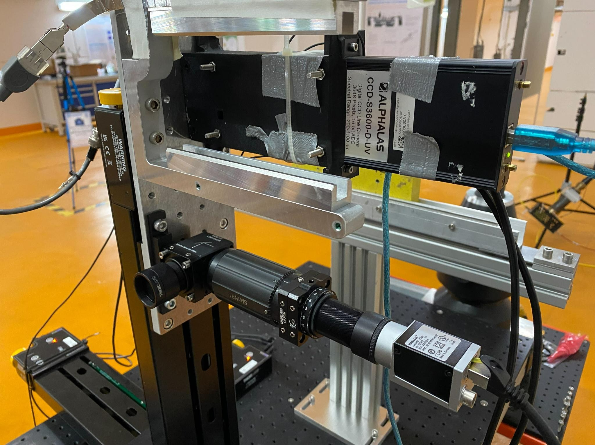
Ultra-low charge BPM / 1D beam profile monitor

Slide 12
D3 tests??
To be clarified with Oliver

Slide 13
Plan
Week 48
Monday
  Tunnel open
    Painting
    cabling
Tuesday
  MSK gun gradient attenuator adjustments
  Ultra-low charge BPM tests
Wednesday
  BPM & intensity monitor tests (tbc)
  Beam manipulation in the EA in air.
Thursday
  AutoAcc
  (BKR Jahresabschlussbesprechung)
Friday
  Tbd
  (tunnel search training)

Slide 14
Schedule
Week 48
Date | Schedule
28.11. | Tunnel open
29.11. | Frank
30.11. | Willi
01.12. | Thomas
02.12. | Hannes
If you want to learn or join the shift: please give the shift leader a call (BKR 2840 / SINBAD Box 2454)

