Slide 1
Mr. Mykola LUBIV Senior Deputy Executive Director Science and Technology Center in Ukraine

Slide 2
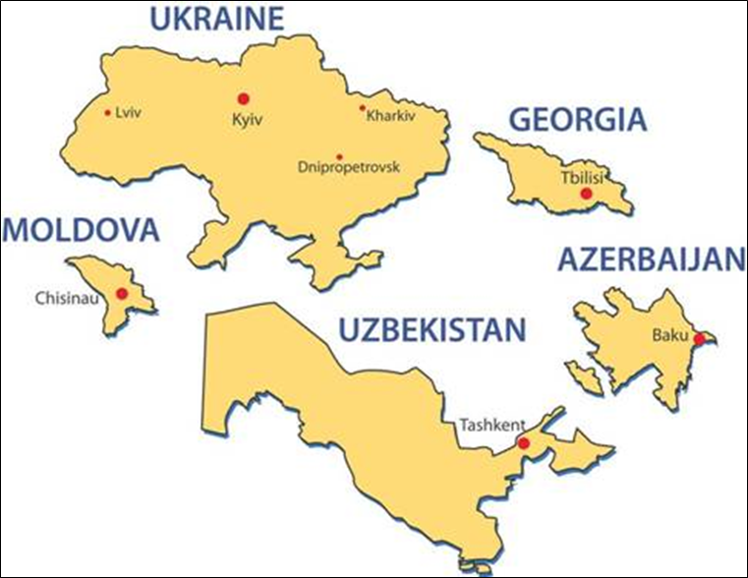
European Union
STCU 7 Member States, including 3 Governing Parties
STCU has engaged:
Nearly 1,000 Scientific Technical Institutes
Over 20,000 scientists, of which over 12,000 were former weapons scientists during the Soviet times
Over 2000 Projects over $387 Million USD

Slide 3
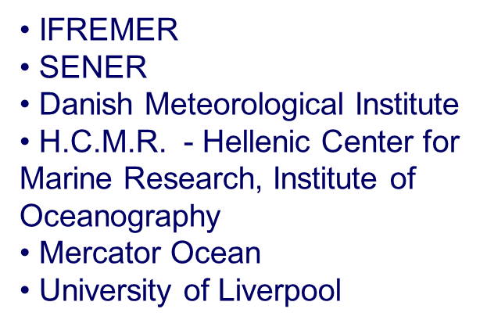
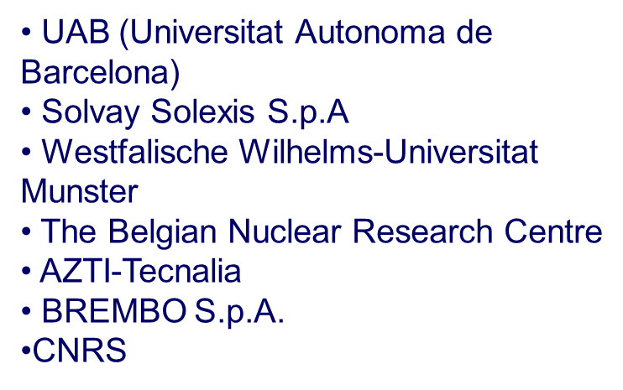
Universities and private companies from the European Union, have used STCU to manage more than (43) Horizon 2020 projects worth over €18.75 million.
Some of STCU H2020 Programs EU Partners

Slide 4
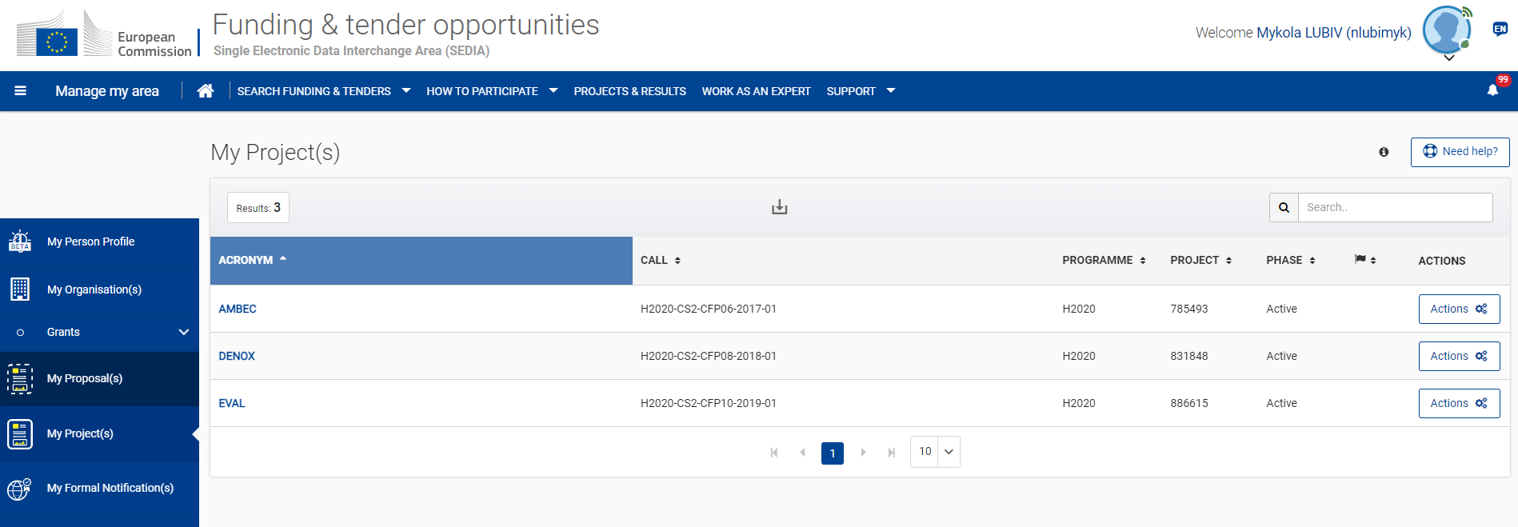
STCU VALIDATION IN H2020 PORTAL 2017
STCU PIC - 933457482

Slide 5
Why work through the -
STCU reduces your business risk in Ukraine and other NIS countries!
Guaranteed business security, reliability and confidentiality
Clear and transparent financial operations
Tax-free grants to scientists through their individual bank accounts
VAT-free purchases
Custom clearance assistance free of all duties and taxes
Project auditing and monitoring, timely delivery of scientific reports and results
Consortium Coordination – free of charge
Host government concurrence

Slide 6
Countering Nuclear Energy Disinformation Fellowship Program
5 ACTIVE PROJECTS
6 UKRAINIANS SCIENTIFIC INSTITUTIONS
32 UKRAINIAN NUCLEAR EXPERTS
Budget: $100,000.00

Slide 7
Virtual Advanced Nuclear Reactor Technology Fellowship Program
17 ACTIVE PROJECTS
9 UKRAINIANS INSTITUTIONS
44 UKRAINIAN SCIENTISTS
Budget: $400,000.00

Slide 8
Virtual Scientist Engagement Fellowship Program for Vulnerable Ukrainian Scientist
39 ACTIVE PROJECTS
19 UKRAINIANS INSTITUTIONS
70 UKRAINIAN SCIENTISTS and ENGINEERS
Budget: $750,000.00

Slide 9
STCU new activities during 2022
Communication support
Research Vetting, Individual Cybersecurity, and Knowledge Security
Nonproliferation Scientist Engagement Program
Strengthening Individual and Institutional Cybersecurity Capacity against Proliferator State Threats for Research Institutes and Academia in Ukraine
Cybersecurity Awareness Training for IT and OT environments

Slide 10
Thank you for attention! Mykola Lubiv Senior Deputy Executive Director Science and Technology Center in Ukraine contact email Mykola.Lubiv@stcu.int

