Slide 1
Towards a
portable & standalone
DAQ for MIMOSIS
Oliver Keller (FAIR)
GSI Detector Lab
o.keller@gsi.de
9.02.2023

Slide 2
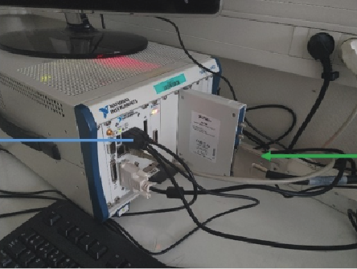
Status Quo: Readout System from IPHC
National Instruments PXIe crate
NI FlexRio FPGA module PXIe-7975/PXIe-7962
NI 6587: 20 x 1 Gbit/s I/O channels (LVDS)
Data taking divided in acquisitions
about 10-30 k frames until RAM buffer full
then data written to disk
dead time in between acquisitions
additional trigger channel for scintillator
Two main variants
Lab setup for single chip characterization
Test beam setup for 6 MIMOSIS chips in telescope configuration
Dedicated software drivers & GUI in C++/LabView for Windows
Developed by IPHC team: G. Claus, M. Goffe, K. Jaaskelainen, M. Specht

Slide 3
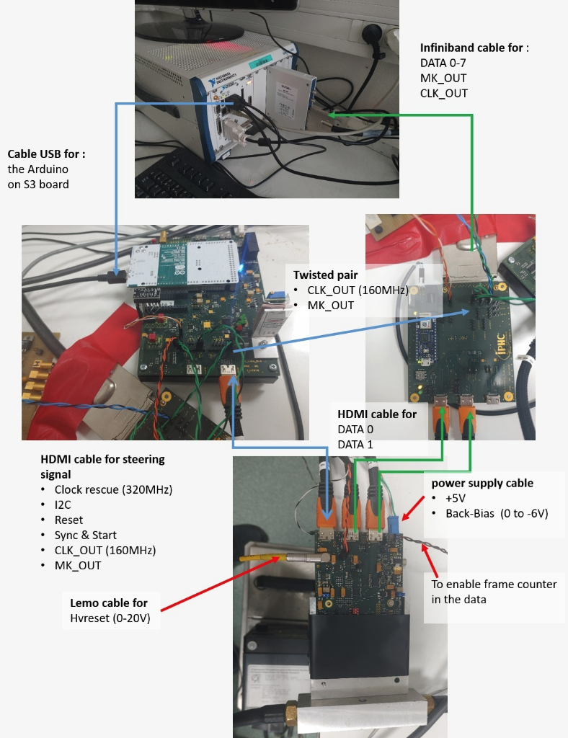
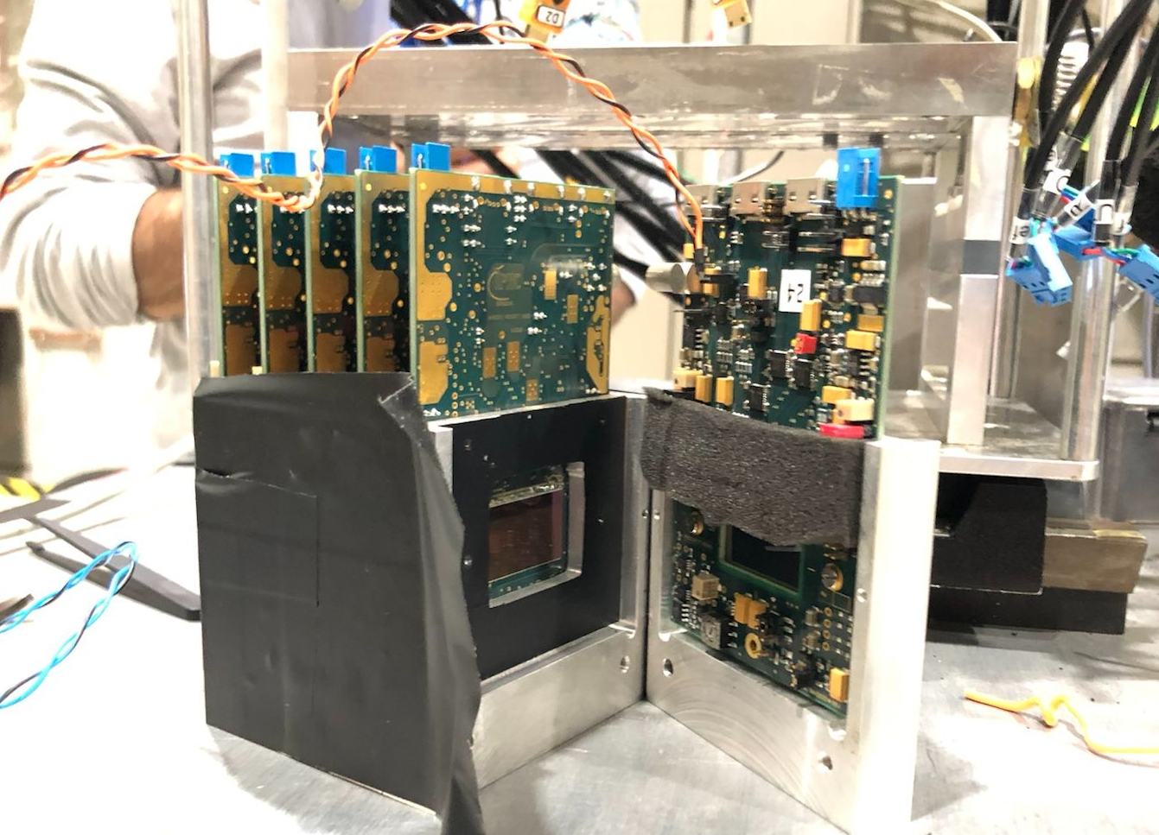
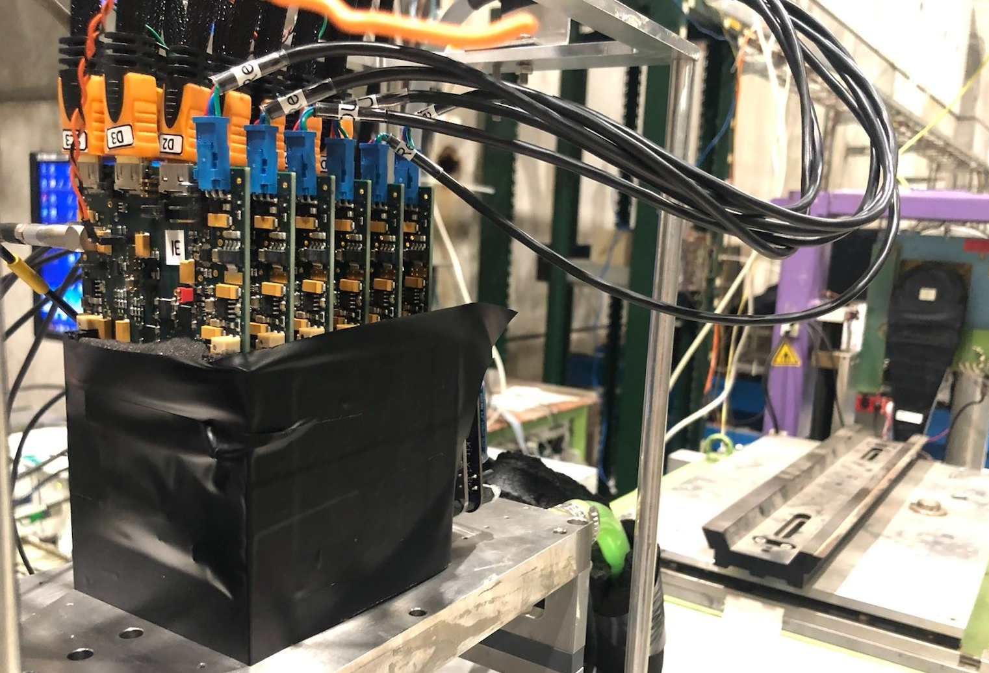
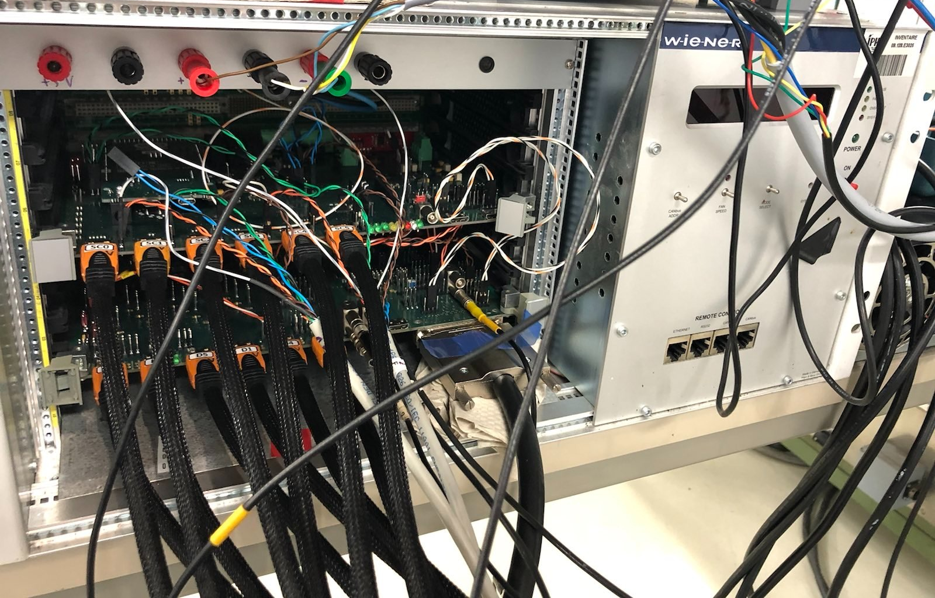
Status Quo: Readout System from IPHC
Lab setup
Test beam setup
M. Goffe/G. Claus

Slide 4
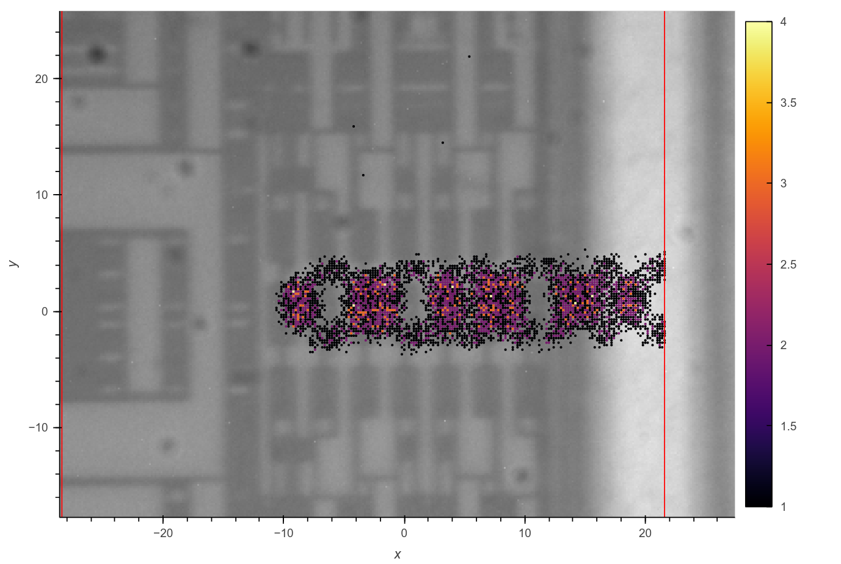
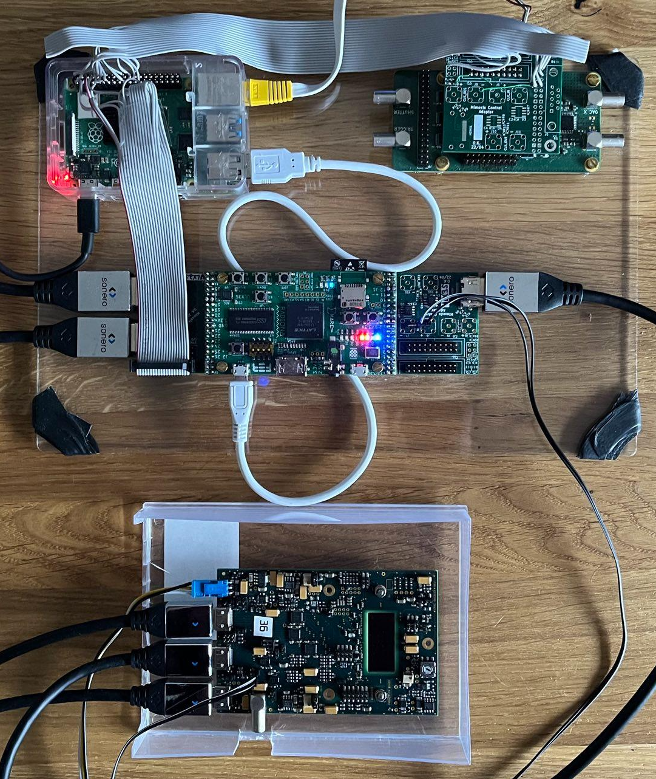
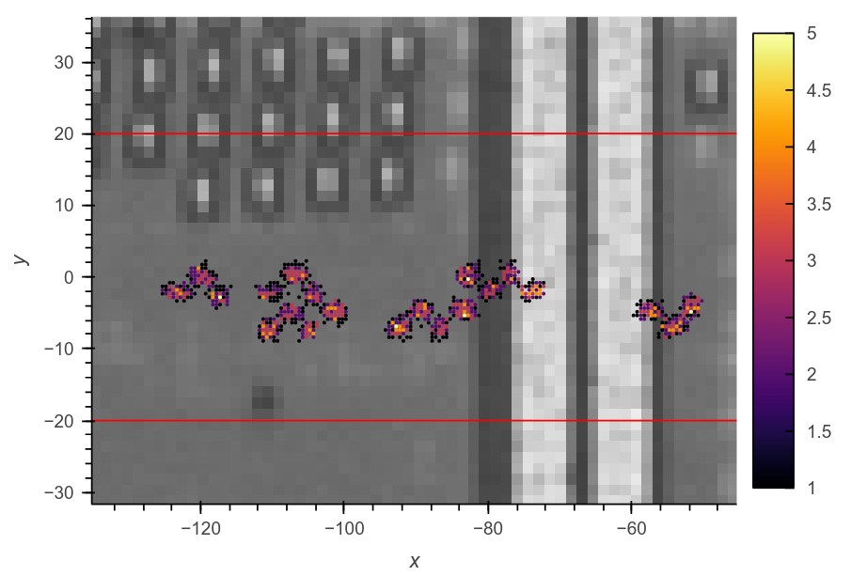
First DAQ prototype at GSI
For SEE testing at GSI Micro-Beam, June 2022
Raspberry Pi 4
main remote controller
I2C slow control master
ULX3S board
Lattice ECP5 FPGA:
22 LVDS I/O pairs up to 400 MHz
up to 5 Gbit/s SerDes (5G version)
provides to MIMOSIS-1:
40 & 320 MHz clocks
slow control sync
various debug & monitoring capabilities
Python library for slow control:
github.com/ozel/Mimosis1-slow-control
Raspberry
Pi 4
ULX3S FPGA & custom MIMOSIS
adapter boards
MIMOSIS chipboard IPHC

Slide 5
Portable MIMOSIS DAQ - Features
Readout of 1-2 MIMOSIS chips per FPGA board at 2.5 Gbit/s Ethernet
MIMOSIS output: 320 Mbit/s on either 1, 2, 4 or 8 channels in parallel
Either 1 MIMOSIS at full speed or 2 at reduced channel count
Current MIMOSIS 6-plane telescope: 2 channels per chip/plane
Ethernet I/O: Pixel data and slow control via UDP/Etherbone
1 Gbit/s Ethernet for reduced data rate (max. 2 channels)
2.5G Ethernet becoming consumer mainstream, new sweet spot
frame buffering and data reduction/filtering requires additional RAM
Implementation using LiteX open FPGA cores: https://github.com/enjoy-digital/litex
IP/UDP stack, 1-10G Ethernet, DDR RAM controller, debugging infrastructure etc.

Slide 6
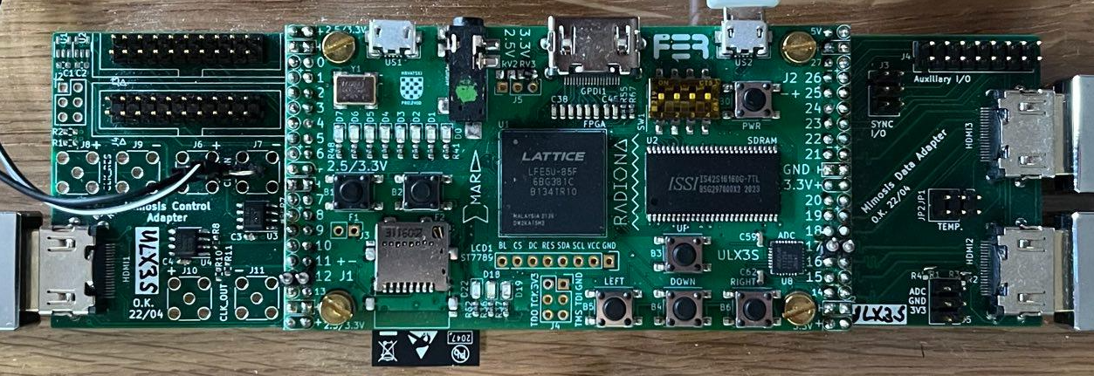
Portable MIMOSIS DAQ - FPGA Hardware
Current ULX3S-based prototype (~150 EUR)
Ok for developing the basics
100 Mbit/s Ethernet added via Pmod module
good enough for S-curve scans
rare but persistent signal integrity problems on certain differential input lines @160 MHz
Next step: Butterstick board (~300 EUR)
on-board 256 MB DDR3 RAM and 1Gbit/s Ethernet
3 extension connectors: SYZYGY standard (‘Zmod’)
30 diff. I/O pairs (incl. 4 SERDES channels)
34 single ended I/Os
dual SFP+ module for multi-gigabit Ethernet
Re-use new MIMOSIS-1 chipboard from GU-IKF
based on FPC cables
if possible: rearrange FPC pinout in 2nd revision

Slide 7
Portable MIMOSIS DAQ - Data Backbone
Encapsulating output of one MIMOSIS in 1-2.5G Ethernet data stream
can be directly received on a modern PC
keep software/operational requirements and dependencies as low as possible
Continuous recording of full pixel data streams from several MIMOSIS
telescope use case: 6 planes x 8 x 320 Mbits/ ~ 15.4 Gbit/s
fits well within 40 Gbit/s Ethernet
40G Ethernet card + switch: ~3 kEUR
High-Speed Ethernet data recording
Linux PF_RING kernel driver with modern Intel systems
allows continuous Ethernet packet dump
direct data copy to disk, no dead time
system requirements:
Intel 10G/40G/100G Ethernet card
Intel Xeon CPU (> 2.5 GHz)
recent SSD disk (typically ~30 Gbit/s write speeds)
6 x 2.5G
Ethernet Switch
1 x 40G

Slide 8
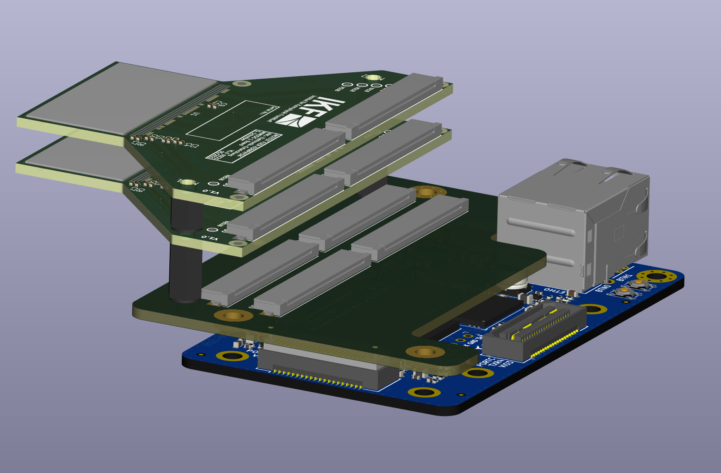
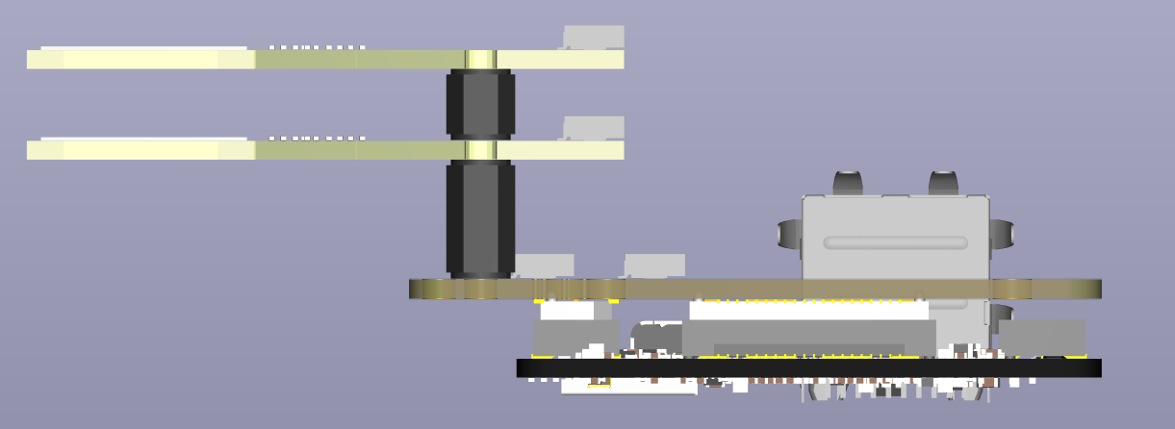
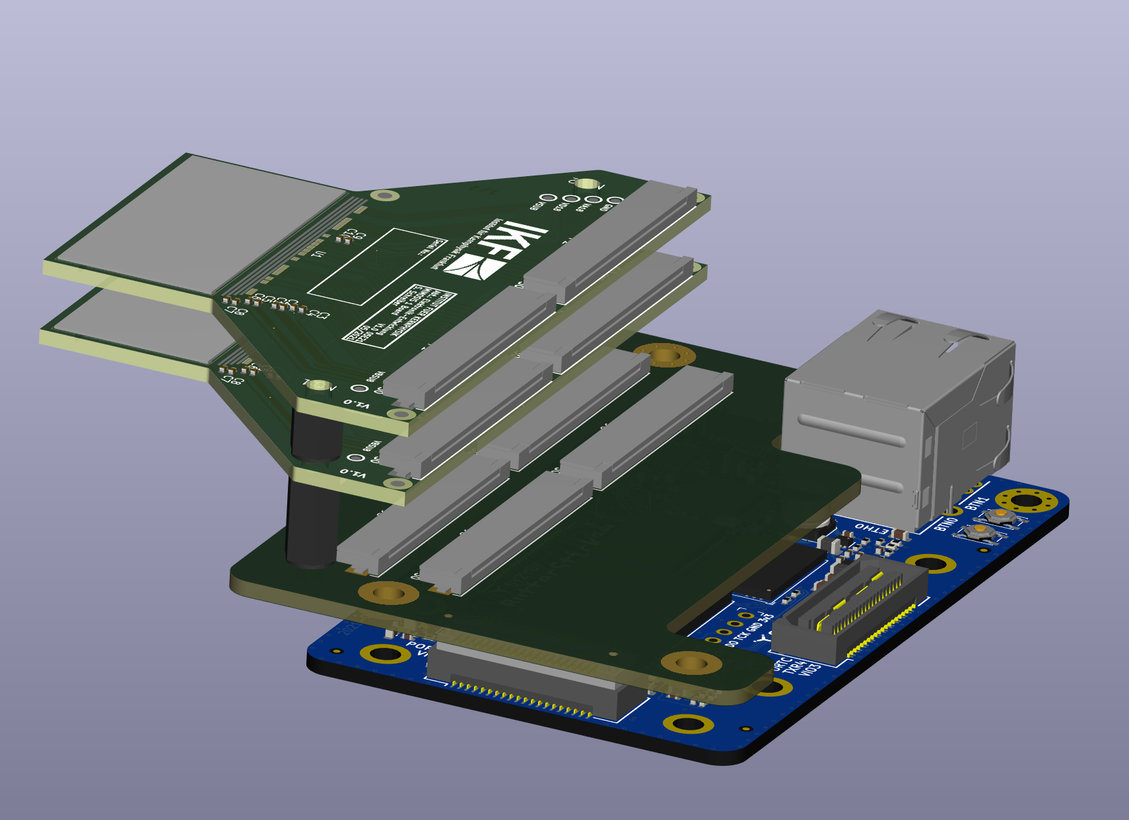
Towards a compact dual layer stack readout
stack of 2 MIMOSIS IKF chipboards via SYZYGY extensions on Butterstick FPGA board
focus on high speed pixel recording as opposed to chip testing & debugging
skip most of proximity board’s circuitry
use start/sync feature of MIMOSIS-2 for synchronized data recording
include sync connector for telescope trigger and logic unit (AIDA TLU)
three of these setups from a 6-plane telescope
FPCs provide spatial flexibility, e.g. side-by-side:
FPC cables

Slide 9
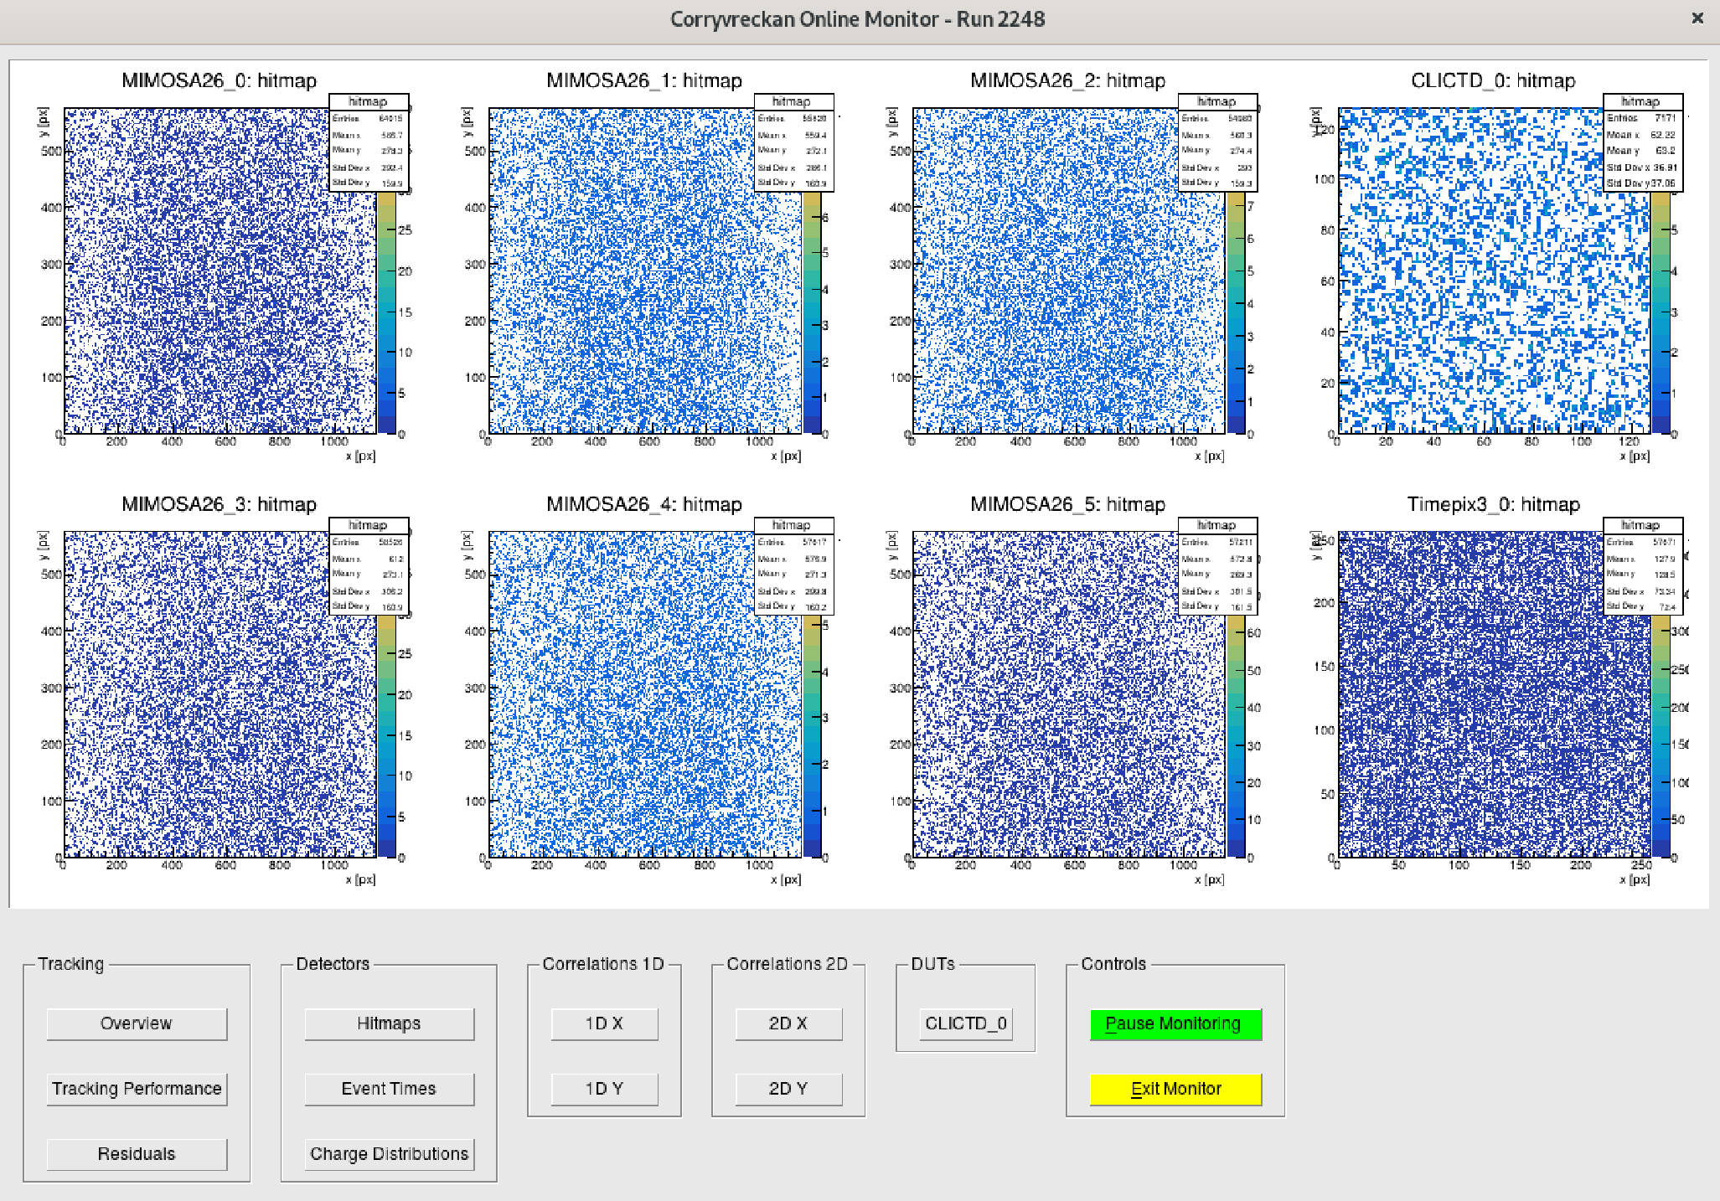
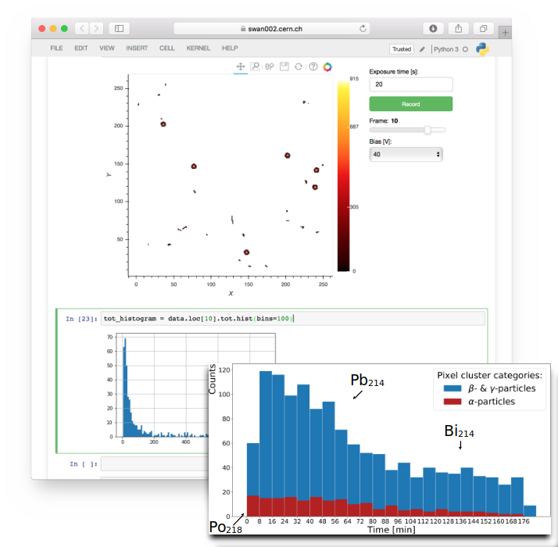
Portable MIMOSIS DAQ - Software
Python scripts for now
good enough/efficient for chip testing/waver probing
autonomous, scripted s-curve scans? => IKF
Corryvreckan
attractive telescope analysis software with large community
allows flexible merging across frame time boundary
supports heterogeneous telescopes composed of various chips
dedicated module for analysis of MIMOSIS data:
https://gitlab.cern.ch/okeller/corryvreckan/-/wikis/home
Online monitor reads live data while recoding to disk
=> testing/debugging!
Dedicated interactive GUI required at some point
Jupyter/Bokeh good candidates

Slide 10
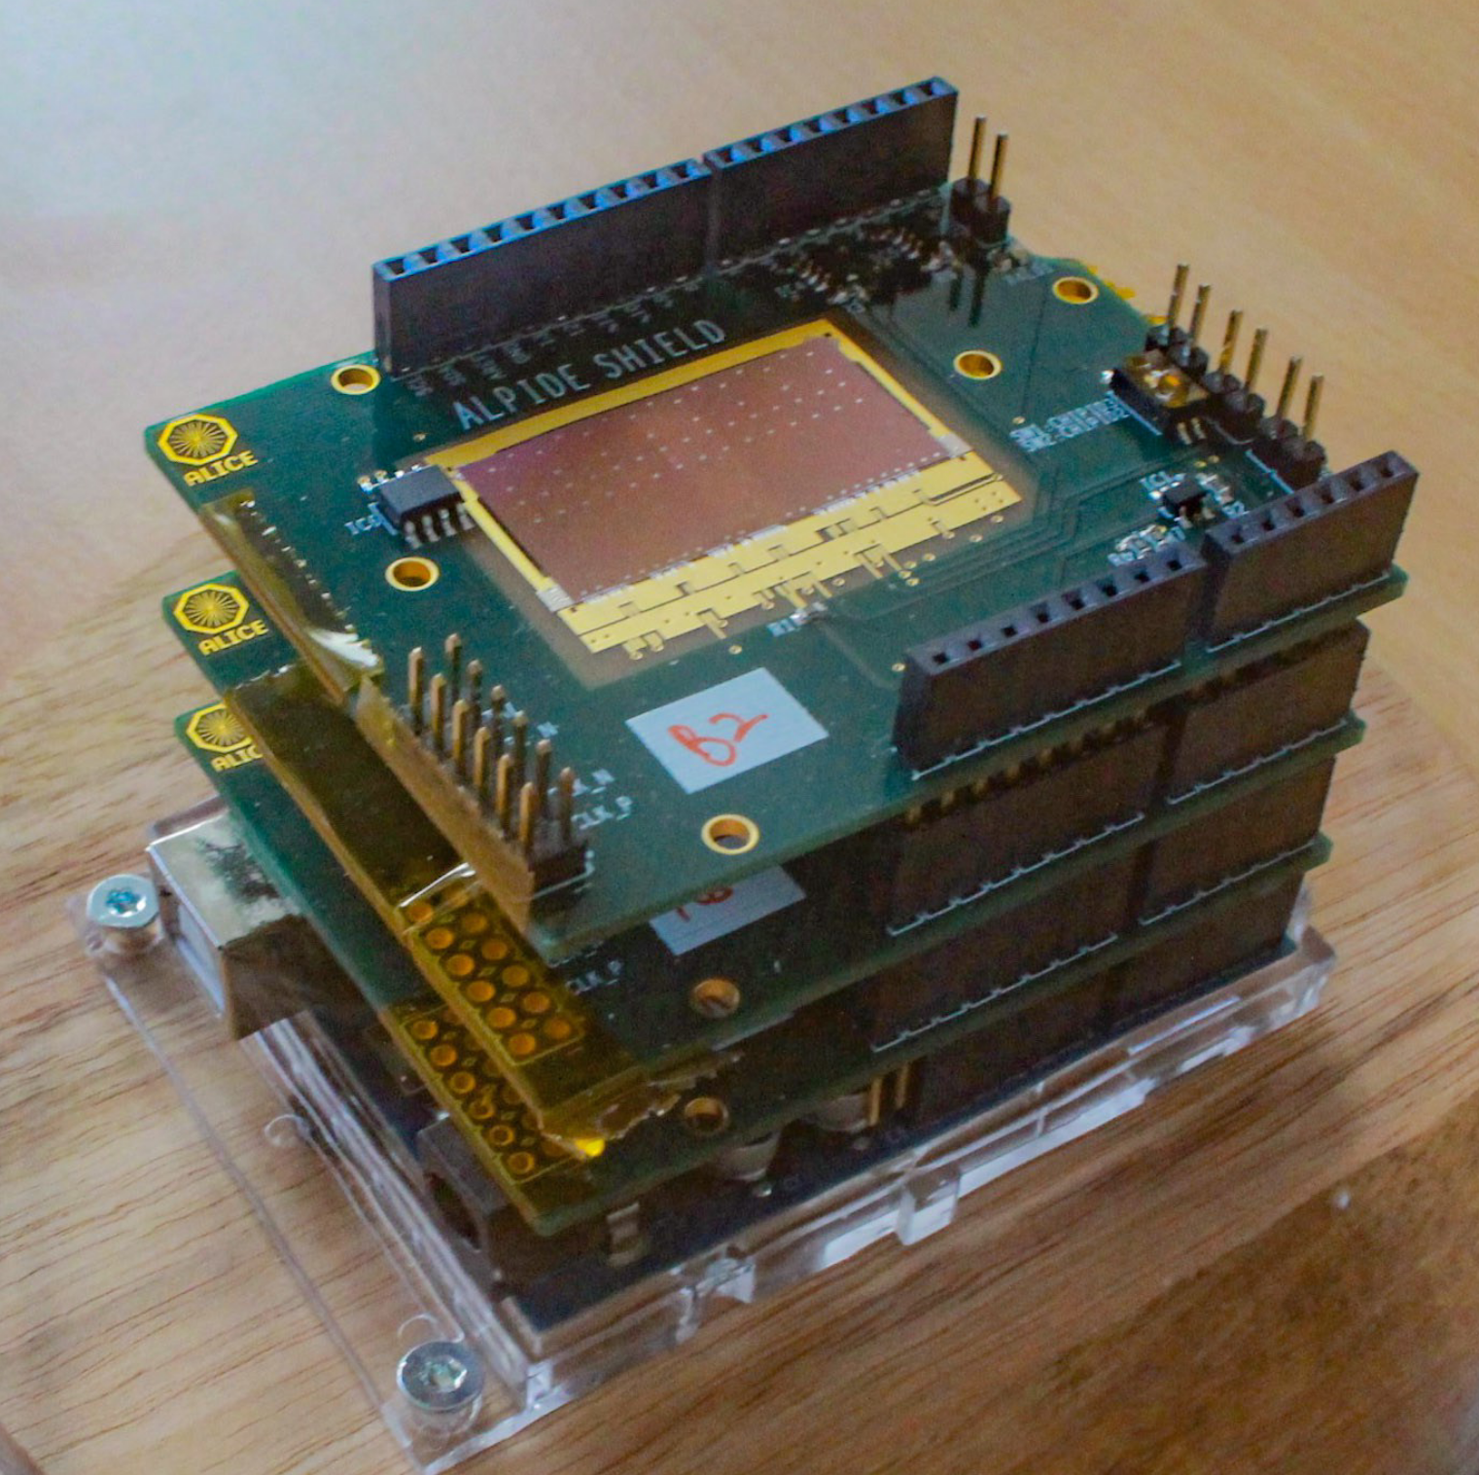
MIMOSIS DAQ Outlook
Current main use cases of MIMOSIS DAQs:
chip testing & evaluation in beam telescope => IPHC DAQ
chip testing & wafer probing for CBM-MVD production => IKF DAQ
gather experience for mCBM & CBM DAQ, test with GBTx
EURIZON user interests:
integration in EuDET telescope @DESY
V. Pugatch research on ion beam dose
MIMOSIS neutron detector
Pixel hit rate requirements?
full MIMOSIS data rate required?
How many MIMOSIS chips at once?
Spatial chip arrangements?
o.keller@gsi.de
M. Mager

