Slide 1
Toward a boron coated CPS for neutron detection
M. Deveaux, GSI/FAIR

Slide 2
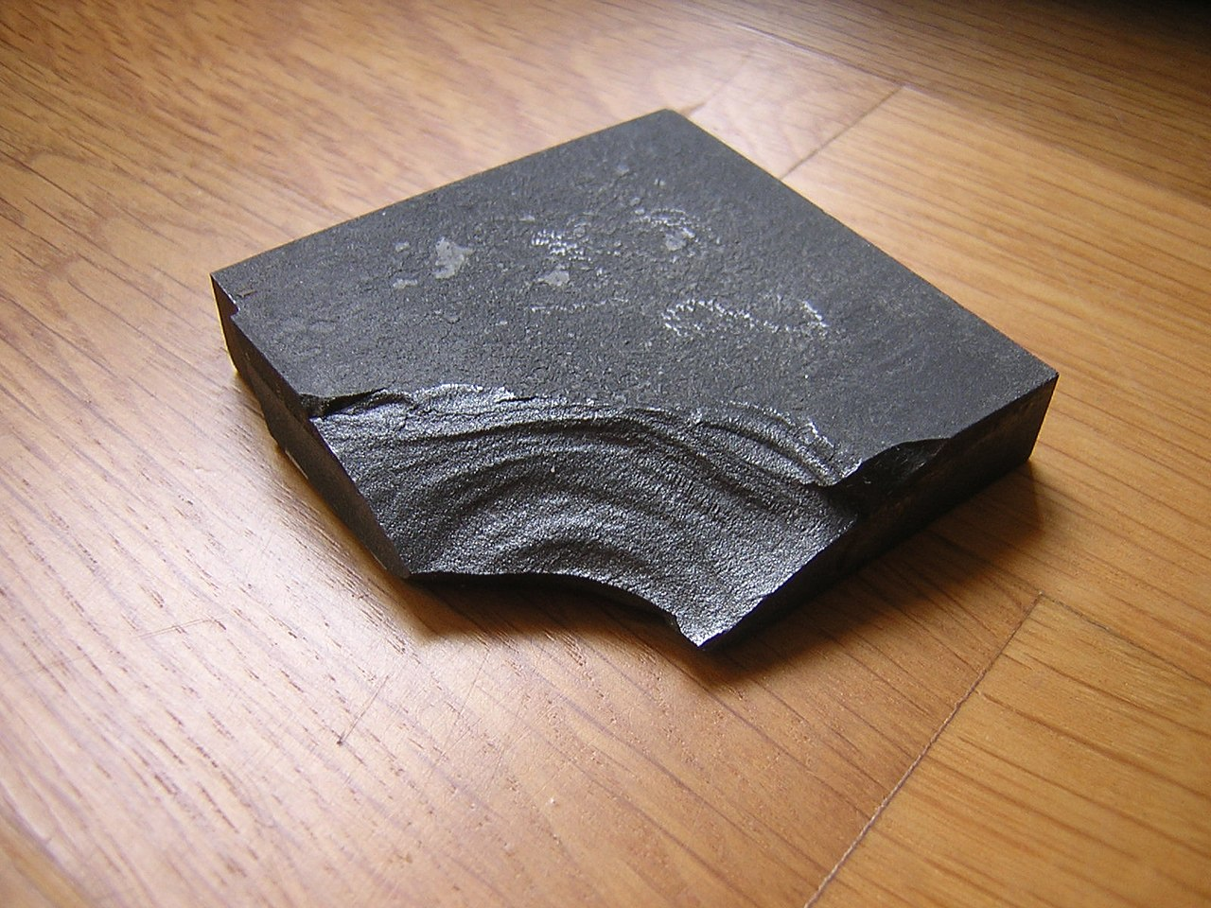
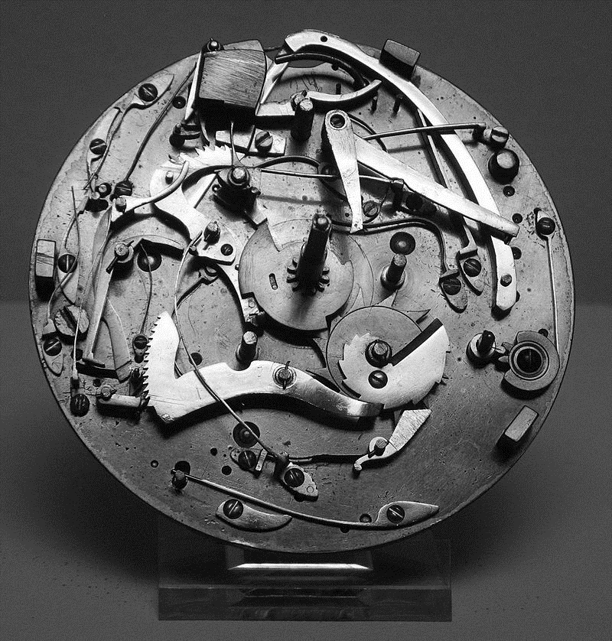
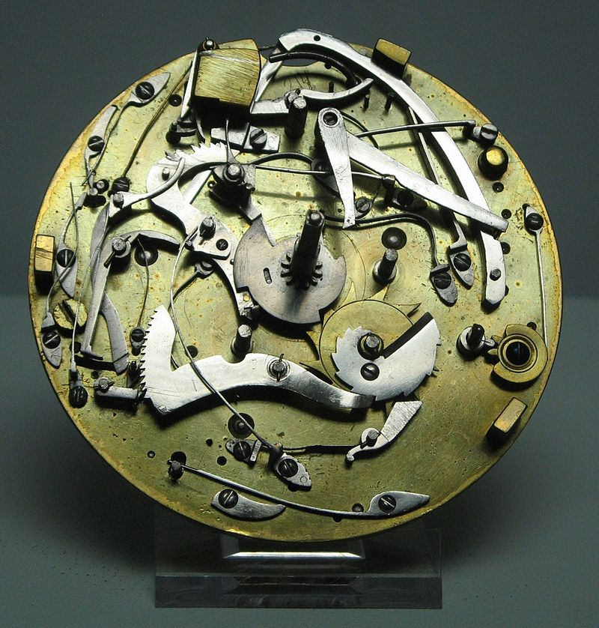
Boron coated CPS (brief reminder)
Why converters:
Neutrons cannot be detected with charged particle detectors.
Need to convert neutrons into charged particles (converter).
Known efficient converter for thermal neutrons: Boron (¹⁰B, 19.9% of natural B).
$n+10B →7Li+α+2.8 MeV$
Possible converter material: Boron carbid B₄C ("Black diamond", $ρ=2.51 g/cm³$)
Von Preslav - Eigenes Werk, Gemeinfrei, https://commons.wikimedia.org/w/index.php?curid=6093884
The vision: Boron coated CPS
n
n
Neutron
source
$$α (E_{kin}<1.7 MeV)$$
DUT
Potential result: Highest resolution/granularity neutron camera.

Slide 3
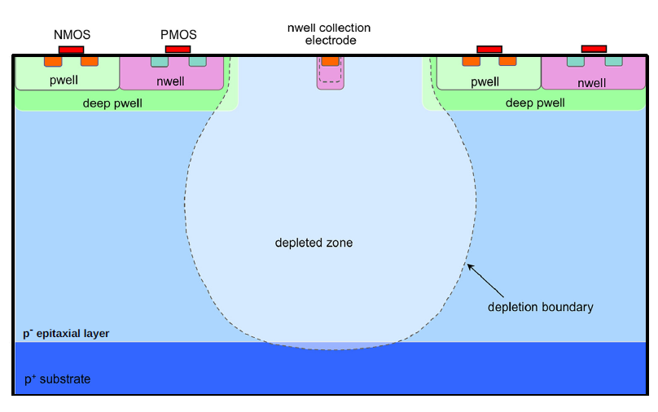
Technological constraints
Range of boron decay particles in Si (SRIM):
$α →6µm$, $7Li →3µm$
SiO₂ + Al-traces
~10 µm
25 µm or 50 µm
>100 µm
May be removed
Entrance window too think for direct ion detection.
=> Need to remove entrance window (back thinning)

Slide 4
Back-thinning
50µm thin CPS
(MIMOSA-26)
log(p-doing)
$$−\vec{E}$$
Thinning of sensors to 50 µm is mastered for decades.
Typically only 15-25 µm epitaxial layer, substrate remains.
Few experience with removing full substrate (mastered but complicated).
Idea: Use 50 µm thinning and integration techniques on a 50 µm thick epitaxial layer.
Should remove the substrate. Avoids complications (?)
Next add a B₄C cover.
See next talk
Test sensors.
50 µm
x

