Slide 1
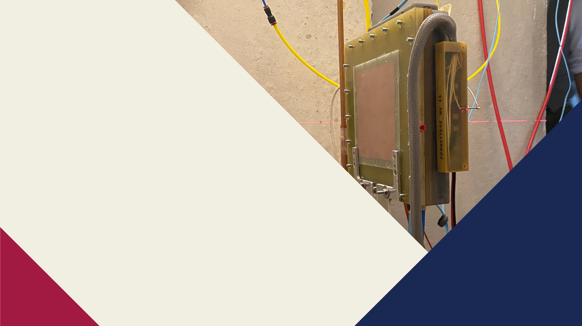





Development of GEM-based neutron detector for spallation sources
Gabriele Croci on behalf of Milano-UNIMIB-CNR Neutron group
2023 Eurizon Annual Meeting

Slide 2
Outline
1 – Introduction and Our involvement in ESS
2 - GEM detectors
3 - The MBGEM detector
4 - The N2-GEM detector
6 – Future Developments
2

Slide 3
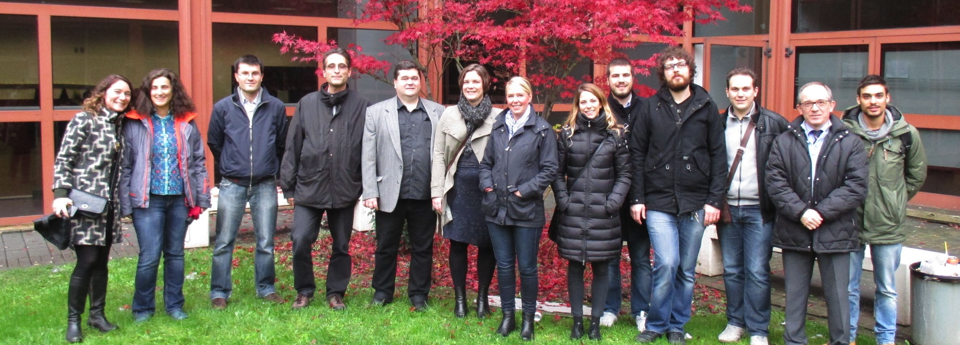
ESS collaboration: strict contact with detector group (Richard Hall-Wilton and Kalliopi Kanaki) and with Linkoeping University (Chung Chuan Lai)
2013-2018: Development of BAND-GEM detector for LOKI
2015-On going: development of borated GEM foils (collaboration between Lai and CERN)
2020 – On going and being evaluated: realization of N2 GEM based beam monitors for FREIA
2021 – On going Evaluation: possibility to use MB-GEM detectors on VESPA
Now we are in contact with Dr. Zivile Kraujalyte

Slide 4
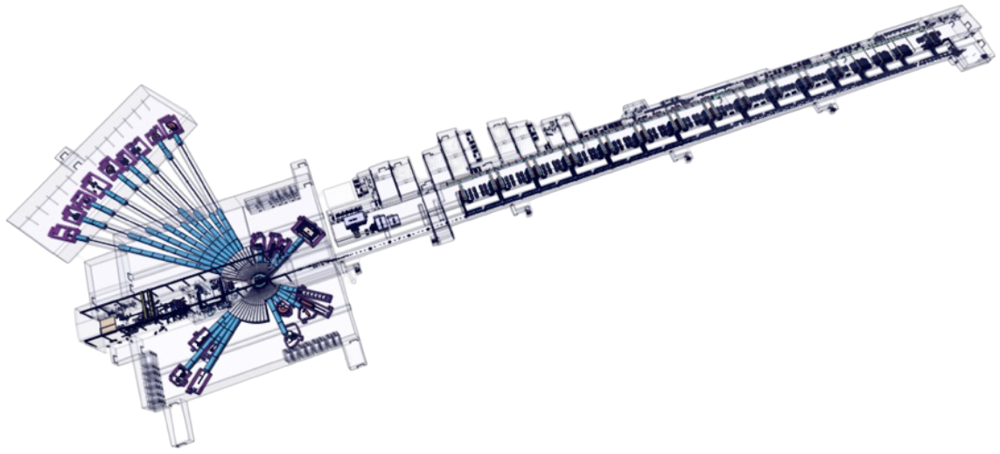
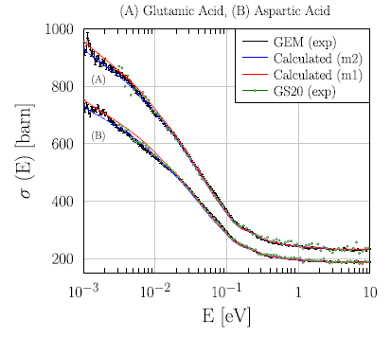
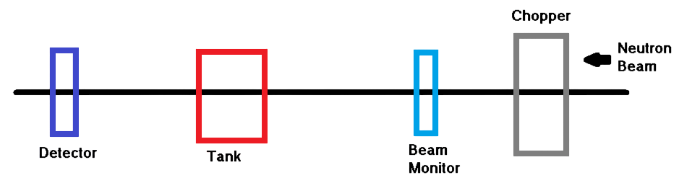
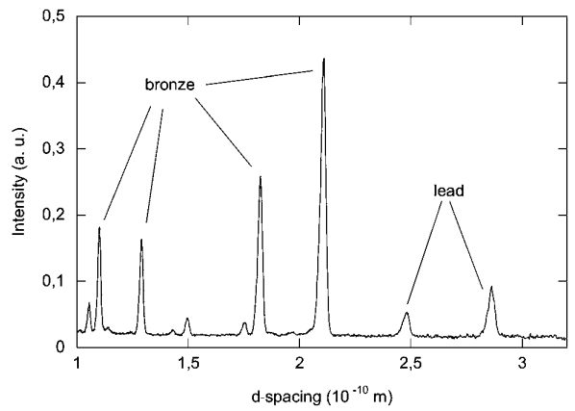
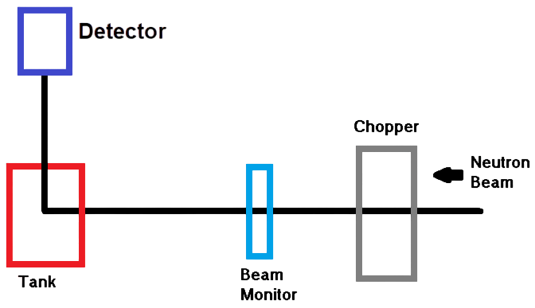
Detectors for Transmission and diffraction measurements
Transmission experiments
The European Spallation Source (ESS)
Romanelli, Giovanni et al. “Thermal neutron cross sections of amino acids from average contributions of functional groups”. Journal of physics. Condensed matter : an Institute of Physics journal 33(28) (2021)
Diffraction experiments
R. Cattaneo J. Anal. At. Spectrom., 2011, 26, 1024
3

Slide 5
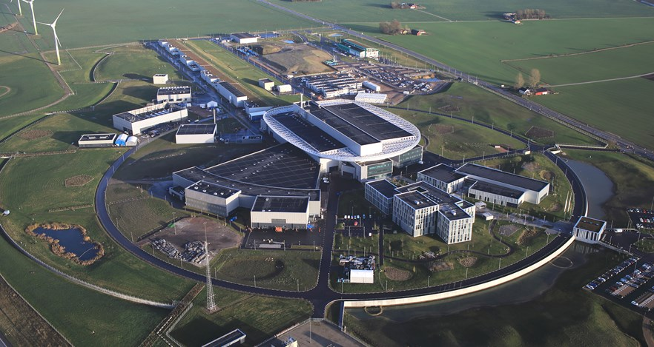
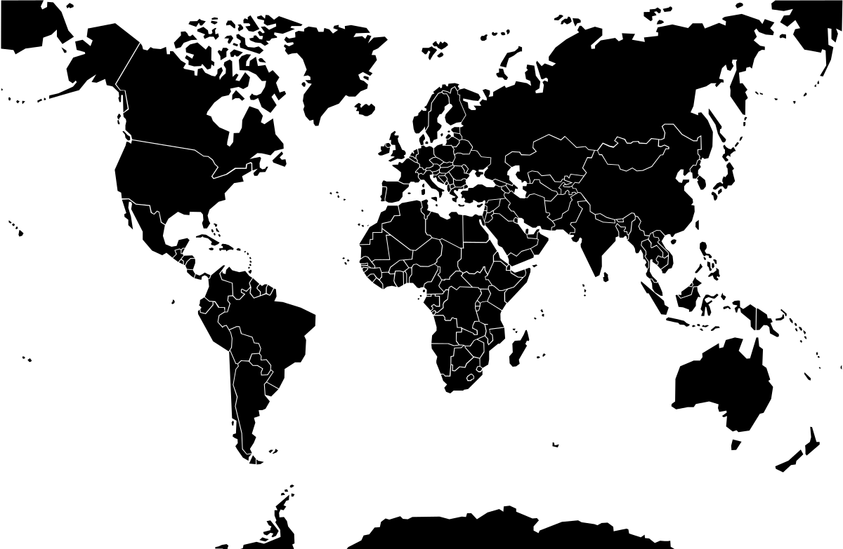
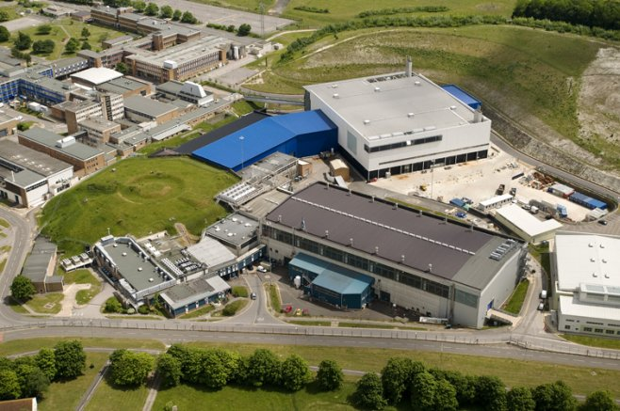
Spallation Sources where we work
ESS (Lund)
Start in 2024
22 instruments to be built
New spallation source
Operative spallation source
ISIS (UK)
19 instruments at TS1
12 instruments at TS2
4

Slide 6
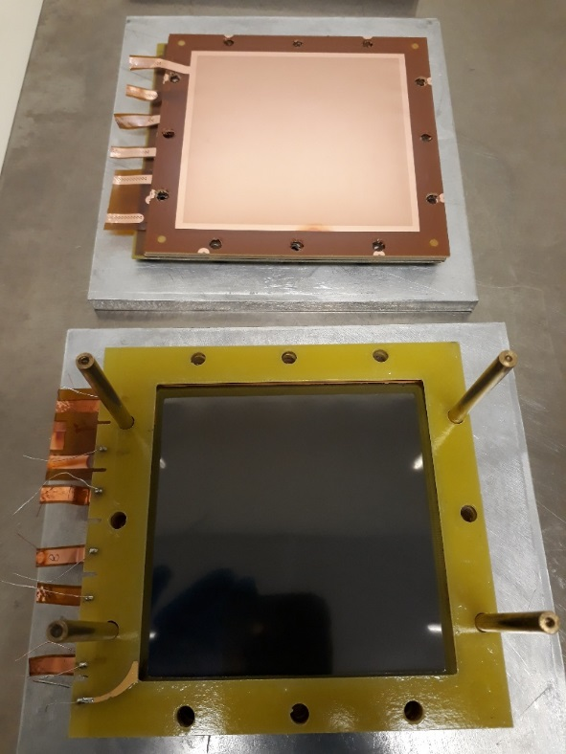
Gas Electron Multiplier (GEM) Detectors
Developed in 1997 by F.Sauli at CERN.
Belong to Micro-pattern Gas Detector.
Gas used: ArCO2(70%-30%).
Standard GEM foil
Thickness of insulating layer: 50 μm
Thickness of conductive layer: 5 μm
Inner diameter of holes: 50 μm
External diameter of holes: 70μ
Pitch:140 μm
5

Slide 7
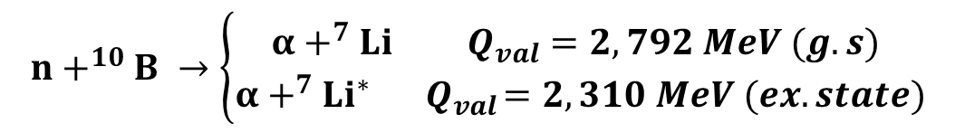
Boron based Neutron-GEM Detectors
Boron coated cathode converter
$$n+^{10}B →\left\{\begin{aligned}α+^{7}Li Q_{val}=2,792 MeV (g.s) \\ α {+^{7} Li}^{∗}{ Q}_{val}=2,310 MeV (ex. state)\end{aligned}\right.$$
S. Cancelli et al 2021 JINST 16 P06003
6

Slide 8
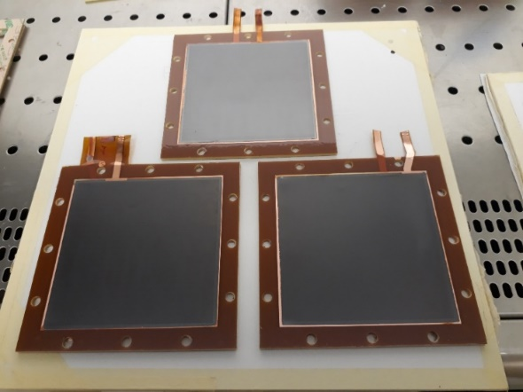
Boron based Neutron-GEM detectors time line in UNIMIB
2013
2019
2021
2022
bGEM
I-BAND-GEM
Multi Boron GEMPix detector
MBGEM detector
1 μm thick ¹⁰B₄C layer on the cathode
Padded anode -> Imaging capabilities
CARIOCA-GEM digital chips
Detection efficiency at thermal neutrons: (9,57±0.76)*10⁻³
11 Al grid coated with 0,65 μm of ¹⁰B₄C
Padded anode
CARIOCA-GEM digital chips
Detection efficiency at 25 meV: 30%
1 μm thick ¹⁰B₄C layer on both GEM foil layers
3 Boron GEM foils of 3x3 cm²
Pixelated anode
TimePix electronic readout
3 GEM foils of 10x10 cm² covered with 1μm of ¹⁰B₄C
Padded anode
GEMINI electronic readout
7

Slide 9

MBGEM: Design of the detector
GEM foils of 10x10 cm² covered with 1μm of ¹⁰B₄C
Stacking of either 3 or 6 Boron-coated (BGEM) foils coupled with three standard GEM foils.
Use of a padded anode of 256 pads (6x6 mm²) allowing imaging capabilities.
Use of GEMINI digital electronic readout.
Gas Mixture ArCO₂CF₄ (45%-45%-10%)
Multiplication region
Conversion region
One of the project of Fabrizio Murtas
Similar approach as CASCADE detectors. GEM foils are borated on both sides.
The technique was developed in collaboration between UNIMIB-CNR, CERN and ESS
8

Slide 10
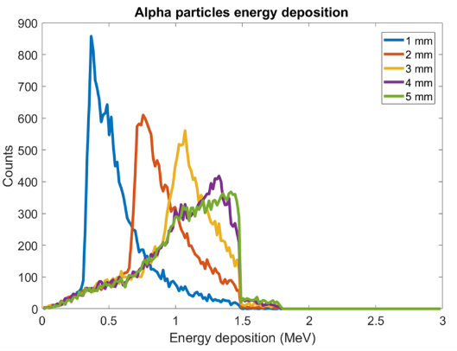
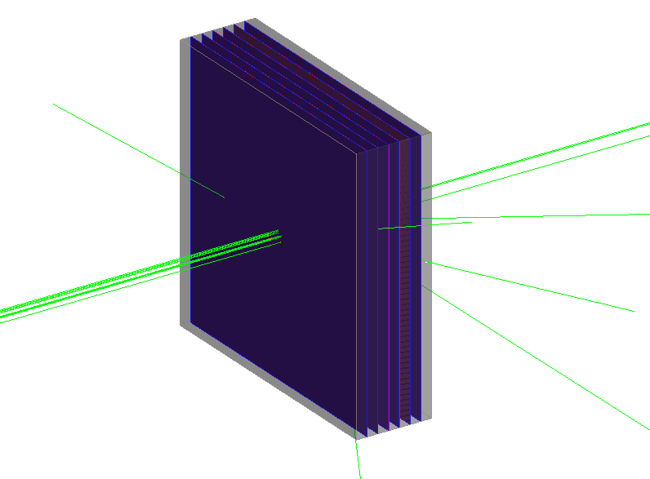
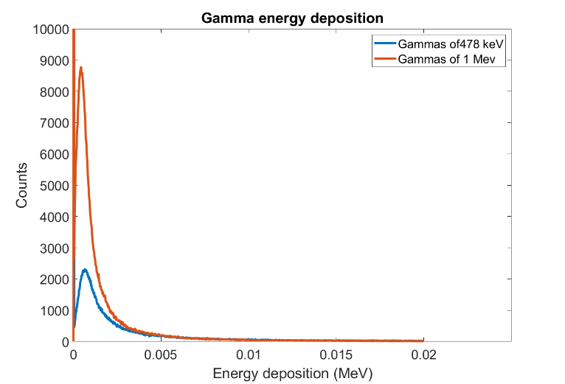
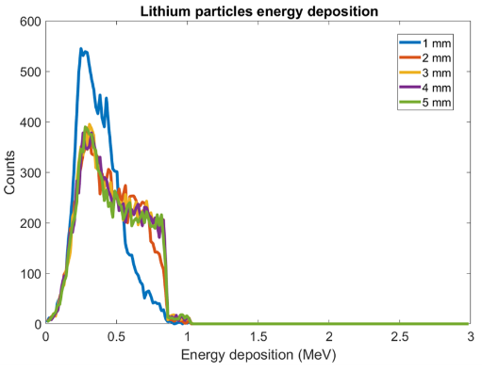
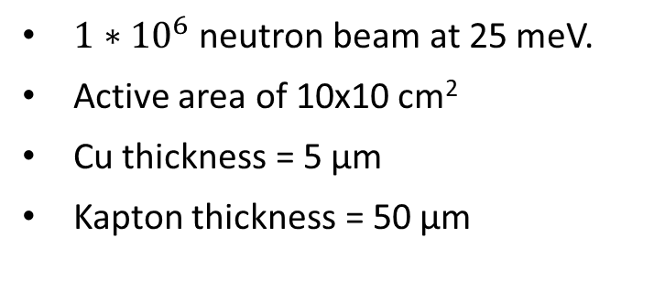
Simulations with GEANT4
Thermal Neutrons
$1∗{10}^{6}$ neutron beam at 25 meV.
Active area of 10x10 cm²
Cu thickness = 5 μm
Kapton thickness = 50 μm
BGAP1
MeV Gamma Rays
BGAP1
9

Slide 11
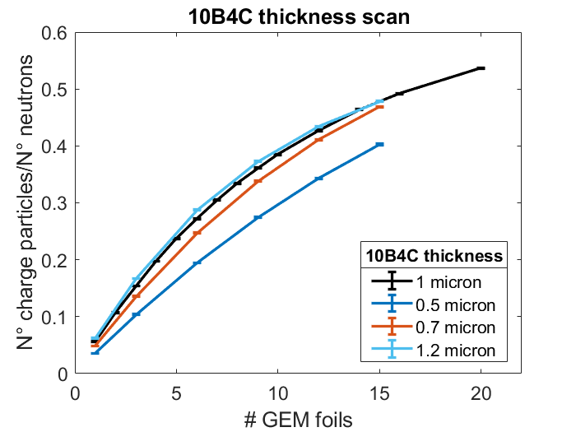
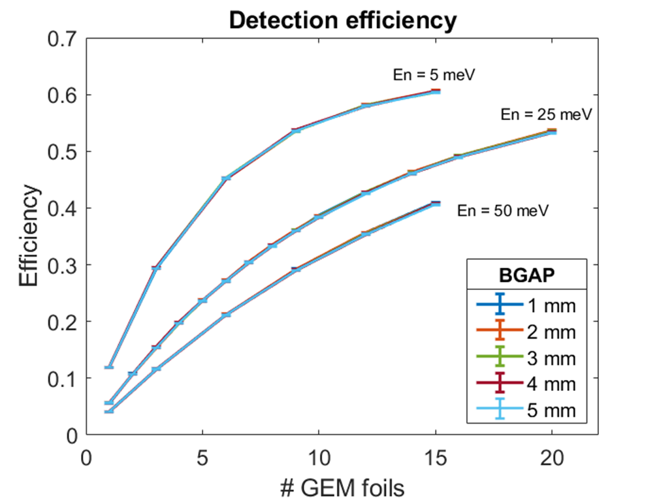
Simulations with GEANT4
BGAPS: 2mm
En = 25 meV
1 μm boron thickness
10

Slide 12



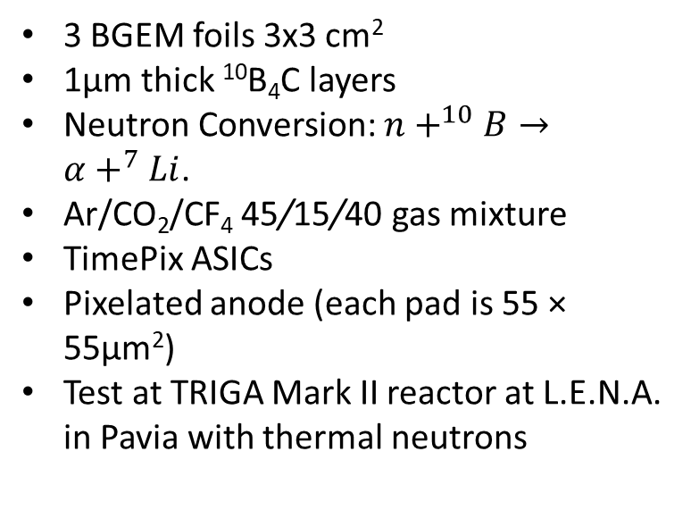
MBGEM: the MBGEM-Pix detector
3 BGEM foils 3x3 cm²
1μm thick ¹⁰B₄C layers
Neutron Conversion: $n+^{10}B→α+^{7}Li$.
Ar/CO₂/CF₄ 45/15/40 gas mixture
TimePix ASICs
Pixelated anode (each pad is 55 × 55μm²)
Test at TRIGA Mark II reactor at L.E.N.A. in Pavia with thermal neutrons
Gamma
Alpha

Slide 13
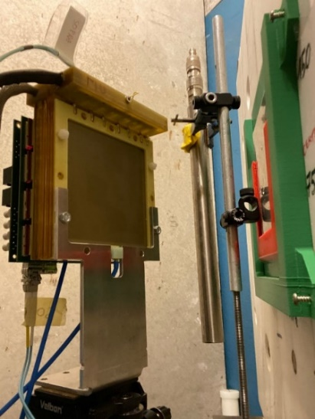
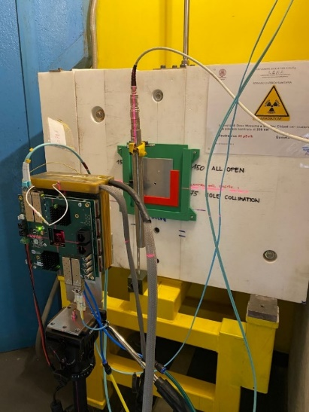
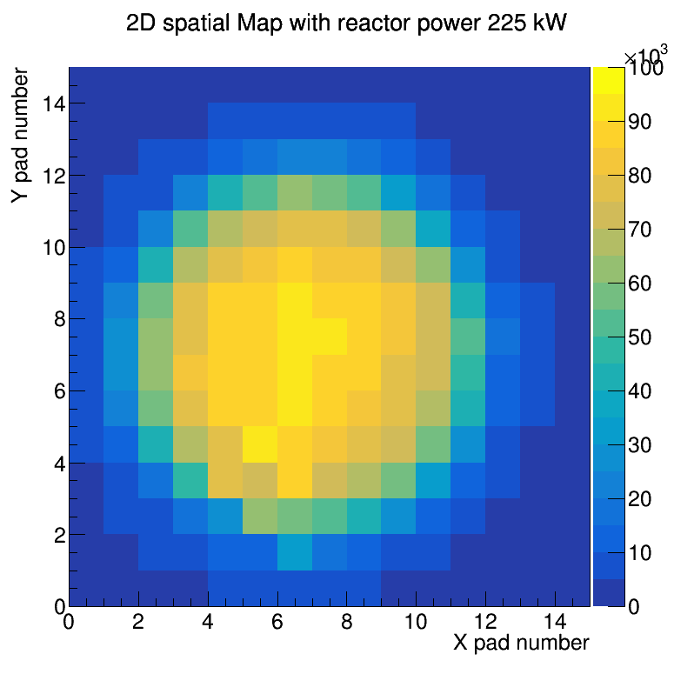
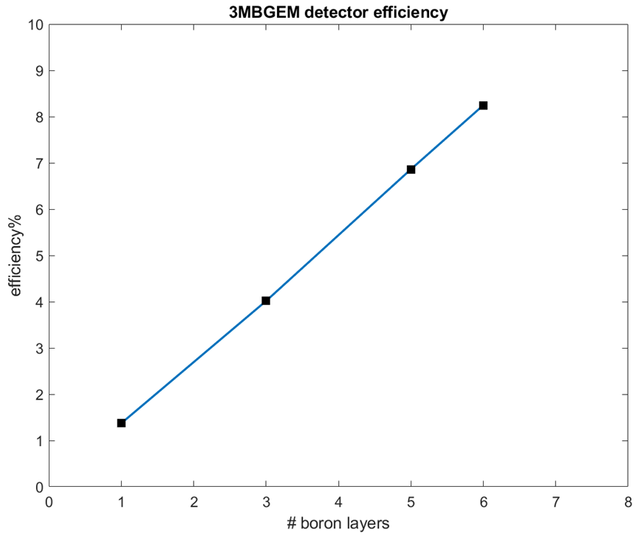
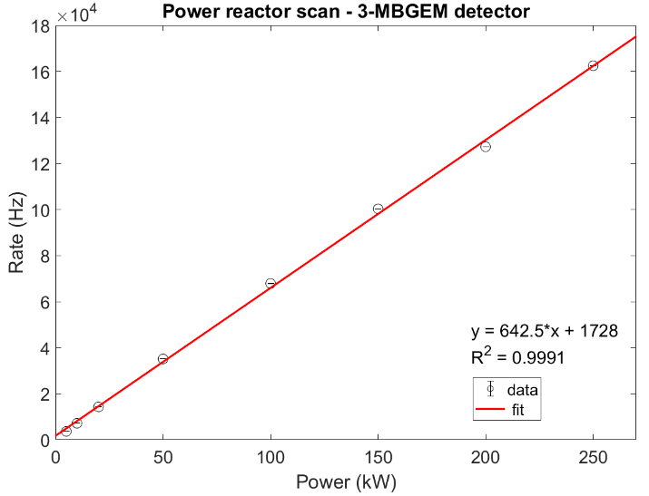
MBGEM: the 3MBGEM detector
3 BGEM foils 10x10 cm²
1μm thick ¹⁰B₄C layers
Ar/CO₂/CF₄ 45/15/40 gas mixture
GEMINI ASICs
Padded anode (each pad is 6 × 6 mm²)
Test at TRIGA Mark II reactor at L.E.N.A. in Pavia with thermal neutrons
Future detector for diffraction experiments at VESPA beamline
Neutron beam
11

Slide 14
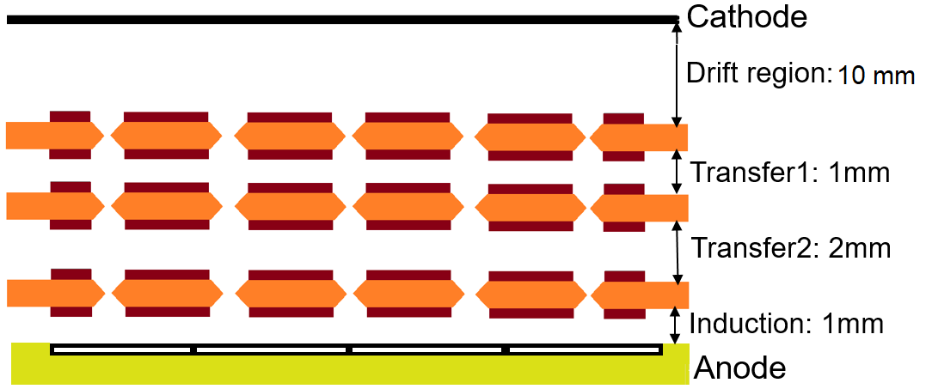
Neutron beam monitors based on GEM Detectors
3 standard GEM foils of 10x10 cm².
256 padded anode.
Use of GEMINI readout.
Test of 3 gas mixtures:
  ArN₂ 90%-10%
  ArN₂ 80%-20%
  ArN₂ 70%-30%
Future beam monitor for FREIA experiment
$n+14N→p+14C Q_{val}=610 keV$
13

Slide 15
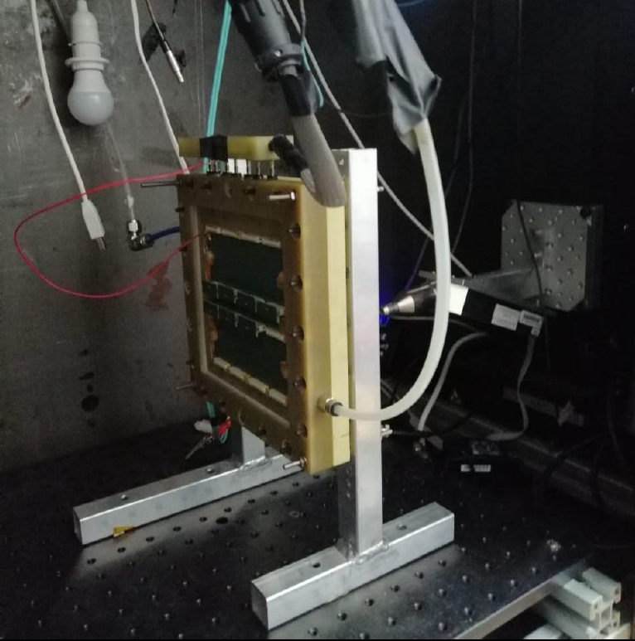
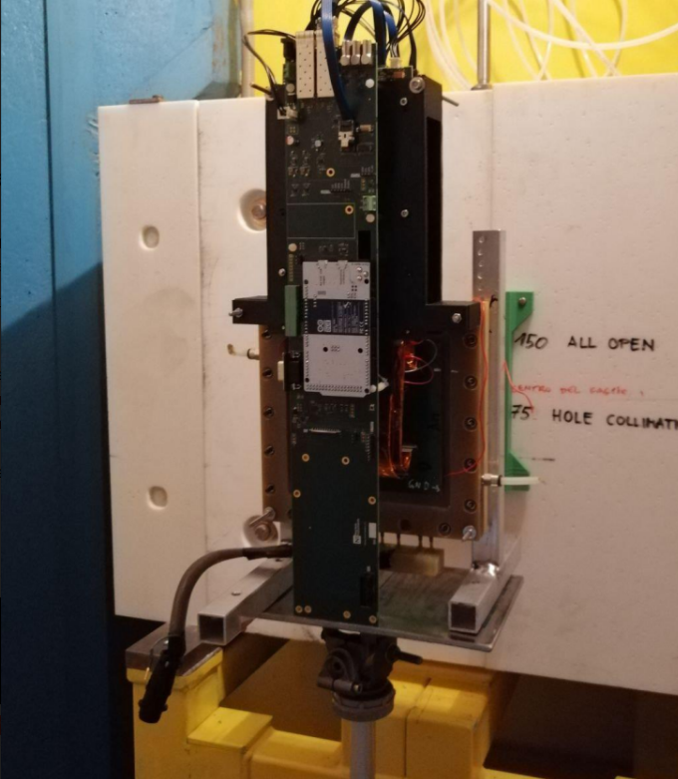
N2GEM: tests with X-Rays and neutrons
X-Rays
UNIMIB laboratory
Ti target-> Kα=4,5 keV
Thermal Neutrons
TRIGA MarkII reactor
En = 25 meV
15

Slide 16
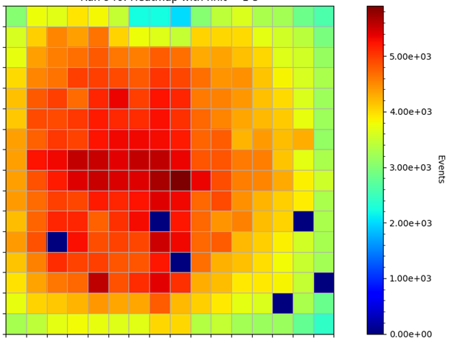
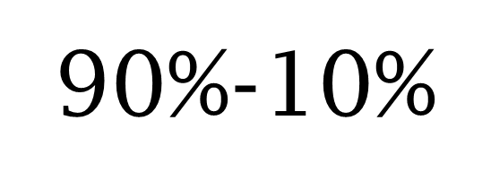
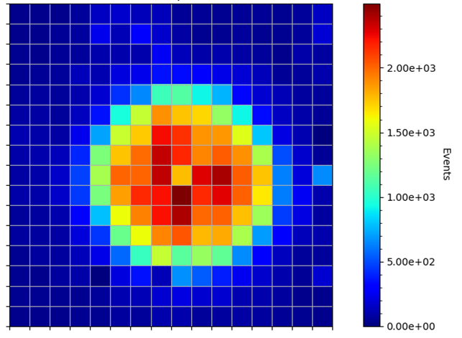
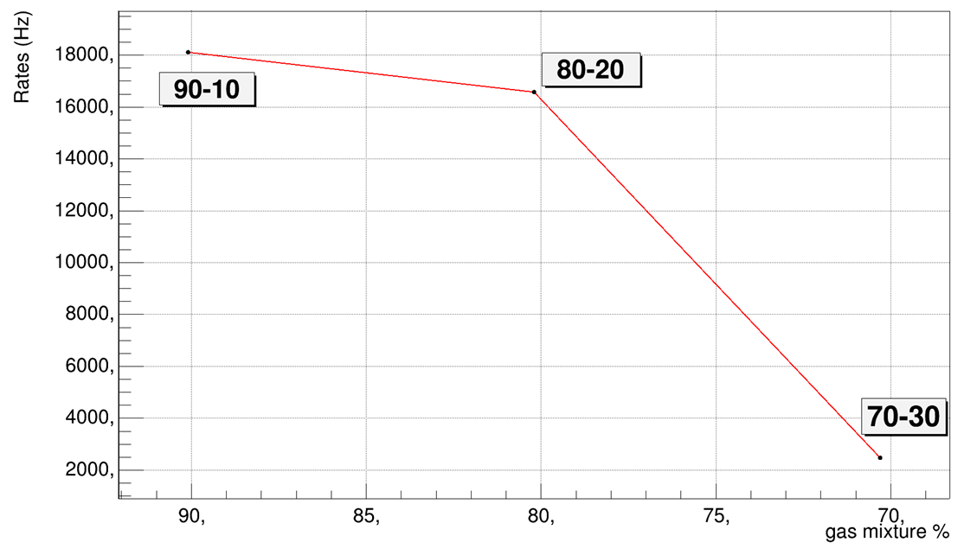
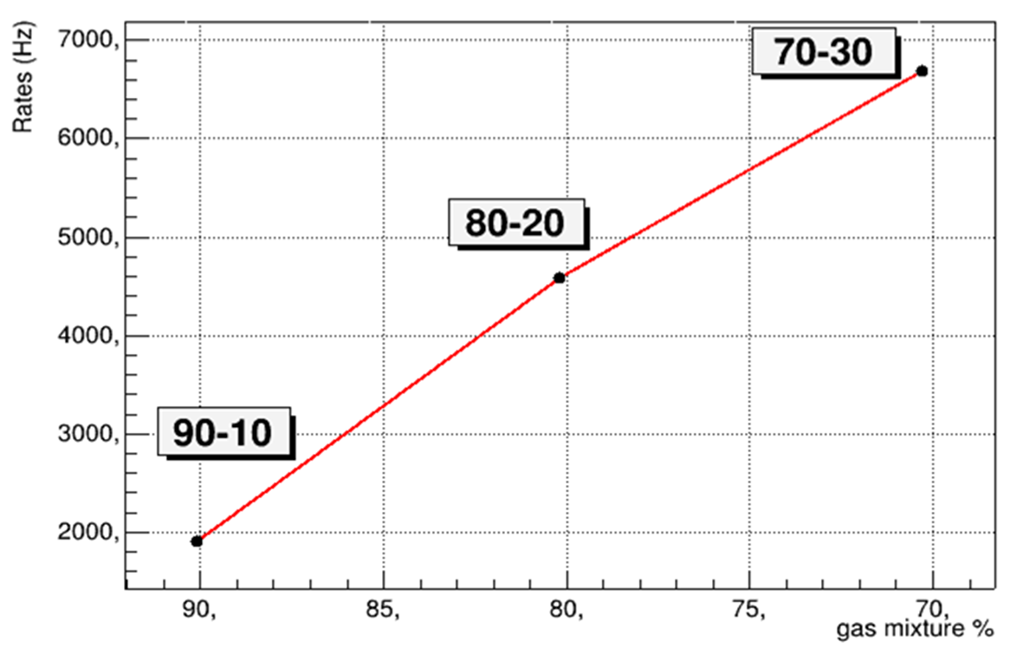
N2GEM: tests with X-Rays and neutrons
X-Rays
Thermal Neutrons
16

Slide 17
Future developments
MBGEM detector:
  New measurements at ISIS Neutron and Muon Source in order to test the detector response with the use of Time Of Flight technique.
  TOF measurements also at GELINA (invited)
  Upgrade to six BGEM foils.
  Study of detector configuration for VESPA
N2-GEM detector:
  Study the new gas mixture at ISIS.
  Build a new detector to study the single or double GEM configuration.
  Sealed detector
17

