Slide 1
Central components of the CBM readout:
Hardware and Software
(m)CBM data Acquisition
DAQ software components
Online processing
Controls
WP 2.2: Developments for the data acquisition chain, for data preprocessing and computing for mCBM and CBM at FAIR

Slide 2
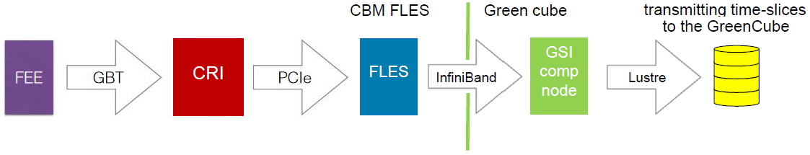
CBM data Acquisition
8 main detector systems
Fully free-streaming acquisition (no HW trigger)
Online processing computing farm in the GSI/Fair “Green IT Cube”: O(100 k) cores
3 main stages:
Readout chains: data generation and system specific transport
DAQ: data organization and generic transport
Online processing: data reconstruction and selection, archiving
Readout
DAQ
Online proc.

Slide 3
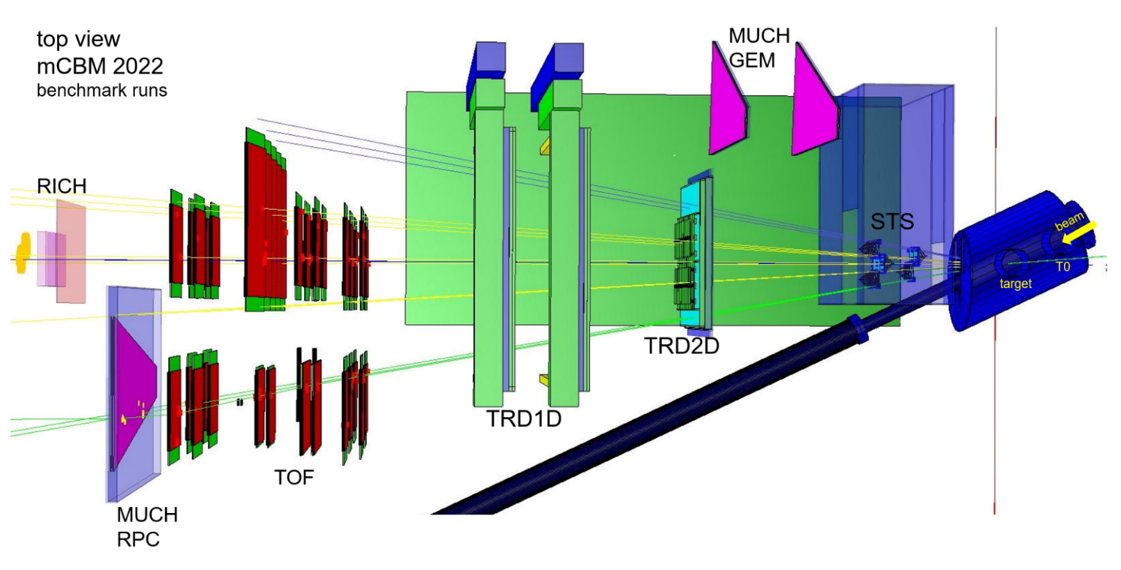
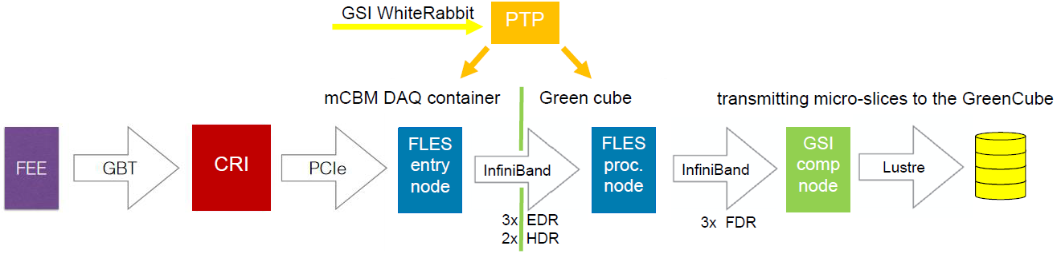
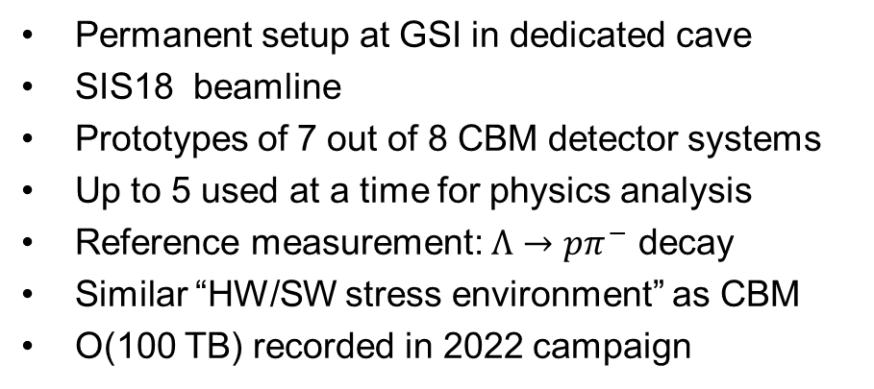
Prototype: mCBM (2nd phase, 2021-2022+)
Permanent setup at GSI in dedicated cave
SIS18 beamline
Prototypes of 7 out of 8 CBM detector systems
Up to 5 used at a time for physics analysis
Reference measurement: $Λ→pπ^{−}$ decay
Similar “HW/SW stress environment” as CBM
O(100 TB) recorded in 2022 campaign
Main differences to CBM in acquisition:
Reduced connectivity (3-10% CBM, detector dep.)
Non final readout interface boards
Evolving setup (each year closer to CBM detectors)
In 1st and 2nd phases, no online data selection
In 1st and 2nd phases, link from entry cluster to compute cluster not used in production
Limited/prototype central coordination features
Local storage (HDD, SSD)
Readout
DAQ
Online proc.

Slide 4
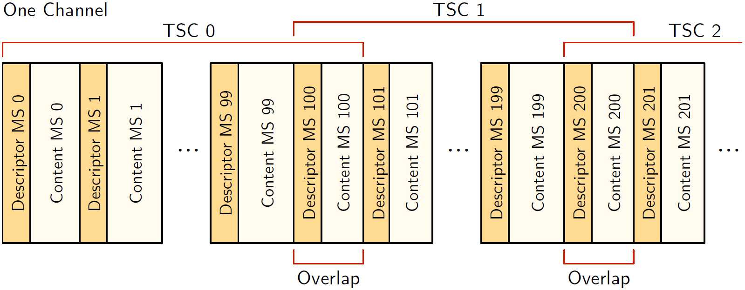
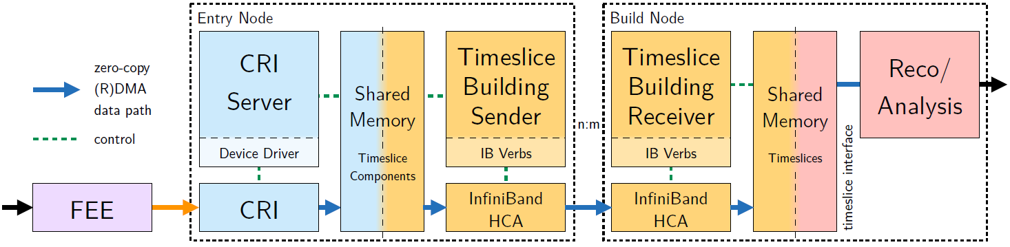
DAQ Software
Data model:
  microslices: self-contained blocks of data from a single source for a given period of time
  timeslices: collections of microslices from multiple sources, overlapping over time
FLES software (aka Flesnet):
  Driver reading from CRI though PCIe
  Timeslice builder sender/receiver
    Internal data transport & flow control
    Timeslice assembly
mCBM specific FLES software:
  Timeslice client
    Archiving of timeslices
    Publishing for monitoring
    Publishing for processing
  InfluxDB + Graphana
    FLES monitoring

Slide 5
DAQ Software: operating mCBM in 2022
No complete Experiment Control Software (ECS) available
Additional layers added, with a CLI, to
  Keep track of runs and their configuration
  Start the cluster processes needed to perform the acquisition and archiving
  Synchronize all systems before starting the readout
  Enable/Disable data emission in a synchronized way for all systems
Typical run sequence:
  Ask detector shifts if they are ready and have their system configured
  If needed, created a “configuration tag” selecting or excluding detector systems
  Start the FLES run with a given recording/readout configuration tag
  Common-start: re-synchronize the time counters of all participating systems, then communicate to all a common start point for data emission in future (5-6 s), strict for all
  Monitoring of data rates in FLES, of data quality in data sample, …
  Common stop: communicate to all system a common stop point for data emission in future, can be loosely obeyed
  Stop the FLES run, which closes all processes in right sequence and archive some run logs

Slide 6
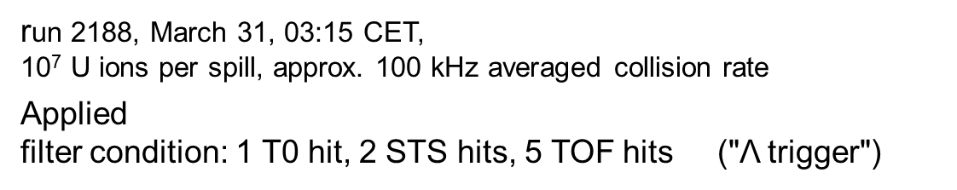
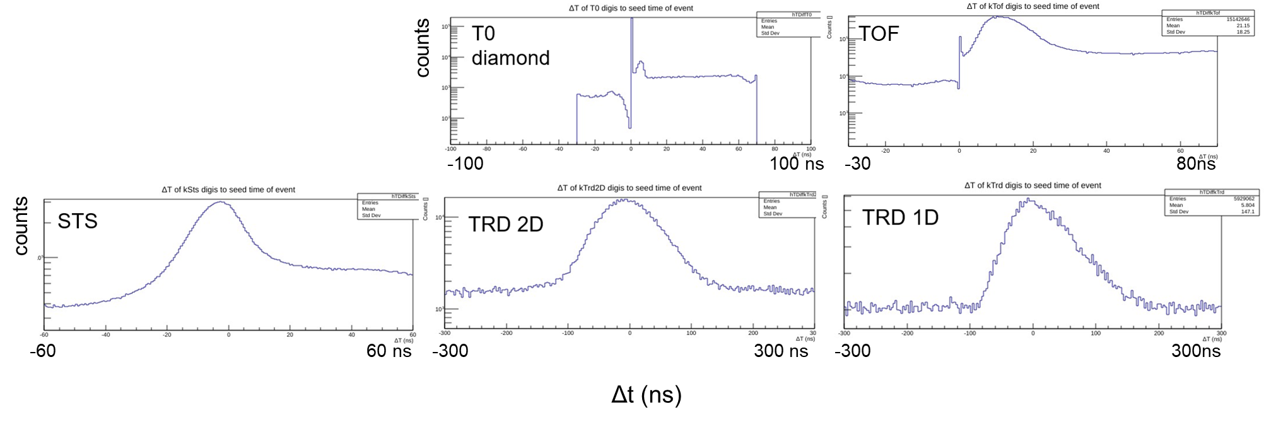
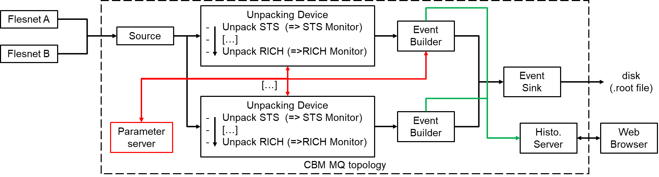
Online Processing: plans and mCBM
CBM plan
Data unit for online processing = Timeslice
Depending on physic cases
  reconstruction from single detector to full setup tracking
  event definitions may vary, ground for decision may not cover all signals
    “Event seeds” more than events
Selection of data from looser time region around these event seeds for archiving
  allow more involved offline calibration if needed
coincidences with T0
mCBM usage
Bring stages of offline selection in FairMQ devices
Online testing with coarse controls
Used for 1st stage of mass offline analysis
Now testing “replay” Online controls with ODC/DDS
Disclaimer: “these solution are maybe/probably not our final choice!”

Slide 7
My main Worksite: Controls? EDC? ECS?
Monitoring service &
Database
Input and computing Farm
Parameter Manager(s)
Logging service
FLES
Control
EDC
=> CBM computing project
User
Interface(s)
Online Processing
ECS
Online Software
Control
Computing Farm
Readout
Controls
DCS
Online Monitoring
& QA
TFC
Read. HW
Env. HW

Slide 8
Readout controls
C++ driver and low level management interfacing to the controls of the CRI FW and the full readout chain
  “Device Control Agent” or DCA
  At least one instance per entry node, at most one per CRI
  Completely event (action) driven, from RPC calls by the controlling Python layer
  Allows for atomic requests, queued requests and timed actions (e.g. periodic read for monitoring)
  For now mostly providing low level register access
  but later planned to hold most of the control logic to provide “atomic commands” and avoid access conflict
  Framework by FAIR colleague and system specific code by FPGA experts
Python control libraries implementing the user interface
  For now (2021-2022) also including most of the control logic and sending single register R/W requests
  Later planned to mostly send “Atomic Command + parameters” , leaving register access to DCA
  Based on client-server architecture to allow “common commands”,
    e.g. asking all detector systems to (re-)synchronize
  Currently stand-alone with either CLI interface or central scripts sending command to all systems
  Will be the main interlocutor of the ECS agents controlling detector systems
  Framework by myself and system specific code either by me or detector experts

Slide 9
ECS: Modular concept
Core functions
& fields
Cmd Core Agent
Logger Client
State Core Agent
Technical
Base functions
& fields
+ Testing
Generic but focused
Base Cmd Agent
State Cmd Agent
Common fcts
& fields
ECS Core Agent
General
Specific
ECA
PCA
SCA
Concrete

Slide 10


Thank you for your attention
For more information:
“Online Systems – Part I: DAQ and FLES Entry Stage”, CBM TDR, currently under review and should be public sometime in 2023
“CBM Progress Report 2021”, 2022, https://repository.gsi.de/record/246663
“mCBM proposal”, CBM proposal to GSI G-PAC, 2017, https://repository.gsi.de/record/220072

Slide 11
WP 2.2: Software for DAQ, Controls, Data analysis
Assignee: P.-A. Loizeau
Activities linked to WP2 in 2020-2022 period:
  Finalization and support of the control SW for the AFCK based readout chain for the STS-XYTER (CBM STS laboratory, Kolkata CBM MUCH laboratory, mCBM 2020, BM@N tests)
  mCBM
    On-site support in the operation of the CBM DAQ prototype for mCBM 2020-21-22 campaigns
    Development of a Python framework to control the CRI boards (High level part) and help for related detector-oriented developments, used for production in mCBM 2022 campaign
    Development and support of online data monitoring tools for various mCBM detectors
    Development and support of raw data unpackers and of event builders for mCBM
    Test-deployment of these on the mFLES and Virgo clusters at GSI with the FairMQ framework to validate online processing concepts and test physical connections
  Coordination of the “Experiment and Detector Controls” CBM computing project
  Development of an “Experiment Control System” prototype for mCBM and CBM
  General support and development with Cbmroot for CBM simulation and data analysis

Slide 12
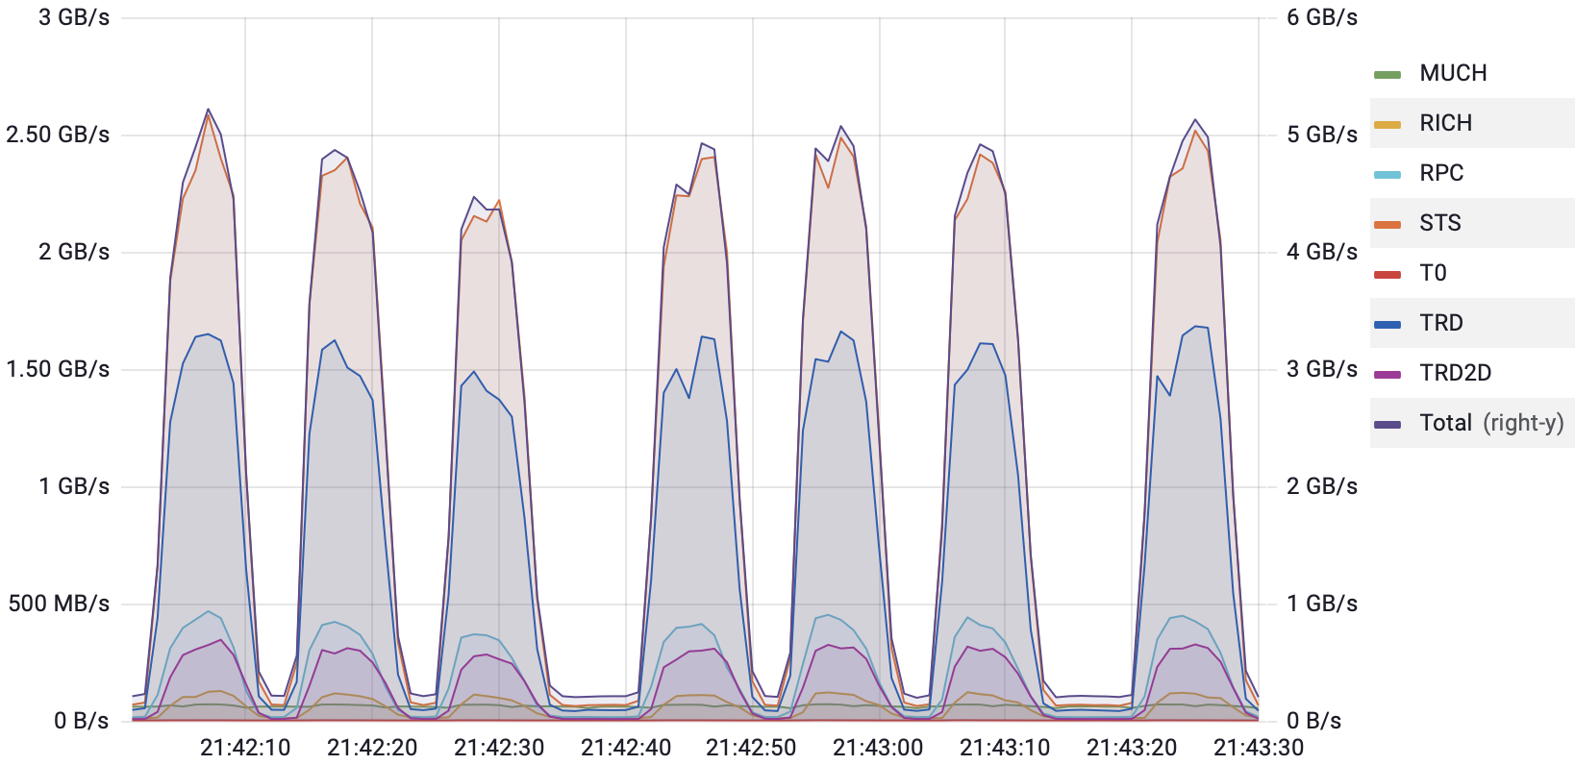
Data rates in a mCBM DAQ high rate run (r2448)

Slide 13
mCBM MQ test
CBM MQ topology
Flesnet A
Unpacking Device
Unpack STS (=> STS Monitor)
[…]
Unpack RICH (=>RICH Monitor)
Source
Event Builder
Flesnet B
Event Sink
disk
(.root file)
[…]
Unpacking Device
Unpack STS (=> STS Monitor)
[…]
Unpack RICH (=>RICH Monitor)
Event Builder
Parameter server
Histo.
Server
Web
Browser

Slide 14
Virgo
Debian CbmOnline container
CBM MQ topology
Flesnet
replayer A
Unpacking Device
Unpack STS (=> STS Monitor)
[…]
Unpack RICH (=>RICH Monitor)
Source
Event Builder
Flesnet
replayer B
Event Sink
[…]
Unpacking Device
Unpack STS (=> STS Monitor)
[…]
Unpack RICH (=>RICH Monitor)
Event Builder
Parameter server
Histo.
Server
“cbm_online”
SLURM
Debian CbmOnline Container
LOGs
ODC server
DDS
Lustre
Operator: ODC Client, …
Web
Browser

Slide 15
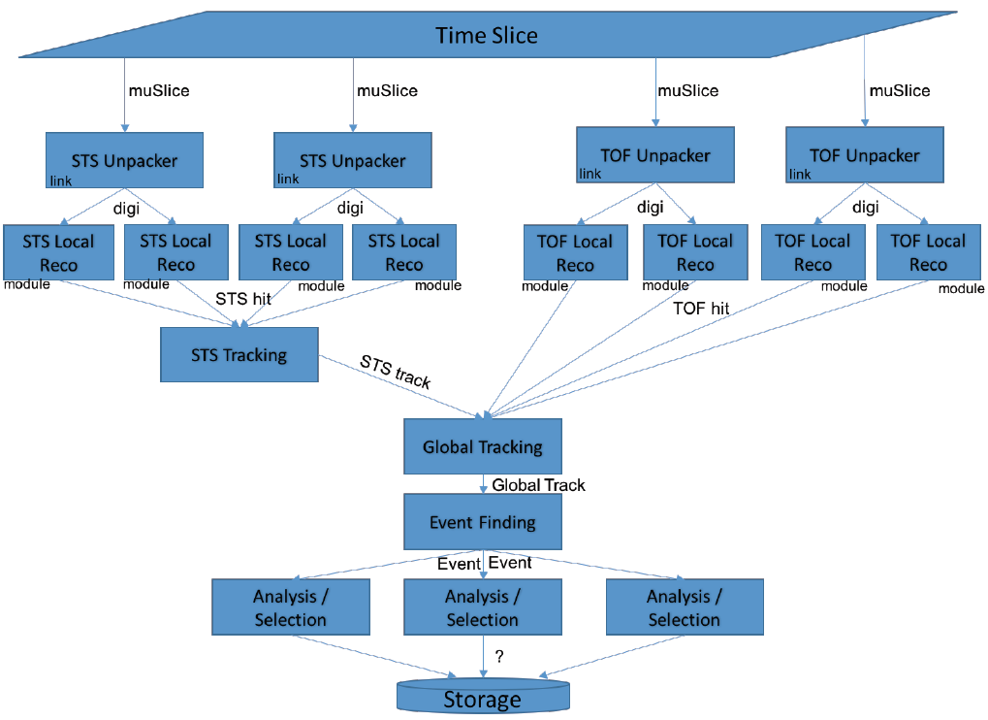
Example: Simple CBM Process Graph (STS + TOF)
V. Friese
Theme Meeting on CBM
3rd February 2023, Jatni, India

