Slide 1


EURIZON Annual Meeting 2023
Task 5-2: Accelerator Technologies for ERL and their use for Colliders
Darmstadt, February 09th 2023
Walid KAABI

Slide 2
Scope change after moving from CREMLIN+ to EURIZON
Initial CREMLIN+ SCOPE:
Task 5.2: Development of collider technologies and fostering synergy between SCT, CLIC, and FCC-ee collider projects (CERN, BINP, IJCLab-CNRS)
Scope: Joint development of accelerator equipment by IJCLab-CNRS and BINP groups
  Development of the electron RF photo-gun with low emittance and high flux electron beam. Production of key elements.
  Development of the polarized electron source. Production of key elements and systems.
  Development of magnet technologies, production and measurement of accelerator magnets.
Deliverable: D5.1: Report on joint development of collider technologies for lepton colliders (M36)
Milestone: M3: Prototyping and measurements of key elements (M42)

Slide 3
Scope change after moving from CREMLIN+ to EURIZON
New EURIZON SCOPE:
Task 5.2: Development of accelerator technologies for Energy Recovery Linacs (ERLs) and their use in colliders
Scope:
  Continue the design study of magnet technologies for ERLs (B-COM) + hopefully prototyping and test
  Study and optimise High Order Mode (HOM) dumping for ERL SRF cavity, fabricate and test HOM coupler prototypes
Consequences:
Loss of expertise, prototyping capability and test equipment at BINP → Delay and over-cost in magnet prototyping to be considered.
Special request addressed to project coordinator:
Use the money initially allocated to Post-doc hiring (104 k€) to prototypes funding, in addition to the 100k€ already allocated → Total budget for prototyping (204 k€).

Slide 4
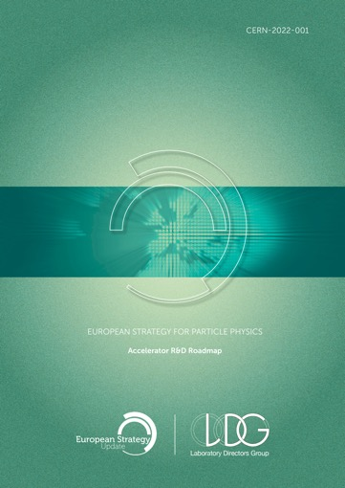
ERLs in the European Accelerator R&D Roadmap
ERL development has been recognized as one of the five main axis of accelerators R&D in support of the European Strategy for Particle Physics (ESPP):
  High-field magnets
  High-gradient RF structures and systems
  High-gradient plasma and laser accelerators
  Bright muon beams and muon colliders
  Energy-recovery linacs
The constituted ERL Roadmap Panel has done a tremendous job with broad and active participation. PERLE & bERLinPro projects were recognized as one of the "essential pillars of the ERL development," with milestones to be achieved by the next ESPP in 2026.
ESPP R&D Accelerator Roadmap: https://arxiv.org/ftp/arxiv/papers/2201/2201.07895.pdf

Slide 5
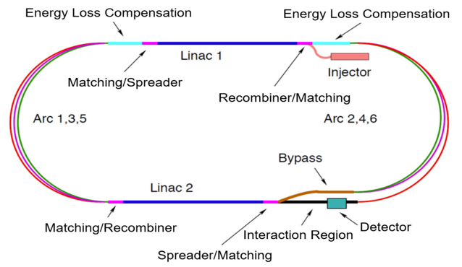
The short story of the PERLE Genesis
Future particle physics imposes strong technical challenges on accelerators and requires a variety of accelerator R&D programs not only to meet the foreseen performances, but also to lower their energetic consumption and enhance their efficiency.
  → Energy Recovery Linacs offer one of the main options for energy frontier colliders
To probe deep inelastic scattering at high energy and to study the Higgs boson, LHeC proposes a high luminosity collider using the HL-LHC protons and an intense electron beam.
For the electron beam, the ERL scenario has many advantages :
  High luminosity, low interference for installation next to LHC, machine size, energy consumption
  Concept also applied to the FCC-eh design
The ERL-ring collider concept of LHeC based on
  synchronous operation of HL-LHC and 50 GeV electron beams
  circumference of e- loop about 1/5 of that of LHC (5.3 km)
  luminosity of 10³⁴ cm⁻².s⁻¹
  Multi-turn ERL (3+3 passes), 50 GeV, RF frequency: 801 MHz,
  20 mA beam current (6 x 20 = 120mA load in the cavities).

Slide 6
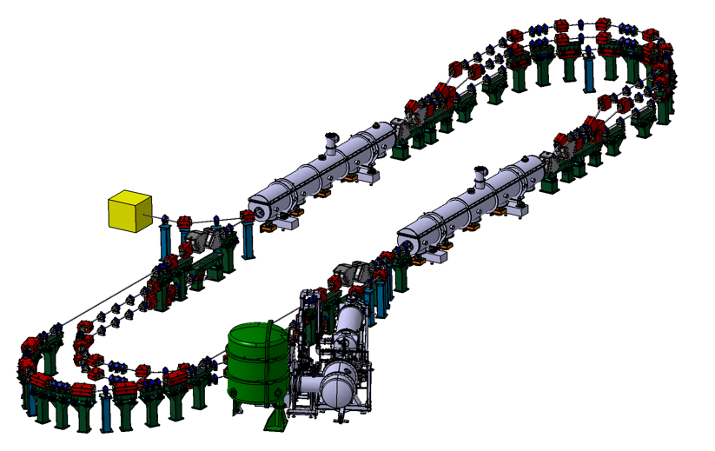
The short story of the PERLE Genesis
PERLE: A testbed to explore and validate a broad range of accelerator phenomena & technical choices on the pathway to the LHeC and other new frontier machines realisation.
Main challenges: Multi-turn, high bunch charge, high power energy recovery, …
2 Linacs (Four 5-Cell 801.58 MHz SC cavities)
3 turns (164 MeV/turn)
Max. beam energy 500 MeV
I = 20mA
Target Parameter | Unit | Value
Injection energy | MeV | 7
Electron beam energy | MeV | 500
Normalised Emittance γε_{x,y} | mm mrad | 6
Average beam current | mA | 20
Bunch charge | pC | 500
Bunch length | mm | 3
Bunch spacing | ns | 25
RF frequency | MHz | 801.58
Duty factor |  | CW

Slide 7
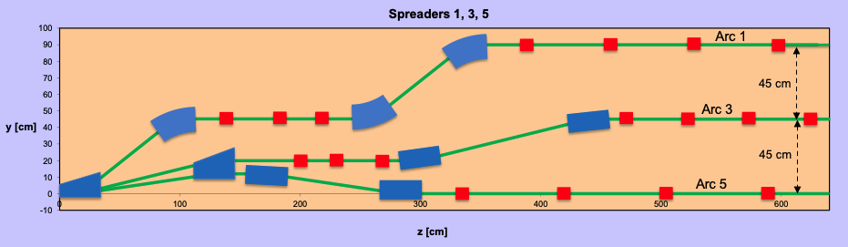

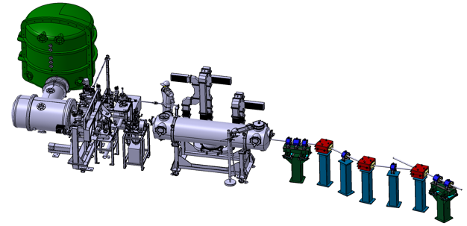
PERLE Configuration
PERLE: first multi-turn ERL, based in SRF technology, designed to operate at 10MW (20 mA, 500 MeV) power regime
Cryomodule with 4 five-Cell cavities
Total gradient 82 MeV
3 acc & 3 decc beams at different energies travelling in the CM.
Switchyard: vertical separation/recombination of beams at different energies
3 staked recirculation arcs for beams at different energies (Arcs 1, 3, 5).
Target Parameter | Unit | Value
Injection energy | MeV | 7
Electron beam energy | MeV | 500
Normalised Emittance γε_{x,y} | mm mrad | 6
Average beam current | mA | 20
Bunch charge | pC | 500
Bunch length | mm | 3
Bunch spacing | ns | 25
RF frequency | MHz | 801.58
Duty factor |  | CW
Beam dump
Interaction Points
HV tank
Photocathodes loading chamber (Sb-based photocathodes)
Buncher
350-500 kV
DC gun
Merger
3 staked (& inversed) recirculation arcs for beams at different energies (Arcs 2, 4, 6)
Injection line delivering 500pC bunches at 7 MeV.
Light box
Green laser 40 MHz
Booster: 5 single-cell cavities (802MHz) individually powered

Slide 8
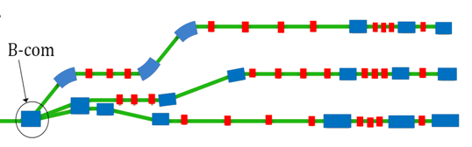
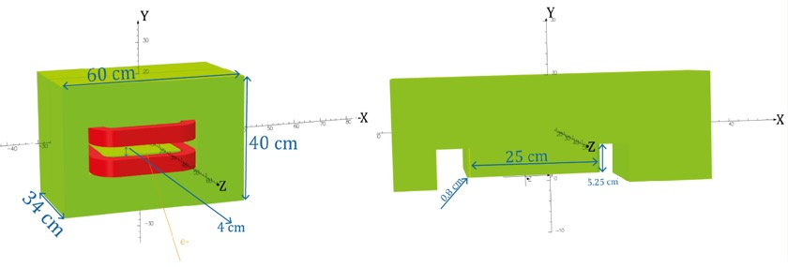
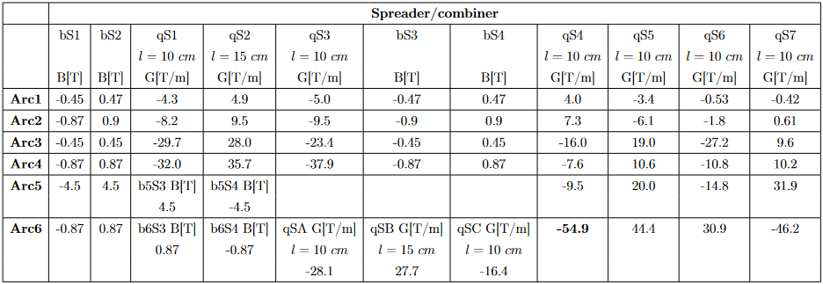
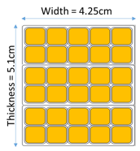
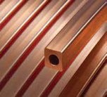
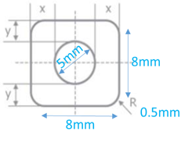
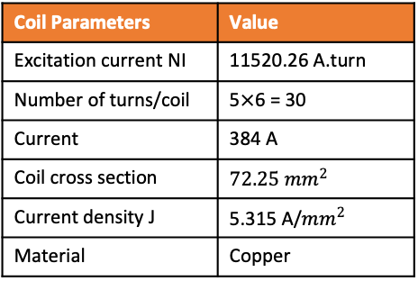
Status of B-com Magnet design
Design parameters
Tool: Opera 3D
Coil
30° bending angle (8.8 cm exit point).
Yoke
Magnet geometry | Initial design * | New design
Width | 40 cm | 40 cm
Height | 57 cm | 60 cm
Length | 34 cm | 34 cm
Aperture | 3.6 cm | 4 cm
Pole width | 22 cm | 25 cm
Pole height | 5.25 cm | 5.25 cm
Pole blend radius | 2.4 cm | 0.8 cm
Coil Parameters | Value
Excitation current NI | 11520.26 A.turn
Number of turns/coil | 5$×$6 = 30
Current | 384 A
Coil cross section | $$72.25{ mm}^{2}$$
Current density J | 5.315 A/${mm}^{2}$
Material | Copper
Optimized aperture of 4 cm.
Pole bend radius modified to lower harmonic content.
Yoke material: standard steel (C content < 0.1%).
Hollow copper conductor
Excitation current calculated at B = 0.87 T

Slide 9
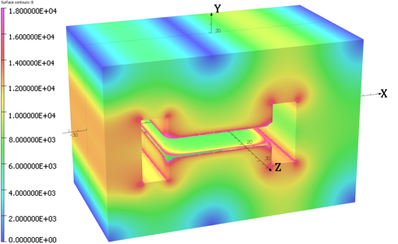
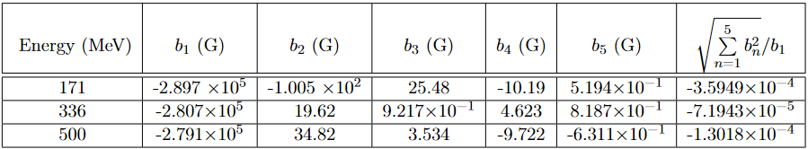
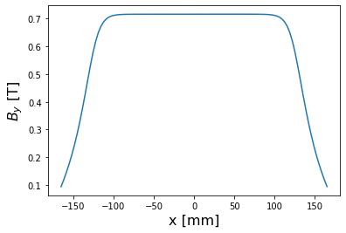
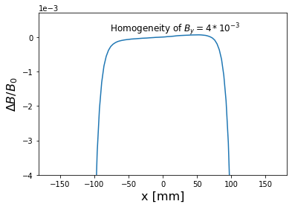
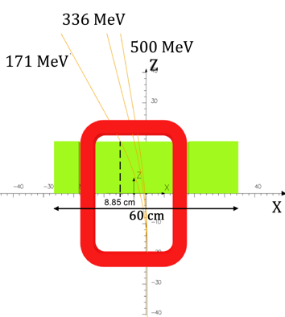
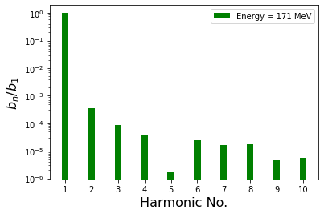
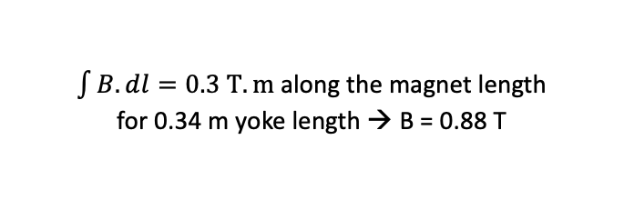


Status of B-com Magnet design
Field calculations:
Harmonics content calculated along beam trajectory:
Field homogeneity along the beam path: 0.036%
→ Quadrupole & sextupole components can be dealt within the lattice.
Initial design: 0.1% field quality
→ Improvement by one order of magnitude
No chamfer or shims added, only a blend radius of 8 mm is used
$$By (0, 0, 0) = 0.716382 T$$
$$\frac{ΔB}{B_{0}}=\frac{B\left(x\right)−B_{0}}{B_{0}}$$
$\int{B.dl}=0.3 T.m$along the magnet length
for 0.34 m yoke length → B = 0.88 T

Slide 10
Plan of magnet activities
Prototype of B-COM magnet:
Pursue the work toward B-COM magnet complete specification.
Proceed to a thermal study and mechanical complete design
Ordering a B-COM magnet prototype to be measured and qualified, is still under discussion.
Challenges:
Prototype would now be made with an industrial partner (fabrication initially foreseen at BINP):
  Risk of over-cost regarding the budget foreseen.
  Long administrative process before purchase regarding the period left for the project (January 24).
We are looking for a magnetic measurement bench to made measurements and characterize the prototype (measurements initially foreseen at BINP).

Slide 11
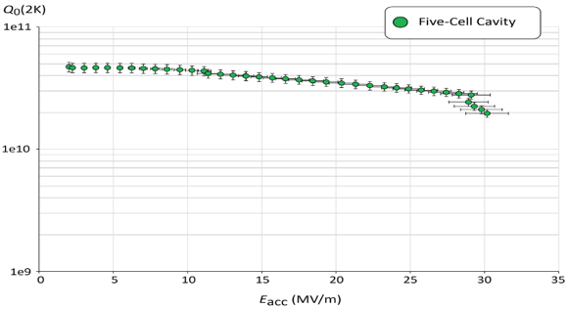
SRF cavity for ERL
Requirements | Impacts | Challenges | Possible Solutions
CW operation (RF) | High dynamic losses | The highest cavity Q₀ | Cavity post-treatment (Doping, infusion…)
High current operation | High HOMs excitation | Efficient HOMs extraction & damping | Act on cavity design: low frequency cavity choice (< 1GHz), larger cavity aperture, fewer cells for the a given gradient, optimisation of end-cell design.
Muti-bunches operation | Increase beam instabilities | The highest BBU threshold | Regular spacing of bunches: optimisation of the bunch filling pattern during Lattice design + BBU study after HOM optimisation (including collective effects).
Q₀ (2k) = 3 e10 @ ~27 MV/m
Quench @ E_{acc} ~ 30 MV/m
PERLE requirements
First Nb 802 MHz 5-Cell cavity fabricated at JLAB

Slide 12
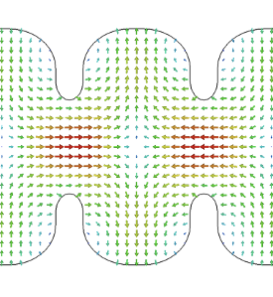
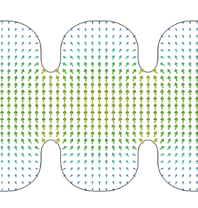
PERLE SRF cavity
HOMs (High Order Modes):
Are parasitic excited modes in a resonant accelerating RF cavity, other than and with frequency greater than the operational mode (FM = Fundamental Mode).
TM011 mode
TE111 mode
Monopole HOMs:
Can lead to timing/phase errors and energy spread.
Contribute to extra dynamic heat losses in cavity walls
Dipole HOMs:
Can deflect the beam from its reference orbit: Unstable beam motion, transverse emittance growth, beam loss

Slide 13
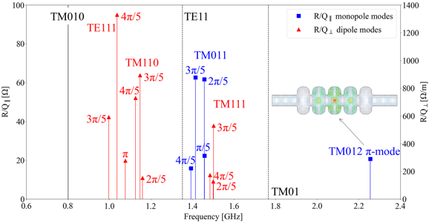
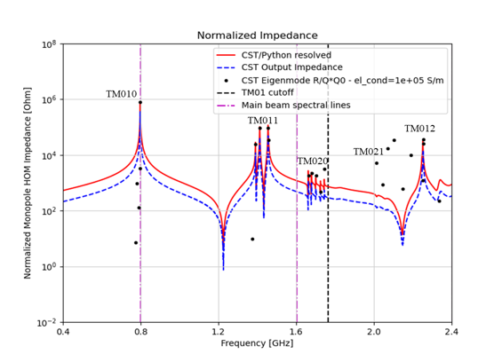
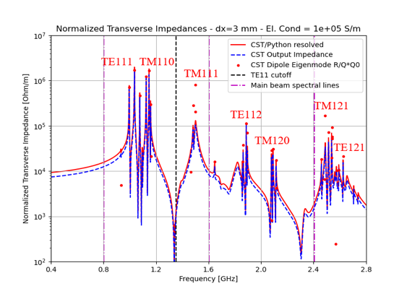
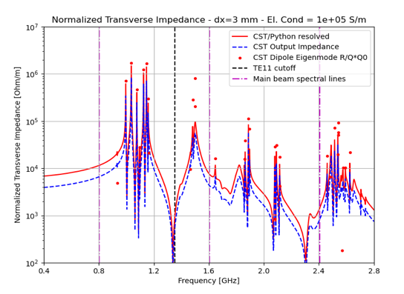

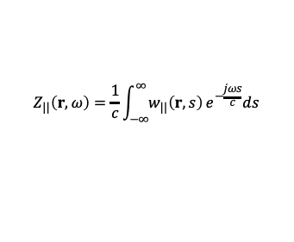
HOM design studies:
3D- Eigenmode simulation: HOMs Identification in PERLE cavity
Wakefield simulations for multi-beam excitation scheme (CST Studio)
TE111
TM110
TM111
TE112
TM121
TM120
TE121
Longitudinal wake impedance [Ω]:
$$Z_{||}\left(r,ω\right)=\frac{1}{c}\int_{−∞}^{∞}{w_{||}\left(r,s\right)}e^{−\frac{jωs}{c}}ds$$
$$Z_{⊥}\left(r,ω\right)=−\frac{jβc}{ω_{n}r_{0}}∇_{⊥}Z_{||}\left(r,ω\right)$$
Transverse wake impedance [Ω/m] – Panofsky-Wenzel Theorem:

Slide 14
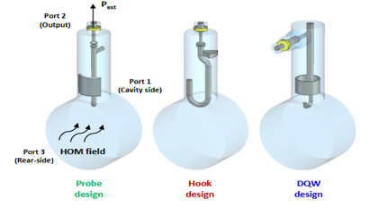
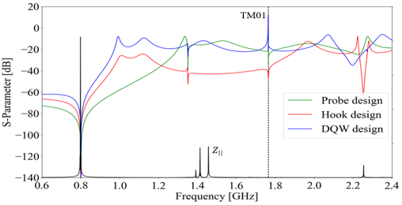
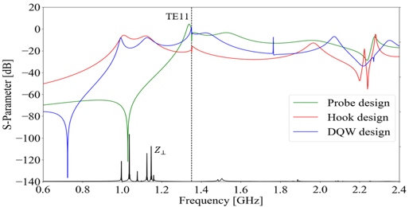
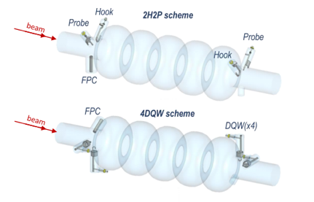
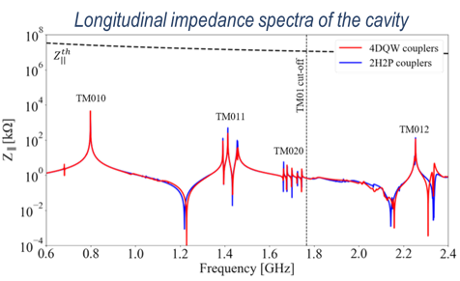
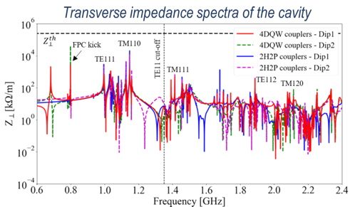
HOM design studies:
HOM coupler optimization of 3 different designs
Couplers geometrically optimized according to the HOM spectrum & S-parameters btw port 1 (beam pipe) & port 2 (coupler output) studied.
The hook coupler provides higher damping of the first two dipole passbands (TE111 and TM110)
The DQW coupler exhibits a better monopole coupling for TM010 mode than the probe design.
Study of 2 damping schemes with 4 HOM couplers (Especially for dipole HOM extraction)
Promising results of DQW configuration: It allow damping both monopole and dipole HOMs below the analytically-computed beam-stability limits

Slide 15
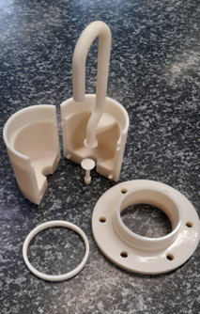
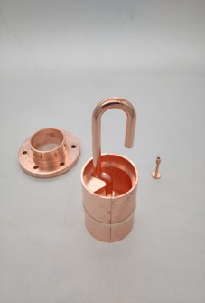
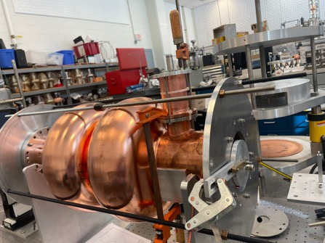
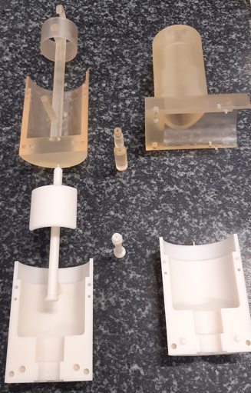
Plans on HOMs and cavity activities :
HOM couplers prototypes:
1 hook HOM coupler was 3D printed in polymer then Copper coated.
Now installed on a 2-cell 801.58 MHz copper cavity to test HOM coupler performance
DQW-type
First Hook type polymer coupler 3D printed then copper coated, now installed in a double-cell Cu cavity for test
Probe-type
Test will be performed also on Probe-type and DQW-type coupler currently under fabrication.
A 5-Cell copper cavity will be fabricated soon @Jlab (same design as the 1st Nb 5-cell cavity fabricated in 2017) to allow end group design optimisation and to test several HOM couplers combinations to assess the best HOM damping scheme.
Ultimately, we aim to fabricate Nb HOM couplers with optimised design and and install them on a new Nb 5-cell PERLE cavity with optimised end groups.

Slide 16
Summary:
Design studies are progressing well, both for magnet and HOM technologies for ERL
Magnet prototyping is under discussion due to new challenges related to cost and timeline (loss of the expertise and capacity of fabrication & test at BINP)
HOM couplers prototyping will be made in the project timeline.
Special request addressed to project coordinator: Use the money initially allocated to Post-doc hiring (104 k€) to prototypes funding. Need to know how to formalize it.

Slide 17
Thank you for your attention!

Slide 18
Introduction- ERL Concept
Acceleration:
RF power provided to cavities
The idea:
(1’)
(1)
New beam injected in ERL loop
Acceleration to the top energy
(2’)…
(2)
The benefits:
Reduce accelerator power consumption
Dumping the beam at injection power
Fresh beam in IP with the same characteristics
ERL Loop
(4)
Kinetic energy of used beam recycled to re-excite cavities
Beam used in IP
(3)
Deceleration:
180° RF Phase shift
More advantages:
Linac-like beam quality with extremely flexible time structure
High operating efficiency
Multi-pass configuration: High average current carrying capability (no more RF power limit) + High average beam power in a compact machine

Slide 19
Introduction- Energy Recovery in RF Fields
λ_{Rf}
E_{Out} = E_{Inj}
E = E_{inj} +ΔE
E = E_{inj} +2 ΔE
E_{Inj}
E = E_{inj} +ΔE
E = E_{inj} +ΔE
(β ~ 1)
L = n · λ + λ / 2
L = n · λ
Energy supply → acceleration
Deceleration = “loss free” energy storage (in the beam) → Energy recovery

Slide 20
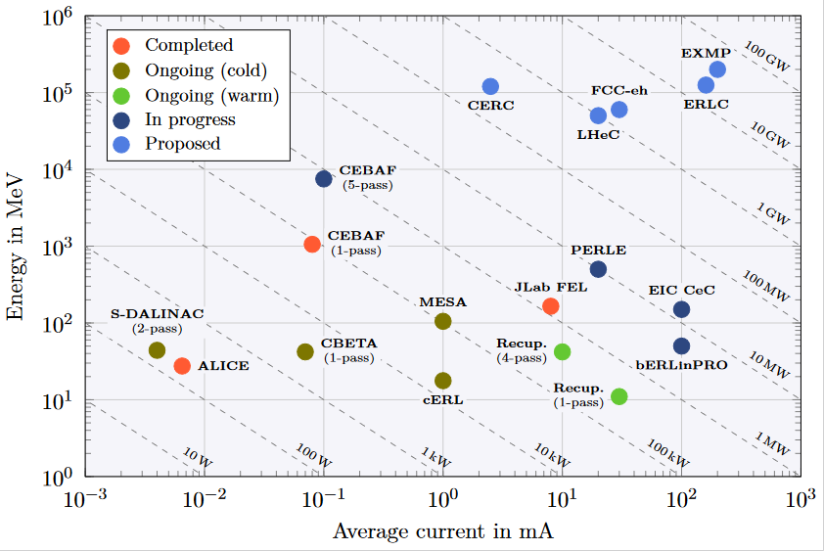
ERL - The global landscape
Funding Limited
Technology Limited

Slide 21
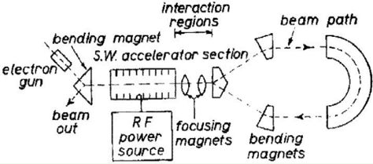
ERL History and achievements
1987 Los Alamos
FEL-operation, nc,
coupled acc/dec cavities
1987 High Energy Physics Lab
Stanford University
SRF cavities, proof of principal experiment
1965 M. Tigner
“A possible apparatus for electron clashing-beam experiments”
2000
Jefferson Lab
“Front End Test”
SRF, first CW
recovery
2002 JEARI, Japan
FEL, SRF, 700kW beam power
2005 Daresbury Lab, GB
“Alice”, SRF, 26MeV, versatile
10-year user program
under construction:
MESA, Germany
particle physics application
PERLE, France
Technology test facility (LHeC/FCC-eh) + eRIB test facility
bERLinPro, Germany
SRF/ERL technology test facility
CeC, BNL, USA
Coherent electron cooling for EIC
2002
Jefferson Lab
“IR-Demo”
SRF, 5mA, 48MeV,
2.1kW beam power IR
2003
CEBAF, 1 GeV, single turn
2007 Upgrade:
9mA, 150MeV
1.1MW beam power with ~300kW total power
2004 BINP, Russia
FEL-operation
normal conducting RF,
30 mA
2007: 4-passes
2013 KEK, Japan
“cERL”, prototype
ERL light source
Industrial applications
2020, Cornell/BNL
cbeta, FFA-arc
4-pass ERL
(80mA injector, e = 0.3mm mrad)
Courtesy to Bettina Kuske

