Slide 1

Reshaping WP7-DETEC for EURIZON,
Statement on Status Feb. 2023
Task 1 Development of CMOS technologies for high-rate Silicon trackers (MAPS)
Task 2 Integration of MAPS sensors in large-area tracking-detector systems
Task 3 Next generation Neutron Detectors
Task 4 Training and school for young scientists on particle detection technologies
Task 5 Development of a position sensitive neutron detector based on MAPS
Christian J. Schmidt
EURIZON Anual Meeting 2023 at FAIR/GSI, Darmstadt
Feb. 9 – 10, 2023

Slide 2
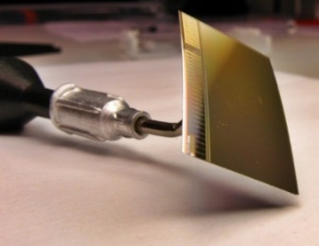

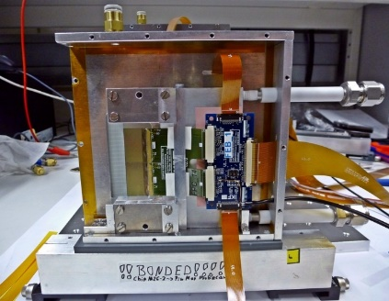
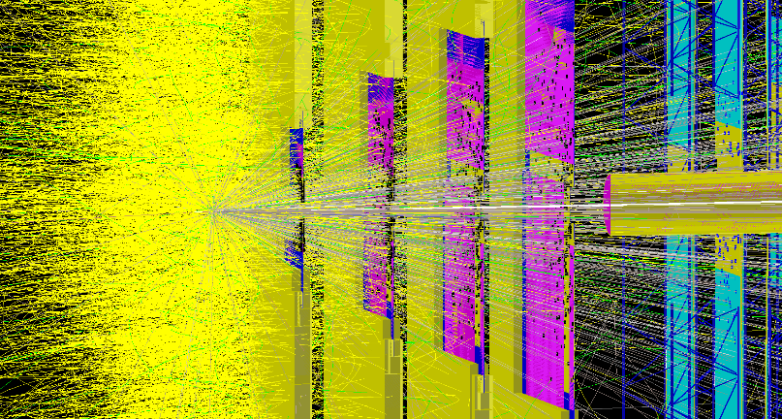




WP7 – DETEC Monolitic Active Pixel Tracking Detector
MAPS integration,
power management
Development target:
increased rate
capability, time granularity and radiation
tolerance.
MAPS sensor design
Silicon integration,
r/o electronics
technological
stake holders
Kiew Institute for Nuclear Research
KINR
silicon detector characterization
and evaluation
Precision e-test-beam facility
characterization of telescope
beneficiary of resulting prototype

Slide 3
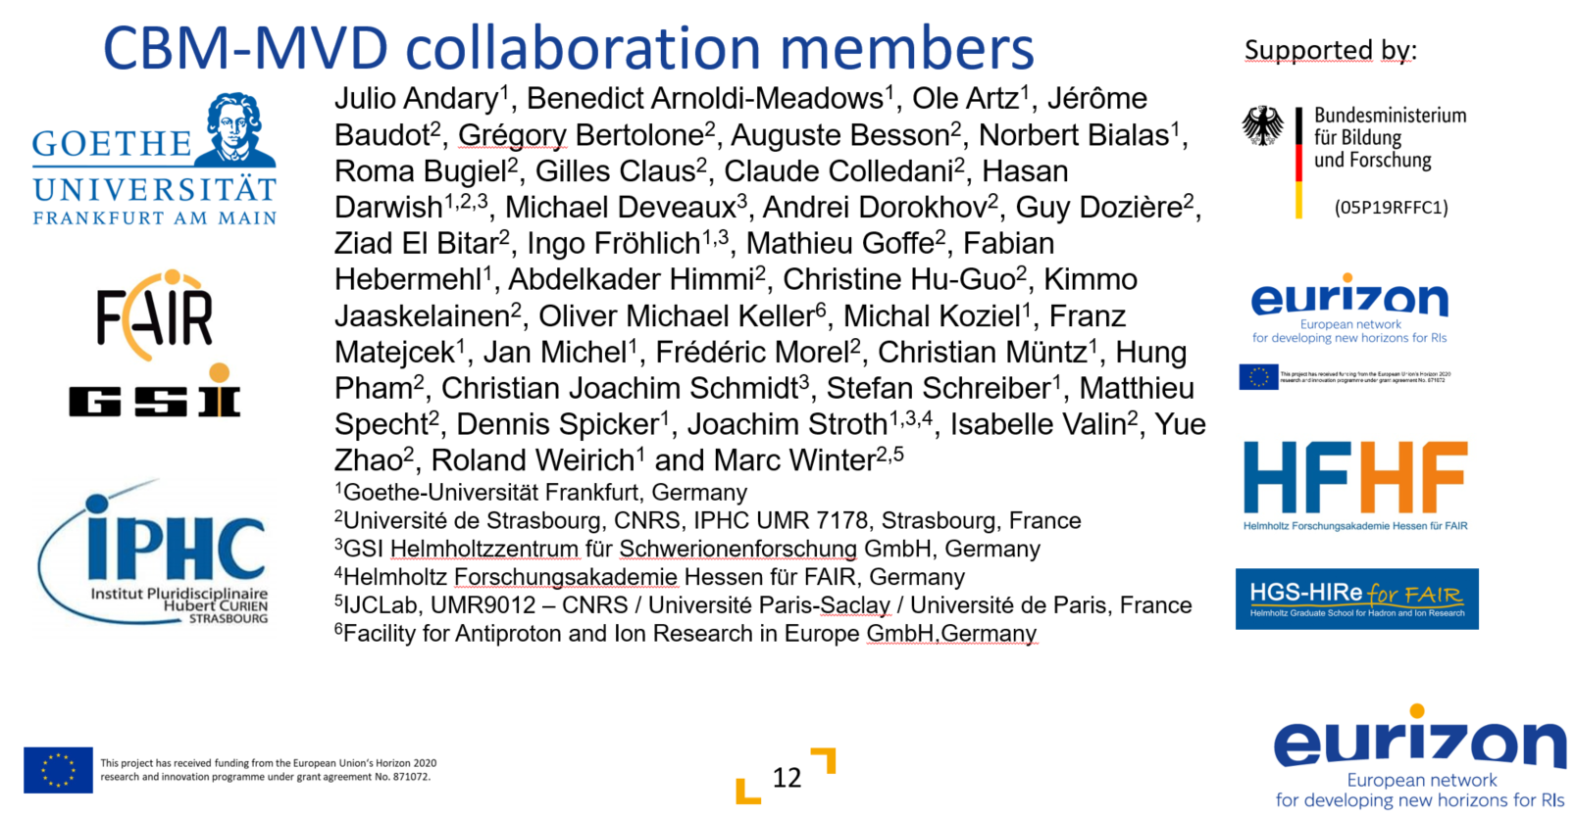
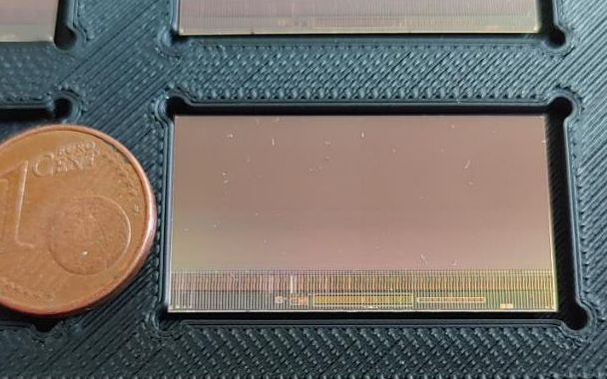

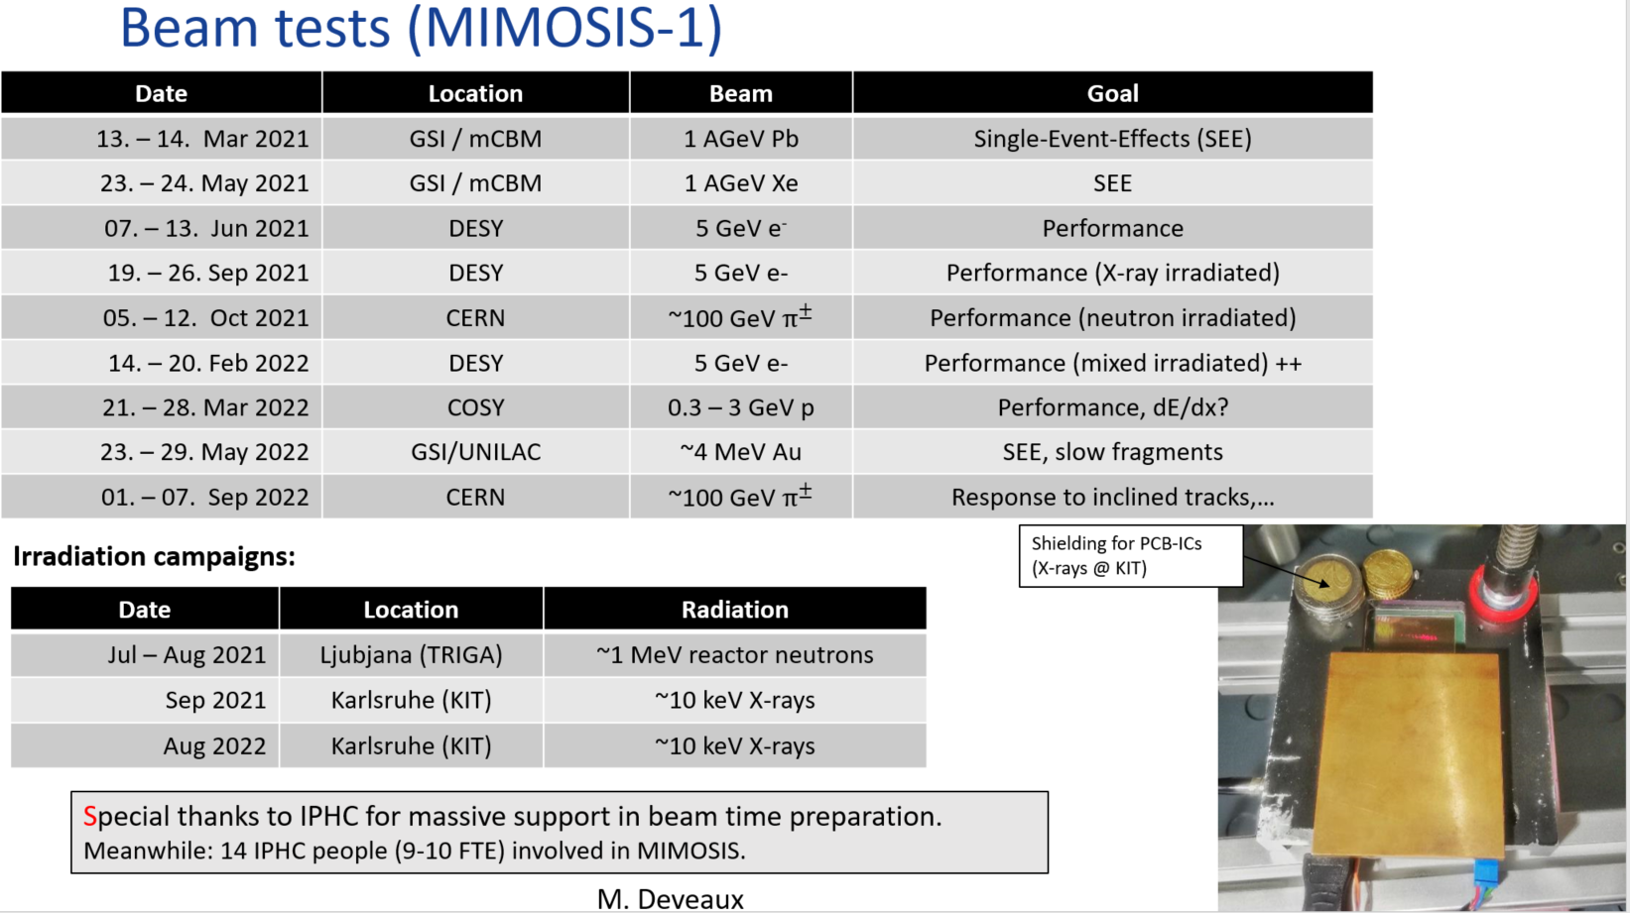
WP7 Task 1 Development of CMOS technologies for high-rate Silicon trackers
Practical: Development of MAPS type MIMOSIS Sensor
Target: CBM (FAIR) Micro Vertex Detector MVD
In parallel: Full activity on sensor integration and readout
→ get Ukrainean students on (KINR)!
MIMOSIS-1 (2020)
Full size sensor 504 x 1024 pixels (30 mm x 13mm active)
fully evaluated during Corona Times, many beam times
MIMOSIS-2 submitted, chips expected (Q2/2023)
On-chip pixel grouping.
Final pixels.
Single event radiation effect hardening (SEE)
MIMOSIS-3
Final sensor for serial production
MIMOSIS-1, 60µm thick

Slide 4

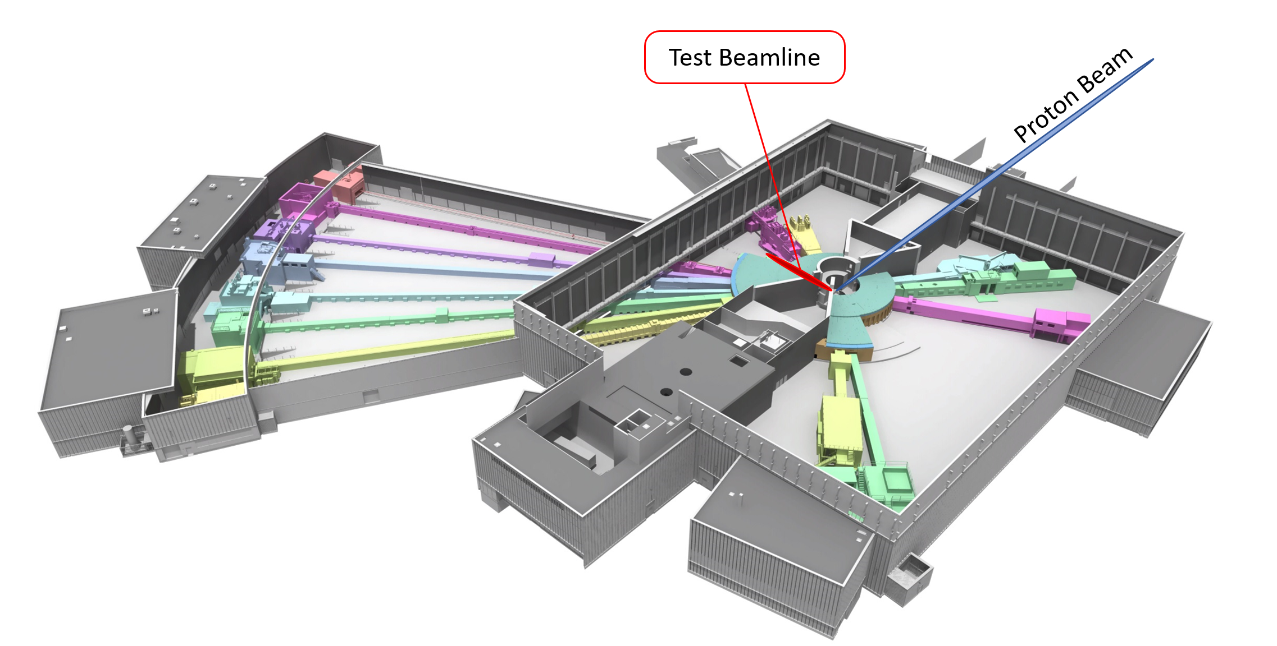
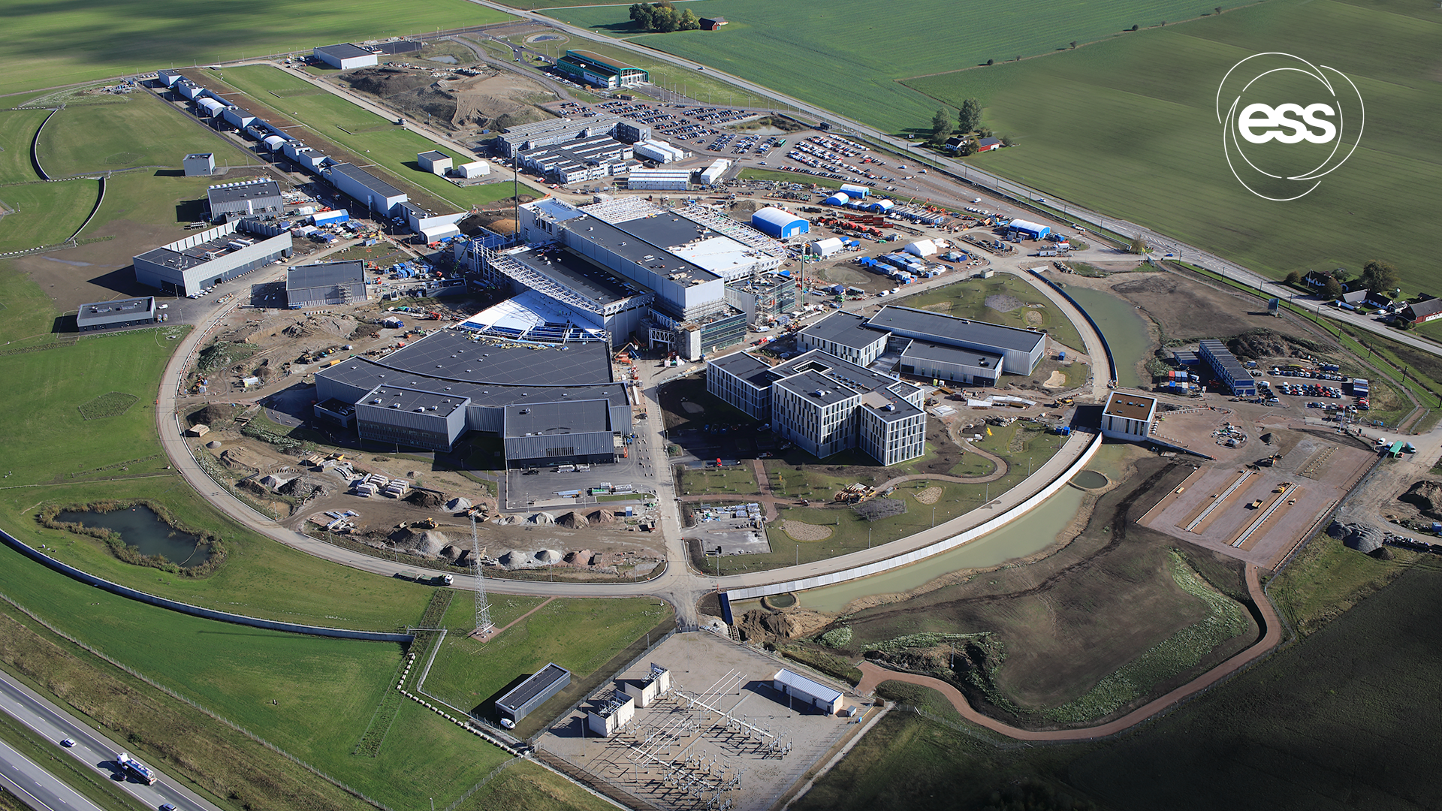
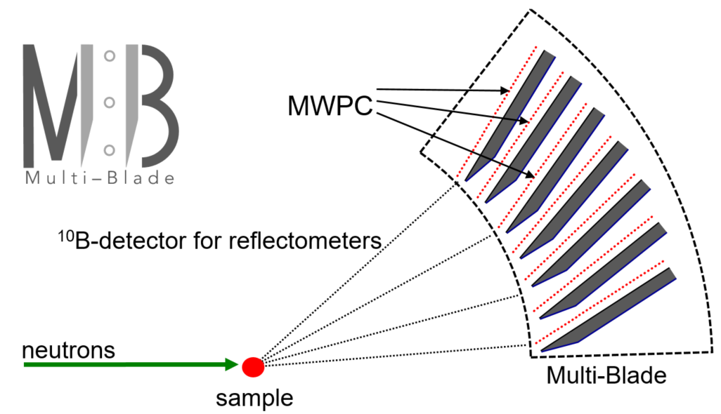
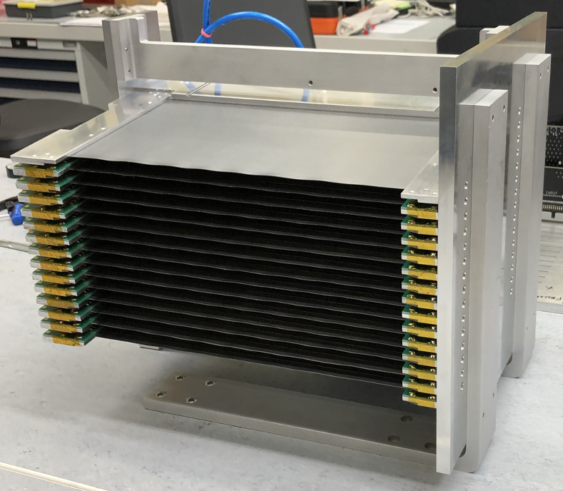
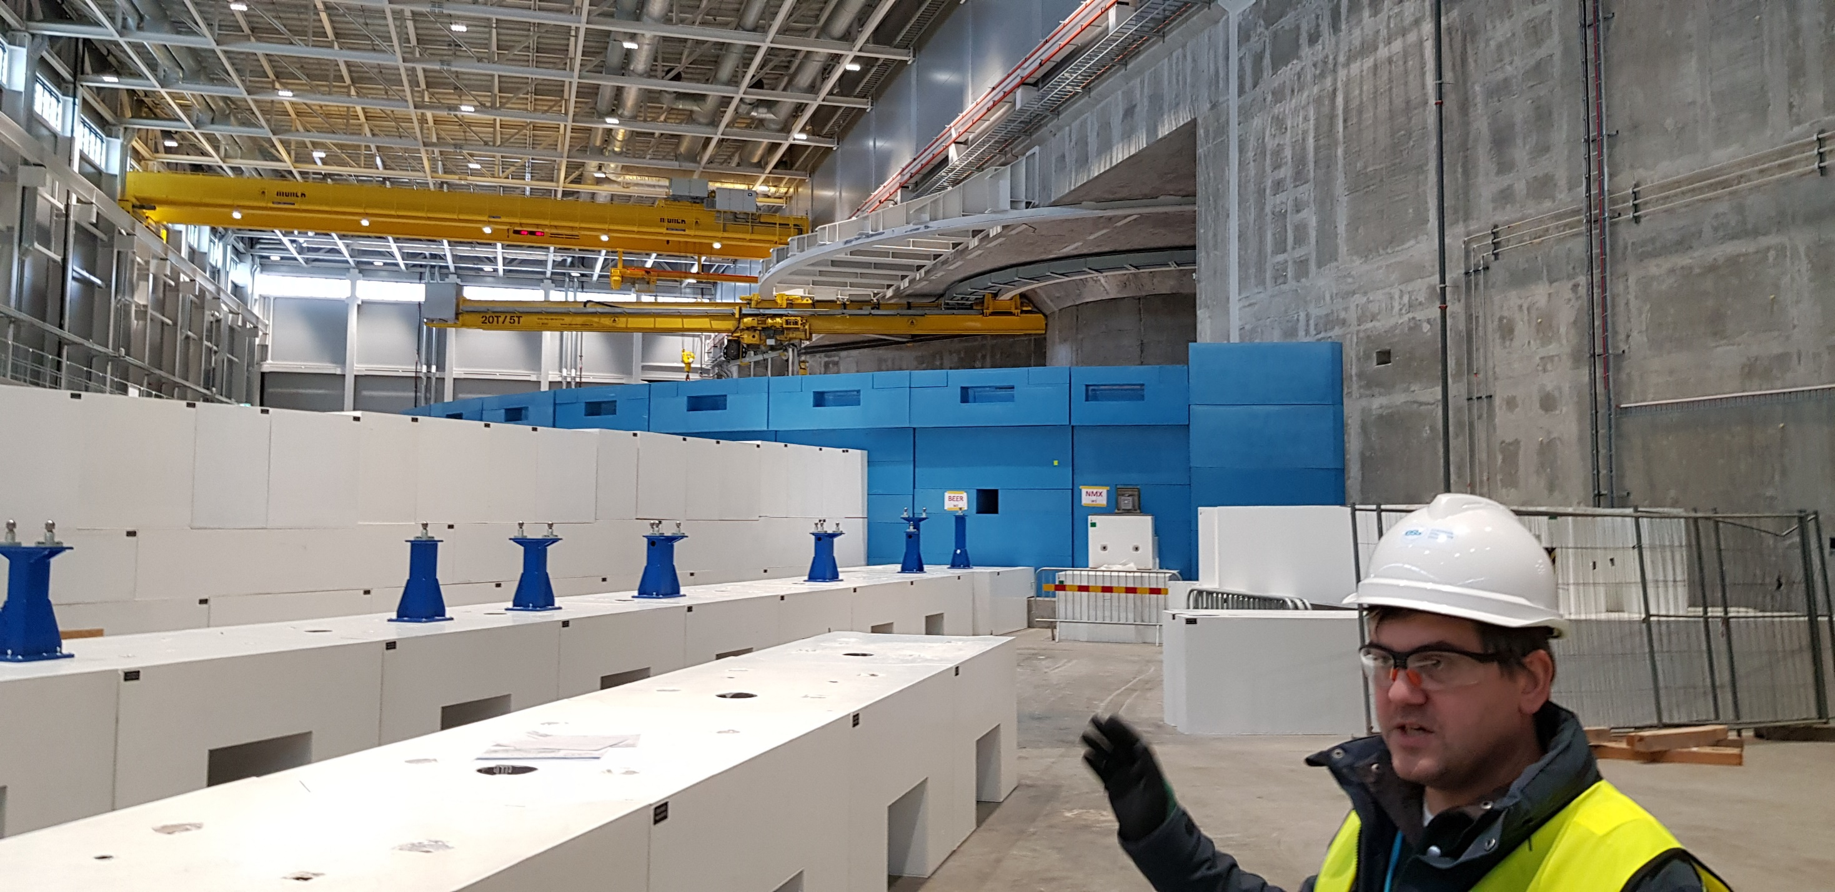

Since 2022: Neutron Detector Competence at ESS
Activity on Neutron Detector Developments
ESS Detector Group
→ Test Beam Line W11 at ESS target application
→ Multi Blade still technology of choice
Uni Milano joined with
Boron-GEM based neutron detector
Notes:
14 spectrometers of different types, a neutron imaging facility, two facilities for neutron nuclear physics investigation and a neutron activation facility
4

Slide 5
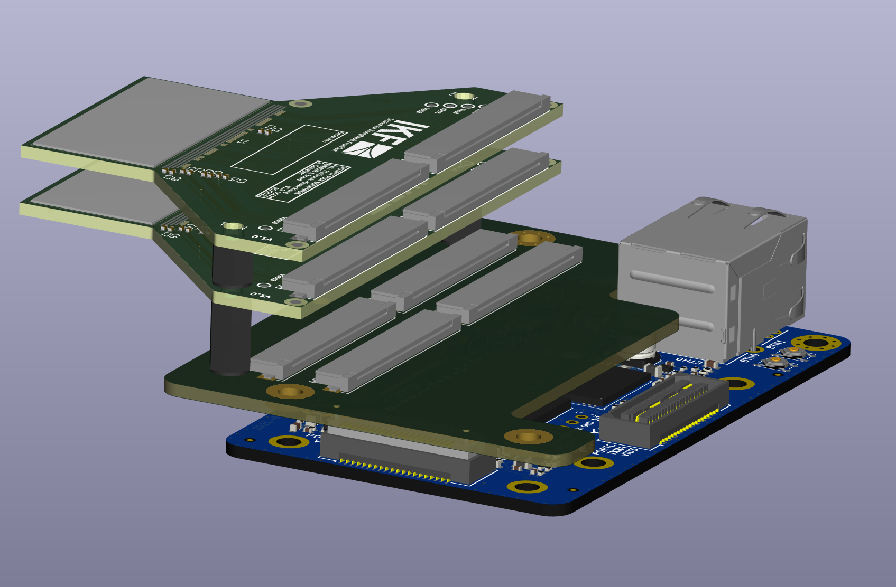
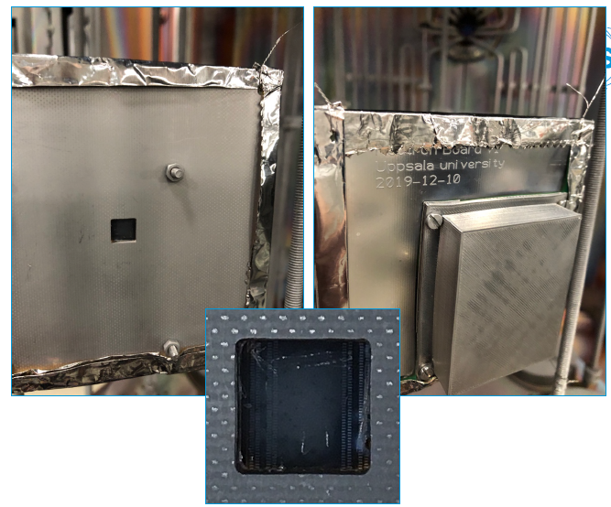
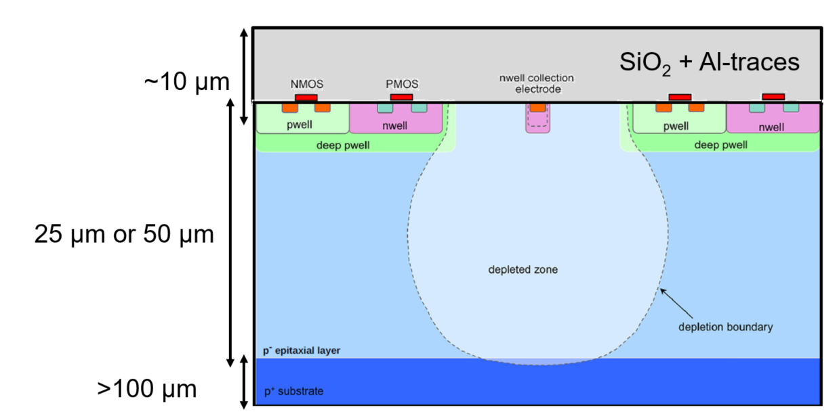
WP7 Task 5 Joint Activity: Devise a Pixel-Neutron-Detector from MIMOSIS
Coating of MIMOSIS with ¹⁰B as thermal neutron converter → ESS B4C coating expertise (Chung-Chuan Lai)
MIMOSIS backside thinning: Window thinning for detection of nuclear fragments (⁶Li, α)
Table top MIMOSIS DAQ-System
also: integrate Ukrainean scientists and students into activity
MIMOSIS-1, 60µm thick
see PhD Eleni Myrto Asimakopoulou, Upsala University 2021 for B₄C coated silicon strip sensor, photograph by Chung-Chuan Lai, ESS

Slide 6

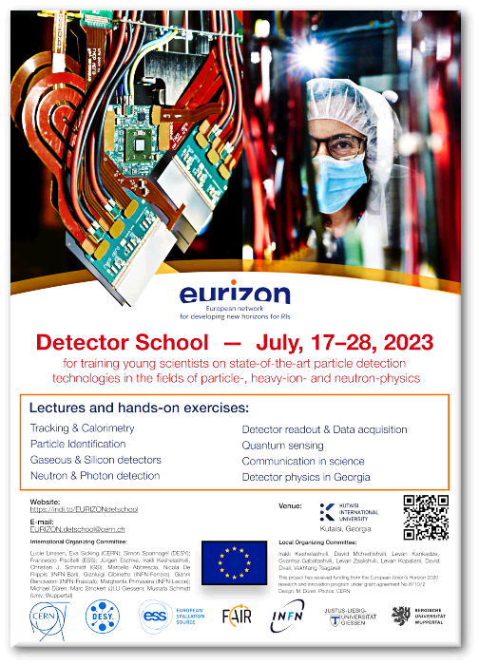
WP7-DETEC
Task 3 New Detector School
School at Budker Insitute in Novosibirsk, July 3-16, 2022
canceled upon Russian war against Ukraine.
See presentation by Nicola De Filippis on Friday (WP7) for more details!
Poster available, call for applicants out!

Slide 7
Outlook
Teams eager for joint post COVID, post restructuring in-person work
practical work will profit enormously from project extension
→ Neutron Multi Blade Detector: ESS test beam facility targeted, University Milano engaged
→ with CMOS-sensors available: joint MIMOSIS sensor integration activities
→ along SAC recommendation: Devise a MIMOSIS-based neutron detector
→ Reborn detector school organized for summer 2023 in Georgia

Slide 8
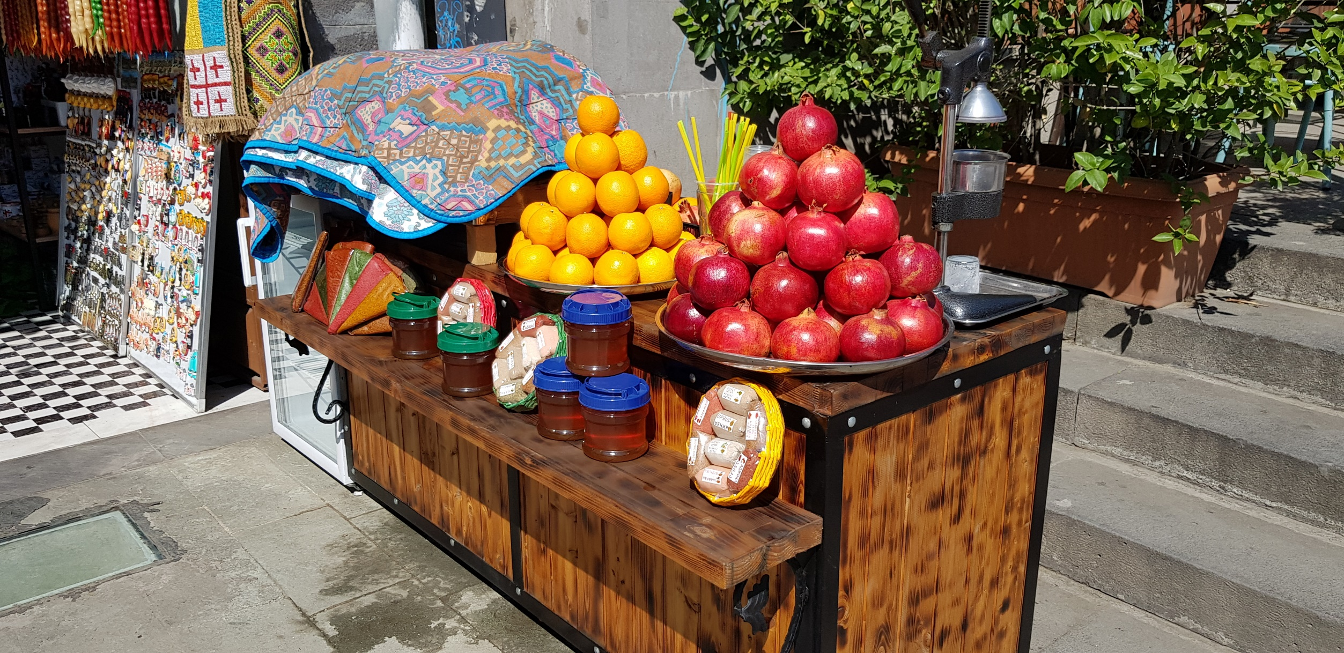
Georgia at its best ☺

