Slide 1
EURIZON NON-TECHNICAL WPs
WP 8: Transnational Access Programme
DESY – Greta Facile

Slide 2
EURIZON NON-TECHNICAL WPs: Introduction
WP 8: Transnational Access Programme
WP 9: Fellowship and
Training programme
WP10: Sustainability of RIs
CLOSED with
“Handbook to transfer access-related knowledge and to develop
structured and transparent access schemes to RIs outside Europe”
UNDER AMENDMENT
introduction of new measures to :
support and train Ukrainian researchers;
to map the status of Ukrainian RIs and to raise awareness in Europe concerning their needs for training and sustainability.

Slide 3
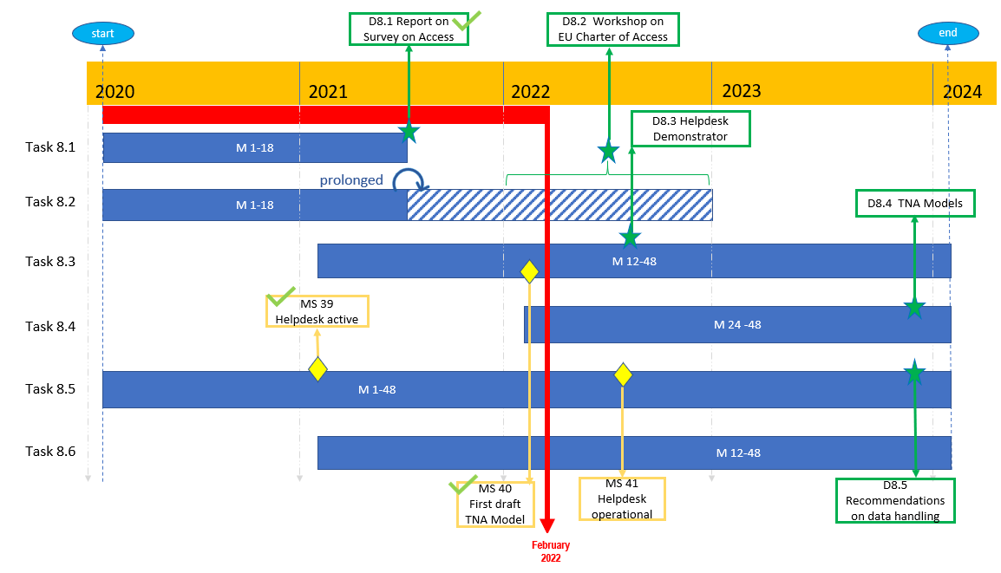
WP 8: Transnational Access Programme on February 2022
TASK 8.1 Analysis and assessment of access potential of LIST-11 RIs (M1- M18)
TASK 8.2 Knowledge transfer from EU to Russia on access policy and governance for RI (M1- M18)
TASK 8.3 Develop transnational access (TNA) models for Russian RIs (M12-M48)
TASK 8.4 Case studies: Transnational access to Russian RIs (M24- M48)
TASK 8.5 Helpdesk and promotion of TNA to Russian RIs (M1-M48)
TASK 8.6 Access to scientific data at Russian RIs (M12-M48)
WP Leader: ICISTE
Other Partners: DESY, NUST MISIS,
NRC KI

Slide 4
WP 8: Transnational Access Programme in CREMLINplus
Despite the Covid-19 Pandemic outbreak and the shift to a fully online working context, the WP8 programme was well on track before the start of Russia´s war against Ukraine.
TASK 8.1 Analysis and assessment of access potential of LIST-11 RIs (M1- M18)
Status: ACHIEVED the extensive report “Survey on potential access to Russian RIs for European Researchers” (WP8) has provided an unprecedented analysis about the access policies of Russian RIs.
TASK 8.2 Knowledge transfer from EU to Russia on access policy and governance for RI (M1- M18)
Status : CANCELLED ( main event “Workshop on the European Charter of Access” was foreseen in September 2022 ).
TASK 8.3 Develop transnational access (TNA) models for Russian RIs (M12-M48)
Status: ACHIEVED the first model of access to Russian RIs was developed and negotiated with the representatives of the LIST-11 RIs was submitted in January 2022.
TASK 8.4 Case studies: Transnational access to Russian RIs (M24- M48)
Status: CANCELLED (main activity: the “Call for access to LIST-11 Russian RIs” was planned to be opened in May 2022).
TASK 8.5 Helpdesk and promotion of TNA to Russian RIs (M1-M48)
Status: CANCELLED (Helpdesk page active but never started to operate as support for the users of the TNA call).
The online event “EU - Russian Federation Symposium on Research Infrastructures” allowed European and Russian RIs managers to present their Infrastructures and to meet online on December 17th, 2021 with more than 100 people attending virtually).
TASK 8.6 Access to scientific data at Russian RIs (M12-M48)
Status: CANCELLED (the workshop “the role of FAIR data in Science” took place in January 2022, the survey for the analysis of data policies of Russian RIs was disseminated but only partial results were received).

Slide 5
WP 8: Transnational Access Programme in EURIZON
Objective: The expertise on transferring knowledge on TNA and structured access to various kinds of RIs outside Europe gained in the first phase of the project in WP8 (TNA) is capitalized for general use.
Task 8.1: Develop a handbook to develop structured and transparent access schemes to non-European RIs [DESY].
Based on the experience of assessing the access policies and access potential of non-EU RIs and of transferring knowledge about access-related European principles and procedures to non-European contexts, we developed a set of recommendations and tools on how to:
Assess the access policies and the access potential of non-European Research Infrastructures and their readiness to provide structured and transparent access for international scientists;
Analyse and assess the data policies of non-European Research Infrastructures;
Transfer knowledge on European access-related values and principles;
Transfer knowledge on European FAIR principles for data management;
Develop and agree on a model for transnational access to non-European Research Infrastructures transferable to different contexts, based on the guidelines set out by (i)the European Charter of Access, by (ii) the Group of Senior Officials (GSO) on global Research Infrastructures recommendations and on (iii) European RIs best practices;
The result of this work is the deliverable D8.4
“Handbook to transfer access-related knowledge and to develop structured and transparent access schemes to RIs outside Europe. Recommendations to set up models of transnational access to research infrastructures of European Interest”
ready to be submitted and further disseminated.

Slide 6
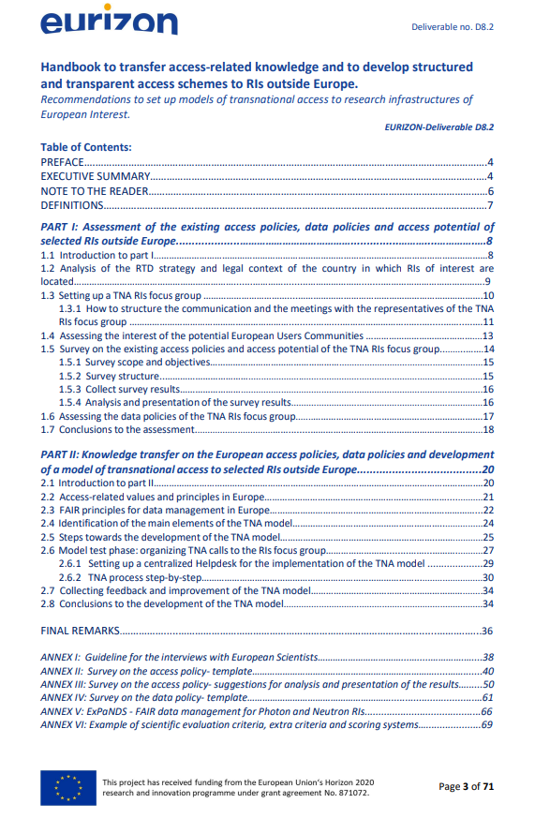
The goal of this document is to make use of the experience acquired in CREMLINplus project, in transferring knowledge about European access principles and in developing models of access to Russian RIs, in order to capitalize the insights and the lessons learned for future use.
The set of recommendations, guidelines and tools collected in this handbook could be used by teams of European experts and scientists that would like to open the doors of research infrastructures to a specific country of interest, outside European borders, in a transparent and structured way.
It includes suggestions on how to transfer knowledge on European access policies and principles, on how to develop and agree on structured and transparent models of access to RIs outside Europe and on how to set up a Transnational access programme for European users,

Slide 7
THANK YOU FOR YOUR ATTENTION!
For further information: greta.facile@desy.de

