Slide 1


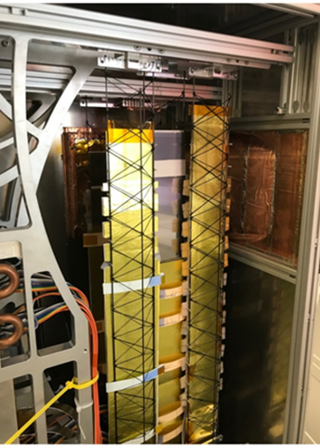
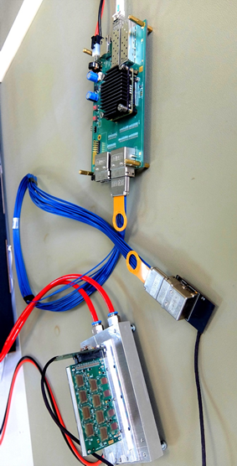
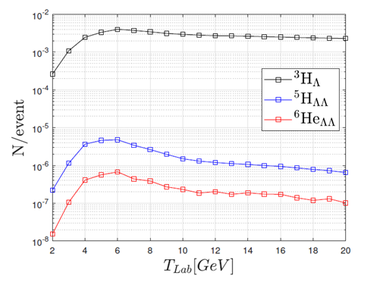
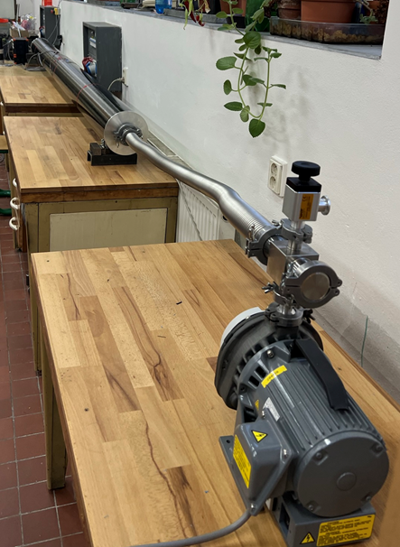
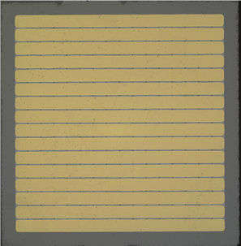
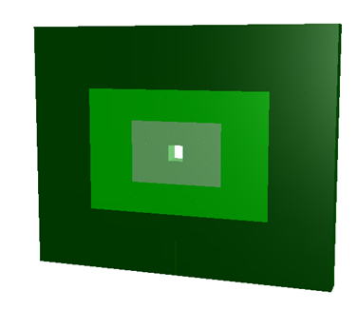
WP2 Heavy Ions
Instrumentation for the CBM experiment at ESFRI landmark FAIR
Participants: FAIR, WUT, Wigner RCP, NPI CAS, EKUT
WP2.1: Preparation of the Silicon Tracking System for CBM/FAIR
[FAIR, EKUT], Task Leader: [Johann Heuser, FAIR/GSI]
WP2.2: Developments for the data acquisition chain, for data
preprocessing and computing for mCBM and CBM at
FAIR [WUT, FAIR], Task Leader: [Wojciech Zabolotny, WUT]
WP2.3: Development of software packages for simulation and
data analysis, participation in physics performance
studies for CBM experiment at FAIR [FAIR, Wigner RCP]
Task Leader: [Ilya Selyuzhenkov, FAIR/GSI]
WP2.4: Development and construction of beam monitors, target
chamber and beam pipe for the CBM experiment at FAIR
[FAIR, NPI CAS] Task Leader: [Peter Senger, FAIR/GSI]
WP2.5: Development of new PSD detector for CBM [NPI CAS]
Task Leader: [Andrej Kugler, NPI CAS]

Slide 2

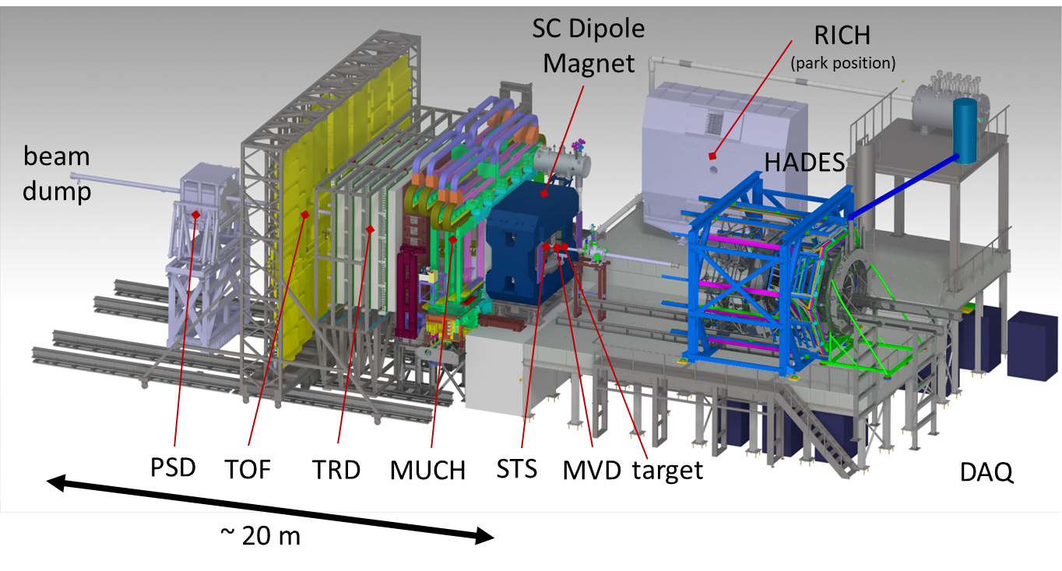
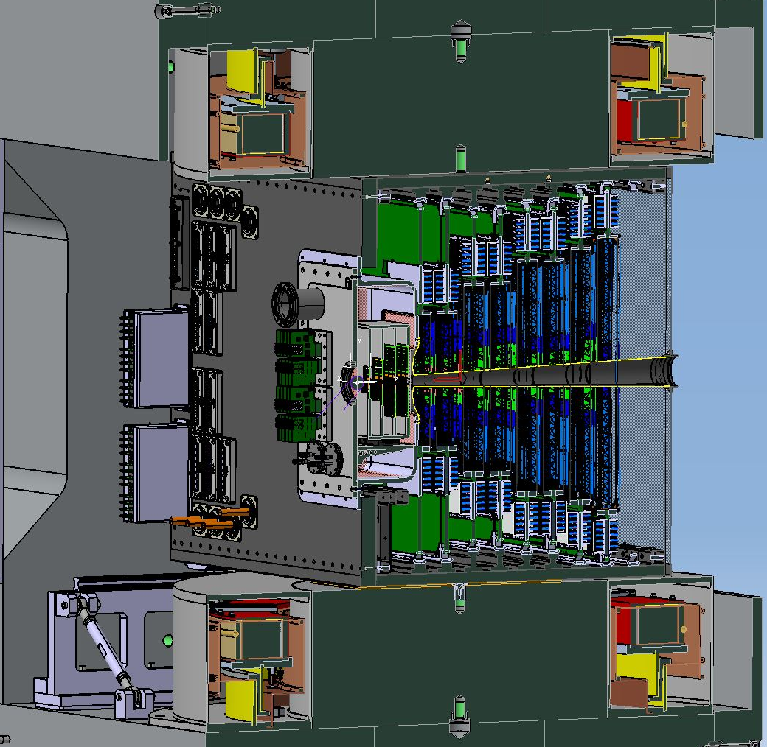
Silicon Tracking System (STS) for CBM/FAIR
WP2.1
STS = main CBM detector for charged-particle trajectory measurement
installed in dipole magnet’s gap
thousands of high-tech components
J. Heuser for the STS group
The CBM experiment
STS
target
beam
pipe
MVD
beam
2.5°
25°
STS

Slide 3
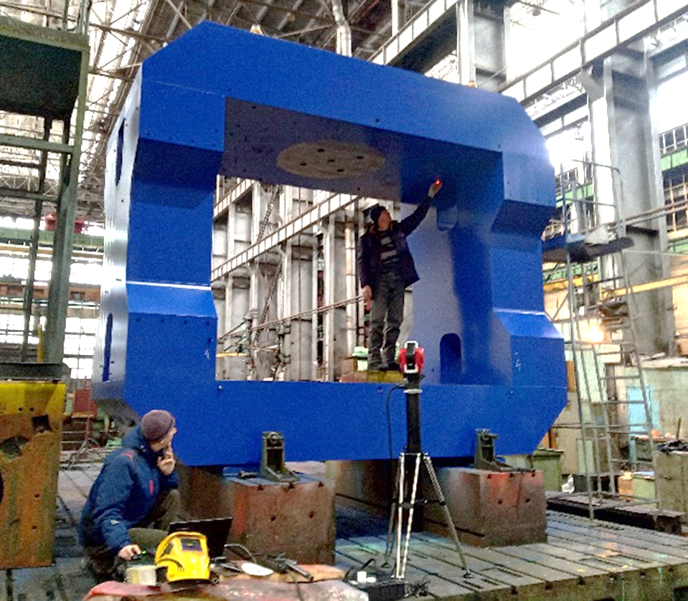
New dipole magnet – improved STS
WP2.1
unavailability of the original dipole magnet requires
new acquisition effort (tender ongoing)
this opens opportunity for geometrical changes:
  larger magnet gap
  to fit a somewhat enlarged STS detector
    with enhanced modular integration
    and upgrade perspectives
Highlights from WP2.1 efforts:
New modular STS has been developed
Physics performance simulations are being done
Pre-series STS module assembly has been achieved
dipole magnet under construction 2022 in Russia – not available any more

Slide 4
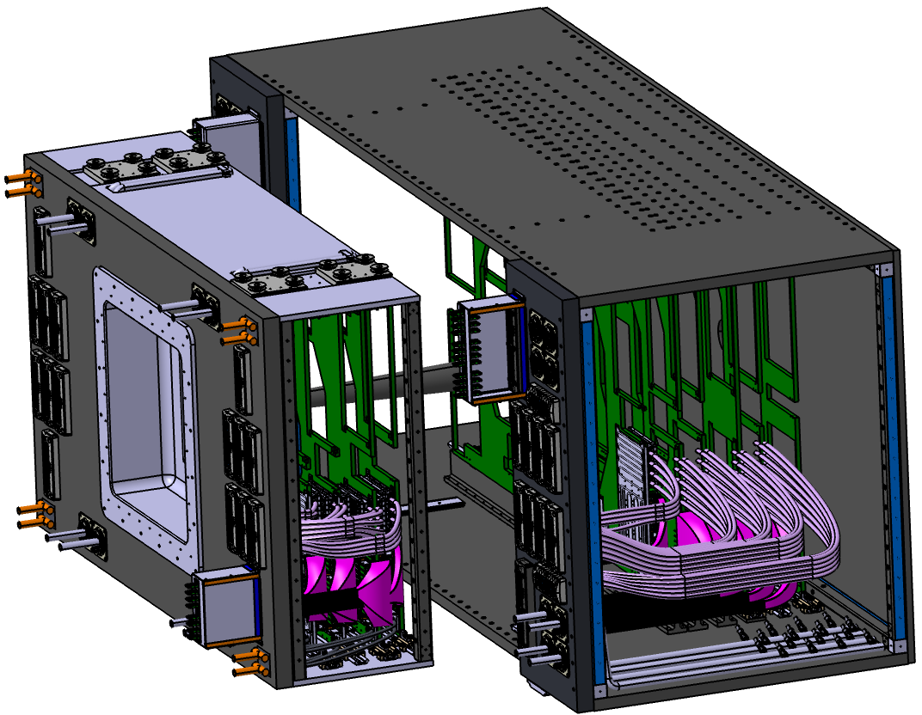
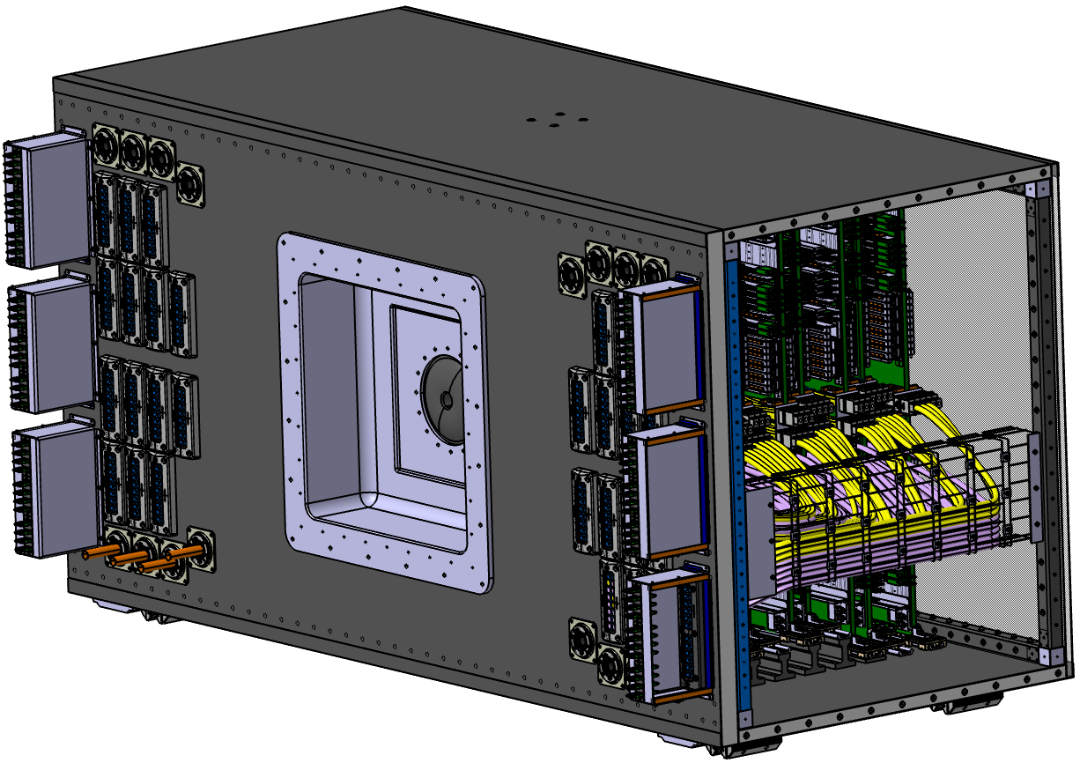
New modular STS
WP2.1
Old “monolithic” STS:
New “modular” concept:
Internal designs are kept!
Unit/station layout and all detector and module designs remain the same.
Outer frames and cabling are adapted.
Overall space requirements change:
  height + 3 cm
  width + 30 cm
  expressed in
  the new magnet
  specifications gap:
  2000 x 3300 x 1470 mm l/w/h
3214 mm
1425 mm
1450 mm
2820 mm
1219 mm
1219 mm
monolithic construction
once assembled no access
maintenance, replacement,
upgrade only by full disassembly
very tight space constraints
modular setup
units U00 – U03 can be moved
separately from the rest U04 – U07
additional rail system
completely independent systems

Slide 5
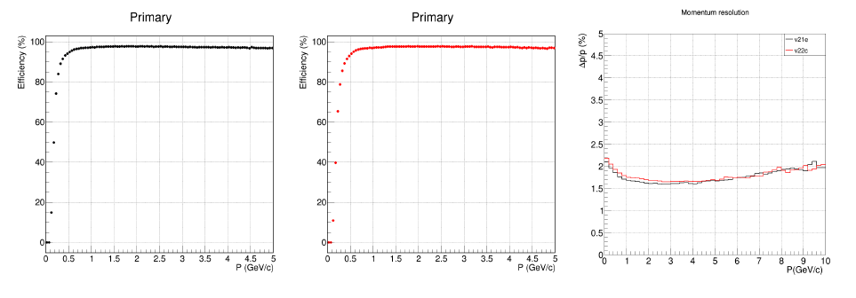
Modular STS – performance simulation studies
WP2.1
new dipole magnet:
field maps prepared by CBM Collaboration
simulation geometry
physics performance remains high!
enlarged gap
primary particles, B = 0.5 T
primary particles, B = 1 T
momentum resolution
Δp/p [%]
efficiency [%]
efficiency [%]
p [GeV/c]
p [GeV/c]
p [GeV/c]

Slide 6
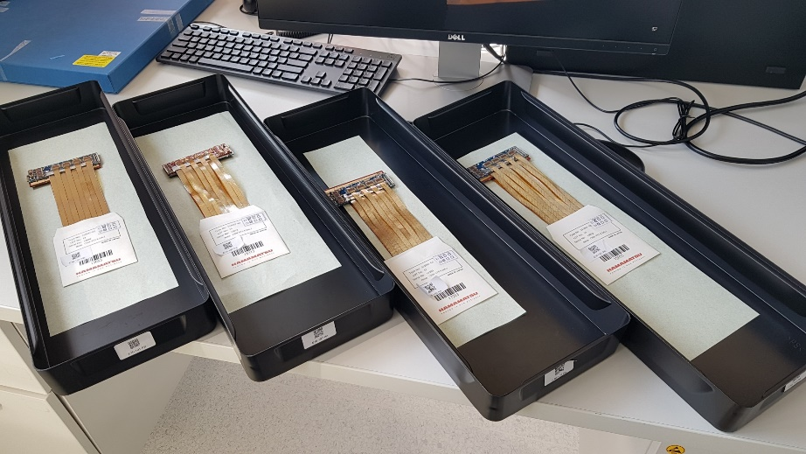
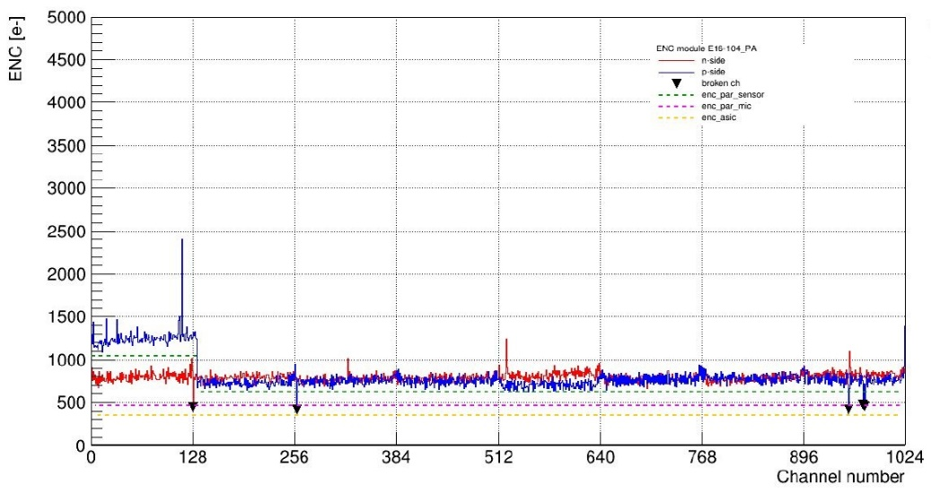
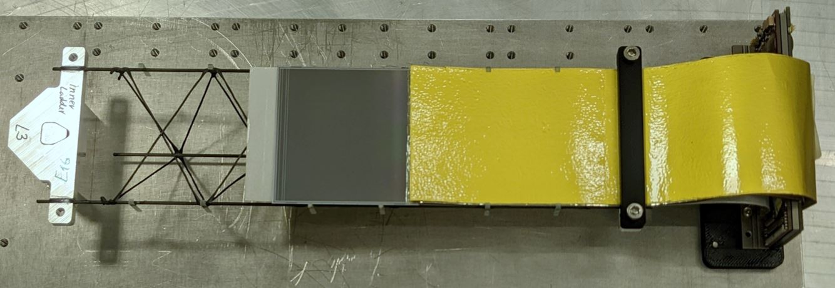
Pre-series production of STS modules
WP2.1
Pre-series assembly of STS modules has been achieved:
10 modules assembled:
test results during module assembly in clean room:
    all in specs, (<< 3% missing channels, noise ~ 1000 e)
mounting on ladder structures ongoing
Application from 2023 in J-PARC E16 experiment (Japan)
for its upgrade with a silicon tracking layer
→ New WP2.1 MS7 Production Readiness (M36): will be reached
→ New WP2.1 D2.2 System engineered (M48): will be reached
equivalent noise charge [e]
channel number

Slide 7
Development of the GERI+GBTxEMU based readout chain
WP2.2
W. Zabołotny, M. Gumiński, P. Loizeau WUT, FAIR
Developments for the data acquisition chain, for data preprocessing and computing for mCBM and CBM at FAIR
Status in 2022
  Cooperation with JINR group stopped after February 24th
  Only WUT staff left involved in firmware development (Marek Gumiński and Piotr Miedzik as the project’s staff, Michał Kruszewski, Krzysztof Poźniak and Wojciech Zabołotny as volunteers)
  Tests planned in JINR in April 2022 were impossible. Development tasks related to application in BM@N experiment were suspended (abandoned in fact?)
  The package was reoriented for preparation of GERI+GBTxEMU based readout chain for mCBM, CBM and other experiments cooperating with FAIR
  GBTxEMU part completed (only maintenance, functionality adjustment, bug corrections needed)

Slide 8
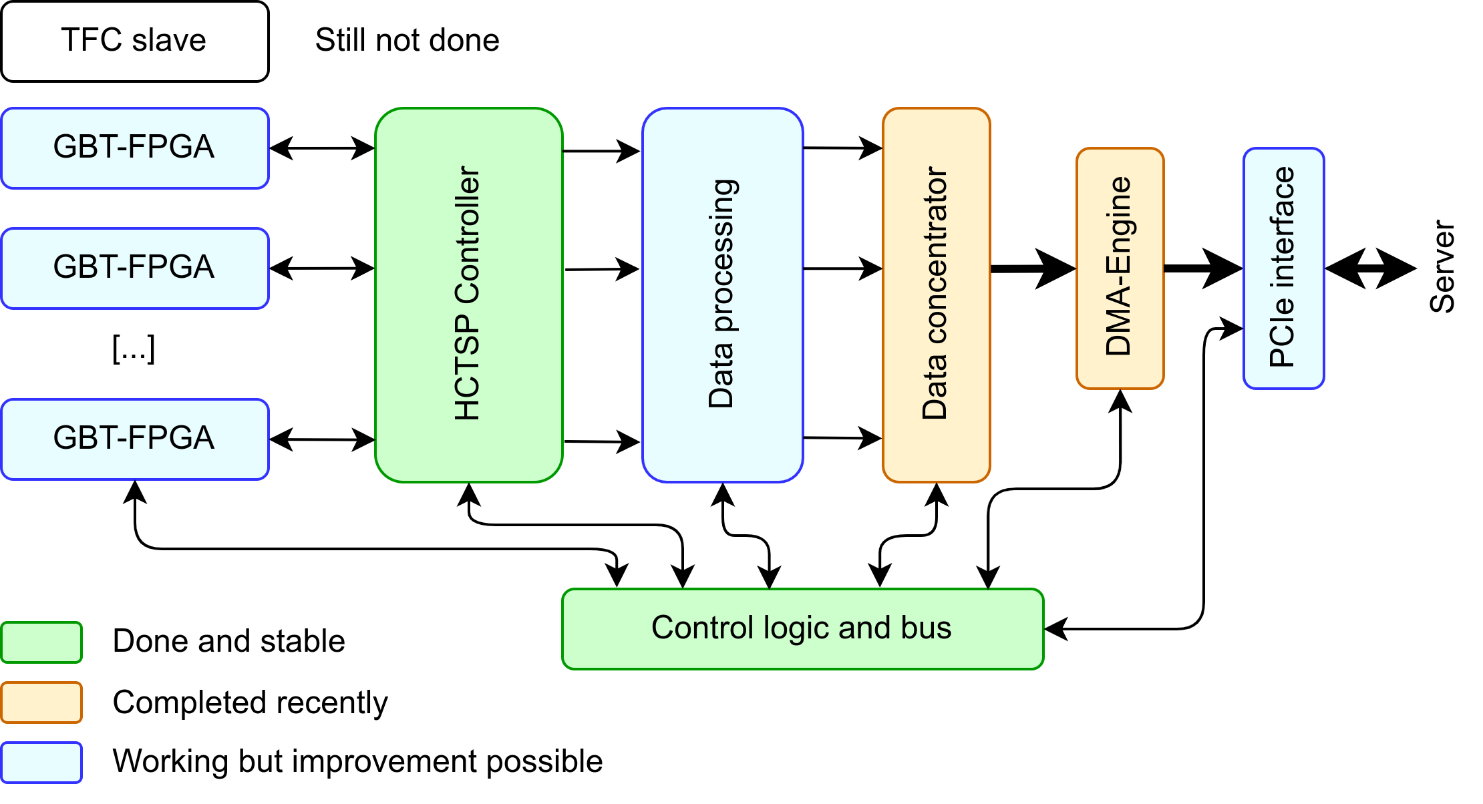
Structure and status of the GERI firmware
WP2.2

Slide 9
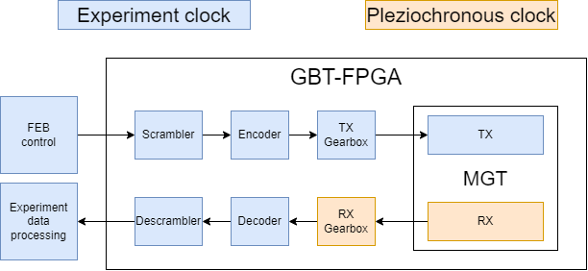
GBT-FPGA
WP2.2
Serial communication interface developed for HEP readout chips https://gitlab.cern.ch/gbt-fpga
FEC encoding and latency determinism for FEB control
Synchronisation of
FE boards
Up to 4.8 Gbps
throughput for
experiment data
readout

Slide 10
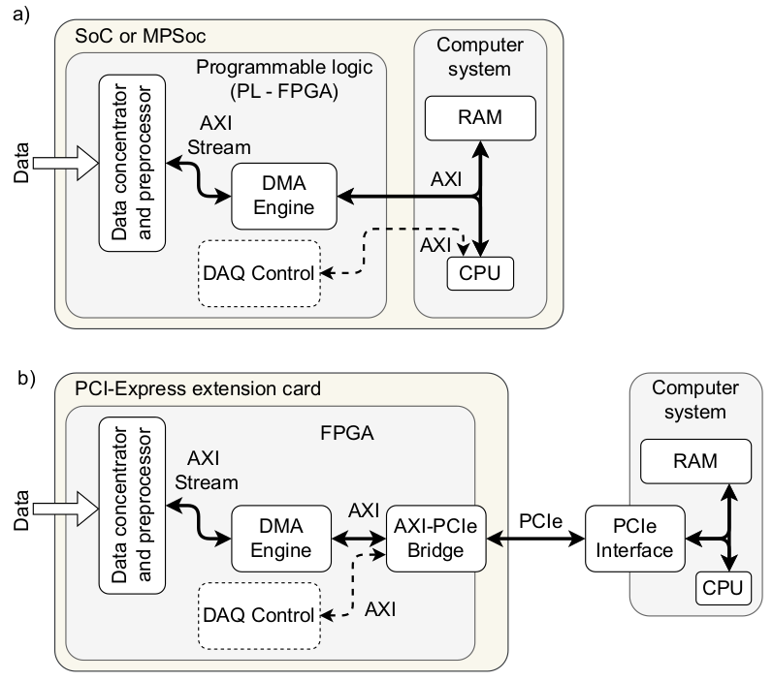
Versatile DMA engine
WP2.2
Core part implemented in HLS
Compatible with PCIe-connected FPGAs and AXI-based MPSoCs
Efficient memory management even in standard Linux. Starting and stopping acquisition in multiple boards without rebooting.
Full utilization of multiple cores in host machine
Described in a paper accepted for publication, preprint available at https://www.preprints.org/manuscript/202301.0328
The design is open-source and available at https://gitlab.com/WZabISE/hls_dma

Slide 11
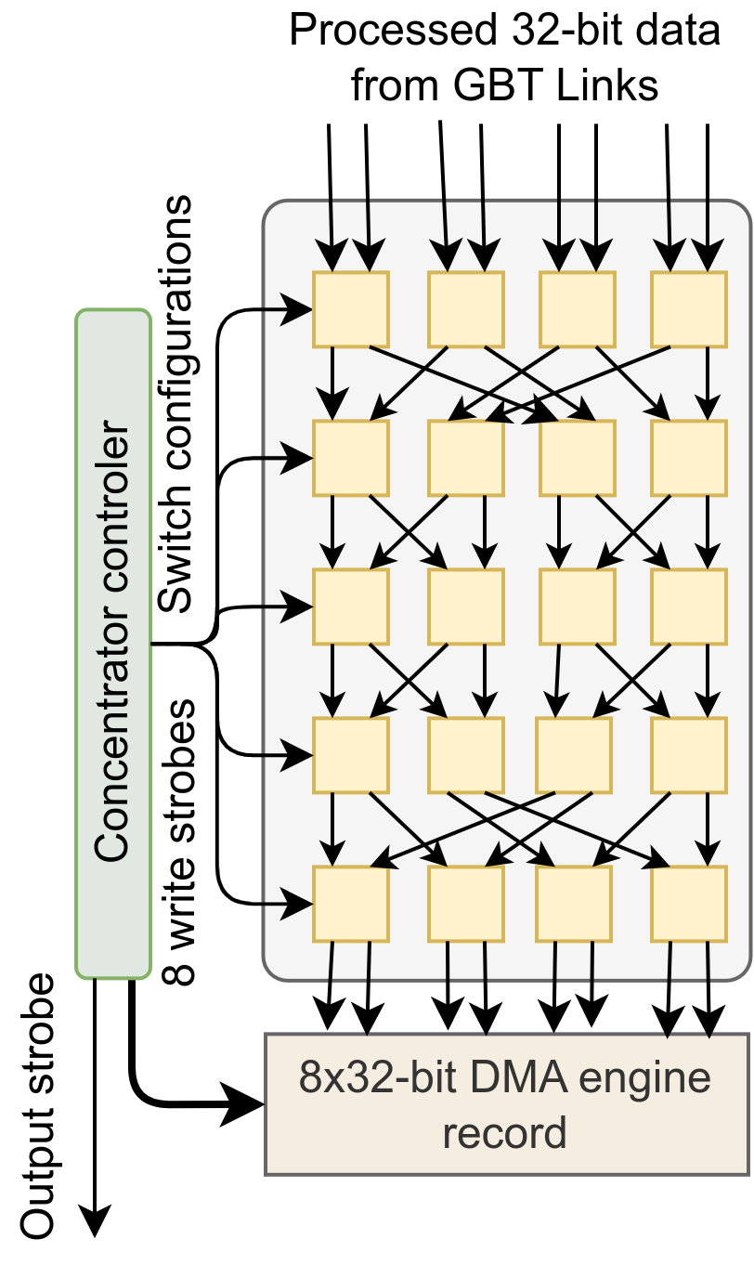
Efficient data concentrator
WP2.2
Solves the problem of efficient high-speed data concentration from multiple low-width words to a single high-width word required by the DMA system.
Optimal in a sense that does not require high-speed local clock, and ensures that the “holes” are eliminated from the output stream even if they present in the input streams.
Design based on so-called Beneš network (technology from 60’s but applied to the new problem).
Efficient implementation in FPGA.
Paper describing the solution is in preparation.
The design will be open-sourced after the publication.
New Deliverable: D2.4 “Functional tests of the developed readout solution” (report at M48)

Slide 12
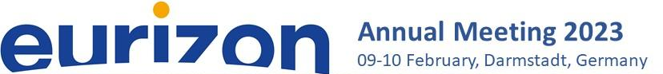
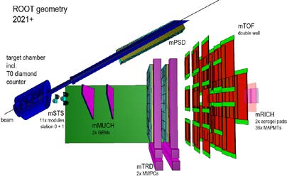
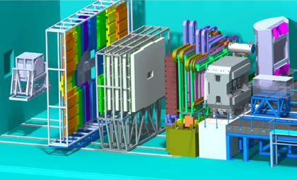
WP2.3
Ilya Selyuzhenkov, FAIR/GSI [GSI/FAIR, Wigner RCP]
Development of common software packages for simulation and data analysis, participation in physics performance studies of the CBM & mCBM experiments at GSI/FAIR
mCBM data taking started in 2019
CBM operation planned for > 2028

Slide 13
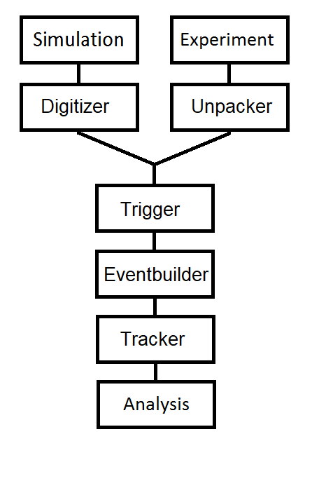
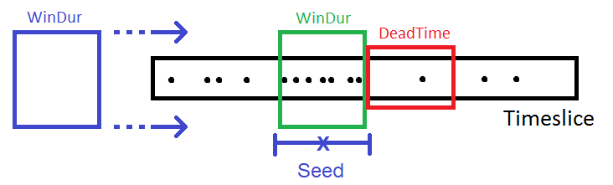
Scientific/technical highlights - I
WP2.3
Dominik Smith, Volker Friese
Online software for CBM
Goal: Make readout chain „online ready“
Implement „algo“ classes in cbm::algo namespace.
Smallest (algorithmically) possible detector unit (parallelizable).
ROOT-free, optimize for speed, separate monitoring.
Unpacking:
Translate detector messages to universal format.
In cbm::algo: One unpacker per timeslice component.
Completed: STS, MUCH, TOF, Tzero
Ongoing: TRD
Triggering:
„Time cluster trigger“ algorithm in cbm::algo.
Shift „sliding window“ through digi stream.
Trigger when digi count exceeds threshold.

Slide 14
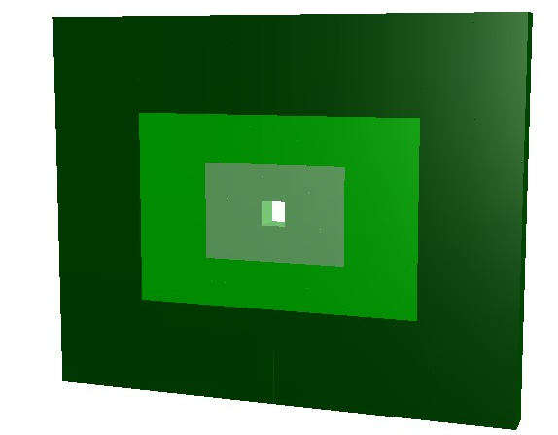
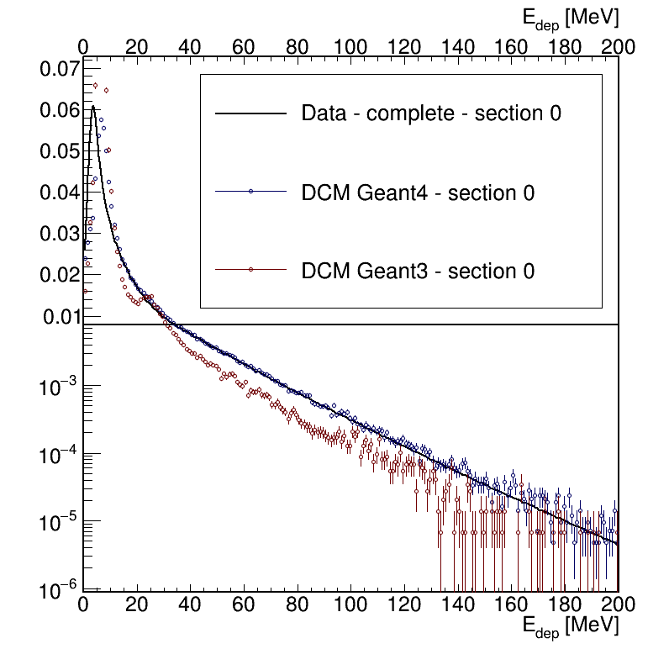
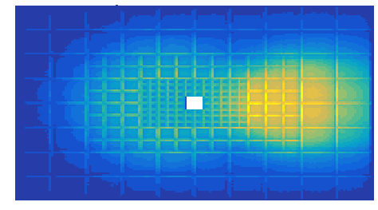
Scientific/technical highlights - II
WP2.3
Lukas Chlad, Ilya Selyuzhenkov
Monte-Carlo studies for new CBM Forward detector
Spectator fragments detection
for beam momenta pbeam = 3.3−12 AGeV/c
Operation at beam intensities up to 10^9 Au ions per second
Reaction plane determination with an accuracy better than 40 degree
Determination of collision centrality classes with an accuracy better than 10%
Simulations
DCM-QGSM-SMM
model with fragments
Geant4
Operational background from
Beam paprticles and
detector materials (beam pipe, etc)

Slide 15
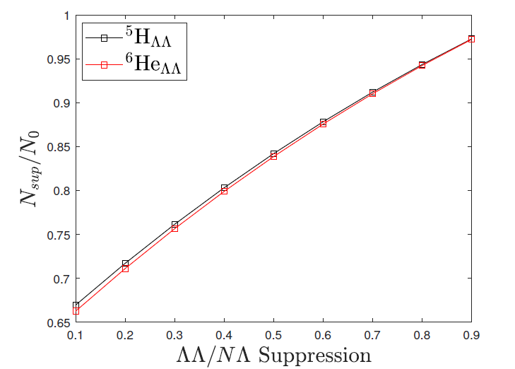
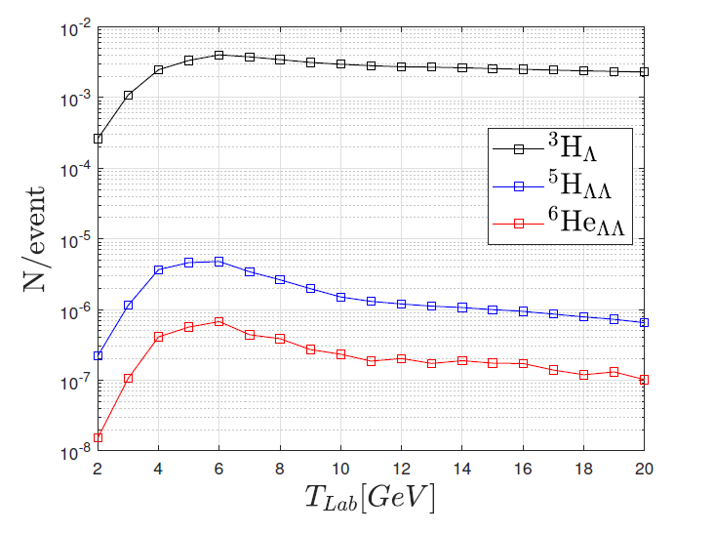
Scientific/technical highlights - III
WP2.3
Gábor Balassa & György Wolf [WUT]
Hypernuclei production in 0-10% central Au+Au collisions
ΛN interaction strength from measurements
ΛΛ interaction strength estimated from:
    ΛΛ=ΛN
    ΛN=k*ΛN , k<1
The energy dependence and expected yields
are comparable with other calculations
The deliverables remain unchanged
D2.5 Simulation results for selected observables - Month 24 (achieved)
D2.6 Physics performance for major observables - Month 48

Slide 16

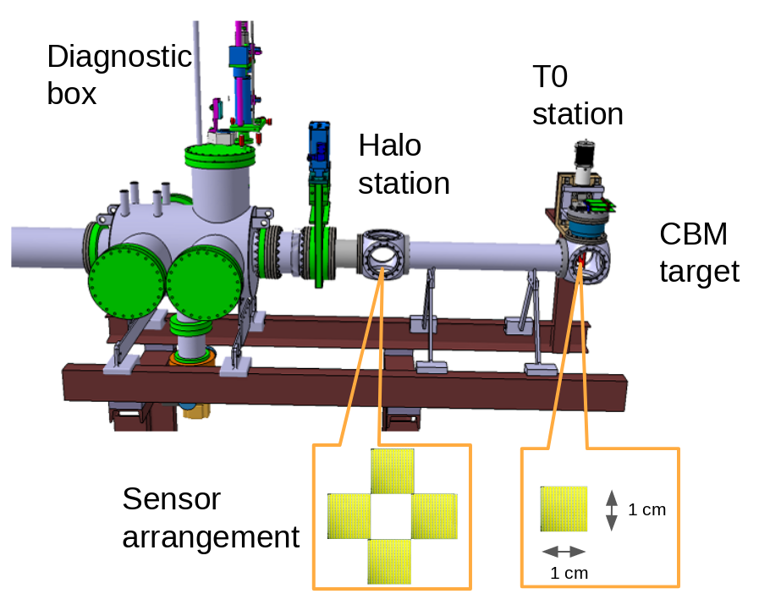
WP2.4: Beam detectors and beam pipe for CBM
Peter Senger, FAIR/GSI
T0 and beam detectors for CBM A. Rost FAIR
Applications and requirements:
Measure start time of reaction (T0) with precision of 50 ps (RMS) at beam intensities up to 10⁷ ions/s
Beam quality monitoring: position (< 50 μm resolution), halo, time structure, …
Part of fast beam abort system
Low material budget and in-vacuum operation
T0 and HaloBAS detector stations will employ pcCVD diamond technology
Detector stations installed in vacuum, in front of the CBM target
Conceptual design report: Ready in Q3 2023

Slide 17
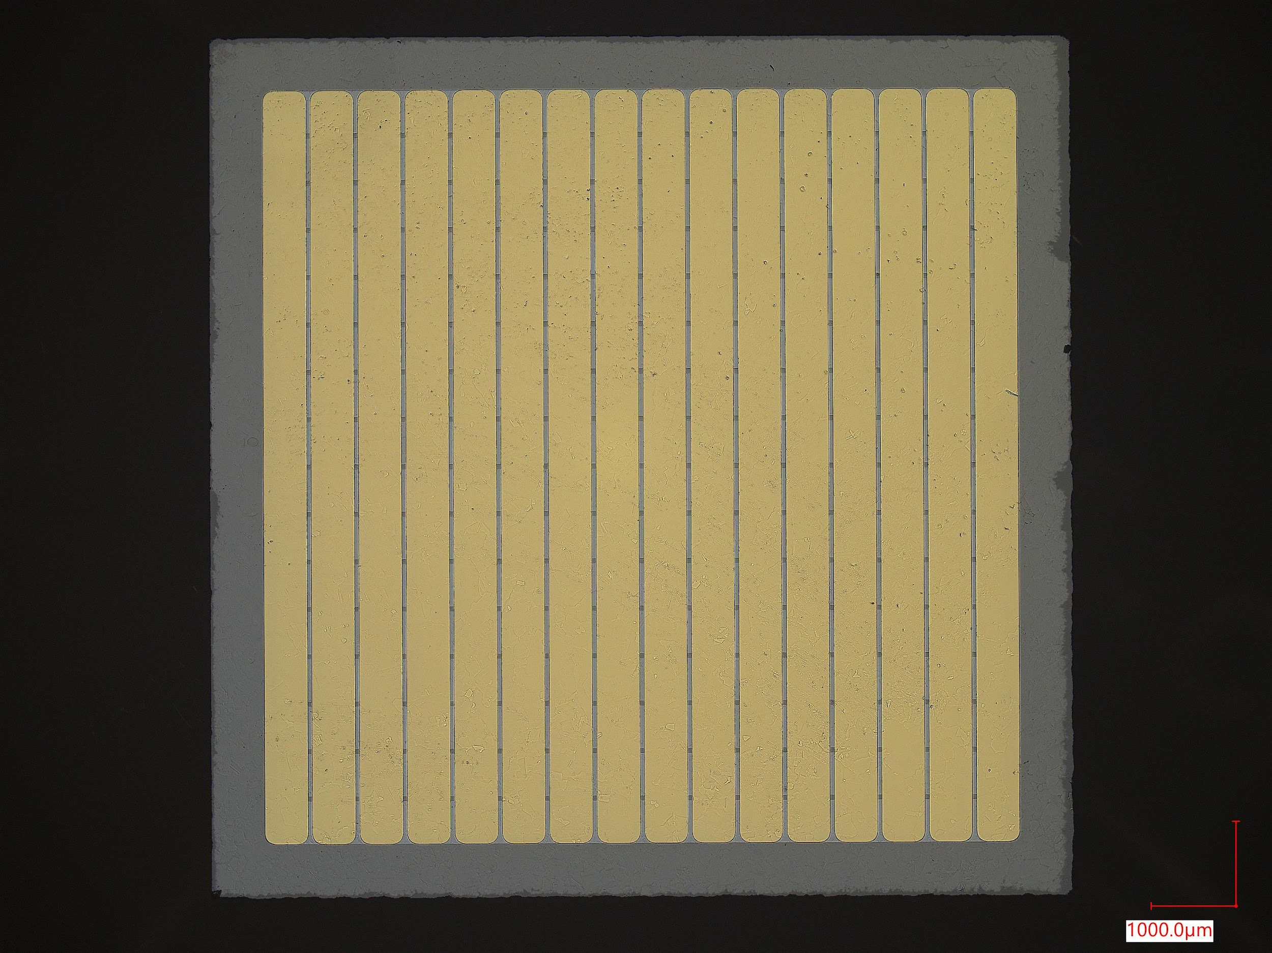
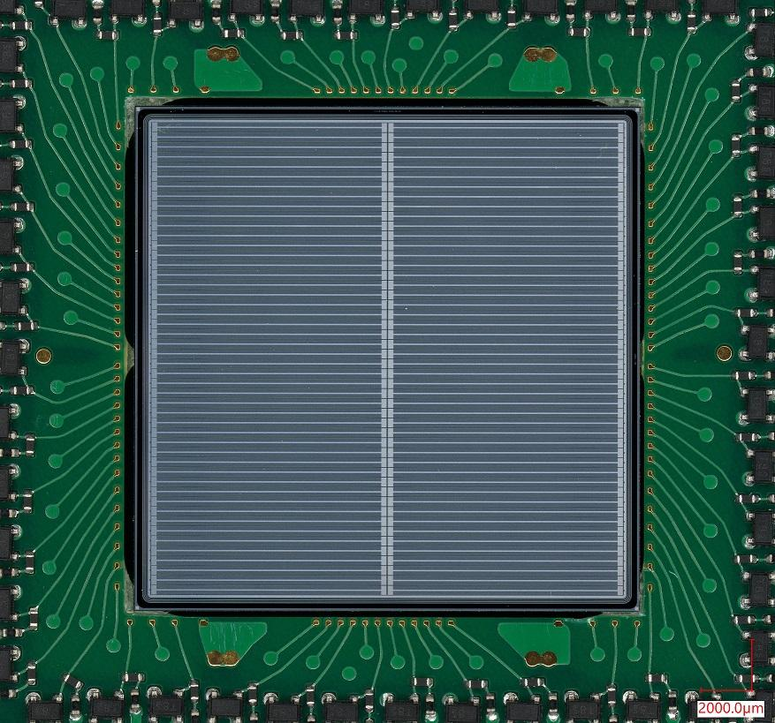
Sensor technologies
WP2.4
A. Rost FAIR
pcCVD diamond sensor: 10 mm x 10 mm x 80 μm, 16 stripes (300 μm) on each side
Diamond for heavy ions
Profit from a long experience with HADES:
High purity sc/pcCVD material,
Radiation damage well known
Low Gain Avalanche Diode technology for MIPs
Profit from R&D for HADES, S-DALINAC and Medical application:
New sensor technology
Successfully used as T0 in HADES production beam-time
Pro: Radiation hard
Cons: small samples, price
HADES LGAD sensor (FBK) 2 cm x 2 cm, 96 ch, 50 μm thick
Pro: large sample, price
Cons: radiation hardness

Slide 18
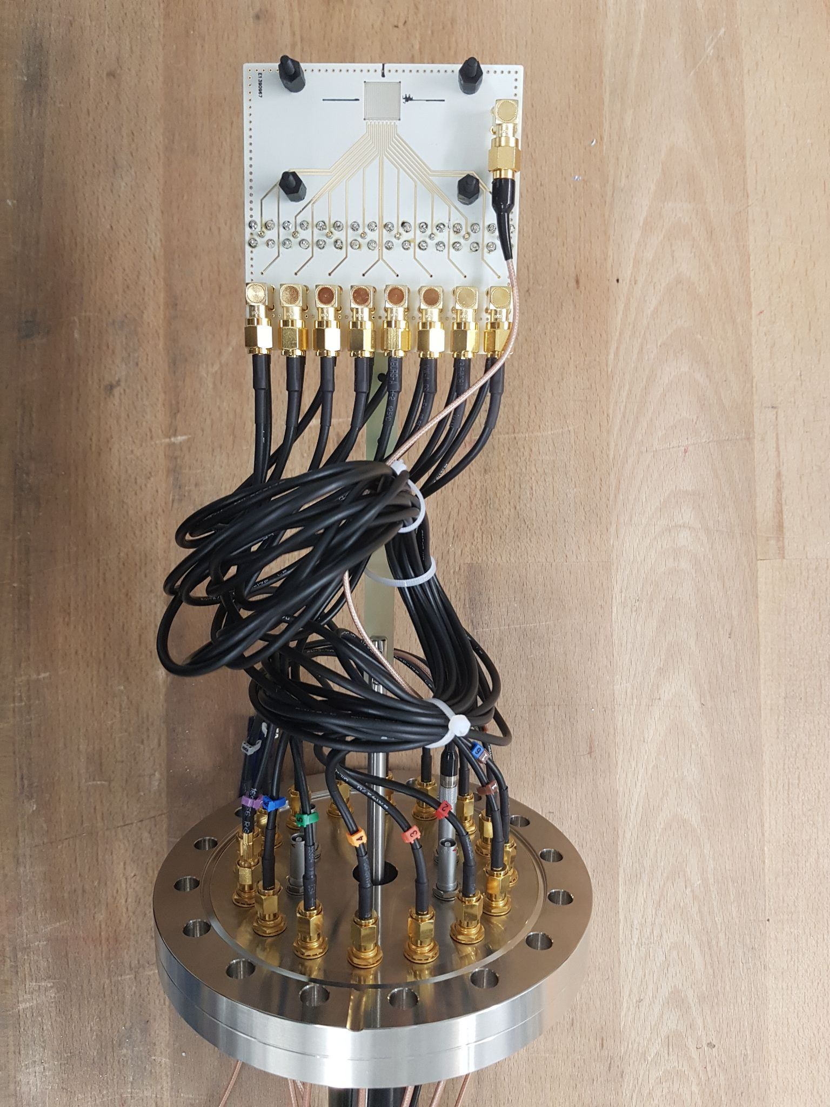
T0 detector demonstrator
WP2.4
A. Rost FAIR
T0 demonstrator used in mCBM beam-times in summer 2022
Readout-system based on PADIX discriminator and GET4 TDC
Used for online beam monitoring during the beam-time
→ Beam-time data is currently being analyzed
Next steps:
Preparation of 16+16 ch. (both side read-out) pcCVD T0 demonstrator for the upcoming mCBM campaigns 2023/2024
Preproduction of the CBM HaloBAS + T0 stations and test with α-source in the laboratory
New 10 mm x 10 mm x 80 μm
16-channels pcCVD diamond sensor
T0 diamond interface PCB with pneumatic drive

Slide 19
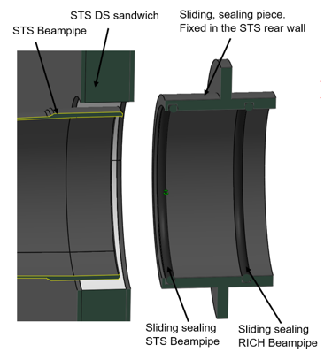
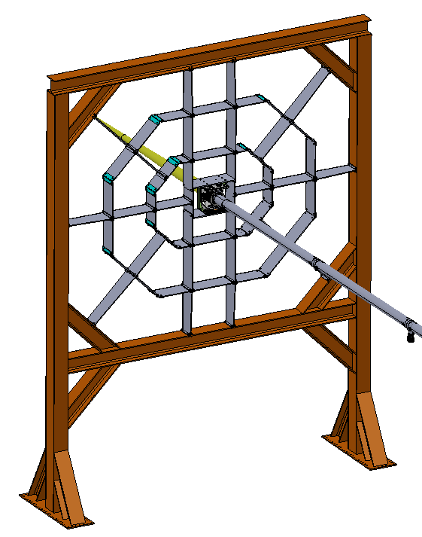
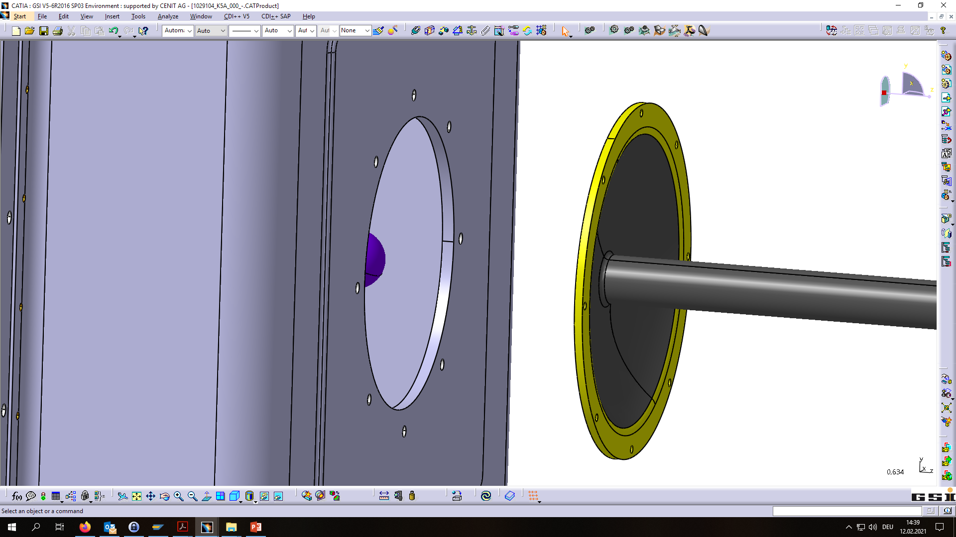
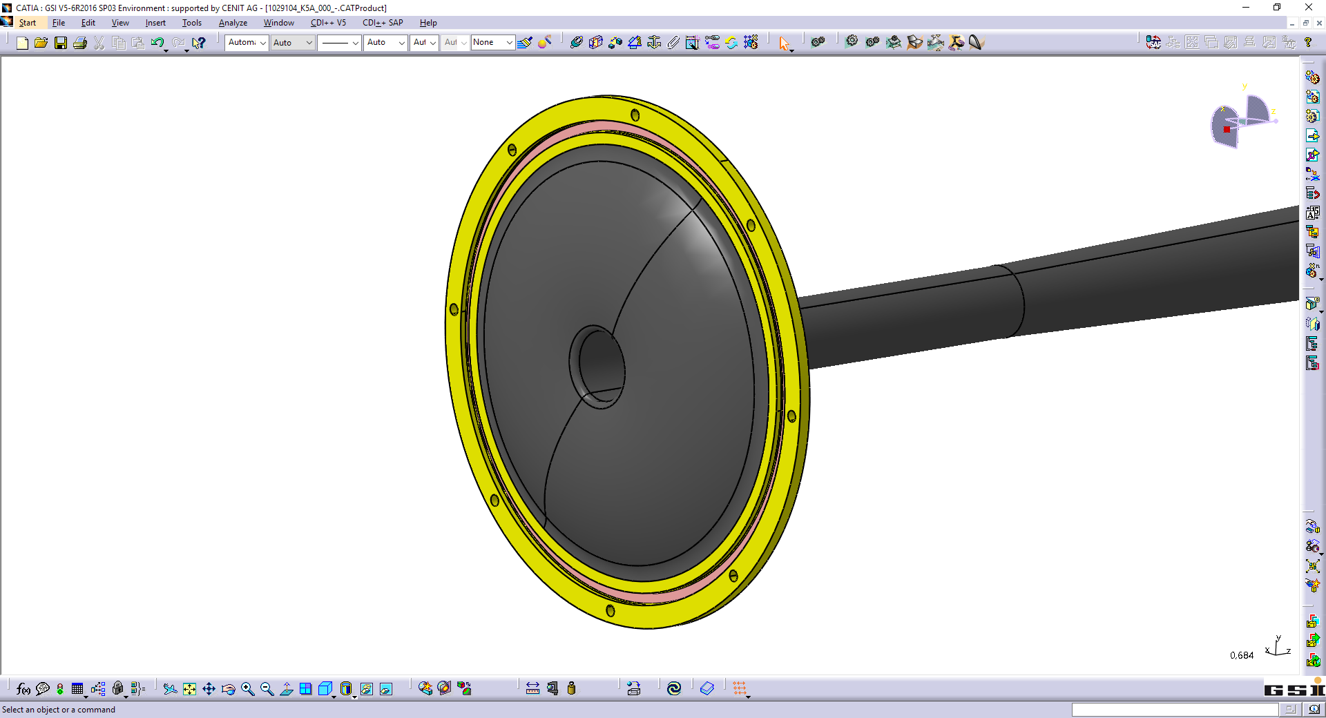
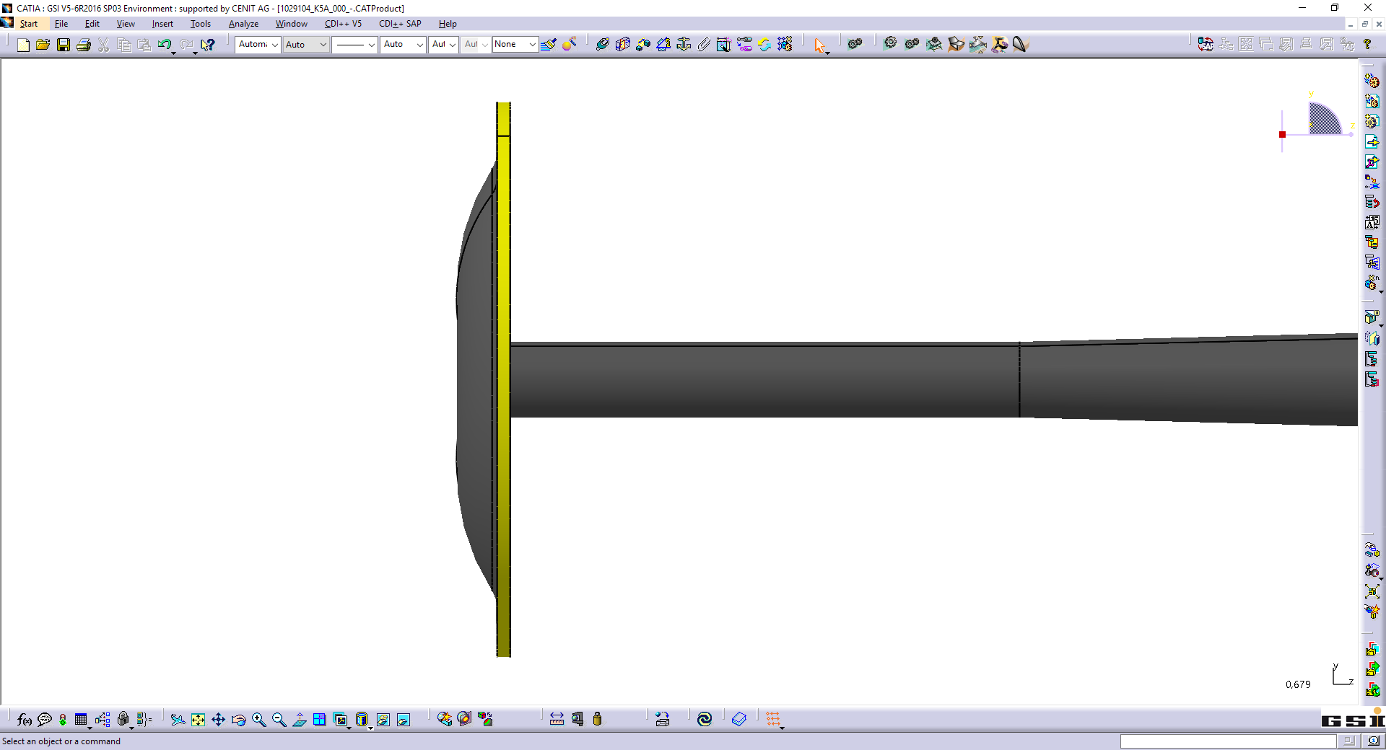
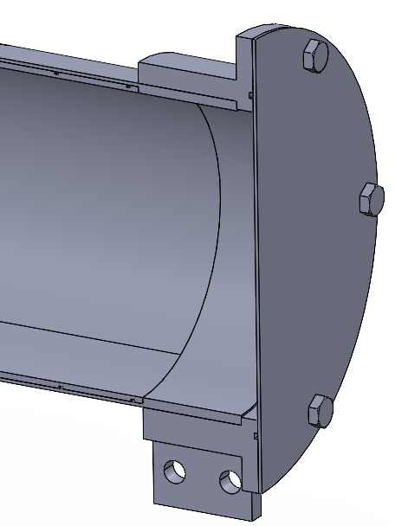
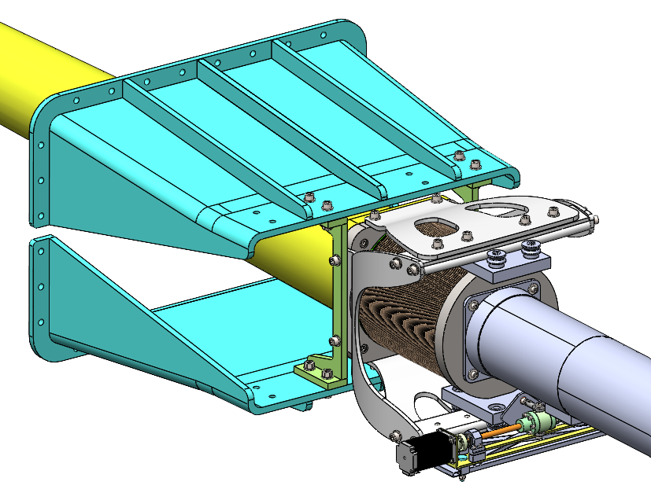
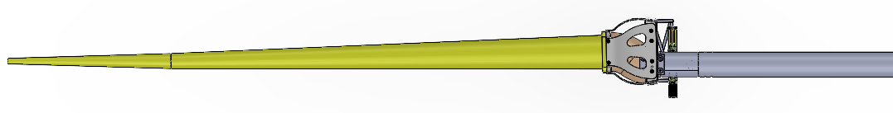
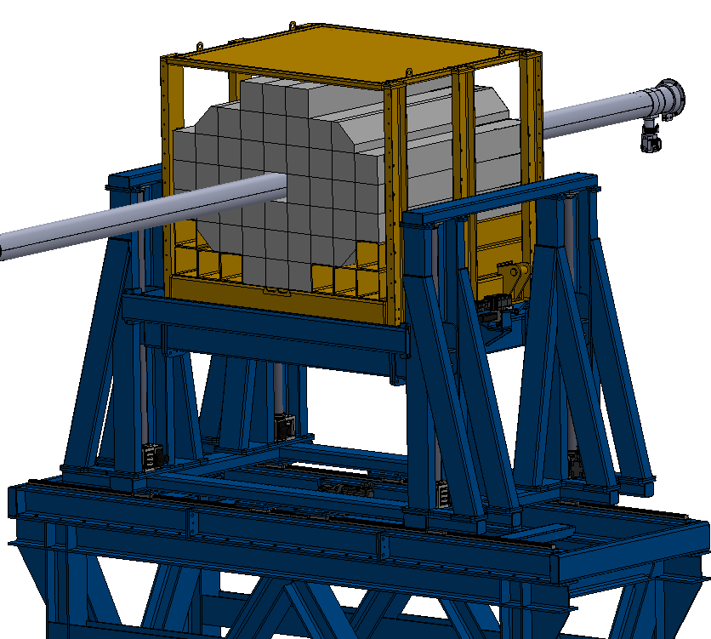
WP2.4
Beam pipe for CBM: Components
J. Kollarczyk
A. Kugler
A. Senger FAIR
Acceptance window
Design of the STS team (Johann M. Heuser, et al.)
Target chamber
O-Ring groove
TRD
STS section
RICH / MUCH section
B.M.
Downstream section
Variable position of TOF
Variable position of PSD
Downstream section
19

Slide 20

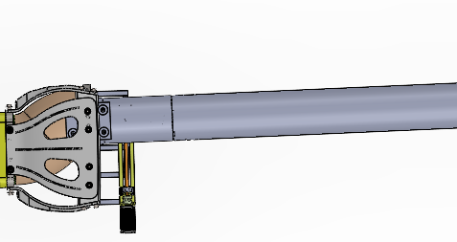
WP2.4
Beam pipe for CBM: Bending concept
J. Kollarczyk
A. Kugler
Downstream beam pipe with deflection:
A. Senger FAIR
Change of polarity
0
1,24°
2,5°
Turn by 180°
Extreme deflection
1,26°
Zero deflection
STS section
RICH / MUCH section
B.M.
Downstream section
Centre of rotation
Deflection in the range of <0°; 2.5°> in a single polarity
20

Slide 21
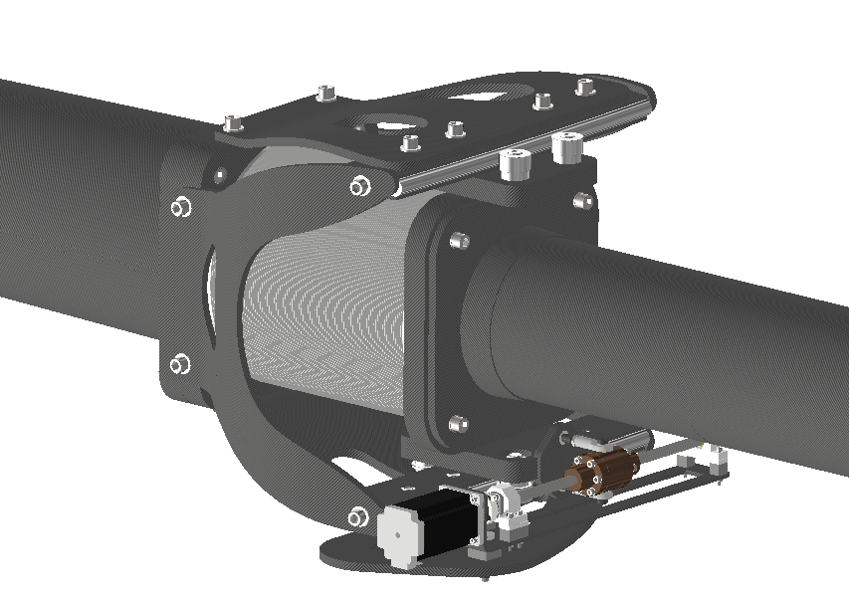
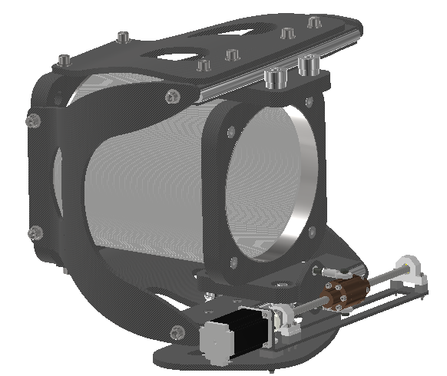
WP2.4
Beam pipe for CBM: Bending mechanism
J. Kollarczyk
A. Kugler
Downstream beam pipe with bending mechanism:
Need of further research
Latest approach
21

Slide 22

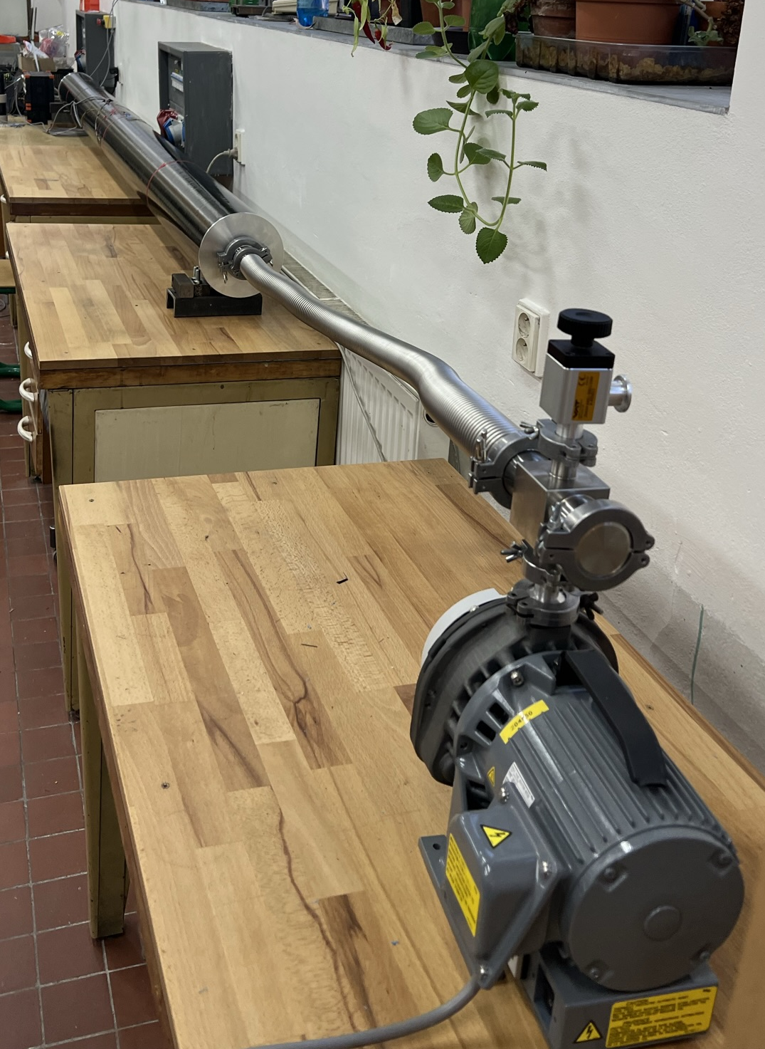
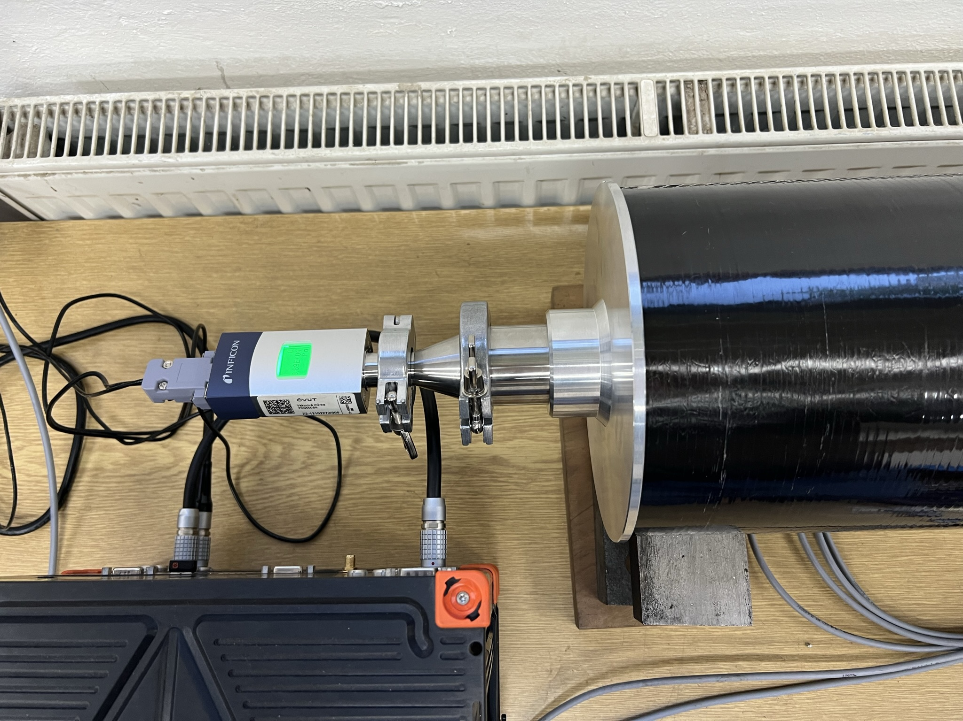
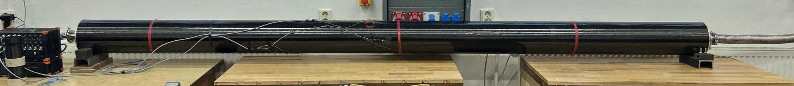
WP2.4
Beam pipe for CBM: Prototype tests
Cylindrical downstream beam pipe:
Stability demonstration
Vacuum conditions
Thickness = 3 mm
Length = 3 350 mm
Strain measurements
Inner vacuum: 10⁻⁵ mbar
22

Slide 23
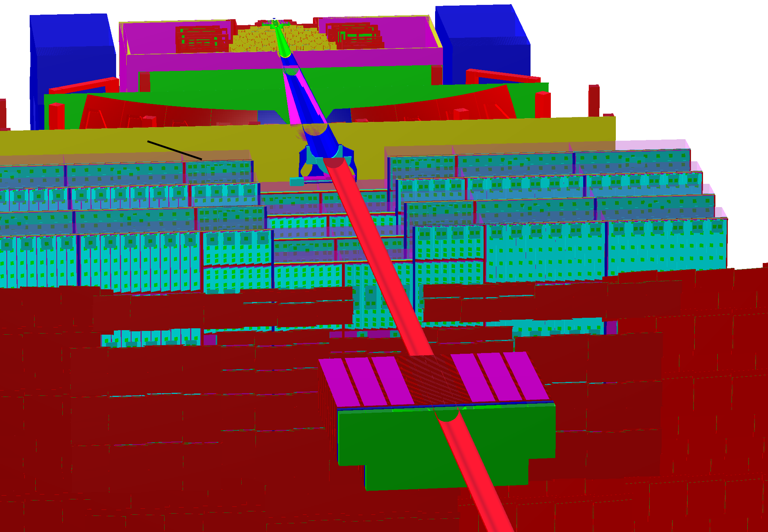
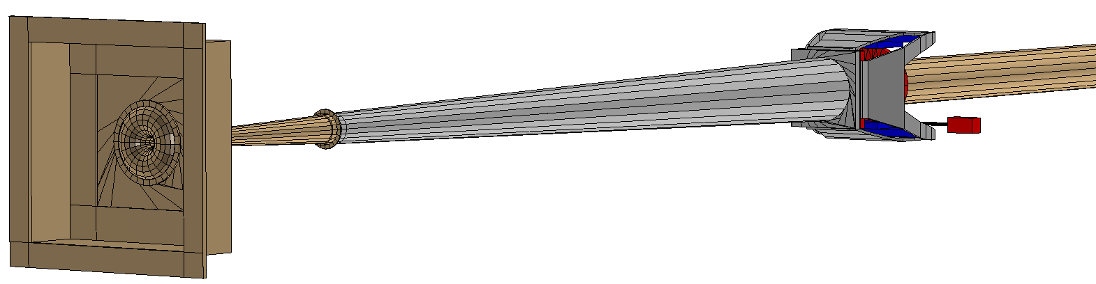
Implementation of beam pipe design into simulation environment
WP2.4
Petr Chudoba, Eoin Clerkin
Delivered:
An extenisve simulation beampipe geometry solution capable of handling beam energies from 3 → 12 AGeV and ranges through the entire length of the CBM detector subsystem, consisting of the following pseudo-independent but integrated parts:
  Downstream cylinderical section
  Bellow assembly mechanism
  Conical RICH/MUCH section
  STS backwall flange
  Toroidial beam window and upstream section.
  Target/MVD chamber.
Integrated with other CBM subsystems
Isolated beampipe geometry
Milestones and deliverables:
M10: Technical design of beam monitors, target chamber and beam pipe for CBM: Month 36
D2.7: Design of beam monitors, target chambers and beam pipes: Month 12 (achieved)
D2.8: Beam monitors, target chamber and beam pipe for CBM constructed: Month 48

Slide 24




Software integration - Geometry
WP2.5:
Development of new PSD detector for CBM
L. Chlad
A. Kugler
aims to be flexible to fit all requirements put on the FWall
starting with 3 sizes of cells
for study purposes use very fine granularity (1x1 cm²) without any hole
  this will be used to set minimum criteria on final design to meet the reaction plane resolution
  also with this setup we can determine what size of hole might be optimal in order to not lose the heavy fragments (keeping in mind also limits coming from irradiation of the material)

Slide 25




Software integration - simulation chain
WP2.5
L. Chlad
A. Kugler
TRANSPORT using Geant engines - store information of energy loss
of charged tracks within active material (scintillator)
DIGITIZATION before we will know outcome of material study with Geant 4 physics list and test beamtimes only simple summing of energy deposition within cell is possible
HIT RECONSTRUCTION for now ideal case is used = copy digi level

Slide 26
Hardware status
WP2.5
L. Chlad
A. Kugler
plastic scintillators for testing to be obtained from Nuvia company
preparation of read-out electronics based on RICH read-out (TRB5sc + DiRich concentrator boards)
SiPMs main criteria is time resolution + radiation hardness (review of recent progress in the field is ongoing)
New Deliverable D2.10: Feasibility studies of new projectile spectator detector for CBM: Month 36
New Deliverable D2.11: Technical design of new projectile spectator detector for CBM: Month 48.

