Slide 1






WP 4 – Synchrotrons and XFELs
Task 4.1: Concepts of 4th generation synchrotron machines (ESRF, DESY)
Task 4.3: Vacuum chamber impedances and beam instabilities (INFN, DESY)
Task 4.4: Linac development (INFN, European XFEL)
Task 4.5: Photogun prototype & beam diagnostics (DESY)
Task 4.6: Development of a generic Conceptual Design Report for automated X-ray Absorption Spectroscopy Beamlines (DESY, ESRF)

Slide 2
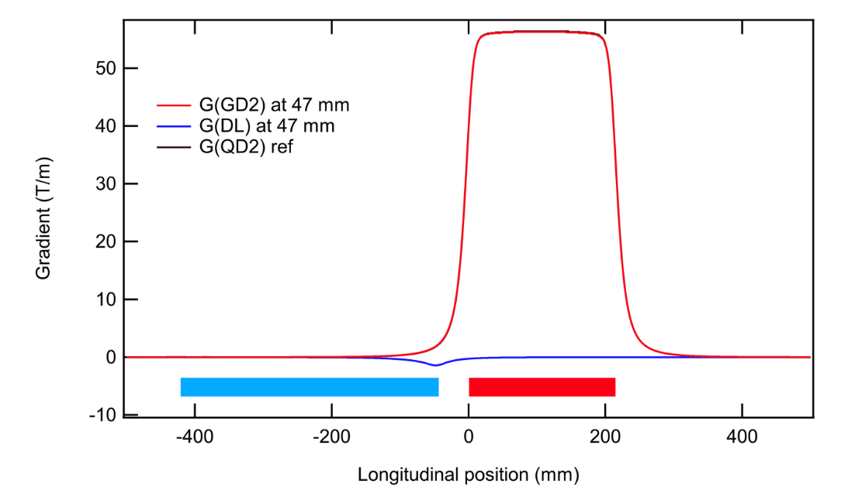
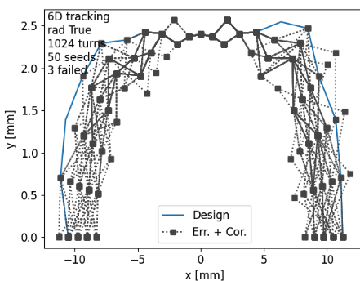
Task 4.1 Improve lattice modelling and test on real beam during Machine dedicated time (Simone Liuzzo, Elena Buratin, et al)
1) Lattice modelling including cross-talks:
2) Error and correction functions in pyAT for simulated commissioning.
3) Machine dedicate time for Optimization of Lifetime and Optics measurements based on Turn by turn data
Done: Correctors cross talk for PETRAIV
Status: awaiting for magnet data
Done: new set of tools in pyAT
Status: progressing, more software to come
Done: 2 MDTs done
Status: 2 MDTs planned, more to be scheduled

Slide 3
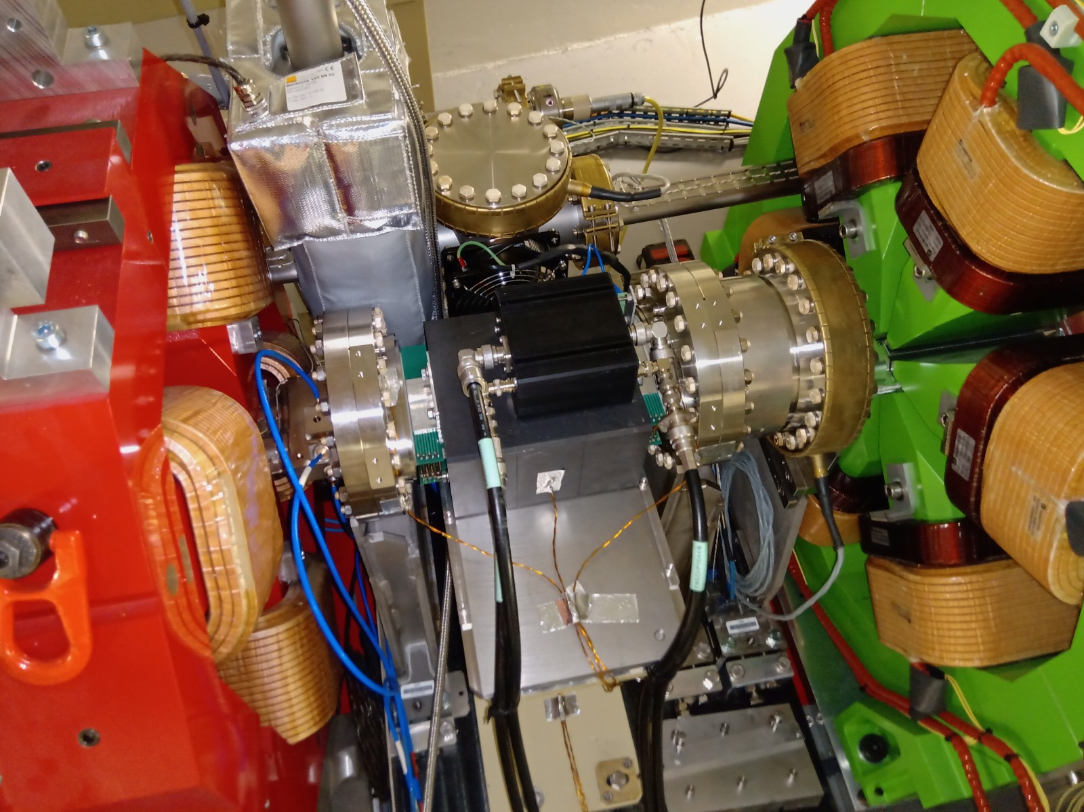
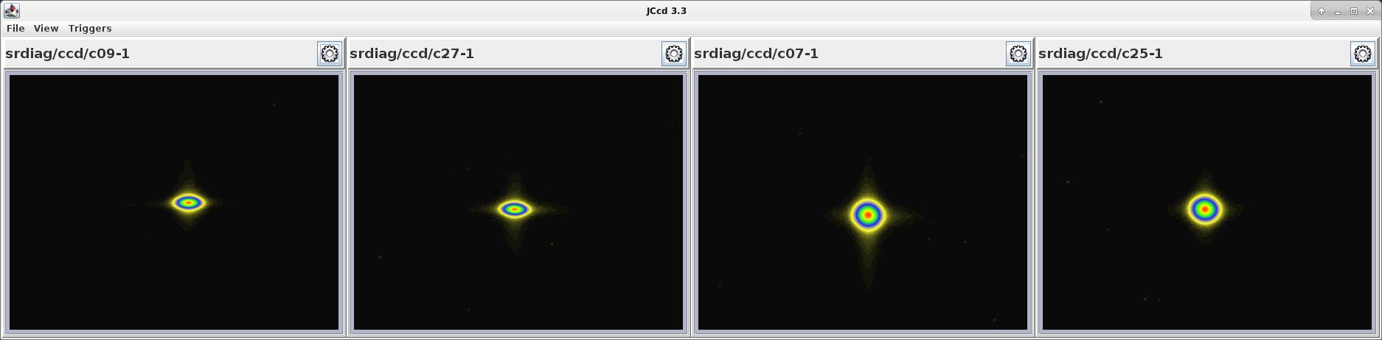
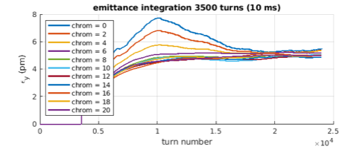
Task 4.1 Vertical emittance blow-up to level vertical emittance to 10pm
(Simone Liuzzo, Elena Buratin, et al)
Vertical emittance
1 pm
Vertical emittance
10 pm
Shaker
EBS system → PETRA IV
Simulations:
high chromaticity = blow up and no coherent motion

Slide 4
Task 4.3 Vacuum chamber impedances and beam instabilities
(Mikhail Zobov et al)
1. High current beam dynamics studies have been carried out for the USSR lattices provided by Task 4.1. It has been shown that more than 5 mA per bunch for timing mode and 200 mA of total current for brightness mode can be stored for users in the USSR storage ring
2. CETA numerical code for analyzing collective effects and instabilities in storage rings has been developed and successfully benchmarked. The work is in progress to implement additional features required for high-current beam dynamics studies.
3. The code BeamImpedance2DX for the resistive wall impedance calculation for the beam pipes with arbitrary cross-sections has been developed and tested.
4. Analysis of the best experience in the low impedance vacuum chamber design acquired in the modern synchrotron light sources and particle factory-class colliders has been carried out. An electromagnetic design of the RF cavities equipped with the waveguide-to-coaxial transition for higher-order mode suppression has been completed.

Slide 5
USSR Modes of Operation and Beam Parameters
Task 4.3 Vacuum chamber impedances and beam instabilities
(Mikhail Zobov, Shalva Bilanishvili et al)
Harmonic number = 1240
Coupling ey/ex=0.03
Parameter | Reference | Brightness Mode | Timing Mode
Total Current (mA) |  | 200 | 200
Number of Bunches |  | 620 | 40
Bunch Current I_{b} (mA) | 0.01 | 0.325 | 5.0
Hor. Emittance ε_{x} (pm) | 68.2 | 85.7 | 123.2
Ver. Emittance ε_{y} (pm) | 2.0 | 2.6 | 3.7
Bunch Length σ_{t} (ps) | 9.20 | 13.11 | 30.1
Energy Spread σ_{E} (10⁻³) | 0.86 | 0.93 | 1.46
Touschek lifetime τ (h) | 49.6 | 25.7 | 5.3

Slide 6
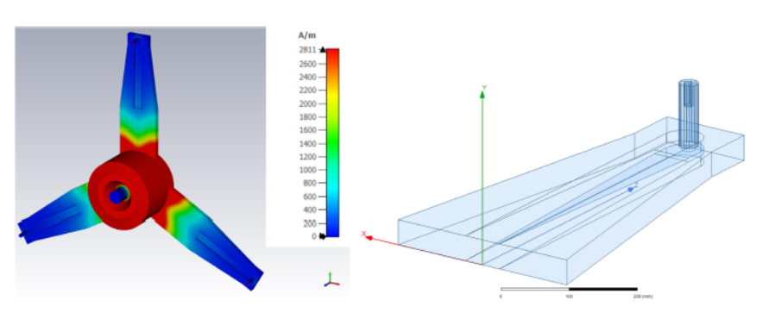
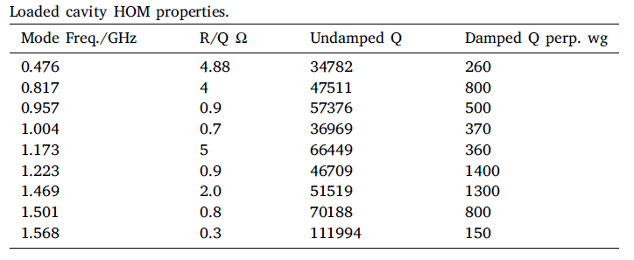
Task 4.3 Vacuum chamber impedances and beam instabilities
RF Cavities with Waveguide-to-Coaxial Transitions for HOM Suppression

Slide 7
Task 4.3 Vacuum chamber impedances and beam instabilities
The future Task 4.3 activity will be aimed at
1. Final release of a software CETA (Collective Effects Tool Analysis) for analytical and numerical studies of beam instabilities in storage rings (Milestone, M48)
2. Studies of the high current beam dynamics by using CETA applied on PETRA-IV synchrotron light source as a specific example (Deliverable, Scientific Report, M48)
3. Electromagnetic design of vacuum chamber components for modern synchrotron light sources with a goal to reduce their beam coupling impedance (Deliverable, Scientific Report, M48)

Slide 8


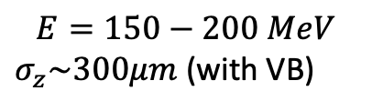
Task 4.4 Linac development (Cristina Vaccarezza et al)
Schematic layout for a 6 GeV Linac
to serve as FEL driver & top-up injector
$$E=150−200 MeV$$
$σ_{z}\sim 300μm$ (with VB)
$$E=2 GeV$$
$$σ_{z}\sim 10 μm$$
$$E=6 GeV$$
$$σ_{z}\sim 10 μm$$
Linac 1
C-band
Linac 2
C-band
Photoinjector
S or C-band
S band
Optimal injection to be studied (S-C-band chopper to preserve energy spread)
Thermionic
Gun
D. Alesini, G. Geloni, A. Giribono, S. Molodtsov, M. Zobov, S. Tocci, C. Vaccarezza

Slide 9
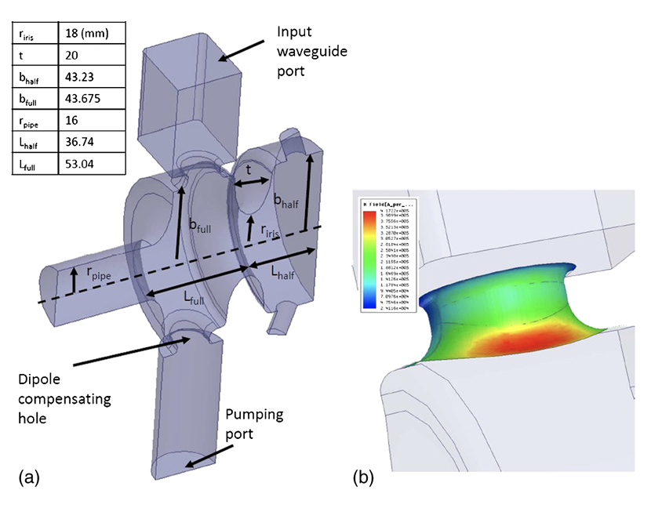
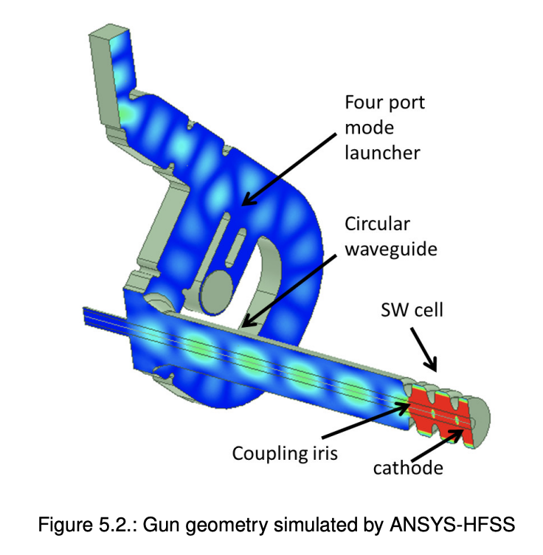
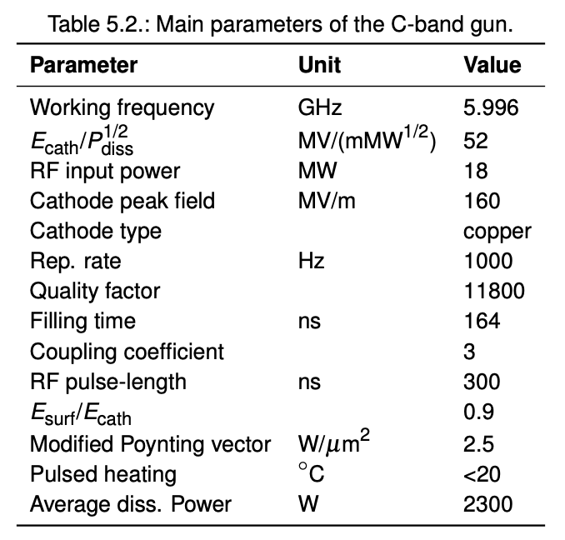
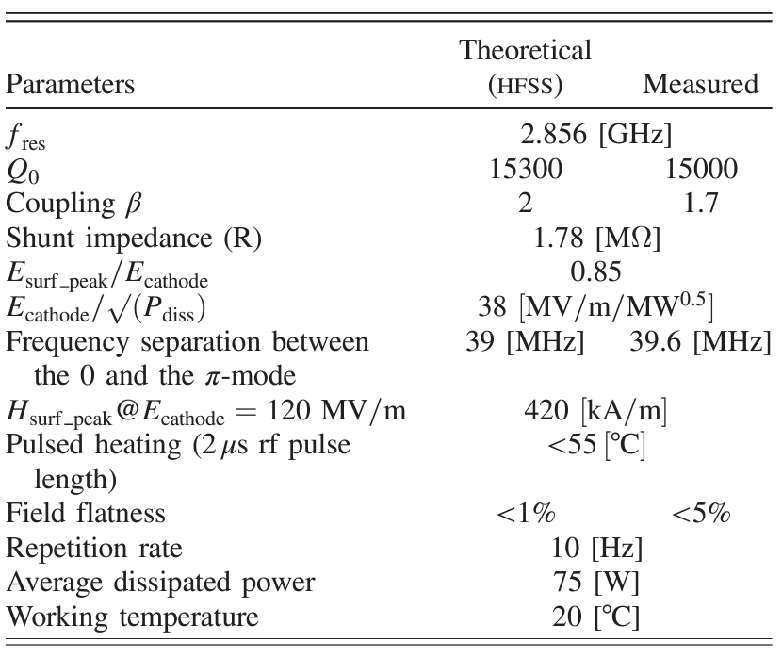
Task 4.4 Linac development
based on INFN-LNF expertise on RF Guns:
S band RF-GUN
C band RF-GUN
D. Alesini et al, PhysRevSTAB.18.092001
M. Ferrario et al., Nucl. Instrum. Meth. Phys. Res. B, vol. 309, pp. 183-188
D. Alesini et al, doi: 10.18429/JACoW-IPAC2022-MOPOMS021
G. Pedrocchi et al: doi =10.18429/JACoW-IPAC2021-WEPAB398

Slide 10
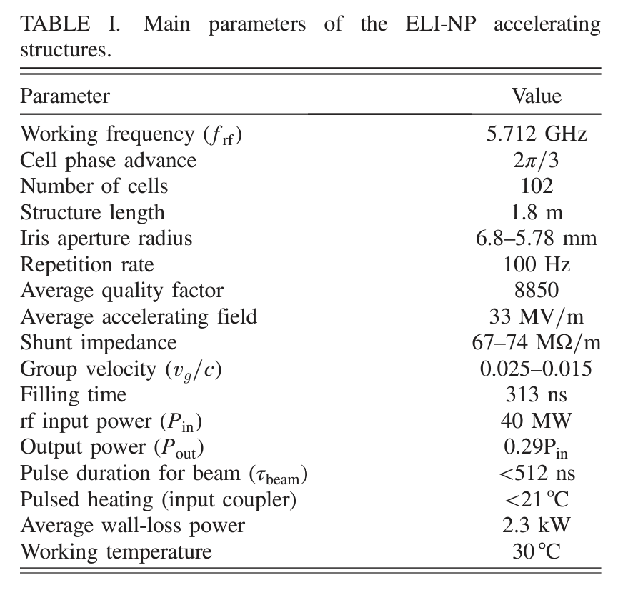
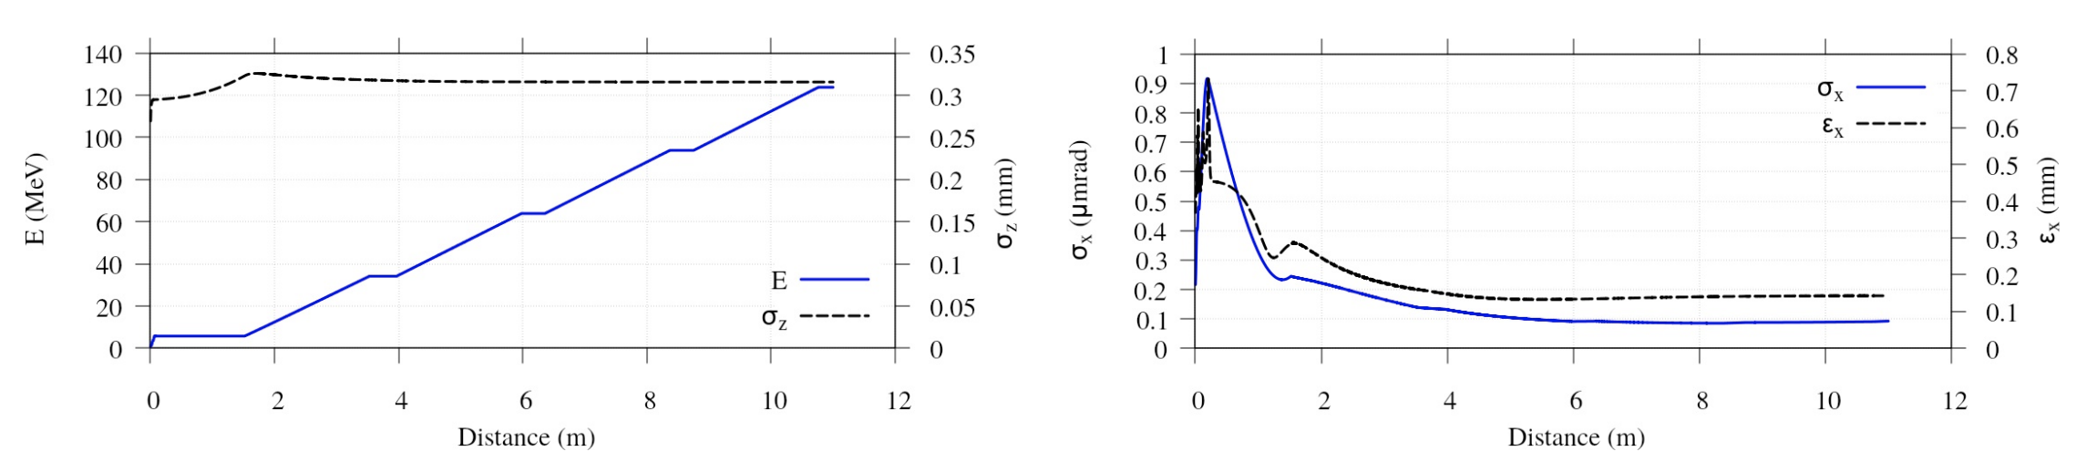
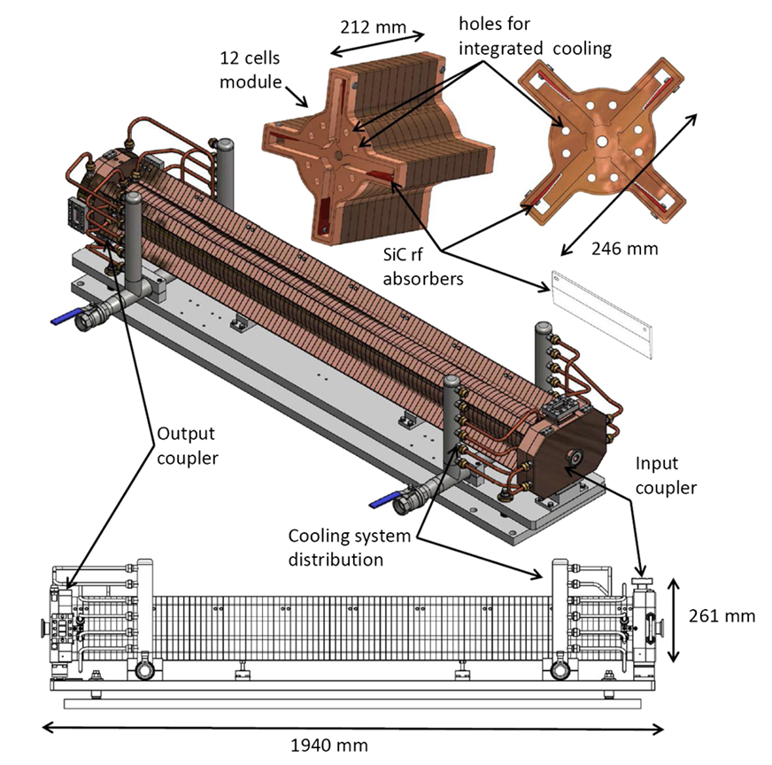
Task 4.4 Linac development
and C-band accelerating structures
Compact-Light
2.5 cell C-band Photoinjector
Evolution of:
the RMS bunch length and energy gain
the transverse normalized emittance and transverse spot size along the photo-cathode RF gun and first C-Band section of the injector.
Compact-Light Design Study (G. D’auria et al, doi:10.18429/JACoW-IPAC2019-TUPRB032)

Slide 11
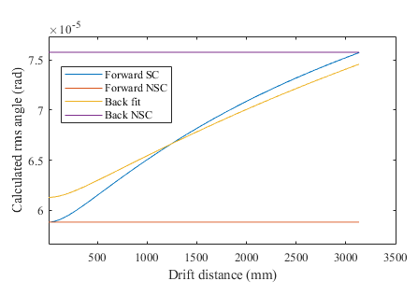
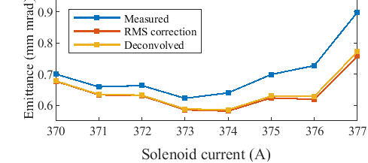
Task 4.5 Photogun prototype & beam diagnostics (Mikhail Krasilnikov,
Chris Richard, et al)
Development of reliable and accurate transverse phase space measurements
Space charge correction model
Measured rms angle
Modern high brightness FELs require accurate and reliable beam characterization for optimal performance
  Need for improvement of emittance measurements to accurately characterize photoguns and reconcile differences between measurements and simulations
Develop methods for correcting systematic errors in phase space measurements
  Corrections for finite slit and camera resolution: Complete
  Corrections for space charge: In development
Deliver software for transverse emittance measurements: In development
Change due to space charge
True rms angle
Correction with model
Slit and camera resolution corrections

Slide 12

(Oliver Seeck, Melanie Nentwich, et al)

Slide 13
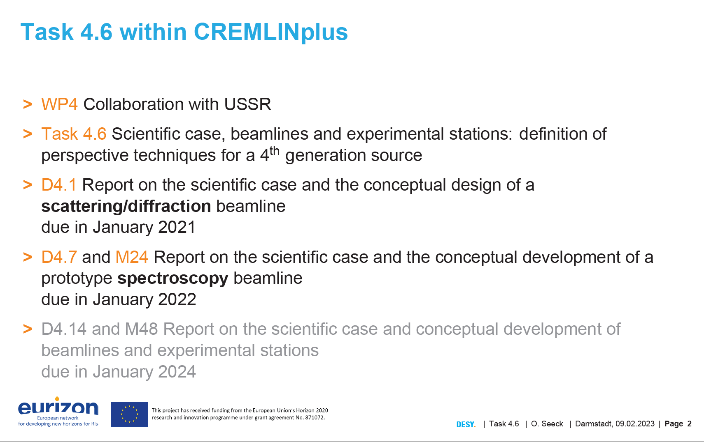

Slide 14
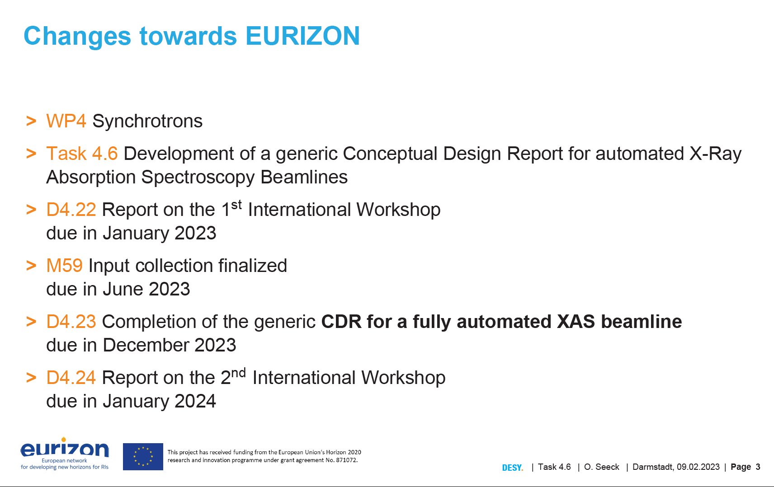

Slide 15


