Slide 1
EURIZON: WP5 Second Reporting Period and Current Status
February 10, 2023
EURIZON Annual Meeting
Andre Sailer (CERN)

Slide 2
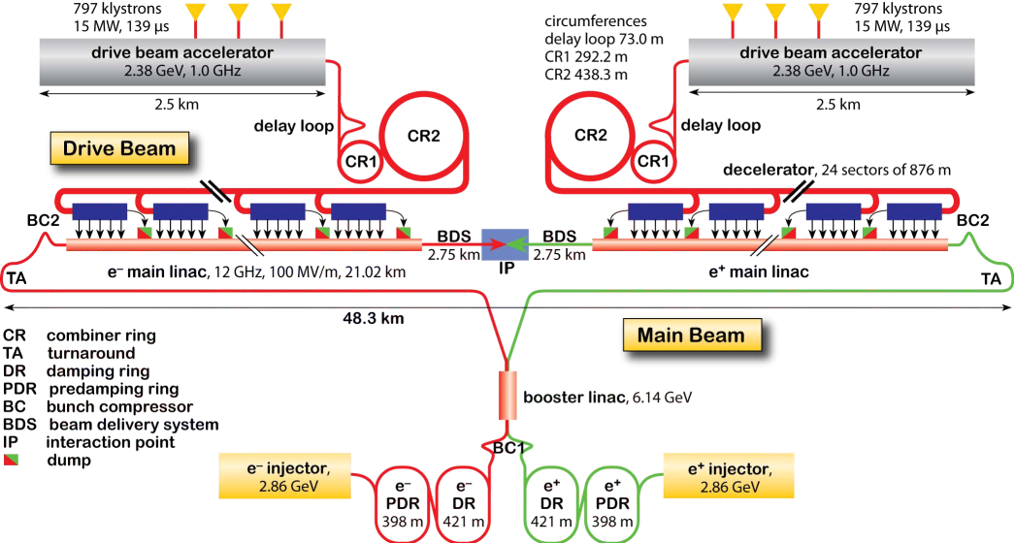
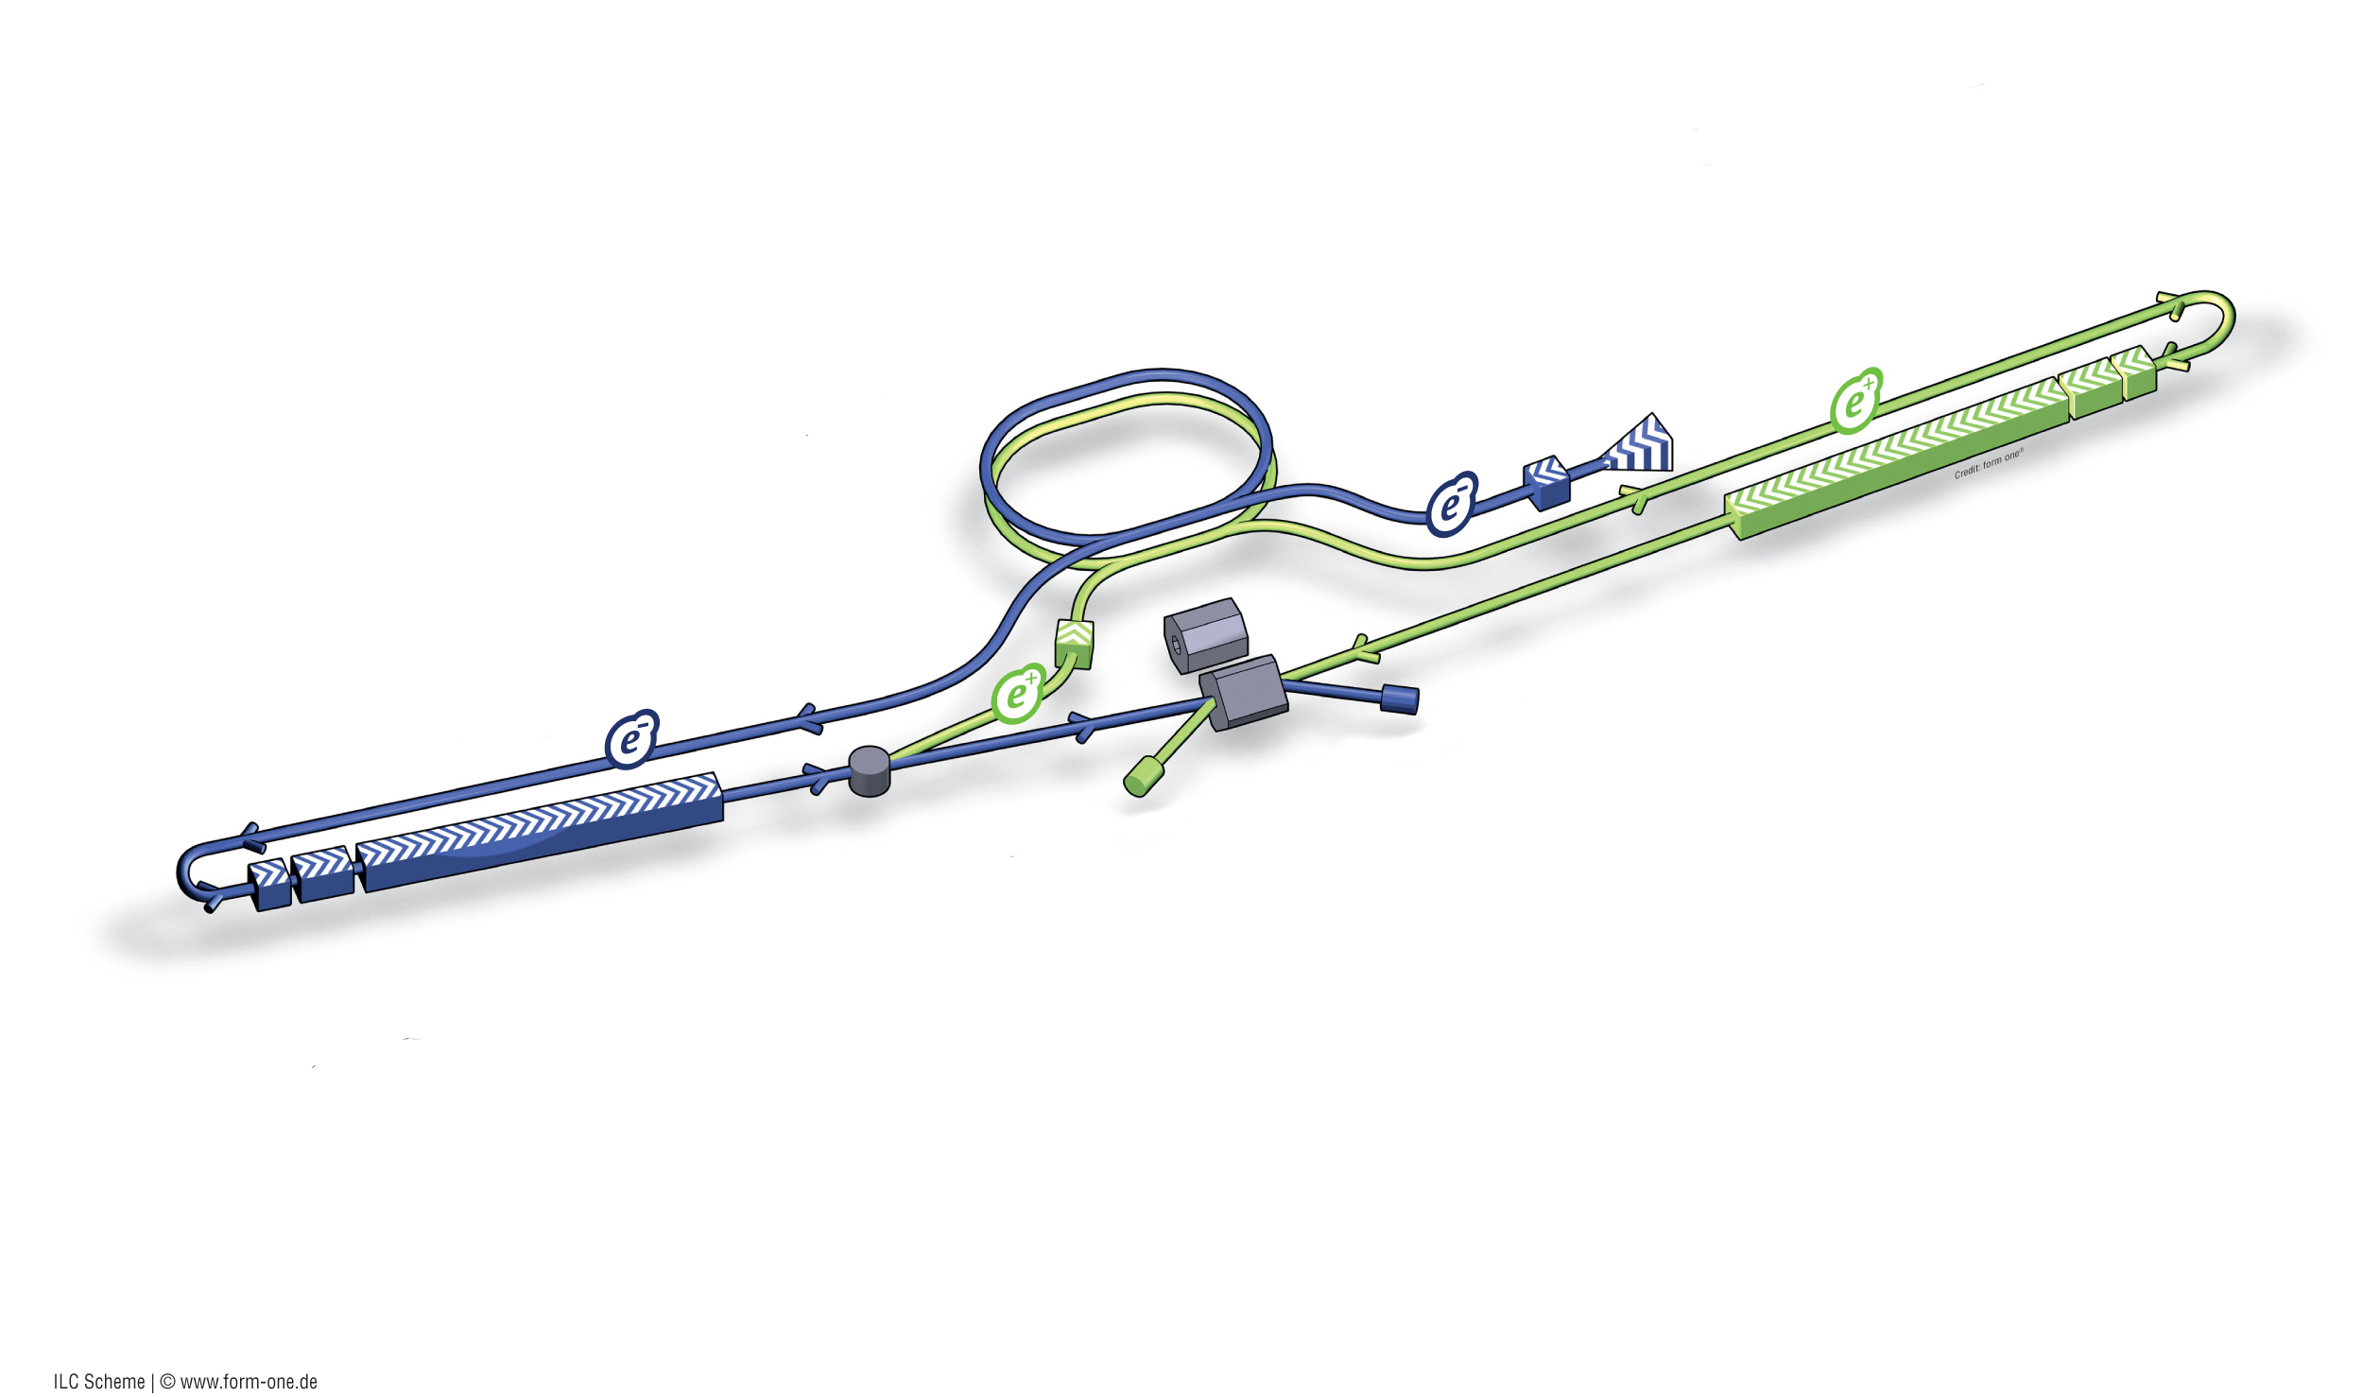
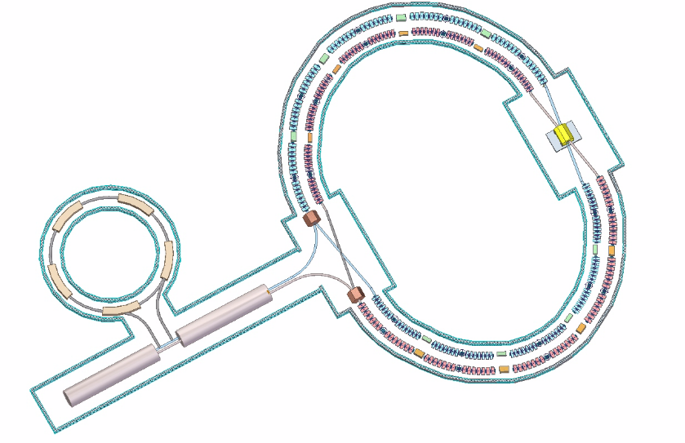
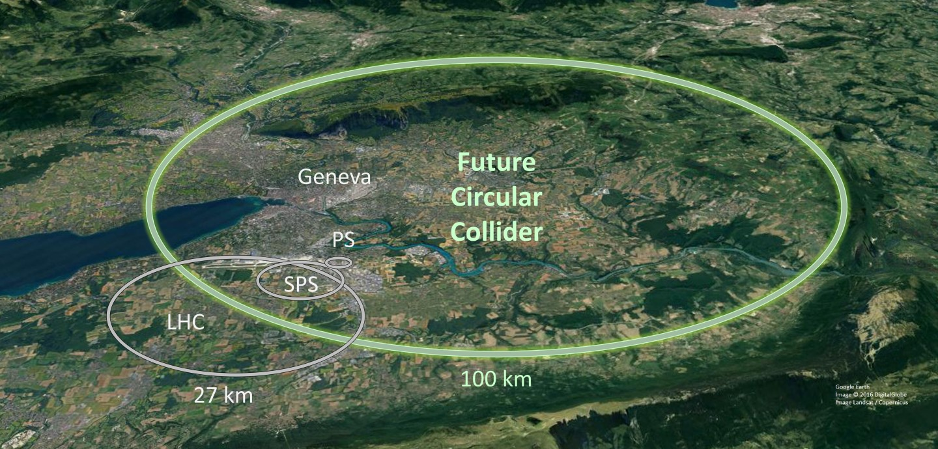
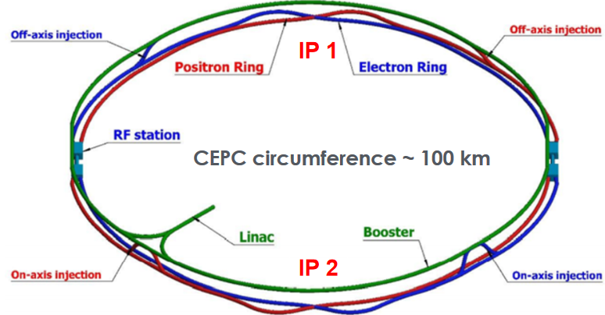
Different Lepton Collider Proposals
STC
ILC
CLIC
https://cicpi.ustc.edu.cn/indico/contributionDisplay.py?contribId=22&confId=2760
https://indico.ihep.ac.cn/event/17020/contributions/117889/
https://cds.cern.ch/images/OPEN-PHO-ACCEL-2019-001-2

Slide 3
Task 5.1: SCT Internationalization

Slide 4
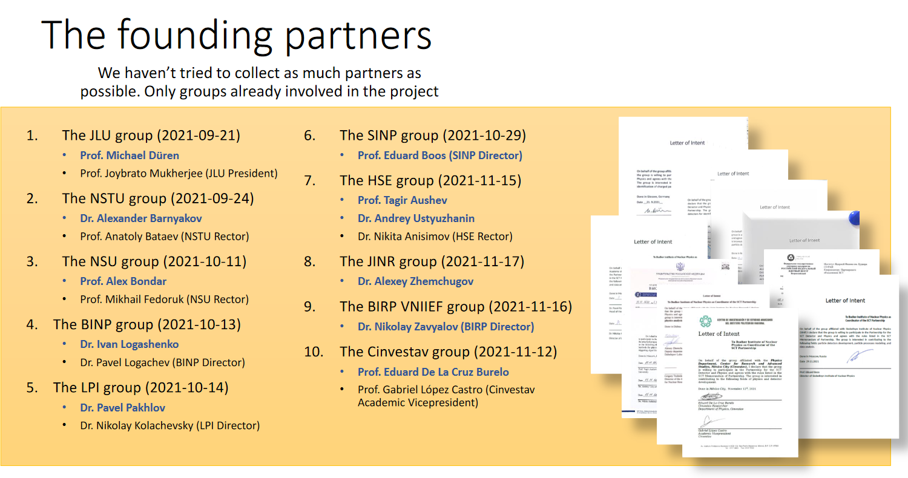
SCT Internationalization/Outreach
November 18, 2021: SCT Partnership kick-off meeting
SCT website launched
Presentations at international workshops
Joint Charm Tau workshop

Slide 5
Task 5.2: Accelerator Developments
Walid Kaabi (IJCLab)

Slide 6
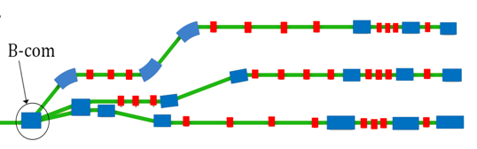
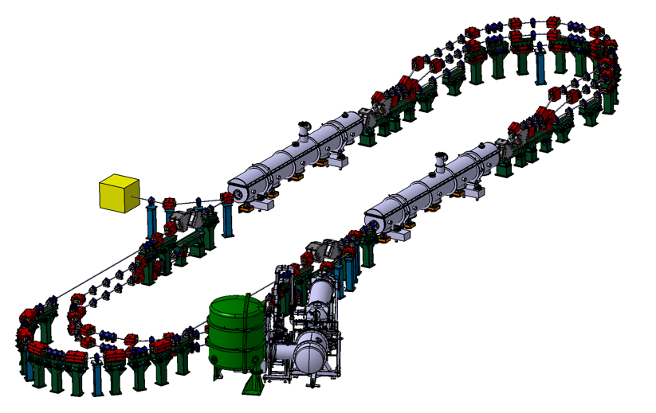
Plan of magnet activities
Prototype of B-COM magnet:
Pursue the work toward B-COM magnet complete specification.
Proceed to a thermal study and mechanical complete design
Ordering a B-COM magnet prototype to be measured and qualified, is still under discussion.
Challenges:
Prototype would now be made with an industrial partner (fabrication initially foreseen at BINP):
  Risk of over-cost regarding the budget foreseen.
  Long administrative process before purchase regarding the period left
  for the project (January 24).
We are looking for a magnetic measurement bench to made
measurements and characterize the prototype (measurements
initially foreseen at BINP).

Slide 7
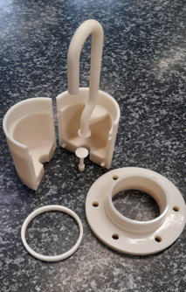
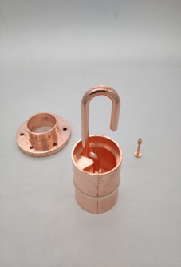
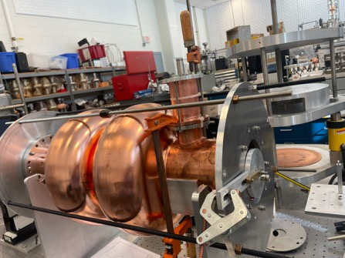
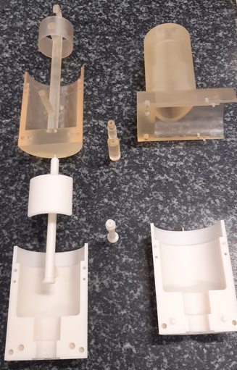
Plans on HOMs and cavity activities :
HOM couplers prototypes:
1 hook HOM coupler was 3D printed in polymer then Copper coated.
Now installed on a 2-cell 801.58 MHz copper cavity to test HOM coupler performance
DQW-type
First Hook type polymer coupler 3D printed then copper coated, now installed in a double-cell Cu cavity for test
Probe-type
Test will be performed also on Probe-type and DQW-type coupler currently under fabrication.
A 5-Cell copper cavity will be fabricated soon @Jlab (same design as the 1st Nb 5-cell cavity fabricated in 2017) to allow end group design optimisation and to test several HOM couplers combinations to assess the best HOM damping scheme.
Ultimately, we aim to fabricate Nb HOM couplers with optimised design and and install them on a new Nb 5-cell PERLE cavity with optimised end groups.

Slide 8
5.2 Summary
Design studies are progressing well, both for magnet and HOM technologies for Energy Recovery Linacs
Magnet prototyping is under discussion due to new challenges related to cost and timeline (loss of the expertise and capacity of fabrication & test at BINP)
HOM couplers prototyping will be made in the project timeline.
Special request addressed to project coordinator: Use the money initially allocated to Post-doc hiring (104 k€) to prototypes funding. Need to know how to formalize it.

Slide 9
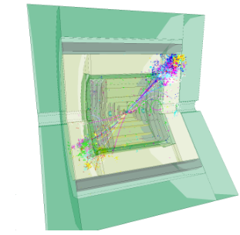
Task 5.3: Development of software for the design of an HEP detector
Andre Sailer (CERN)

Slide 10
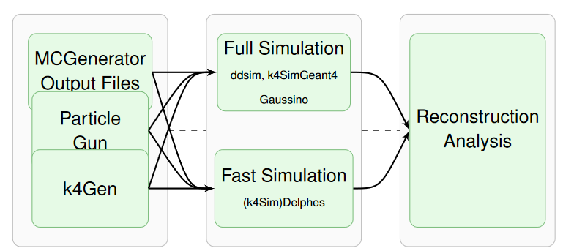
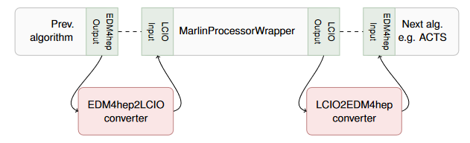
Software for Future Collider Studies (Key4hep)
Fully integrated framework for event generation, simulation (fast/parameterized, full), reconstruction,
analysis
  “Turnkey Software Stack”
  Endorsed by ECFA Higgs/Electroweak/Top
  Factories studies (ILC, CLIC, FCCee experiments)
Integrating standard tools from HEP world
  Gaudi, DD4hep, podio, Geant4, ROOT,
  spack
Integration of existing tools
(FCCSW, iLCSoft (→k4MarlinWrapper)

Slide 11
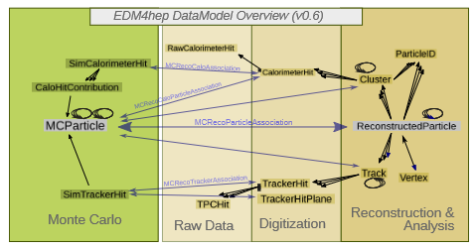
Software for Future Collider Studies
Continued developments
  Event Data Model evolution: e.g., necessary for drift
  chambers (cluster counting, cf. task 5.5)
  Integration of new state-of-the art tools: e.g., ACTS
  for track reconstruction
  Development of continuous validation system
Technical Student started this month to work on Distributed Computing (DIRAC) with focus for FCCee large scale MC production

Slide 12


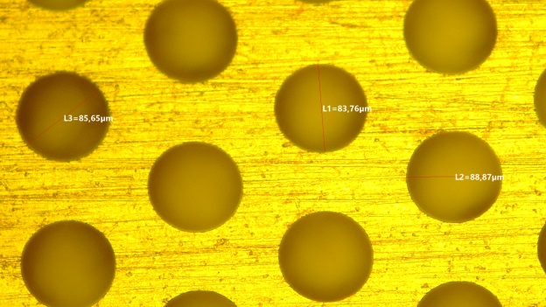
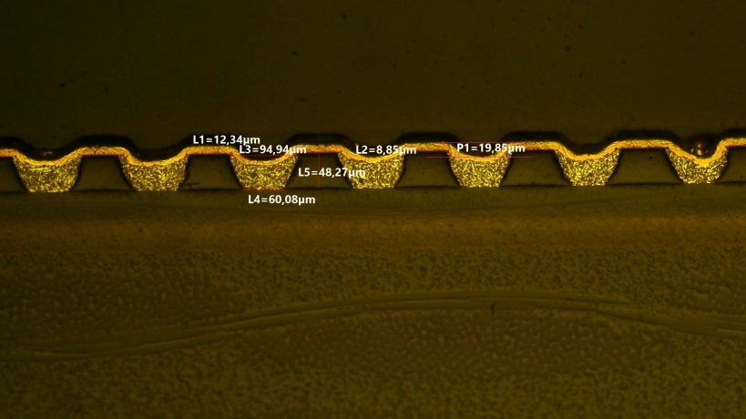
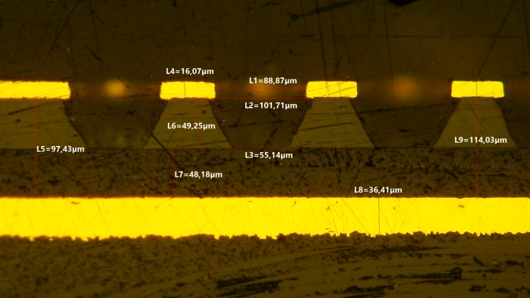

WP 5.4: Cylindrical RWELL as Inner tracker for SCTF
G. Bencivenni, E. de Lucia
on behalf of
LNF-INFN, Ferrara – INFN, Torino INFN
February 2023

Slide 13

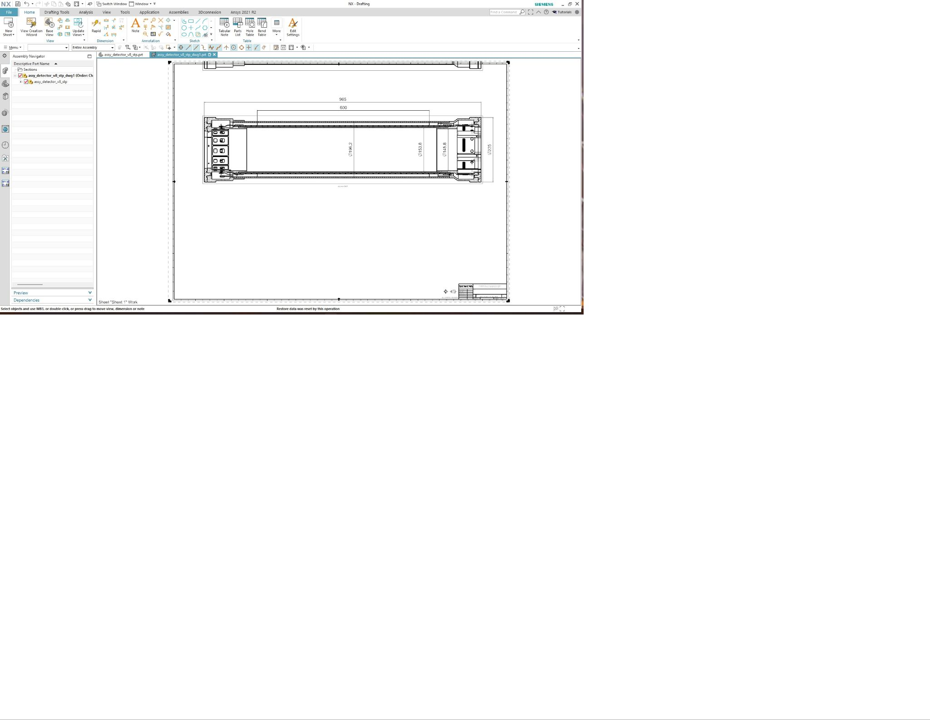
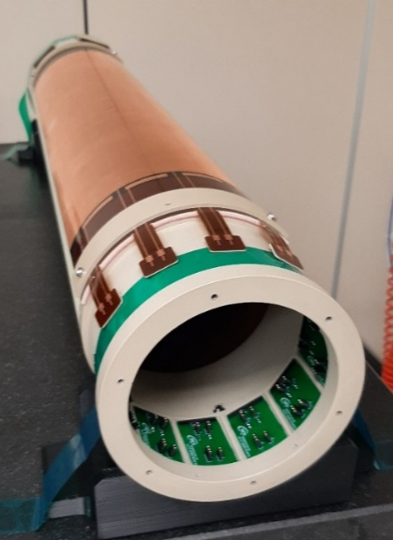
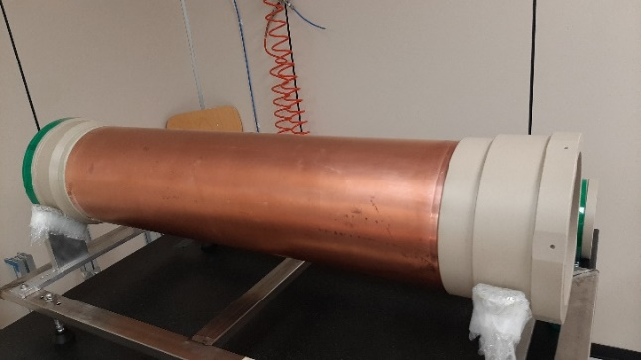
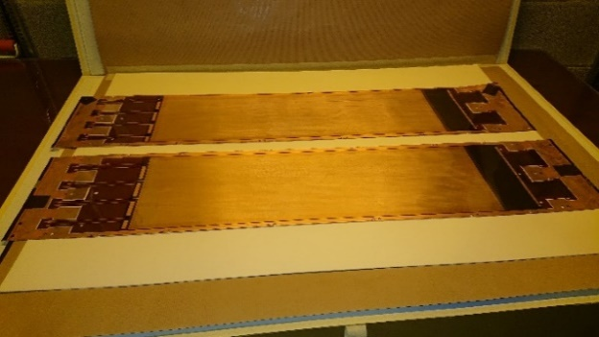
WP 5.4 Status Report – Detector construction
B2B layout
Development of an ultra-light modular cylindrical μ-RWELL (C_RWELL) as inner tracker for Tau-Charm Factories.
The B2B layout (a double radial TPC – with a central cathode) is designed to have a very low material budget (0.86÷0.96% X0) and modular roof-tile shaped detector units, based on μ-RWELL technology.
A single gap C-RWELL prototype is under construction as demonstrator.
Prototype size
anode diameter = 168.5 mm
cathode diameter = 188.5 mm
active length = 600 mm
drift gap = 10 mm
Final concept
Project Status
Design completed
Components manufacturing completed
Detector assembly started
Cosmic ray test
13

Slide 14
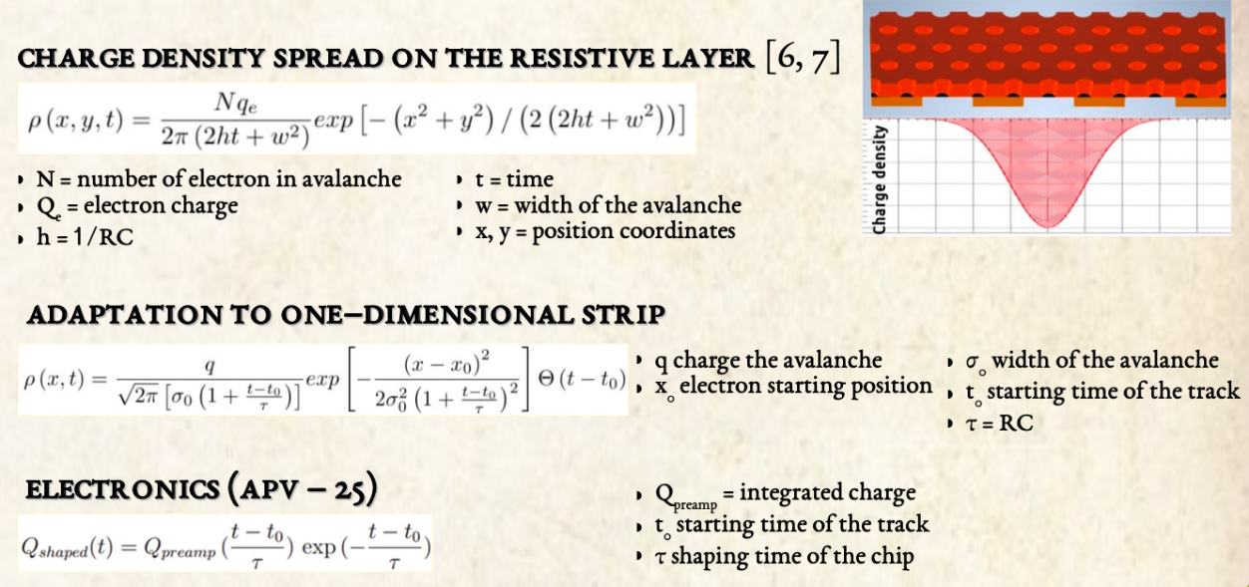
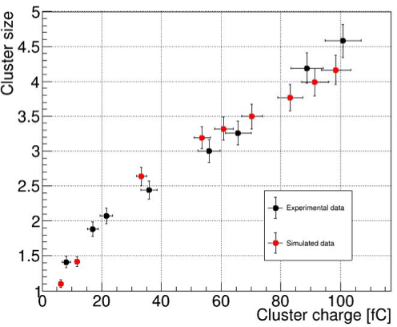
WP 5.4 Status Report – Simulation: Detector
Response Parametrization
The complete simulation of the C_RWELL includes also the response of the detector to the energy deposition, with the description of the formation of the electronic signal inside the detector
Simulation software developed for BESIII triple-GEM detectors → Adapted to μ−RWELL detector (Parsifal tool-kit)
Simulate resistive configuration
Preliminary results from the comparison of simulation with experimental data show a good agreement
14

Slide 15


EURIZON
Task 5.5 Status
F. Grancagnolo
for
INFN Bari and Lecce

Slide 16

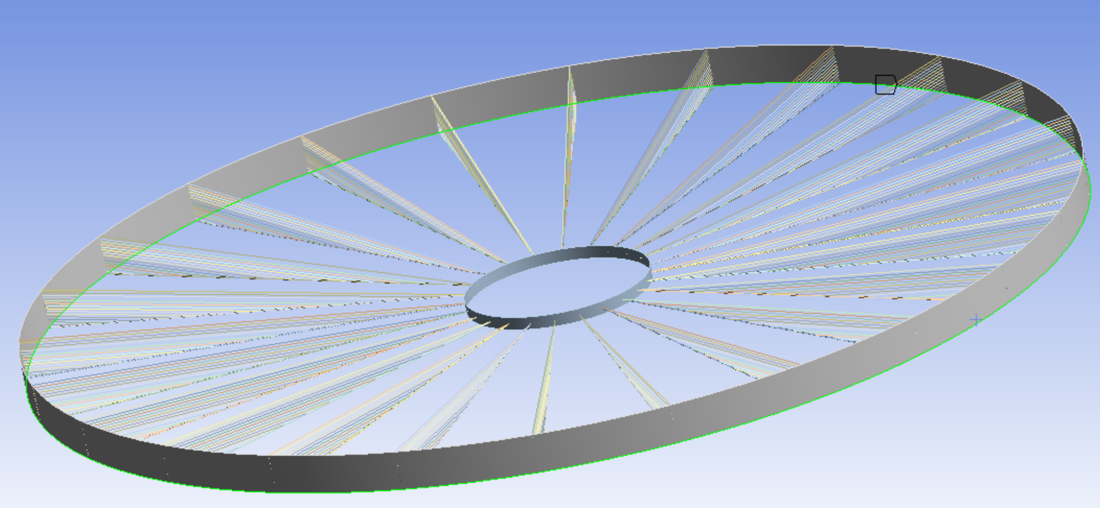
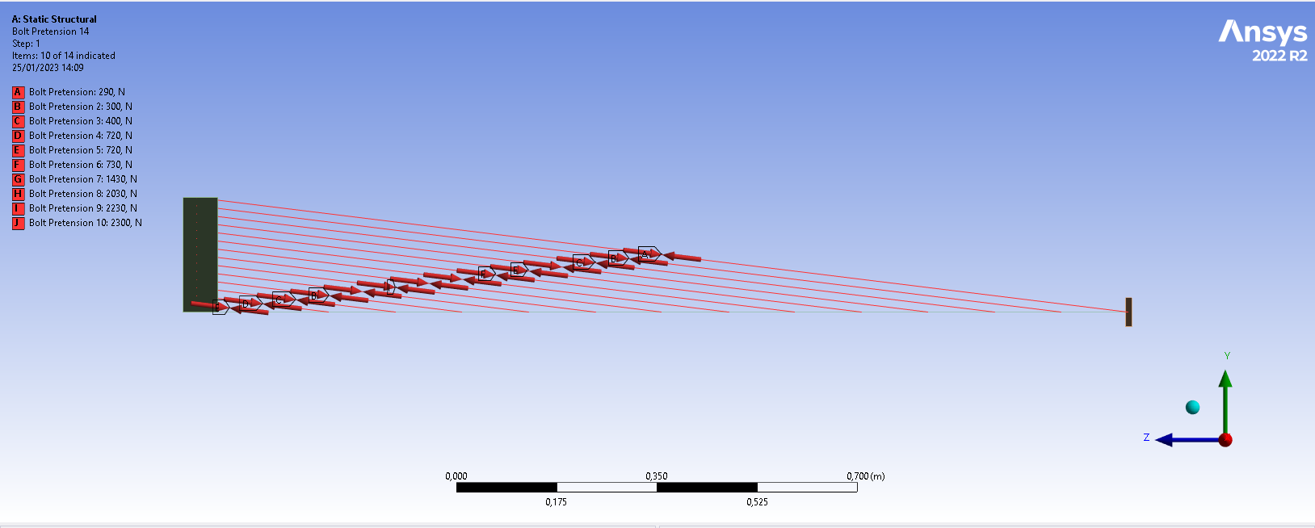
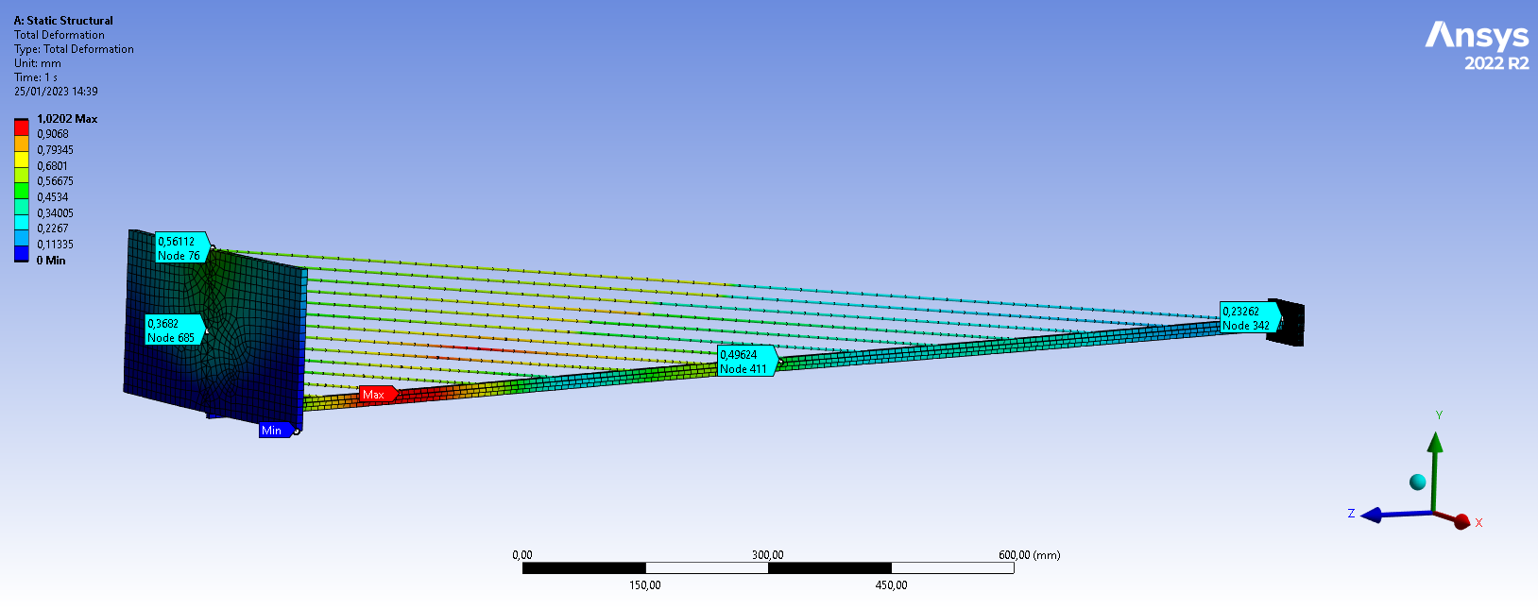
Subtask 5.5.1 - Mechanical design of the IDEA drift chamber
Boundary conditions of the end-plate model
Pre-stressing of stays to compensate DC wires tension
Stays and spoke deformation (to be fully optimized)
Conceptual design of the IDEA drift chamber completed.
Preliminary FEA with homogeneous materials in conclusive phases.
Transition to composite materials undergoing.
Goal is to complete the full design by fall 2023 and to start construction of
  a full-length, 1/12 wedge, prototype before the end of 2023.

Slide 17
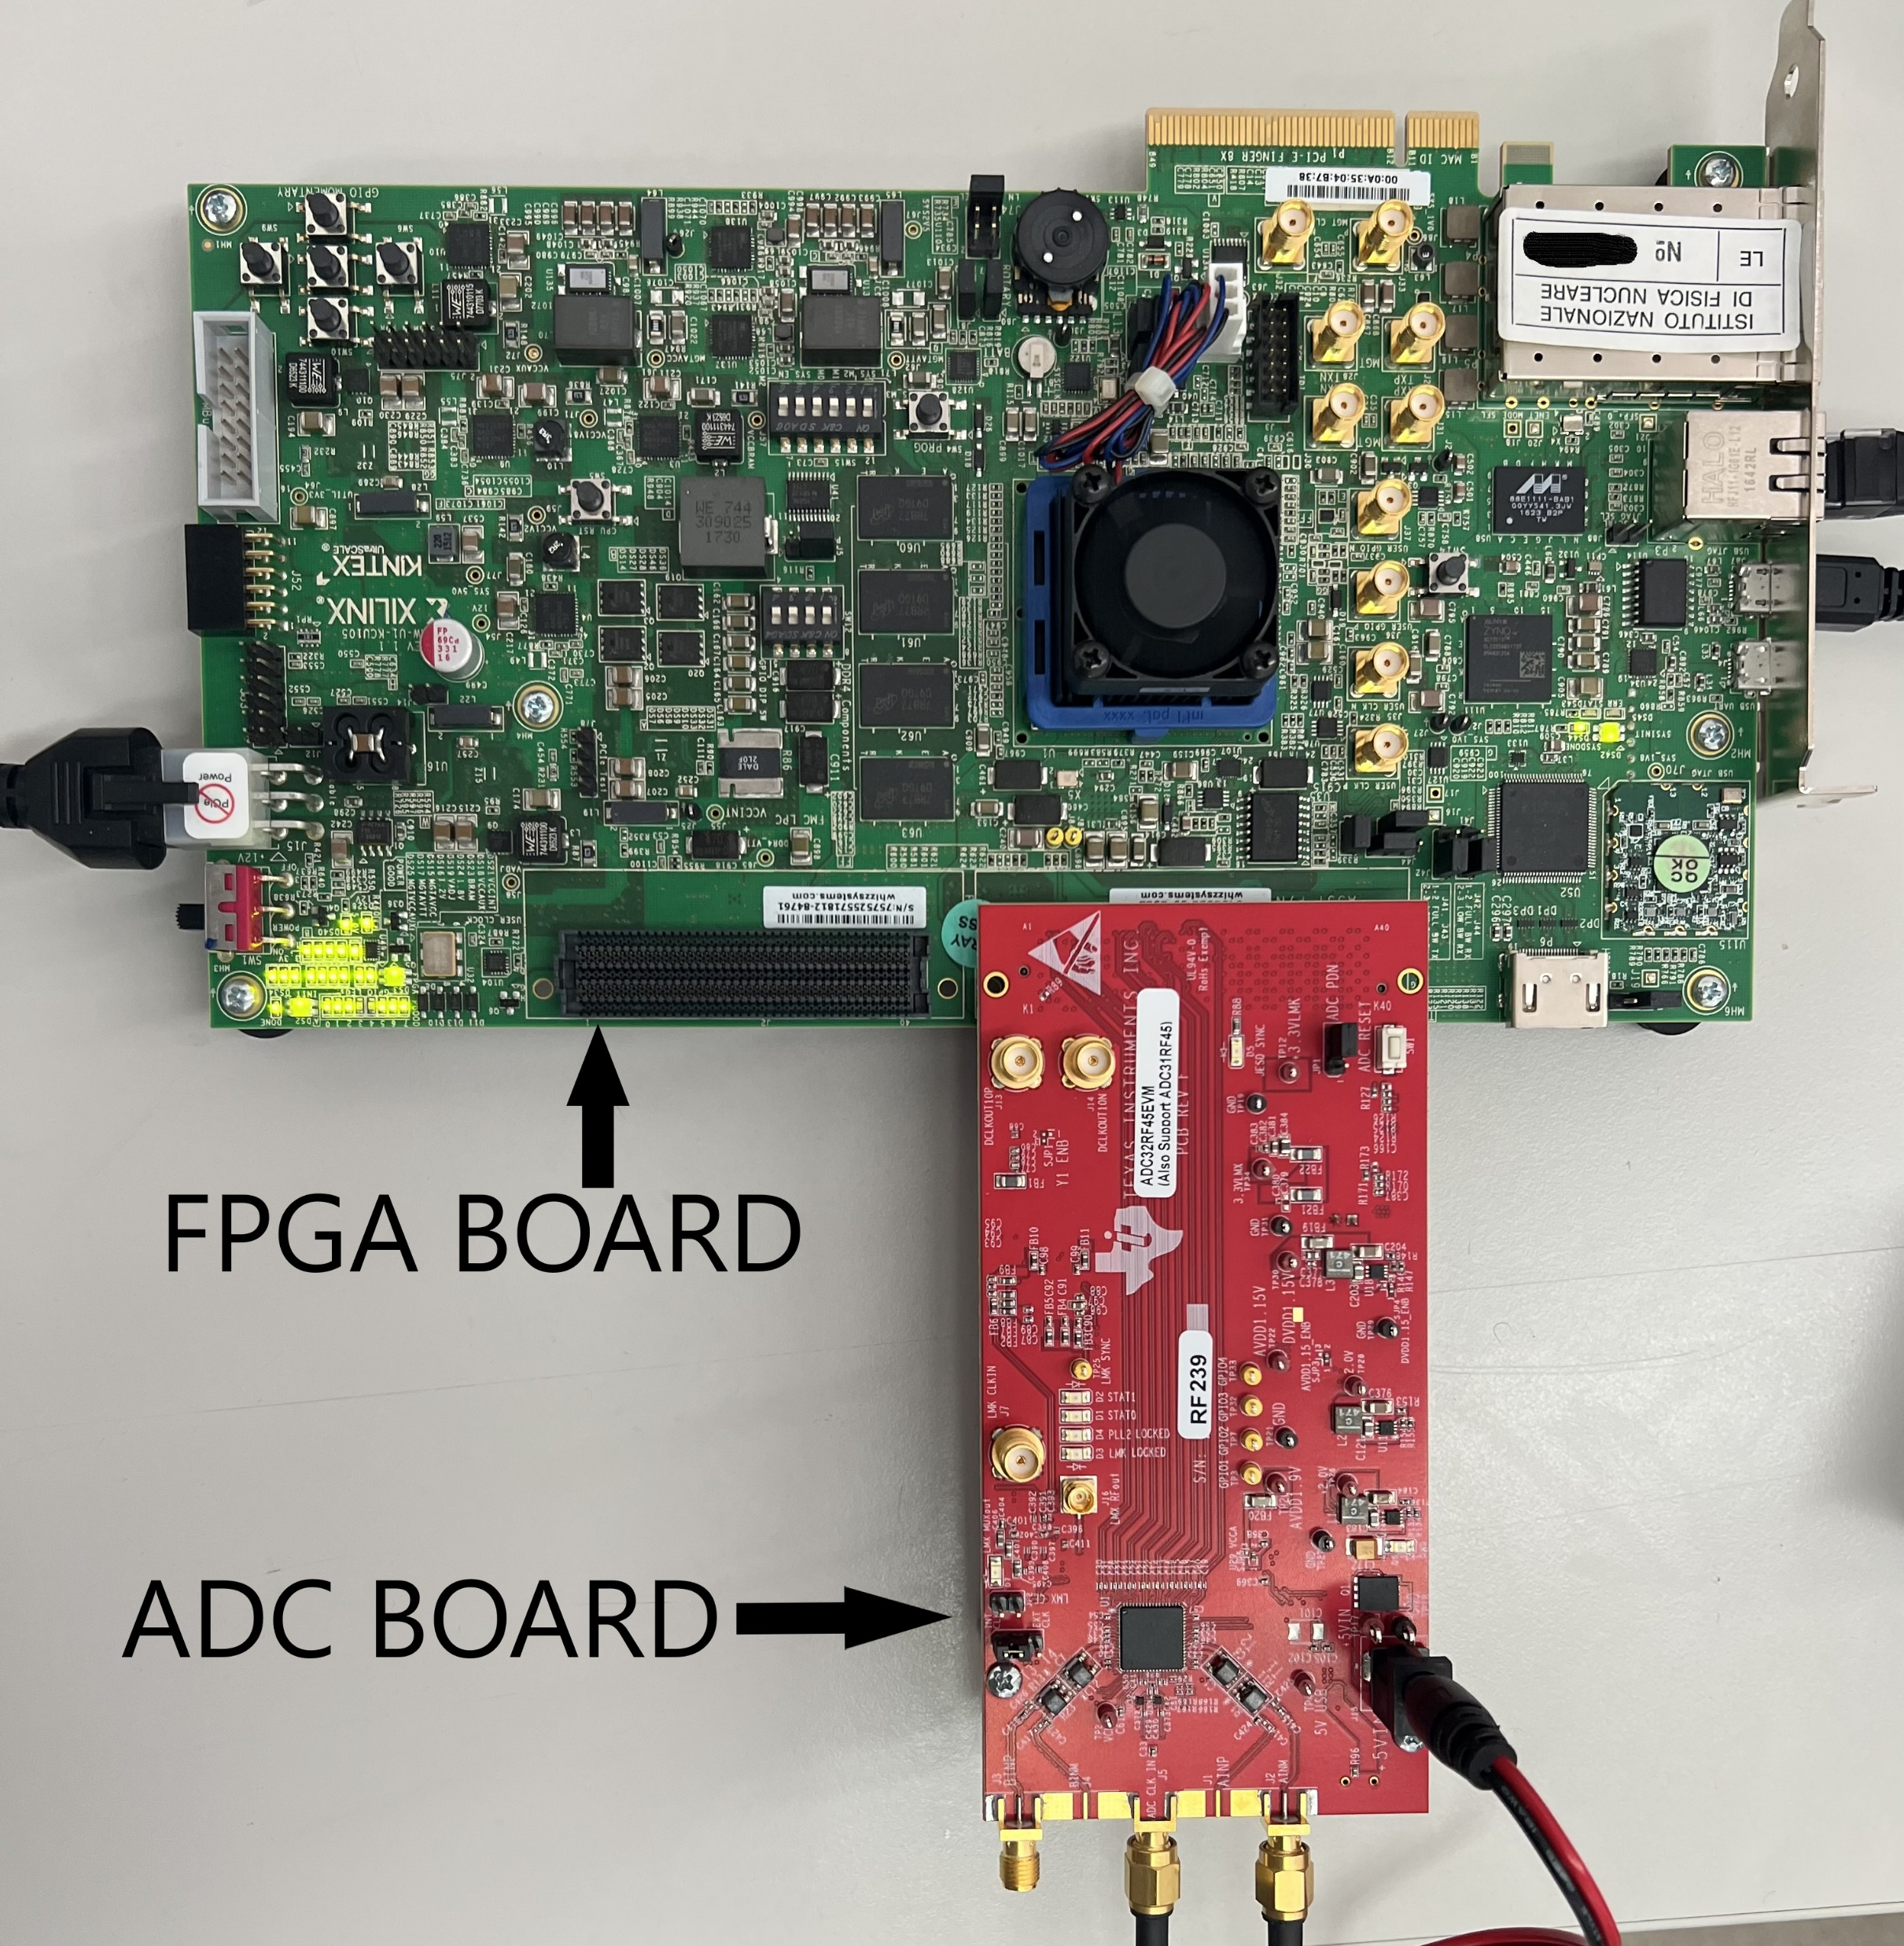
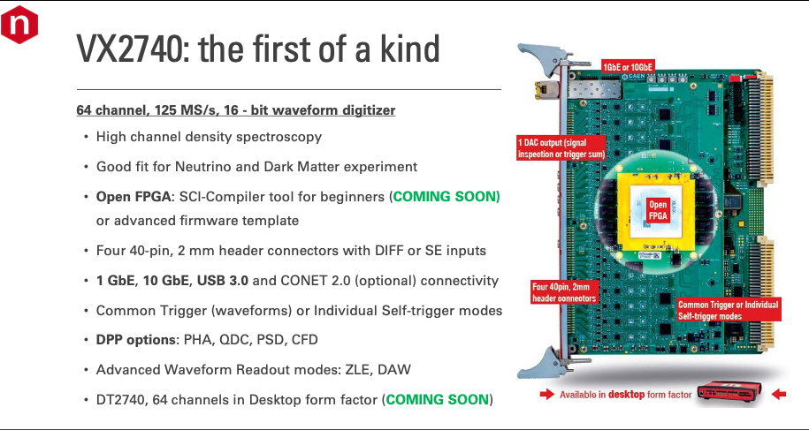
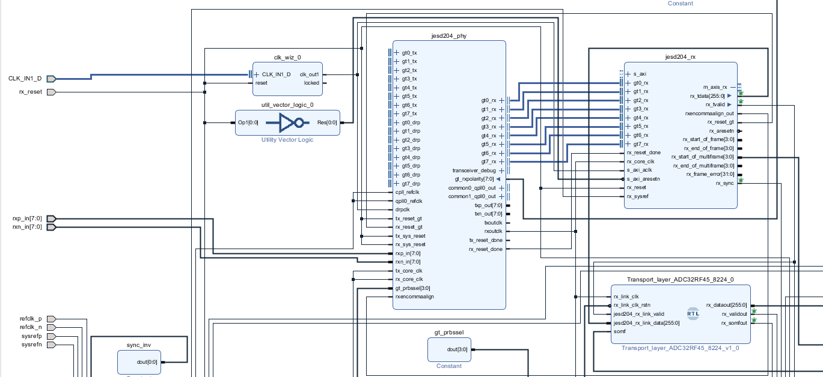
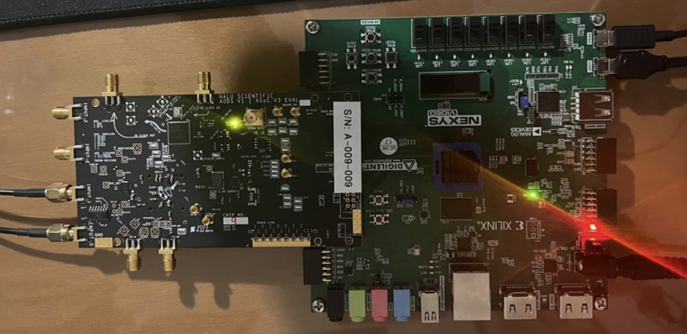
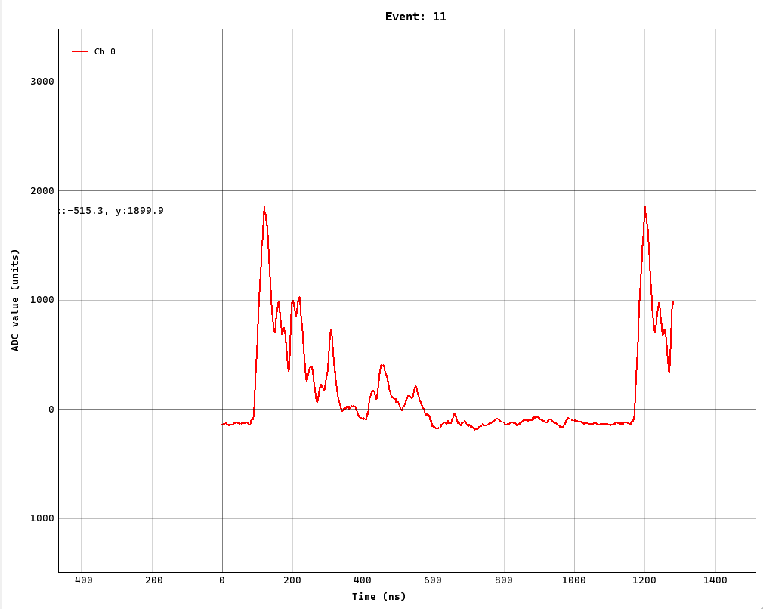
Subtask 5.5.2 - FPGA-based fast digitizer for the cluster counting regime
approach #1: KINTEX KCU105 + TEXAS ADC ADC32RF45
approach #2: CAEN VX2740 (VX2751, when available)
some synchronization issues
yet to be solved
just received the
software license
to program our
cluster finding
algorithms
approach #3: NALU Scientific ASoCv3
real signals read out with the AsoC chip, (used AWG with low performance: not all peaks detected)

Slide 18
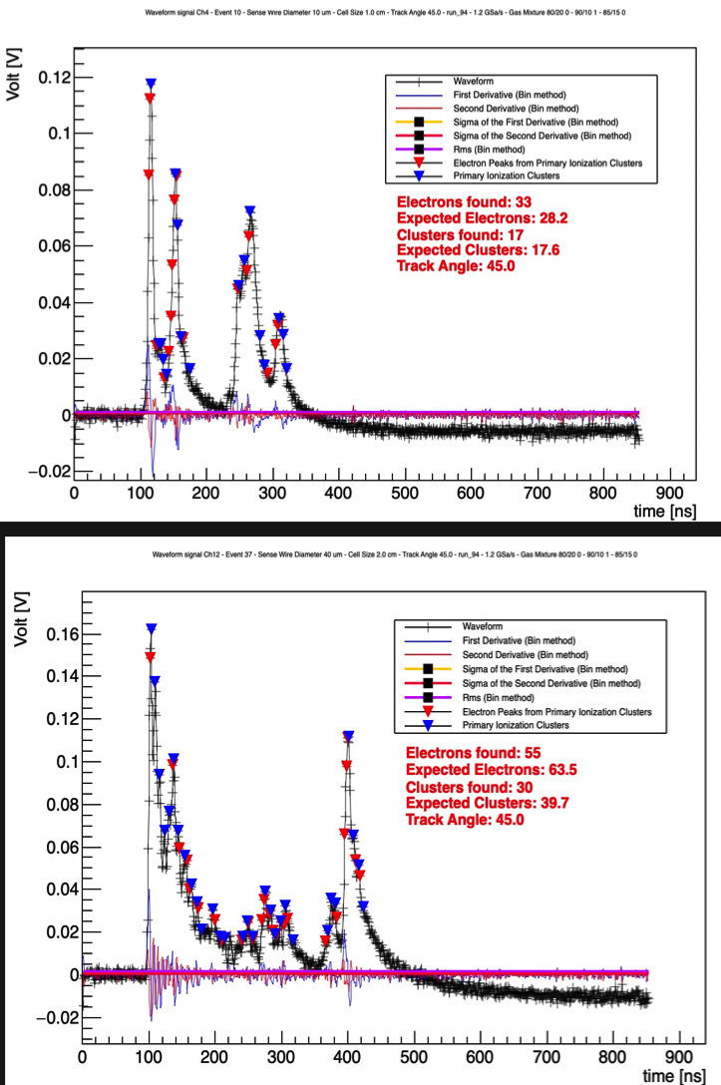
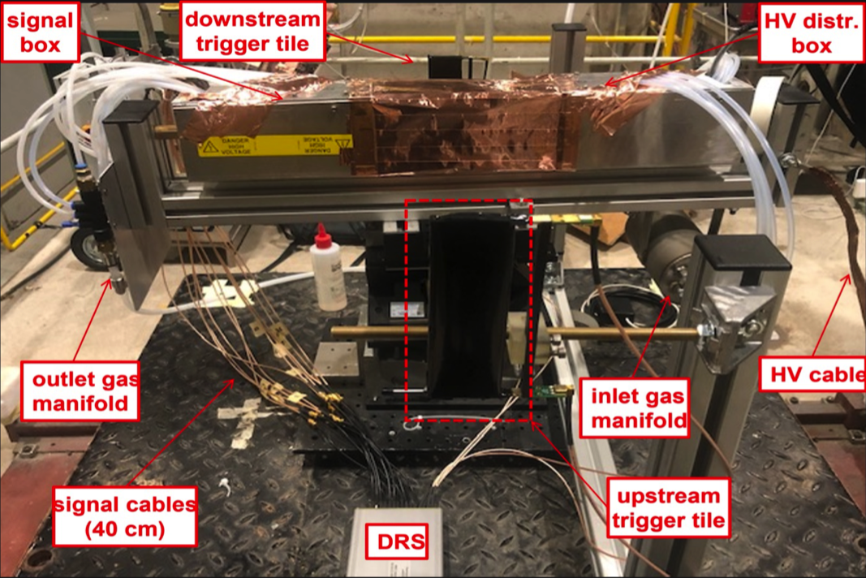
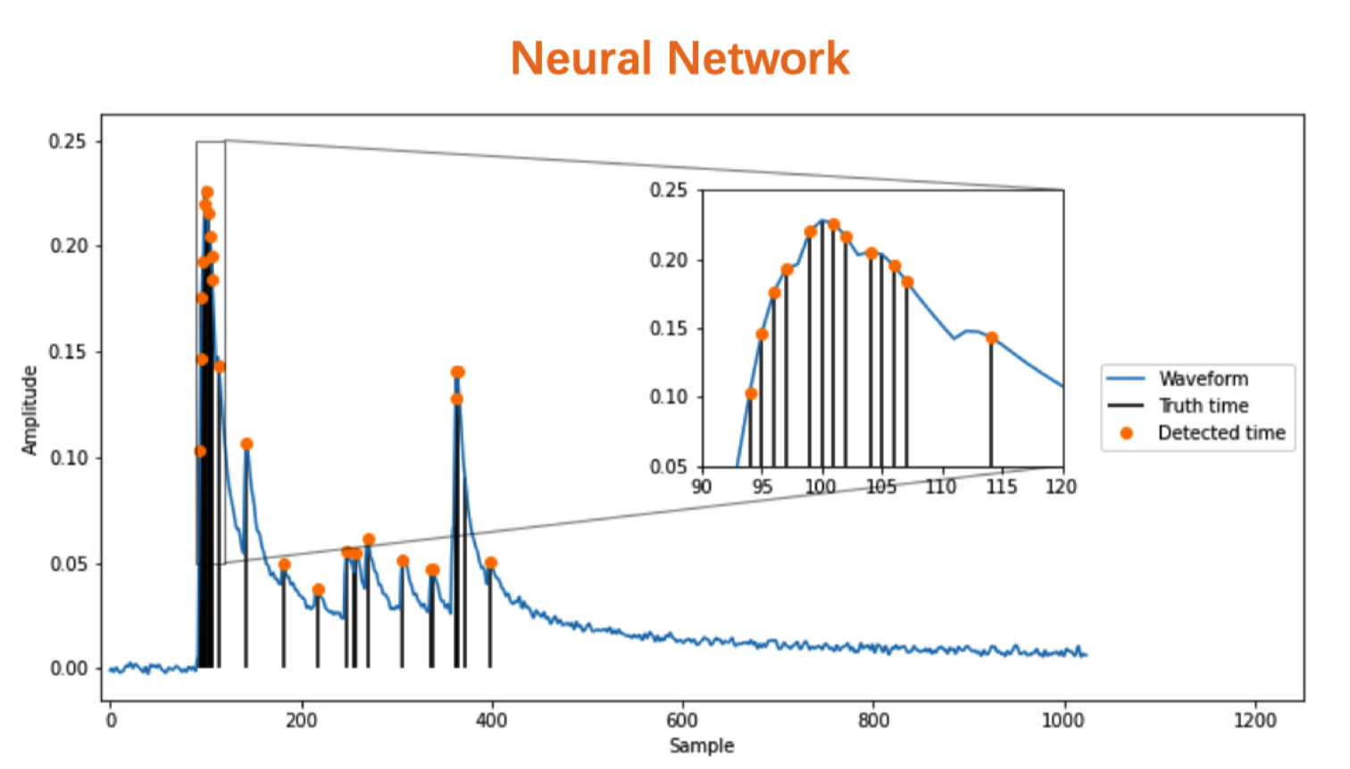
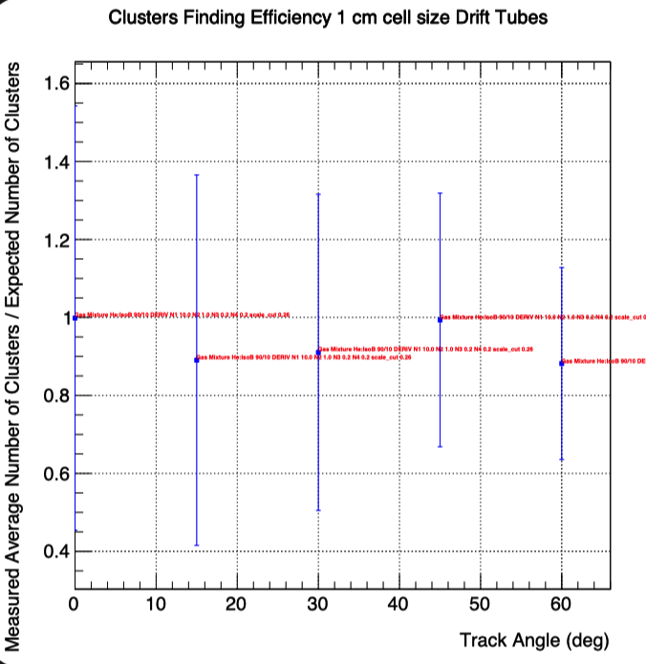
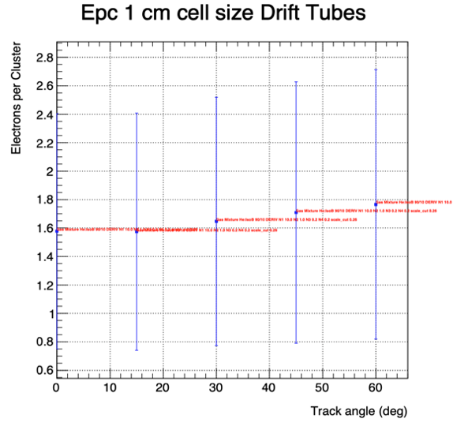
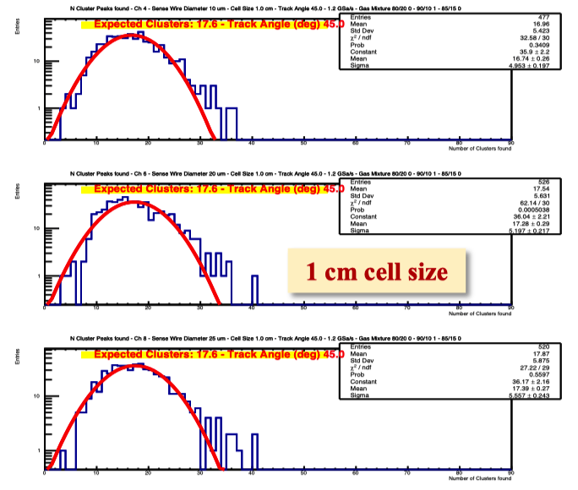
Subtask 5.5.3 - Analysis of beam tests data for cluster counting
Beam test setup at CERN-H8
0.8 cm drift
1.8 cm drift
Poisson distributions!
0.8 cm drift, 45°

Slide 19
Task 5.6: PID
Michael Düren (JLU Giessen)

Slide 20


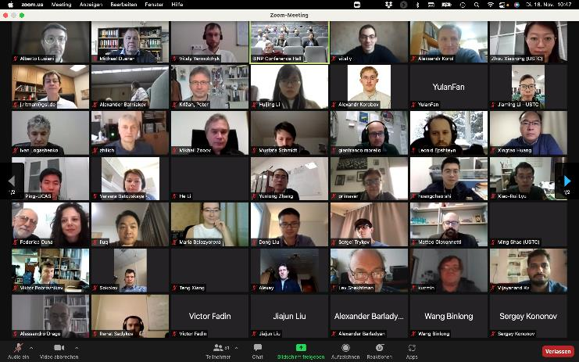
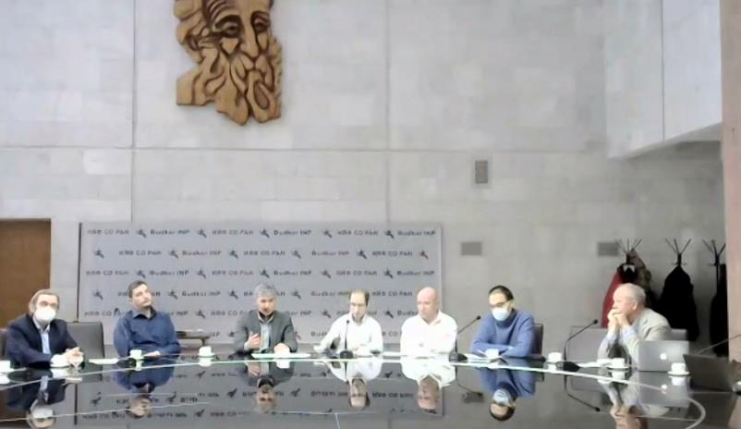
Task 5.6 (1.8.21-8.4.22):
CREMLINplus: Development and design of a Particle Identification system for the SCT detector
FARICH prototyping
Bi-weekly intense cooperation by video conferences
Discussion and modification of PID detector design
Common development of Monte Carlo Simulations
FDIRC prototyping
Chinese-Russian-European Workshop
on Super Charm Tau Experiments
Memorandum of Partnership signed by JLU Sept. 2021
as first non-Russian institution; discontinued March 2022

Slide 21
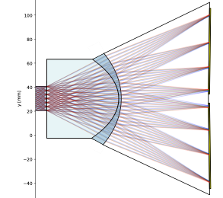
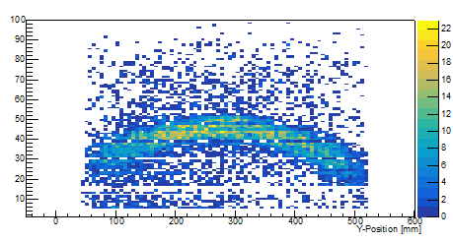
Task 5.6 (9.4.22-31.1.23): EURIZON: Development and design of a Particle Identification system for a future flavour factory detector
FDIRC prototyping
Optimize FDIRC optics by using lenses instead of focusing mirrors and by including chromatic dispersion corrections
Monte Carlo simulations of a Disc DIRC Cherenkov Detector with Dispersion Correction
Study the use of SiPMs in single photon detection in RICH and DIRC detectors
System tests of a prototype FDIRC in the Giessen Cosmics station using reconstructed muons
“Cherenkov-Smile” from Cosmic Muons in DIRC prototype (Thesis Lisa Brück)
Example of a DIRC focusing
design with chromatic correction
(Thesis Sophie Kegel)
Channel

Slide 22
Deliverables and Milestones

Slide 23
Outstanding Milestones and Deliverables
Relative Number in WP | Number | Name | Lead Beneficiary | Type | Dissemination Level | Due Date (in months)
D5.5 | D48 | Report on development of collider technologies for lepton colliders | CNRS-IJCLab | R | PU | 44
D5.6 | D49 | Final report on the software developments | CERN | R | PU | 44
D5.7 | D50 | Final report on R&D work on (low mass, modular) inner tracker for a detector at future lepton colliders | INFN | R | PU | 44
D5.8 | D51 | Final report on R&D work on central tracker for a detector at future lepton colliders | INFN | R | PU | 44
D5.9 | D52 | Final report on R&D work on charged particle identification systems at future lepton colliders | JLU | R | PU | 44
Number | Name | Lead Beneficiary | Due Date (in months) | Description
M28 | Construction and test of the inner tracker based on C-RWELL prototype | INFN | 40 | Conference contribution
M29 | Prototype of RF equipment for high power beam | CNRS-IJCLab | 42 | Conference contribution
M30 | Construction and test of the drift chamber prototype | INFN | 42 | Conference contribution
M31 | Prototype for PID system | JLU | 42 | Conference contribution

Slide 24
Summary

Slide 25
Summary
More details in https://indico.desy.de/event/37137/sessions/14728/
Despite difficulties progress has been made in all tasks
Reaching Milestones and Deliverables should be possible, maybe with delay of few months (44→48?) to achieve more complete results

Slide 26
Thank you for your attention!

