Slide 1
EURIZON Annual Meeting 2023
WP6 - "Technology development for future high-power laser facilities“
Restructuring and current status
Lead beneficiary : CEA
Catalin MIRON, CEA-LIDYL
9 February 2023, Darmstadt, Germany

Slide 2
WP6 : Transition from CREMLINPlus to EURIZON
CREMLINPlus (01/02/2020 – 23/02/2022) | Lead beneficiary | EURIZON (24/02/2022 – 31/01/2024) | Lead beneficiary
Task 6.1A – Using relativistic plasma mirrors as ‘light condensers’ | CEA (FR) | Task 6.1 – Intensity enhancement of high-power ultrashort laser beams using optically controlled curved plasma mirrors | CEA (FR)
Task 6.1B - Temporal contrast improvement CafCA - completed | IAP (RU)
Task 6.1C - Two-stage nonlinear compression of fs laser pulses – only simulations | IAP (RU)
Task 6.2A – Advanced metrology of ultrashort laser beams (Experiment@IAP) | CEA (FR) | Task 6.2 – Advanced metrology of ultrashort laser beams (SC@SourceLab) | CEA (FR)
Task 6.2A – Non-linear devices for E-field reconstruction – intended for the last 24M | IAP (RU)
Task 6.3 – Training and scientific exchange involving ELI-DC AISBL (BE) | LLE AISBL (BE) | Task 6.3 – Training and scientific exchange involving ELI ERIC (CZ) | LLE AISBL (BE)
Joint technology developments for XCELS
(IAP, CEA, LaserLab-Europe AISBL, ELI-DC AISBL)
Technology development
for future multi-PW laser facilities
(CEA, LaserLab-Europe AISBL, ELI ERIC)

Slide 3
WP6 : Work progress
Task 6.1 – Towards the Schwinger limit : Intensity enhancement of high-power ultrashort laser beams using optically controlled curved plasma mirrors – completed
- D6.4 - Conceptual design towards extreme intensities using plasma mirrors (M36) - submitted

Slide 4
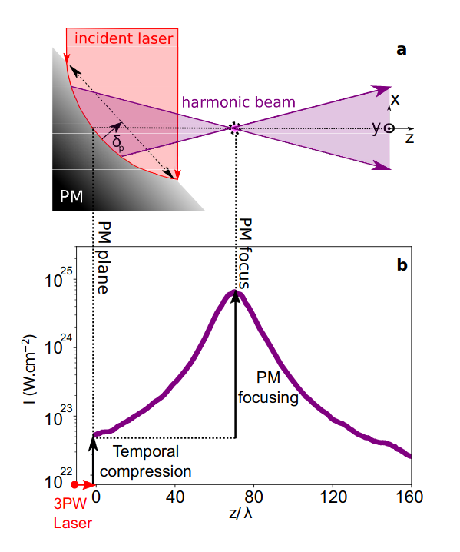
Laser intensity can be boosted by 3 orders of magnitude!

Slide 5
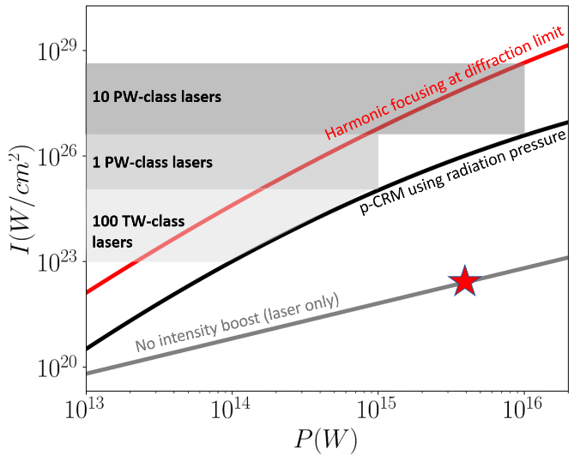
Laser intensity can be boosted by 3 orders of magnitude!
F. Quéré & H. Vincenti HPLSE, 2021
Present record

Slide 6
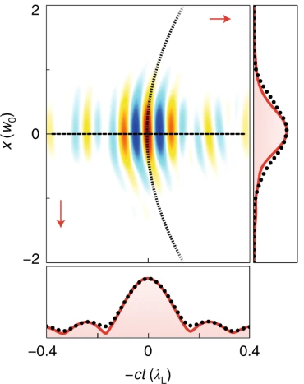
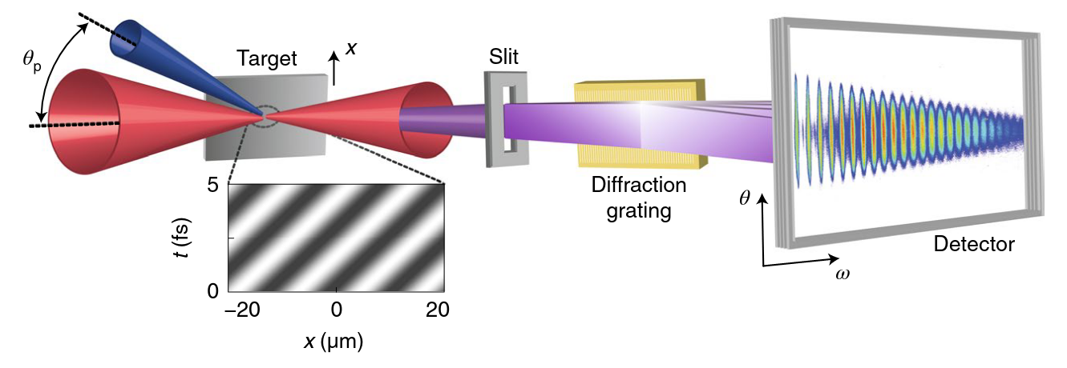
Curvature of harmonics beam phase-front was
observed in a proof-of-principle experiment
Experiment carried out at the
100-TW UHI100 laser facility (CEA-LIDYL)
L.Chopineau et al. Nat.Phys. 17, 968–973 (2021)

Slide 7
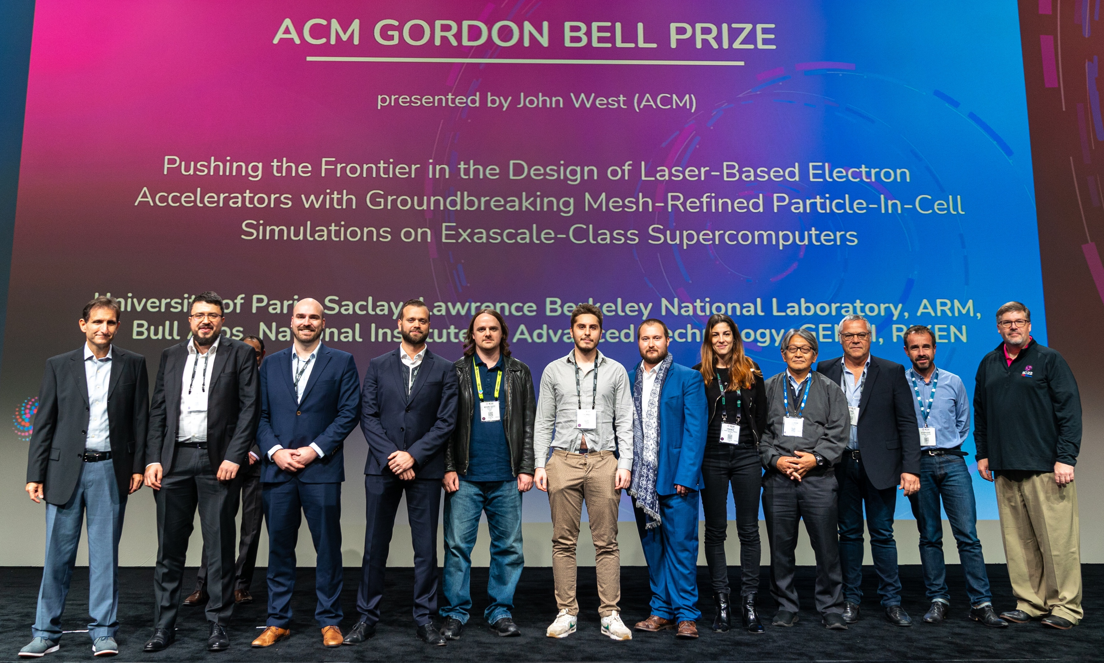
Gordon Bell Prize 2022
2022 ACM Gordon Bell Prize Awarded to International Team for Particle-In-Cell Simulations on Exascale-class Supercomputers. International Team Demonstrates Groundbreaking Mesh Refinement Capability
Luca Fedeli, Neïl Zaim and Henri Vincenti
involved in WP6 - Task 6.1 work
Luca Fedeli, Axel Huebl, France Boillod-Cerneaux, Thomas Clark, Kevin Gott, Conrad Hillairet, Stephan Jaure, Adrien Leblanc, Remi Lehe, Andrew Myers, Christelle Piechurski, Mitsuhisa Sato, Neil Zaїm, Weiqun Zhang, Jean-Luc Vay, and Henri Vincenti

Slide 8
WP6 : Work progress
Task 6.1 – Towards the Schwinger limit : Intensity enhancement of high-power ultrashort laser beams using optically controlled curved plasma mirrors – completed
Task 6.2 – Advanced metrology of ultrashort laser beams – ongoing (40%)

Slide 9
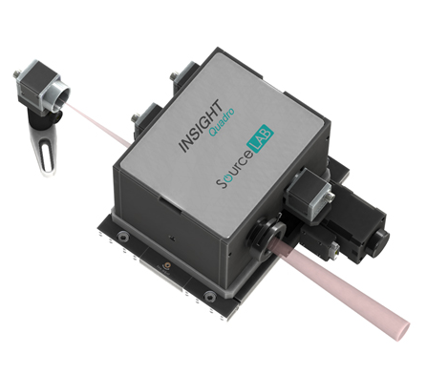
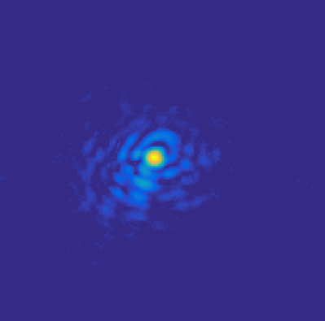
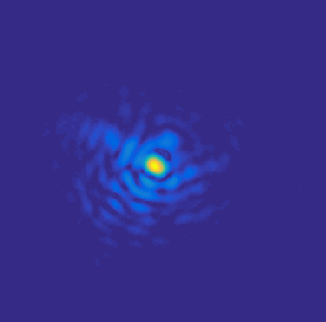
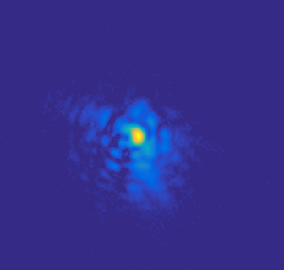
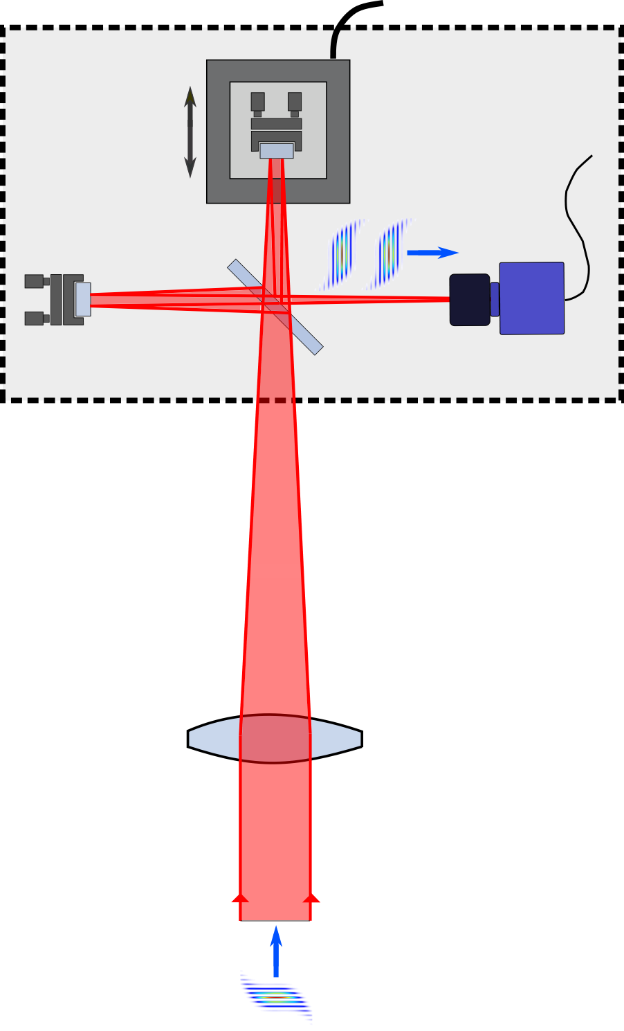
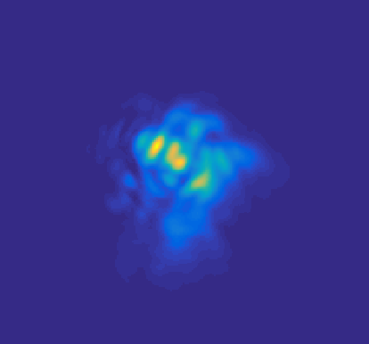
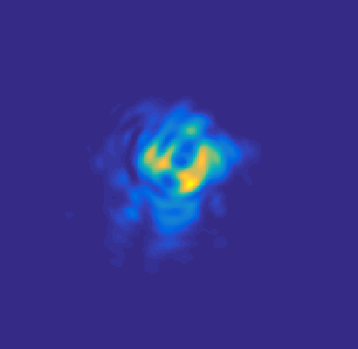
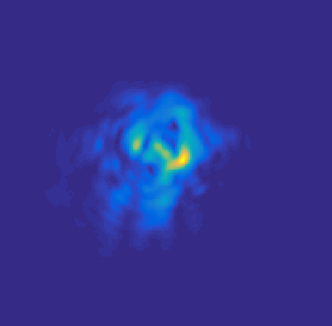
Principles of Measurements and Signal Processing
Amplitude profiles for each frequency
Piezo
z
Z +δz
GSA
ω
(at z₀)
ϕ(ω, r)+ α(ω)
(100’s to 1000’s shots)
ω
(at z₀+δz)
ϕ(ω, r)
9

Slide 10
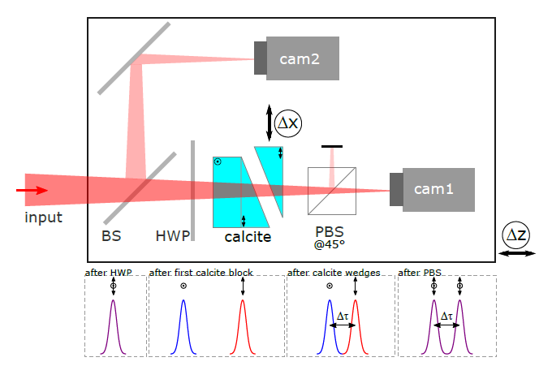
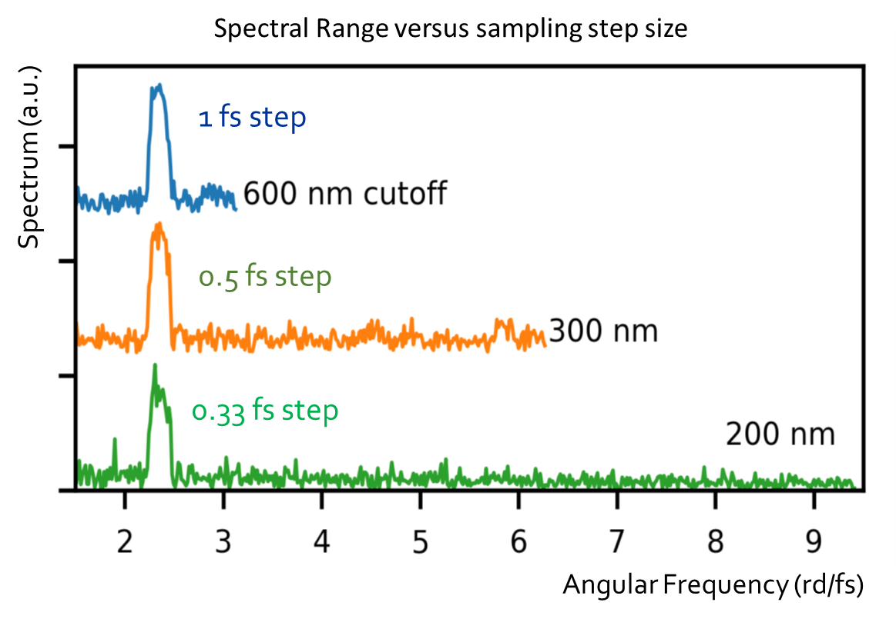
INSIGHT improvement : TWINS INSIGHT
R ≃ 125
10 to a few 10’s of shots – for low repetition rate
Sampling step stability improvement
(better quality spectrum reconstruction)
Possibility to decrease the sampling step
S.W. Jolly, O.Gobert, and F.Quéré, "Spatio-spectral characterization of ultrashort laser pulses with a birefringent delay line," OSA Continuum 4, 2044-2051 (2021)

Slide 11
Advanced metrology prototype for low repetition rate HP lasers : TWINS INSIGHT
SourceLab as a subcontractor of CEA in the framework of EURIZON project (prototype integration and test)
Already done :
Study of different ways to decrease the number of laser shots necessary to make a measurement of the full-field
Numerical simulation studies
Demonstration of the validity of the approach: experimental studies with different types of laser (TiS, Ytterbium)
Modification of the SourceLab software and test with an Astrella TiS laser
Remains to be done in 2023 :
Prototype of the TWINS INSIGHT integrated and tested with SourceLab software
Tests of the system for the characterization of the spatio-temporal couplings and full electric field reconstruction of a UHI laser with few shots

Slide 12
WP6 : Work progress
Task 6.1 – Towards the Schwinger limit : Intensity enhancement of high-power ultrashort laser beams using optically controlled curved plasma mirrors – completed
Task 6.2 – Advanced metrology of ultrashort laser beams – ongoing (40%)
- SourceLab SME subcontracted in June 2022
- numerical studies, control software & hardware provisioned
- prototype assembly and tests to be finalized in 2023
Task 6.3 – Training and scientific exchange – ongoing (66%)
- 2 training sessions organized (D6.1 & D6.3 submitted)
- additional training session to be organized in 2023

Slide 13
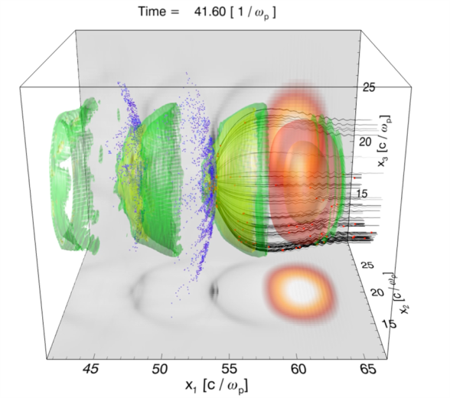
Training and scientific exchange – D6.1
Training event on "Modelling of ultra-intense laser propagation in plasmas and laser-plasma accelerators: fundamentals“
26-29 April 2022, online event Organised by GoLP/IPFN/Instituto Superior Técnico, Lisbon, Portugal
Format
4 days, 2 hour lecture per day, followed by remote hands-on sessions
Challenges and flash presentations of participants
Topics
PIC codes and ZPIC installation
Laser dynamics and plasma accelerators
Numerical modelling of laser-plasma interactions
Laser propagation in plasmas
Advanced Visualization and Data analysis
Target group
PhD students, post-docs, researchers in laser-plasma interactions
with both experimental and theoretical backgrounds
Participants
23 active attendees, 25% female
majority affiliated with Laserlab-Europe and ELI facilities
some from other European laboratories and Israel
3D Simulation of a laser wakefield accelerator

Slide 14
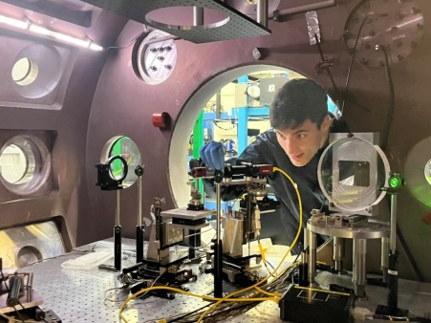
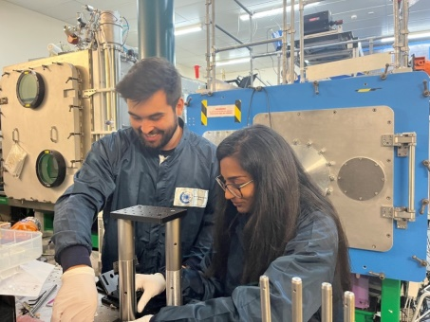
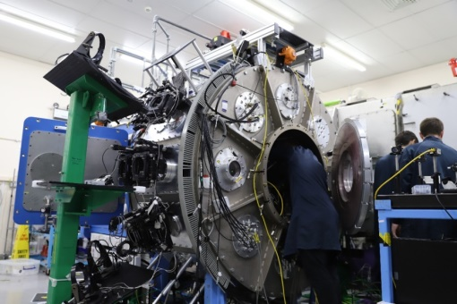
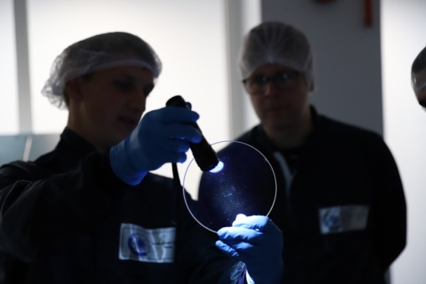
Training and scientific exchange – D6.3
Training Weeks on Experimental Laser-Plasma Physics
25 July - 5 August 2022 and 1-12 August 2022 Organised by the Central Laser Facility, Rutherford Appleton Laboratories, UK
Format
2-weeks courses, 4 students per course
Topics
basic skills for experimental laser-plasma physics
optical alignment
target manufacturing
setting up an experimental geometry
taking shots and analysing data
Participants
8 participants for the EURIZON weeks
affiliated with Laserlab-Europe and ELI-NP
majority 1st year and 2nd year PhD students
Week 1: basic elements of experiments
Basic optics and optomechanics
Imaging systems
Parabola alignment
Spectrometers
Particle diagnostics, e.g. Thomson Spectrometer, electron spectrometer, radiochromic film (RCF) pack design
Optics handling
Target fabrication
Week 2: bring the skills to the lab
build an experiment from scratch

Slide 15
WP6 : EURIZON Deliverables and Milestones
Deliverable / Milestone | Lead beneficiary | Status | Delivery date
D6.1 Training event on beam delivery and propagation at extreme intensities (M15) | LLE AISBL | Postponed to M30 by amendment due to COVID-19 travel restrictions | 10.08.2022
D6.3 Training event on pulse metrology, techniques and challenges (M28) | LLE AISBL | Postponed to M34 by amendment due to COVID-19 travel restrictions | 25.11.2022
MS32 Workshop : improving spatio-temporal metrology of high- power fs lasers (M36) | CEA | Workshop held on 12/05/2022 | 04.02.2023
D6.4 Conceptual design towards extreme intensities using plasma mirrors (M36) | CEA | Delivered | 04.02.2023
D6.6 Training event on pulse metrology, techniques and challenges (M42) | LLE AISBL | Pending | -
D6.8 Prototype for spatio-temporal metrology of high-power fs lasers (M48) | CEA | Pending | -
Thank you for your attention !

