Slide 1
ARES Operation Meeting
Summary of week 48 / 2022
Willi Kuropka, on behalf of the ARES crew

Slide 2
Summary of week 48
Mon | Tue | Wed | Thu | Fri
Cellar painting X-band cabling Scintillator BPM prototype installed FL screen station scintillator replaced | New FL scintillator tested Adjusted LLRF settings of the gun with Matthias (MSK) Tested scintillator BPM with Hossein | Work on BPM parameters by Bastian (MDI) Testing large beam sizes in FL section Acquired charge vs. pharos user attenuator data for gun simulations SH.E2 screen charge calibration test | Characterizing beam in low energy section AutoAcc:Continuing BO vs. RL studies at higher charges for space charge influence | Tunnel search training Gun beam characterization Charge map tool testing TWS2 phase correction doocs server/panel tests Pulse shot mode and charge counter tests
Tunnel open | Gun modulator charge voltage is limiting klystron output | Increased gun modulator charge voltage in 5V steps during the day Then increased gun SP over night |  | DAQ configuration/tests by V. Rybnikov Tunnel opened for the weekend
Achievements
Difficulties
Notes

Slide 3
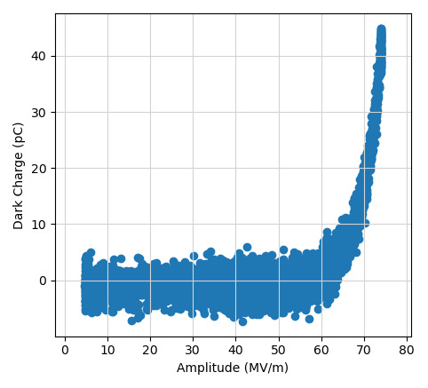
Recent dark charge measurement
Still old low level RF settings

Slide 4
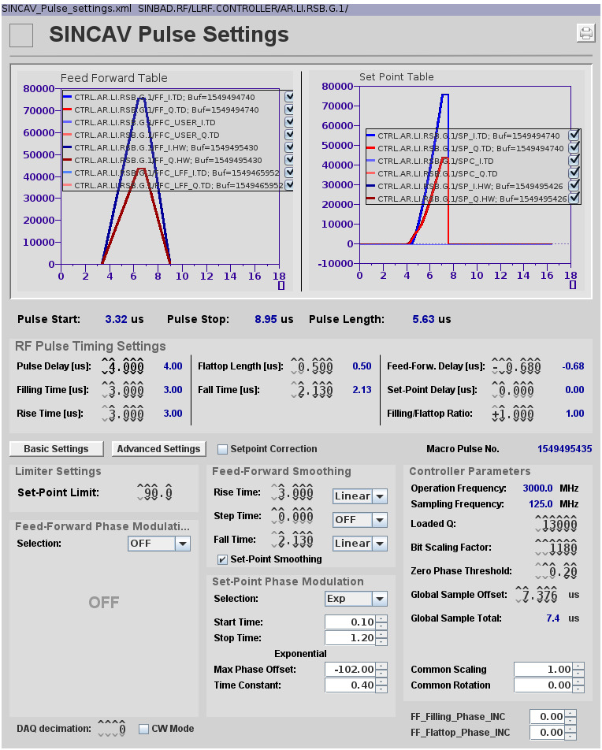
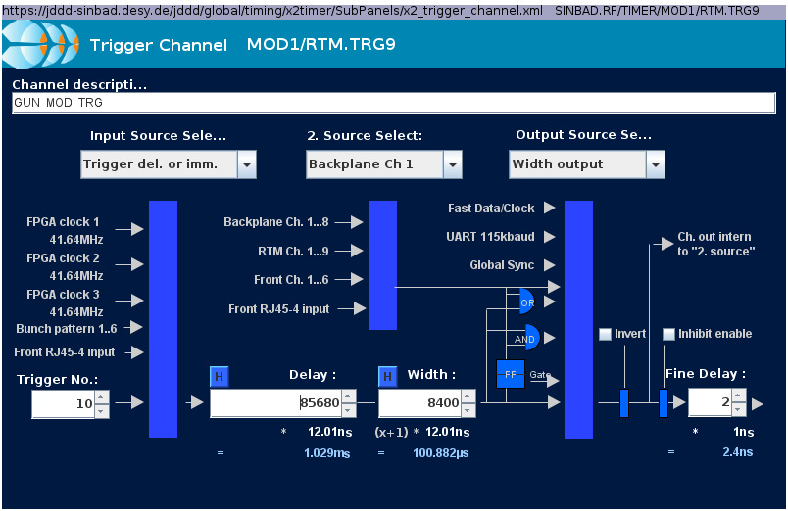
Adjusted gun pulse settings and moved modulator pulse timing
New settings

Slide 5
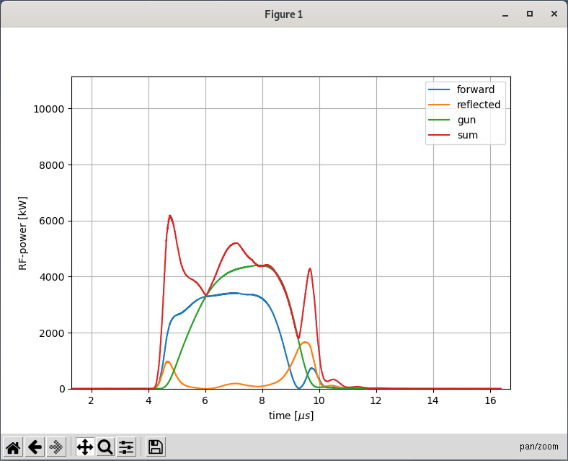
Gun power signals after pulse shape and timing optimization

Slide 6
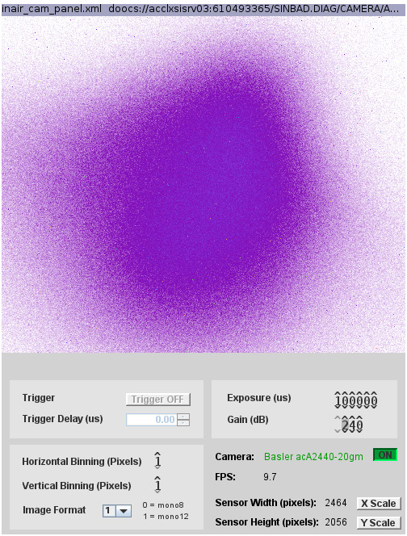
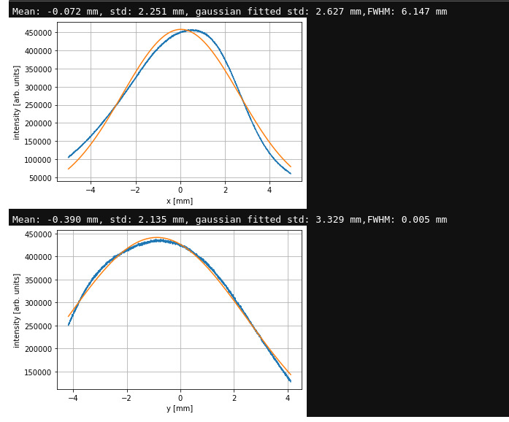
Larger beam size in FL section

Slide 7
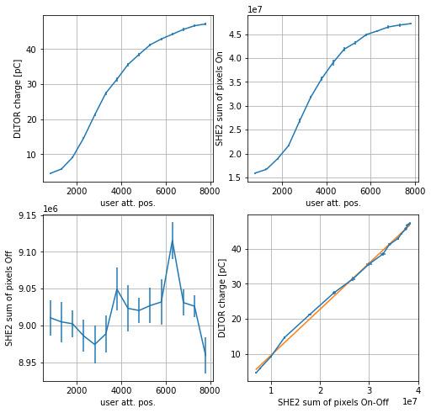
Screen charge calibration
 | We tested the routine for different binning and gain settings of the camera as well as for different charge ranges. Unfortunately, the values are inconsistent and need further investigation.

Slide 8
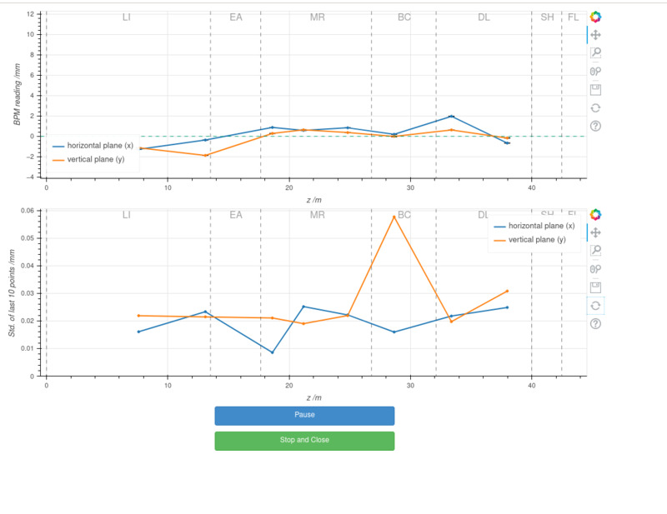
Orbit live tool

Slide 9
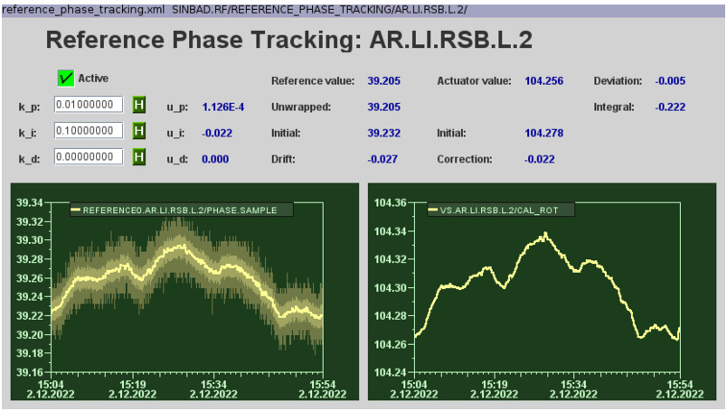
TWS2 reference phase tracking panel

Slide 10
Today
MIN cabling work for PolariX
Painting of modulator cellar
MCS work

Slide 11
Plan for this week
Establish larger beam size in FL section
Wednesday MDI intensity monitor tests
Thursday AutoAcc
Friday visit by CLARA operation lead
Friday arrival time stability measurement

Slide 12
Schedule
Week 49
Date | Schedule
05.12. | Tunnel open
06.12. | Willi Kuropka
07.12. | Frank Mayet
08.12. | (Hannes Dinter)
09.12. | Thomas Vinatier
If you want to learn or join the shift: please give the shift leader a call (BKR 2840 / SINBAD Box 2454)

