Slide 1
FLUKA studies with the 3 dumps 2nd update
Stewart Boogert, Kyle Fleck
21/12/2022 LUXE simulation meeting

Slide 2
Introduction
Need for FLUKA simulations
  Trusted for radioprotection
  Especially low energy hadronic processes
  Cross check of Geant4 simulations (lxsim)
  (Re-)start detailed dump simulations (G4/Fluka)
Excellent starting point from Kyle Fleck (QUB)
  Three configurations (elaser, glaser, nomagnet)
  Pyg4ometry converted GDML with hand added DEFAULTS, BEAM, BEAMPOS, MGNFIELD, USRBIN, USRBDX, RANDOMIZ, START
  Included small hand edits for Gamma detector
Improvements
  2M histories per configuration (1M/3 hours on NAF)
  Proper comparison with Geant4
  New analysis scripts with deal with LXSIM and FLUKA data in completely even way
  Inclusion of electro- and photo-nuclear processes (FLUKA mainly on)
  Understanding of the neutron transportation in FLUKA
https://github.com/LUXEsoftware/lxflusim

Slide 3
Reminder slides

Slide 4
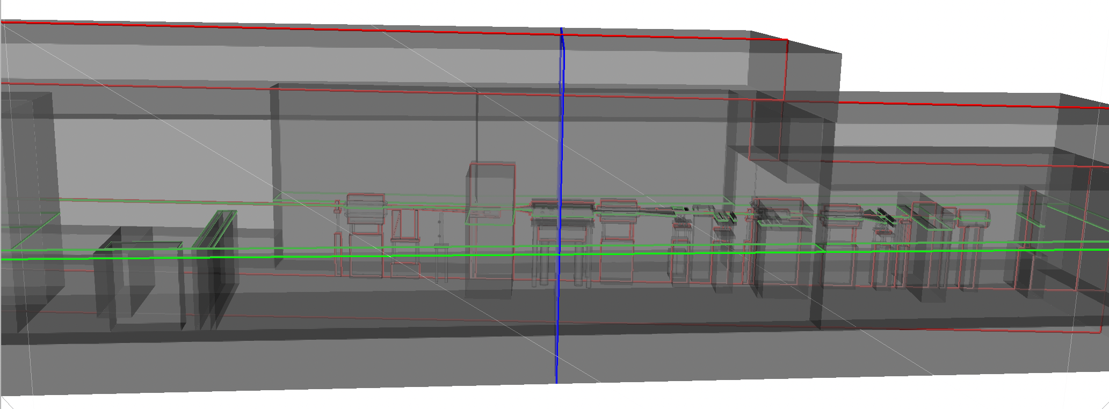
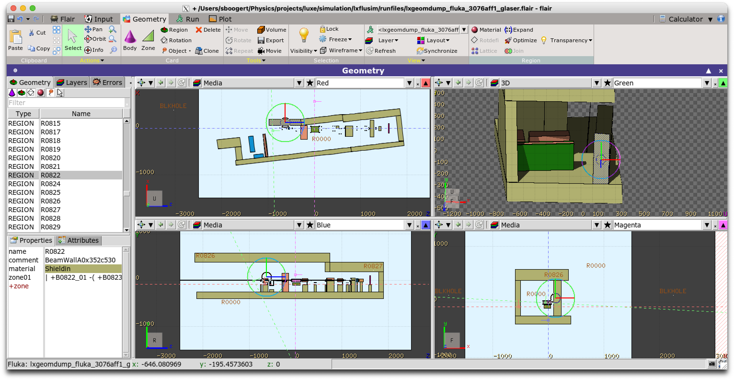
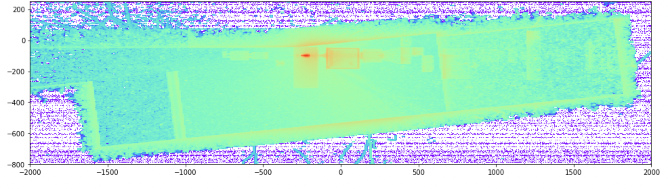
FLUKA workflow
GMDL/pyg4ometry
Run lxsim and generate GDML geometry
Convert lxsim GDML geometry to FLUKA
Augment with control cards (BEAM, BEAMPOS…etc)
Run FLUKA jobs
Merge output from all jobs (utilities provided by Fluka)
Plotting in matplotlib and/or VTK (pyvista)
  Output are 3d histograms or spectra.
  Binning x [-800,400], y [-250,250], z [-2000,2000], 400
Flair
Fluka output
https://bitbucket.org/jairhul/pyg4ometry/

Slide 5
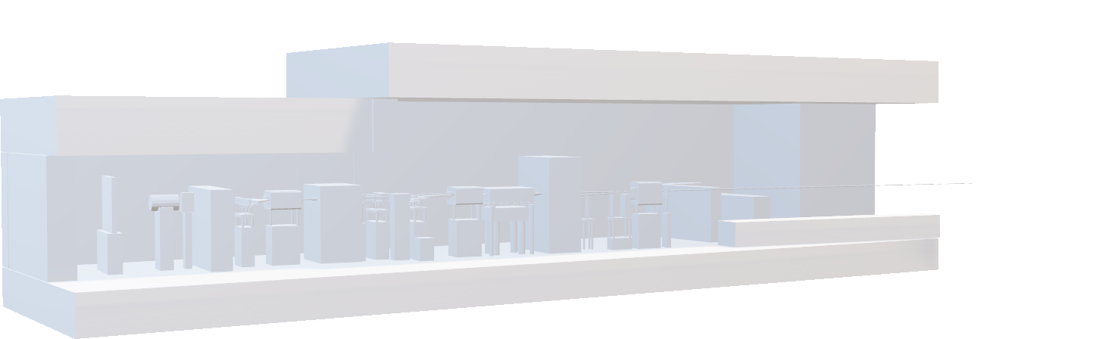
Pyg4ometry (showing off)
https://bitbucket.org/jairhul/pyg4ometry/src/develop/
https://pypi.org/project/pyg4ometry/

Slide 6
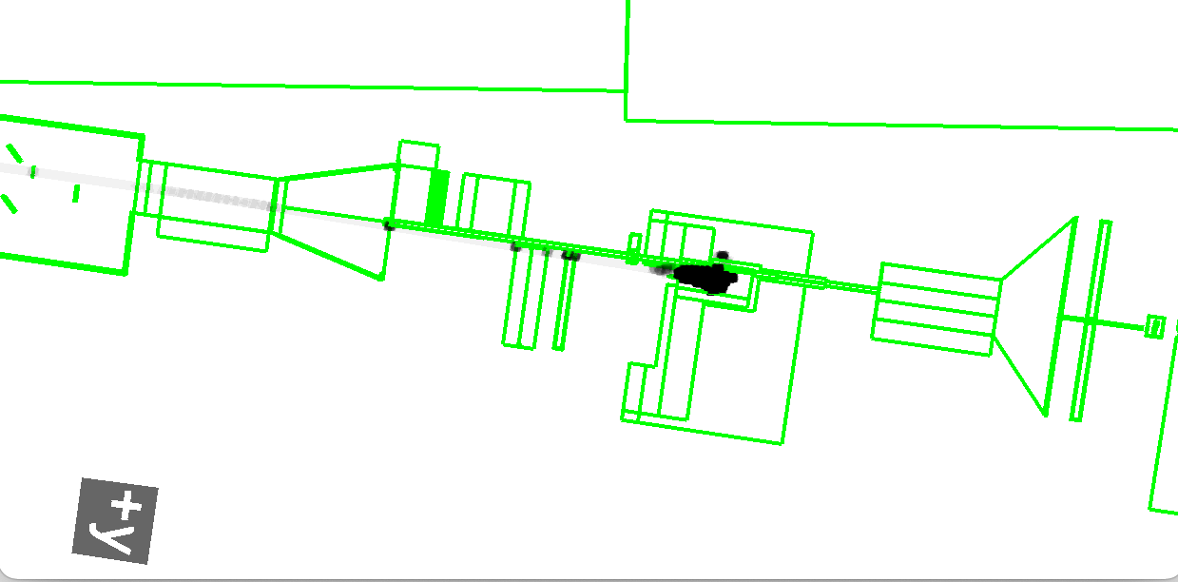
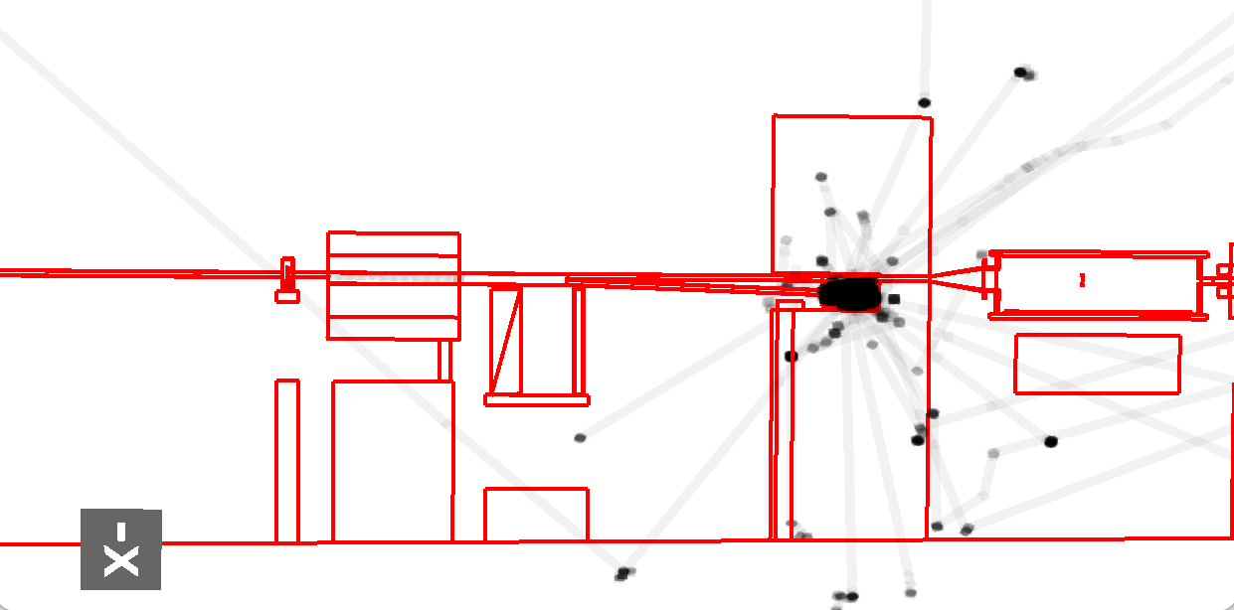
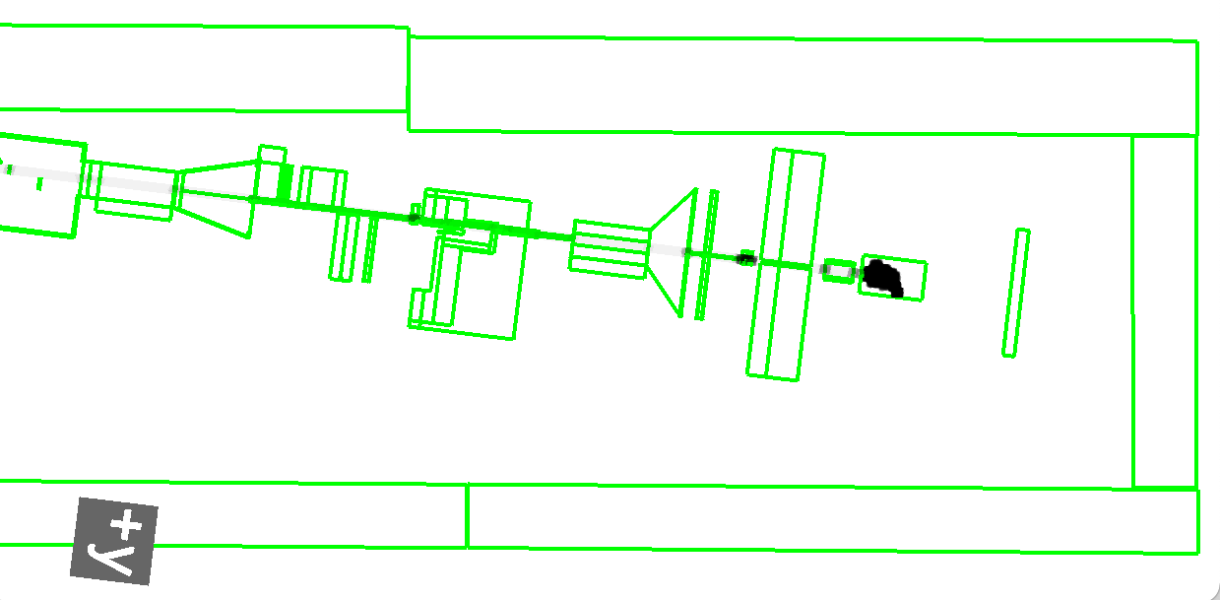
Model verification
Electron-laser
Geometry
  Very advanced conversion (written by me for another project)
  Flair (GUI for FLUKA) would indicate geometry errors (overlaps)
Materials
  Converted from Geant4 down to isotopic composition
  Hard to independently check (could with simplified models i.e a block of material in G4/Fluka)
Magnetic fields (3 important)
  Track test particles and dump all trajectories (see right)
Gamma-laser
No magnets

Slide 7
Scoring distribution comparison (g-laser)
Plan view of different scoring maps for g-laser configuration.
edep
gamma
em-edep
neutron
dose
proton
elec
muon-
pos
muon+

Slide 8
FLUKA neutron transport

Slide 9
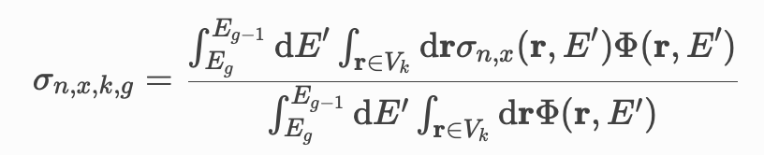
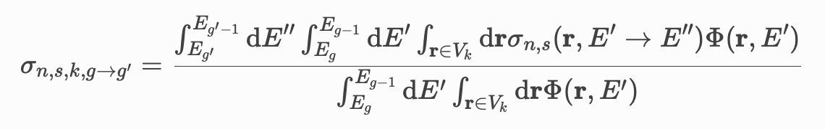
Point like/Multigroup transportation
FLUKA uses both continuous and discontinuous neutron transport
  Mutligroup does not simulate elastic and inelastic exclusive processes
  Divides neutrons into 260 energy bins (groups) and simulates group to group transfer probabilities (10⁻¹⁴ to 2 x 10⁻² GeV)
  Energy boundary for 260 multigroup is 20 MeV
Potentially could expect a difference for low energy neutrons
Pointwise transportation still possible with the
  LOW-NEUT and LOW-PWXS cards
  LOW-PWXS uses ENDF libraries like JEFF, ENDF, JENDL, CENDL, BROND
Cross section for group g, for space point r, for region V_{k},
Multigroup scatting matrix
https://docs.openmc.org/en/v0.12.1/examples/mgxs-part-i.html

Slide 10
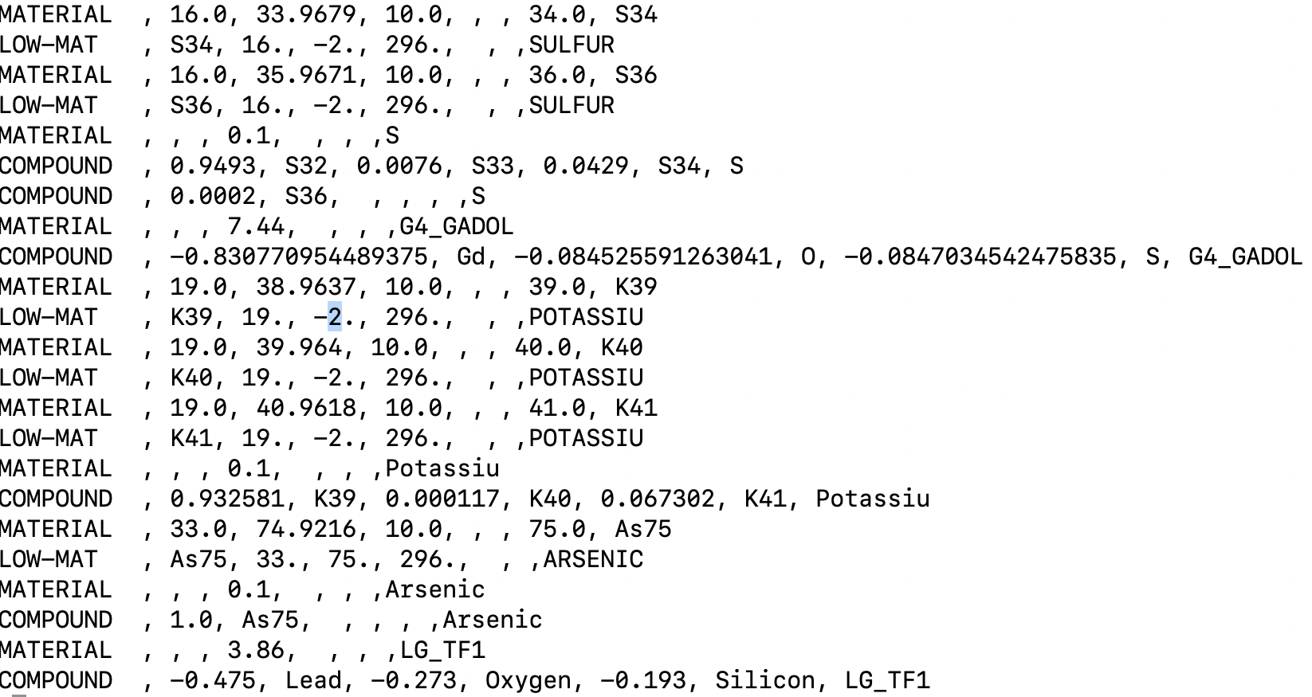
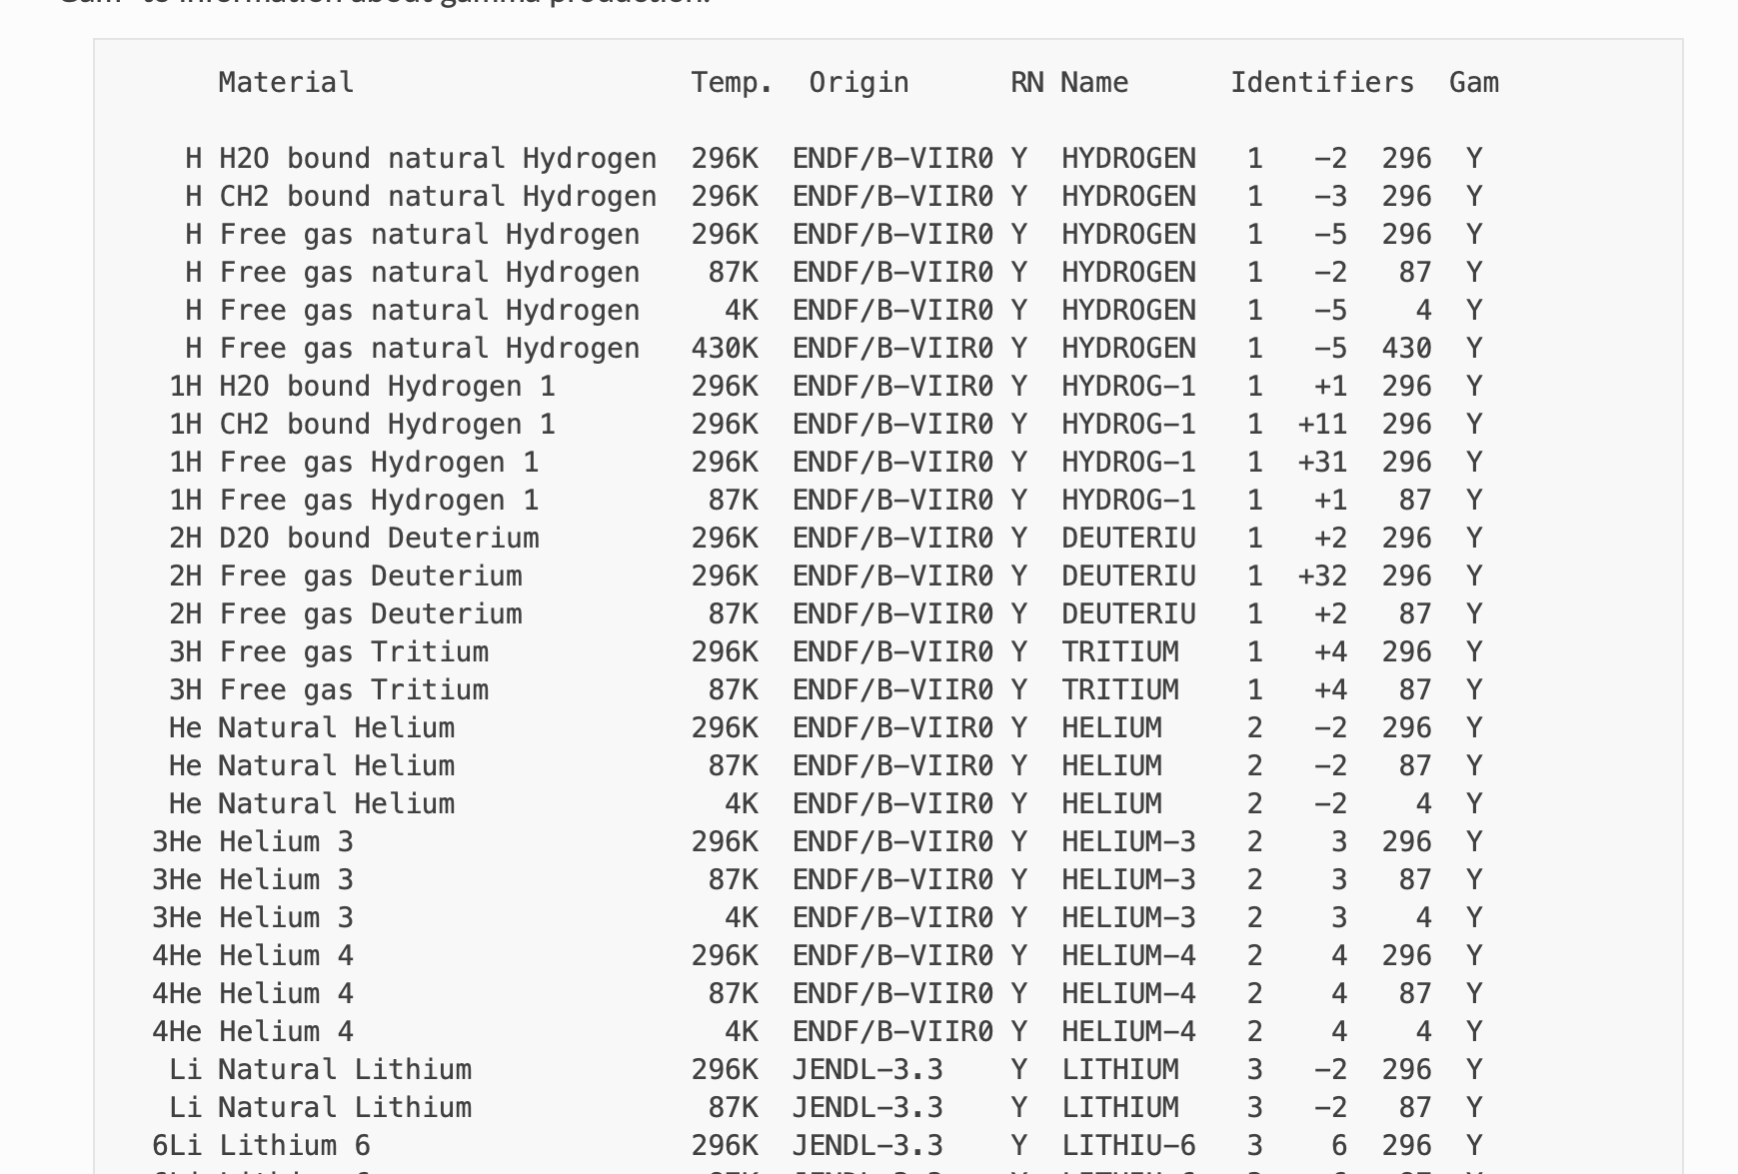
Low energy neutron cross sections
FLUKA input
G4 and FLUKA need to assign material (atomic number, mass number, density, state, temperature etc).
Possible to directly convert this information between G4 and FLUKA
Low energy neutron cross-sections/transportation are a different matter
Hand implemented by Kyle
Need automatic assignment and checking of validity
FLUKA mats

Slide 11
New results

Slide 12
3D neutron fluence (gamma-laser)
2D sections around maximum bin

Slide 13
Comparision between FLUKA and G4 (gamma-laser)
1D section (single line of bins) around maximum bin
x
y
Neutrons/mm²
z
Photo-nuclear processes
(missing in the last presentation)

Slide 14
Comparision between FLUKA and G4 (gamma-laser)
2D section (plane of bins) around maximum bin (@ centre of e- dump)
Horizonal section
FLUKA
LXSIM/G4

Slide 15
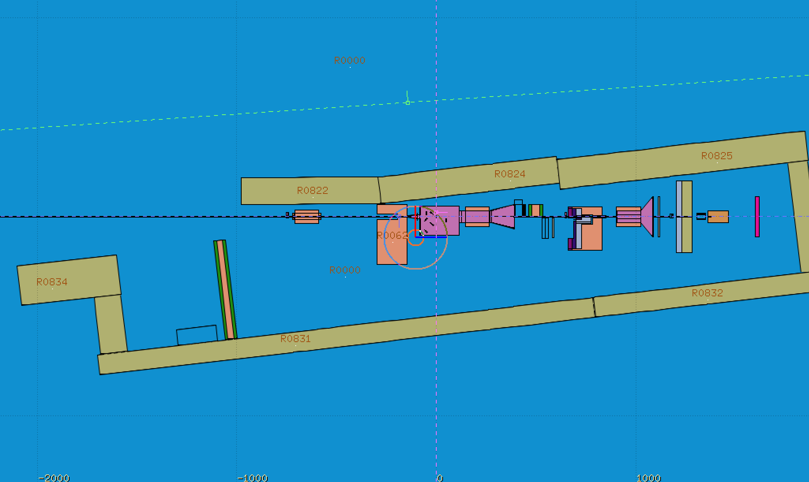
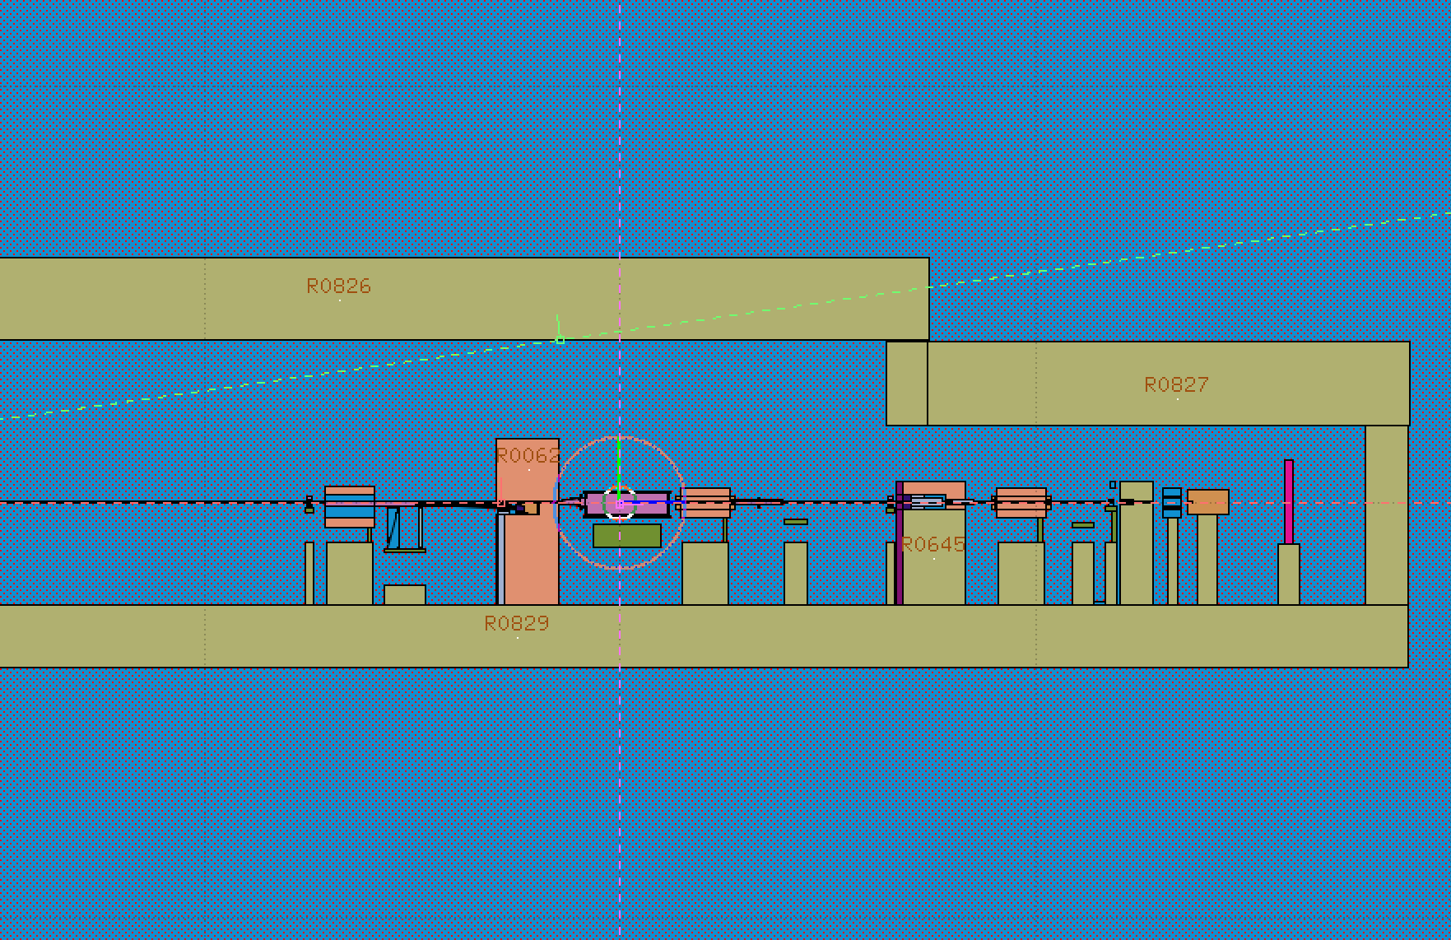
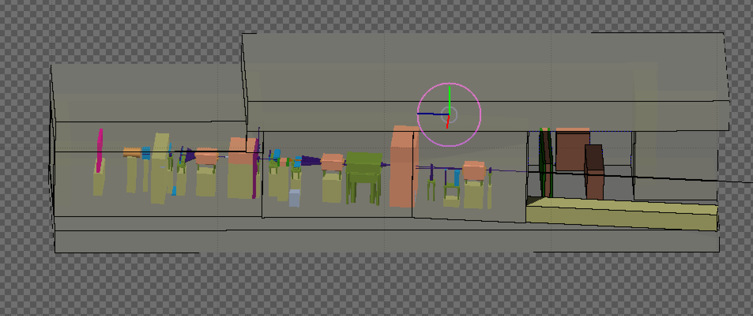
Locations sampled for neutron fluence
Plan
Elevation
W3
C1
W1
W2
c3
W8
W4
c2
W4
W7
W5
W6
F1
W1-8 : Walls
C1-3 : Ceiling
F1 : Floor
R1: XFEL dump rack
R1

Slide 16
XFEL rack spectrum
Compare R1 neutron spectrum

Slide 17
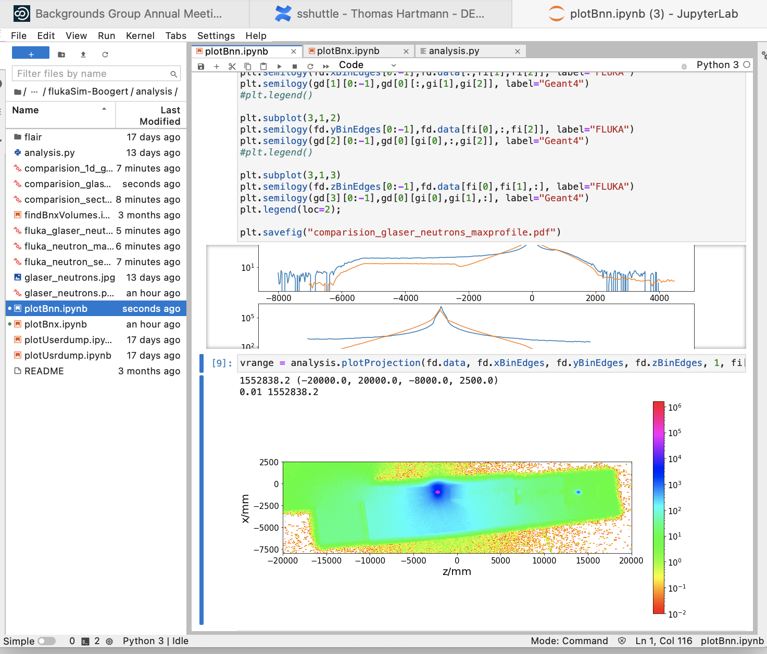
Access to results (juypter on NAF)
All data on NFS
Simple and fast python library and jupyter notebooks
Locations
Data: /nfs/dust/luxe/user/sboogert/01_luxe_fluka/output/
Scripts:
/nfs/dust/luxe/group/MCProduction/tmp/flukaSim-Boogert/analysis/
If you require access let me know

Slide 18
Summary
Next steps
Compare all configurations (e-laser, no-magnet)
Compare all particles (e^{+/-}, photons, protons, muons, etc)
Compare all critical areas (fluence and spectrum), so XFEL racks etc.
Automate low energy neutron cross section assignment
Check other neutron transportation in FLUKA (Pointwise transportation)
Other related study
Dumps (starting with final dump)
Likely to resolve some of the neutron differences (source of the difference)

