Slide 1
ARES Operation Meeting
Summary of week 49 / 2022
Blae Stacey, on behalf of the ARES crew

Slide 2
Summary of week 49
Mon. 5th December | Tue. 6th December | Wed. 7th December | Thu. 8th December | Fri. 9th December
MIN cabling work for PolariX; Painting of modulator cellar; MCS work | Beam characterisation in low energy section; Checking BC collimators influence on DC at the end of the beam line; Maximising beam size in the FL section (measured beam size with FL screen and wire scanner). | Beam characterisation at high energy; Measuring dark charge and comparing to FL BLM; Quick pulse shot mode test (using MCS panel); Measuring beam sizes in FL section at high charge; FC amplifier and tuning discussion with Timmy (MDI). | AutoAcc measurements – RL vs BO for further charges; New button on the cockpit panel, to save machine file with the current settings and prints the file location to logbook; New Save button in scan tool to save current state of the scan tool as a preset. | ARES visit by CLARA; Low charge set-up; Arrival time stability measurement.
 | FL section BLM position probably needs adjusting to increased signal to noise for the new stage position.
 |  | Adjust RF setting to use lower bunch charge |  | Tunnel open over the weekend
Achievements
Difficulties
Notes

Slide 3
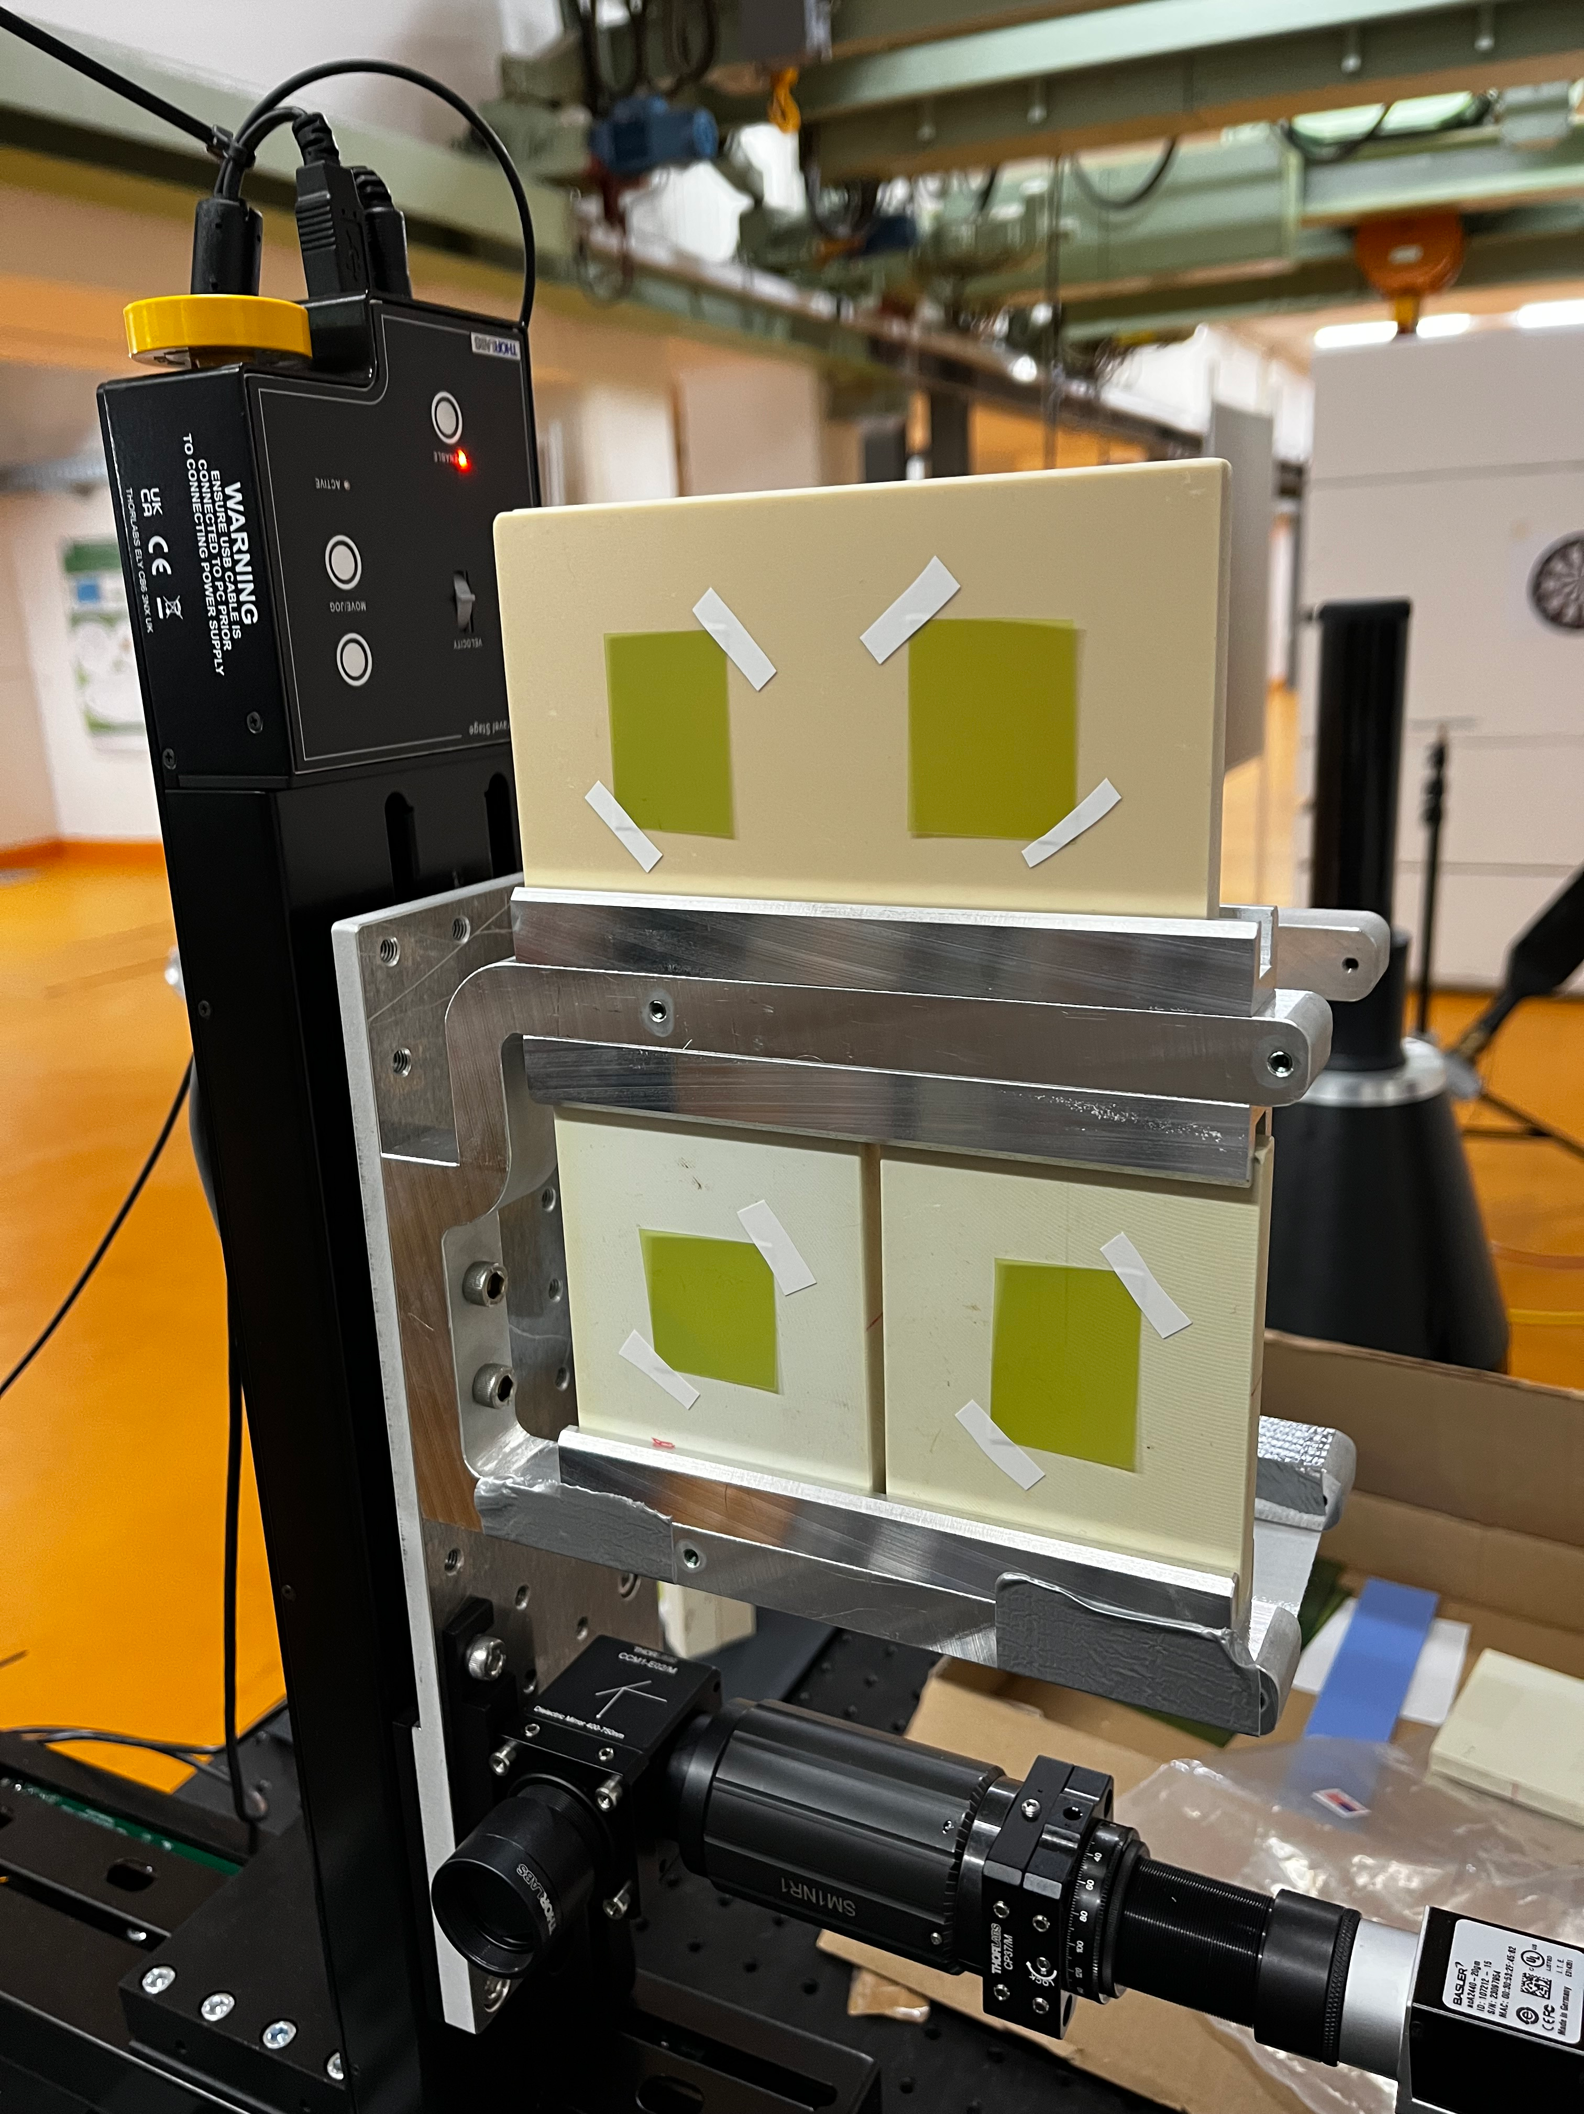
New UKE targets installed

Slide 4
Plan
Week 50
Monday
  Tunnel open
    MEN cabling work
    Installation of new UKE targets
Tuesday
  Charge counter server tests
  Autonomous Accelerator workshop at ARES with MSK and KIT
Wednesday
  ARES visit from UKE (tunnel open)
  Irradiation beam time for UKE targets
Thursday
  Maybe MDI
Friday
  Maybe MDI

Slide 5
Schedule
Week 50
Date | Schedule
12.12. | Tunnel open
13.12. | Willi Kuropka, Frank Mayet (?)
14.12. | Frank Mayet, Willi Kuropka
15.12. | Thomas Vinatier, Hannes Dinter (?)
16.12. | Thomas Vinatier
If you want to learn or join the shift: please give the shift leader a call (BKR 2840 / SINBAD Box 2454)

