Slide 1


XFEL Operation Modes
Winni Decking
XFEL Machine Layout Coordinator
RF Synchronisation Users Meeting, 25.11.2010
Notes:
How to edit the title slide
Upper area: Title of your talk, max. 2 rows of the defined size (55 pt)
Lower area (subtitle): Conference/meeting/workshop, location, date,
your name and affiliation,
max. 4 rows of the defined size (32 pt)
Change the partner logos or add others in the last row.

Slide 2
Pulse Patterns
Assumption: linac is most stable with constant bunch pattern/beam loading
Pulse switching is done with fast kickers
Both beam lines have same bunch properties
Options:
  All pulses in one beam line (max. beam power 300 kW !)
  One split per pulse into two beam lines
  Arbitrary patterns in each beam line
  Closely spaced bunches by splitting RF laser

Slide 3
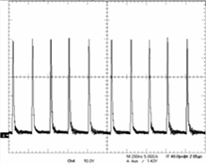
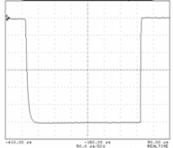
Pulse pattern creation
4.5 MHz Dump Kicker
5 MHz Dump Kicker
Gun Linac
5MHz Dump Kicker
(pulse pattern)
(pulse pattern)
(Pulse pattern)
Dump
Flat Top Kicker (pulse width 290 μs)
a)
Dump Gap
< 20 μs
290 μs
μ
600
μ
600
s
650us
s
low accuracy
(>1 %)
4.5 MHz burst operation
200 ns
high accuracy
(< 0.01 %)
10 Hz operation
300 μs
example:
pulser prototype measurement
example:
pulser prototype measurement

Slide 4
More Pulse Pattern creation
SASE 1 / 2 undulator
Fast Kicker
Corrector
Corrector
Reasonable in one undulator only if L_{und}>L_{sat}
Bunch to bunch switching possible
Separate beam lines (θ ≈ 10 μrad) possible ?
‘De-coupled’ operation of SASE1 and SASE3 obviously possible

Slide 5
Energy Variation – Within Bunch Train
E₀+1.5%
ΔE/E_{max} = 3 %
E₀
E₀-1.5%
280 μs
1350 bunches
SASE1, SASE3
280 μs
1350 bunches
SASE2, UN1, UN2
ΔE/E = + 10⁻⁴ / μs
- 10⁻³ / μs
E₀+1.5%
20 μs
E₀
20 μs
E₀-1.5%
300 μs
1350 bunches
SASE1, SASE3
300 μs
1350 bunches
SASE2, UN1, UN2

Slide 6
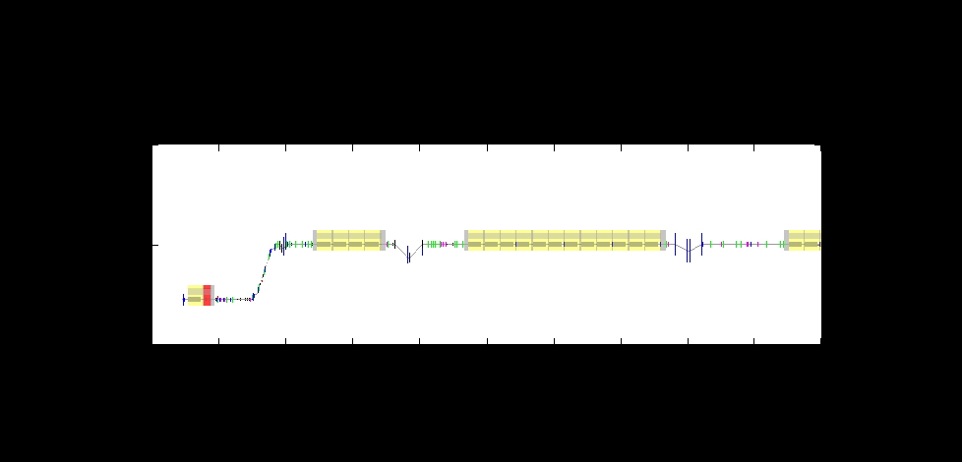
Bunch Compression System Overview
σ_{σ} = 2 mm
I_{peak} = 50 A
σ_{Ε} = 0 %
σ_{σ} = 1 mm
I_{peak} = 100 A
σ_{Ε} = 1.5 %
σ_{σ} = 0.1 mm
I_{peak} = 1 kA
σ_{Ε} = 1 %
σ_{σ} = 0.02 mm
I_{peak} = 5 kA
σ_{Ε} = 0.3 %
4 accelerator modules
12 accelerator modules
3rd harm.
module
diagnostics
diagnostics
gun
dogleg
R56 = 0
bunch
compression
chicane
R56 = 60-120 mm
E = 130 MeV
R56 = 60-120 mm
E = 500 MeV
R56 = 30-100 mm
E = 2000 GeV

Slide 7
Bunch Compressor Chicanes
Chicane | Minimum R56 [mm] | Maximum R56 [mm]
BC0 | 0, 60 | 120
BC1 | 60 | 120
BC2 | 30 | 100
 | Δt [ps]
BC0 | 200
BC1 | 100
BC2 | 120

Slide 8
Bunch Compression at different charges

Slide 9
Bunch Compression at different charges

Slide 10
Summary
Baseline layout assumes constant linac and bunch compression parameters
But, in 2015 multiple users will require full flexibility of XFEL
  Different bunch length/charges pulse to pules or even within pulse
  Different energies
  ….
Operating options with fast varying compression schemes (i.e. only RF variation studied next)

Slide 11
Summary cont.
Full tuning range of BC chicane has to be maintained
XFEL optimized for minimal peak current jitter, not timing jitter
  With nominal bunch compression setting (Σ R₅₆ ≈ 150 mm) and 1e-4 RF amplitude stability Δt ≈ 50 fs

