Slide 1
Electromagnetic calorimeters with small Moliere Radius
Wolfgang Lohmann
BTU, DESY and RWTH

Slide 2
Motivation
Forward region of an e+e- collider detector
LumiCal for precise
luminosity measurement
(Counting Bhabhas)
BeamCal for fast luminosity
Measurement
(using beamstrahlung)
Both for large polar angle
coverage
(important for new particle
searches)
Small Moliere radius
High granularity

Slide 3
Motivation
Lessons from ILC BeamCal simulations
Average the background depositions for 10 BX per pad
Subtract them from a signal event
Search for a local shower in the remaining depositions
Local deposition of a single electron
▼50 GeV
100 GeV
250 GeV
Efficiency depends on the
Relative fraction of the depositions

Slide 4
Motivation
Positron detection in LUXE ECAL
Low ξ: non, one or a few positrons
Single shower reconstruction on top of wider spread background
Small Moliere radius, compact calorimeter
High granular sensors

Slide 5

Motivation
$$L=\frac{N_{BH}}{σ_{BH}}$$
Number of Bhabha events in a certain θ range
Luminosity measurement
Bhabha cross section
range
How to control the range?
Sharp edges
Small leakage
Important in case limited space available

Slide 6
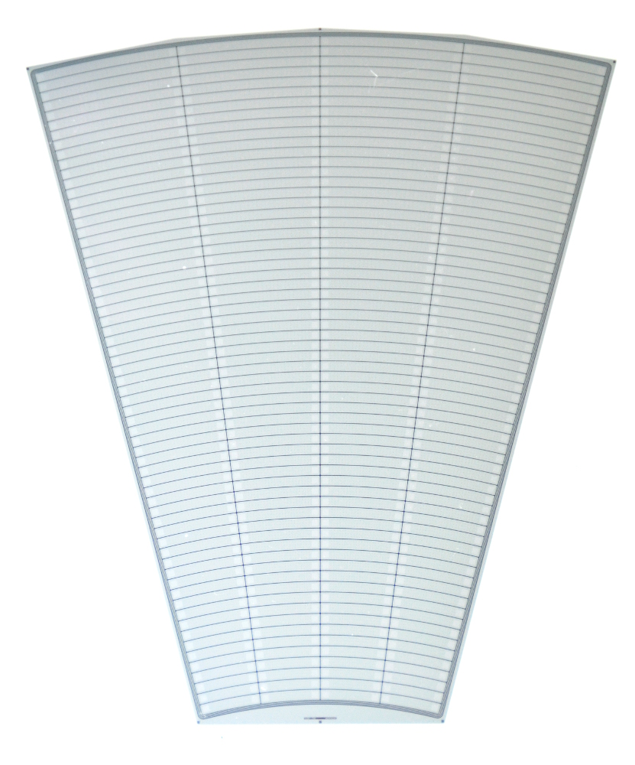
Technology
Si/W sandwich calorimeter
Thickness 320 μm
p⁺ in n
DC coupled to FE
Outer active radius R = 195.2 mm
Inner active radius R = 80.0 mm
Si sensor prototype
Full depletion at 60-70 V

Slide 7
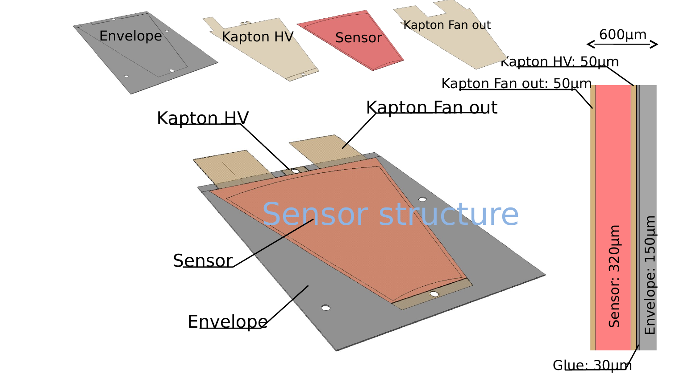
Technology
Si/W sandwich calorimeter
Thin sensor planes (< 1mm)
Readout via copper traces on flexible Kapton PCB

Slide 8
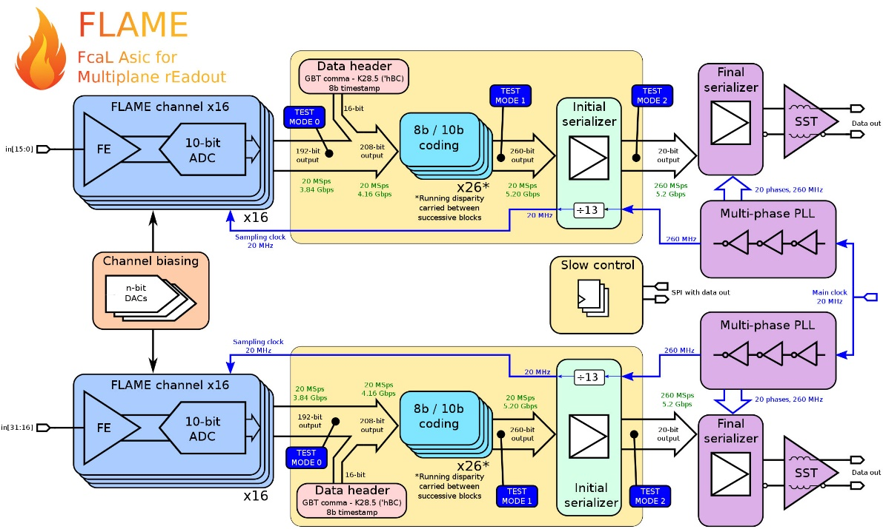
FE electronics
Dedicated FE electronics in 130 nm TSMC
Variable gain (MiP sensitive)
10-bit SAR
Peaking time 55 ns
Power dissipation
2 mW per channel
Signal processing using FPGA
More details in the talk by Marek Idzik in WP11

Slide 9
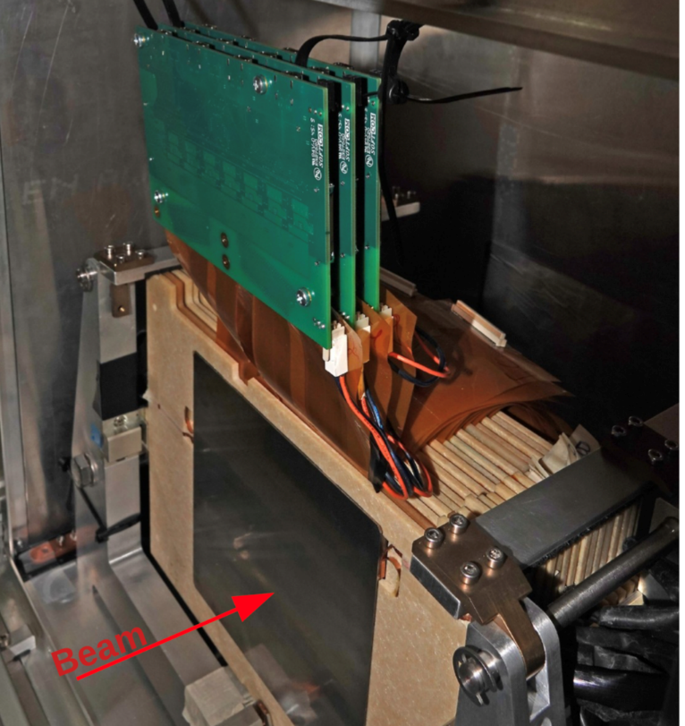
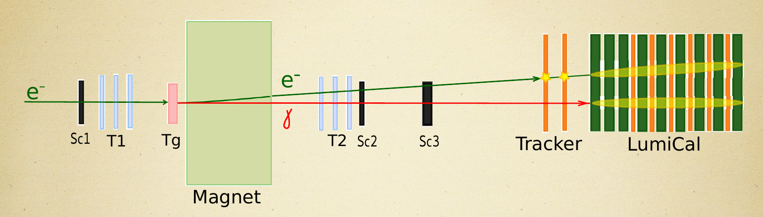
Prototype
LumiCal prototype
20 sensor planes
Partly instrumented with FLAME ASICs
Longitudinal shower dvelopment

Slide 10
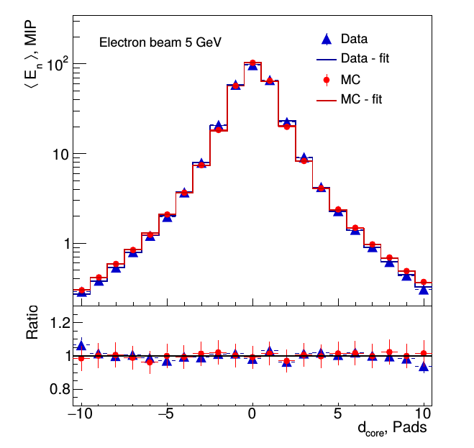
Moliere radius
Effective Moliere radius: ~ 8 mm (5GeV)
approaching the technological limit
Position resolution : ~ 0.5 mm (5 GeV)
Energy dependence of R_{M} due to limited number of sensor planes
Published in: Eur.Phys.J.C 79 (2019) 7, 579

Slide 11
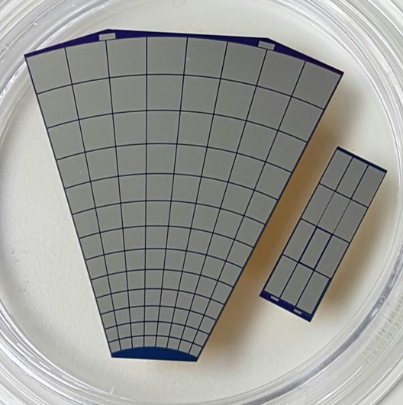
GaAs sensors
Within FCAL many years ago a collaboration with Tomsk State University was established for the development of high resistivity GaAs sensors
Measurements in the lab and in previous test-beams (2011) were very promising
Sensor thickness 500 μm
Resistivity 10⁹ Ωm
Bias voltage 100 V
Leakage current O(100nA) per pad
S/N ≈ 20

Slide 12
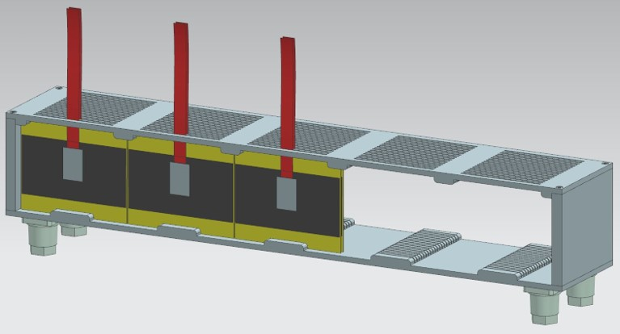
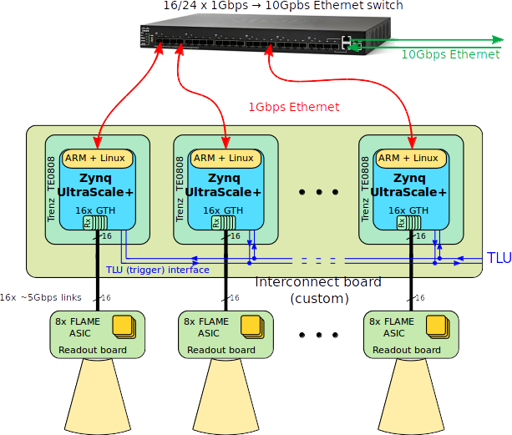
LUXE ECAL-P
ECAL-P concept
GaAs/tungsten sandwich calorimeter
Frame aluminum, fiducial volume
53x5.2x9 cm³
20 tungsten plates 1 X₀ thick
GaAs:Cr sensors 550 μm thick, 52x76 mm²
area
FE ASICs FLAXE (derived from FLAME) on top of ECAL
FPGAs for orchestrating the read out and preprocessing in a rack a few m away
TLU trigger and readout adapted to EUDAQ
To be updatedold figure,
but shows the principle

Slide 13
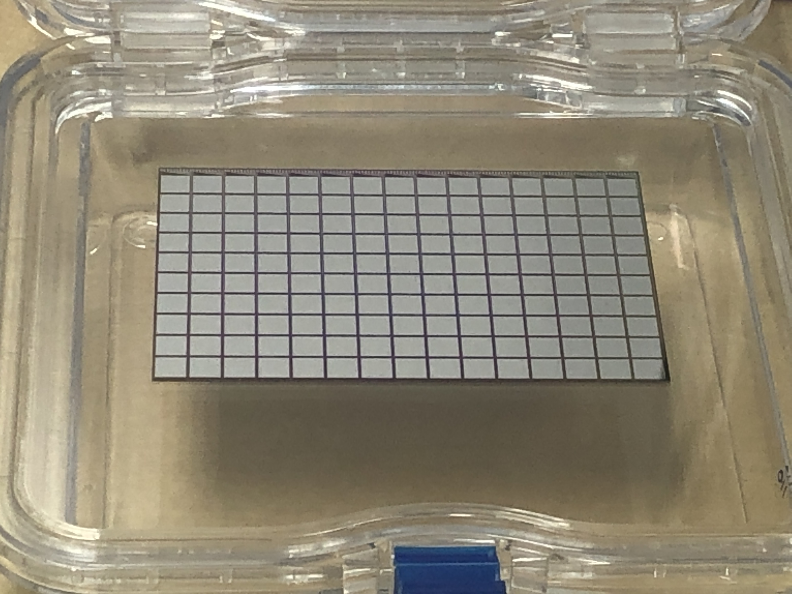
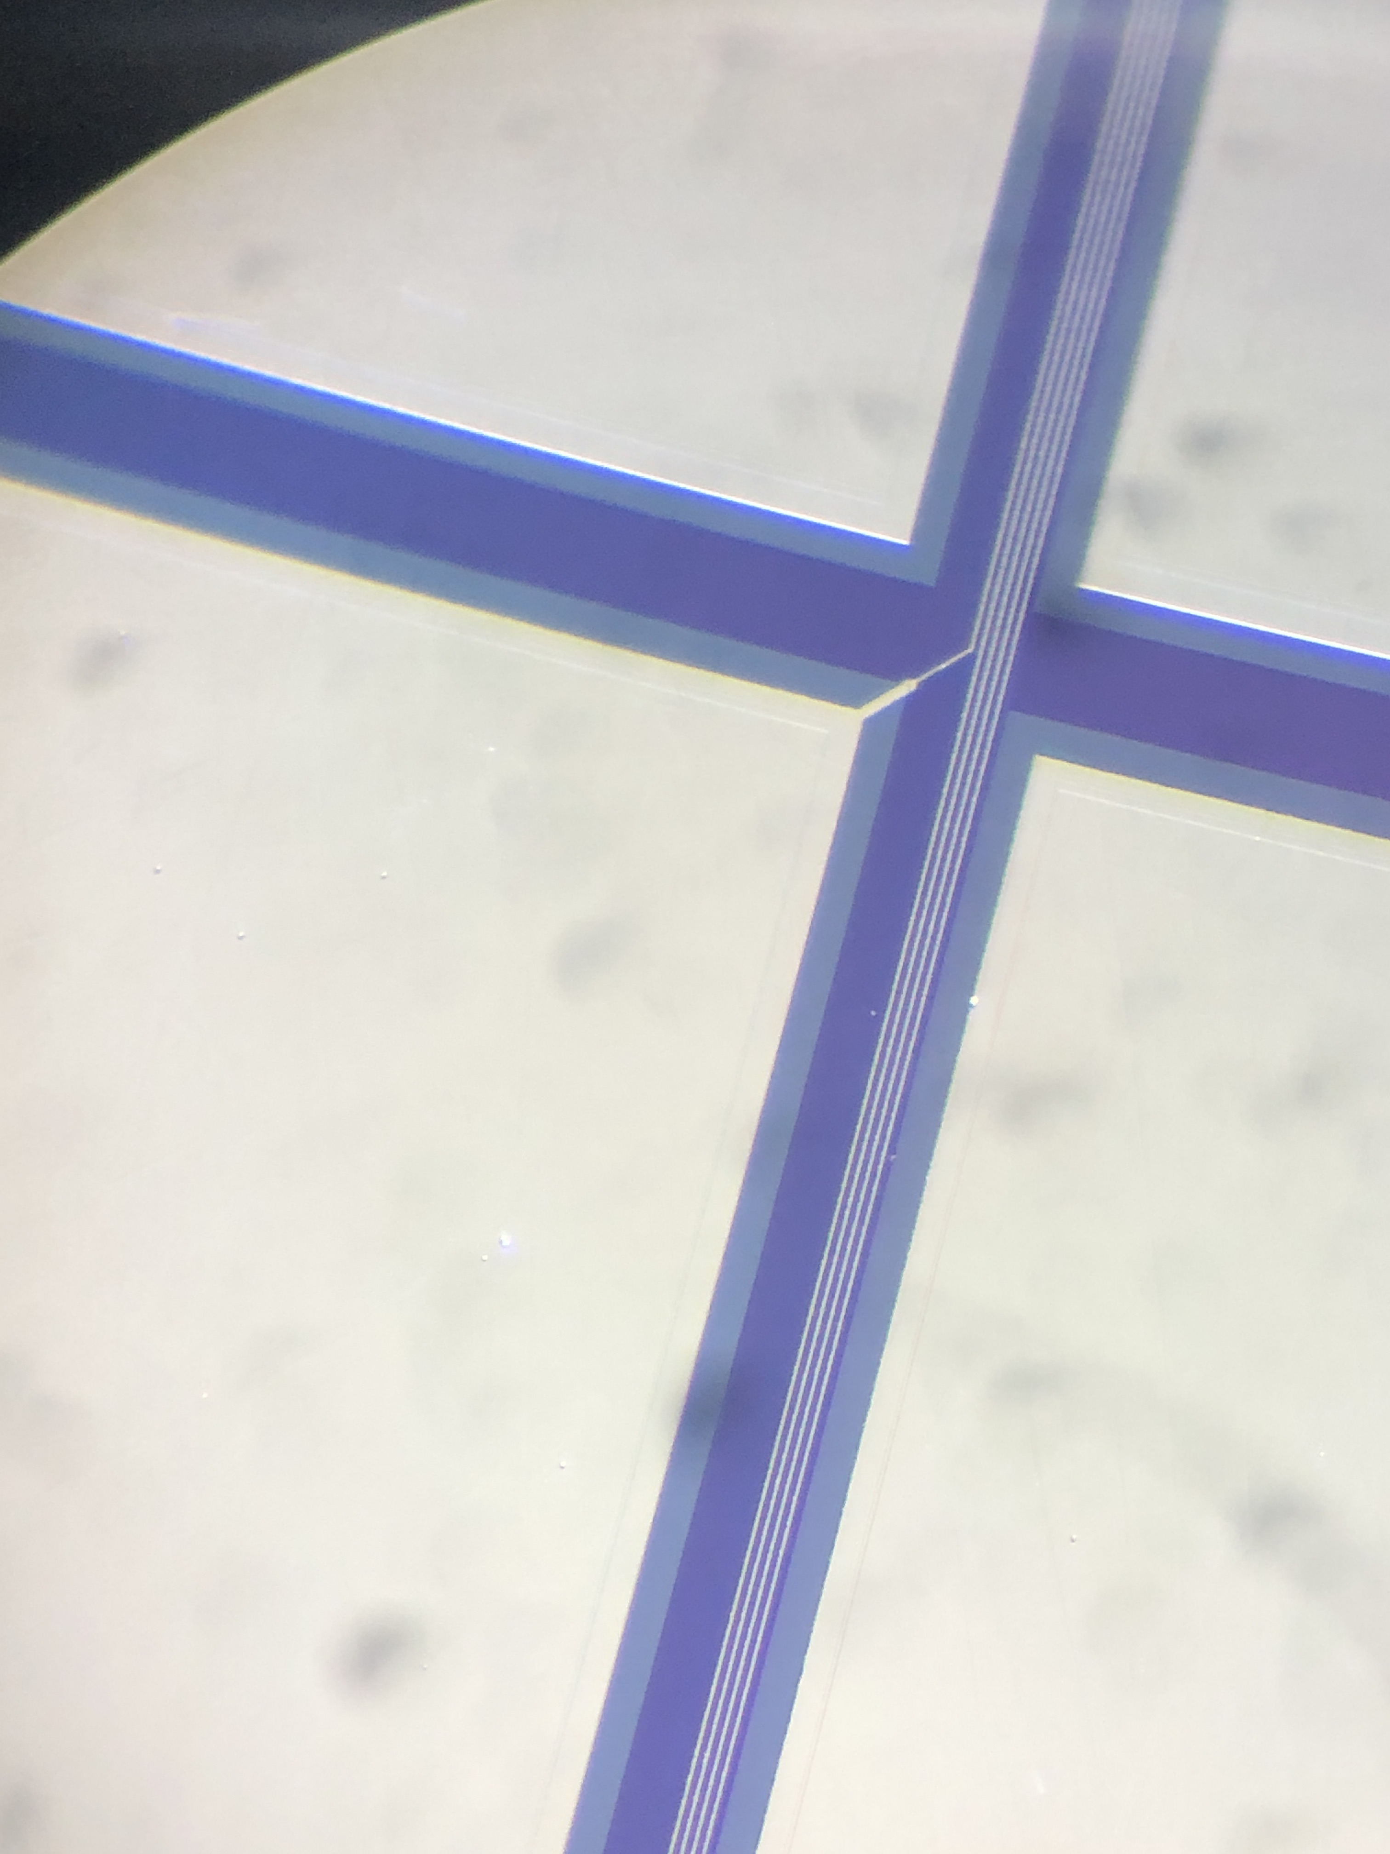
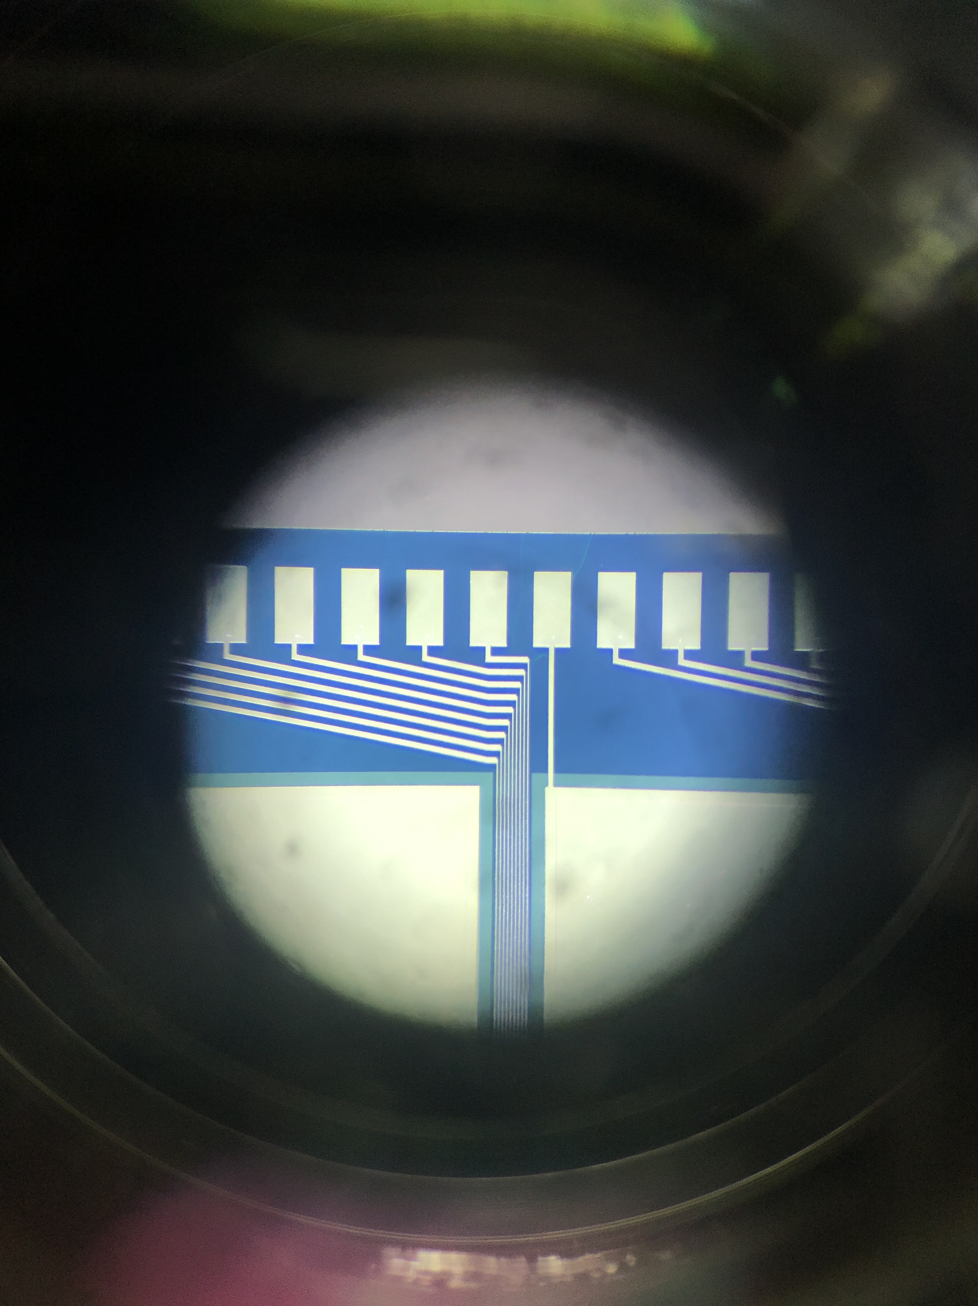
^new GaAs sensors
New technology→Sensors, with signal routing integrated on the
sensor
15 x 10 pads
Pad connected to Al readout trace
Bond pads at the upper sensor edge,
To be connected to the FE ASIC

Slide 14
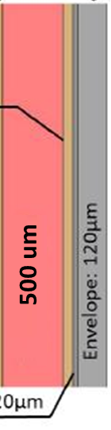
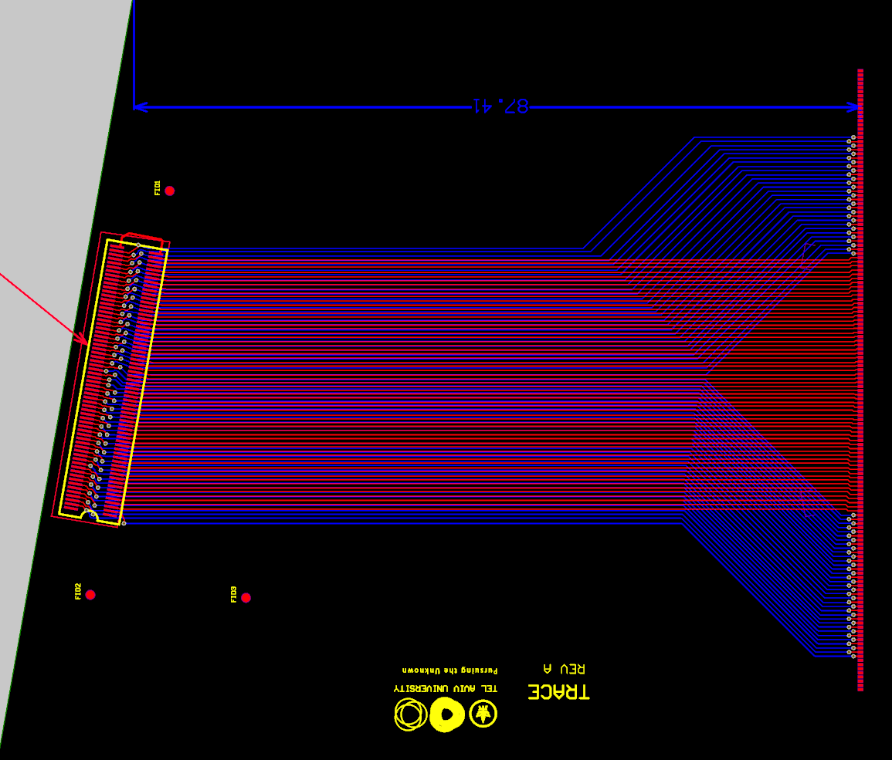


Read out connctions
Assembled sensor plane
Sensor: 500um
Thickness 710 μm
Details still to be designed for a robust and reliable connectivity scheme,
Prototype below

Slide 15
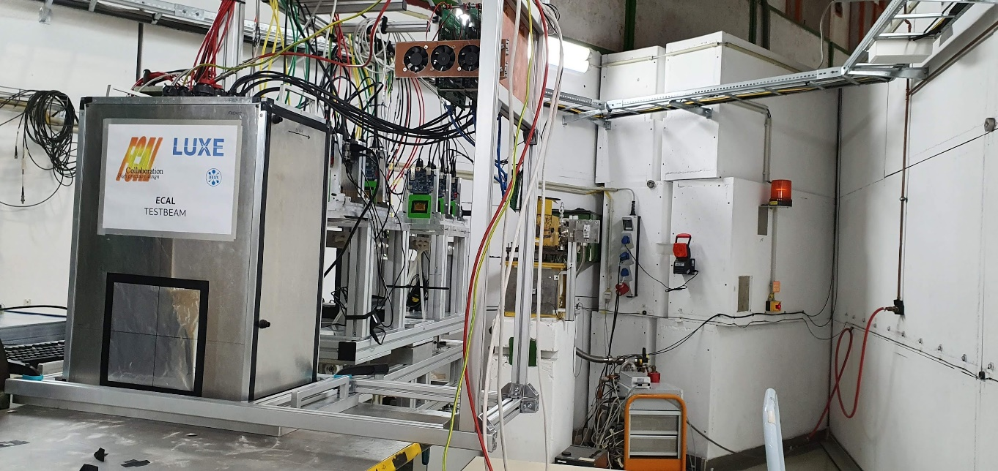
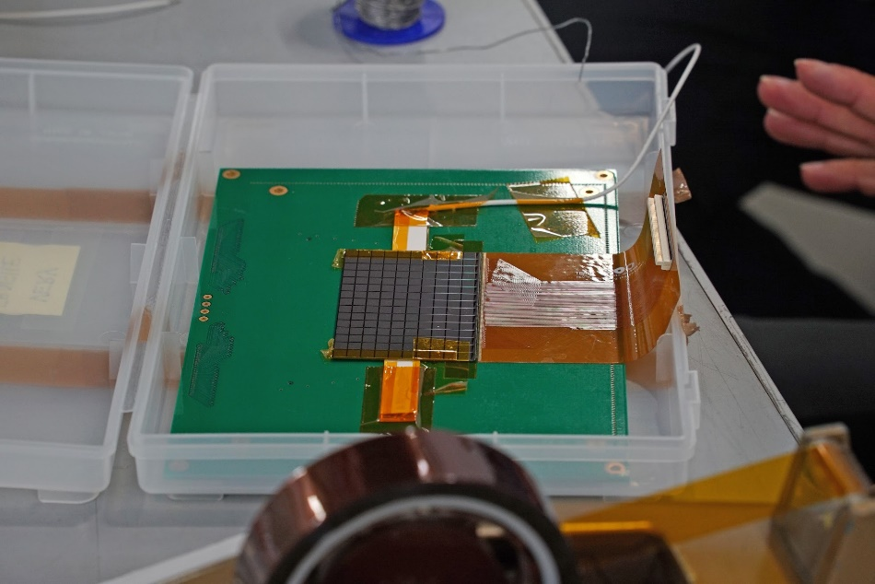
Testbeam
New signal routing technology on GaAs sensors
Beam test Nov. 8-14 at T24
Sensor box (DUT) downstream of the beam talescope
Two GaAs sensors (with new routing Al strips) and two Calice silicon sensors were prepared to be connected to FLAME readout

Slide 16
Test-beam results
Signal size for Si and GaAs similar (in GaAs very low hole mobility)
MPV values for several pads
Signal distribution

Slide 17
Test-beam results
MPV as a function of the pad number
Similar for GaAs and silicon sensors,
Assuming 5% calibration uncertainty of the FE ASIC channels -> response is independent of the pad number
Quantitative study in the next test-beam

Slide 18
Summary
A prototype of a highly compact SiW electromagnetic calorimemter has been build
Fine-granular sensors and dedicated FE electronics were developed
Assembled sensors planes of less than 1 mm thickness were build
The transversal and longitudinal shower shape was measured in an electron beam up to 5 GeV, and compared with simulations
The effective Moliere radius was measured and approched the ‚technological limit‘
GaAs sensors have been developed with signal routing traces integrated in the sensor
Test-beam results show expected performance, signal size comparable to silicon
The current political situation requires to reconsider the next steps

Slide 19
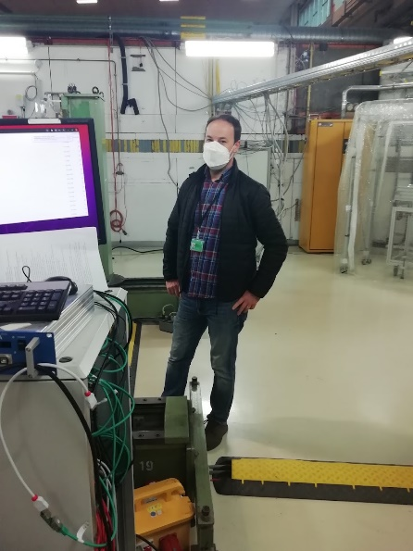
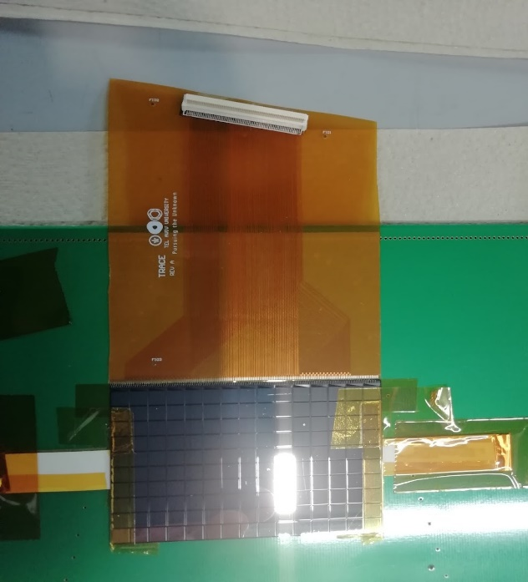
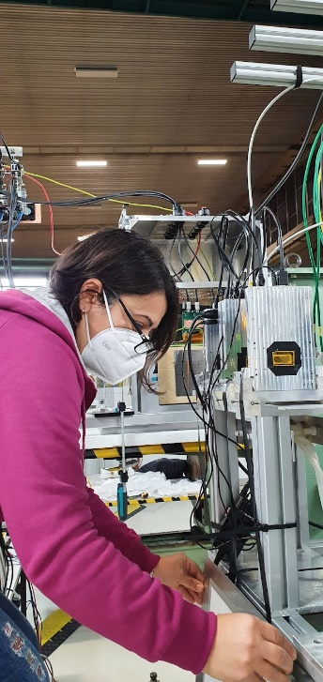
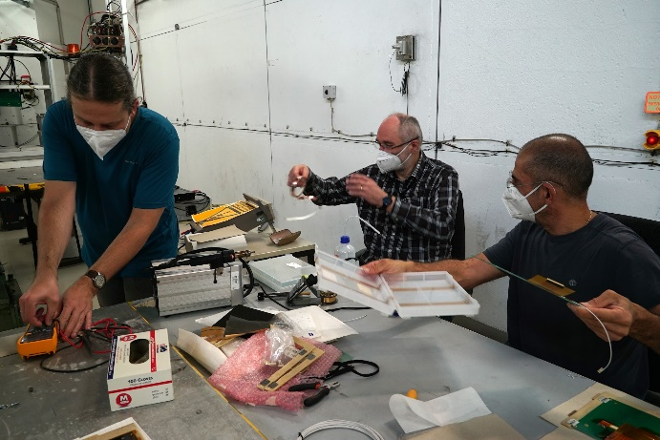
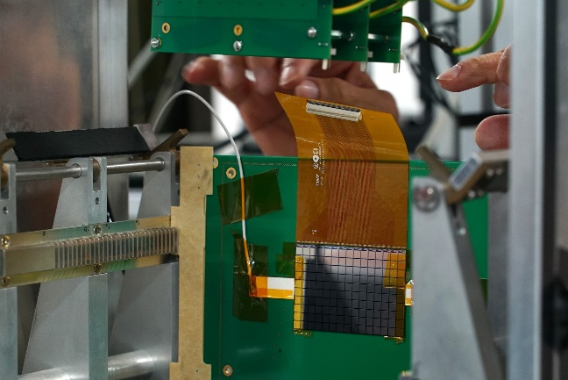
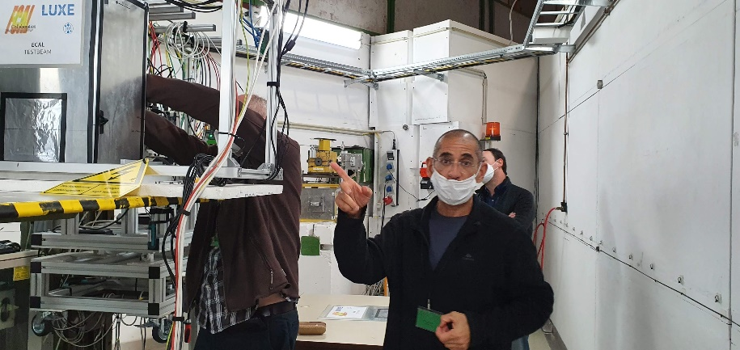
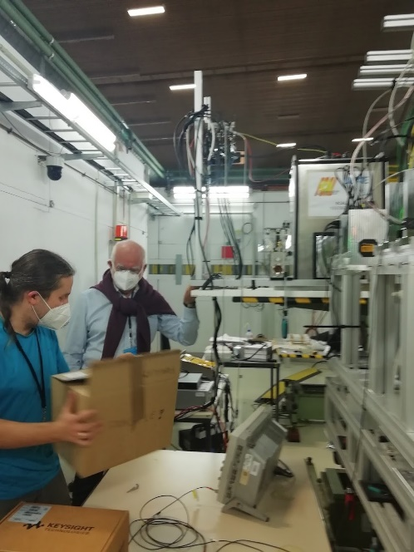
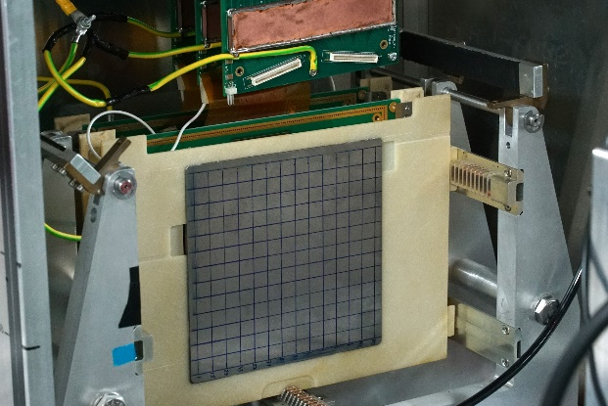
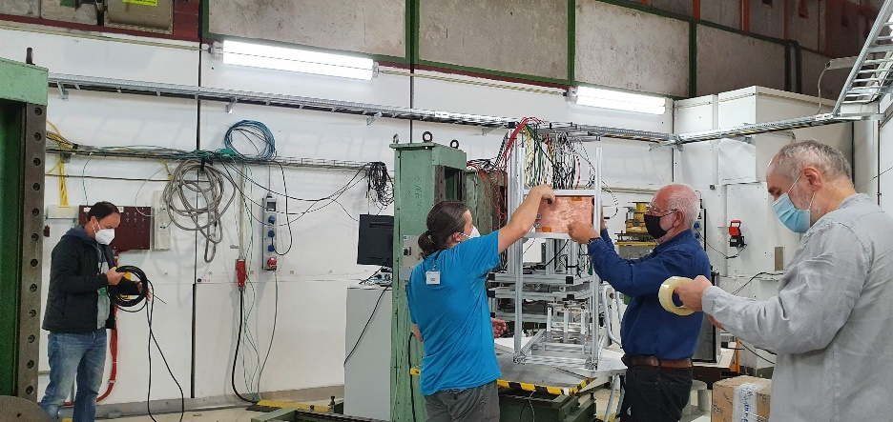
Beam-test campaign
Participants from AGH-UST, ISS TAU

Slide 20
backup

Slide 21
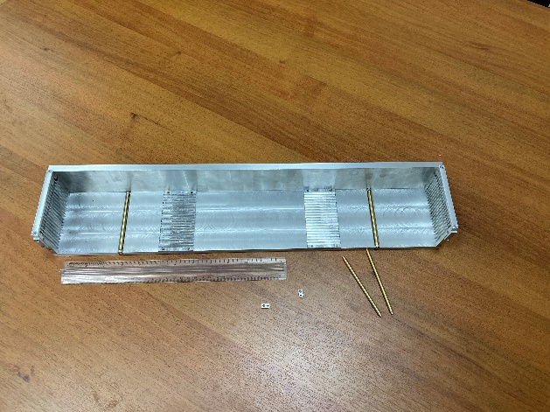
Conclusions
The concept for ECAL is almost ready
Mechanical frame is produced, first 5 tungsten planes
in lab measurments
GaAs is the baselaine sensor option, to be confirmed by test-beam analysis
Delivery plan exists (TSU)
Design of FLAXE FE ASICs almost ready, delivery might be critical
Connectivity scheme sensor-FLAXE and mechanics for FE ASICs still to be designed
Tests of components and full system test foreseen in 2023/24
So far we are well in time

Slide 22
GaAs sensors
GaAs measurement results 2011
Response to a single electron
Using the information from the ZEUS beam telescope
Growing pad size

