Slide 1
NPOD background simulation studies update
Raquel Quishpe
January 9th, 2023

Slide 2
MC simulation status
Beam-laser simulation run with ptarmigan-v0.11
Referenced input file from NAF-LUXE /nfs/dust/luxe/group/MCProduction/Signal/ptarmigan-v0.11/elaser/phase1/npod
${1.5∗10}^{9}$ e- per BX
E = 16.5 GeV
10 BXs simulated for phase-1
Data available in ETP at /ceph/rquishpe/luxe/npod/ptarmigan-v0.11/phase1
Notes:
Use length 5cm, 10cm

Slide 3
G4 NPOD simulation status
Used different dump materials: Pb, W, Cu
Used different dump lengths: 1m, 50cm, 30cm
For reference, the simulation requires 3500 jobs per BX, 1 job (100k events) of
W at 1m needs ~4.5h, ~75MB
Pb at 1m needs ~6.5h, ~110MB
Cu at 1m needs ~2h, ~90MB
Shorter dump lengths require huge amount of computing resources, e.g.
W at 10cm 70% of 1 job needs ~70GB
W at 20cm 1 job needs ~4h, ~9GB
On average, 1BX can be simulated in 2 days

Slide 4
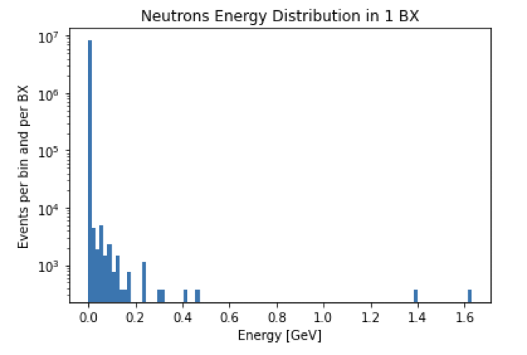
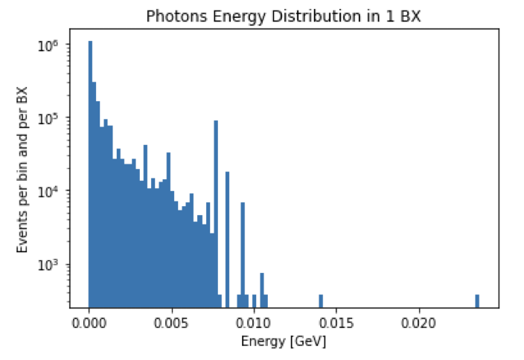
Previous results from Nicolò
Data corresponds to ~0.44% of a BX
Dump: Cu at 1m
Cuts:
detid = 9000
$\left|x\right|<999$
$\left|y\right|<999$
$\left|z−1600\right|<0.1$

Slide 5
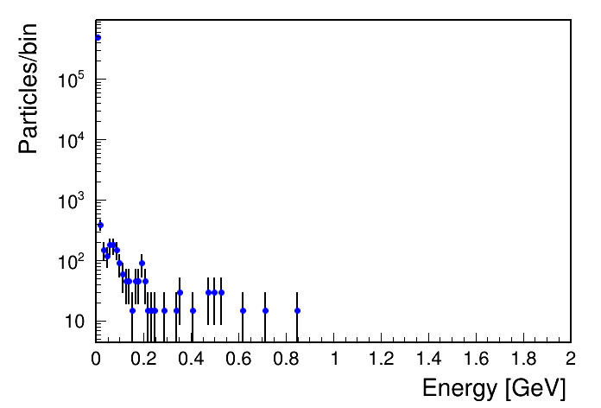
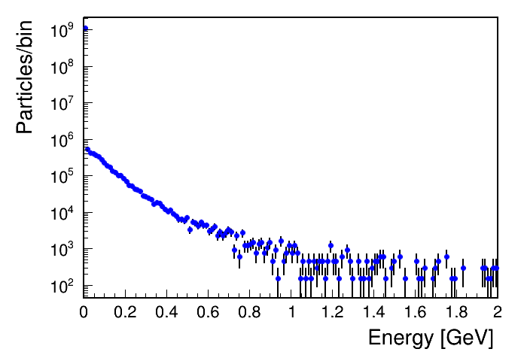
Comparison old vs. new simulations
Dump: Cu at 1m
Neutrons - Old simulation ~0.44% BX
Neutrons - New simulation 1 BX
(Normalization under discussion)

Slide 6
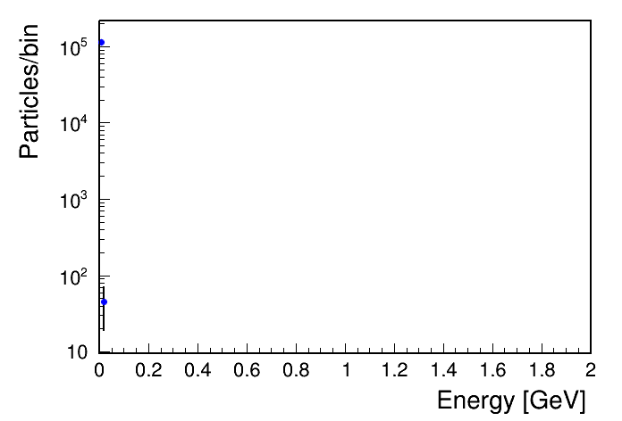
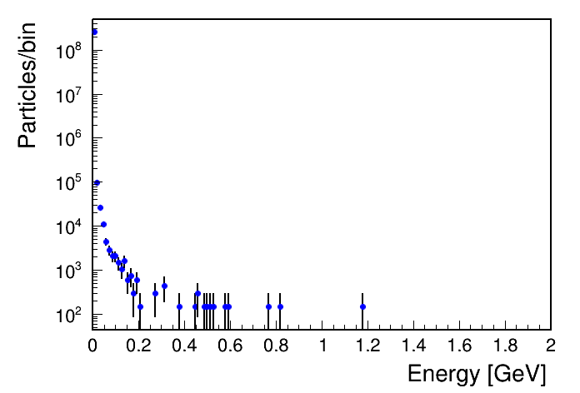
Comparison old vs. new simulations
Dump: Cu at 1m
Photons - New simulation 1 BX
Photons - Old simulation ~0.44% BX

Slide 7
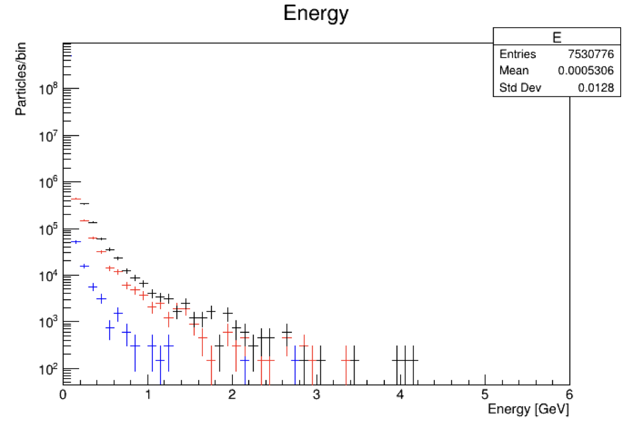
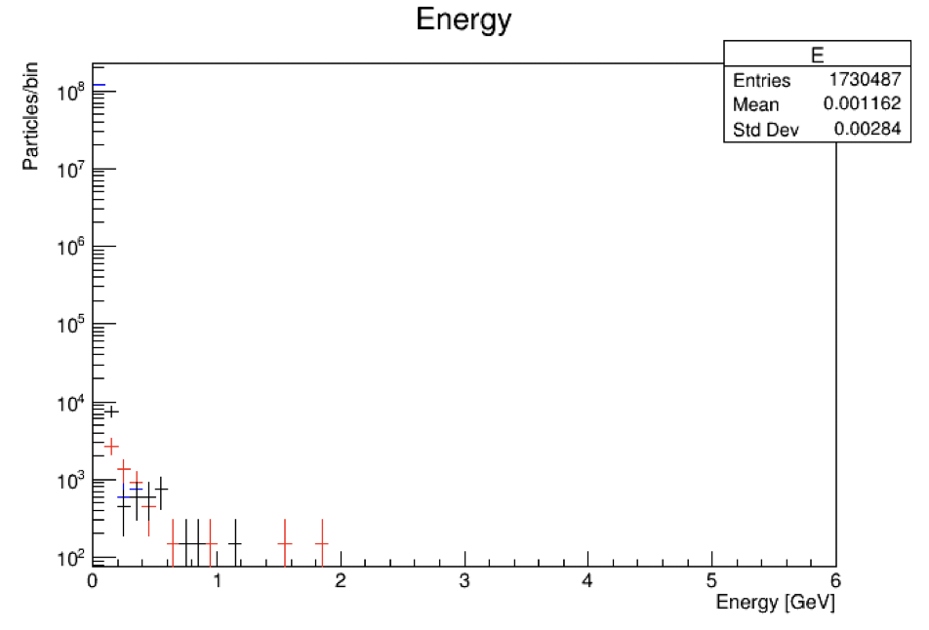
New simulations at dump length 1m
Neutrons
Photons
W
Cu
Pb
Data presented corresponds to 1 full BX
Current status:
Simulations for different dump lengths ongoing for 1 BX
Simulations for W at 1m done for 6 full BX

Slide 8
Thanks!

Slide 9
Backup

Slide 10
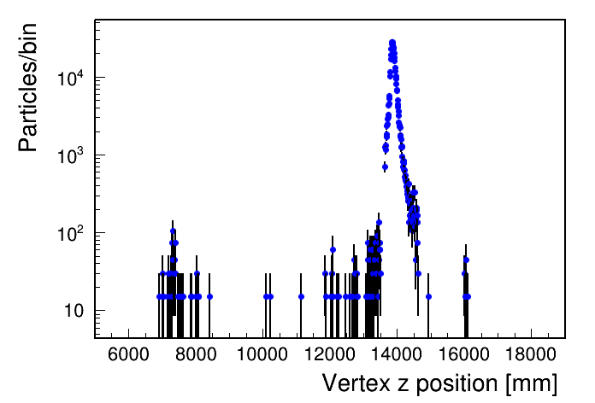
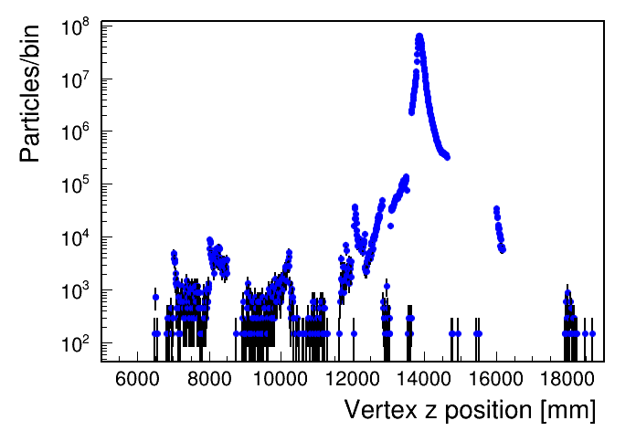
Neutrons – Cu at 1m
Old simulation ~0.44% BX
New simulation 1 BX

Slide 11
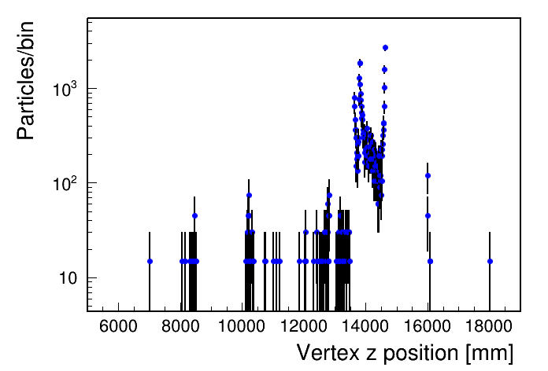
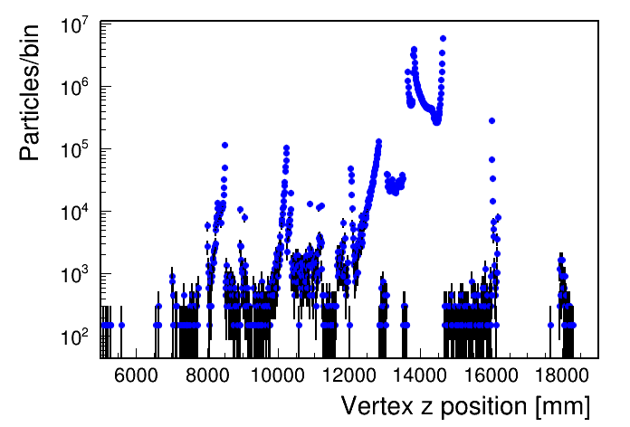
Photons – Cu at 1m
Old simulation ~0.44% BX
New simulation 1 BX

