Slide 1
Likelihoods
1) Brief Introduction
2) Do’s & Dont’s
Louis Lyons
Oxford & Imperial College
CMS
Aachen
March 2023

Slide 2
Topics
What it is
How it works: Resonance
Uncertainty estimates
Coverage
Several Parameters
Do’s and Dont’s with Likelihoods:
COMBINING PROFILE LIKELIHOODS
NORMALISATION FOR LIKELIHOOD
Δ(ln L) = 0.5 RULE
L_{max} AND GOODNESS OF FIT
Bayes and Frequentism: What is Probability?

Slide 3
DO’S AND DONT’S WITH L
NORMALISATION FOR LIKELIHOOD
JUST QUOTE UPPER LIMIT
Δ(ln L) = 0.5 RULE
L_{max} AND GOODNESS OF FIT
BAYESIAN SMEARING OF L
USE CORRECT L (PUNZI EFFECT)

Slide 4
Simple example: Parameter for Angular distribution
y = N (1 + β cos²θ)
y_{i} = N (1 + β cos²θ_{i})
= probability density of observing θ_{i}, given β
L(β) = Π y_{i}
= probability density of observing the data set y_{i}, given β
Best estimate of β is that which maximises L
Values of β for which L is very small are ruled out
Precision of estimate for β comes from width of L distribution
CRUCIAL to normalise y N = 1/{2(1 + β/3)}
(Information about parameter β comes from shape of exptl distribution of cosθ)
β = -1 β large L
cos θ cos θ β

Slide 5
How it works: Resonance
y ~ Γ/2
(m-M₀)² + (Γ/2)²
m m
^{Vary M}₀ ^{Vary Γ}
Find overall optimum by allowing both to vary simultaneously

Slide 6
Conventional to consider
l = ln(L) = Σ ln(y_{i})
For large N, L → Gaussian

Slide 7
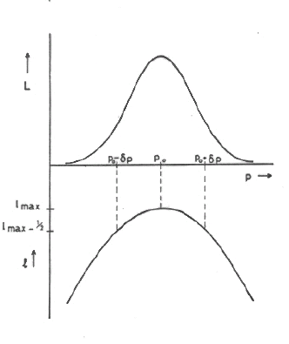

Slide 8
Maximum likelihood uncertainty
Range of likely values of param μ from width of L or l dists.
If L(μ) is Gaussian, following definitions of σ are equivalent:
1) RMS of L(µ)
2) 1/√(-d²lnL / dµ²) (Mnemonic)
3) ln(L(μ₀±σ) = ln(L(μ₀)) -1/2
If L(μ) is non-Gaussian, these are no longer the same
“Procedure 3) above still gives interval that contains the true value of parameter μ with 68% probability”
Uncertainties from 3) usually asymmetric, and asym uncertainties are messy. So choose param sensibly
e.g 1/p rather than p; τ or λ

Slide 9
Lifetime Determination
Realistic analyses are more complicated than this

Slide 10
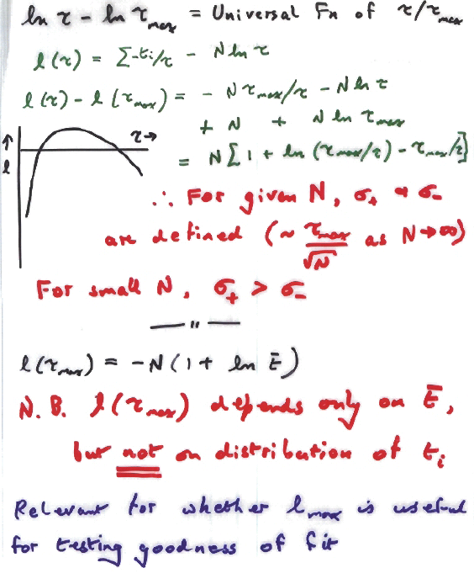

Slide 11
SEVERAL PARAMETERS
1 param p l = lnL
. p from dl/dp = 0 i.e from max of L
σ_{p}² = 1/(-d²l/dp²)
Many dimensions l(p₁, p₂,….)
p₁, p₂, from dl/dp_{i} = 0 i.e. from max of L
For uncertainties, define
H_{ij} = d²l/dp_{i} dp_{j} = Inverse Covariance Matrix
Covariance Matrix E_{ij} = (H⁻¹)_{ij}
Diagonal Elements for variances off-diag for covariances
For many params:
N.B1 Ellipsoid with l=l_{max} -0.5 does not have 68% assymptotic coverage.
N.B2 Uncert on x is not given by
varying x till l = lmax -0.5, while keeping all other params constant
PROFILE L
L_{prof} =L(β,ν_{best}(β)), where
β = param of interest
ν = nuisance param(s)
Uncertainty on β from decrease in ln(L_{prof}) by 0.5

Slide 12
ML and EML
ML uses fixed (data) normalisation
EML has normalisation as parameter
Example 1: Cosmic ray experiment
See 96 protons and 4 heavy nuclei
ML estimate 96 ± 2% protons 4 ±2% heavy nuclei
EML estimate 96 ± 10 protons 4 ± 2 heavy nuclei
Example 2: Decay of resonance
Use ML for Branching Ratios
Use EML for Partial Decay Rates

Slide 13
Extended Maximum Likelihood
Maximum Likelihood uses shape → parameters
Extended Maximum Likelihood uses shape and normalisation
i.e. EML uses prob of observing:
a) sample of N events; and
b) given data distribution in x,……
→ shape parameters and normalisation.
Example: Angular distribution
Observe N events total e.g 100
F forward 96
B backward 4
Rate estimates ML EML
Total --- 100±10
Forward 96±2 96±10
Backward 4±2 4± 2

Slide 14
DO’S AND DONT’S WITH L
COMBINING PROFILE Ls
NORMALISATION FOR LIKELIHOOD
Δ(ln L) = 0.5 RULE
L_{max} AND GOODNESS OF FIT
PDFs and LIKELIHOODS

Slide 15
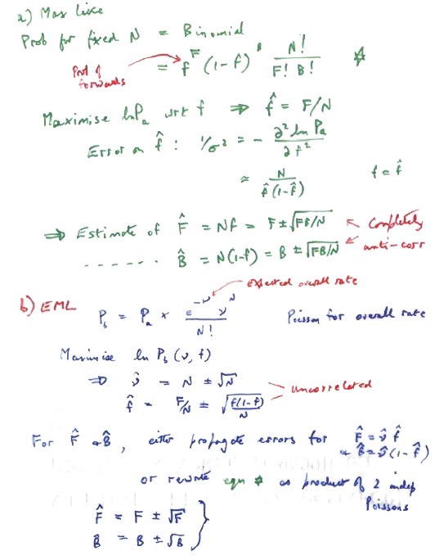

Slide 16
Danger of combining profile Ls
Experiments quote Likelihood, profiled over nuisance parameters, so that combinations can be performed.
Very simple ‘tracking’ example:
* No magnetic field
* 2-D fit of straight line y = a + bx
a = parameter of interest, b = nuisance param
* Track hits in 2 subdetectors, each of 3 planes

Slide 17
y= a +b*x
(a)
b
(b)
y
a
L_{comb}
L₂
L₂
L₁
L₁
x
(a) Hits in 2 sub-detectors, each with 3 planes
(b) Covariance ellipses for separate fits L₁ and L₂, and combined L_{comb}
(c) lnL_{prof} as function of a, for all 3 lines
(d) b_{best} as a function of a
a
lnL_{prof}
(c)
L₁
L₂
N.B. b_{best} for L₁ and L₂ are the same
*** Combining L_{prof} for L₁ and L₂ loses a lot of information, and a_{best} wrong *****
a
(d)
b_{best}
L₁
L₂

Slide 18
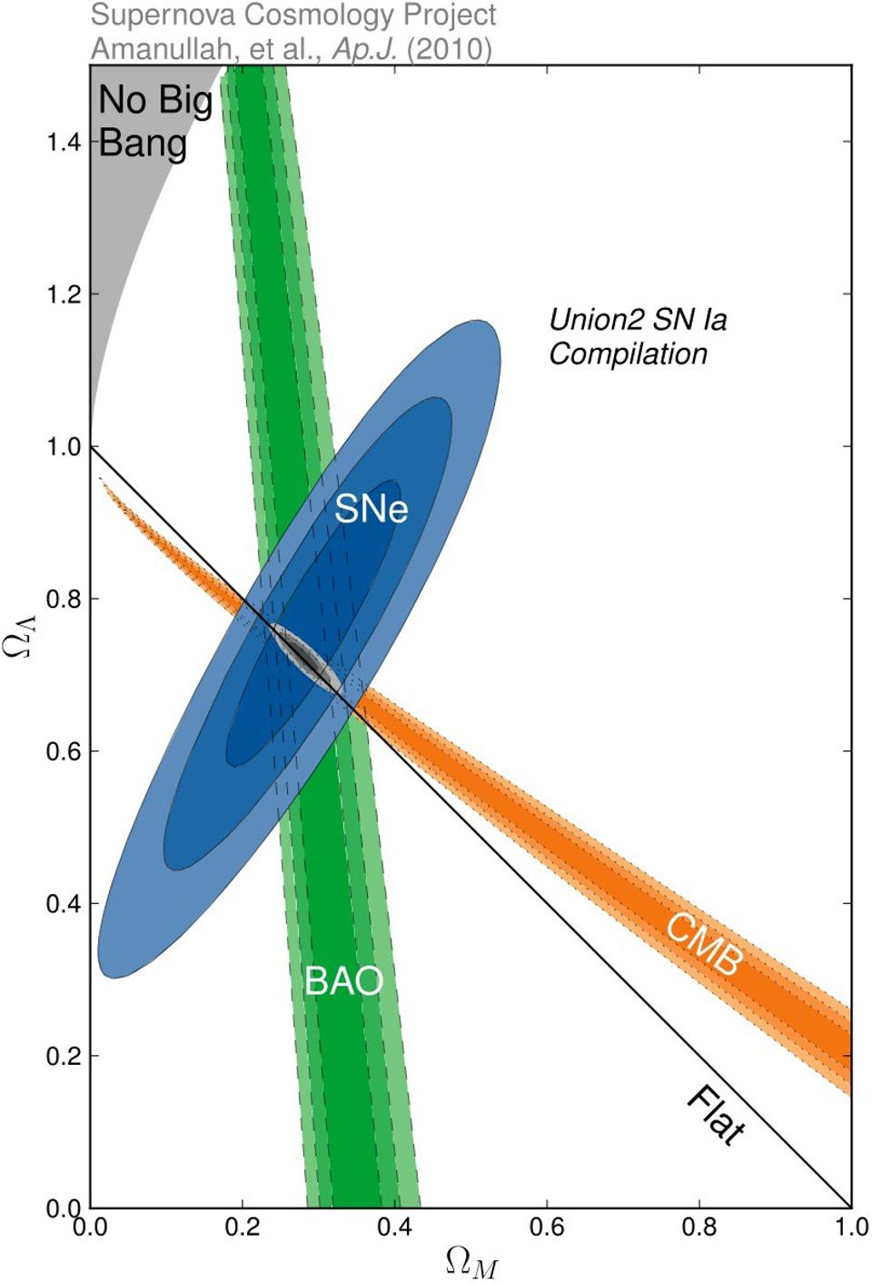
COSMOLOGY EXAMPLE
Plot of dark energy fraction v dark matter fraction by various methods. Each determines dark energy fraction poorly, but combination is fine, because of different correlations.
Combining Profile Likelihoods would give very large uncertainty on dark energy fraction.

Slide 19
NORMALISATION FOR LIKELIHOOD
MUST be independent of μ
Data Param
Exponential Distribution
INCORRECT
P
(
t
|
τ
)
=
e
−
t
/
τ
Missing 1/τ
τ infinite
τ too large
τ about right
t

Slide 20
QUOTING UPPER LIMIT
“We observed no significant signal, and our 90% conf upper limit is …..”
Need to specify method e.g.
L
Chi-squared (data or theory error)
Frequentist (Central or upper limit)
Feldman-Cousins
Bayes with prior = const,
“Show your L”
1) Not always practical
2) Not sufficient for frequentist methods

Slide 21
90% C.L. Upper Limits
For Upper Limits
For 2-sided intervals
μ
x
x₀

Slide 22
ΔlnL = -1/2 rule
If L(μ) is Gaussian, following definitions of σ are equivalent:
1) RMS of L(µ)
2) 1/√(-d²L/dµ²)
3) ln(L(μ₀±σ) = ln(L(μ₀)) -1/2
If L(μ) is non-Gaussian, these are no longer the same
“Procedure 3) above still gives interval that contains the true value of parameter μ with 68% probability”
Heinrich: CDF note 6438 (see CDF Statistics Committee Web-page)
Barlow: Phystat05

Slide 23
Coverage
μ_{true} μ
* What it is:
For given statistical method applied to many sets of data to extract confidence intervals for param µ, coverage C is fraction of ranges that contain true value of param. Can vary with µ
* Does not apply to your data:
It is a property of the statistical method used
It is NOT a probability statement about whether µ_{true} lies in your confidence range for µ
* Coverage plot for Poisson counting expt
Observe n counts
Estimate µ_{best} from maximum of likelihood µ
L(µ) = e^{-µ} µ^{n}/n! and range of µ from ln{L(µ_{best})/L(µ)} < 0.5
For each µ_{true} calculate coverage C(µ_{true}), and compare with nominal 68%
C(µ)
68%
Ideal coverage plot

Slide 24
Coverage
Fraction of intervals containing true value
Property of method, not of result
Can vary with param
Frequentist concept. Built in to Neyman construction
Some Bayesians reject idea. Coverage not guaranteed
Integer data (Poisson) → discontinuities
Ideal coverage plot
C
μ

Slide 25
COVERAGE
How often does quoted range for parameter include param’s true value?
N.B. Coverage is a property of METHOD, not of a particular exptl result
Coverage can vary with μ
Study coverage of different methods of Poisson parameter μ, from observation of number of events n
Hope for:
100%
Nominal value

Slide 26
COVERAGE
If true for all : “correct coverage”
P< for some “undercoverage”
(this is serious !)
P> for some “overcoverage”
Conservative
Loss of rejection power

Slide 27
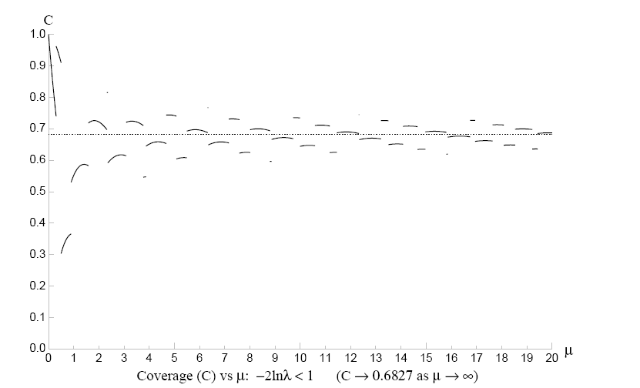
Coverage : L approach (Neyman construction)
P(n,μ) = e^{-μ}μ^{n}/n! (Joel Heinrich CDF note 6438)
-2 lnλ< 1 λ = P(n,μ)/P(n,μ_{best}) UNDERCOVERS

Slide 28
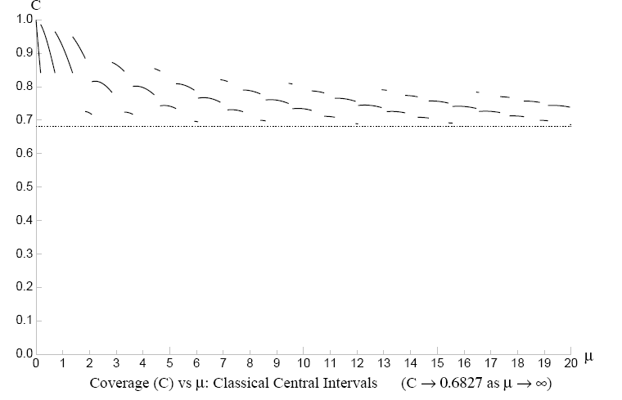
Neyman central intervals, NEVER undercover
(Conservative at both ends)

Slide 29
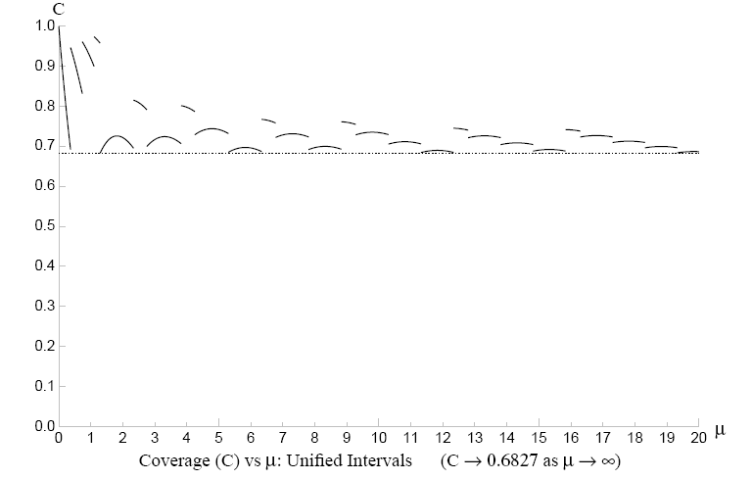
Feldman-Cousins Unified intervals
Neyman construction so NEVER undercovers

Slide 30
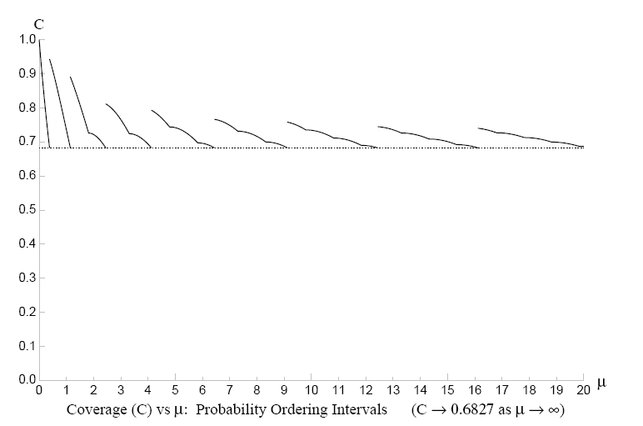
Probability ordering
Frequentist, so NEVER undercovers

Slide 31
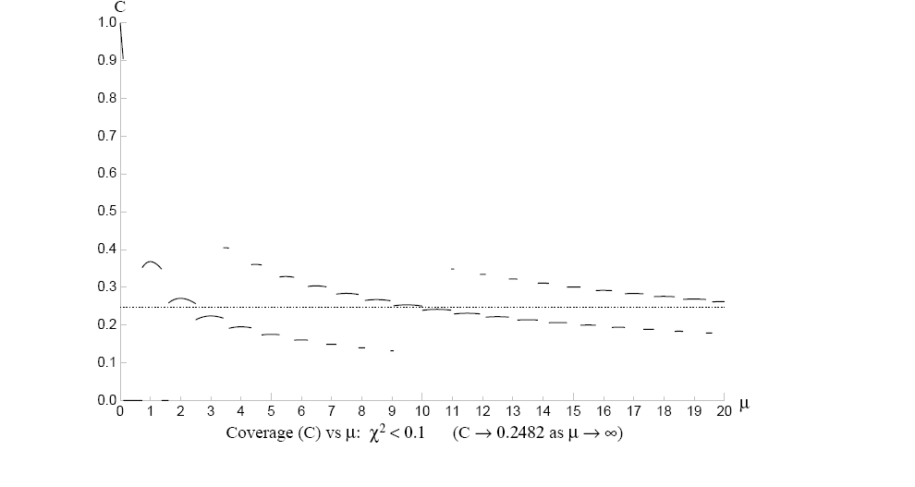
χ² = (n-µ)²/µ Δ χ² = 0.1 24.8% coverage?
NOT Neyman : Coverage = 0% → 100%

Slide 32
Unbinned L_{max} and Goodness of Fit?
Find params by maximising L
So larger L better than smaller L
So L_{max} gives Goodness of Fit??
Bad
Good?
Great?
Monte Carlo distribution
of unbinned L_{max}
Frequency
L_{max}

Slide 33
Difference between L and pdf
Not necessarily: pdf
L(data,params)
fixed vary
L
Contrast pdf(data,params) param
vary fixed
e.g. p(λ) = λ exp(-λt) data
Max at t = 0 Max at λ=1/t
p L
t λ

Slide 34
Example 1
Fit exponential to times t₁, t_{2 ,}t₃ ……. [ Joel Heinrich, CDF 5639 ]
L = π λ exp(-λt_{i})
lnL_{max} = -N(1 + ln t_{av})
i.e. Depends only on AVERAGE t, but is
INDEPENDENT OF DISTRIBUTION OF t (except for……..)
(Average t is a sufficient statistic)
Variation of L_{max} in Monte Carlo is due to variations in samples’ average t , but
NOT TO BETTER OR WORSE FIT
pdf
Same average t same L_{max}
t

Slide 35
Example 2
L =
cos θ
pdf (and likelihood) depends only on cos²θ_{i}
Insensitive to sign of cosθ_{i}
So data can be in very bad agreement with expected distribution
e.g. all data with cosθ < 0
and L_{max} does not know about it.
Example of general principle

Slide 36
Example 3
Fit to Gaussian with variable μ, fixed σ
lnL_{max} = N(-0.5 ln2π – lnσ) – 0.5 Σ(x_{i} – x_{av})² /σ²
constant ~variance(x)
i.e. L_{max} depends only on variance(x),
which is not relevant for fitting μ (μ_{est} = x_{av})
Smaller than expected variance(x) results in larger L_{max}
_{x} _{x}
Worse fit, larger L_{max} Better fit, lower L_{max}

Slide 37
L_{max} and Goodness of Fit?
Conclusion:
L has sensible properties with respect to parameters
NOT with respect to data
L_{max} within Monte Carlo peak is NECESSARY
not SUFFICIENT
(‘Necessary’ doesn’t mean that you have to do it!)

Slide 38
Binned data and Goodness of Fit using L-ratio
p_{ni}(µ_{i})
p_{ni}(µ_{i,best})
p_{ni}(n_{i})
n_{i} L =
μ_{i} L_{best}
x
ln[L-ratio] = ln[L/L_{best}]
large μ_{i} -0.5χ² i.e. Goodness of Fit
L_{best} is independent of parameters of fit,
and so same parameter values from L or L-ratio
Baker and Cousins, NIM A221 (1984) 437

Slide 39
L and pdf
Example 1: Poisson
pdf = Probability density function for observing n, given μ
P(n;μ) = e ^{-μ} μ^{n}/n!
From this, construct L as
L(μ;n) = e ^{-μ} μ^{n}/n!
i.e. use same function of μ and n, but . . . . . . . . . . pdf
for pdf, μ is fixed, but
for L, n is fixed μ L
^{n}
N.B. P(n;μ) exists only at integer non-negative n
L(μ;n) exists only as continuous function of non-negative μ

Slide 40
Εxample 2 Lifetime distribution
pdf p(t;λ) = λ e ⁻ ^{λt}
So L(λ;t) = λ e ^{–λt} (single observed t)
Here both t and λ are continuous
pdf maximises at t = 0
L maximises at λ = t
Ν.Β. Functional form of p(t) and L(λ) are different
Fixed λ Fixed t
p L
t λ

Slide 41
Example 3: Gaussian
N.B. In this case, same functional form for pdf and L
So if you consider just Gaussians, can be confused between pdf and L
So examples 1 and 2 are useful
pdf(x;µ) = exp{-(x-µ)²/2σ²} /(σ√2π)
L(µ;x) = exp{-(x-µ)²/2σ²} /(σ√2π)

Slide 42
Transformation properties of pdf and L
Lifetime example: dn/dt = λ e ^{–λt}
Change observable from t to y = √t
So (a) pdf changes, BUT
(b)
i.e. corresponding integrals of pdf are INVARIANT

Slide 43
Now for Likelihood
When parameter changes from λ to τ = 1/λ
(a’) L does not change
dn/dt = (1/τ) exp{-t/τ}
and so L(τ;t) = L(λ=1/τ;t)
because identical numbers occur in evaluations of the two L’s
BUT
(b’)
So it is NOT meaningful to integrate L
(However,………)

Slide 44
 | pdf(t;λ) | L(λ;t)
Value of function | Changes when observable is transformed | INVARIANT wrt transformation of parameter
Integral of function | INVARIANT wrt transformation of observable | Changes when param is transformed
Conclusion | Max prob density not very sensible | Integrating L not very sensible

Slide 45
CONCLUSION:
NOT recognised statistical procedure
[Metric dependent:
τ range agrees with τ_{pred}
λ range inconsistent with 1/τ_{pred} ]
BUT
Could regard as “black box”
Make respectable by L Bayes’ posterior
Posterior(λ) ~ L(λ)* Prior(λ) [and Prior(λ) can be constant]

Slide 46
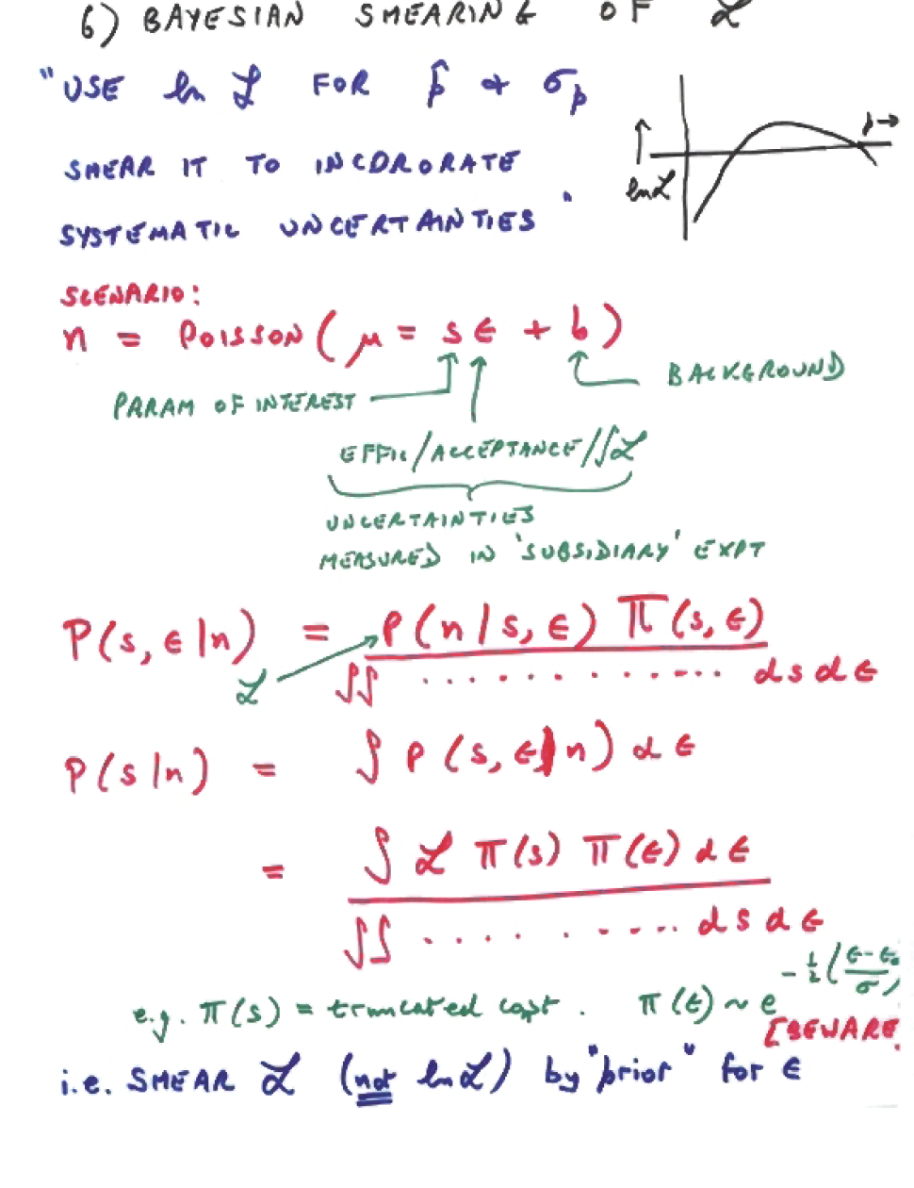

Slide 47
Getting L wrong: Punzi effect
Giovanni Punzi @ PHYSTAT2003
“Comments on L fits with variable resolution”
Separate two close signals, when resolution σ varies event by event, and is different for 2 signals
e.g. 1) Signal 1 1+cos²θ
Signal 2 Isotropic
and different parts of detector give different σ
2) M (or τ)
Different numbers of tracks → different σ_{M} (or σ_{τ})

Slide 48
Events characterised by x_{i} and σ_{i}
A events centred on x = 0
B events centred on x = 1
L(f)_{wrong} = Π [f * G(x_{i},0,σ_{i}) + (1-f) * G(x_{i},1,σ_{i})]
L(f)_{right} = Π [f*p(x_{i},σ_{i};A) + (1-f) * p(x_{i},σ_{i};B)]
p(S,T) = p(S|T) * p(T)
p(x_{i},σ_{i}|A) = p(x_{i}|σ_{i},A) * p(σ_{i}|A)
= G(x_{i},0,σ_{i}) * p(σ_{i}|A)
So
L(f)_{right} = Π[f * G(x_{i},0,σ_{i}) * p(σ_{i}|A) + (1-f) * G(x_{i},1,σ_{i}) * p(σ_{i}|B)]
If p(σ|A) = p(σ|B), L_{right} = L_{wrong}
but NOT otherwise

Slide 49
Punzi’s Monte Carlo for A : G(x,0,σ_{Α})
B : G(x,1,σ_{Β})
f_{A} = 1/3
L_{wrong} L_{right}
σ_{Α} σ_{Β} f_{A} σ_{f} f_{A} σ_{f}
1.0 1.0 0.336(3) 0.08 Same
1.0 1.1 0.374(4) 0.08 0. 333(0) 0
1.0 2.0 0.645(6) 0.12 0.333(0) 0
1 → 2 1.5 →3 0.514(7) 0.14 0.335(2) 0.03
1.0 1 → 2 0.482(9) 0.09 0.333(0) 0
1) L_{wrong} OK for p(σ_{Α}) = p(σ_{Β}) , but otherwise BIASSED
2) L_{right} unbiassed, but L_{wrong} biassed (enormously)!
3) L_{right} gives smaller σ_{f} than L_{wrong}

Slide 50
Explanation of Punzi bias
σ_{A} = 1 σ_{B} = 2
A events with σ = 1
B events with σ = 2
x → x →
ACTUAL DISTRIBUTION FITTING FUNCTION
[N_{A}/N_{B} variable, but same for A and B events]
Fit gives upward bias for N_{A}/N_{B} because (i) that is much better for A events; and
(ii) it does not hurt too much for B events

Slide 51
Another scenario for Punzi problem: PID
A B π K
M TOF
Originally:
Positions of peaks = constant K-peak → π-peak at large momentum
σ_{i} variable, (σ_{i})_{A} = (σ_{i})_{B} σ_{i} ~ constant, p_{K} = p_{π}
COMMON FEATURE: Separation/Error = Constant
Where else??
MORAL: Beware of event-by-event variables whose pdf’s do not
appear in L

Slide 52
Avoiding Punzi Bias
BASIC RULE:
Write pdf for ALL observables, in terms of parameters
Include p(σ|A) and p(σ|B) in fit
(But then, for example, particle identification may be determined more by momentum distribution than by PID)
OR
Fit each range of σ_{i} separately, and add (N_{A})_{i} → (N_{A})_{total}, and similarly for B
Incorrect method using L_{wrong} uses weighted average of (f_{A})_{j}, assumed to be independent of j
Talk by Catastini at PHYSTAT05

Slide 53
What else can we do with Ls?
So far mainly parameter determination (also
Baker & Cousins’ Goodness of Fit with Likelihood ratio)
Other possibilities:
Frequentist approach:
Construction of parameter confidence intervals
Likelihood ratios for comparing Hypotheses
Bayesian approach:
Together with priors → parameter credible intervals;
and Comparing Hypotheses
More in lectures by Olaf Behnke & Glen Cowan

Slide 54

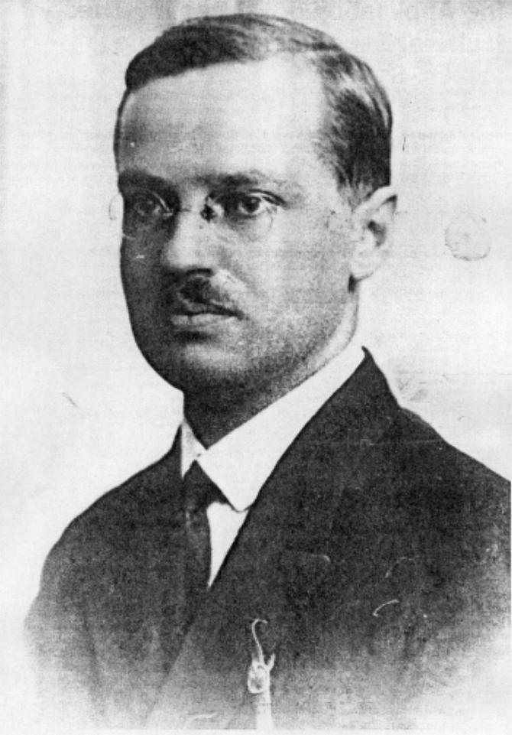
BAYES and FREQUENTISM
The Return of an Old Controversy

Slide 55
Parameter Determination
We need to make a statement about
Parameters, Given Data
The basic difference between the two:
Bayesian : Prob(parameter, given data)
(an anathema to a Frequentist!)
Frequentist : Prob(data, given parameter)
(a likelihood function)

Slide 56
WHAT IS PROBABILITY?
MATHEMATICAL
Formal
Based on Axioms
FREQUENTIST
Ratio of frequencies as n→ infinity
Repeated “identical” trials
Not applicable to single event or physical constant
BAYESIAN Degree of belief
Can be applied to single event or physical constant
(even though these have unique truth)
Varies from person to person ***
Quantified by “fair bet”
Picture of Bayes
LEGAL PROBABILITY

Slide 57
Picture of Reverend Bayes
Maybe it isn’t Bayes?
“Probability that this is actually a picture of Bayes” is not Frequentist probability.
“Probability of Bayes” is Bayesian probability.

Slide 58
Bayesian
Bayes’ Theorem
p(param | data) α p(data | param) * p(param)
posterior
likelihood
prior
Problems: p(param) Has particular value
“Degree of belief”
Prior What functional form?
Coverage

Slide 59
P (Data;Theory) P (Theory;Data)
(Example of P(A;B) P(B;A) )

Slide 60
P (Data;Theory) P (Theory;Data)
Theory = male or female
Data = pregnant or not pregnant
P (pregnant ; female) ~ 3%

Slide 61
P (Data;Theory) P (Theory;Data)
Theory = male or female
Data = pregnant or not pregnant
P (pregnant ; female) ~ 3%
but
P (female ; pregnant) >>>3%

Slide 62
Classical Approach: Neyman Construction
Neyman “confidence interval” avoids pdf for
Uses only P( x; )
Confidence interval :
P( contains _{t} ) =
True for any _{t}
Varying intervals from ensemble of experiments
fixed
Gives range of for which observed value was “likely” ( )
Contrast Bayes : Degree of belief = is in

Slide 63
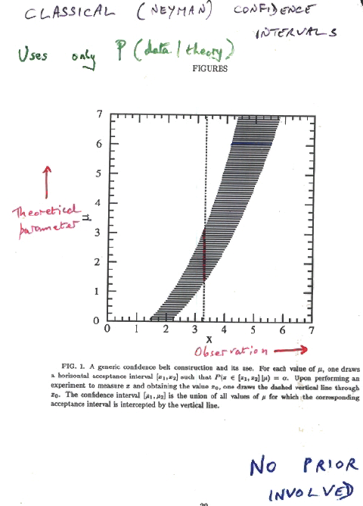
Classical (Neyman) Confidence Intervals
Uses only P(data|theory)
Theoretical
Parameter
µ
Observation x →
μ≥0 No prior for μ

Slide 64
at 90% confidence
and known, but random unknown, but fixed Probability statement about and
Frequentist
and known, and fixed unknown, and random Probability/credible statement about
Bayesian

Slide 65
Conclusions: What you now know
How it works, and how to estimate uncertainties
Δ(ln L) = 0.5 rule and coverage
Several Parameters
Commbining Profile Ls loses information
Unbinned L_{max} and Goodness of Fit
Intro to Bayes and Frequentism

Slide 66
FINAL MESSAGE
You cannot become an expert on Statistics by just reading books and listening to lectures.
You have to work at it – solve lots of problems, etc.
Best of luck with Statistics, and with your
research and enjoy this School!

