Slide 1
ARES Operation Meeting
Summary of week 02
Hannes Dinter, on behalf of the ARES shift crew

Slide 2
Summary week 02
 | Mon 9th January | Tue 10th January | Wed 11th January | Thu 12th January | Fri 13th January
Achievements / Overview | Tunnel open | Ramping up after winter shutdown Fixed a lot of issues Over night: stability measurement | Pulse shot mode tests Restored bash aliases and juypter lab Added buttons for conditioning tools to main taskbar Adjusted sampling point of TWS2 RB Added RF power readback values to alarm server D3 Pandora tests Over night: stability | Measured beam on in air screen station Setting up max charge operation Testing and adjusting the collimator in the FL section Testing low beam momentum WP Test for AutoAcc | Checking MMG phases Planning discussion Machine setup for BPM tests BPM tests
Difficulties |  | Many (see next slide, all fixed) FC1 DC baseline is at around -12pC | Vacuum valves except for LI closed by "SSK" event (false alarm) ZZ camera image is delayed w.r.t. audio by ca. 5 seconds (expert informed)

Slide 3
Difficulties after winter shutdown / controls system update
DIO 0 and DIO 1 cannot be switched on (fixed by MPC)
TWS2 water heater was switched off (fixed by MKK)
Terminal aliases for conditioning tools gone (fixed, additionally added buttons to the main taskbar)
Cannot bring TWS2 modulator to TRIGGER mode due to OpLocation fault (fixed by MIN)
TWS2 voltage SP and RB differ by a factor of 2 (fixed by MSK)
TWS1 power is way too low, even though the amplitude RB is fine (fixed by MSK)
FL observation camera and in-air camera not reachable (fixed)
FC signal shows disturbances when TWS1 modulator is in higher states than STDBY. Maybe this causes the baseline calculation for the dark charge measurement to fail, resulting in the negative dark charge (under investigation)

Slide 4
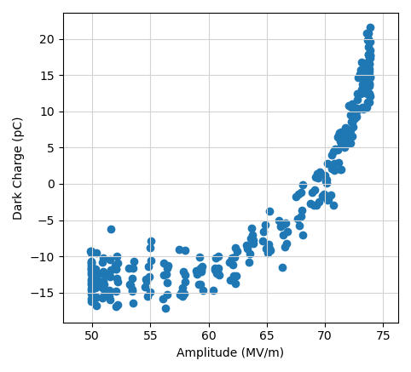
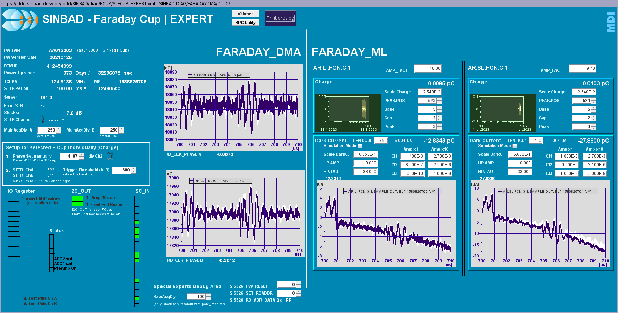
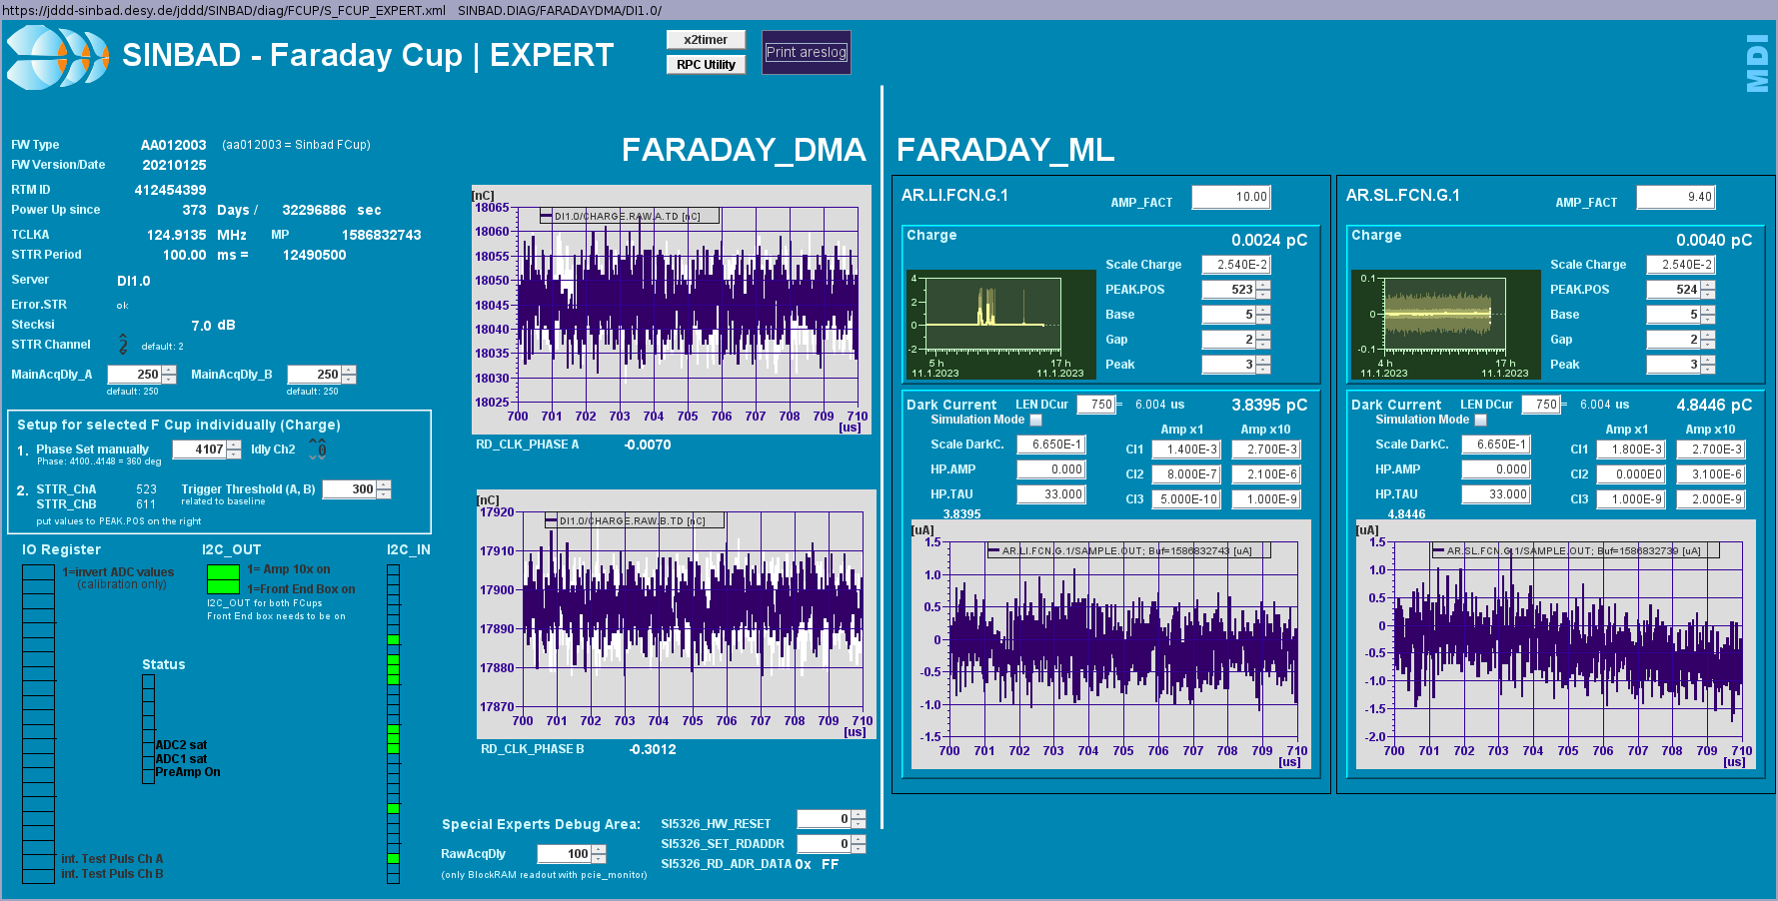
FC signal + TWS1 modulator
Presumably the reason for the negative dark charge
TWS1 modulator on
TWS1 modulator off

Slide 5
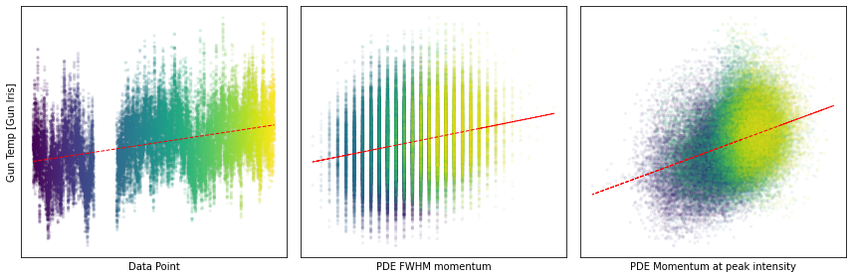
New candidate for oscillations: ambient air temperature
Air Temperature

Slide 6
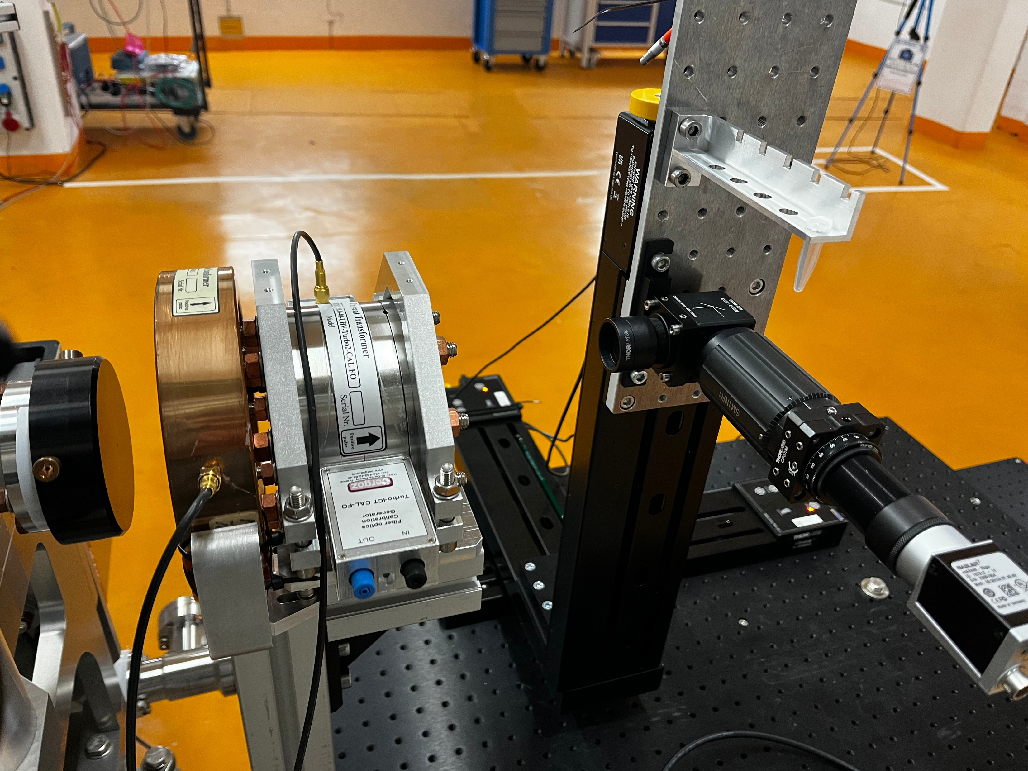
Turbo-ICT and sample holder for user experiment installed

Slide 7
Plan for this week
Monday
  MDI ICT installation
  MIN x-band cabling
Tuesday
  Close tunnel, ramp up
  Bring beam to end of linac
  Test with different charges (around 30pC)
Rest of week
  Preparation of user experiment

Slide 8
Schedule
Week 03
Date | Shift leader
16.01. | Florian Burkart, MDI, MIN (tunnel open)
17.01. | Frank Mayet, Max Kellermeier
18.01. | Willi Kuropka, Florian Burkart
19.01. | Hannes Dinter, Max Kellermeier, Frank Mayet
20.01. | Thomas Vinatier, Max Kellermeier (morning)
If you want to learn or join the shift: please give the shift leader a call (BKR 2840 / SINBAD Box 2454)

