Slide 1
FLARE 1st Project Meeting:
Laser Heater and Results from recent beamtimes
Christopher Gerth,
21.02.2023, DESY Hamburg

Slide 2
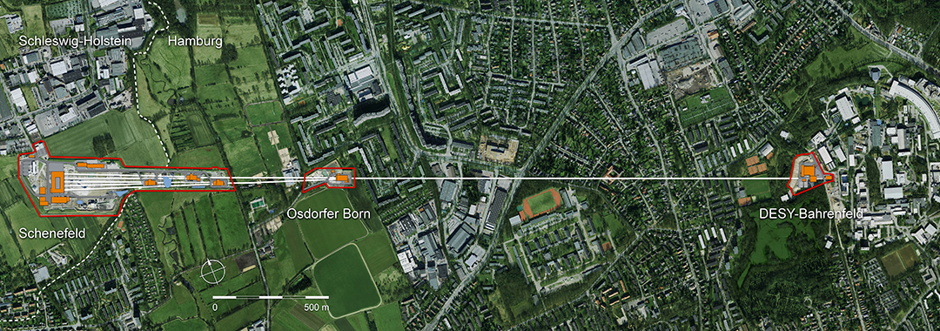
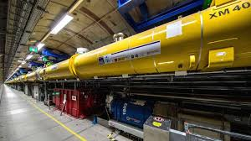
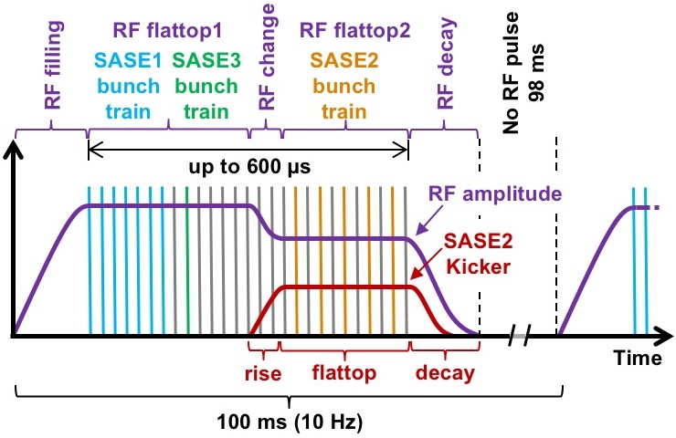
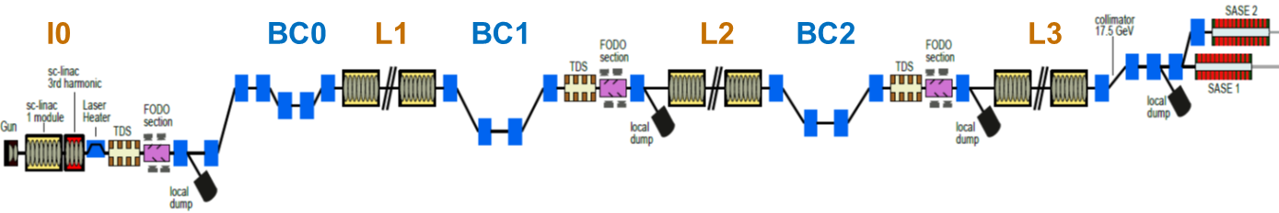
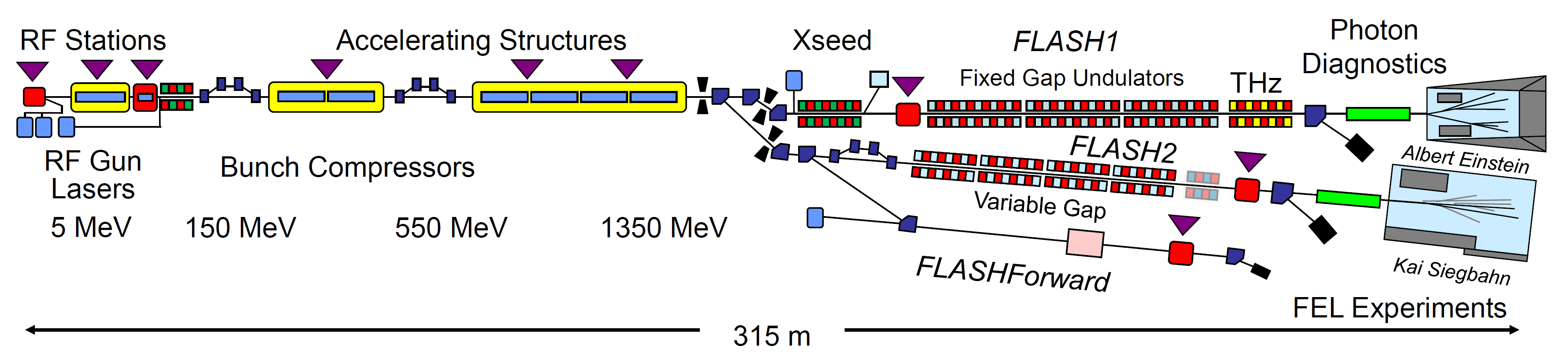
European XFEL
FELs at DESY
PETRA3
FLASH
SC-linac
SASE1 / SASE2
0.05 – 0.4 nm
SASE3
0.4 – 4 nm
130 MeV
600 MeV
2.5 GeV
17.5 GeV
3.4 km
FLASH1 / FLASH2
4 – 60 nm
Time

Slide 3
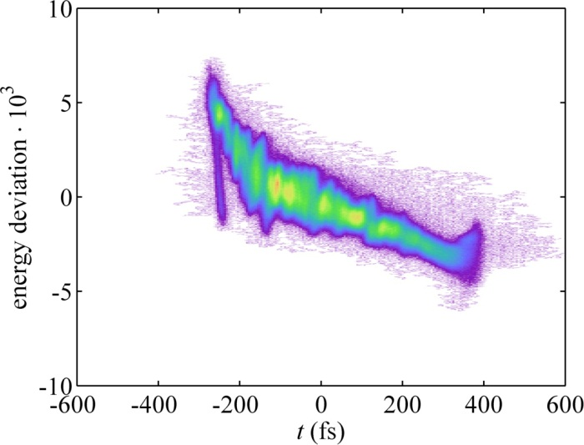
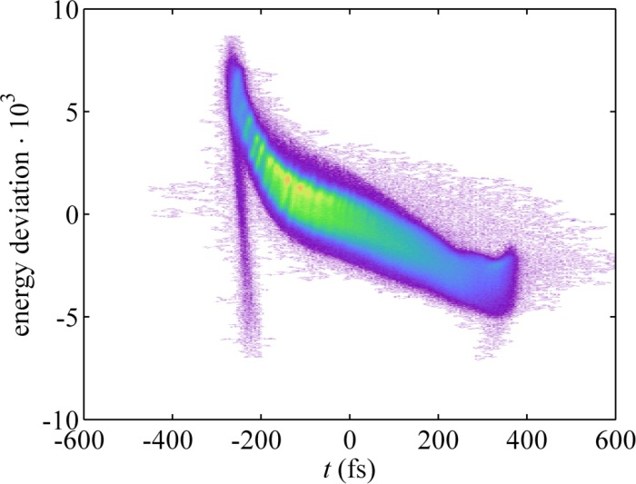
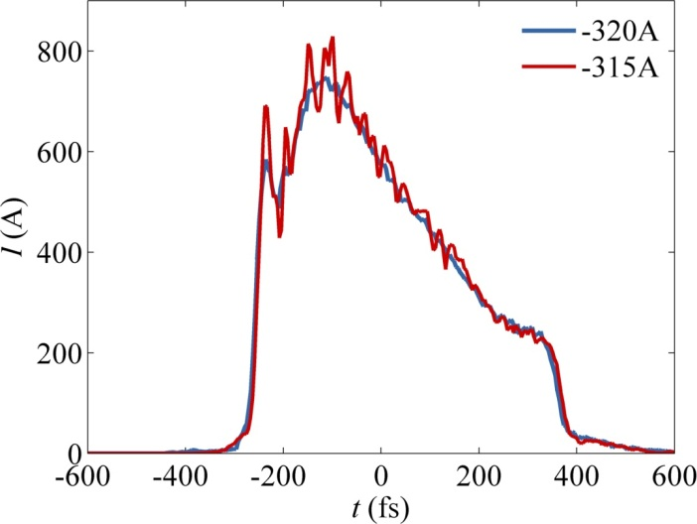
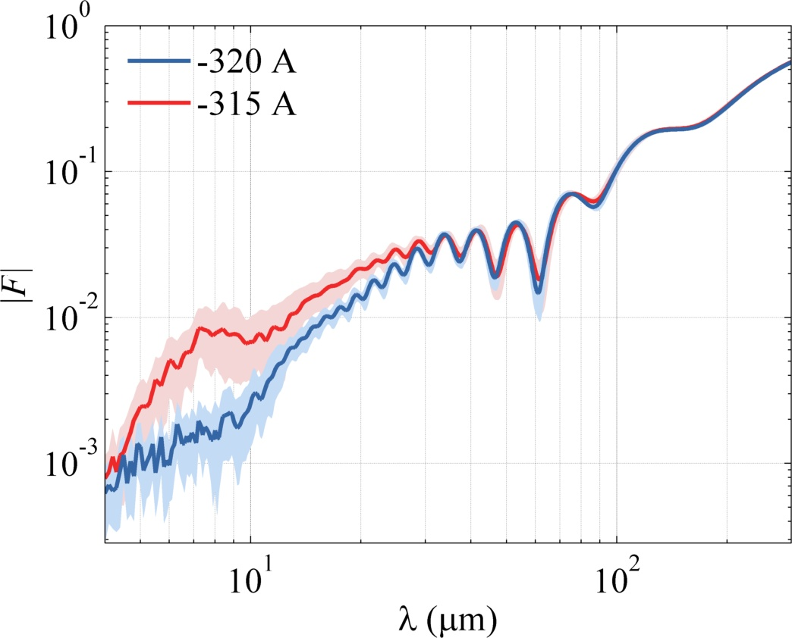
Why Laser Heater: Micro-bunching Instability
Long. Phase Space with TDS
PhD Minjie Yan
Random charge density modulations at the gun can be amplified
=> during bunch compression
=> due to longitudinal space charge
This micro-bunching instability can drastically degrade the lasing process
=> SASE but especially external seeding processes
Gun solenoid I_{S} = -315A
σ_{t} = 167±4 fs
Micro-bunching
Current Profiles
Fourier Transforms to wavelengths
TDS time resolution
Gun solenoid I_{S} = -320A
σ_{t} = 168±3 fs
Spectrum shows peak around 5 - 10 um.

Slide 4

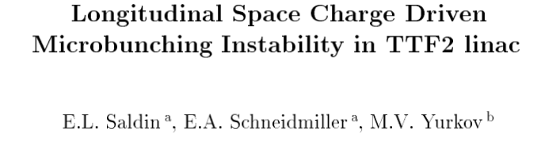
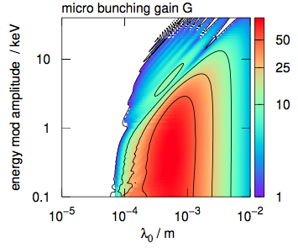
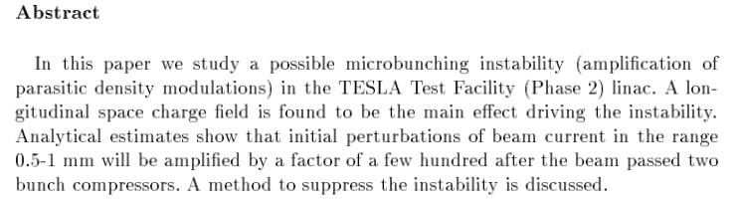
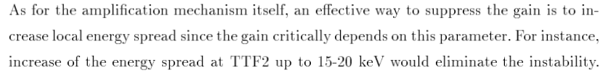
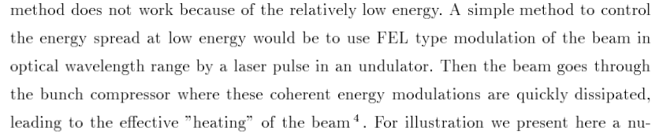
Microbunching Instability at FLASH: Proposal and Simulations
2003
2021
Simulations:
Charge Q = 250 pC, peak current at gun I₀ = 15 A,
Compression C = 70, final peak current I_{f} = 1000A
Factor of microbunching gain
10 – 20 keV
100
How to cure the microbunching instability:
…
O.2 – 1 mm

Slide 5
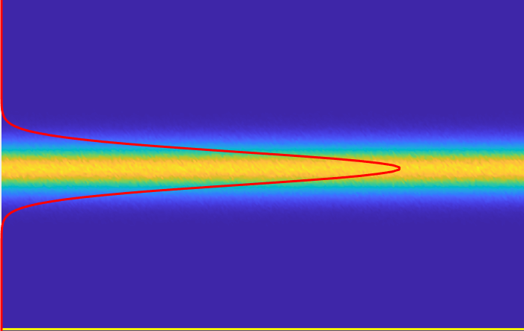
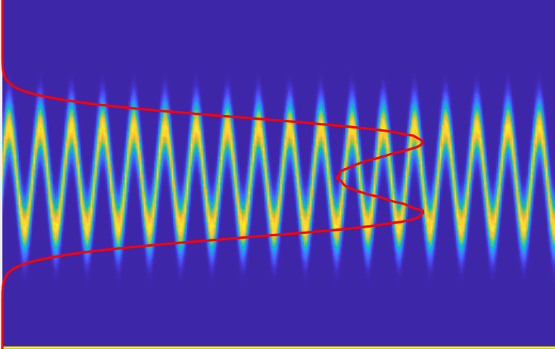
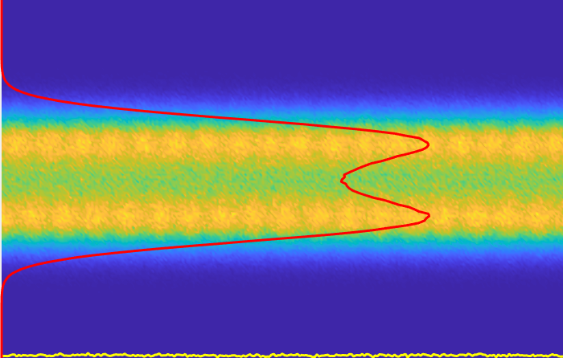
FLASH Shutdown 2021/2022 – Installation of the Laser Heater
Laser Heater
LH Chicane
LH Undulator
D2
D3
Laser Diagnostics
Screen
Screen
D1
D4
D1
D4
Laser
D2
D3
BC1 Chicane

Slide 6
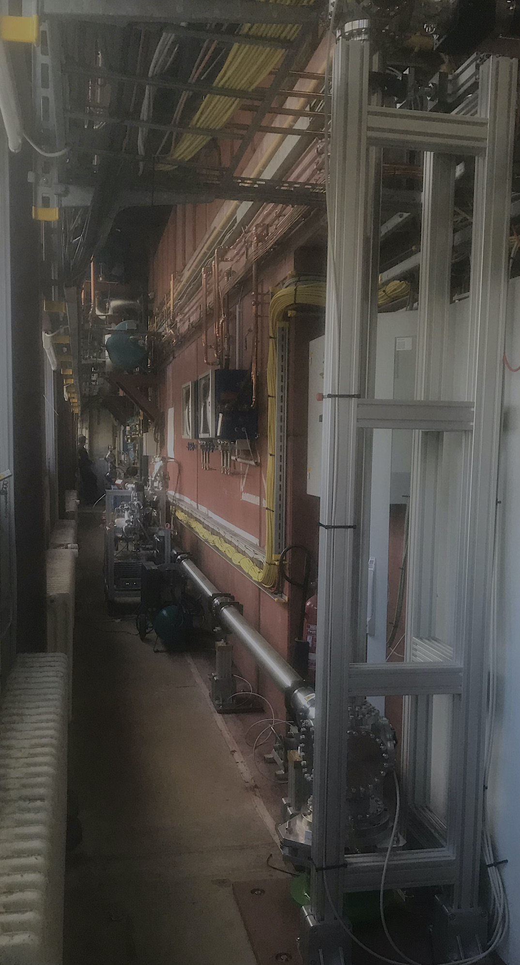
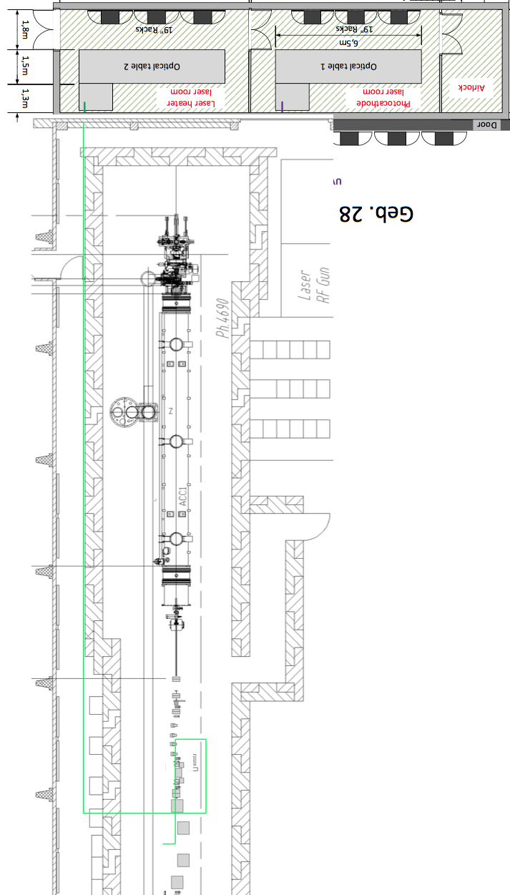
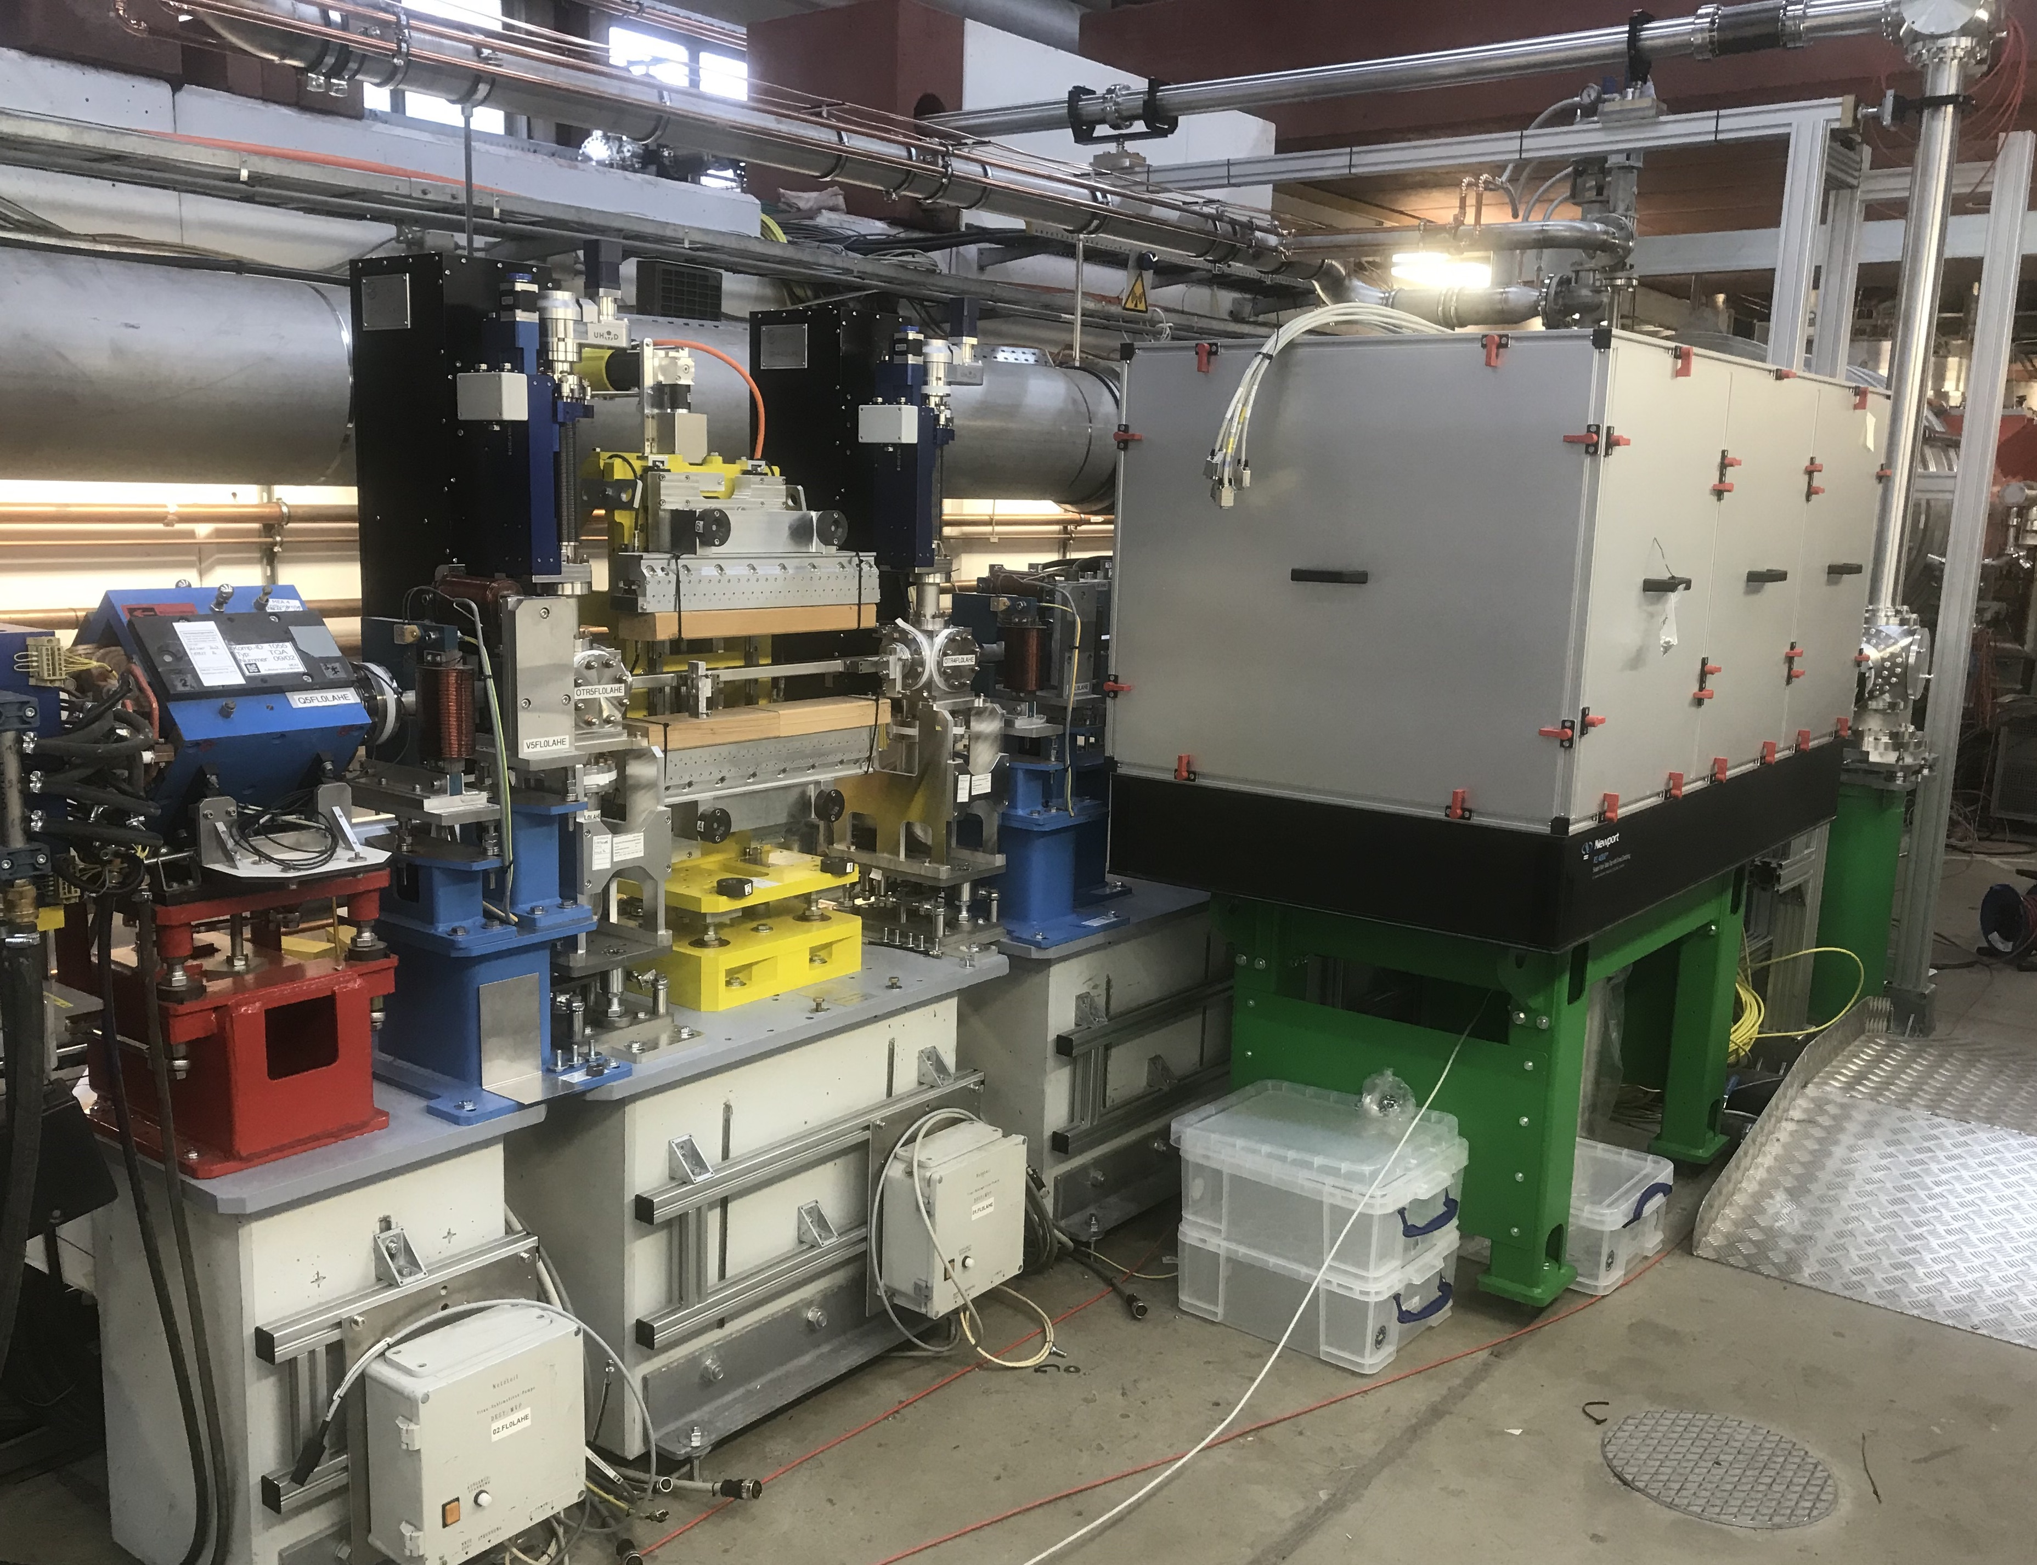
Laser Heater Installation: LH Laser Beamline
FLASH2020+ LH laser beamline:
Use relay-imaging (2 lenses)
=> better pointing stability
=> TEM stabilisation system
DN100 for easier transport (compared to XFEL)
=> relaxes steering through beamline
FLASH
Injector
LH table
LH undulator

Slide 7
7. Outlook <= Slide from kick-off Meeting
A) LH commissioning shifts
Before 25.10.
  Transport through LH Laser beamline with TEM mirror system to In-coupling Table ✅
  Commission Laser Safety system ✅
  Prepare DOOCS servers and panels for LH Laser and equipment on In- and Out-coupling Stations ✅
One shift 25.10. (access to tunnel): prepare spatial overlap e-beam & LH laser beam
  Transport LH laser from In-coupling table to Out-coupling Station
  Commission equipment (diagnostics, motors, etc.) on In- and Out-coupling Stations
  Adjust OTR stations OTR4/5LAHE to see LH laser on CHROMOX screens (MDI required)
Two shifts 25.11. and 27.11.: Achieve temporal overlap e-beam & LH laser beam
  Adjust coarse timing with PD with LH laser pulse and LH Undulator radiation
  Achieve temporal overlap by employing various diagnostics (OTR, BCM signal, PolariX)
  Measurement of induced energy spread vs. LH laser peak power
  Study stability and reproducibility of temporal overlap

Slide 8
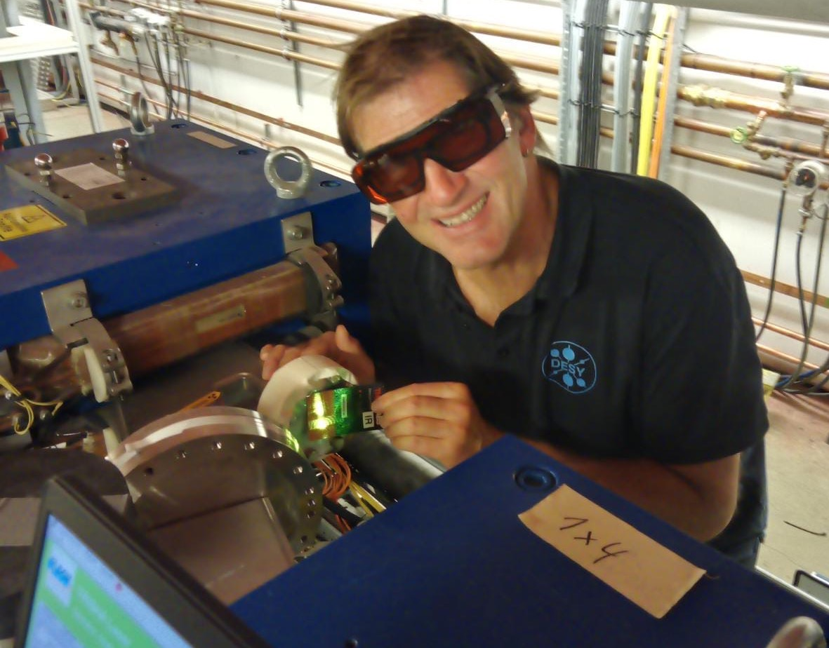
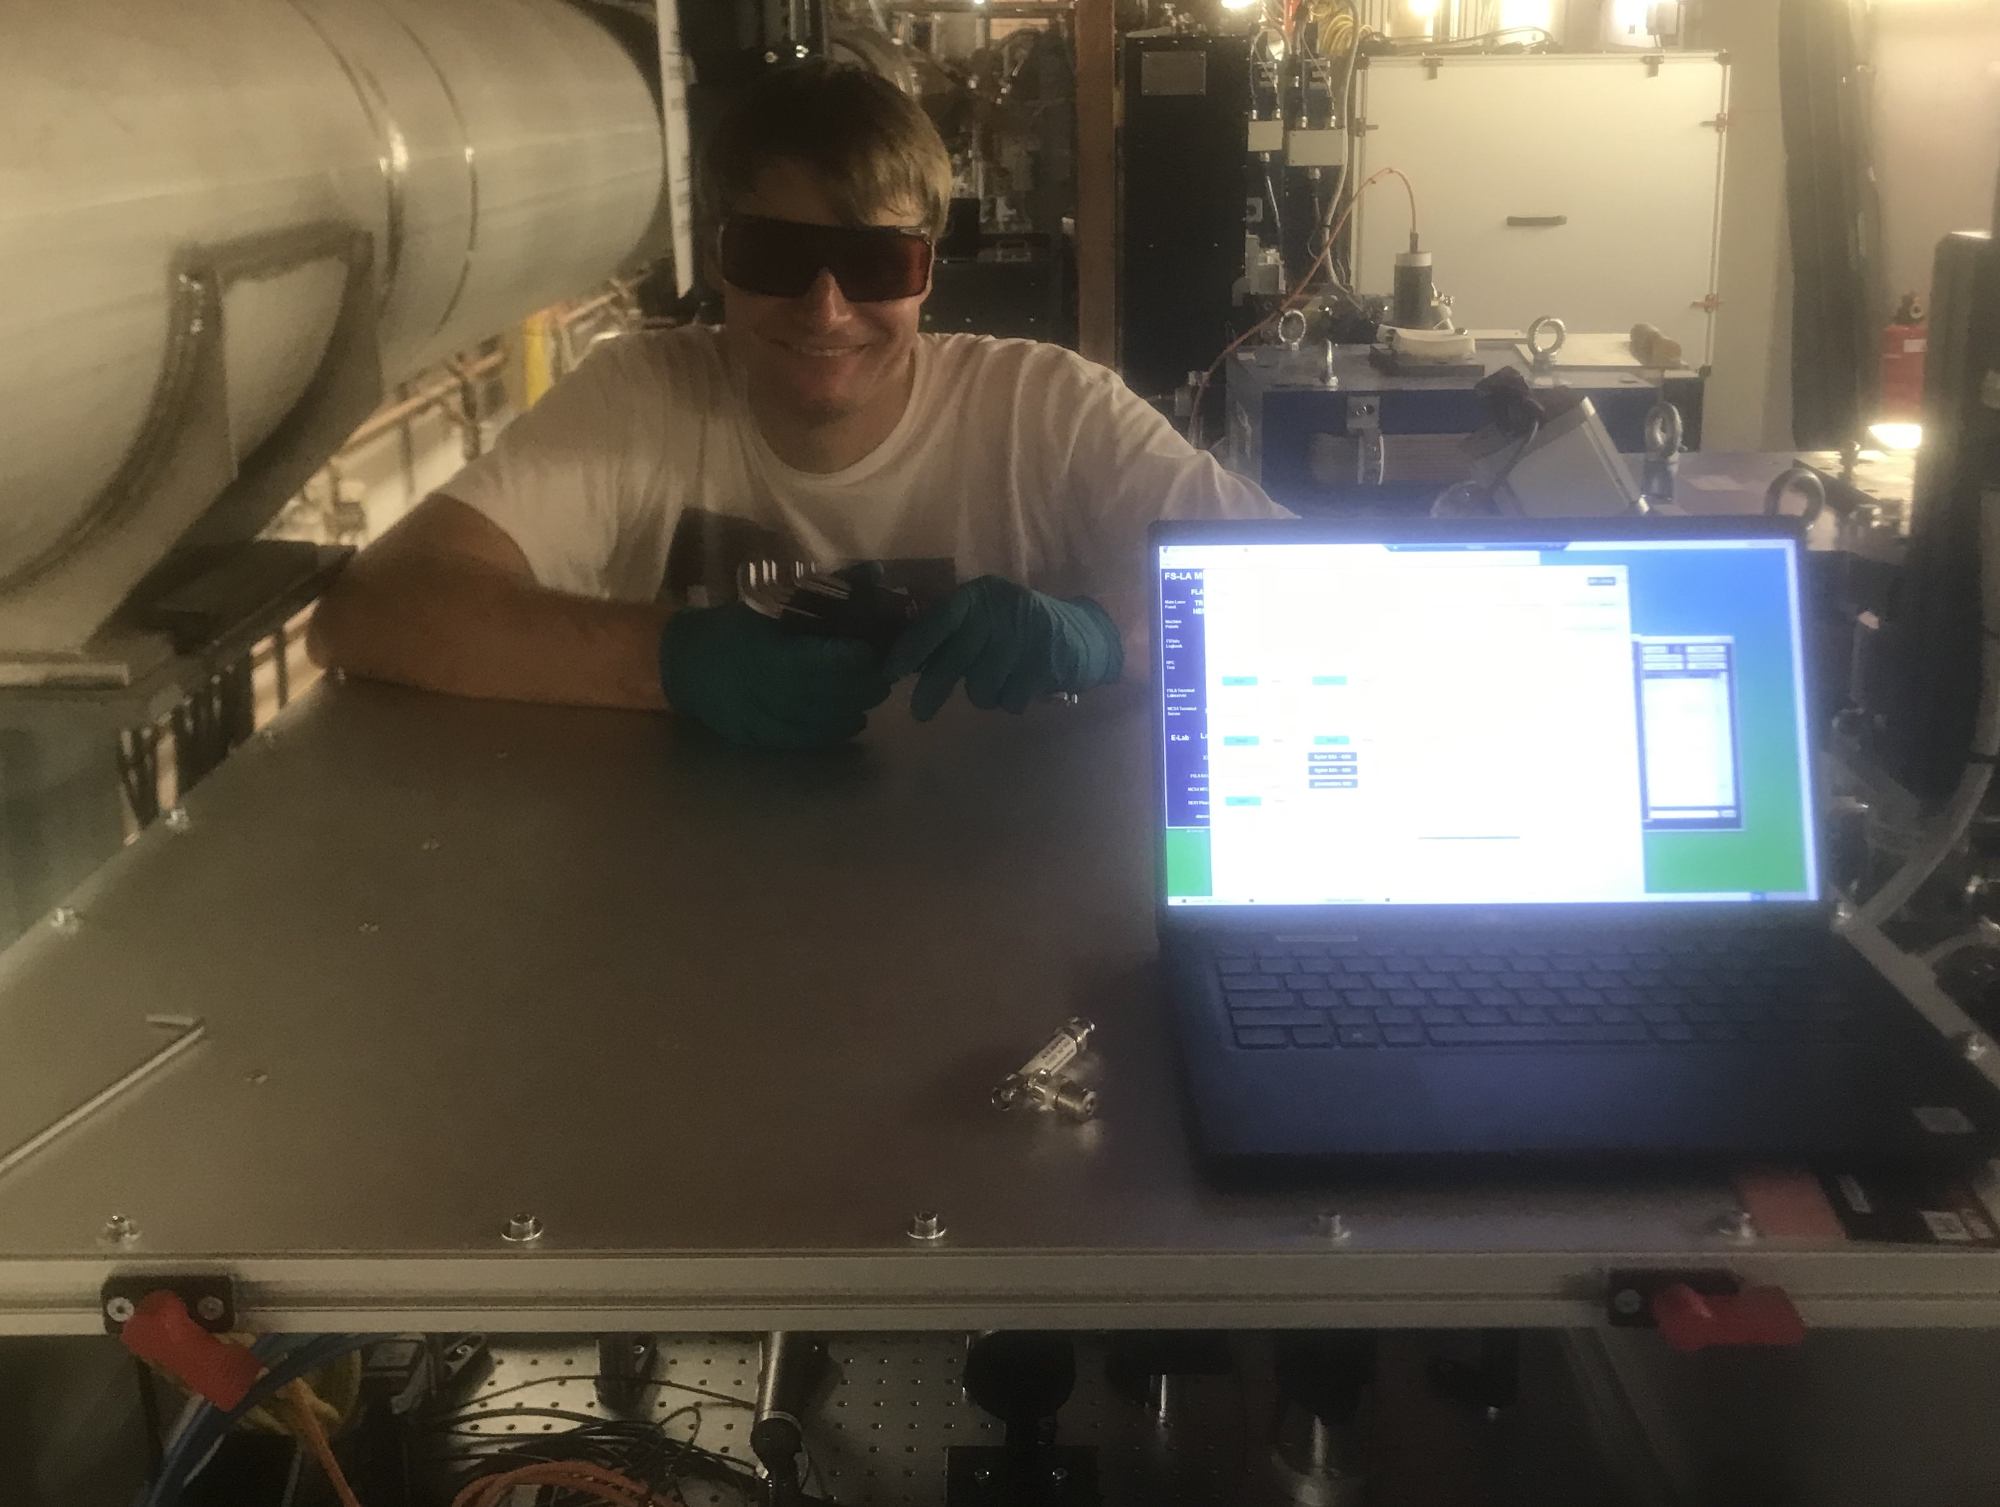
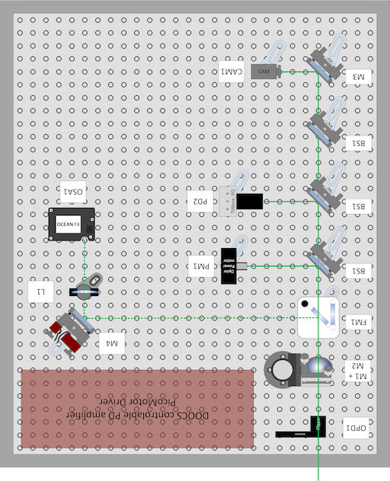
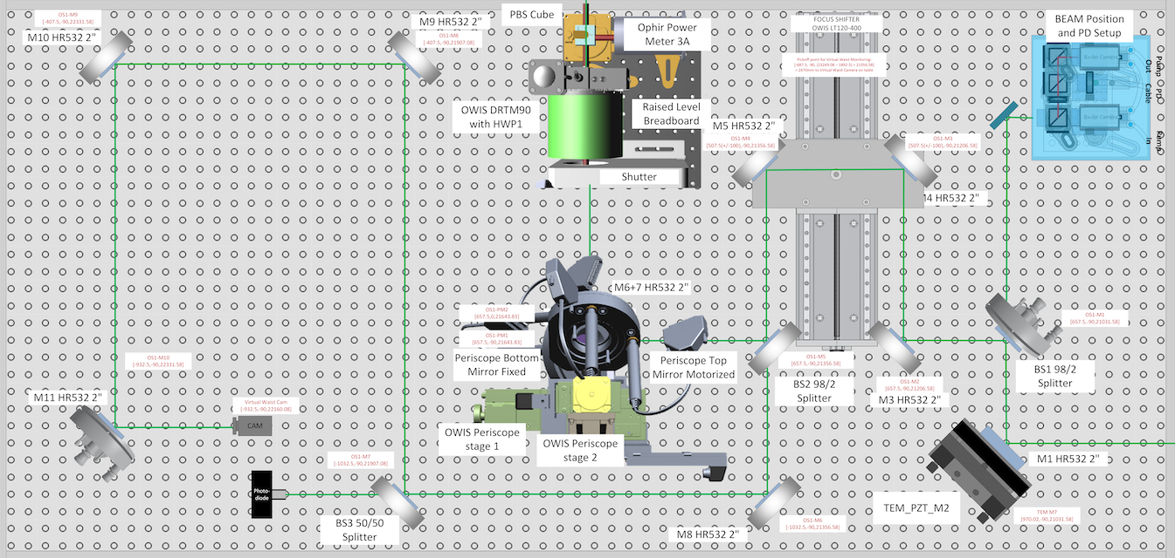
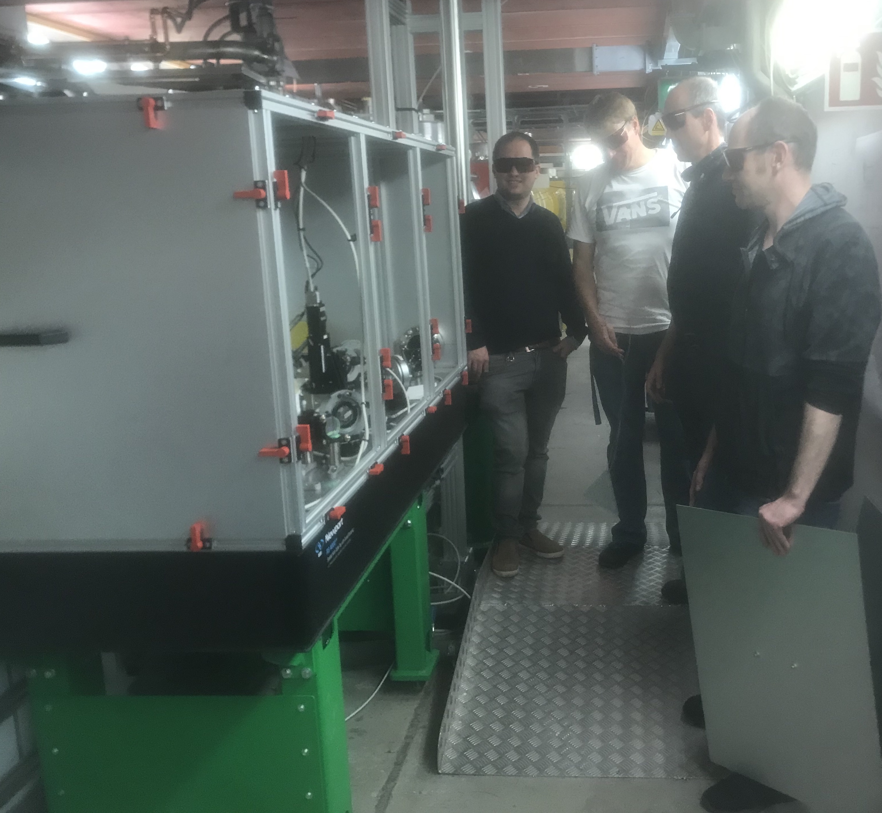
LH Laser Beamline
Laser Heater Installation: In- and Out Coupling Tables (25.10.22)
Tunnel wall
3.2 m
ca. 90 x 90 cm²
LH Laser
Out-Coupling
LH Chicane
D1
Q5
OTR5
LH Undulator
OTR4
D3
D2
H5
V5
H4
V4
D4
D1
Vacuum chamber height only 8 mm!!!
180 x 90 cm²
D2
LH Laser In-Coupling

Slide 9
7. Outlook <= Slide from kick-off Meeting
A) LH commissioning shifts
Before 25.10.
  Transport LH Laser through beamline with TEM mirror system to In-coupling Station ✅
  Commission Laser Safety system ✅
  Prepare DOOCS servers and panels for LH Laser and equipment on In- and Out-coupling Stations ✅
One shift 25.10. (access to tunnel): prepare spatial overlap e-beam & LH laser beam ✅
  Transport LH laser from In-coupling table to Out-coupling Station ✅
  Commission equipment (diagnostics, motors, etc.) on In- and Out-coupling Stations ✅
  Adjust OTR stations OTR4/5LAHE to see LH laser on CHROMOX screens (MDI required) ✅
Two shifts 25.11. and 27.11.: Achieve spatial and temporal overlap e-beam & LH laser beam
  Adjust coarse timing with PD with LH laser pulse and LH Undulator radiation
  Achieve temporal overlap by employing various diagnostics (OTR, BCM signal, PolariX)
  Measurement of induced energy spread vs. LH laser peak power
  Study stability and reproducibility of temporal overlap

Slide 10
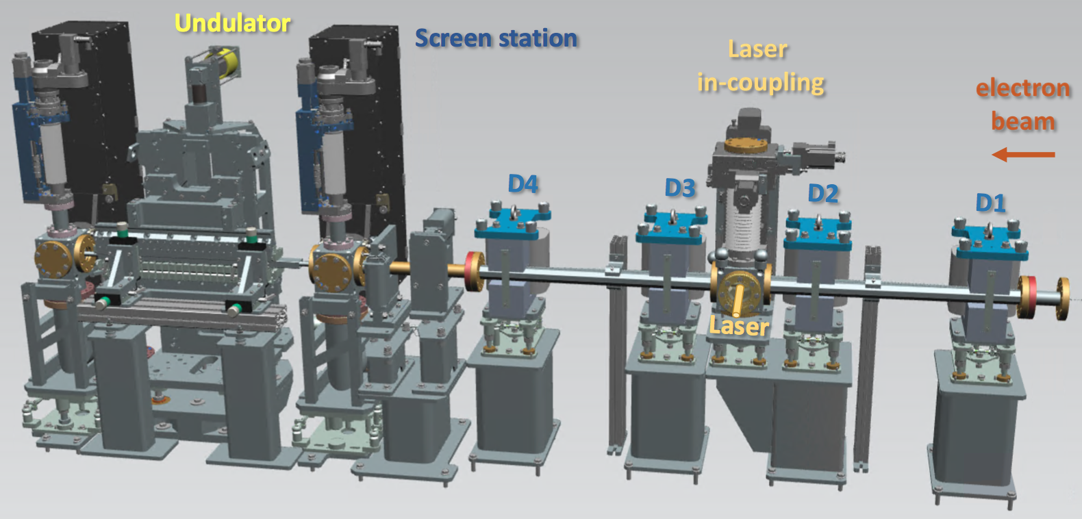
Laser Heater Commissioning (Nov. 2022)
LH chicane had to be switched on and LH undulator to be closed
=> Beam mismatch => No transmission through the machine
OTR
OTR
LH Diagnostics: Instrumentation
Spatial Overlap: Beam size/position of LH laser and e-beam => OTRs LAHE
Temporal Overlap: Coarse (~ns) and fine timing (~ps) of LH Laser and e-beam
  Induced energy spread in a dispersive section => OTR in BC1
OTR in BC1
OTRs LAHE
LHU

Slide 11
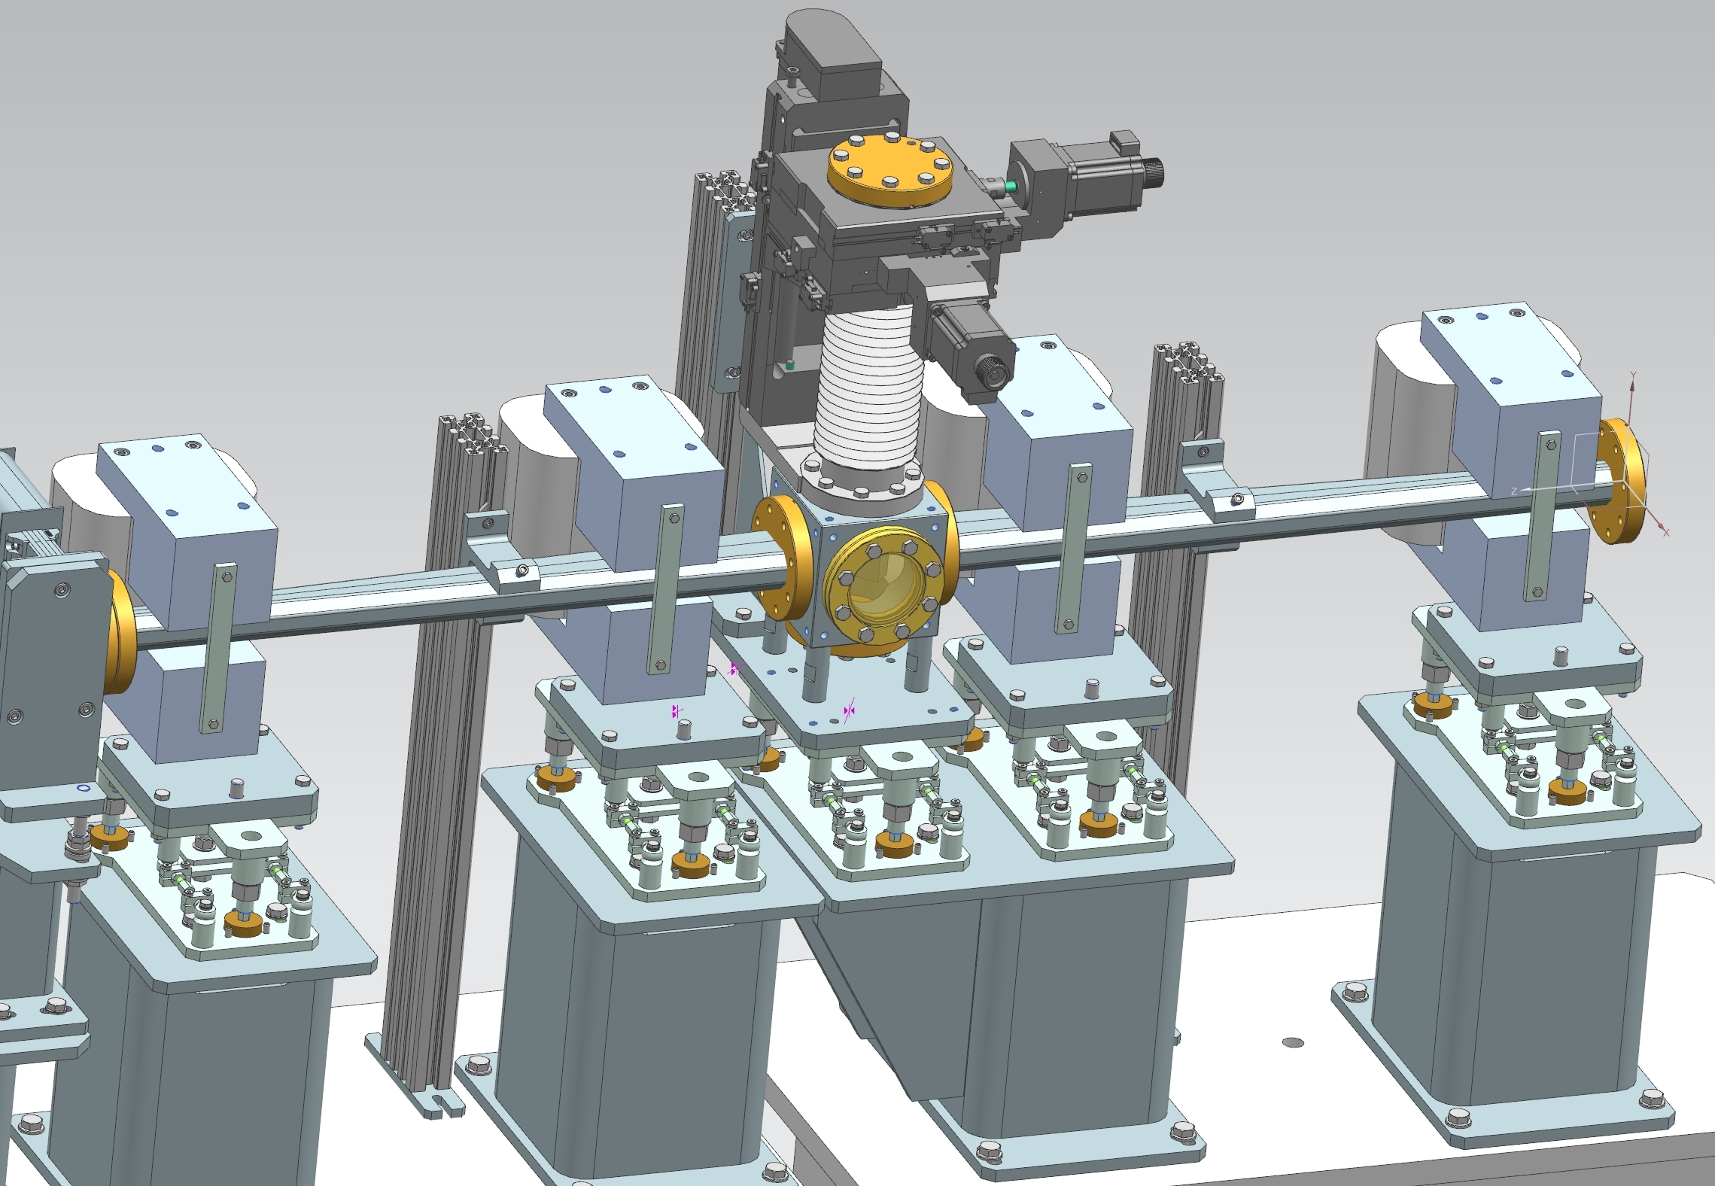
Top view
LH Chicane Commissioning
Dipole magnet
TCA-40,
offset = 30 mm
Dipole magnet
e-beam
TCA-40
17
Chicane offset
35
17
30
34
Nom. beam axis
12
23
Beam in Nov. 2022
Laser Beam
Magnets: Four TCA-40 Steerers (in MEA storage)
Need geodetic and magnetic measurements (MEA)
4 separate PS to correct B-field variations
1st dipole and Mirror Mover in MPS to protect the mirror

Slide 12
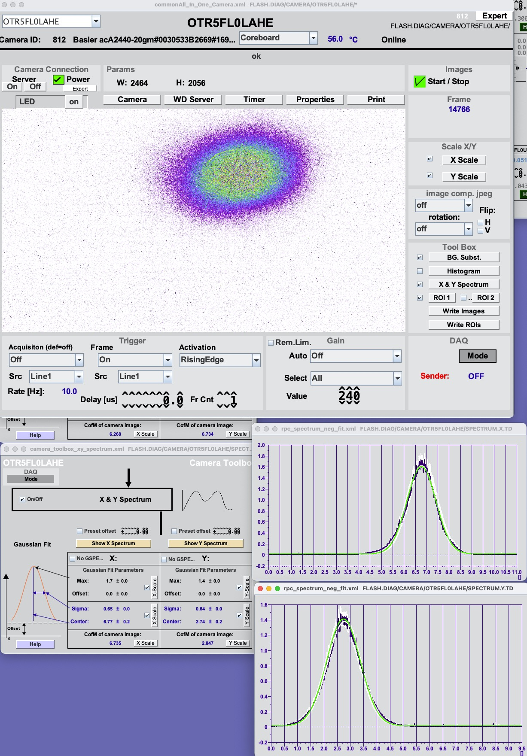
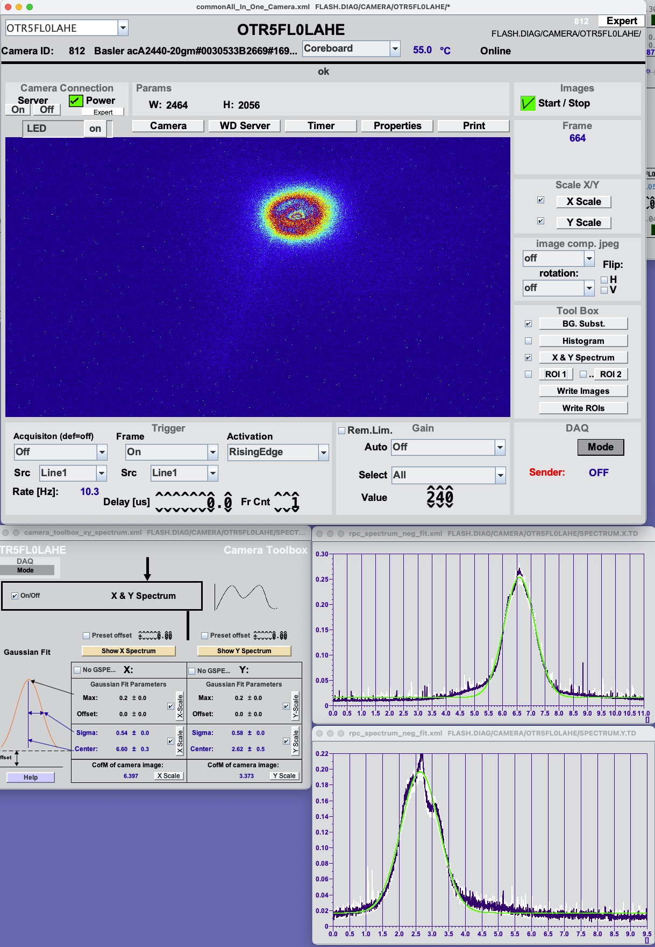
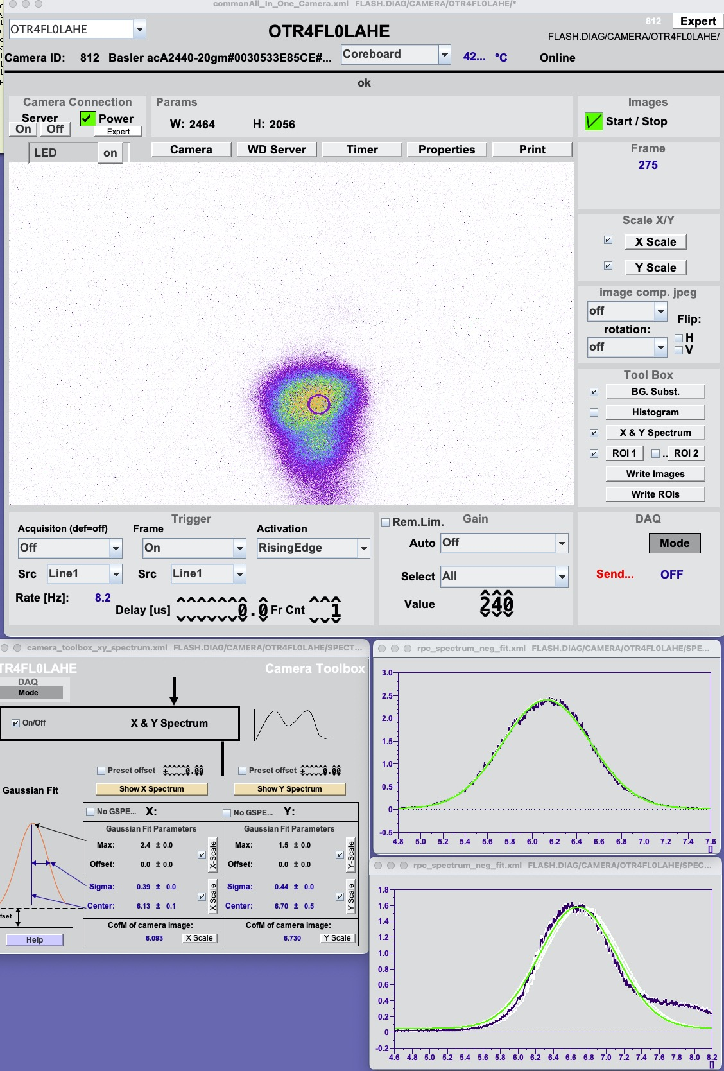
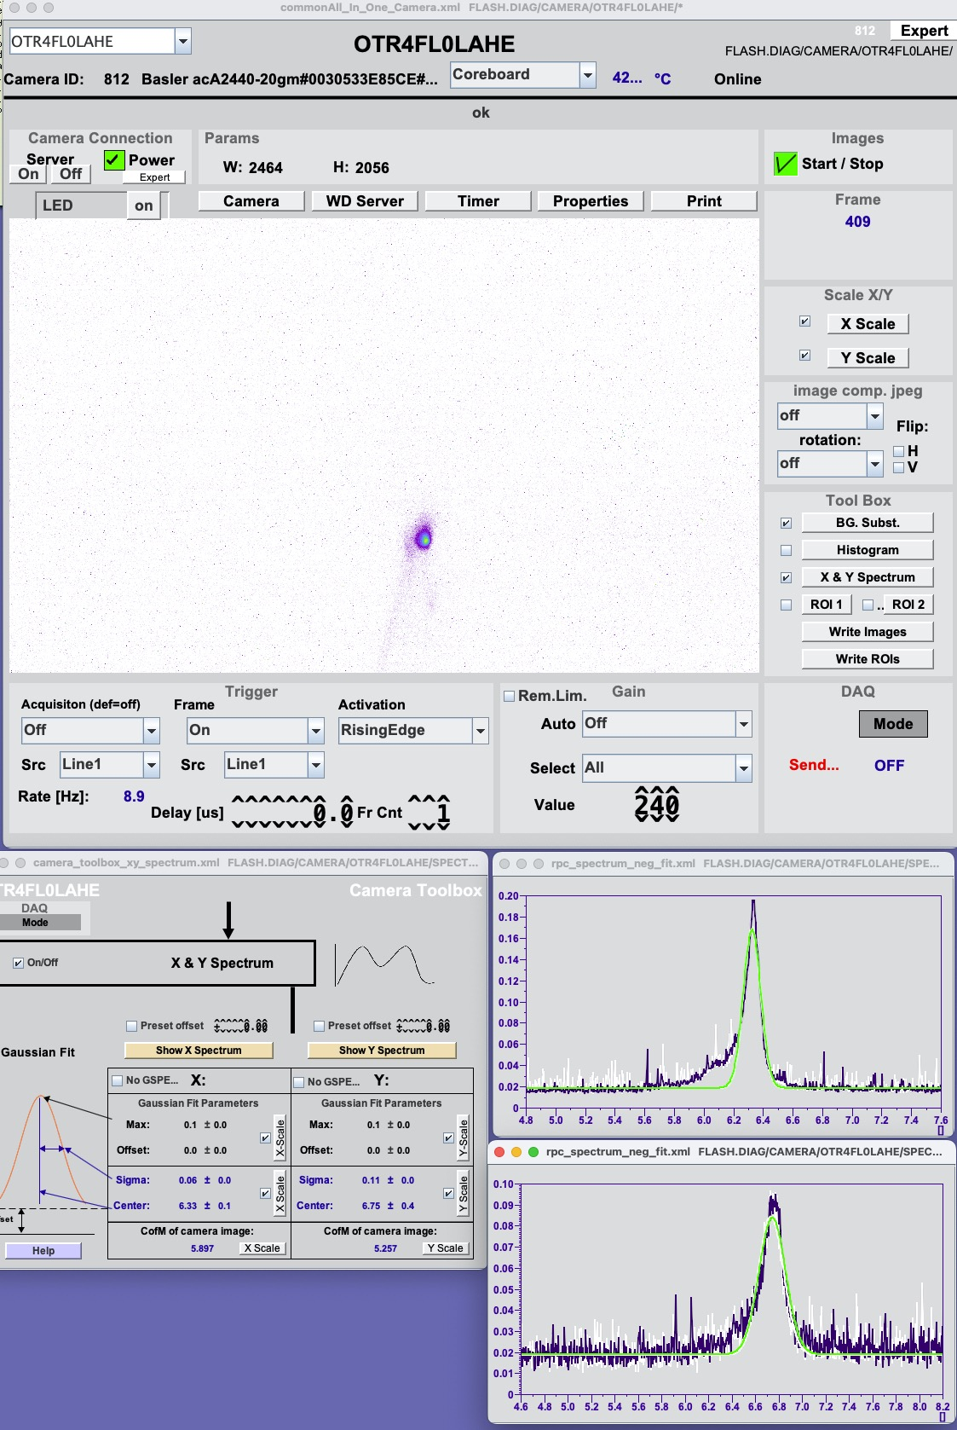
Spatial Overlap: OTR Stations with Chromox Screens
ca. 90 x 90 cm²
BLM5
BLM4.U
LH In-Coupling Chicane
LH Laser
Out-Coupling
D1
D3
Q5
OTR5
LH Undulator
OTR4
D4
D2
D1
H5
V5
H4
V4
BPM5
Nominal
e-beam rms ~ 0.3 mm
Nov. 2022:
e-beam rms ~ 0.5 mm
LH Laser rms ~ 0.6 mm
Jan. 2023:
LH chicane in operation
Correction of LH chicane
Re-matching of e-beam
e-beam rms ~ 0.1 mm
LH Laser rms ~ 0.6 mm
LH laser
e-beam
LH laser
e-beam
D2
LH laser beam expander for adjustment of spot size not in operation yet
Requires more experience

Slide 13
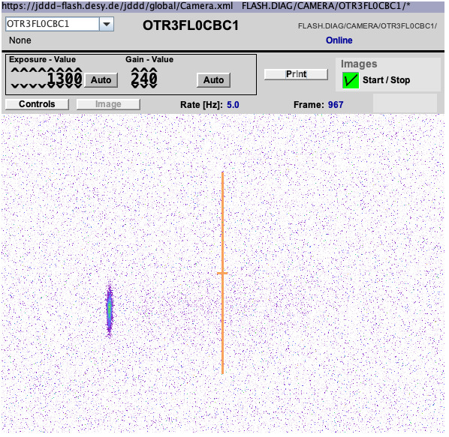
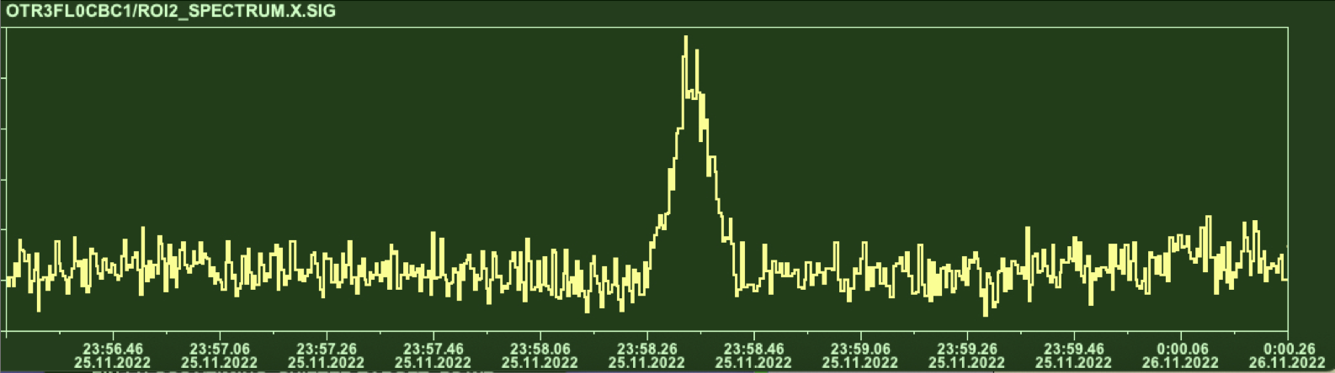
Laser Heater Commissioning
Temporal Overlap: Fine timing (~ps) of LH Laser with
  Induced energy spread in a dispersive section => OTR in FL0CBC1
Increased energy spread = Temporal overlap
First heating of e-beam: 25/11/22 at 23:58
Optimized beam for minimum beam width:
Accelerator settings
Focusing with Quadrupol
e-beam rms width
OTR in BC1
e-beam width
time
LHU

Slide 14
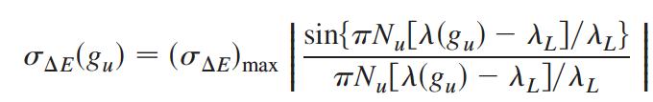

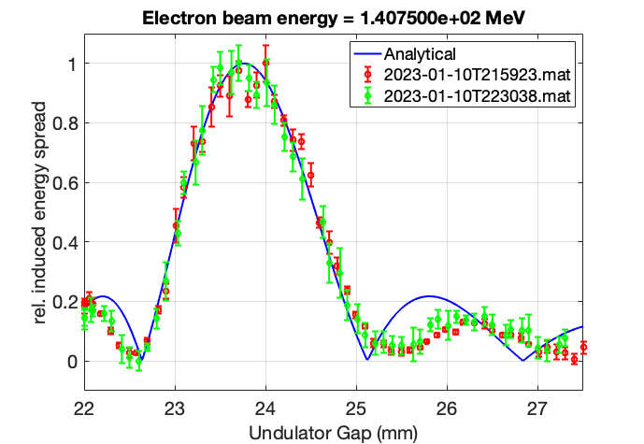
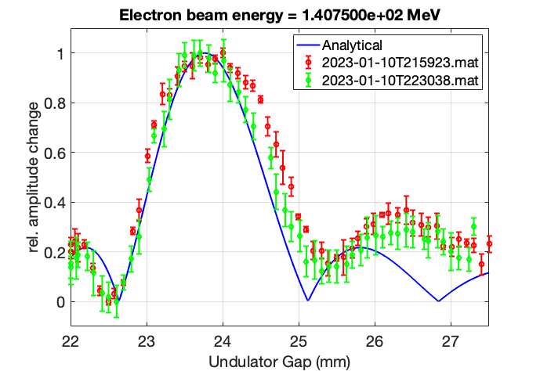
Gap Scan at OTR FL0CBC1 – Jan 2023
Detuning between the LH undulator resonance wavelength and LH laser wavelength
Data from scantool: Gaussian fit to horizontal beam profile
=> “free parameter” is the e-beam energy: 140.7 MeV compared to 143 MeV (or ~ +0.4 mm gap)

Slide 15
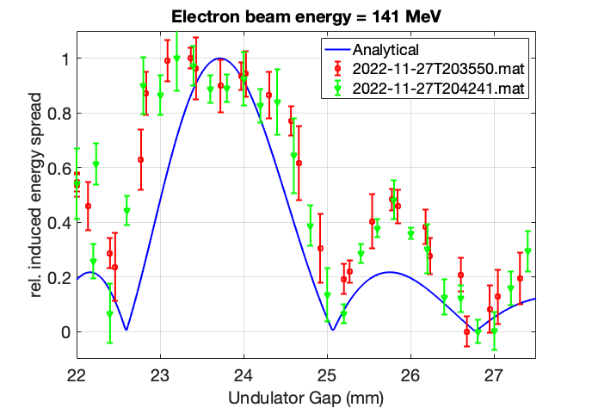
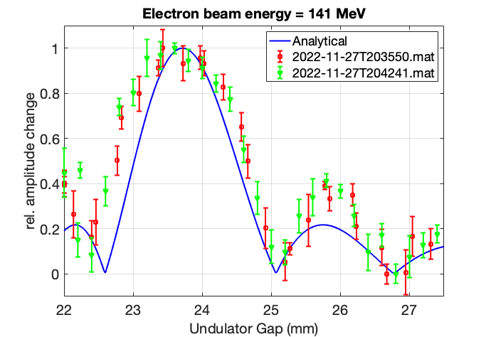
Gap Scan at OTR FL0CBC1 – Nov 2022
Data from Nov 2022 unscaled

Slide 16
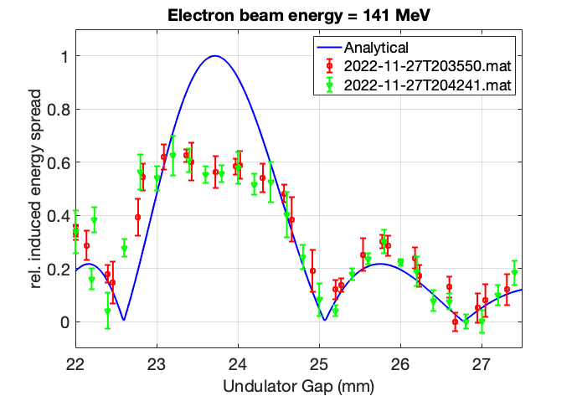
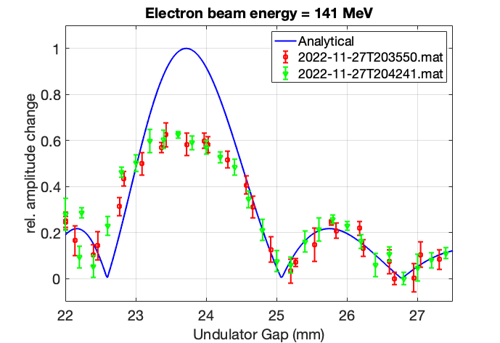
Gap Scan at OTR FL0CBC1 – Nov 2022
Data from Nov 2002 divided by 1.6
=> Heating with high LH laser power is not Gaussian

Slide 17
Laser Heater Commissioning: Jan 2023 (2 shifts)
LH Diagnostics: Modelling
Temporal Overlap: LH Laser and e-beam
  Induced energy spread in a dispersive section => OTR in BC1 => Results by Dmitrii
  Measurement of integrated radiation intensity => photodetector in NIR (1–5 μm) at 28g => next slides
  Transverse Deflecting Structures
    Induced Slice energy spread with TDS in a dispersive section => LOLA or PolariX
    Measurement of MBI structures => LOLA / PolariX => next slide and results by Philipp
OTR in BC1
28g
LOLA
PolariX

Slide 18
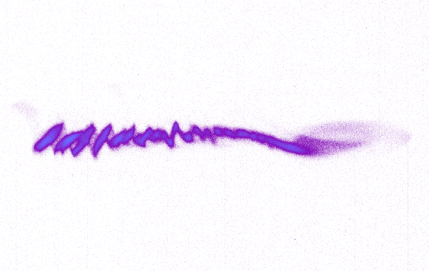
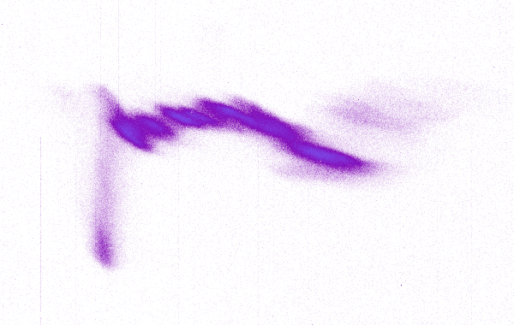
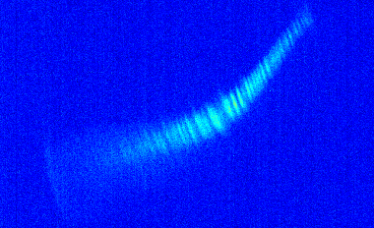
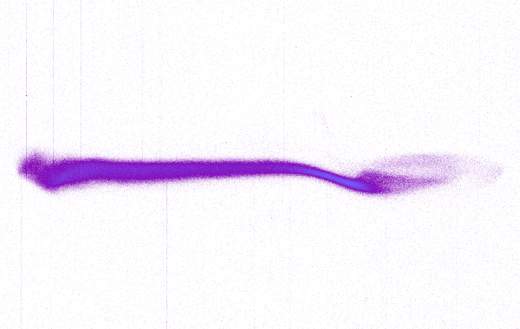
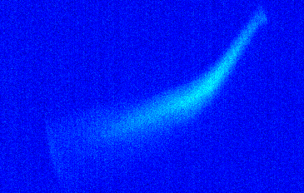
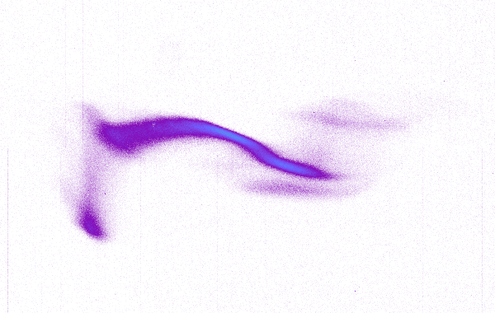
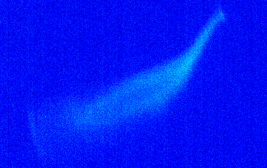
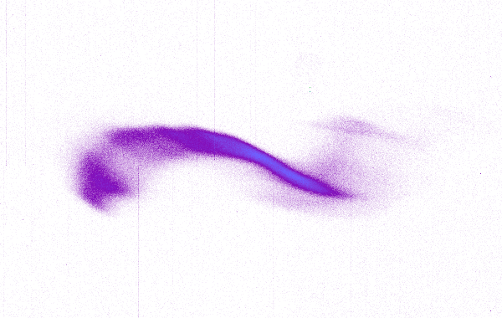
LH Commissioning
MBI: micro-bunching instability ⬄ unwanted bunching
MBI studies with LOLA and PolariX
PolariX
FEL lasing
Bunch „optimized“ for MBI
LOLA
LOLA
LH off
Strong MBI
LH low intensity
MBI washed out
Non-Gaussian
heating
More results of MBI study by Philipp Amstutz …
LH full intensity
e-beam „blown up“

Slide 19
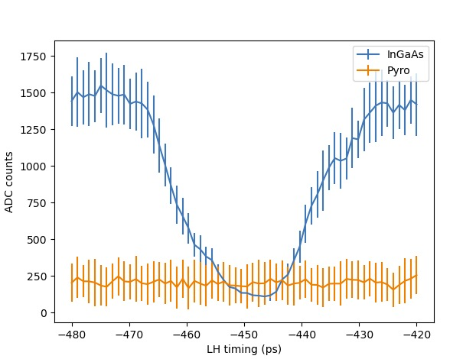
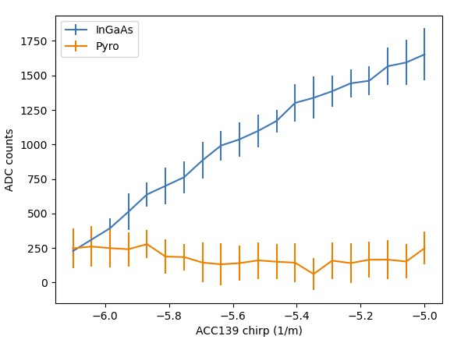
28g
InGaAS Detector
1) Machine Setup for Seeding bunches
2) Compression scan
Timing Scan

Slide 20


LH Commissioning: Effect on FEL process
1) LH full intensity: e-beam „blown up“ => SASE destroyed
2) Optimize LH laser power for FEL
Timing Scan
No overlap
overlap

Slide 21
Backup Slides

Slide 22



A look to Laser Heaters at other Facilities
LCLS
2004: Design: https://journals.aps.org/prab/abstract/10.1103/PhysRevSTAB.7.074401
2010: Commissioning: https://journals.aps.org/prab/abstract/10.1103/PhysRevSTAB.13.020703
FERMI@Elettra
2014: Commissioning: https://journals.aps.org/prab/abstract/10.1103/PhysRevSTAB.17.120705
PAL-XFEL
2017: Commissioning: https://www.sciencedirect.com/science/article/pii/S0168900216311214
PAL-XFEL
LCLS
FERMI
LH undulator in a small chicane (easy for in- and out-coupling of the LH laser beam (TiSa: ~800 nm))
R₅₂ of 2nd part of LH chicane is used to ‘smear out’ the energy modulation
Risk of residual density modulation in BC that is not smeared out completely => ‘trickle’ heating (see LCLS 2010)

Slide 23



3. FLASH Laser Heater: Analytical Calculations
Different laser beam sizes
Matched laser and e-beam size
15 – 20 keV
Note: FLASH has largest γ and σ_{L}
Other facilities have huge overhead in laser power
Not much overhead in laser power:
more challenging for finding timing overlap
Peak power of 2 MW requested
LH Laser delivers > 6 MW

Slide 24
OTR
OTR
5. Laser Heater Commissioning
LH Diagnostics: Instrumentation
Undulator Gap: Resonant wavelength => Spectrometer in BC1
Spatial Overlap: Beam size/position of LH laser and e-beam => OTRs LAHE
Temporal Overlap: Coarse (~ns) and fine timing (~ps) of LH Laser and e-beam
  (Typical at other facilities: TDS in the injector)
  Induced energy spread in a dispersive section => OTR in BC1
  Induced Slice energy spread with TDS in a dispersive section => LOLA or PolariX
  Measurement of integrated radiation intensity => photodiode in NIR (1–5 μm) at 28g
  Measurement of MBI structures => LOLA / PolariX
OTR in BC1
28g
OTRs LAHE
LOLA
LHU
Spectrometer
PolariX

