Slide 1
Sustainability Onno, dCache workshop, 2023-06-01

Slide 3
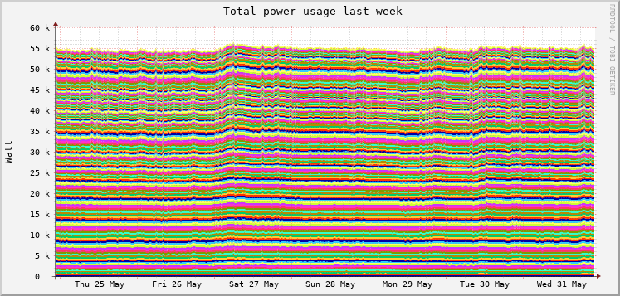

Slide 4
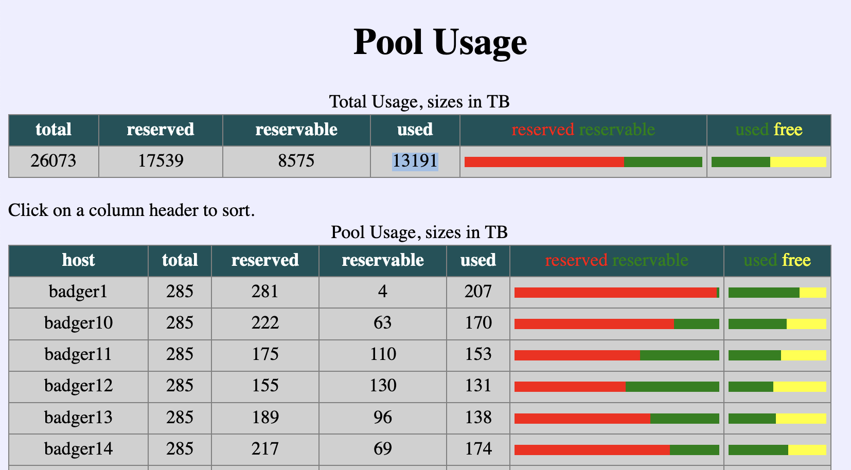

Slide 5
Our dCache uses ~5W per stored TB. At the moment a little bit less because of decommissioned hardware Reading & writing does not make a big difference

Slide 6
Low hanging fruit Move data to newer servers that use less watt per TB. Switch off the old servers.

Slide 8
Wrap-up
Moving data from old, small, inefficient servers to new, large, efficient servers and switching them off early is an easy way to reduce energy consumption.
Still investigating environmental impact, especially production of the hardware. When we have time.
Haven’t looked at hardware energy settings yet.
“Green” electricity often based on certificates – doesn’t help. Buying locally produced green electricity may stimulate energy suppliers to become more sustainable.
All this pales in comparison to the effect you can have as a climate activist.

Slide 9
Links
https://ganglia.grid.surfsara.nl/cgi-bin/usage.py
https://ganglia.grid.surfsara.nl/power.php

