Slide 1
Detector Software Integration
Andrea Parenti, Cyril Danilevski
DET Workshop, 18/9/2023

Slide 2
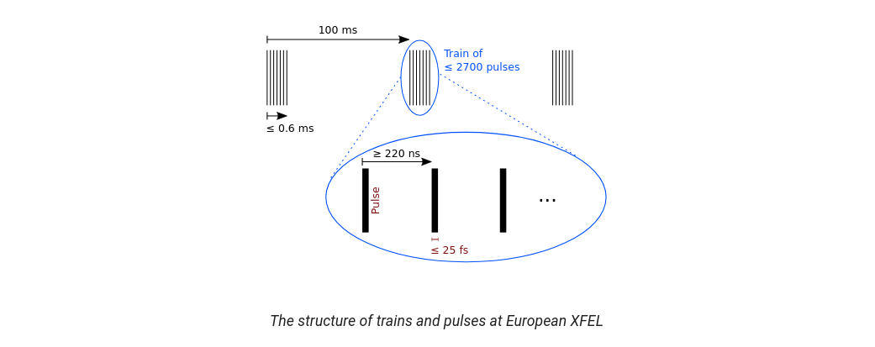
The Setup
European XFEL generates a pulse train of up to 2700 individual X-ray pulses, at a rate of 10 trains per second.
Within a train, pulses arrive with a maximum frequency of 4.5 MHz.
Each train receives an unique train ID, which is used to find and match up data.
Some kinds of data are recorded once per train, others may be per pulses, some have even higher sampling rates.
Notes:
Introduce briefly the beam structure here, and elaborate in the next slide the need to control and DAQ.

Slide 3

The Setup
3 types of detectors:
  Commercial detectors (e.g. Cameras, Spectrometers) ➔ the easiest ones to integrate
  “Semi-commercial” detectors (eg. JUNGFRAU developed at PSI)
  Bespoke large detectors (AGIPD, DSSC, LPD) ➔ the most complex
Karabo: European XFEL’s Control System
  Control
  DAQ
  Monitoring
Notes:
Consequently, we have a need for bespoke detectors.
We can consider 3 types of detectors at XFEL:
Large detectors made for XFEL
“Semi-commercial” detector from which we benefit from a close relation with the developers
Commercial, which we are provided an SDK to integrate and regular customer support

Slide 4
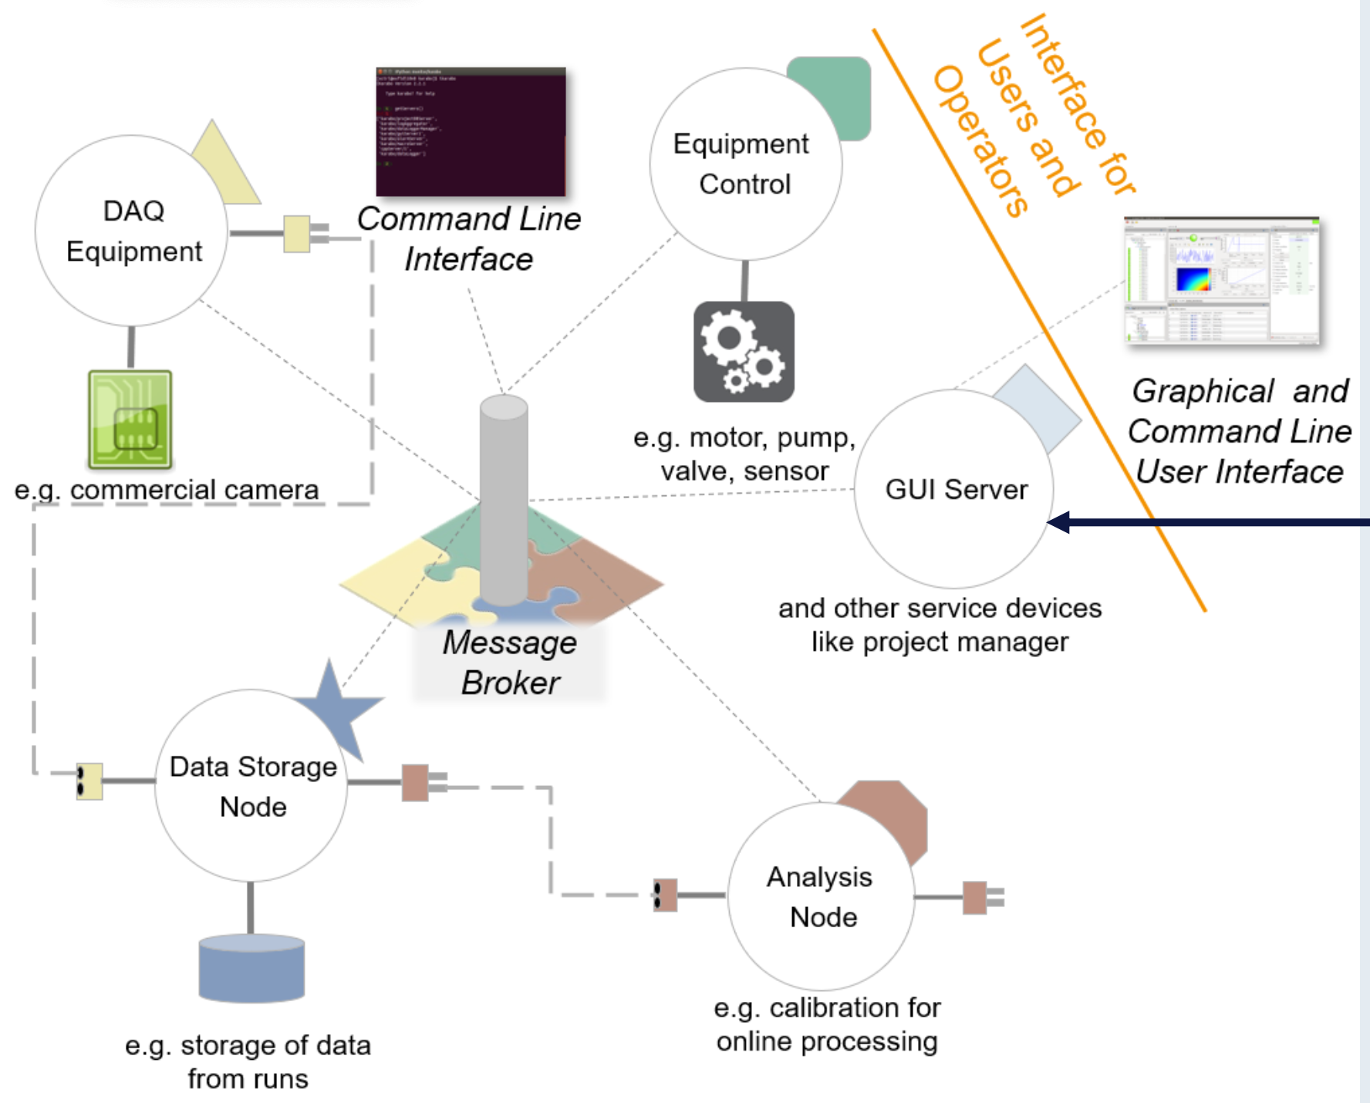
The Karabo Control System
Distributed system of devices that communicate with each other through a message broker
A device can be a physical device, like a motor or a camera, or a logical device
Devices are aggregated in Topics. Each XFEL instrument has its own Topic – e.g. MID, SPB, SCS
The GUI Client allows Scientists and Engineers to interact with and control the devices in a topic

Slide 5
The Karabo Control System
Its tight coupling of controls and DAQ is meant for large bespoke detectors
  DAQ is generic for all data source
  Centrally stored, centrally accessible
Control Integration enables orchestration of different parts
  Power procedures
  Dark procedures
  Interlocking ensures operations under safe conditions
  Vitals (eg. temperatures, power)
Data previews enable near real-time experiment feedback

Slide 6
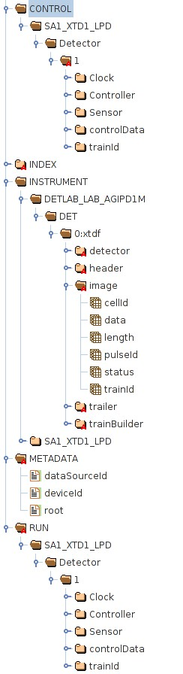
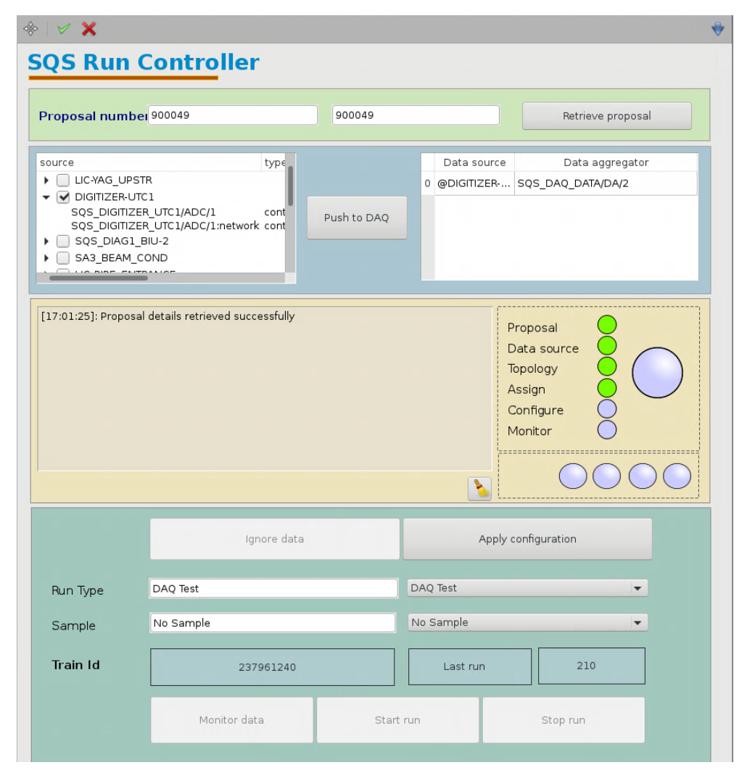
The Data Acquisition (DAQ)
Uniformity is key
Anything in Karabo can be recorded
One Manager
One central storage
One portal to access data
Everything indexed by trainId
➔ FAIR Data
Findeable, Accessible, Interoperable, Reusable

Slide 7
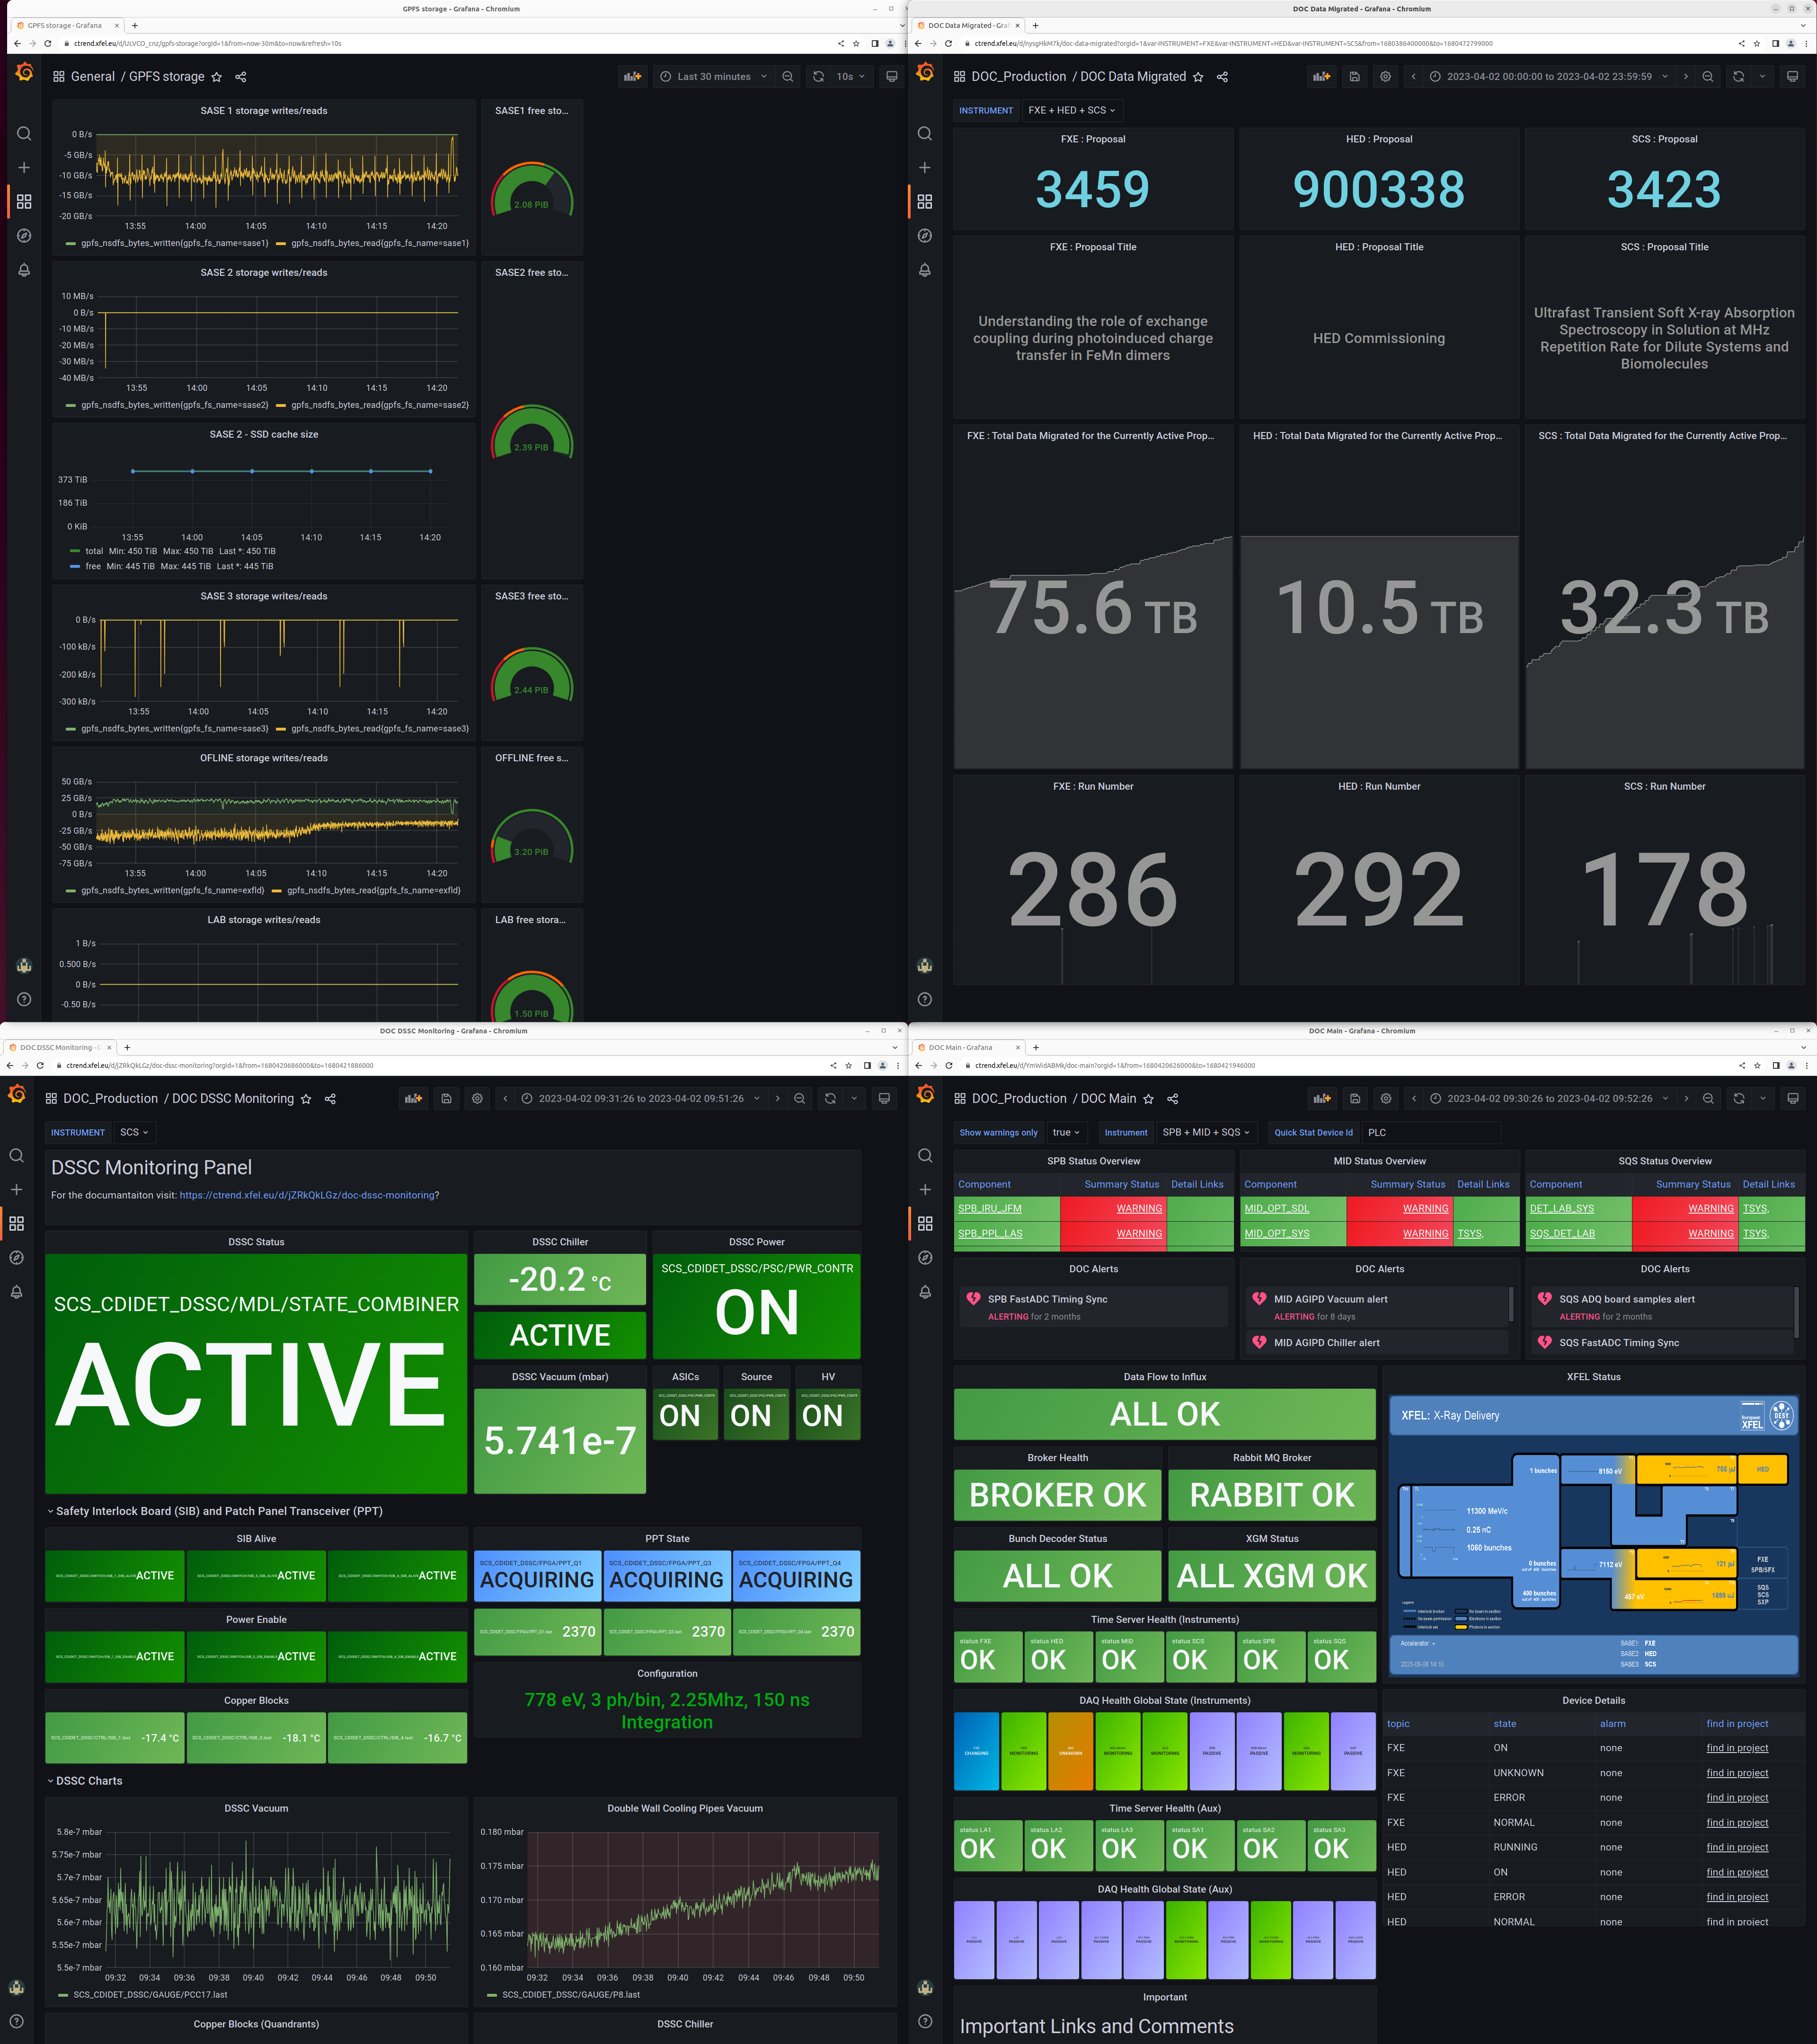
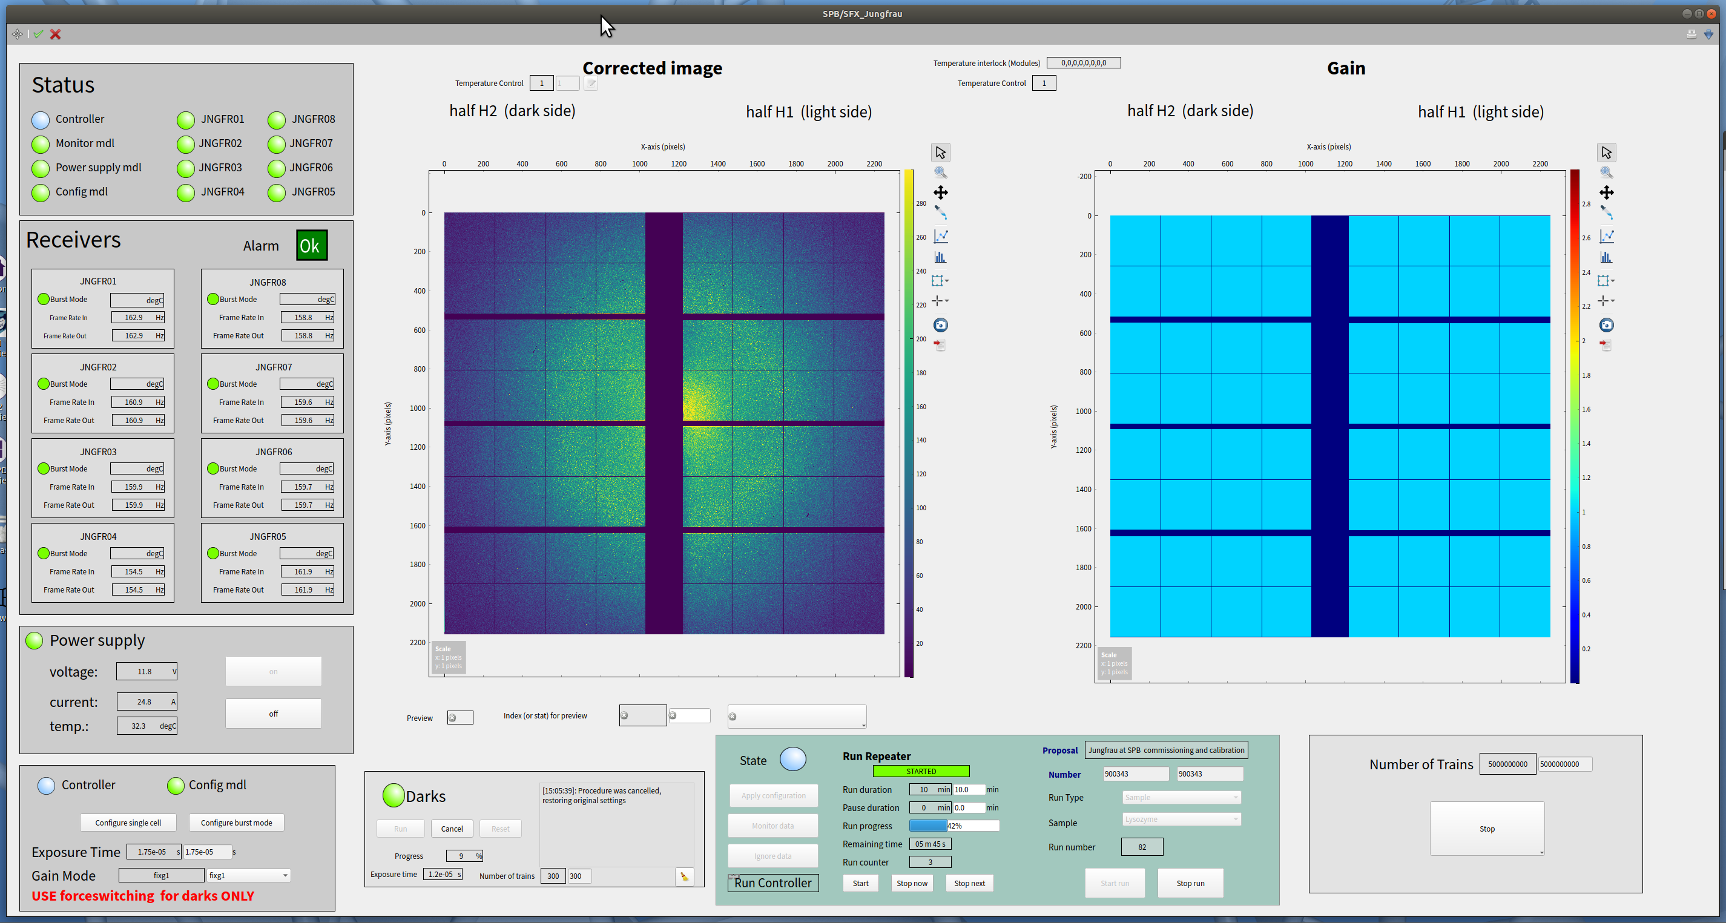
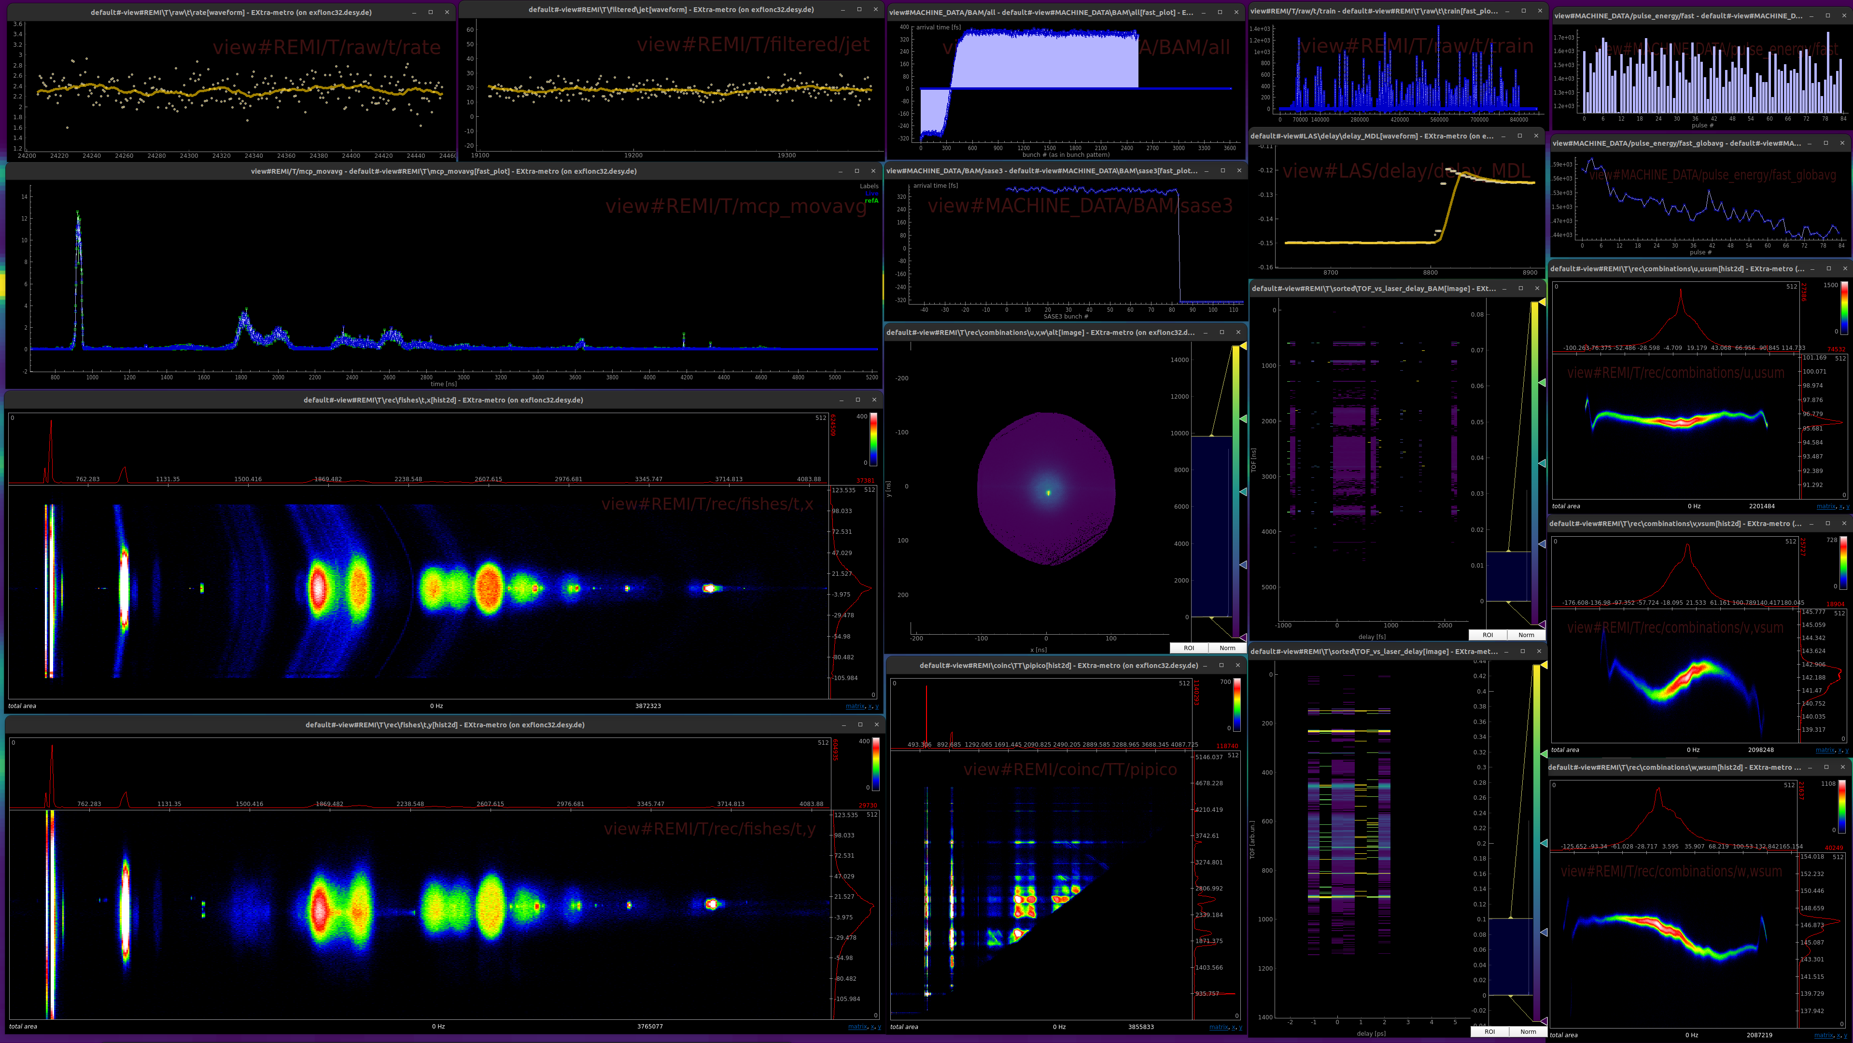
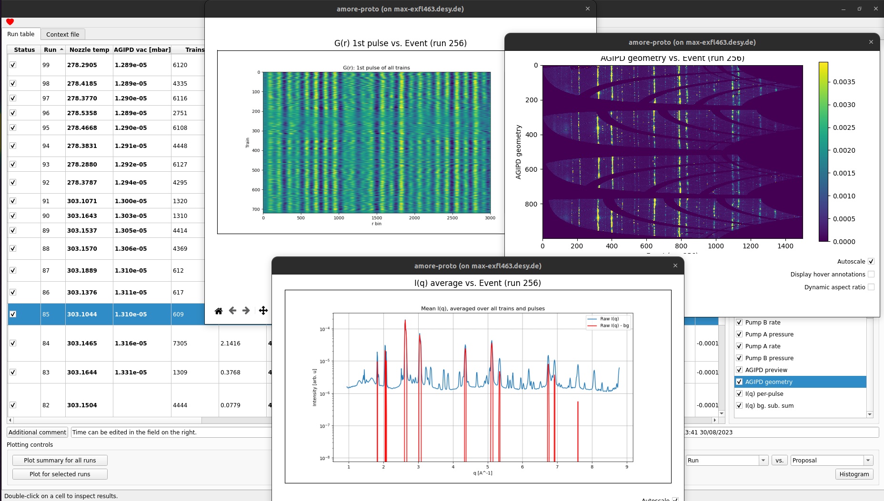
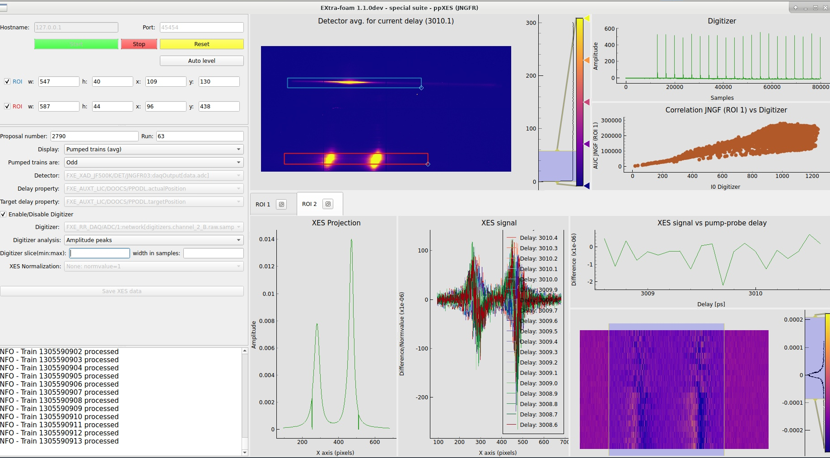
Control and Preview
Detector and facility monitoring
Online and Offline Analysis
Notes:
A typical monitoring view, in Grafana, featuring facility status, detector activity, and storage information

Slide 8
Detector integration in Karabo
Karabo offers C++ and Python API on Linux
Prerequisite for a standard integration is therefore a C/C++ library, a Python module or well defined communication protocol
  In case of external library, open-source is a plus as it enables to investigate ourselves bugs and create (or suggest) fixes
  Use of standard protocols* can also be beneficial, as already existing and well tested libraries can be used for the integration
* e.g. GenICam for Ethernet or USB cameras

Slide 9
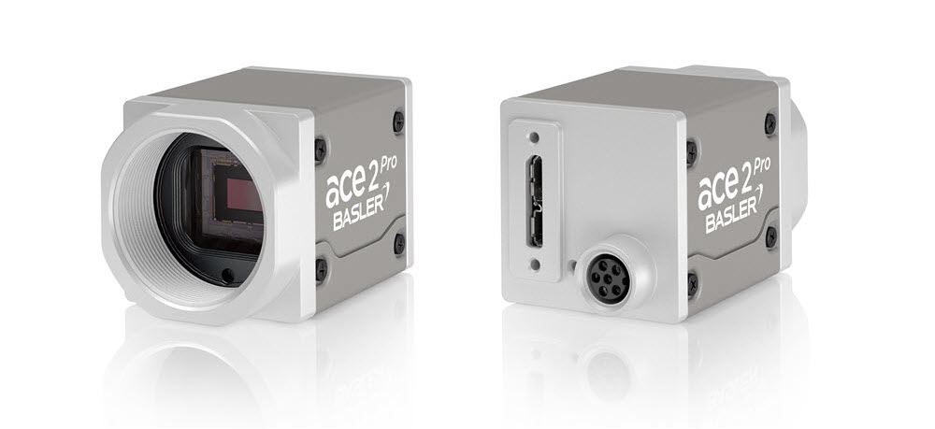
Zoom on Commercial Detectors: Basler Cameras
650+ Basler cameras in the facility, 30+ models from 1st and 2nd generation (according to the inventory)
Selected because of standard interface (Ethernet) and standard communication protocol (GenICam)
“Easy” to integrate: only control device and possibly remote power
Vendor provided GUI (PylonViewer) used for first tests and diagnostic
Integration into the control system is needed to have data stored by DAQ (NB synchronization of the sources is crucial!)
Originally integrated in Karabo via the LImA library (Python), currently via the ARAVIS library (C)
  Both can support cameras from several vendors, thus most of the Karabo code is in a base class
  Integration of other “compliant” cameras can be done with “small” effort
Large range of models supported by just two Karabo devices (for 1st and 2nd generation cameras)
Default scene is provided by the device (and full access to all parameters via the navigator panel)
Custom scenes can be created by instruments with no coding

Slide 10
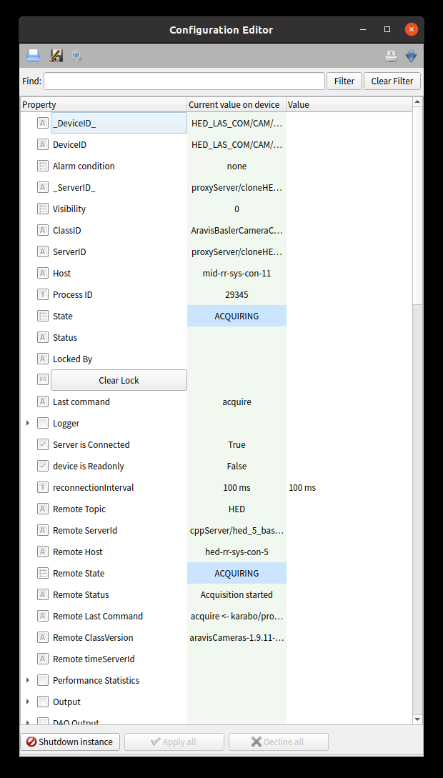
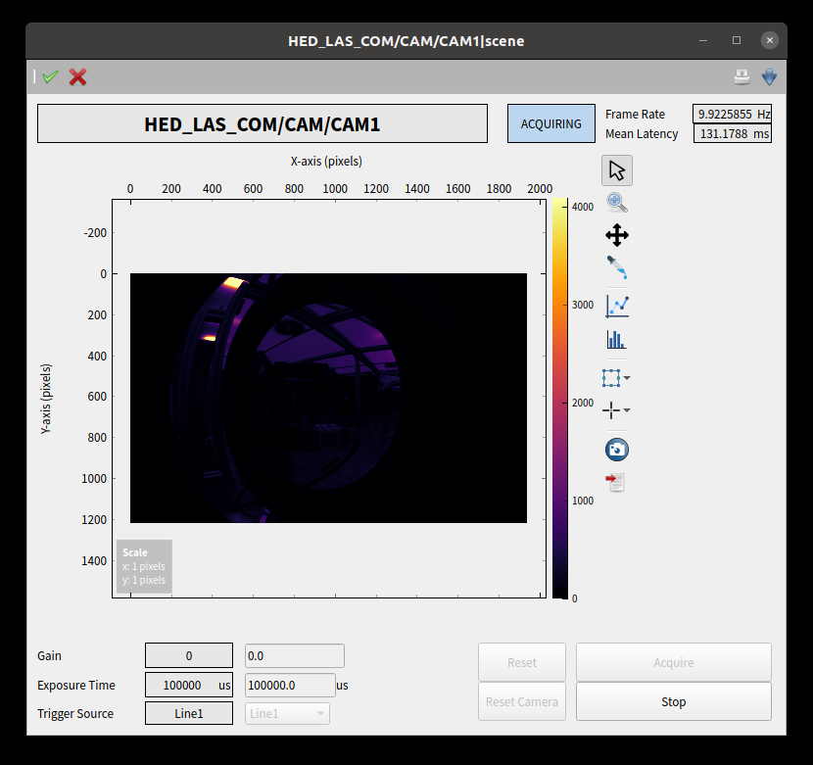
Device provided scene and expert view
The Karabo device provides a default scene with the most important settings
All other (implemented) settings are available in the “navigator” GUI panel

Slide 11
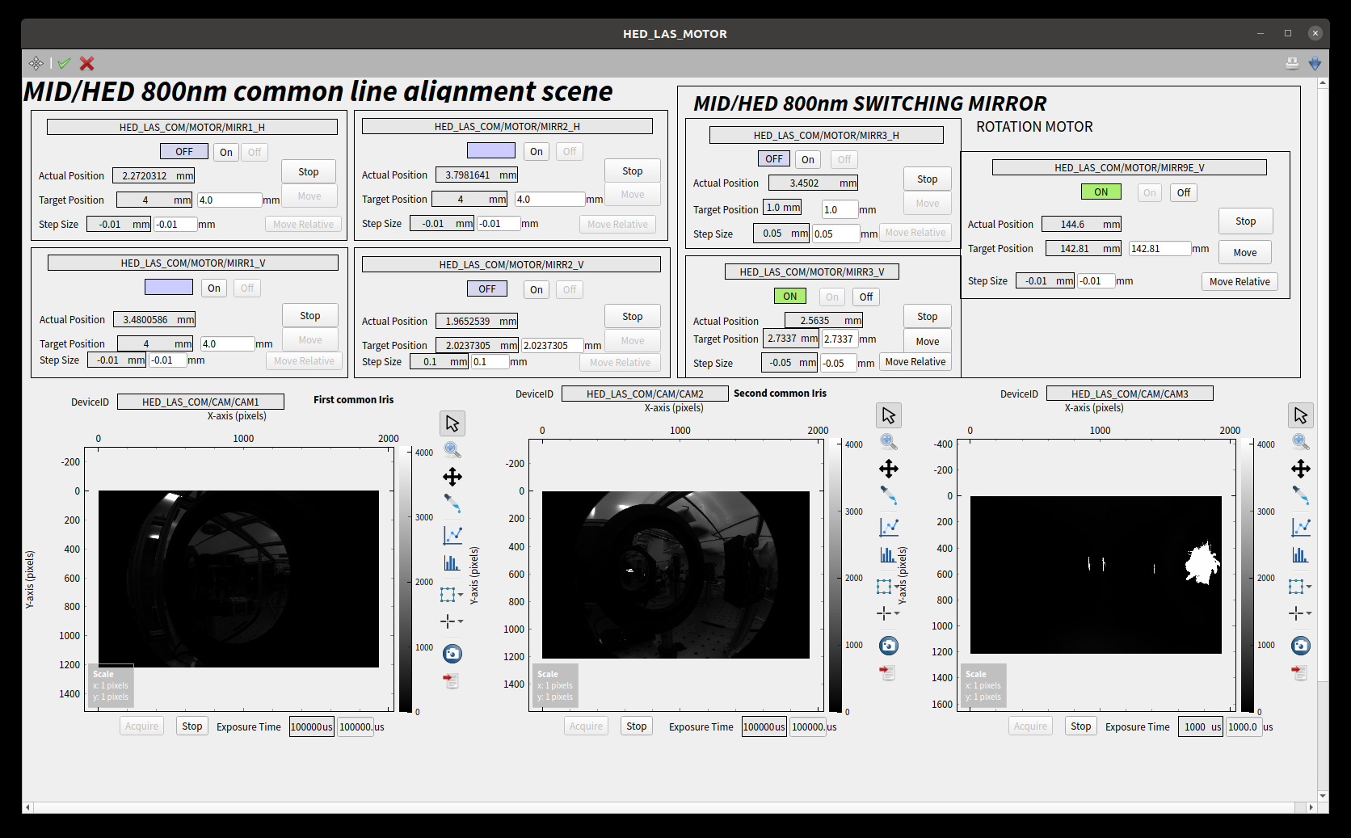
Custom scene in MID

Slide 12
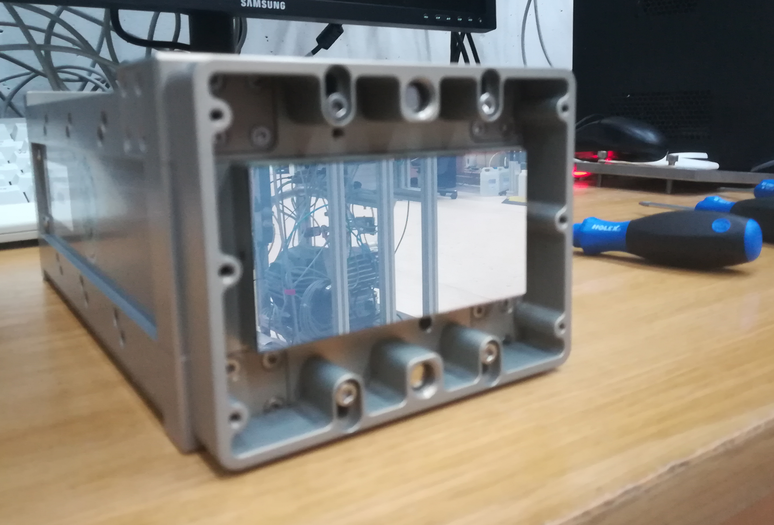
Zoom on Semi-Commercial Detectors: JUNGFRAU
18 modules in the facility
Provided SLS command-line tools used for first tests and diagnostic
Integrated in Karabo via the provided SLS library
  C++ open source library
  Good relationship with manufacturer enables rapid feedback and eases integration of new features when needed
  Most of the features implemented in a base class, also used for Gotthard and Gotthard-II
Control and receiver devices are just the first step of the integration

Slide 13
JUNGFRAU Integration: How Did We Get There?
Low level Karabo device, based on the SLS detector library
From manual to remote power via Karabo device
From manually taking dark runs to a fully automatic procedure
  Loop over detector settings
  Automatically configure all modules
  Automatically acquire data in the DAQ
  Automatically create calibration constants
Corrected online preview
  Partial images from the 8 modules are glued together according to the geometry
  Images are corrected used previously taken dark runs and displayed live in the Karabo GUI

Slide 14
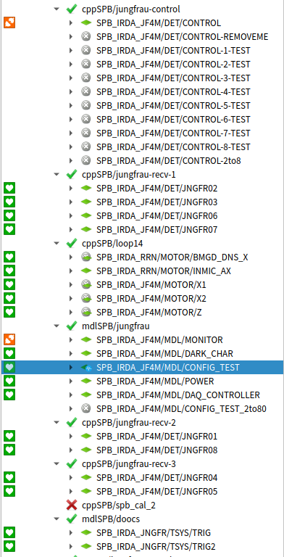
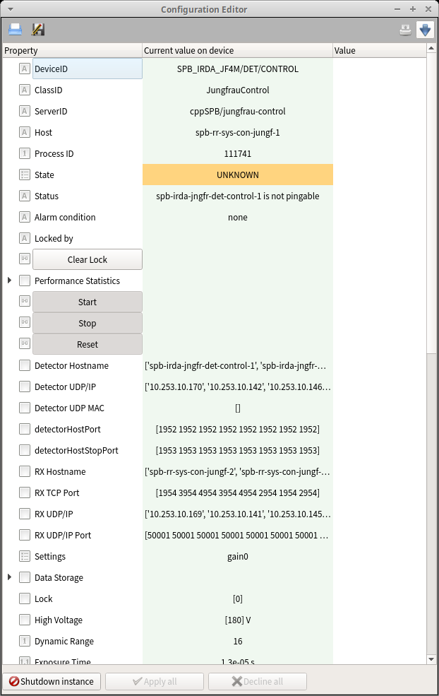
JUNGFRAU Control at SPB
The 8 JUNGFRAU modules at SPB are controlled by Karabo devices based on PSI’s SLS detector library (C++)
In addition to low-level control devices, high-level device have been added over time to ease detector operation:
  Temperature monitor device
  Configuration device
  Power procedure device
  Dark run device
Already pretty complex Karabo setup:
  1x control device
  8x receiver devices
  1x power device
  1x monitor device
  1x dark procedure device (+2 configuration devices)
  2x trigger configuration devices
The overview scene can be created by the detector expert without the need of any coding.

Slide 15
The main JUNGFRAU SPB scene #1

Slide 16
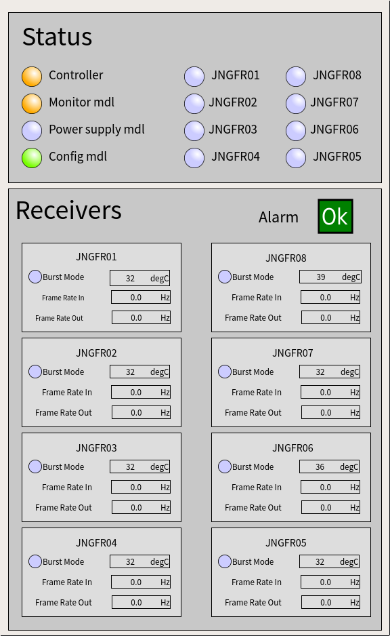
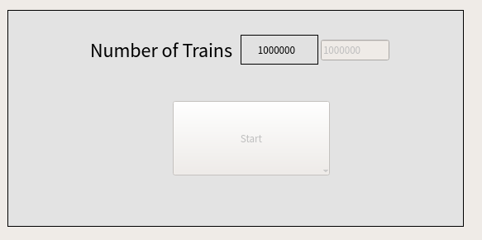
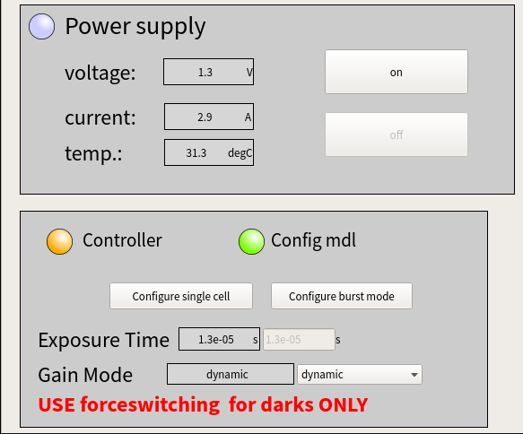
The main JUNGFRAU SPB scene #2
Overview of Karabo devices’ states
Configuration and start
of acquisition
Power on/off
the modules
Detailed status
of the modules
Configure all
modules at
once

Slide 17
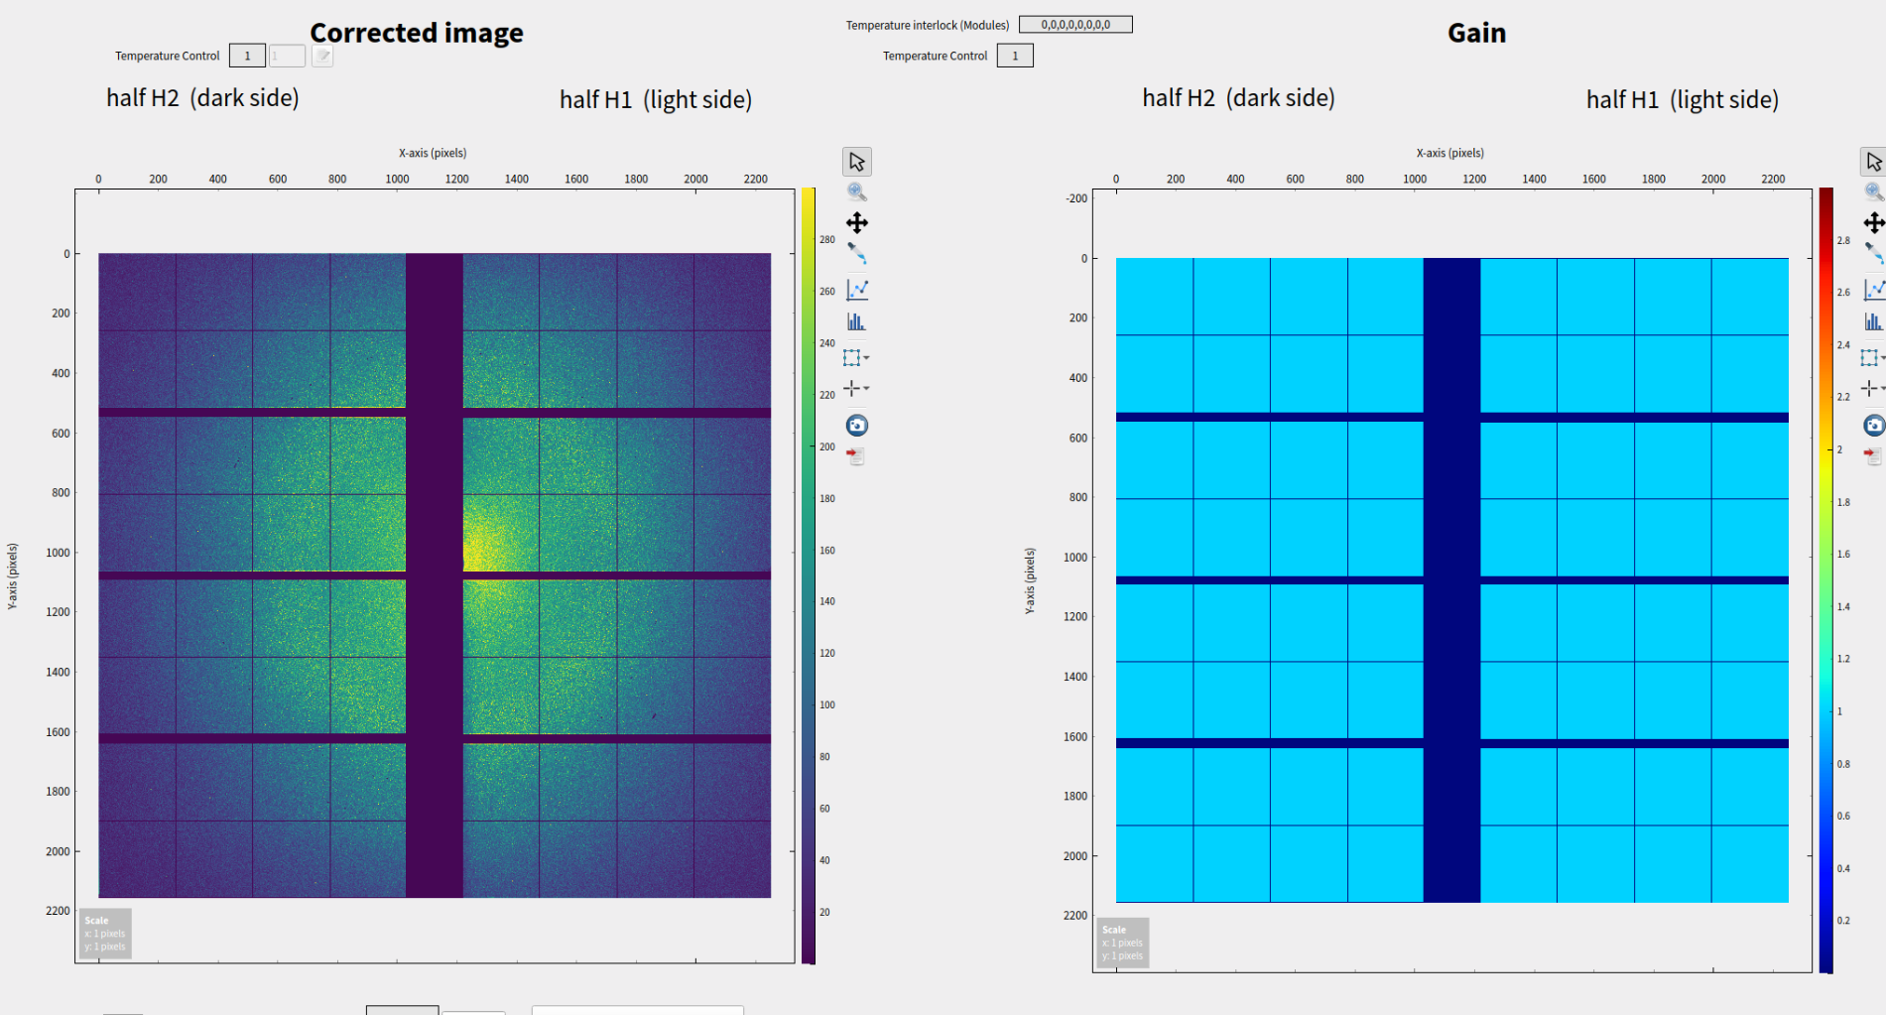
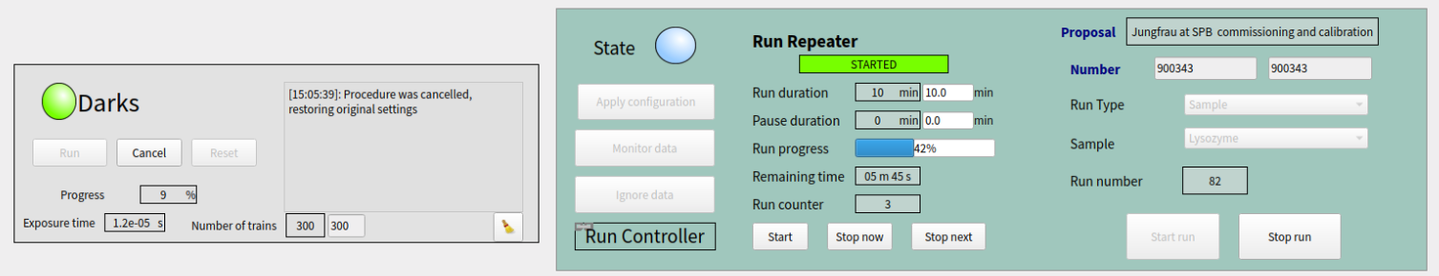
The main JUNGFRAU SPB scene #3
Image online preview
The SPB run controller device
Karabo device for taking dark runs
65 devices of 19 different classes

Slide 18
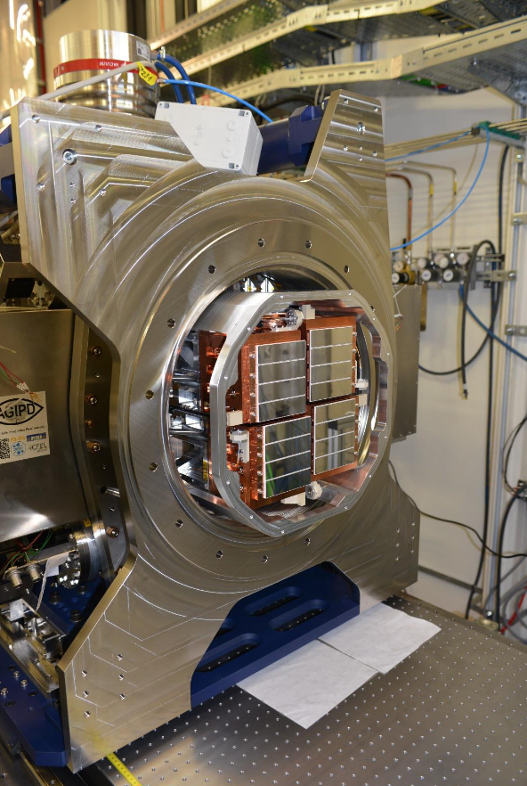
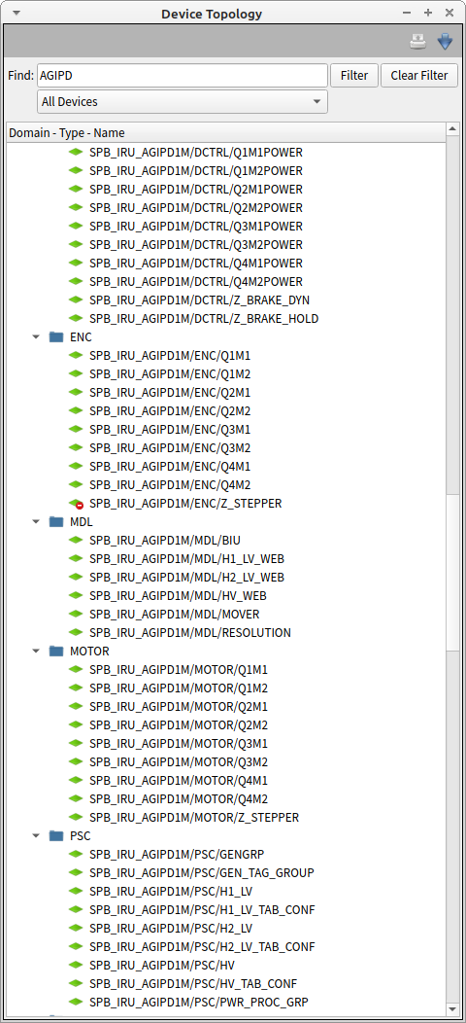
Zoom on Bespoke Detectors: AGIPD
237 Karabo devices for AGIPD 1M
  21 Motors
  38 Interlocks
  76 Timing and environment
  14 Power
  22 Control
  28 DAQ
  27 Online Calibration
  11 Analysis

Slide 19
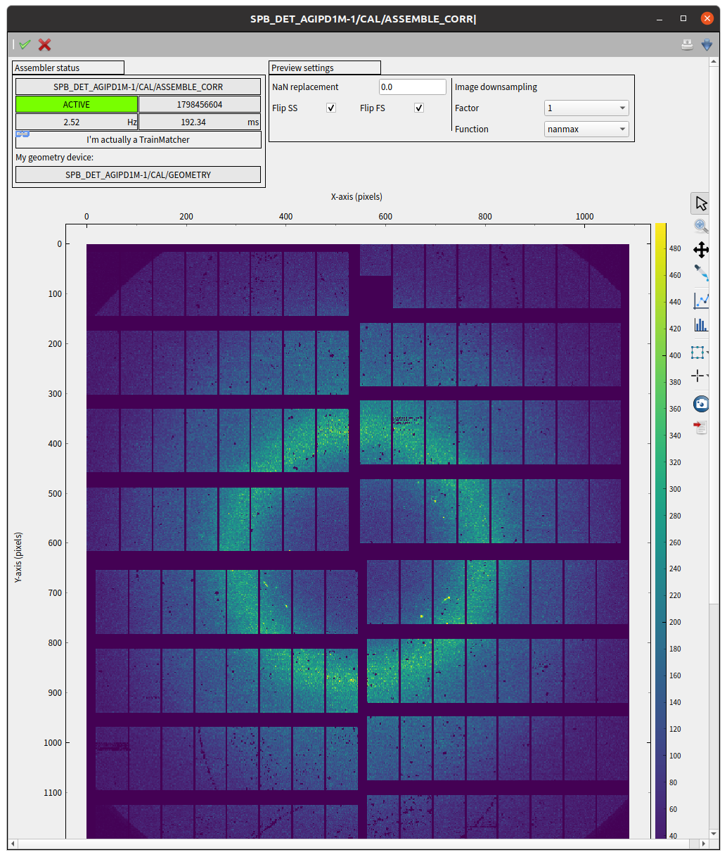
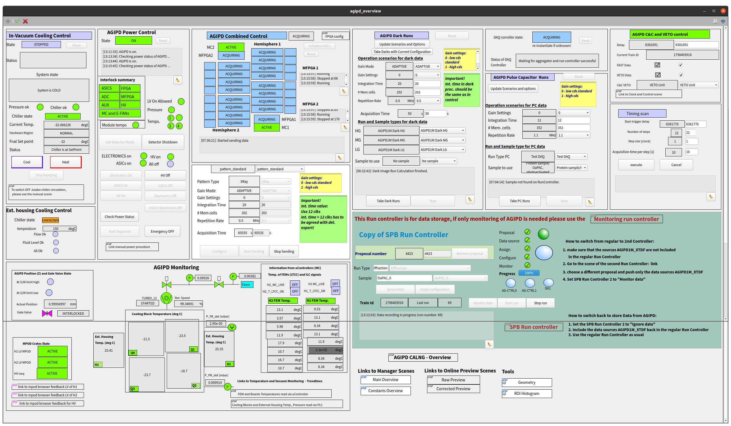
The main AGIPD scene

Slide 20
The main AGIPD scene
Device for taking dark runs
Devices for Timing scans
Detailed status
of the modules
Power on/off
the modules
Configuration and start
of acquisition
The SPB DAQ Control
Image online preview

Slide 21
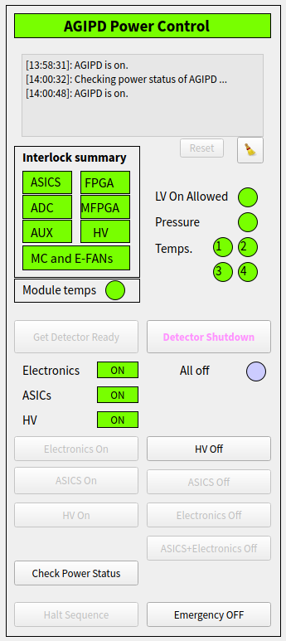
The main AGIPD scene

Slide 22
Integration Highlights
What Went Well
What Could Be Better
Full integration of bespoke detectors
Smooth integration of commercial detectors
Near real-time correction and analysis
Power procedures
Power feedback independent from detector
Expert feedback from detector
Different interfaces makes integration difficult
Documentation
Notes:
During these integrations, highlight What Went Well, What Could Be Better, Follow-ups (AKA Lessons learnt)
Max 2 items each
No black boxes please
Highlight want for early collaboration on control and DAQ interfaces
Highlight how early days were challenging as facility, detectors, and control system were developing at the same time

Slide 23
Integration Highlights
What Went Well
What Could Be Better
What We Want
Full integration of bespoke detectors
Smooth integration of commercial detectors
Near real-time correction and analysis
Power procedures
Power feedback independent from detector
Expert feedback from detector
Different interfaces makes integration difficult
Documentation
Early Collaboration, to reduce complexity
No Black Boxes
Communication for faster iteration
Notes:
During these integrations, highlight What Went Well, What Could Be Better, Follow-ups (AKA Lessons learnt)
Max 2 items each
No black boxes please
Highlight want for early collaboration on control and DAQ interfaces
Highlight how early days were challenging as facility, detectors, and control system were developing at the same time

Slide 24
Thank you

Slide 25
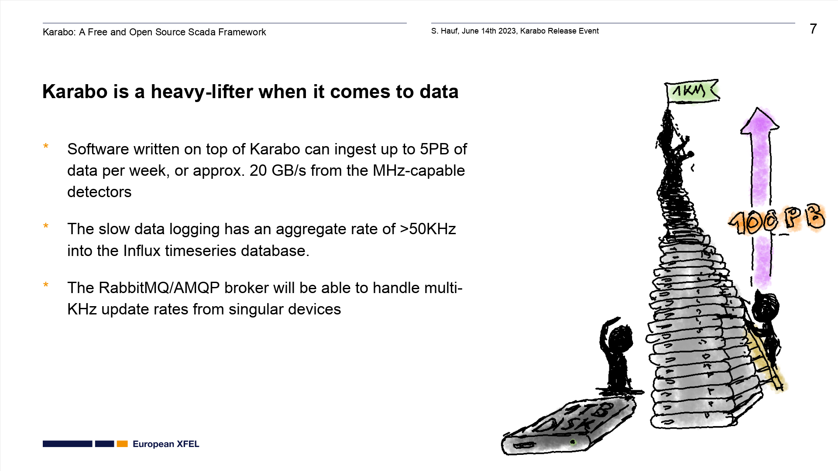

Slide 26
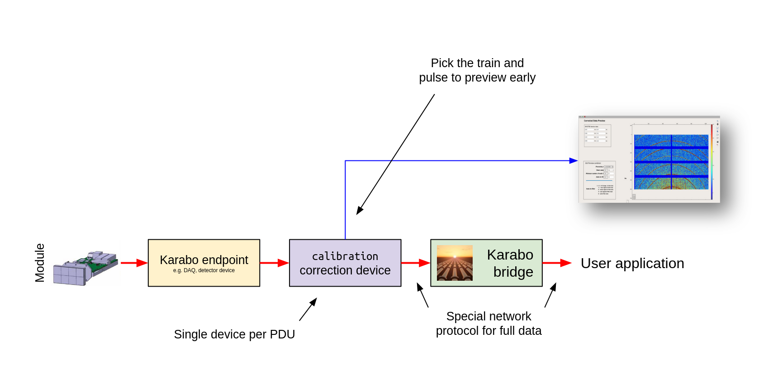
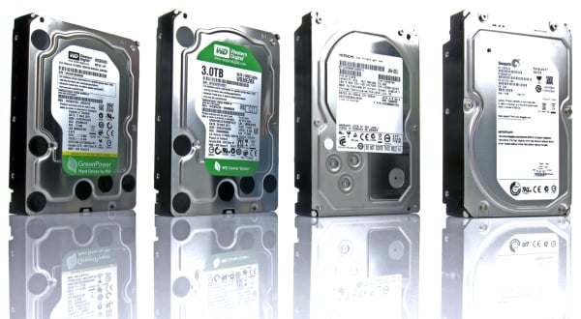
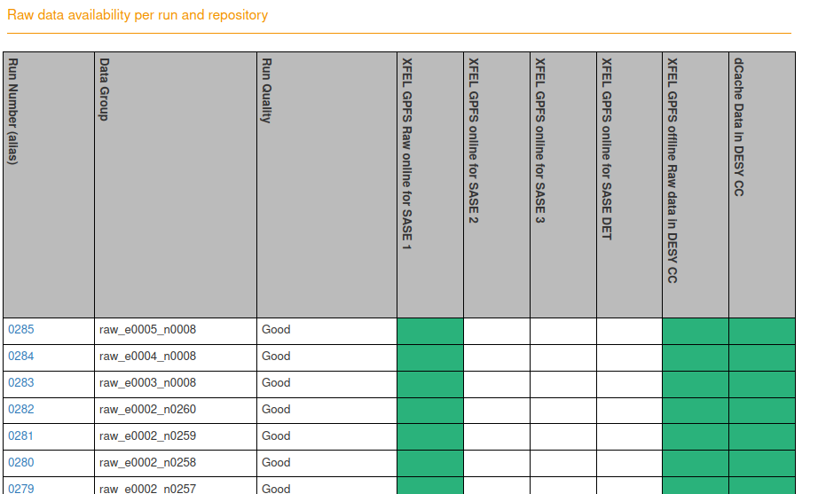
Online Corrections and Previews
One device per PDU

Slide 27
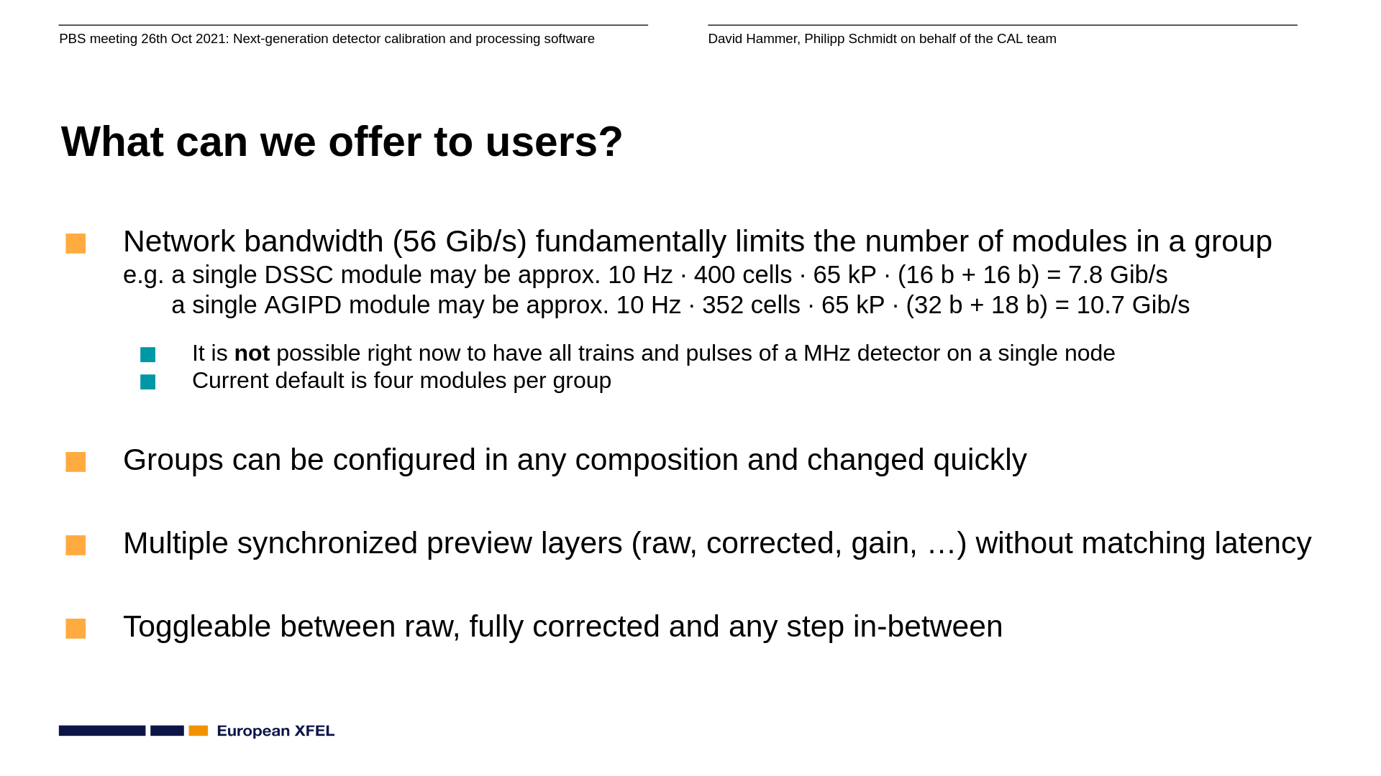
Notes:
Backup: details on online processing

