Slide 1
Data Volume Management: Challenges and Solutions
Krzysztof Wrona
ITDM
Schenefeld, September 2023

Slide 2
Experiment teams generate and manage diverse types of Scientific Data.
Raw
Intermediate analysis step data
Metadata
Auxiliary
Simulation data
Corrected
Analysis results
Logbook entries
Calibration constants
Processed
Detector Geometry data

Slide 3
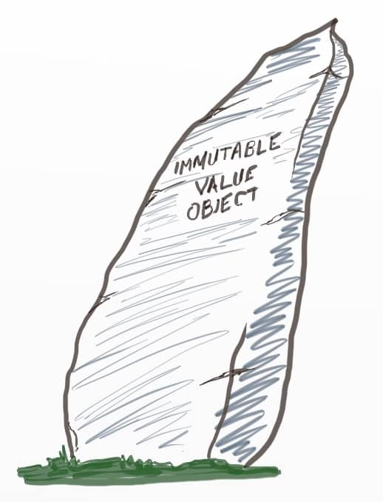
Data characteristic
Data can be immutable, alterable or even volatile
Data and metadata are stored in a form of files and database records
Multiple copies may exist on different storage systems

Slide 4
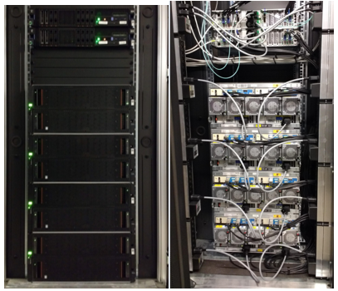
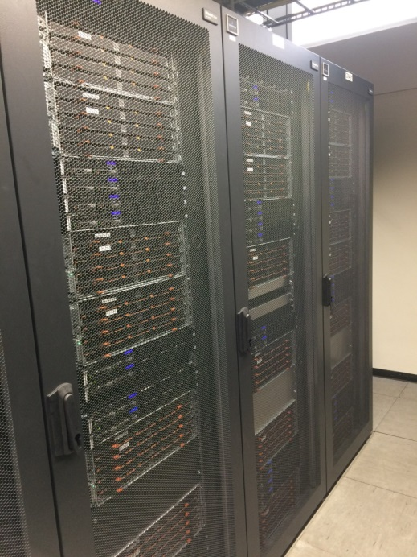
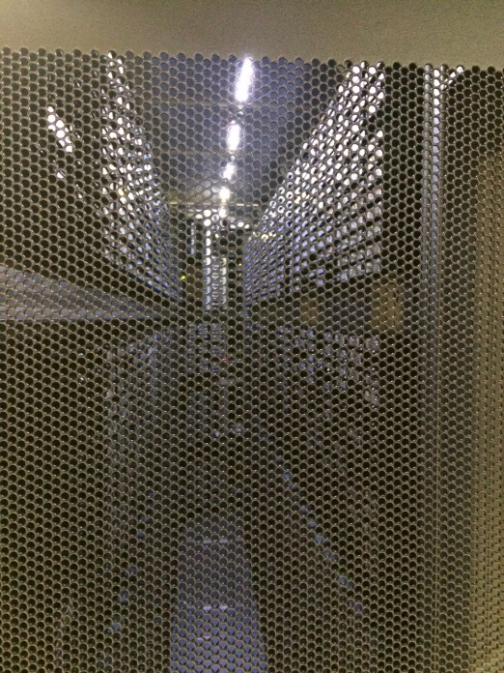
European XFEL Storage Overview
Schenefeld
DESY Data Center
Online GPFS
Offline GPFS
dCache
Tape Archive
Cache
Performance
Capacity
Safety
Extremly high performance
Data available immediately
Optimised for concurrency
High redundancy
Dedicated storage for each SASE
Very high cost per PB
Capacity for a few days
High performance
Large scale data analysis
High redundancy
High cost per PB
Shared within XFEL
Large capacity
Lower performance
Lower cost
Scalability
Shared within XFEL
High capacity
Very slow
Even lower cost
Very high capacity
Safety (second copy)
Shared within DESY campus
Long term

Slide 5
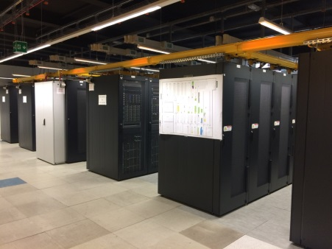
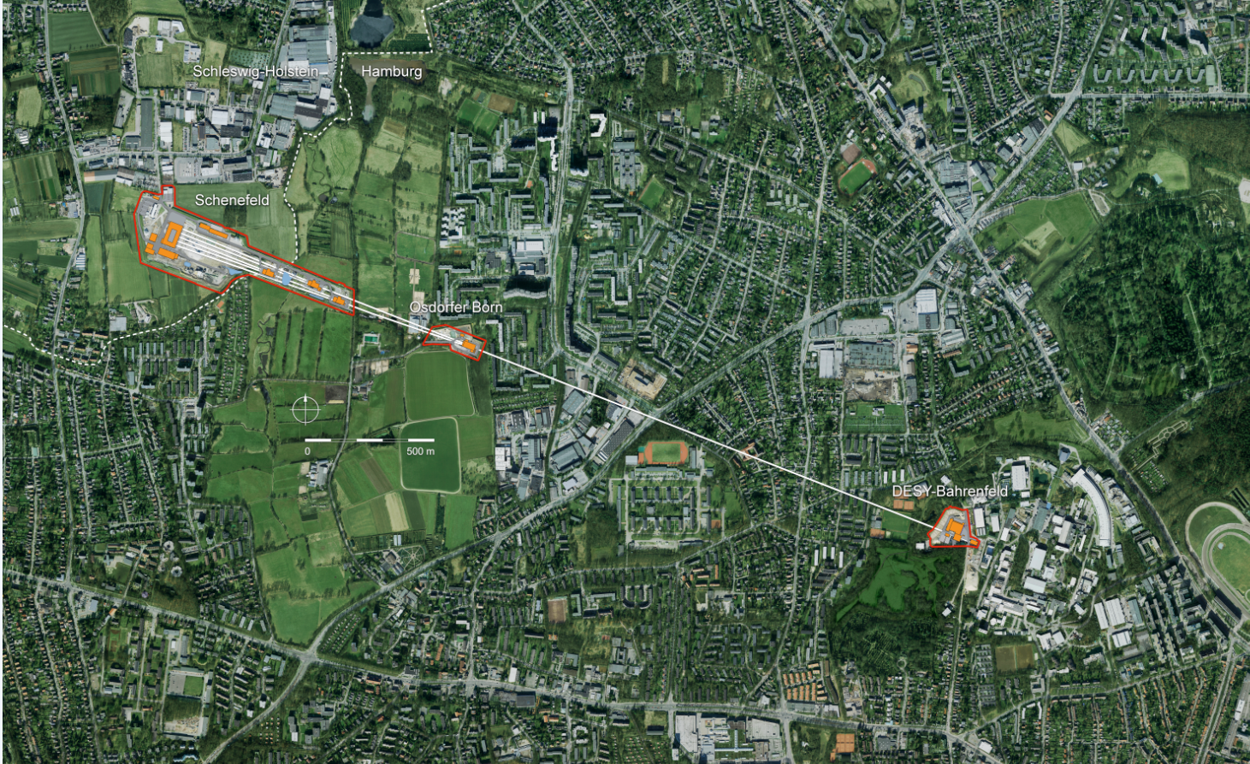
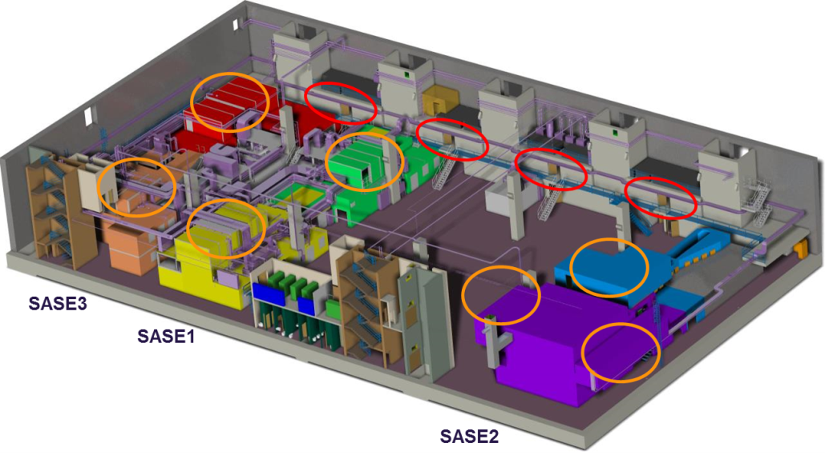
European XFEL data infrastructure
XFEL Campus
DESY Campus
Online
Offline

Slide 6
Data Storage Capacity for European XFEL
60 PB
120 PB
Size [PB]
0 PB
0 PB
High-Perfromace Storage
year
Mass Storage

Slide 7
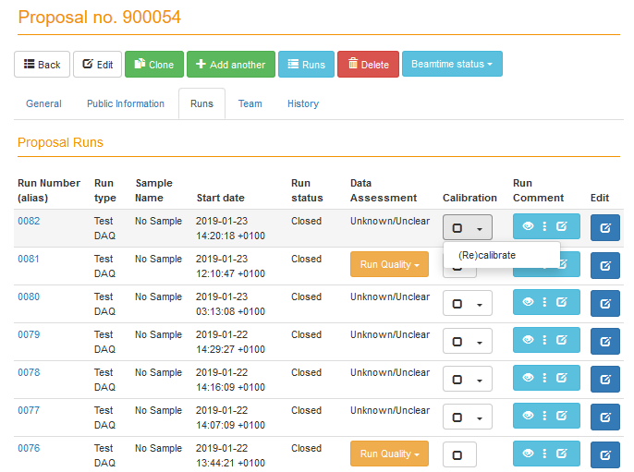
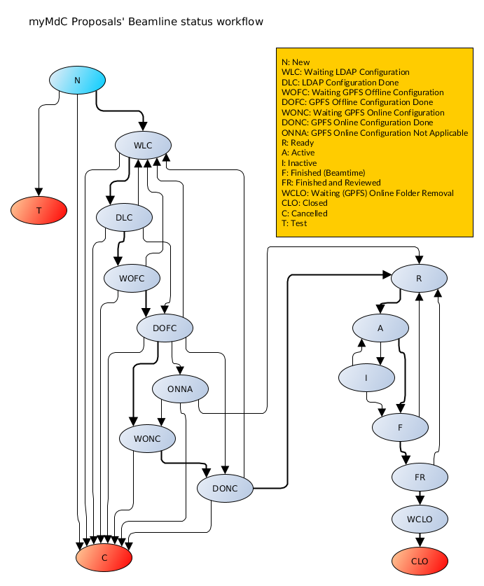
Data Management Activities using myMdC
Preparation for beamtime (storage folders, LDAP,…)
Catalog and document the data generated
Data migration services
Keep track of data location
Allow data publishing and export
Manage permissions and accesses to the data in an uniform manner and guarantee that only authorized people have access to the data
Data Retention Policies control and execution
Data Quality Assessment
Data Calibration
Data Archiving
Data Cleanup

Slide 8
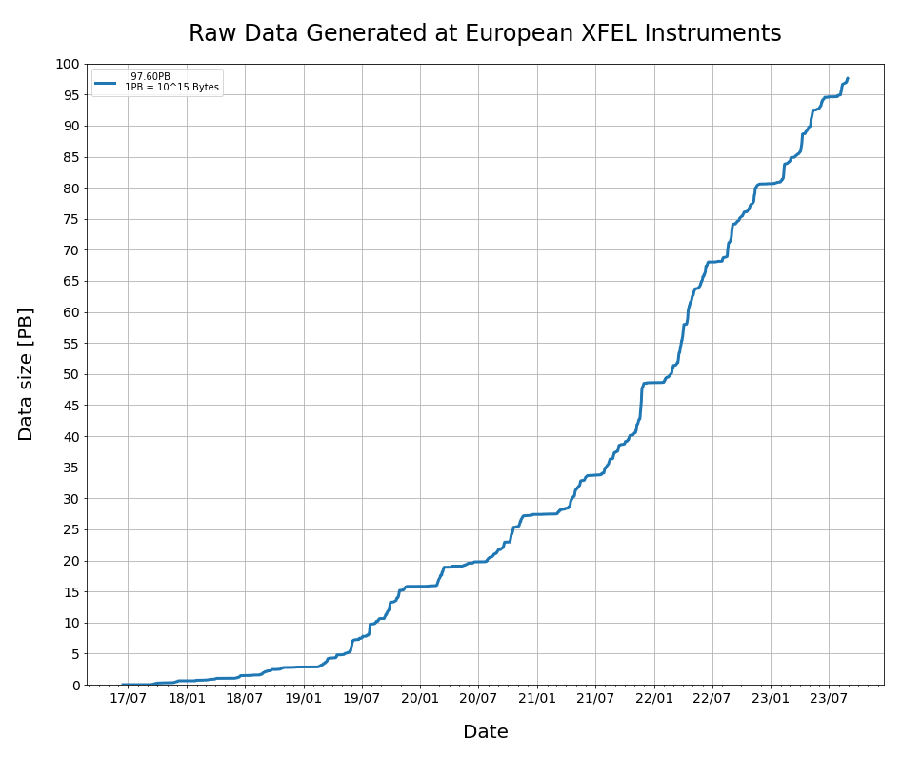
[in]Valuable Scientific Data
100PB
We generate increasingly massive amounts of scientific data
2D detectors generate an overwhelming majority of this scientific data
The approach of storing all generated data long-term is becoming unsustainable
We have an obligation to increase the value of the data by adhering to the FAIR principles

Slide 9
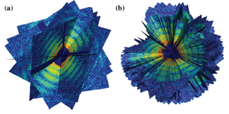
Data Reduction Becomes Unavoidable
Reduce to Process
Reduce to Store
Reduce to Transport

Slide 10
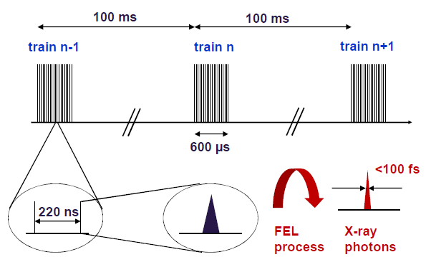
Can’t you just use a trigger….?
Detector type | Data/sec
AGIPD 1Mpxl | ~7 GB/s
AGIPD 1Mpxl Double images | ~14 GB/s
AGIPD 4Mpxl | ~30 GB/s *
LPD 1Mpxl | ~10 GB/s
DSSC 1Mpxl | ~16 GB/s
* Will not be run at full rate in current design
The data flow from all four experiments at LHC for Run 2 was anticipated to be about 25 GB/s after data reduction
ALICE: 4 GB/s (Pb-Pb running)
ATLAS: 800 MB/s – 1 GB/s
CMS: 600 MB/s
LHCb: 750 MB/s
Data reduction in particle physics is built into it’s DNA, it is intrinsic to the field’s experimental viability.
The experiments are designed from the ground up on data reduction.

Slide 11
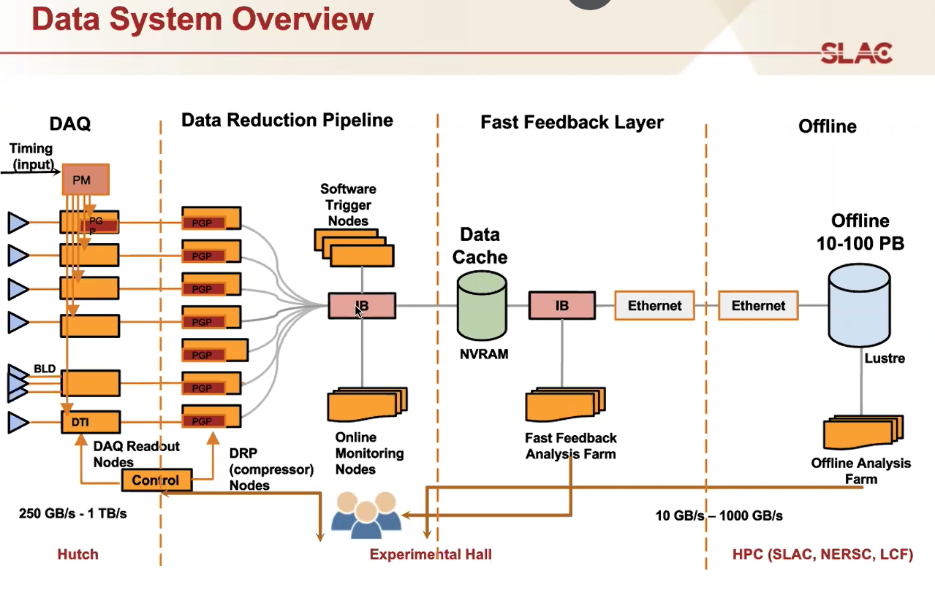
Can we continue without trigger and real-time data reduction in the future?
LCLS-II data rates
250GB/s if not reduced
Real-time reduction to 25GB/s
Up to 1PB/shift
Require 1PFLOP/experiment, in extreme cases 1EFLOP

Slide 12
Scientific Data
Policy
Data Management
Tools
&
Procedures
Data Management
Plans
per Proposal

Slide 13
Why do we need a Scientific Data Policy?

Slide 14
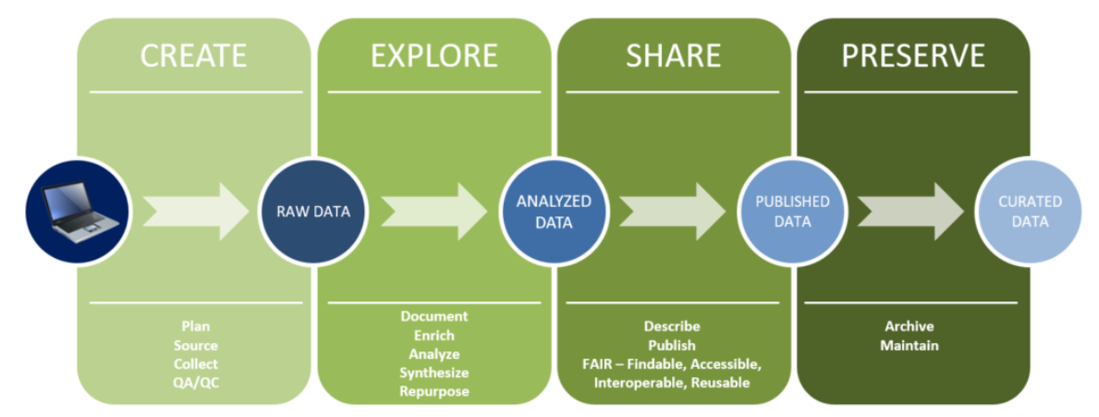
Highlights of Data Policy
Introduction of the data management plan
PI responsibilities and rights concerning data
Open Access
Free availability after three years embargo
More on persistent identifiers
DOI, ORCID
Preserving user data
Definition of European XFEL data format

Slide 15
Scientific Data Policy
Quality of
Data Services
Individual DMPs are based
on the Scientific Data Policy
and the data retention scheme defined in the QDS
Proposal
specific
adjustments
Data Management Plan 0001
European XFEL Data Format
Data Management Plan 0102
PI
Data Management Plan 1903
Data Management Plan 2348
Data Management Plan 6001
DMPs are living documents
defined for each proposal
Notes:
Not Appendix now separate document

Slide 16
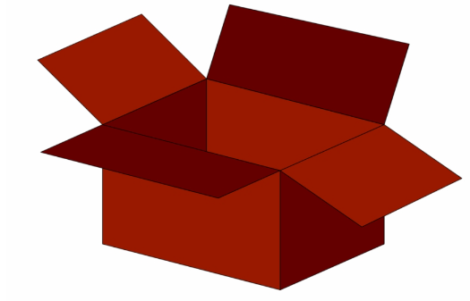
Reduced Data
Reduced data (RED) is a selection of reduced raw data, facility-processed data, and user-processed data in the format supported by the European XFEL GmbH
RAW
Selection of runs
Selection of detector modules
Extracted events (train/pulse)
Removed detector gain bit values
PROC
Selection like for RAW data but contains:
corrected detector images
processed images (e.g. conversion to photons, azimuthal integration)
other derived data
Examples
Proposal | Raw Data size | Max. RED data size
p000001 | 20TB | 20TB
p000002 | 60TB | 50TB
p000003 | 380TB | 50TB
p000004 | 620TB | 62TB
p000005 | 2100TB | 210TB
User-processed
Selection like for RAW data but contains:
User-computed properties
Experiment’s specific data corrections
Must adhere to the European XFEL data format
RED box capacity:
max(10% of RAW data size; min(50TB;RAW data size))

Slide 17
Catalogue of data reduction methods
Provide a catalogue of supported data reduction methods
Provide comprehensive documentation for the supported methods, including their constraints and applicability to the experimental techniques and operation scenarios
Integrate the catalogue with the DMP
Operation-specific methods | Technique-specific methods
LitFrameFinder | event reconstruction (reaction microscope)
Selecting data based on the pulse-picker unit | hit-finding (based on peak detection for serial femtosecond crystallography or lit-pixel detection for single particle imaging),
Defining regions of interest | azimuthal integration (for small- and wide-angle X-ray scattering)
Rounding pixel intensities to the absolute number of photons | g2 correlation functions (for X-ray photon correlation spectroscopy and X-ray cross-correlation analysis)
Removing AGIPD analogue gain data
Centroiding TIMEPIX3 data
Data Compression

Slide 18
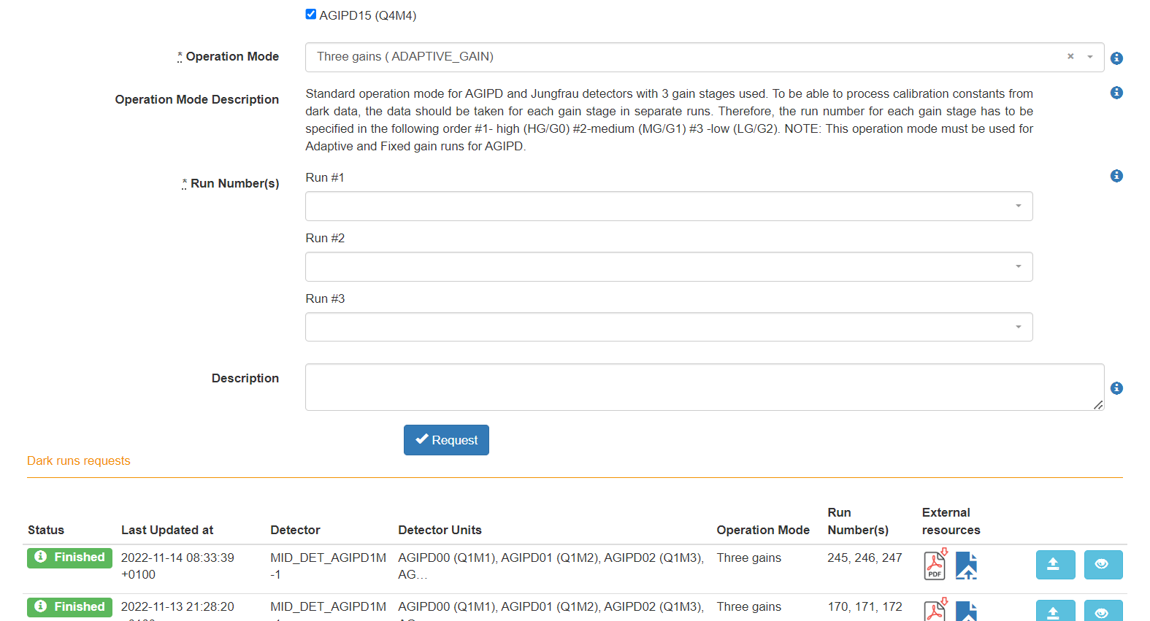
Services and web interfaces
Ideally, most of the tools need to be integrated with the existing services, e.g. metadata catalogue, to streamline data reduction processes
Implementing data reduction workflows, identifying roles and responsibilities
Implementing additional functionality
Subsequent assessments of collected data
Selection of reduced data
Definition and registration of custom data sets
Handling requests for data archiving or restoring
Reminders

Slide 19
Quality of data reduction process
Ensuring high-level data quality and integrity throughout the process is crucial for maintaining trust between the facility and users. To achieve this, several key steps should be taken:
Data provenance for the data-taking chain, including all data reduction steps from the DAQ through to the metadata catalogue, and finally, the data archive for open access
Implement routine checks to ensure data quality and consistency. Verify the results against established benchmarks or simulations
A continuous integration-like approach for the technical quality
Adapt or develop various metrics for evaluating the scientific quality of the reduced data.

Slide 20
Data reduction promotes open access
The Principal Investigator (PI) can define, register, and open customised data sets containing:
Selection of Reduced Data
Selection of Auxiliary Data
Frequently, publishers mandate opening relevant data sets before accepting a publication.
The proposed solution provides PIs with the necessary flexibility and ensures that data can be openly accessed regardless of the embargo period.
Once the embargo period concludes, all reduced data and the complete set of metadata associated with the raw data automatically become open access, promoting transparency and collaboration in research

Slide 21
Summary
We handle huge volumes and diverse types of data generated during experiments and later during data analysis
Scientific data handling is challenging and requires complex and expensive infrastructure
An update of the Scientific Data Policy aims to improve data fairness and introduce efficient methods of enabling the long-term preservation of high-value data
Real-data reduction will be mandatory with the new generation of detectors

