Slide 1




XIDyn collaboration a new approach to high-energy 2D detection for
4th generation synchrotrons
Paolo Busca¹
on behalf of the XIDyn collaboration
1. European Synchrotron Radiation Facility
Future Detectors for the European XFEL. Sep 18 – 19, 2023

Slide 2
Outline
1. Introduction
    Motivation
    DynamiX and XIDER projects
    XIDyn collaboration
2. Front-end architecture
    Readout concept
    Continuous and pulsed illumination
    Data handling and telegram protocol
3. Experimental results
    Prototypes and characterisation
    High-flux CZT
4. XIDyn collaboration
    Common MPW design
    Scale-up plans

Slide 3

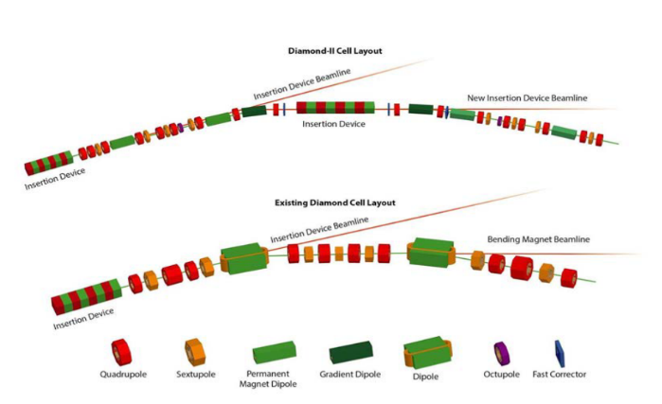

Motivation
Example of ESRF brilliance gain
[photons/s/0.1BW/mm2/mr2]
  New generation (4th) of synchrotron and FEL facilities
Diamond II
  Planned upgrade
ESRF Extremely Brilliant Source (EBS)
  In user mode since 2020
  New science opportunities require improved instrumentation
X-ray detectors
  Extended dynamic range
  Shorter time domains: intrinsic time resolution and frame rate
  Detection of high energy photons
×100
×230
Schematic of current Diamond and future Diamond II lattice

Slide 4

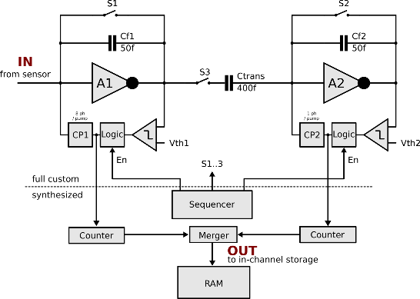
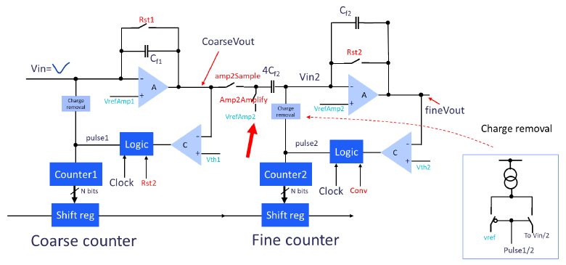


DynamiX and XIDER projects
DynamiX
XIDER
“Low energy” single-crystal diffraction
“Soft” organic samples (e.g. protein crystals)
Energy range: 15 to 30 keV
Data accuracy is a must (crystal structure determination)
“Long” integration times: ~10 µs to (many) ms
Frame rate determined by integration time
“High-energy” time resolved diffraction
“Hard” inorganic samples (often polycrystalline)
Energy range: 30 to 100 keV
Sensitivity to fast changes is crucial
Sub-µs repetition (limited by beam time structure)
Continuous and burst mode readout (memory)
Different target applications and parameter space!

Slide 5
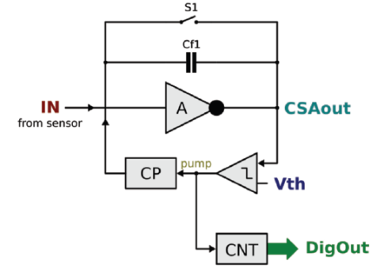
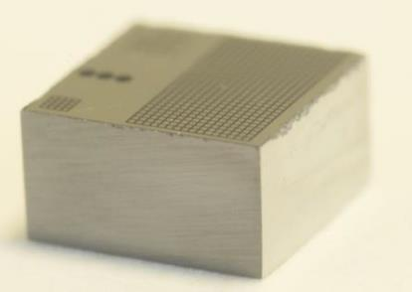
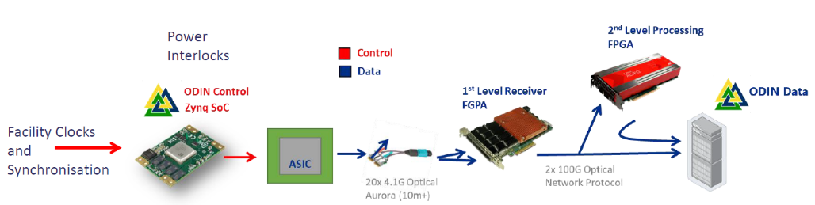



XIDyn collaboration
Common technical choices
Readout concept
High-flux CZT
Data Acquisition Framework
  XIDyn collaboration
  Started in 2022
  Development of a common platform
  Attempt to merge both designs
Front-end concept
High-flux CZT
(Redlen & Due2Lab)
Data Acquisition System

Slide 6
Outline
1. Introduction
    Motivation
    DynamiX and XIDER projects
    XIDyn collaboration
2. Front-end architecture
    Readout concept
    Continuous and pulsed illumination
    Data handling and telegram protocol
3. Experimental results
    Prototypes and characterisation
    High-flux CZT
4. XIDyn collaboration
    Common MPW design
    Scale-up plans

Slide 7
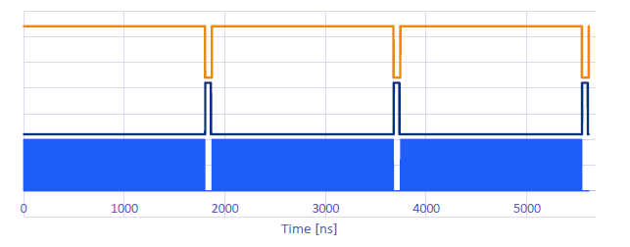
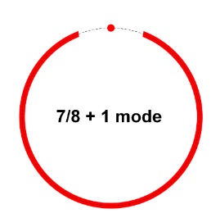
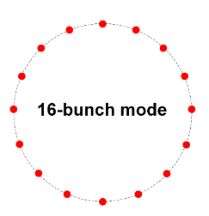
Readout Concept
  Common “pixel” requirements
Pixel size: 100 µm
Conceived for high-Z sensors → Cd(Zn)Te
High dynamic range:
      Single photon sensitivity
      Up to ~ 10⁹ photons/s/pixel (or above if possible)
    Operation with “continuous” and “pulsed” beams
Nearly 100% duty-cycle operation should be possible
    Focus on XIDER architecture
    Similar considerations for DynamiX
Example of Diamond II fill pattern
Example of ESRF-EBS fill patterns
176 ns
Continuous mode
(high flux)
Pulsed mode
(time resolved )

Slide 8
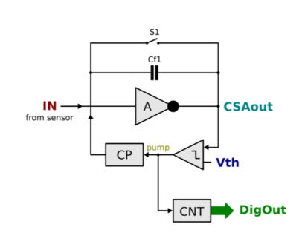
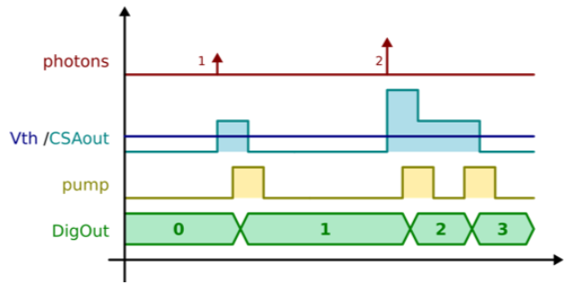
Readout Concept
  Continuous conversion front-end with one stage
Charge-sensitive amplifier (CSA) collects charge
Charge pump removes well-defined charge packets
(eq. to n photons) from the input node
    Single photon sensitivity
    Infinite dynamic range (ultimately limited by counter depth)
    Pumping must be fast enough to handle the photon rate
  Mostly insensitive to CSA saturation
Data output is digital
Schematics
Signal sequence

Slide 9

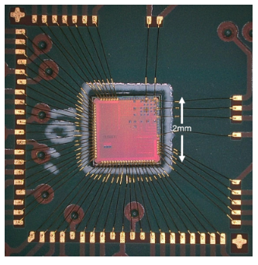
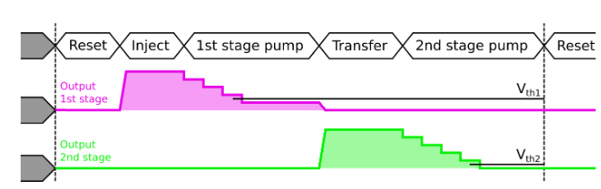
Readout Concept
  Continuous conversion front-end with two stages (pipeline)
First stage (coarse) → high dynamic range
Second stage (fine) → single photon (or sub-photon) resolution
Transfer stage in between
8 photons
1 photon
Readout implementation discussed in: J. Inst. 16 P03023
https://doi.org/10.1088/1748-0221/16/03/P03023

Slide 10
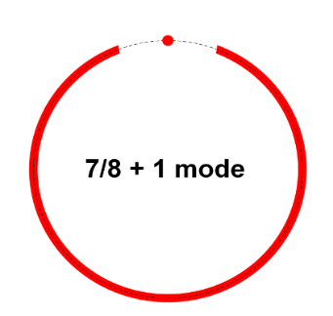
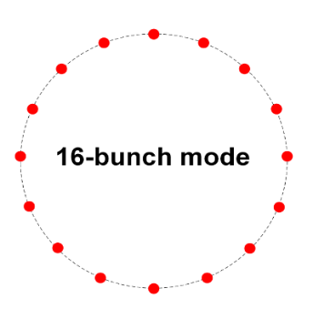
Flexible front-end
Continuous mode
(high flux)
Pulsed mode
(time resolved)
176 ns
5.7 MHz
    Flexible front-end to cope with both modes

Slide 11
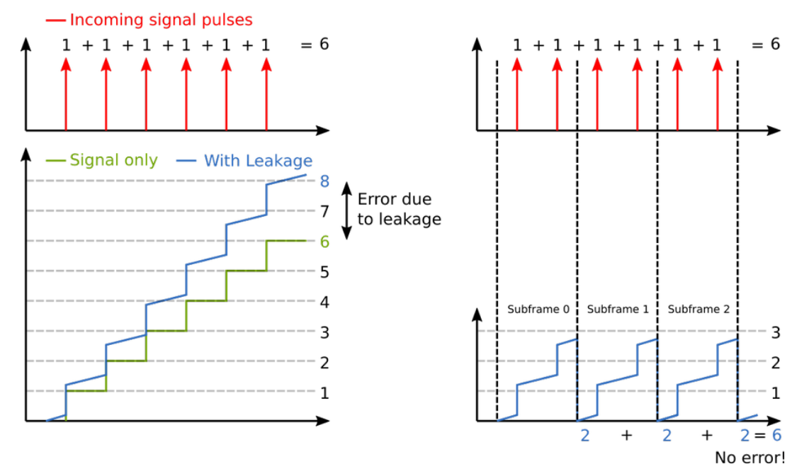
Continuous illumination
Incremental digital integration concept
Exposure time
sliced into N subframes
Digitise and Discriminate
Integrate
Accumulate
Per-pixel level
Incremental digital integration discussed in: J. Inst. 15 C01040
https://doi.org/10.1088/1748-0221/15/01/C01040
Standard integration
Leakage accumulated
Digital Integration
Integration
Digitization
Accumulation

Slide 12
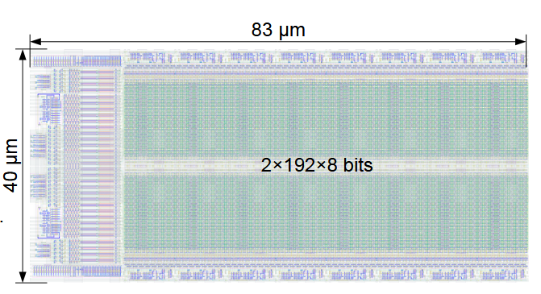
Pulsed illumination
Full-custom RAM design
Features
Fast front-end (rise time ~10-20 ns)
192×16 bit RAM storage per pixel
Dynamic range limited by charge pump frequency
Major limitation: reset and transfer time
Example for XFEL
f_{burst}: 1 MHz
f_{cp}: 200 MHz
N_{ph}: 8 ph
DR: 8×200MHz/1 MHz ~ 1600 ph
X-ray pulse
f_{cp}
1 μs
    Dynamic range can be easily adapted with bigger packet size

Slide 13
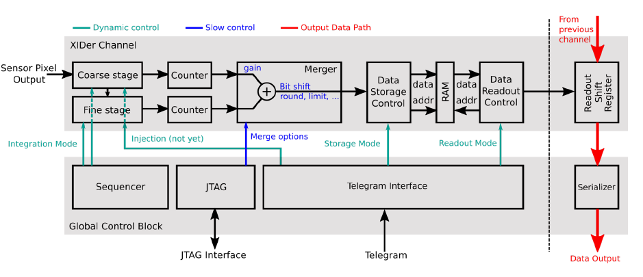
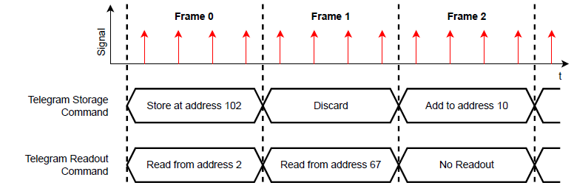
On chip data handling
Telegram concept discussed in “Concepts for the Data Flow Control on the XIDer Readout ASIC” D. Schimansky, conference record ULITIMA 2022, under publication
Custom-designed telegram protocol
Maximum flexibility in data taking
Sends commands to the ASIC channels on frame-level for data storage and readout
Allows for event-by event decisions, like triggering or data rejection.

Slide 14
Telegram protocol storage mode examples
• There are many more modes
• Actual choice depends on the user’s requirements

Slide 15
Outline
1. Introduction
    Motivation
    DynamiX and XIDER projects
    XIDyn collaboration
2. Front-end architecture
    Readout concept
    Continuous and pulsed illumination
    Data handling and telegram protocol
3. Experimental results
    Prototypes and characterisation
    High-flux CZT
4. XIDyn collaboration
    Common MPW design
    Scale-up plans

Slide 16
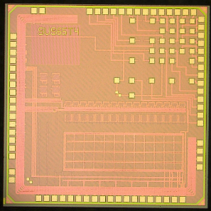
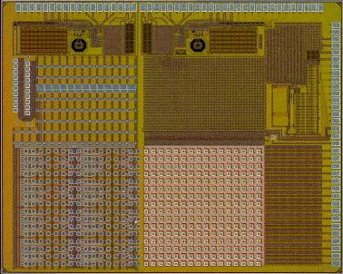
Prototypes
ASIC design
The XIDER pixel functionality is particularly complex
Fast analog front-end
In-pixel analog-to-digital conversion
Digital logic, sequencer, multiple modes of operation
Built-in memory
Power hungry
The pixel design has progressed incrementally
  Six chips (T1 to T6) designed so far
  Not all the chips have used for X-ray testing
  Last X-ray measurements with T4: investigation at
  the pixel level
  T7 is planned
More info on T6&T7 in the last section
ASIC T4: 4×4 pixels
2018
T1!
T2
T3
XIDER
T4
ASIC T6: 16×16 pixels
T5
T6
2022
XIDyn
T7
TSMC CMOS 65nm

Slide 17
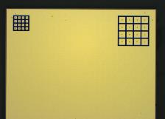
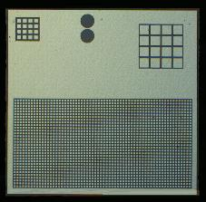
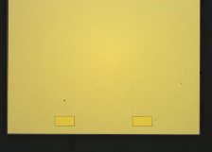
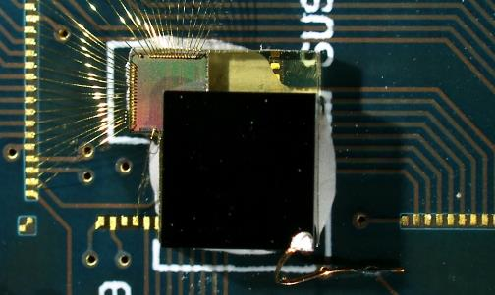
Prototypes
Prototypes T4
  CdTe-ohmic (Acrorad) or CZT (Due2Lab & Redlen)
      1 mm thick CdTe (ohmic contacts)
      2 mm thick high-flux CZT
  4×4 matrices of 100 or 200 µm pitch
  TSMC CMOS 65nm technology (version T4)
  Interconnection by Polymer Assembly Technology
Characterization
  The initial investigation work was done with CdTe assemblies
  CdTe devices perform poorly
      Instability and irreproducibility of dark/leakage current
  High-flux CZT assemblies available only very recently
  Measurements taken both with 30 keV X-rays at BM05/ESRF and with LED sources at the lab
Cd(Zn)Te sensors
100 µm
200 µm
CdTe
(Acrorad)
High-flux CZT
(Redlen / Due2lab)
Sensor-ASIC prototype
4×4 mm²
1-mm thick
CdTe
ASIC T4
65 nm

Slide 18
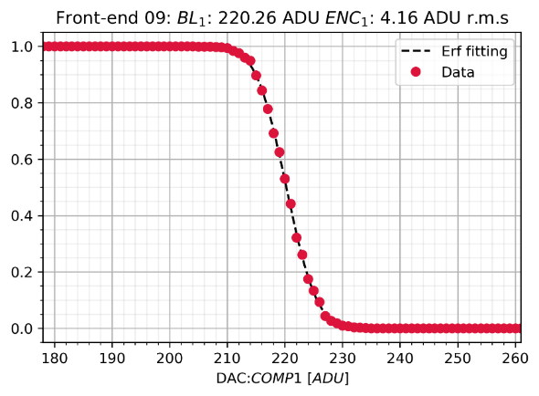
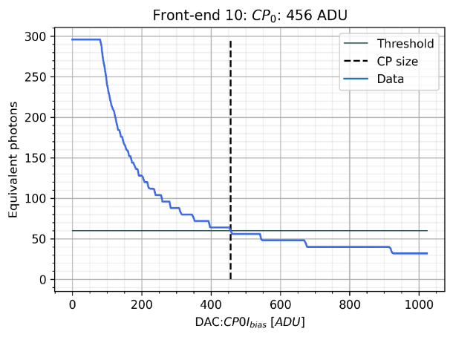
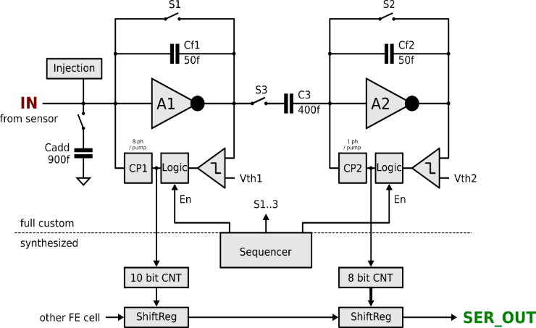
Calibration
Parameters to be calibrated
Threshold calibration
Charge packet calibration
Parameters to be calibrated
  Thresholds and charge pumps (×2)
  All trimmable with 10-bit DACs
  Using internal (or external) charge injection

Slide 19
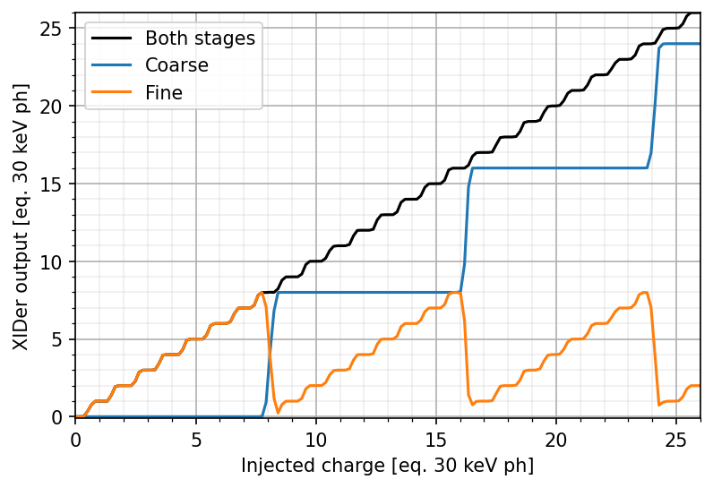
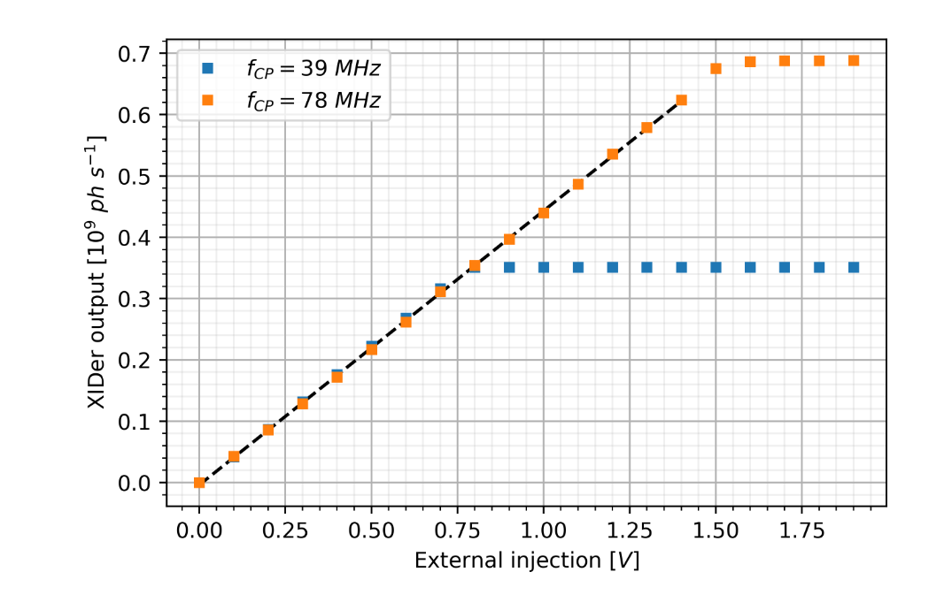
Characterisation
Example of calibrated channel
Dynamic range vs charge pump frequency
  Internal injection circuit
  Coarse stage counts in packet of 8 photons
  Fine stage in packets of 1 photon
  Mid-tread response
  Electronic noise: 350 e⁻ rms
  External injection circuit
  Dynamic range can be extended with charge pump frequency
  Dynamic range already approaching 0.7×10⁹ ph/s/pixel

Slide 20
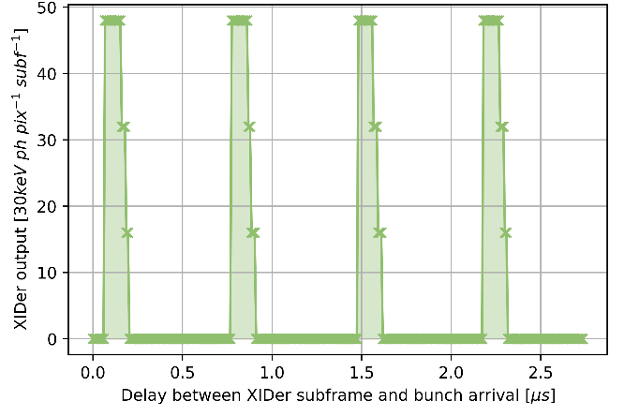
Time-resolved capabilities
Concept
Example of 4-bunch full orbit scan
period: 704 ns
X-ray pulses
subframe interval
Time
subframe delay
XIDER active subframe of ~100 ns
4-bunch filling mode: 100 ps X-ray pulses every 704 ns
Photon induced signal

Slide 21
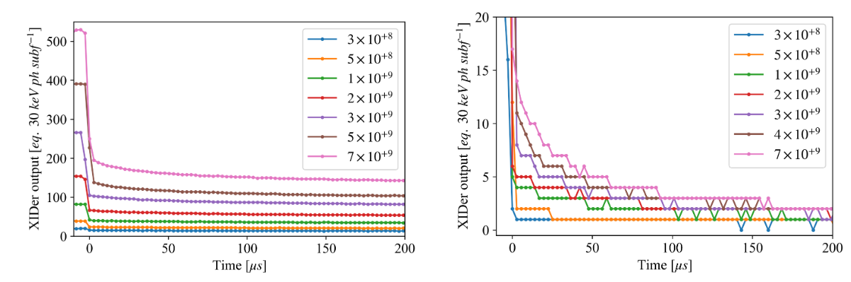
High-flux CZT
XIDER T4 - CdTe sample
XIDER T4 – HF-CZT sample
  Afterglow/aftersignal
  Extra-charge delivered by the sensor after end of irradiation
    CdTe performs much worse than CZT
    Residual still present in HF-CZT
  For XFEL pulsed operation → effect mitigated
* Fluxes in ph/s/px

Slide 22
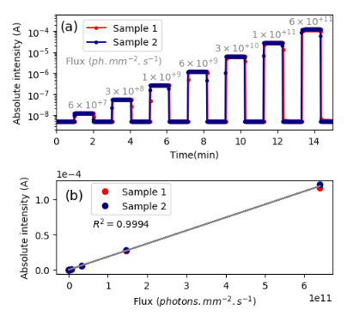
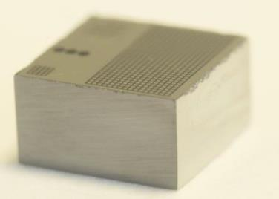
High-flux CZT
HF-CZT linearity
  “High-flux” CZT
  Better charge transport properties than CdTe
  High-flux version improves hole transport properties
  Redlen Technologies
  Redlen does not supply prototypes, slowly opening to the synchrotron market
  Their sensor processing technology (e.g. pixelation) is still somewhat “rudimentary”
  Collaborating with IMEM-CNR-Due2Lab (Parma):
  IMEM reprocesses “high-flux” CZT sensors from Redlen
  Developed a suitable platinum contact technology
    First devices by the end of 2022 with very promising results:
    Low leakage current (significantly lower than CdTe)
    In terms of time stability (reduced polarization effects)
    Good linearity up to high X-ray flux densities
Linearity up to
6×10⁹ 20 keV ph / sec / 100µm pixel

Slide 23
Outline
1. Introduction
    Motivation
    DynamiX and XIDER projects
    XIDyn collaboration
2. Front-end architecture
    Readout concept
    Continuous and pulsed illumination
    Data handling and telegram protocol
3. Experimental results
    Prototypes and characterisation
    High-flux CZT
4. XIDyn collaboration
    Common MPW design
    Scale-up plans

Slide 24
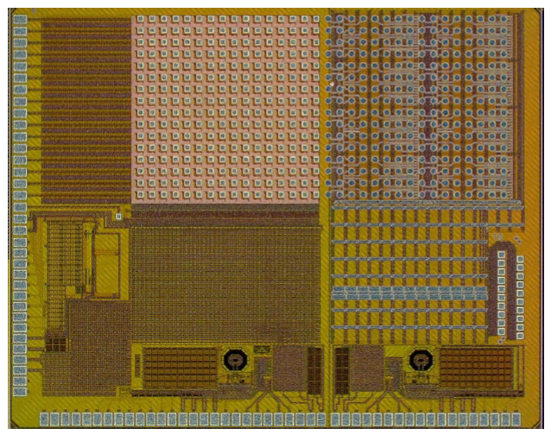
Common MPW design
T1!
MWP ASIC: 2×16×16 pixels
MPW ASIC
  DynamiX: 16×16 pixel
  XIDER: 16×16 + STFC serialiser
  14 Gbps high-speed data serializers
  Pitch is continuous (110 µm)
  One piece of CZT over the device
  Chip is alive
  New ASIC/sensor prototypes under assembly
T2
T3
XIDER
T4
T5
DynamiX
XIDER T6 + STFC ser.
T6
XIDyn
T7

Slide 25
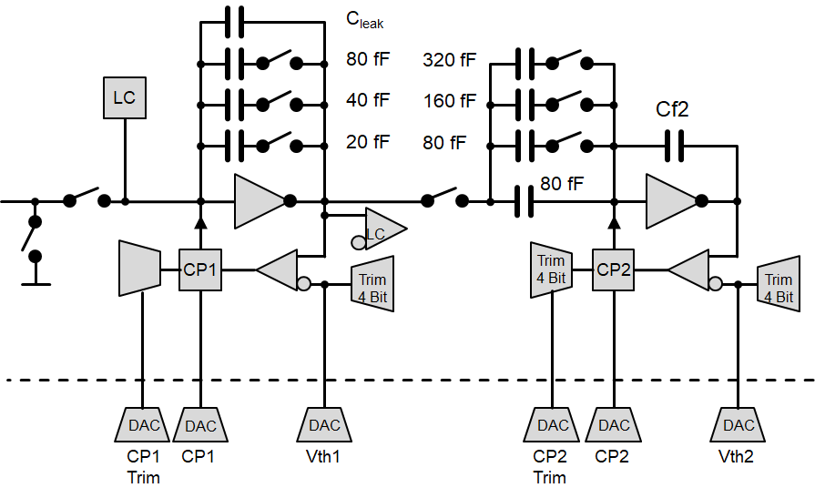
Full reticle scale-up plans
  “STFC Detector Hub” funding scale up to full reticle over next 18 months
  Merging design: add adjustable gains/cancellations to match ESRF and Diamond needs
  Performance optimisation
    Power, timing distribution
  Aim for adjustable number of serialisers. For example
    8 for high rate → 100kHz readout $$$
    1 for low rate → 10kHz readout $
  Use RAM to sum and keep flux capability or sum sequence of frames, rolling buffer, veto, compare…
  Interested in other collaborators, requirements… this version and future ones
Possible merged XIDyn design

Slide 26
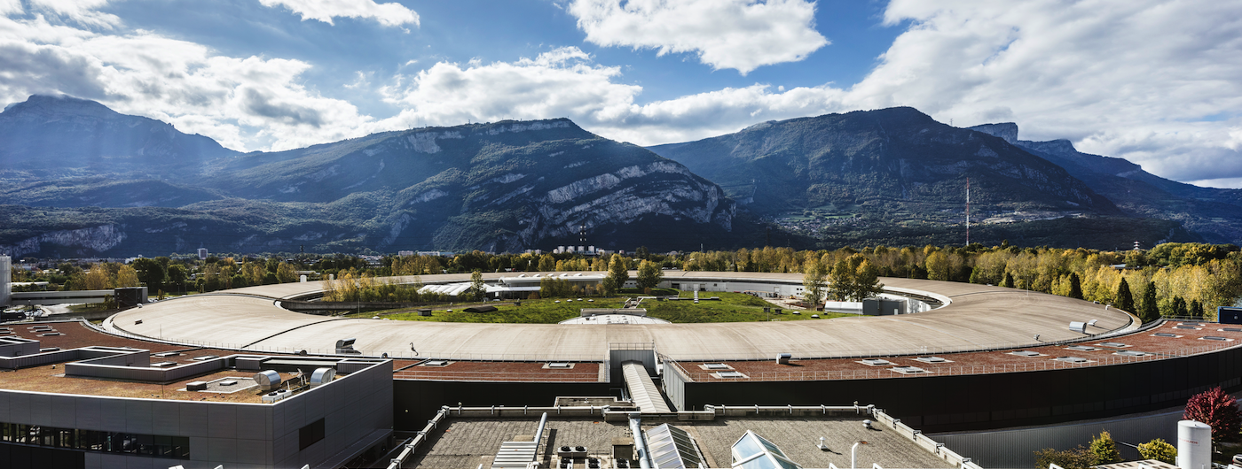





















Thank you for your attention

