Slide 1
Polimi experience towards development of new Front-end solutions for next generation of EuXFEL detectors
Carlo Fiorini
Politecnico di Milano and INFN, Milano, Italy
Workshop on “Future Detectors for the European XFEL”, Hamburg, 18th of Sept. 2023

Slide 2
OUTLINE
Front-end design for the DSSC readout ASIC
Front-end design in 65nm for low noise readout (of UV sensors)
‘Predictive’ Gain-Switching approach
Possible contribution to FE designs for future EuXFEL detectors

Slide 3
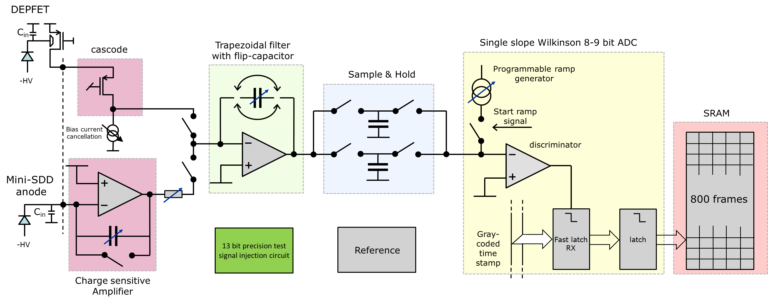
The DSSC readout ASIC
POLIMI contributions

Slide 4
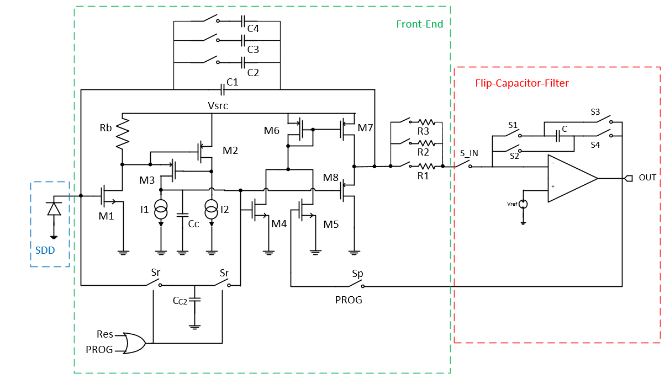
Charge preamplifier for the DSSC readout ASIC (1)
Selectable feedback capacitor:
60 fF to 360 fF;
Selectable resistor: 7, 10, 15 kΩ;
Dynamic range: 256 or 2560 photons;
Energy range from 0.5 to 3 keV;
CSA current consumption of 120 µA.

Slide 5
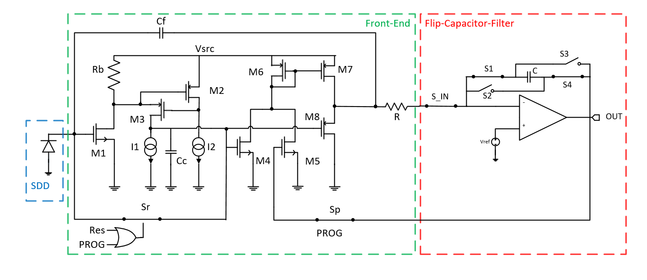
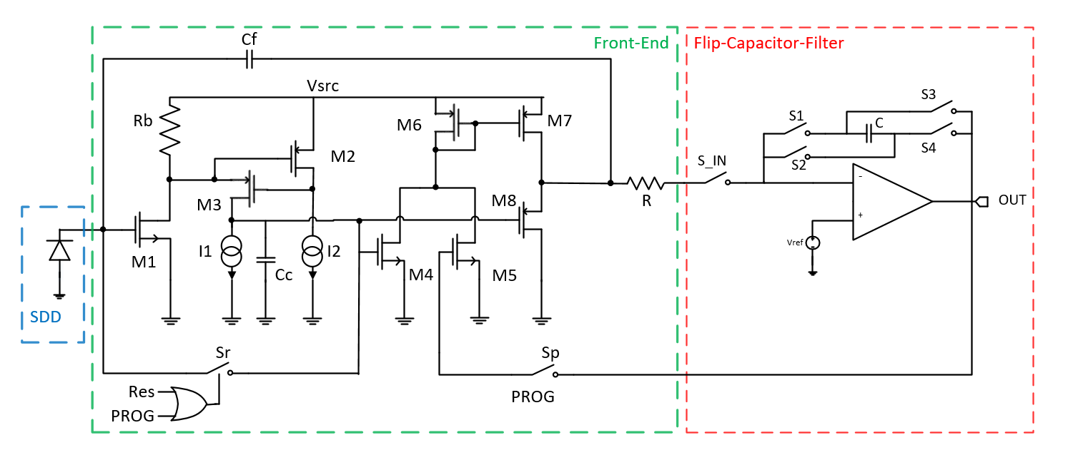
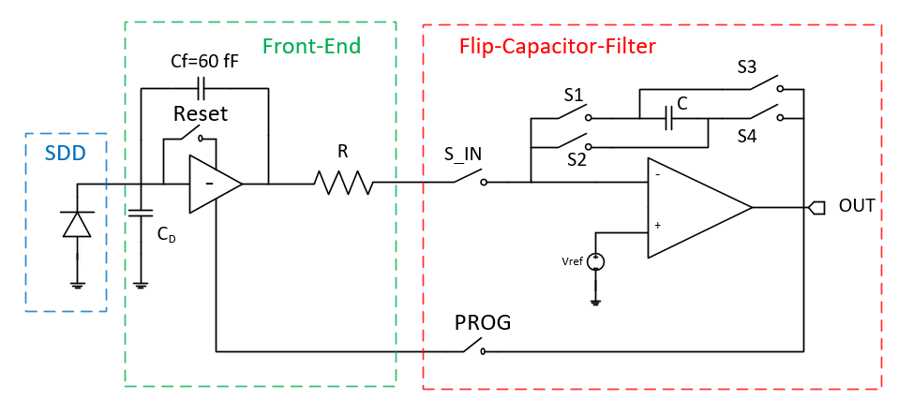
Charge preamplifier for the DSSC readout ASIC (2)
Programming phase
A control loop is been implemented during the programming phase
The loop exploits the CSA output stage;
The loop programs the CSA output voltage to the same Filter virtual ground voltage (Offset Compensation).

Slide 6
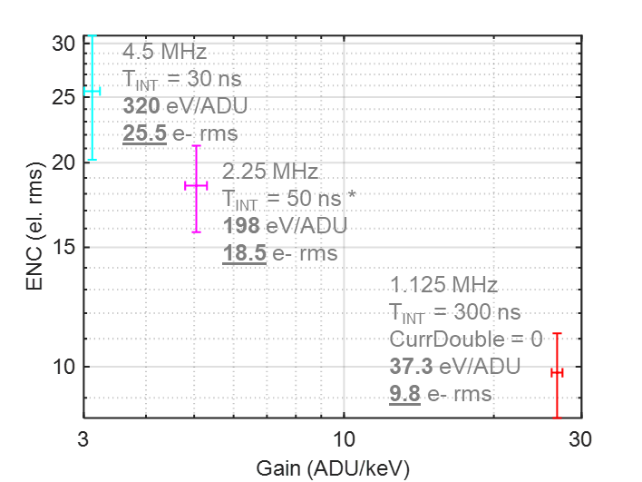
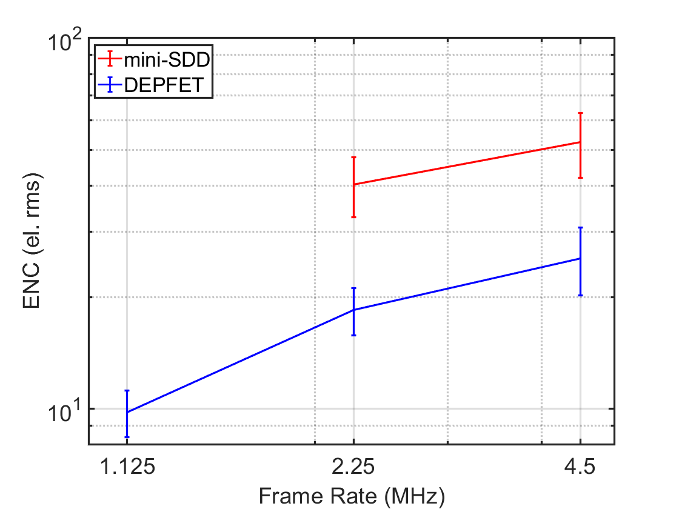
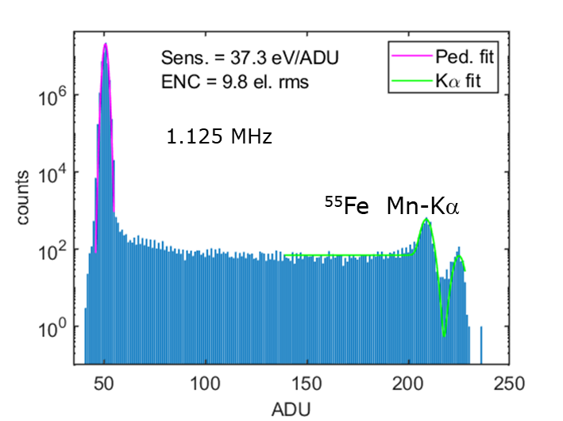
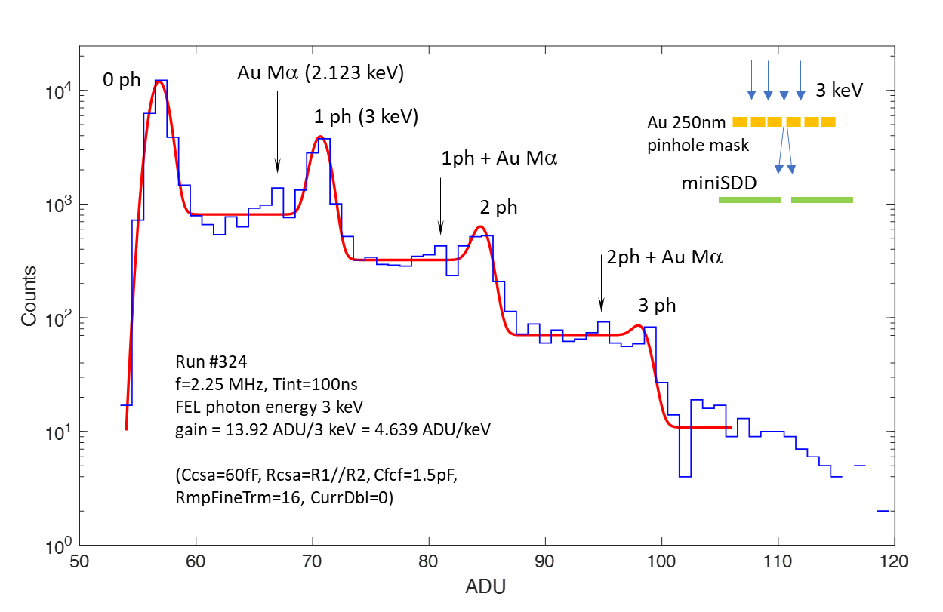
Electronics noise vs. Integration time (courtesy M.Porro)
Noise vs. T int @ 2.25 MHz
Mini-SDD
Front-end
DEPFET
Front-end
T=-20 °C
f=4.5 MHz
f=1.125 MHz
50.2
f=2.25 MHz
43.1
40.3
gain = 7 ADU/3 keV = 2.333 ADU/keV
Spectral resolution @ 3keV + Au Mα (2.123keV)

Slide 7
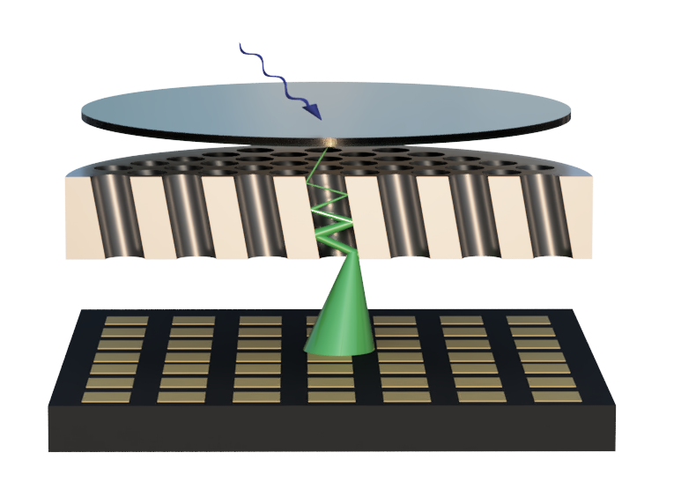

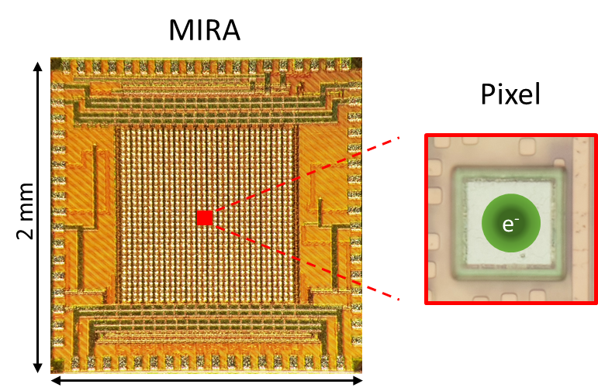




Pixel Readout in 65nm (MIRA ASIC)
UV-ray
Photocathode
MCP
$$e^{−}$$
Pixel readout channel
MIRA
From adjacent pixels
$$R_{eq}$$
C1
$$C_{F}$$
Readout
C2
$$V_{\begin{aligned}THL \\ \end{aligned}}$$
CSA
Sum.
Disc.
CSCL
Counters
To adjacent pixels
bot.
right

Slide 8





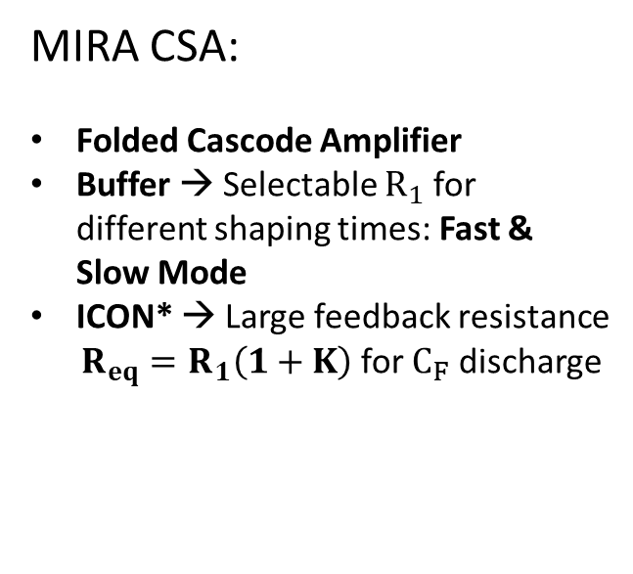








MIRA Charge Sensitive Amplifier (CSA)
Buffer
$$V_{DD}$$
ICON*
$$V_{DD}$$
$$V_{DD}$$
MIRA CSA:
Folded Cascode Amplifier
Buffer → Selectable $R_{1}$ for different shaping times: Fast & Slow Mode
ICON* → Large feedback resistance
$R_{eq}=R_{1}\left(1+K\right)$ for $C_{F}$ discharge
Amplifier
K : 1
$$V_{DD}$$
$$M_{IN}$$
$$V_{out}$$
$$I_{out,dc}$$
$$I_{in}$$
$$M_{R1}$$
$$M_{R1}$$
K : 1
$$R_{eq}$$
$$C_{F}$$
$$C_{F}$$
* Refs:
R. L. Chase, A. Hrisoho, J.-P. Richer: "8-channel CMOS preamplifier and shaper with adjustable peaking time and automatic pole-zero cancellation." Nucl. Instr. and Meth. A, vol. 409, 1998, p. 328−331.
C. Fiorini and M. Porro, “Integrated RC cell for time-invariant shaping amplifiers”, IEEE Trans. Nucl. Sci., Vol. 51, n°5, pp. 1953 –1960, Oct 2004.

Slide 9
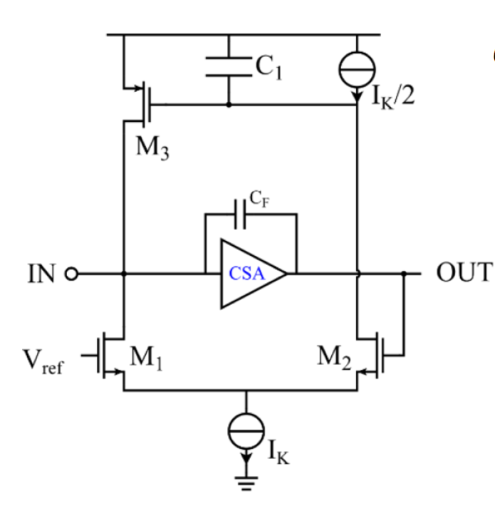

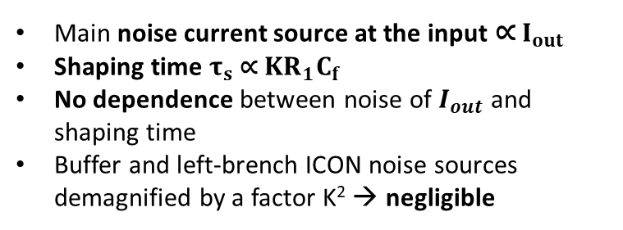










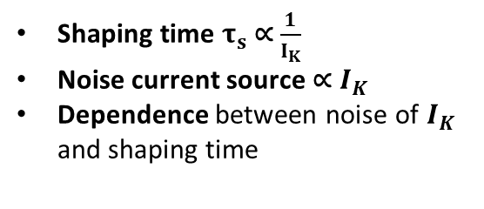
Noise current source vs. pulse duration
Krummenacher*
MIRA CSA
Buffer
$$V_{DD}$$
ICON
$$V_{DD}$$
$$V_{DD}$$
Amplifier
K : 1
$$V_{DD}$$
$$I_{out}$$
$$M_{IN}$$
$$V_{out}$$
$$I_{in}$$
$$C_{in}$$
$$R_{1}$$
K : 1
$$R_{1}$$
$$C_{F}$$
Shaping time $τ_{s}$∝ $\frac{1}{I_{K}}$
Noise current source ∝ $I_{K}$
Dependence between noise of $I_{K}$ and shaping time
Main noise current source at the input ∝ $I_{out}$
Shaping time $τ_{s}$∝ $KR_{1}C_{f}$
No dependence between noise of $I_{out}$ and shaping time
Buffer and left-brench ICON noise sources demagnified by a factor K² → negligible
*Ref: Krummenacher, Francois. ”Pixel detectors with local intelligence: an IC designer point of view.” Nuclear Instruments and Methods in Physics Research Section A 305.3 (1991): 527-532

Slide 10
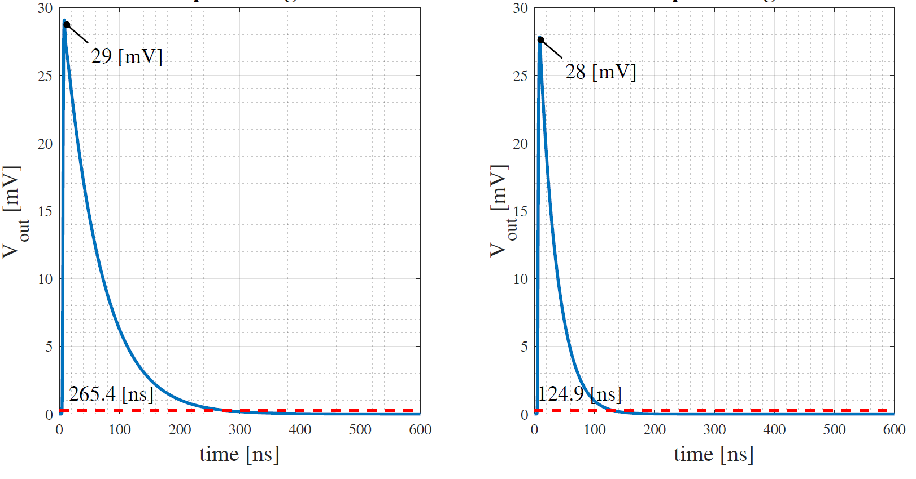
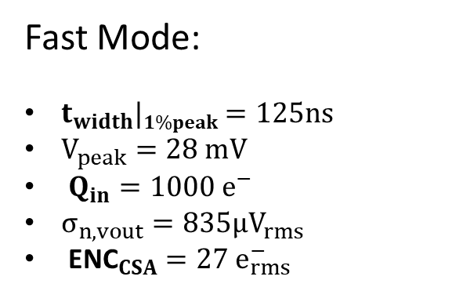
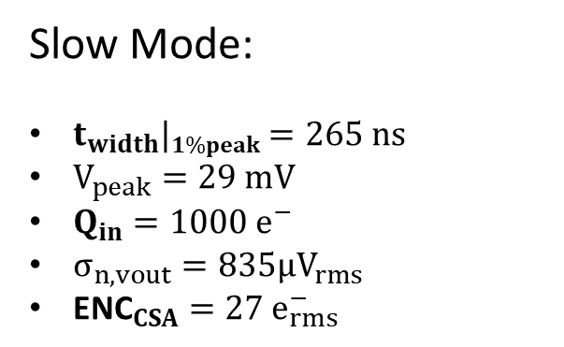
MIRA CSA Transient Pulse and Noise - Simulations
Slow Mode
Fast Mode
Slow Mode:
$t_{width}|1\%peak=265 ns$
$V_{peak}=29 mV$
$Q_{in}=1000 e^{−}$
$σ_{n,vout}=835{μV}_{rms}$
${\text{ENC}}_{CSA}=27 e_{rms}^{−}$
Fast Mode:
$t_{width}|1\%peak=125ns$
$V_{peak}=28 mV$
$Q_{in}=1000 e^{−}$
$σ_{n,vout}=835{μV}_{rms}$
${\text{ENC}}_{CSA}=27 e_{rms}^{−}$
$$Q_{in,MAX}=4000 e^{−}$$

Slide 11
Noise contributions - Simulations

Slide 12
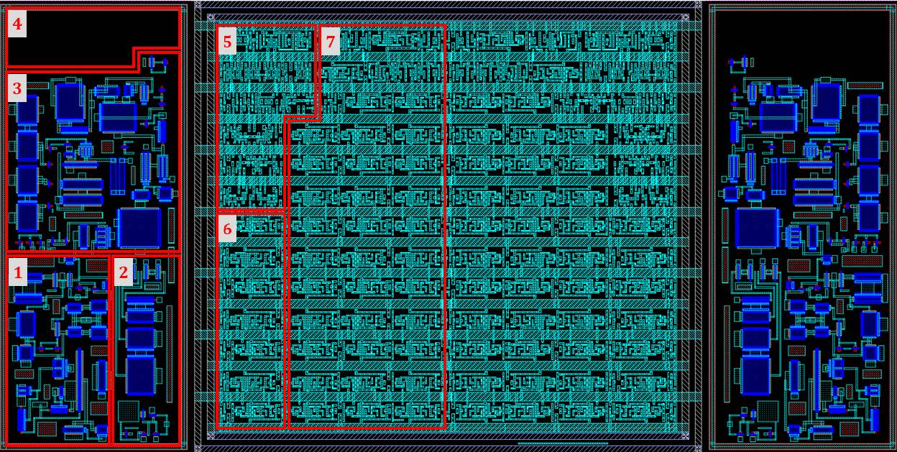
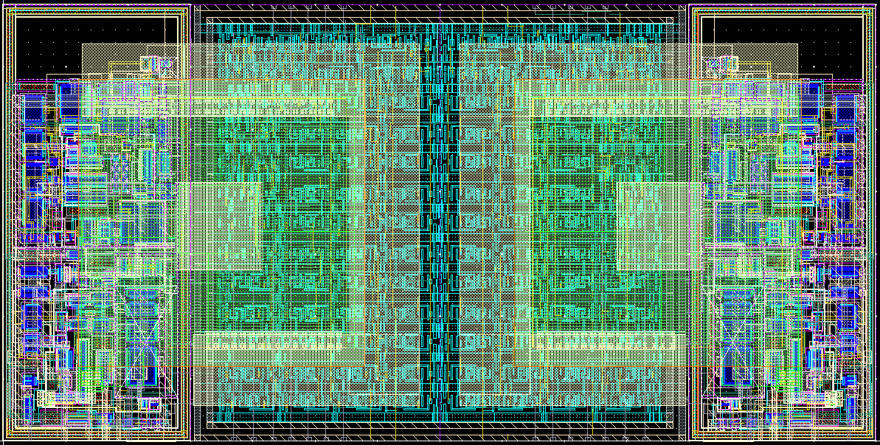



The SuperPixel - Layout
35μm
$35µ$m
Cap.
Digital
Analog
A
D
A
D
CSCL
Sum. Stage
& Current Comp.
35μm
$35µ$m
Counters
ANODE
Shared Logic
CSA
DAC
PCR
The SuperPixel:
Two mirrored pixels with adjacent digital parts
35x35 μm² pixel size with 20x20 μm² anode size
Half-analog and half-digital pixel
Fully-custom design for analog part, RTL design and synthesis for digital part
$20µ$m
Anode
Pixel

Slide 13
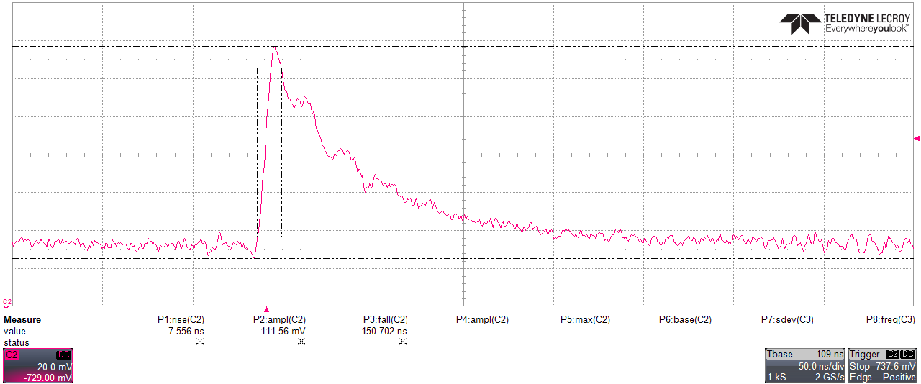
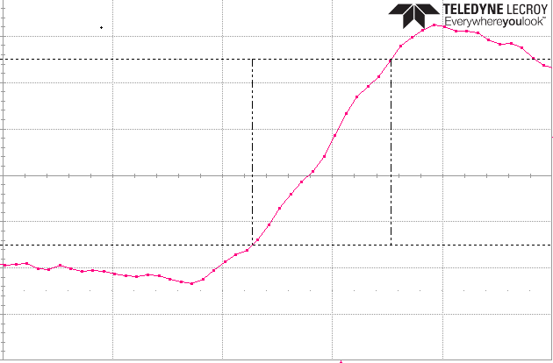
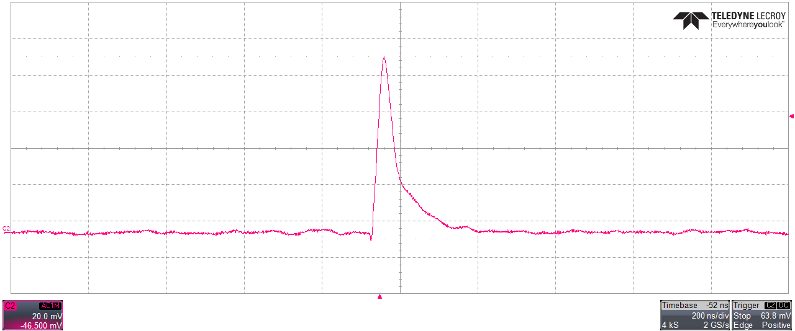
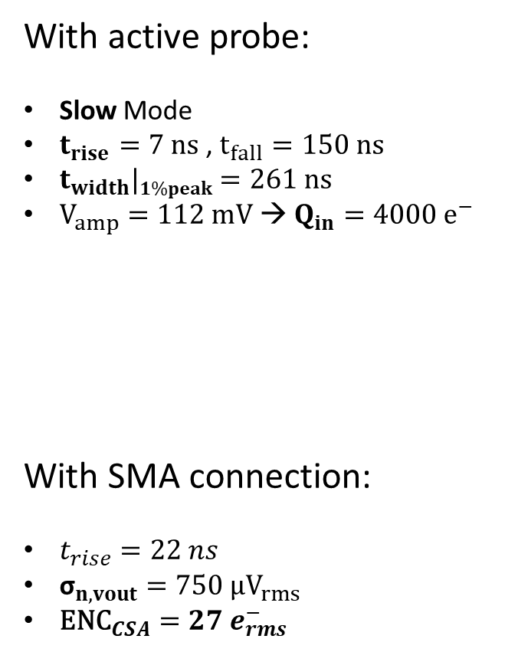

MIRA I CSA Transient Response - Measurements
With active probe:
Slow Mode
$t_{rise}=7 ns$ , $t_{fall}=150 ns$
$t_{width}|1\%peak=261 ns$
$V_{amp}=112 mV$ → $Q_{in}=4000 e^{−}$
With SMA connection:
$t_{rise}=22 ns$
${\text{σ}}_{n,vout}=750 µV_{rms}$
${\text{ENC}}_{CSA}=27 e_{rms}^{−}$
t_{rise}
t_{fall}
V_{amp}
$${\text{σ}}_{n,vout}$$

Slide 14
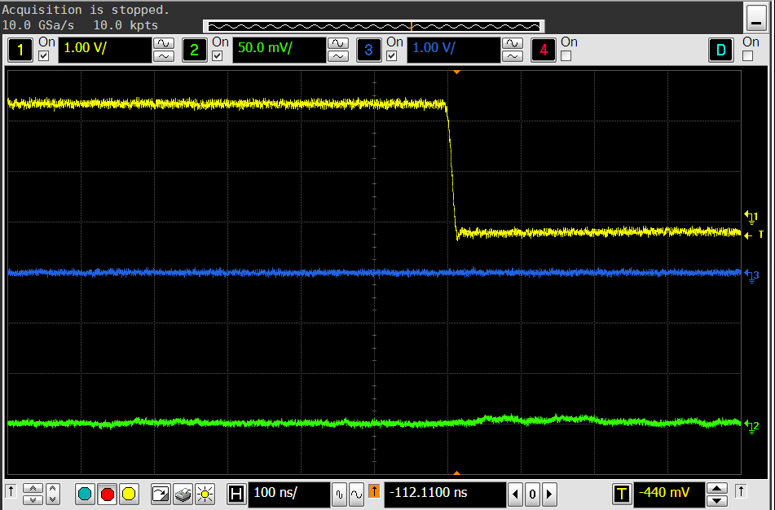
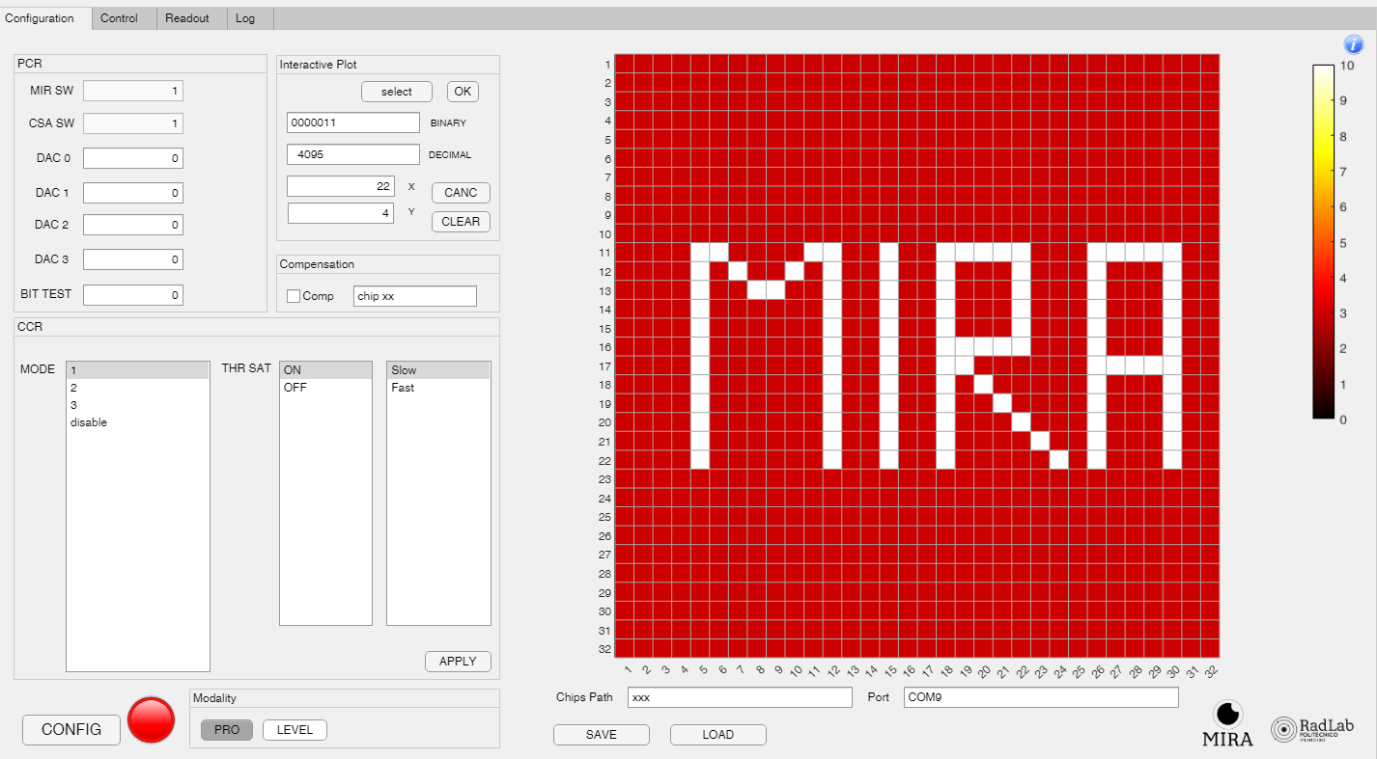
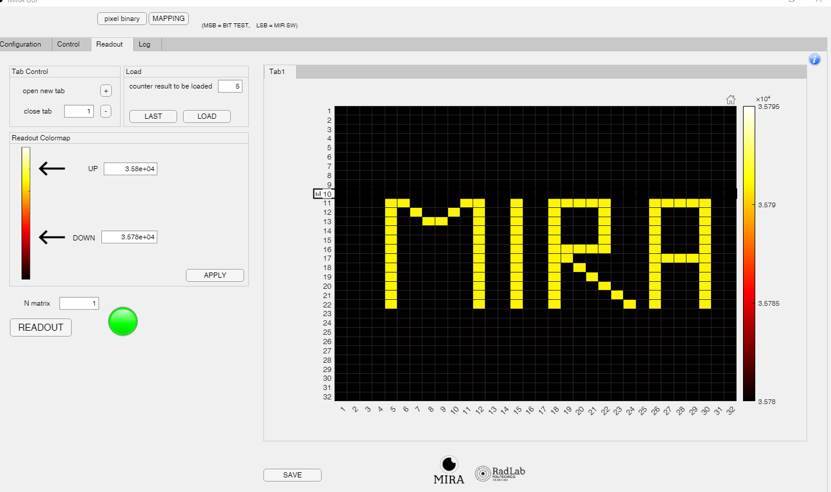
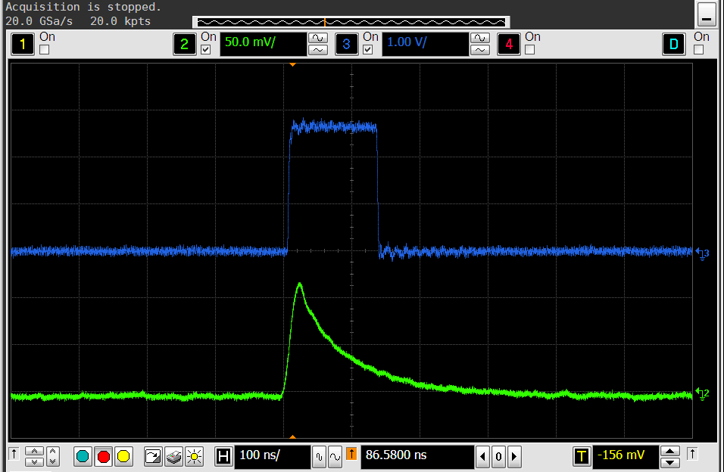
MIRA II –Results
Low-threshold operation
All pixels are configurable and readable
CK1
V_{out}
Discriminator
V_{out}
ENC = 20 e⁻_{rms}

Slide 15
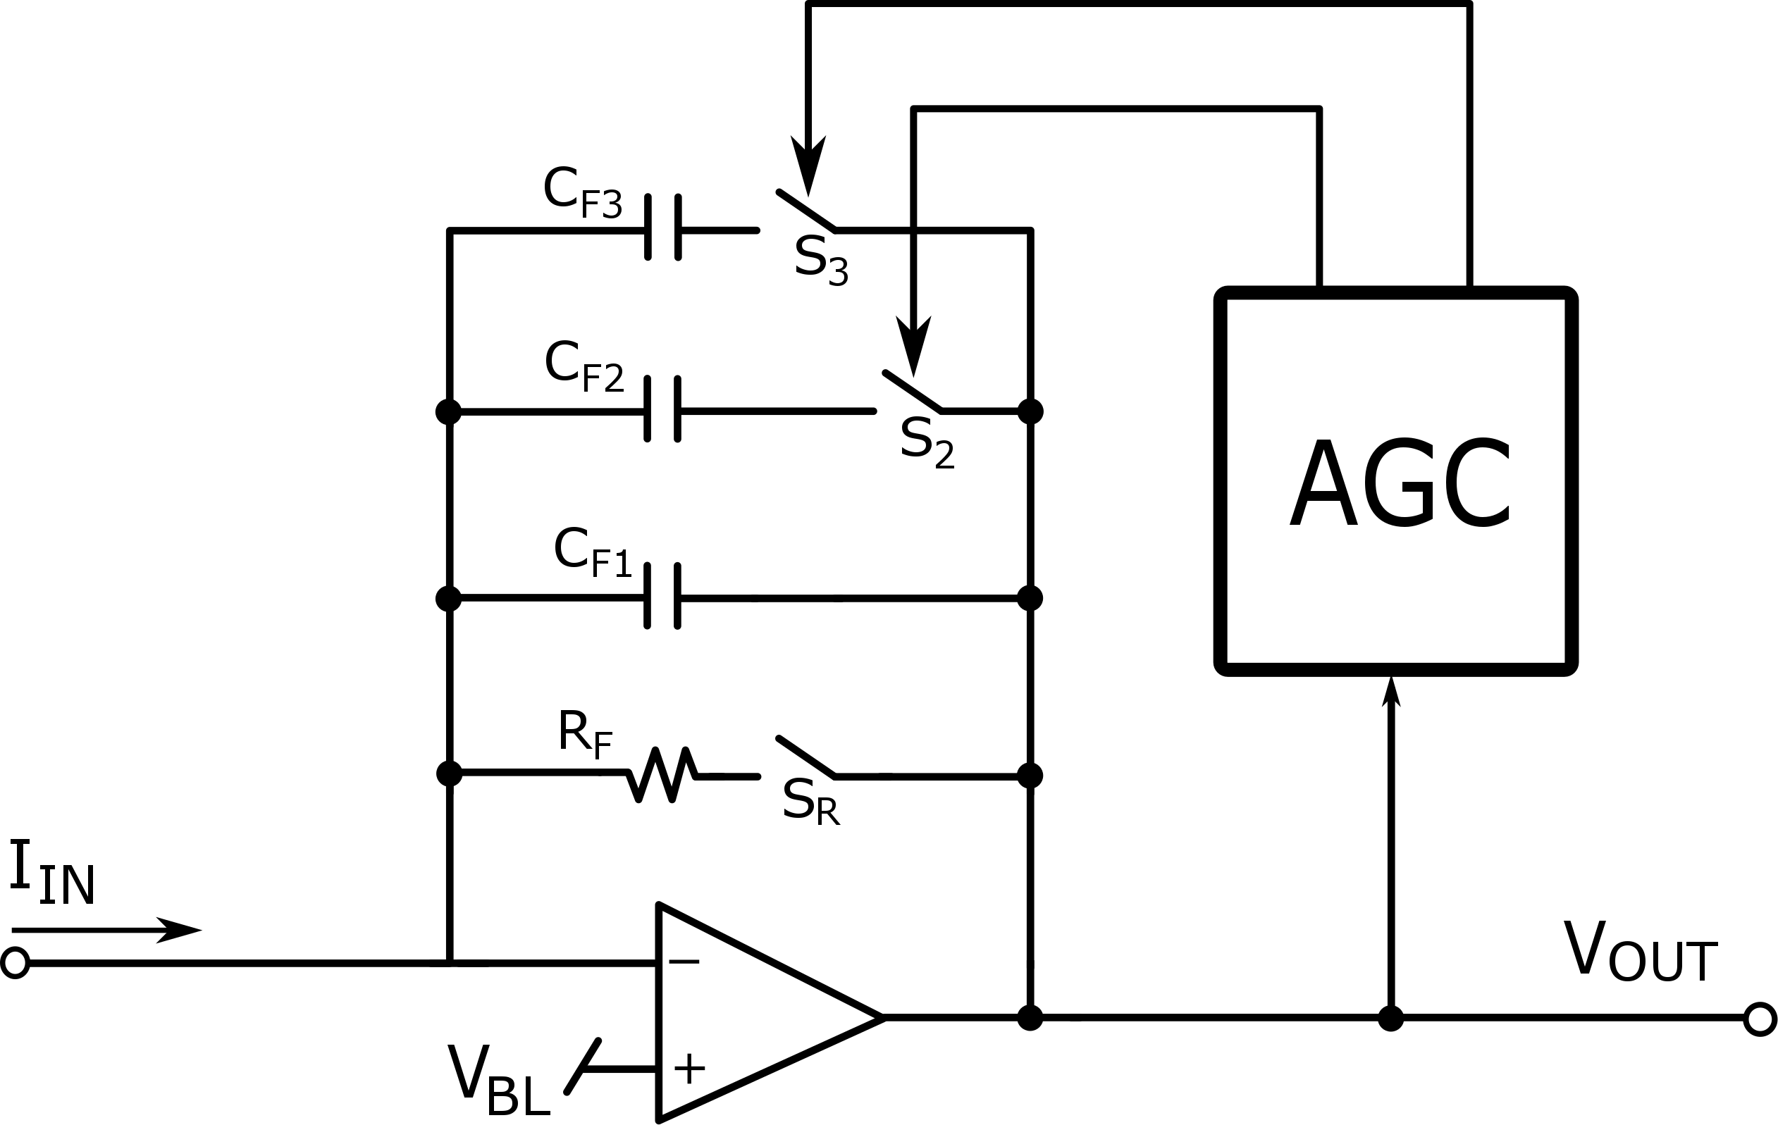
Gain-switching: standard approach
V
V
V
Threshold
G₁
G₁→G₂
G₁→G₂→G₃
t
t
t

Slide 16
Gain-switching: ‘predictive’ approach
V_{DD}
V_{DD}
V_{DD}
V_{th}
V_{th}
V_{th}
High Gain
High Gain → Mid Gain
High Gain → Low Gain
T1
T2
T1
T2
T1
T2
Input signal
Output voltage
Features:
Only one gain transition among multiple gains
Relative freedom in setting the threshold
Gain-switch decision taken quite early vs. end of integration

Slide 17
Implementation in a SiPM-readout ASIC
L.Buonanno, D.Di Vita, M.Carminati and C.Fiorini, "GAMMA: A 16-Channel Spectroscopic ASIC for SiPMs Readout with 84-dB Dynamic Range", (2021) IEEE Transactions on Nuclear Science, 68 (10), pp. 2559-2572.

Slide 18
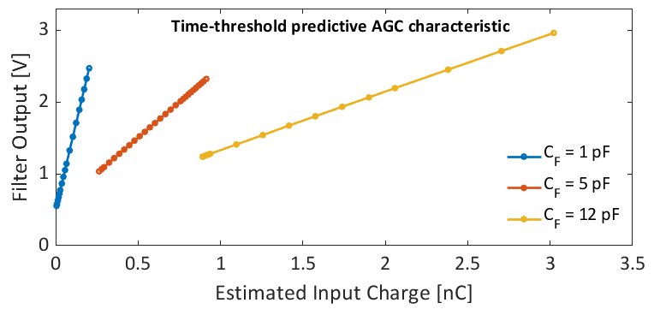
Experimental results
Non linearity

Slide 19
Implementation in a gamma-ray detector
M. Agnolin et al., "A γ-Ray Detector Based on a 3" LaBr3:Ce:Sr Crystal with SiPM Readout for 80 keV – 16 MeV Energy Range with Position Sensitivity for Doppler Correction," in IEEE Transactions on Nuclear Science, doi: 10.1109/TNS.2023.3312424.

Slide 20
Gain switching statistics

Slide 21
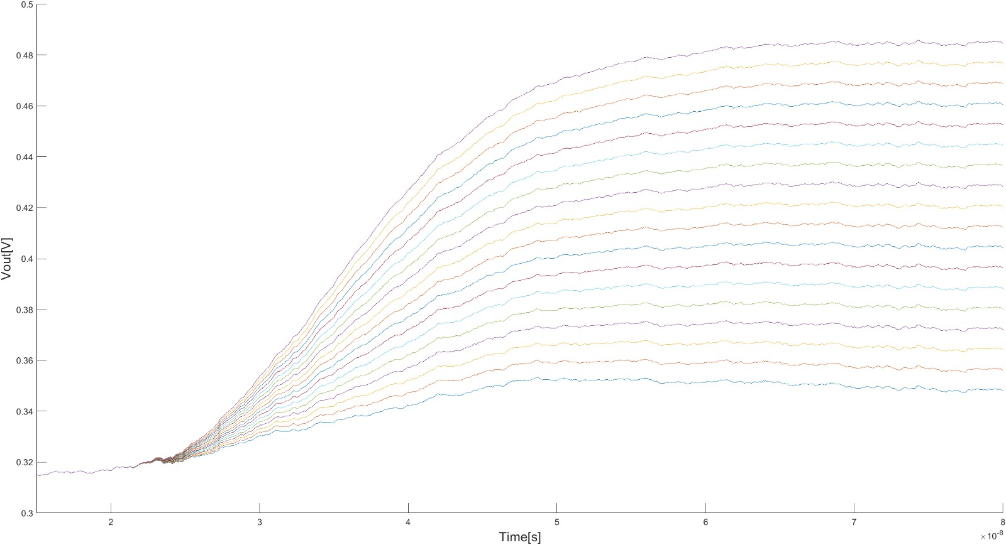
Study of FE in 65nm for EuXFEL detectors
Range1: 1-20ph @1keV
Range2: 20-1000ph @1keV
Range3: 10³-10⁴ph @1keV
C_{F3}
Gain switching
C_{F2}
Trapezoidal
Filter
C_{F1}
G₁
2000e-
C_{D}
G₂
Q
G₃
300e-

Slide 22
Preliminary noise evaluations...
Range1: 1-20ph @1keV
ENC @50ns T_{int}: 31e- rms (S/N ~ 9.0 @1keV)
ENC @100ns T_{int}: 26e- rms
ENC @150ns T_{int}: 24e- rms
Range2: 20-1000ph @1keV
ENC: 246e- rms → 1.1ph @1keV
Range3: 10³-10⁴ph @1keV
ENC: 1880e- rms → 6.7ph @1keV
(C_{T}=130fF, Range1,2 do not include 2nd stage noise contributions)

Slide 23
Wrap-up..
Polimi team is willing to contribute to the development of FE solutions for detectors for EuXFEL and to collaborate with other teams for new large scale ASICs.
Acknowledgments:
Matteo Porro
European XFEL GmbH, Hamburg, Germany and Università Ca’ Foscari Venezia, Venezia, Italy
Leonardo Nassi, Adele Ciavarella, Edoardo Fabbrica, Davide di Vita
Politecnico di Milano an INFN, Milano, Italy

