Slide 1
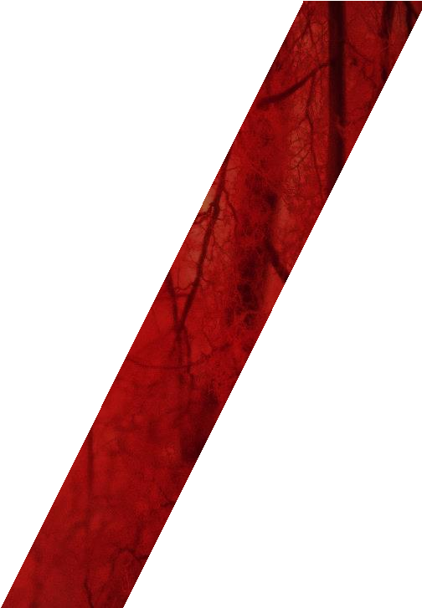
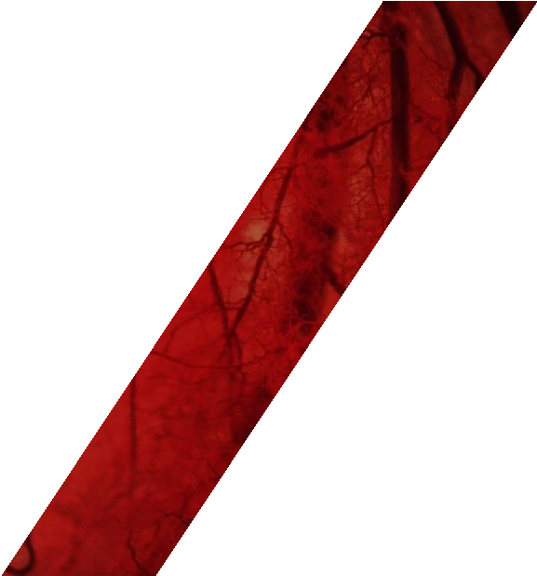
CdZnTe Detector Technology for Emerging Applications in advanced X-Ray sources
Glen Wu, Manager, Business Development
Redlen Technologies, Saanichton, BC, Canada

Slide 2
Agenda
CdZnTe Technology
Redlen Technologies
CZT for Applications in FELs and Synchrotrons
Fine Pixel Pitch (FPP) Custom Sensor Offering
Conclusions and Outlook

Slide 3
CdZnTe Technology

Slide 4
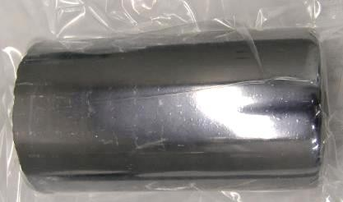
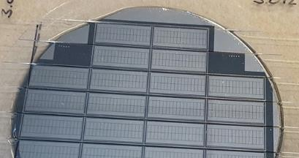
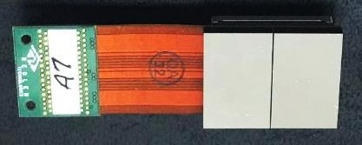
CdZnTe Semiconductor Radiation Detectors
Cadmium Zinc Telluride (CZT)
Optimal X-ray and Gamma ray detection at room temp
High resolution / High sensitivity / Low radiation dose
Available today in volume production
Two main types
Low-flux process (5 to 15 mm thickness, spectroscopic) optimized for electron transport
High-flux process (2 to 2.5 mm thick, photon counting), optimized for balanced electron and hole transport
Redlen has solved the CZT high-flux problem
Proprietary “Traveling Heater Method” (THM) growth
24 years of R&D and production scaling
High yields, high performance, consistent quality
CZT Boule
CZT Sensor Wafer
CZT Detector Module

Slide 5
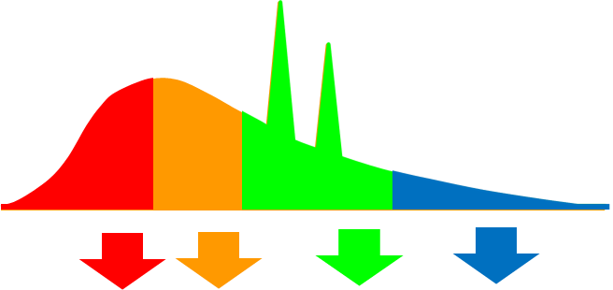
CZT’s Value Proposition for X-Ray Imaging
Scintillator
Redlen - CZT
CZT Benefits
Small Pixels = Better Image Resolution
Better Efficiency = Up to 80% less radiation
Elimination of electronic noise
Equal contribution of lower energy quanta
Energy Bins = More Data / Photon (10x) = Better Materials Identification
X-Ray Spectrum
X-Ray Spectrum
TWO STEP
SINGLE STEP
1
Light
Scinti- llator
1
CZT
2
Light to Electron
Photo- Diode
Photon Counting Direct Conversion Detector
Scintillator Integrating Detector
Light to
Electron

Slide 6
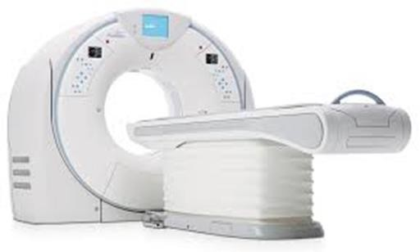
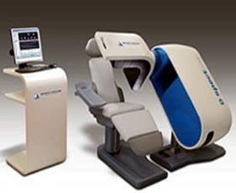
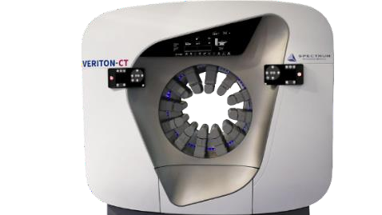
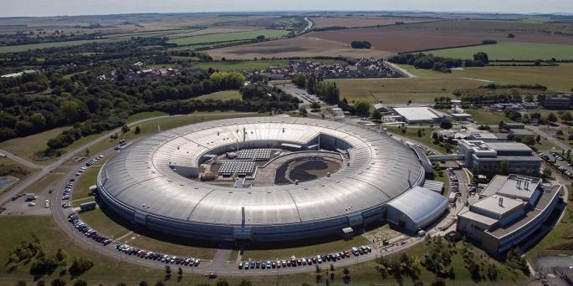
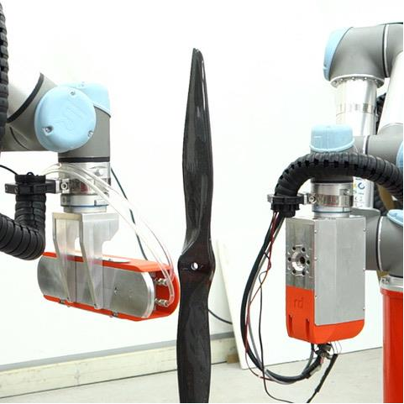
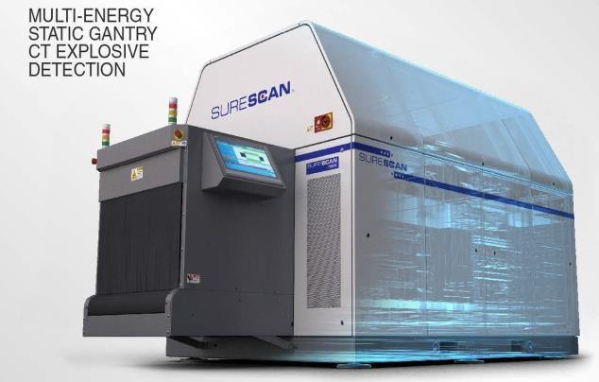
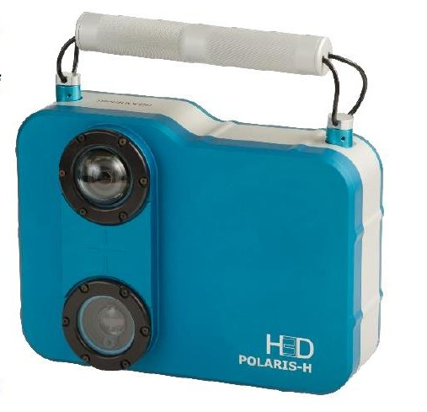
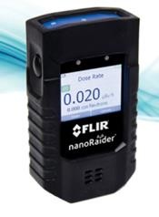
Medical, Security, NDT & Science CZT Applications
Photon Counting CT
NM Cardio
SPECT / CT
Synchrotrons
Baggage Scanning
Radiation ID
NDT
Space Science

Slide 7
Redlen Technologies

Slide 8
About Redlen: CZT Detector System Foundry
Founded in 2000, Victoria, BC, Canada
200+ staff, 15+ PhDs, 40,000 sq-ft production facility
Vertically integrated company - Crystal growth, sensor fab, module development and assembly, test and validation
Core competency: High flux CZT sensors
Canon Inc. acquired Redlen, Sept 2021
Redlen is now a wholly-owned subsidiary of Canon Inc
Canon is committed to supporting global adoption and high-volume supply of premium quality CZT

Slide 9
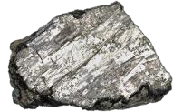
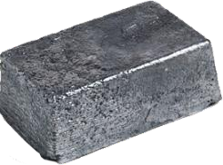
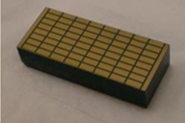
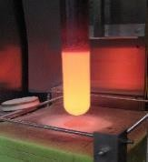
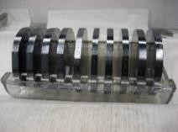
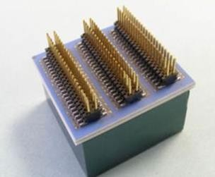
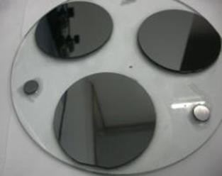
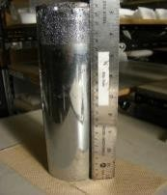
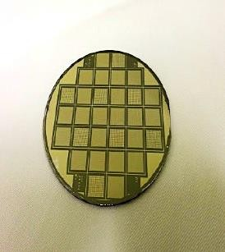
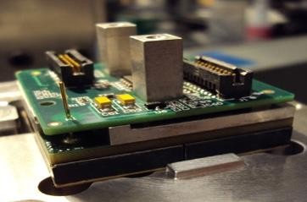
CZT Manufacturing Process
Sensor and Module Level Products
Crystal Growth
Wafer Slicing, Annealing and Fabrication
Raw Metals
Raw Wafers
Sensor
Wafer Anneal
CZT
Compounding
Attached Sensor Assembly
THM Crystal Growth
Wafer Lap & Polish
CZT
Boule
Wafer Fabrication
Detector Module

Slide 10
Redlen’s detector system foundry
Customer co-development: process, sensor, read-out electronics,
module assembly, test
Elemental Metals
Electronic components
Crystal Growth
Wafer Processing
Sensor Fabrication
Module Assembly
Sensor sales
Module sales

Slide 11
Synchrotron and FEL Applications

Slide 12
Statement of Problem
4th gen Synchrotron and FEL Light Source upgrade is taking place and will last for the next ten years
Very high photon flux (x10-100)
Moderate to high photon energies (above 25keV hard X-ray)
Key requirements for next generation detectors
Flux: 10¹⁰ cps/pixel
Pixel pitch size: ≤100μm
Frame rate: 100 kHz
Sensitive Energy range: 25 keV for high-Z
Large active area: up to 16M pixels or more
Highly modulable detector assemblies

Slide 13
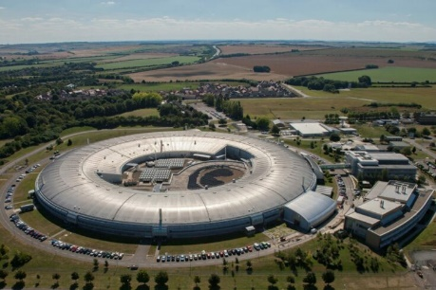
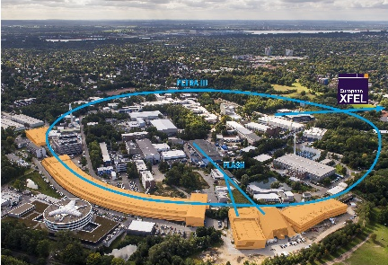
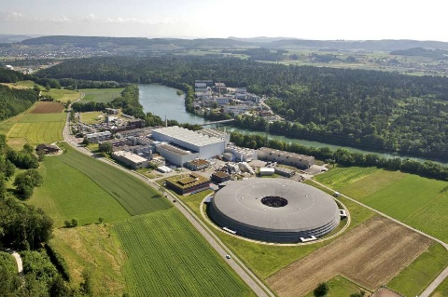
Redlen CZT
Redlen High-Flux CZT is proving to be one of the most suitable detector material for this purpose
Very high photon flux (up to 10¹² cps/mm²)
Moderate to high photon energies (30 – 200 keV)
Lower dark current and lower noise
Better spectral stability
Lower afterglow
Looking forward to collaboration with science research community and detector industry players
Proven material for a variety of ASICs including Medipix3, Timepix4 and more for successful system deployments
More custom development programs are in progress (under NDA)

Slide 14
Fine Pixel Pitch (FPP) Custom Sensor Offering

Slide 15
Overview
Canon acquisition has enabled Redlen to improve production capabilities of FPP sensors to an acceptable quality level and scalability according to initial feedbacks
Canon has blessed Redlen to do everything we can to service this market in the years to come
Such program will provide opportunities to both science communities and industrial players to gain access to Redlen’s photon counting CZT at prototype and massive production volume
CZT foundry only - focusing on sensor fabrications
ASIC and module developments are Redlen’s off limits

Slide 16
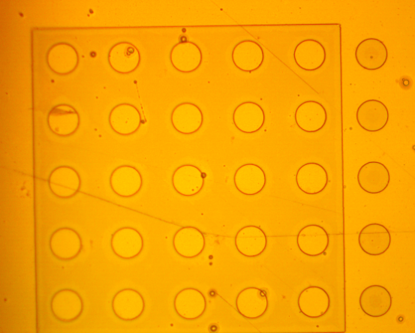
Description
Key Highlights
HF CZT
Pixel Pitch < 250μm
Max X or Y Dimension: 40mm
Sensor Thickness: 2mm
Contact Metallization:
Single metal (Pt), or
Bi-Metal (Pt/Au)
Street Width > 20μm
Guard-ring: Optional
Passivation: SU-8
Edge Gap: > 50μm
Visual inspection only:
Anode defective pixel %: TBD
Cathode delamination %: TBD
SU-8 40mm openings
Bright Field Inspection
Dark Field Inspection

Slide 17
Conclusions and Outlook

Slide 18
Conclusions
CZT – a mature, enabling, available technology
Yield and quality have achieved levels enabling volume applications in Synchrotrons
Redlen continues to invest further its global leadership in commercial supply of CZT
Expanding advanced production capability, improving quality, driving cost reduction
High-Flux CZT is the next-generation high performance detector material for Synchrotrons and FELs
Superior detector performance in high energy and high photon flux imaging
Redlen’s fine pixel pitch sensor program is available today
Proven with a wide range of state-of-the-art ASICs

Slide 19
Outlook
Redlen is enhancing CZT technology to meet increasingly challenging market applications
Supporting customer development and production of CZT based cameras in multiple light sources
Improving processes to increase X-Y dimensions and reduce sensor thickness
Development of novel metal stack and passivation solutions
Development of smaller street width and edge gap to reduce dead area

Slide 20
Please visit us on Booth# 54 at 2023 IEEE NSS MIC RTSD between 6th and 9th of November in Vancouver Canada!

