Slide 1
Summary of KW 5
 | Monday 30th January | Tuesday 31st January | Wednesday 1st February | Thursday 2nd February | Friday 3rd February
Achievements | * Tunnel open for maintenance day | * Investigations on beam position stability * Various tools development | * UKE irradiation tests (105 pC) * D3 irradiation tests (50 pC) * Charge map overnight (failed) | * AA shift: Testing new environment code on several screens; running pytest across RL environments * Turbo-ICT timing scans (to be extended) | * Data acquisition for arrival time jitter measurement vs gun phase * EA spectrometer working fine
Perturbating events | - | * BPMs not working properly | - | - | * TWS2 forward power is having small jumps from time to time
Notes | - | - | - | - | -

Slide 2
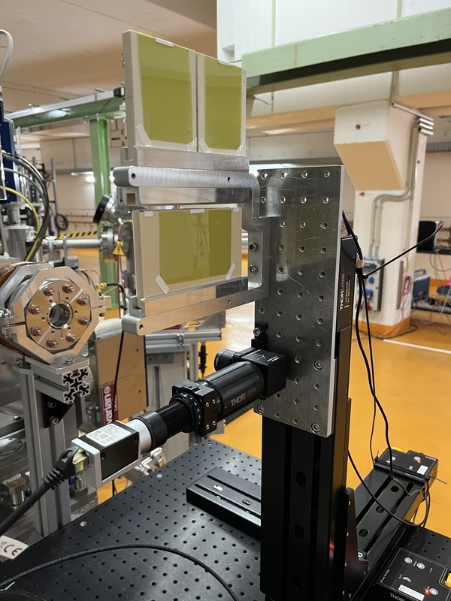
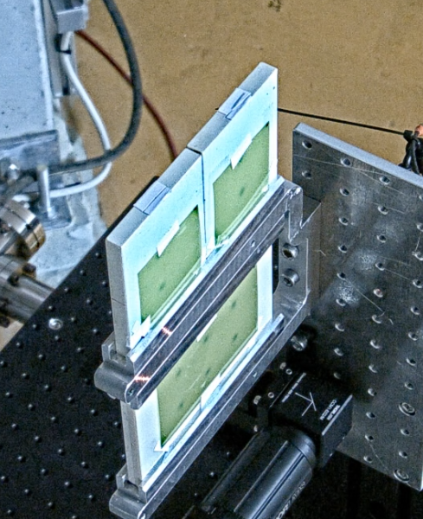
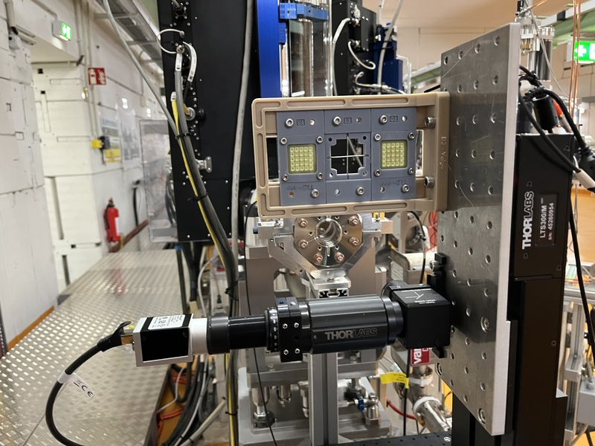
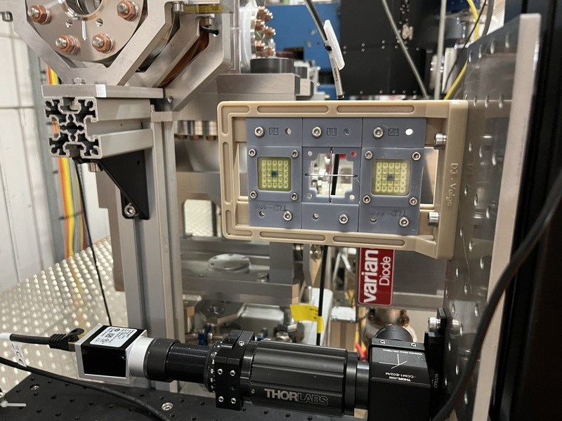
Irradiation tests (UKE & D3)
D3: Irradiation of TLD dosimeters
UKE: Film irradiation

Slide 3
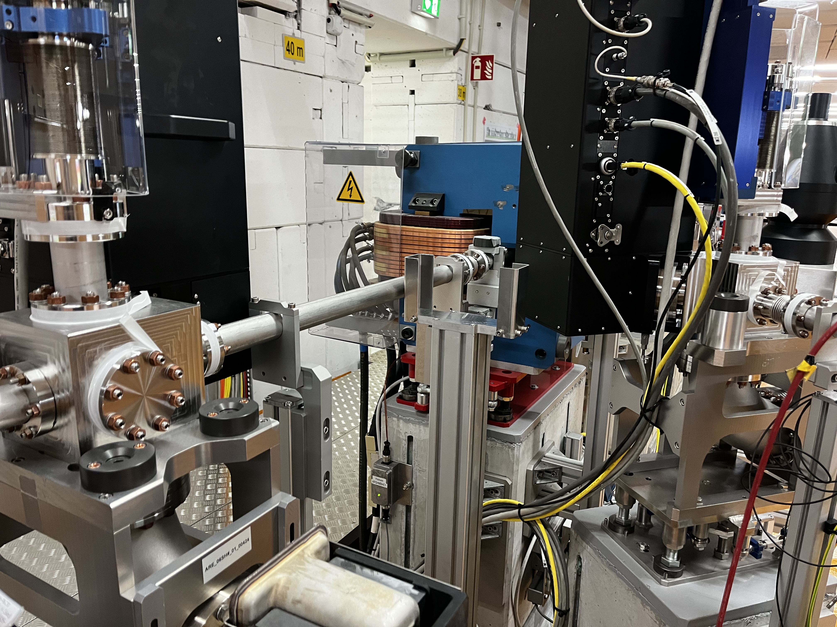
Lead brick holder installed

Slide 4
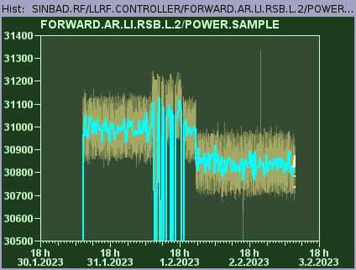
TWS2 forward power jumps
TWS2 forward power is sometimes suddenly jumping by +/- 100-200 kW (≈ +/- 0.1 MeV/c) without any change in the reflected power.
First observations: It seems to happen preferentially after vacuum events and after large phase change in a single step (like typing +120 degree when being at 0 degree).

Slide 5
Schedule
Week 6
Date | Shift leader
6.2. | Florian (Tunnel open)
7.2. | Frank
8.2. | Hannes
9.2. | Max
10.2. | Thomas
If you want to learn or join the shift: please give the shift leader a call (BKR 2840 / SINBAD Box 2454)

