Slide 1
STRV-R1
A SEU tolerant RISC-V implementation
Verbundmeeting 28.02.2023

Slide 2
Background - Typical Application
Many custom ASICs have a similar structure:
Design of a custom ASIC is complex and time consuming
Reuse of generic blocks possible (ADC, voltage regulators, etc.)
Adaptation of internal logic difficult
  → Often custom to original application, requiring full redesign
Idea: Replace internal data processing logic with RISC-V core
  Adaptation to new application / Bugfixes via firmware updates
AD / DA Converter
Internal Logic
Communication Interface
Data Acquisition
Data Processing
Data Transfer

Slide 3
STRV-R1 | Architecture
RV32-IMC Core
  3 stage pipeline
  Multiplication extensions
  Compressed instruction extension
Three SRAM Instances with Scrubbing algorithm
  Dual Port SRAM
  3x 32Kbyte
1.2V Core & I/O supply

Slide 4
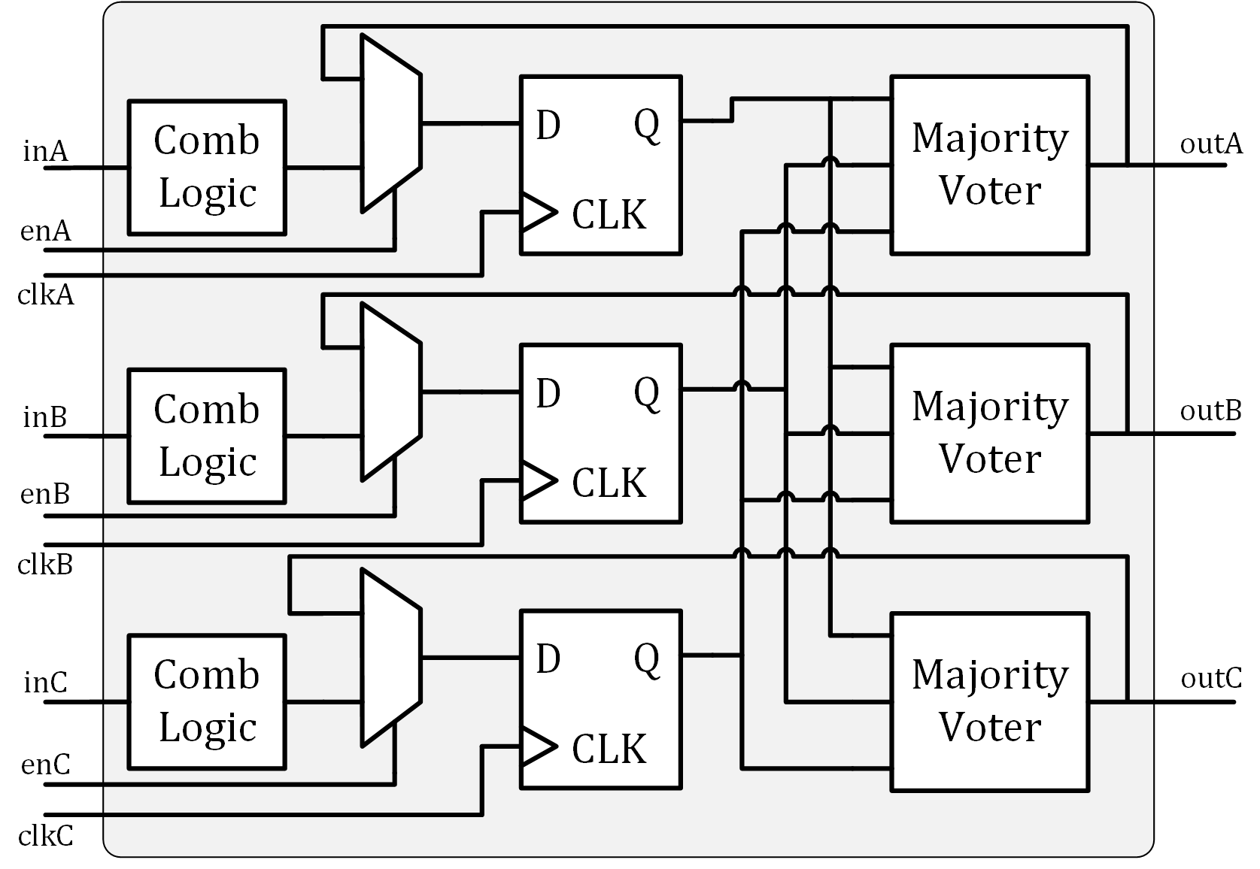
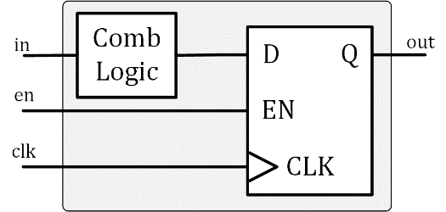
Triple modular redundancy (TMR)
Triple modular redundancy (TMR)
  Triplication of combinational logic / storage elements
  Elimination of single points of failure
Majority voter → following logic receives corrected Signals
  Mismatch Signal available
Additional feedback is integrated via multiplexer
  Feedback uses majority voter output
  Possible bit errors are corrected within one clock cycle

Slide 5
SRAM | Single Event Effect Mitigation
SRAM must be treated explicitly
  Large area, high likelihood of SEUs
  Some data accessed very rarely
  Risk of accumulated SEUs
Three SRAM instances with majority voting
  Access to one row at a time
  In case of disagreements:
  Majority voted data written back
Dual-Port RAM required
Refresh rate depended on SRAM module size
Read SRAM Row
Compare 3 Instances
Write SRAM Row
Increase SRAM Row

Slide 6
SEU Detection Network
Detection of occurred SEUs
  Data acquisition during irradiation
Majority voter provides mismatch signal
  During runtime: SEU occurred
  Signal fed to SEU counters
  Accessible via memory mapped registers
SEU Signal available
  Via Software
  Via Pad on the Chip / direct output
SRAM
SRAM
SRAM
Refresh
SRAM
SEU Register
SRAM Counter
Voter
1
Voter
≥1
2
Core Counter
Voter X
Periph Counter
Core Instances
Voter
1
Voter
≥1
2
Voter X
Periph Instances

Slide 7
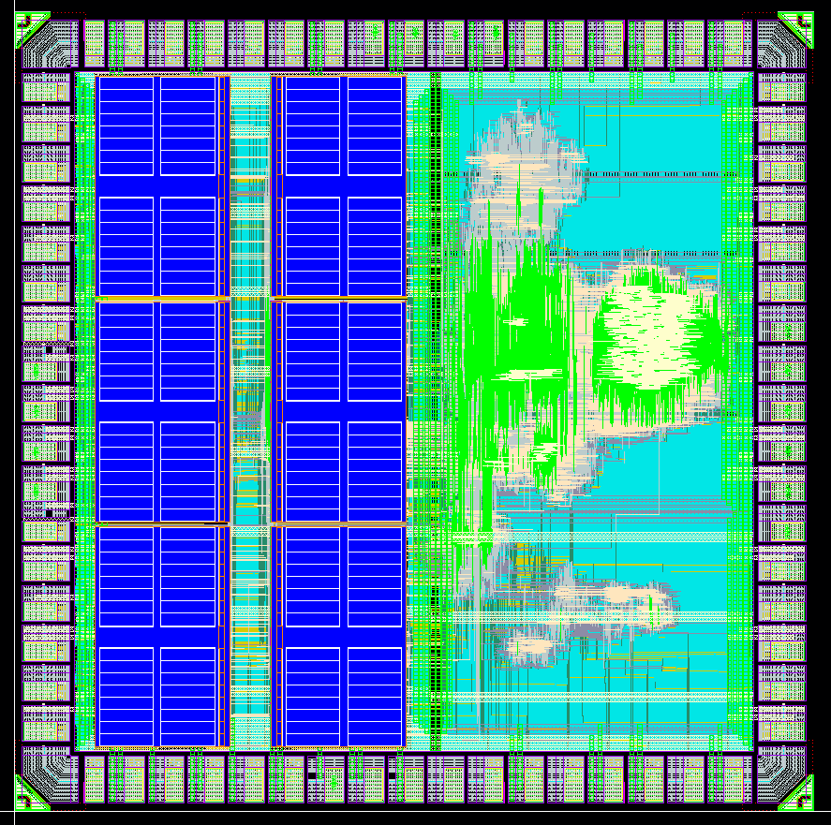
STRV-R1 | Implementation
65nm Technology
Size: 2x2mm
RV32I Core with M and C extension
50 MHz @ 1.2V
3x32 Kbyte Dual-Port SRAM
  Divided into two 16Bit wide SRAM cells
SRAM-Scrubbing
  Upper refresh limit 320μs @ 50MHz
Interfaces:
  UART, JTAG, 27 GPIOs
Separate power domains:
  Core
  SRAM
  Peripherals + Padring
SRAM
1A
SRAM
2A
CORE
SRAM
1B
SRAM
2B
SRAM Interface
SRAM
1C
SRAM
2C
PERIPH

Slide 8
STRV-R1 | Implementation
65nm Technology
  Thing gate oxide transistors only
  →increased TID hardness
  IO-voltage limited to 1.2V
TMR Strategy:
  Triplication of all components
    including peripherals
  Three separate clock-trees
  CLK, Reset, JTAG use triplicated Pads
  Other signals voted before Padring
Spacing between redundant instances:
  15μm
STRV-R1 Layout
Left: SRAM Right: Core & Peripherals

Slide 9
Test system | Overview

Slide 10
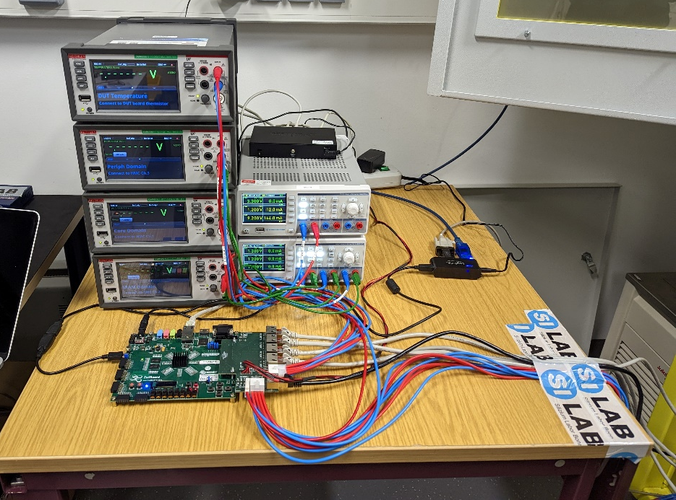
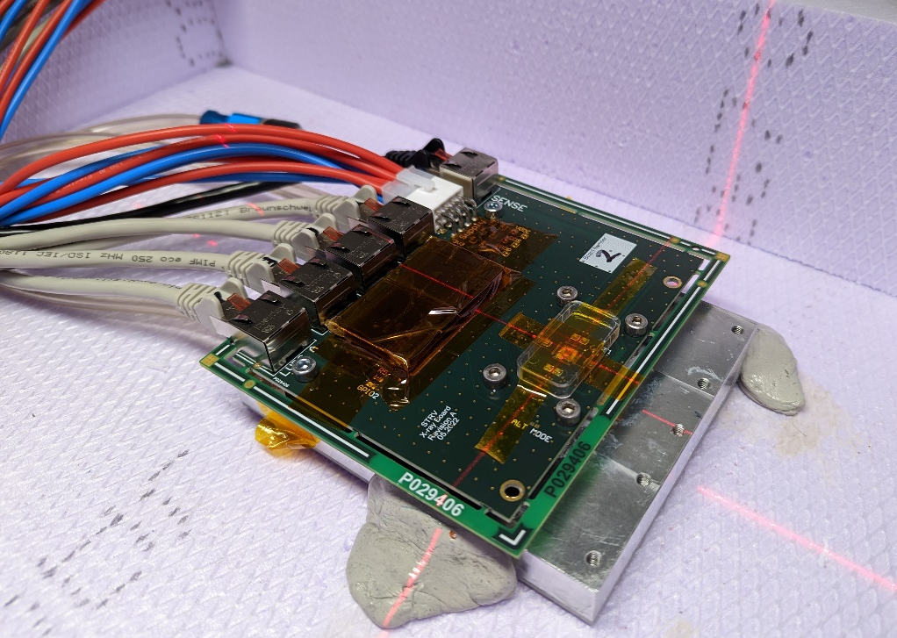
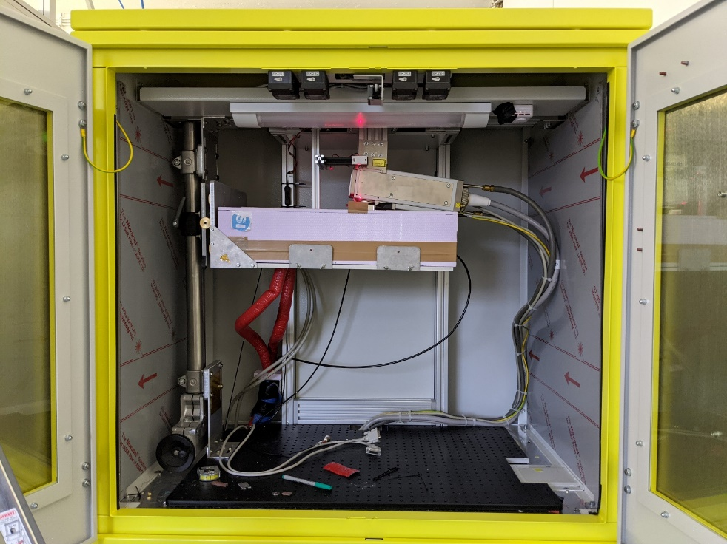
Test system | X-ray Irradiation
X-ray irradiation with TID >1GRad
Dose-rate 2.08 MRad/h
X-ray irradiation performed at -10°C
Leakage and dynamic power measured
No functional interrupt observed

Slide 11
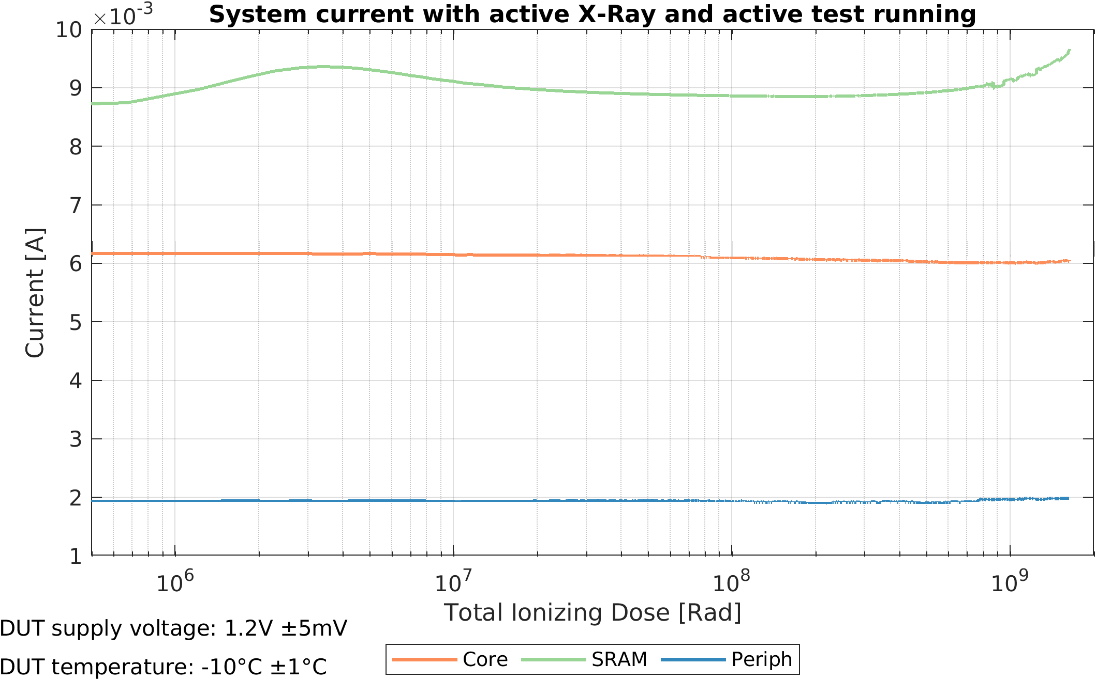
TID Results | System Currents

Slide 12
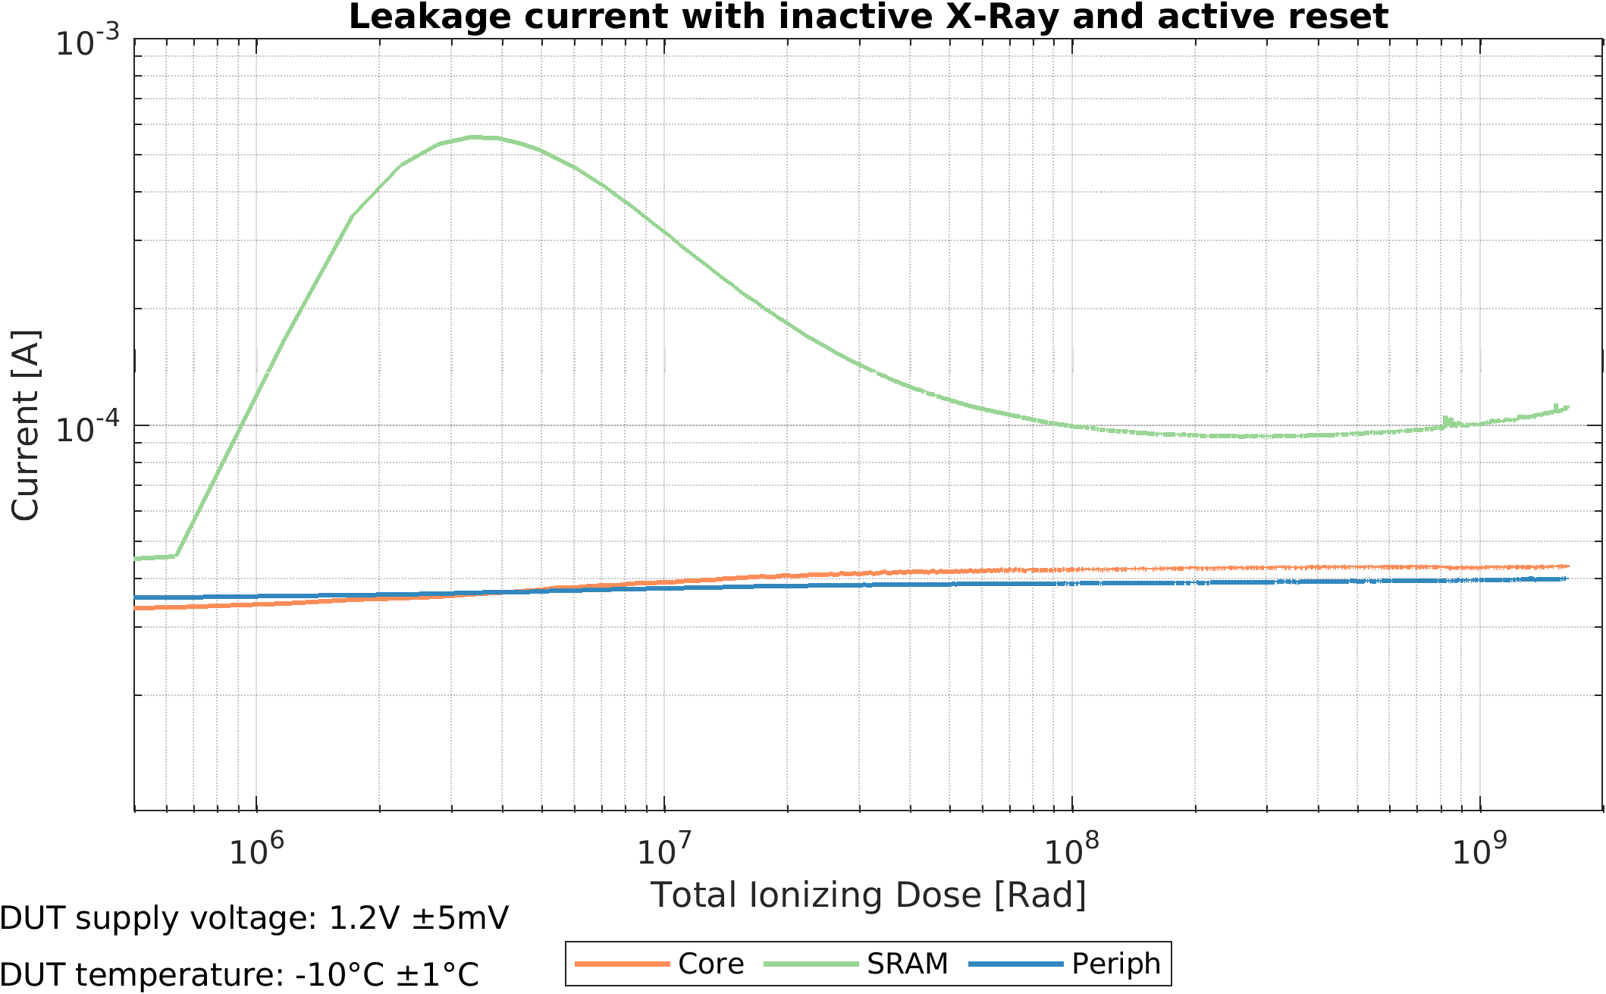
TID Results | Leakage Currents

Slide 13
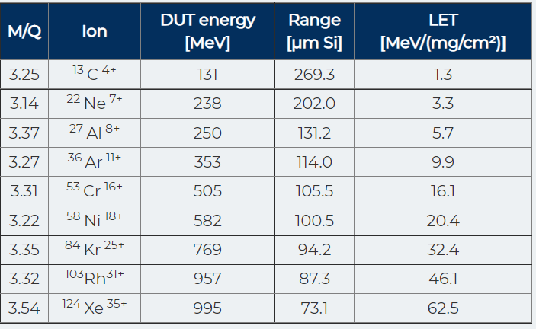
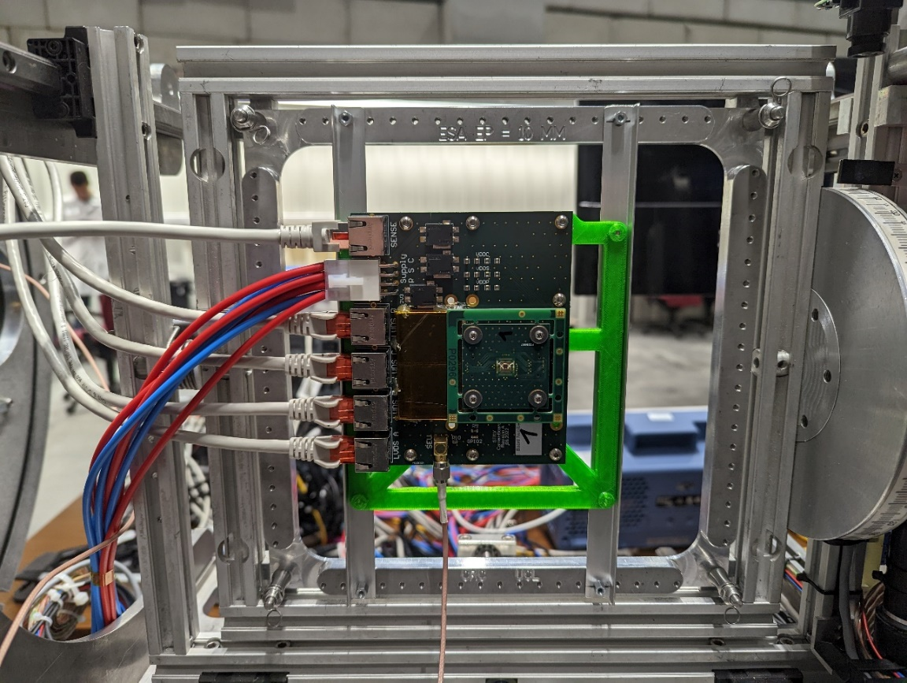
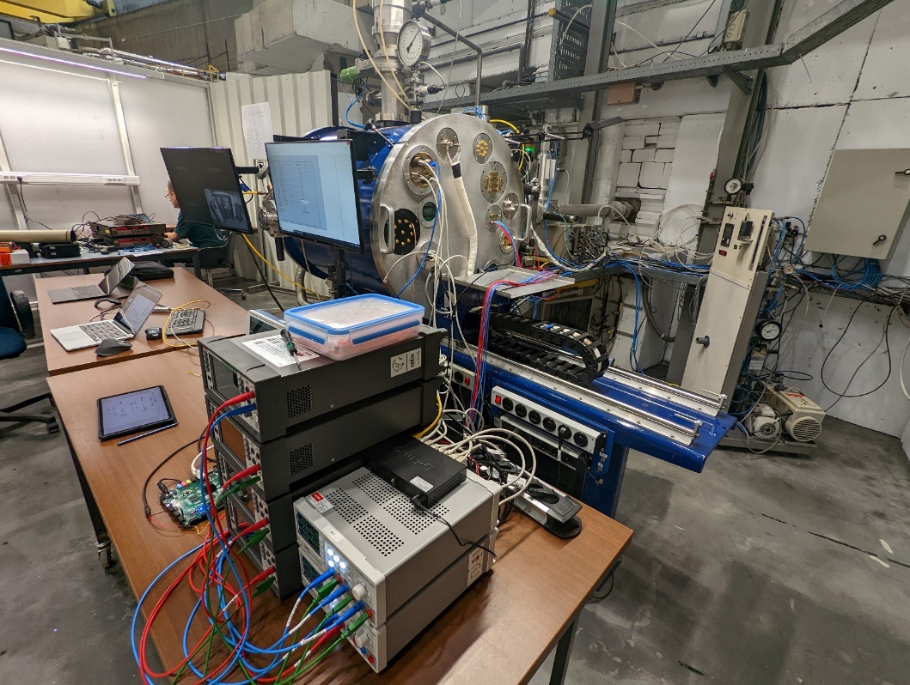
Test system | Heavy-Ion Irradiation
Beam Flux: 1,5 x 10⁴ p/(s*cm²)
Beam Diameter: 25mm (+-10%)

Slide 14
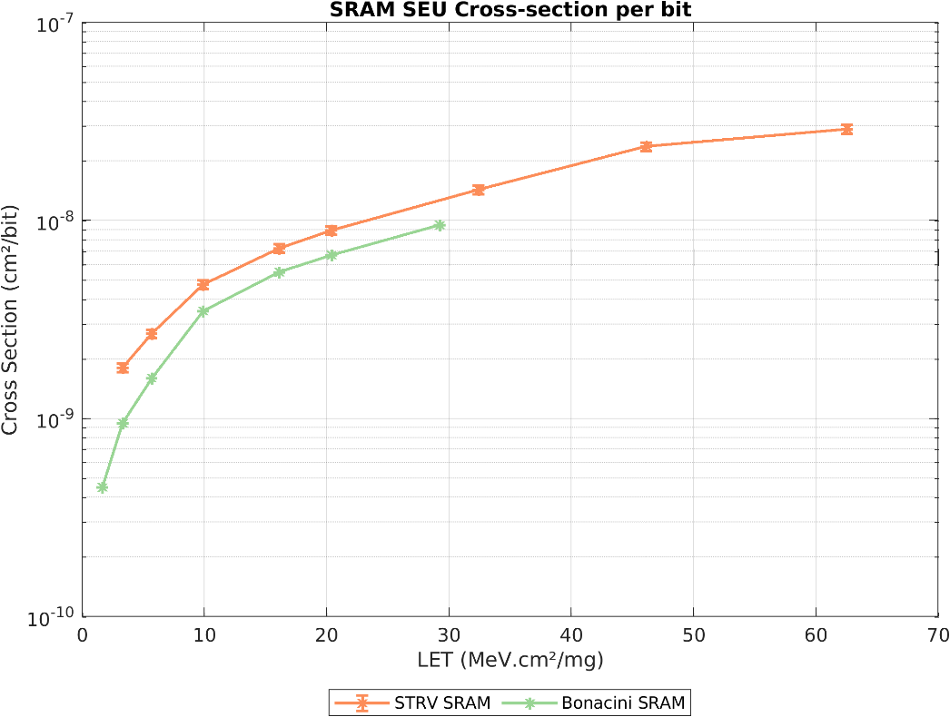
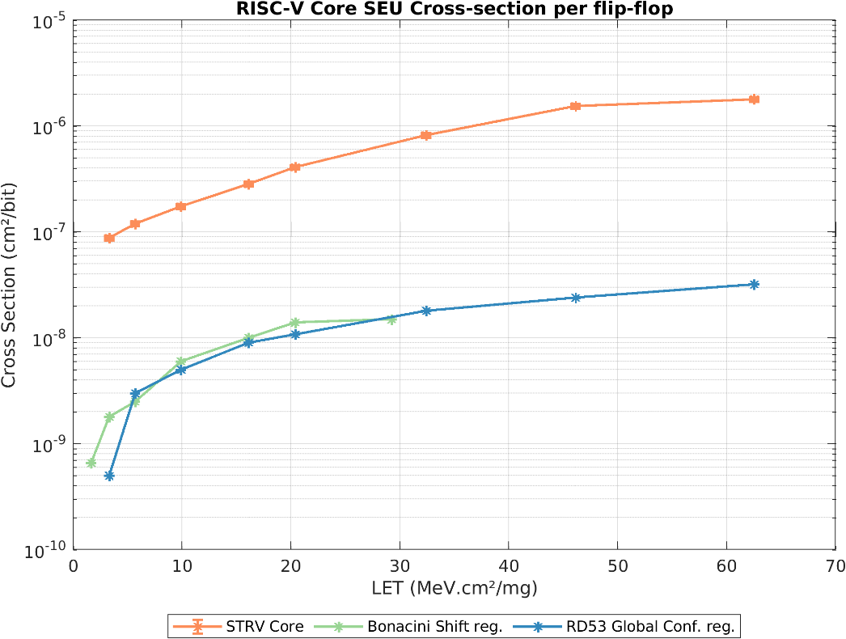
Heavy-Ion| SEU Cross-Section
SRAM Macros (SRAM-Refresh) RISC-V Core (Majority Voter)
Cross-section of occurring SEUs, no correction / mitigation
RISC-V Core: Cross-section significantly larger than observed by previous works
  Likely caused by large combinational logic between flip-flop
  SETs are propagating through design, captured by flip-flops as SEU

Slide 15
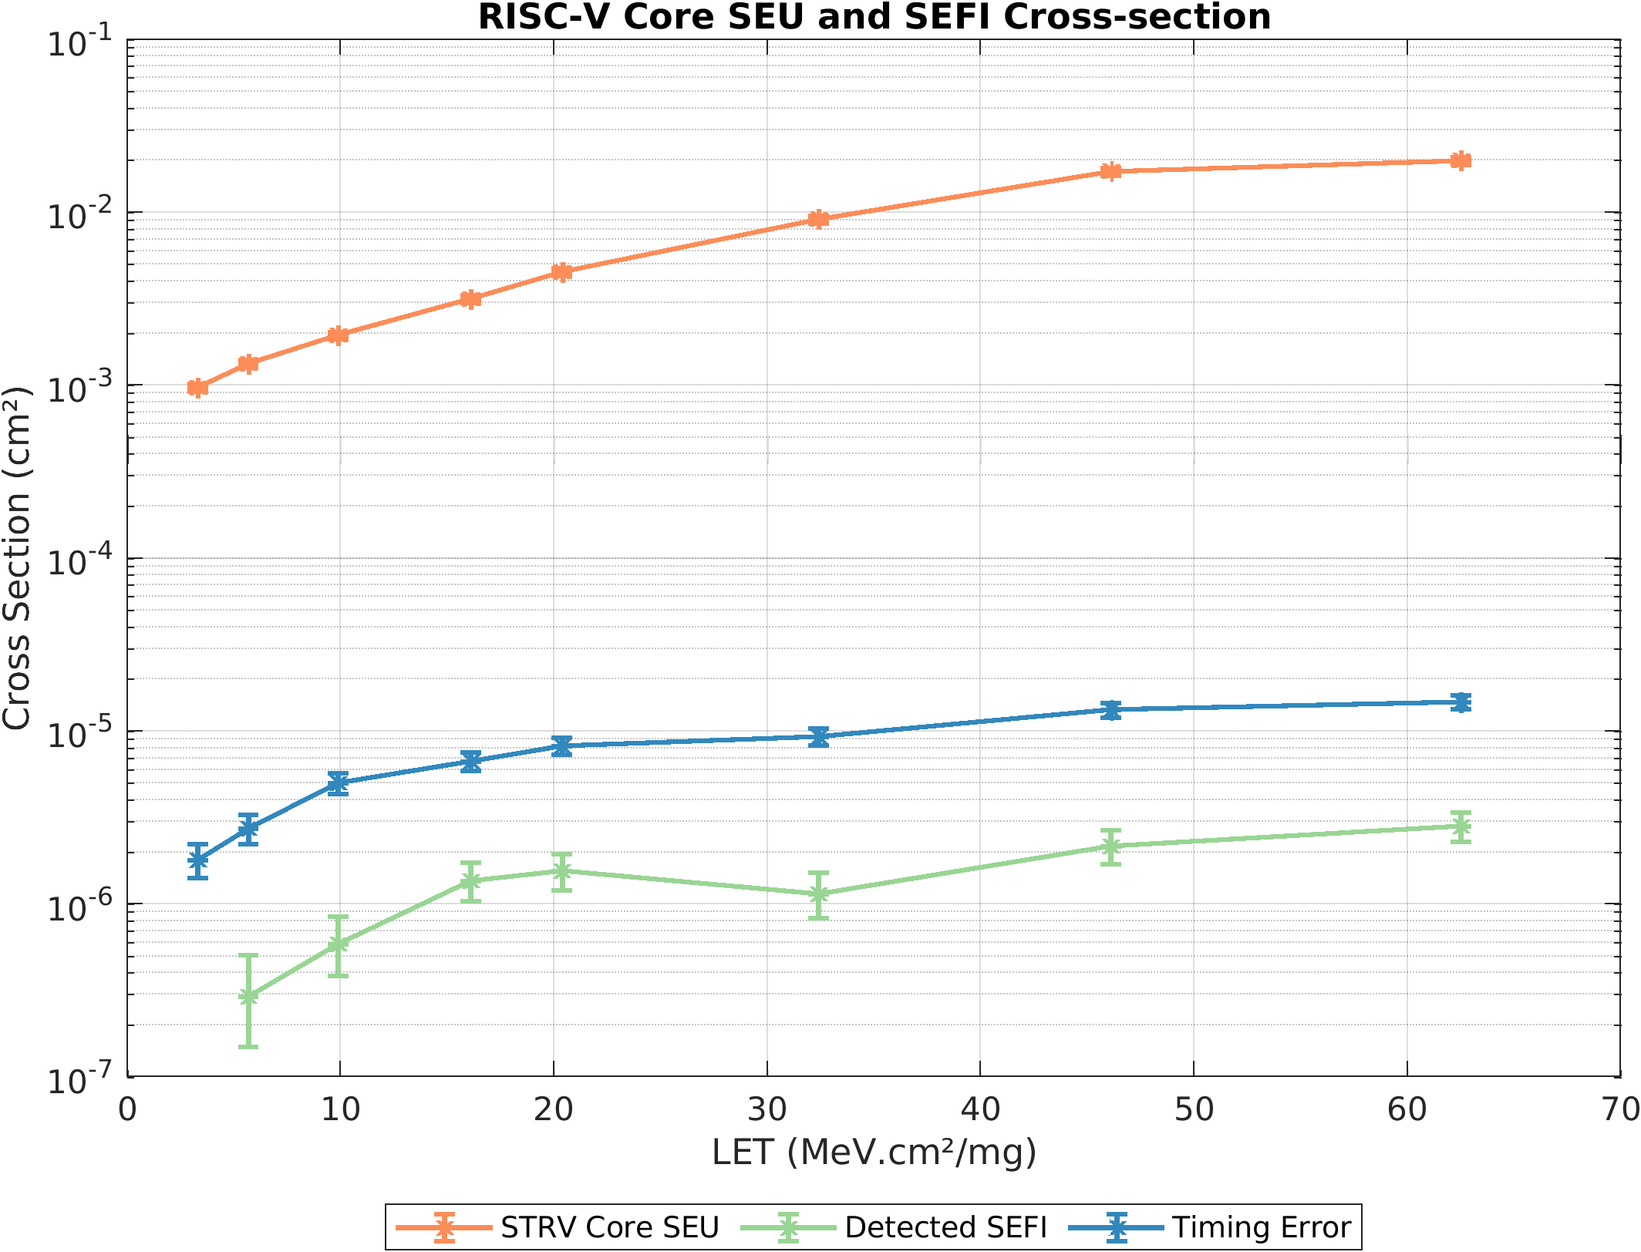
Heavy-Ion| SEFI Cross-Section

Slide 16
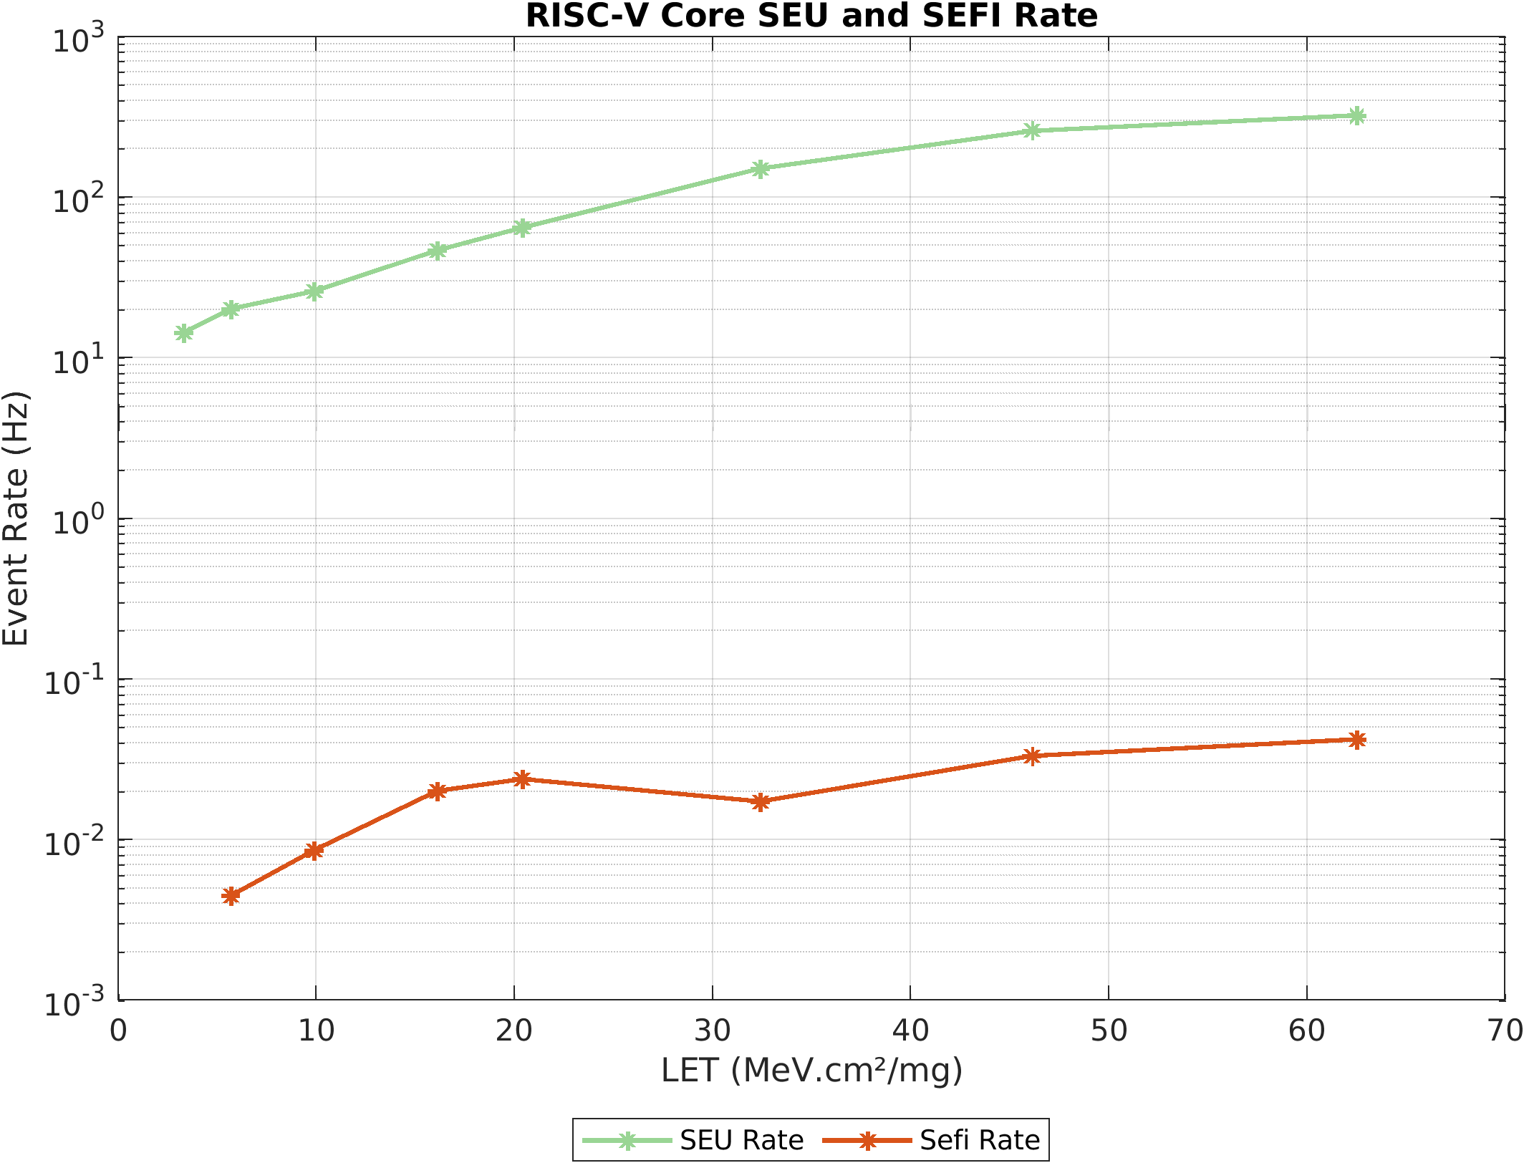
Heavy-Ion| Event Rate SEUs & SEFIs

Slide 17
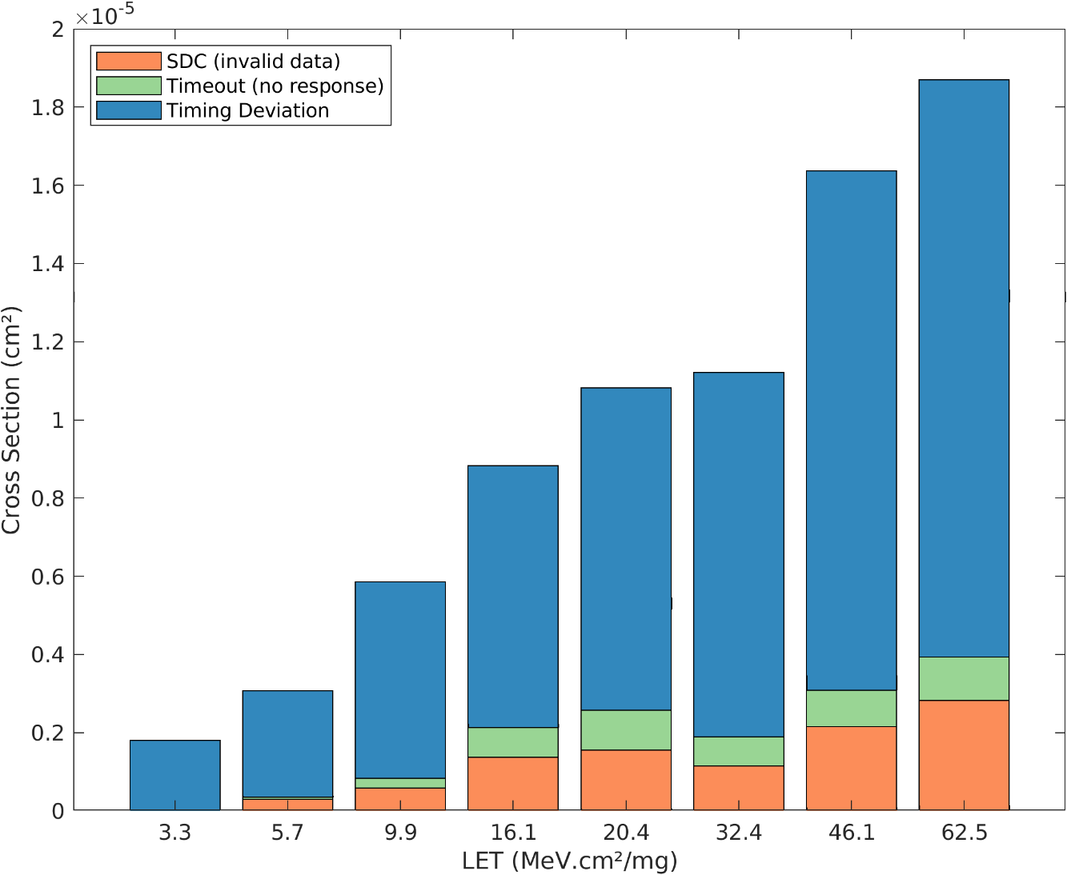
Heavy-Ion| SEFI Type

Slide 18
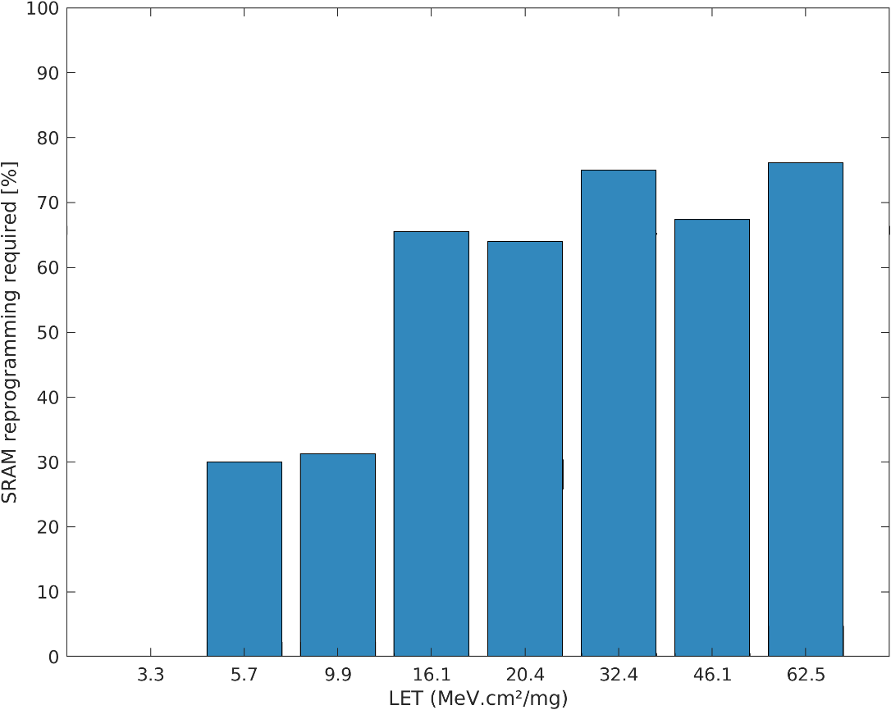
Heavy Ion | SEFI Recovery
Test system resets the RISC-V core after a SEFI occurred
Not all SEFI can be recovered by a reset of the RISC-V core
  Data and Instructions in the SRAM can be upset
  Reprogramming of the SRAM required
Reprogramming rate depending on LET:
For low LET (<16 MeV.cm²/mg):
  Reprogramming required in 30% of SEFIs
For higher LET (>16 MeV.cm²/mg):
  Reprogramming required in most cases (>65%)
→ More non-corrected upsets
in SRAM at higher LET

Slide 19
Backup

Slide 20
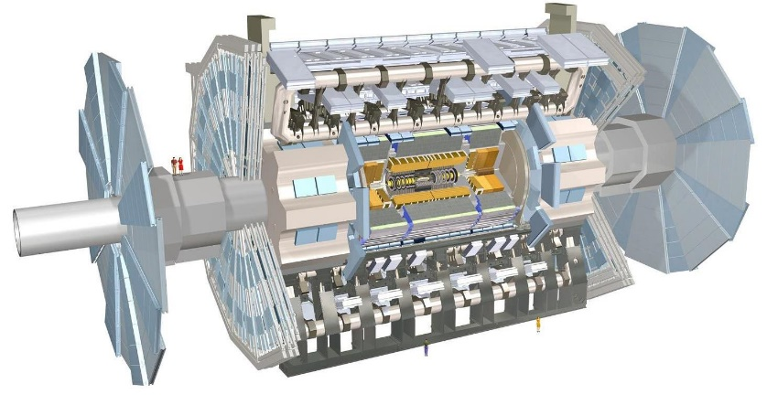
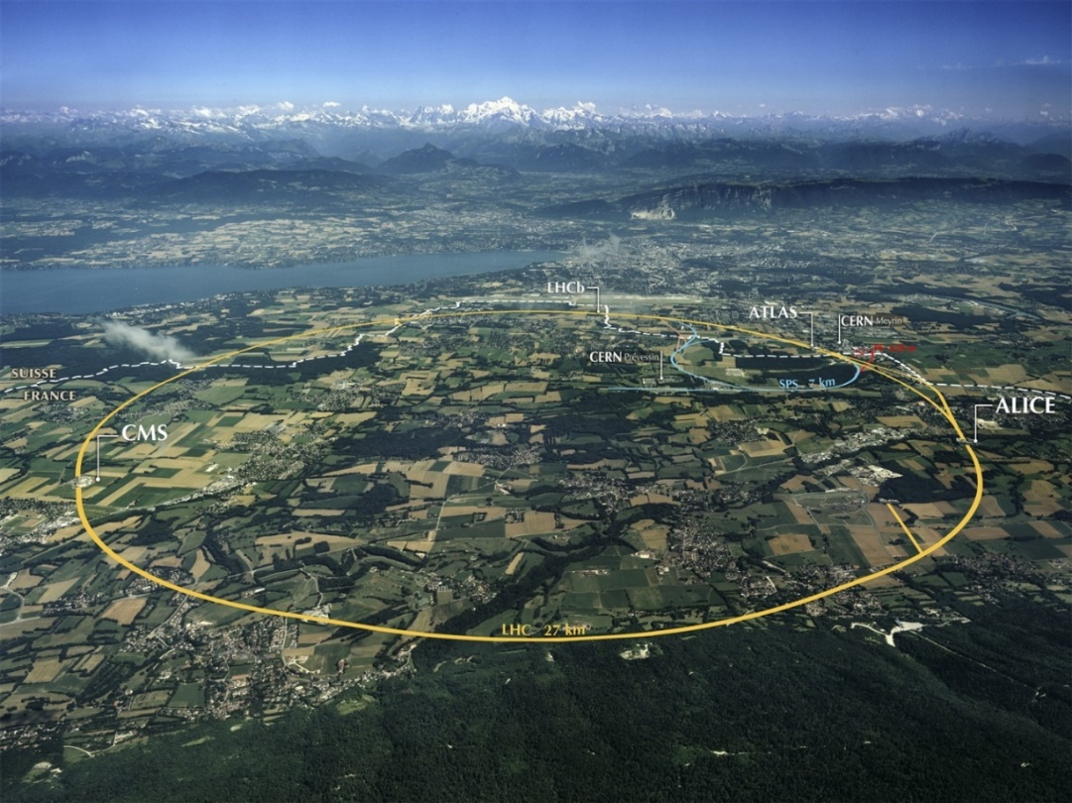
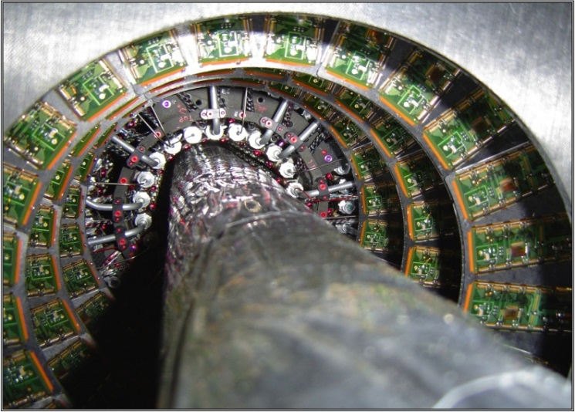
Backup | Background
FH Dortmund is member of the ATLAS and RD-53 CERN collaboration
Involved in development of custom ASICs:
  Power supply (regulators)
  Monitoring & control system
Pixel detectors placed around beam pipe

Slide 21
Backup | Background - Typical Application
Many custom ASICs have a similar structure:
Design of a custom ASIC is complex and time consuming
Reuse of generic blocks possible (ADC, voltage regulators, etc.)
Adaptation of internal logic difficult
  → Often custom to original application, requiring full redesign
Idea: Replace internal data processing logic with microprocessor core
  Adaptation to new application / Bugfixes via firmware updates
AD / DA Converter
Internal Logic
Communication Interface
Data Acquisition
Data Processing
Data Transfer

Slide 22
Backup | STRV-R1 Memory Layout
Instruction and data are stored in the same SRAM
  Instruction data not persistent
Flexible memory layout is possible
  IMEM instruction bus & DMEM data bus can access whole SRAM address range
Instruction and data bus share the same SRAM interface
    Pipeline of RISC-V stalls during load & store instructions to SRAM
    load & store to peripherals simultaneously possible

Slide 23
Backup | STRV-R1 Peripherals
Memory mapped registers
  Accessible via DMEM bus & MEM Bridge
Address based AHB-lite slave multiplexer
  Currently 3 slaves
  Expandable in the future
GPIOs
  4 control register
  1 status register
16550 compatible UART
  16 Byte FIFO buffer
  Interrupt to Core support

Slide 24
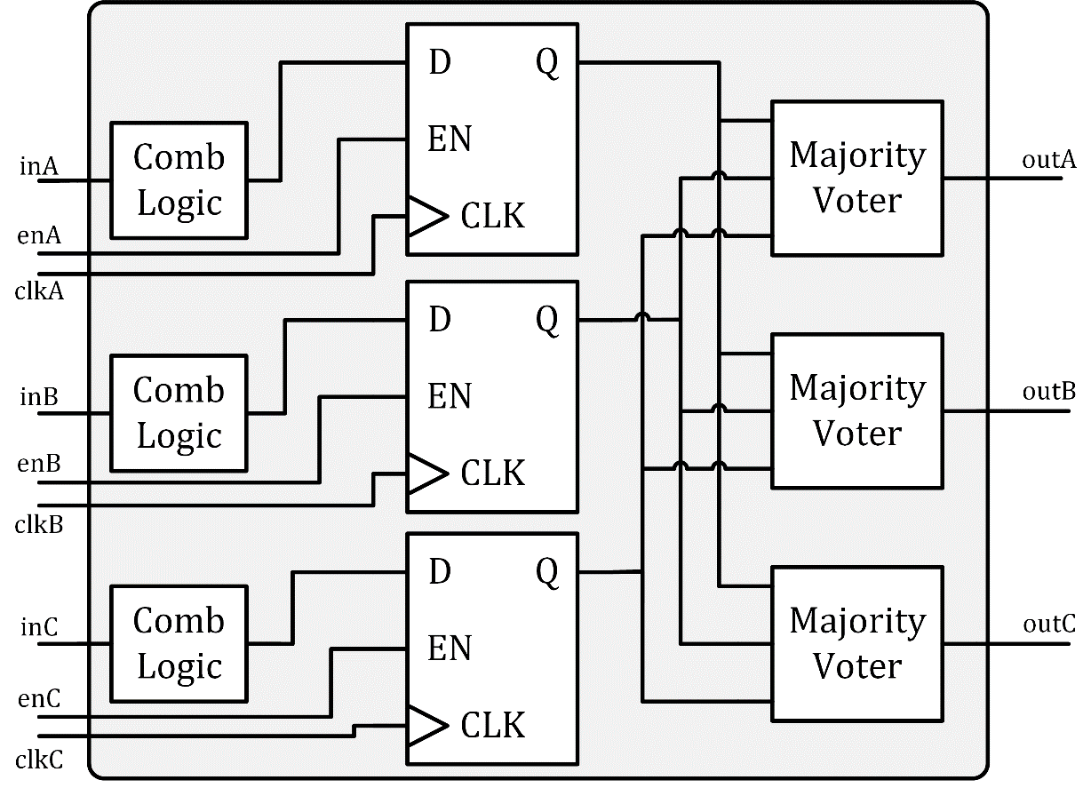

Backup | Triple Modular Redundancy
Digital circuits usually consist of combinational logic and synchronous storages
Triple modular redundancy (TMR)
  Triplication of combinational logic / storage elements
  Elimination of single points of failure
Majority voter → following logic receives corrected Signals
  Simple cell layout, small cross section
  Three voters, preventing single point of failure
Single majority voter needed at the edge of the digital block
  Single output interface signal

Slide 25
Backup | Triple Modular Redundancy - Issues
Not all flip-flops updated regularly
  Example: Control / Status Register
  Content of the flip-flop only updated when en signal actice
Data corrupted by SEU remain stored in flip-flops
  Particularly affected : Flip-flops with low refresh rate
  Increased risk: 2 of the 3 flip-flops are flipped by SEUs
→ Output signal invalid despite triplication
↯
↯
↯
↯
↯

Slide 26
Backup | Triple Modular Redundancy - Feedback
Goal: Automatic correction of memory contents
  Logic function and memory elements are already triplicated
Additional feedback is integrated via multiplexer
  Feedback uses majority voter output
  Either new values or corrected data is saved (refresh)
  Possible bit errors are corrected within one clock cycle
Disadvantage: Increased area / power consumption

Slide 27
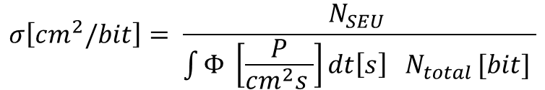
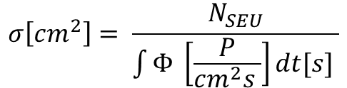

Backup | Cross-Section Definition
Cross-Section Definition:
$$σ\left[cm^{2}\right]= \frac{N_{SEU}}{\int{Φ} \left[\frac{P}{cm^{2}s }\right]dt[s] }$$
$$σ\left[cm^{2}\right]= \frac{N_{events}}{φ\left[\frac{P}{cm^{2} }\right]}$$
$$σ\left[cm^{2}/bit\right]= \frac{N_{SEU} }{\int{Φ} \left[\frac{P}{cm^{2}s }\right]dt\left[s\right] N_{total }[bit] }$$

Slide 28
Backup | Test System Flow

Slide 29
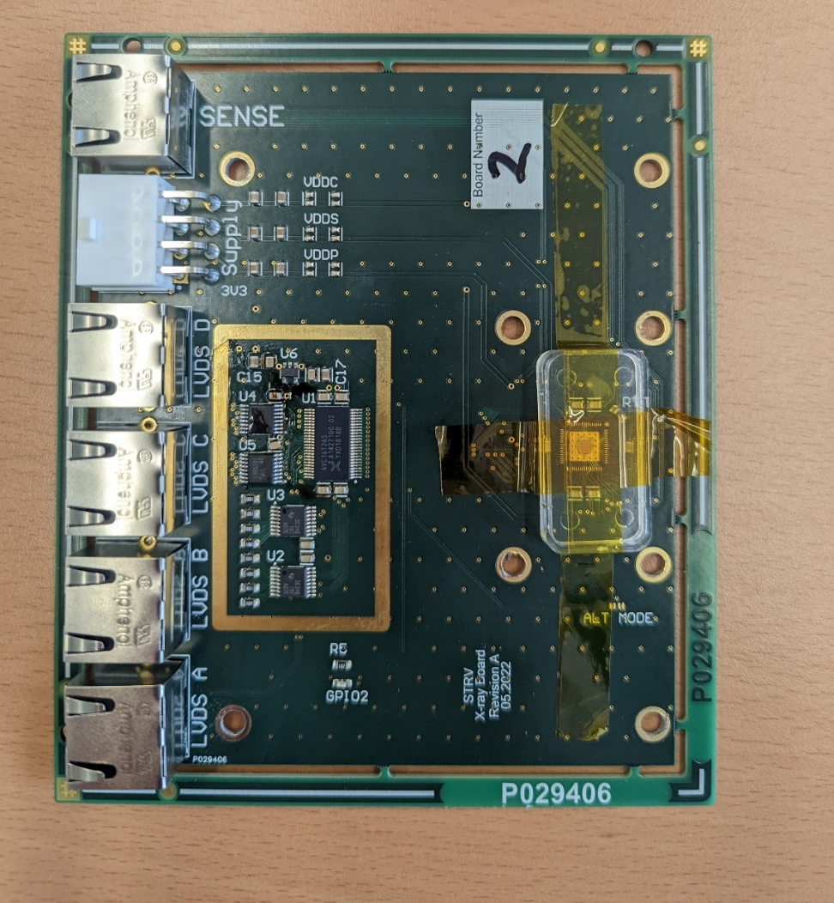

Backup | X-ray Test Setup

Slide 30
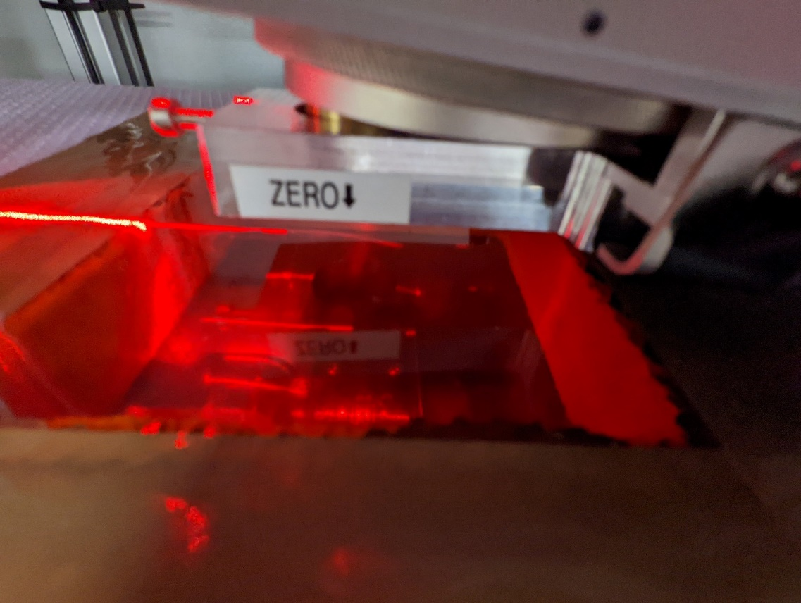
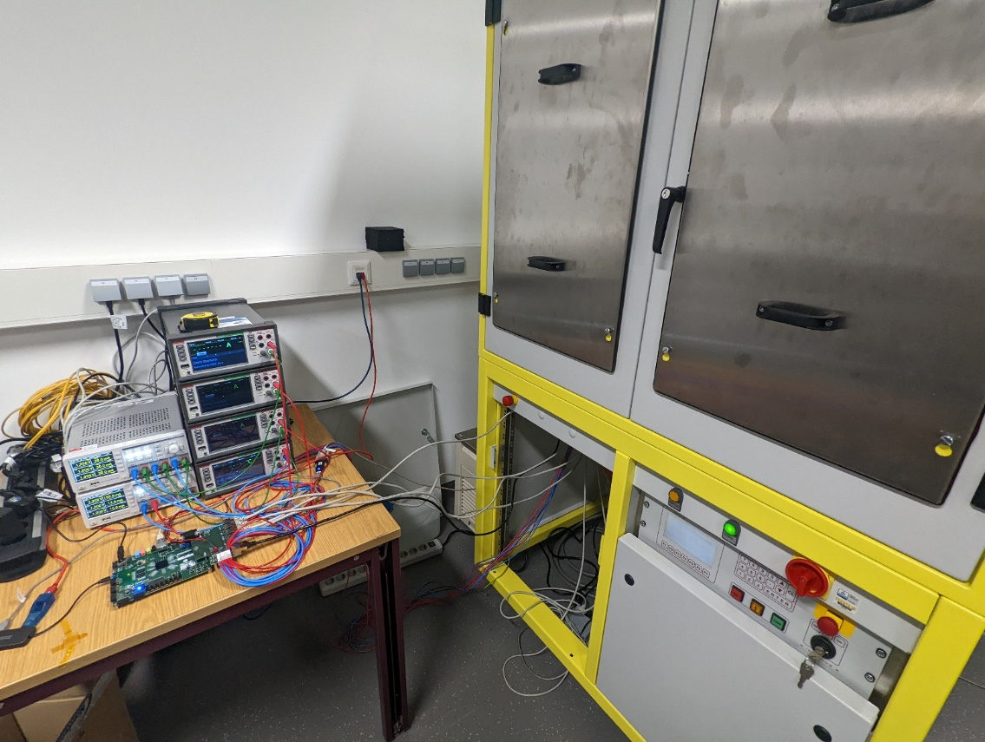
Backup | X-ray Test Setup

Slide 31
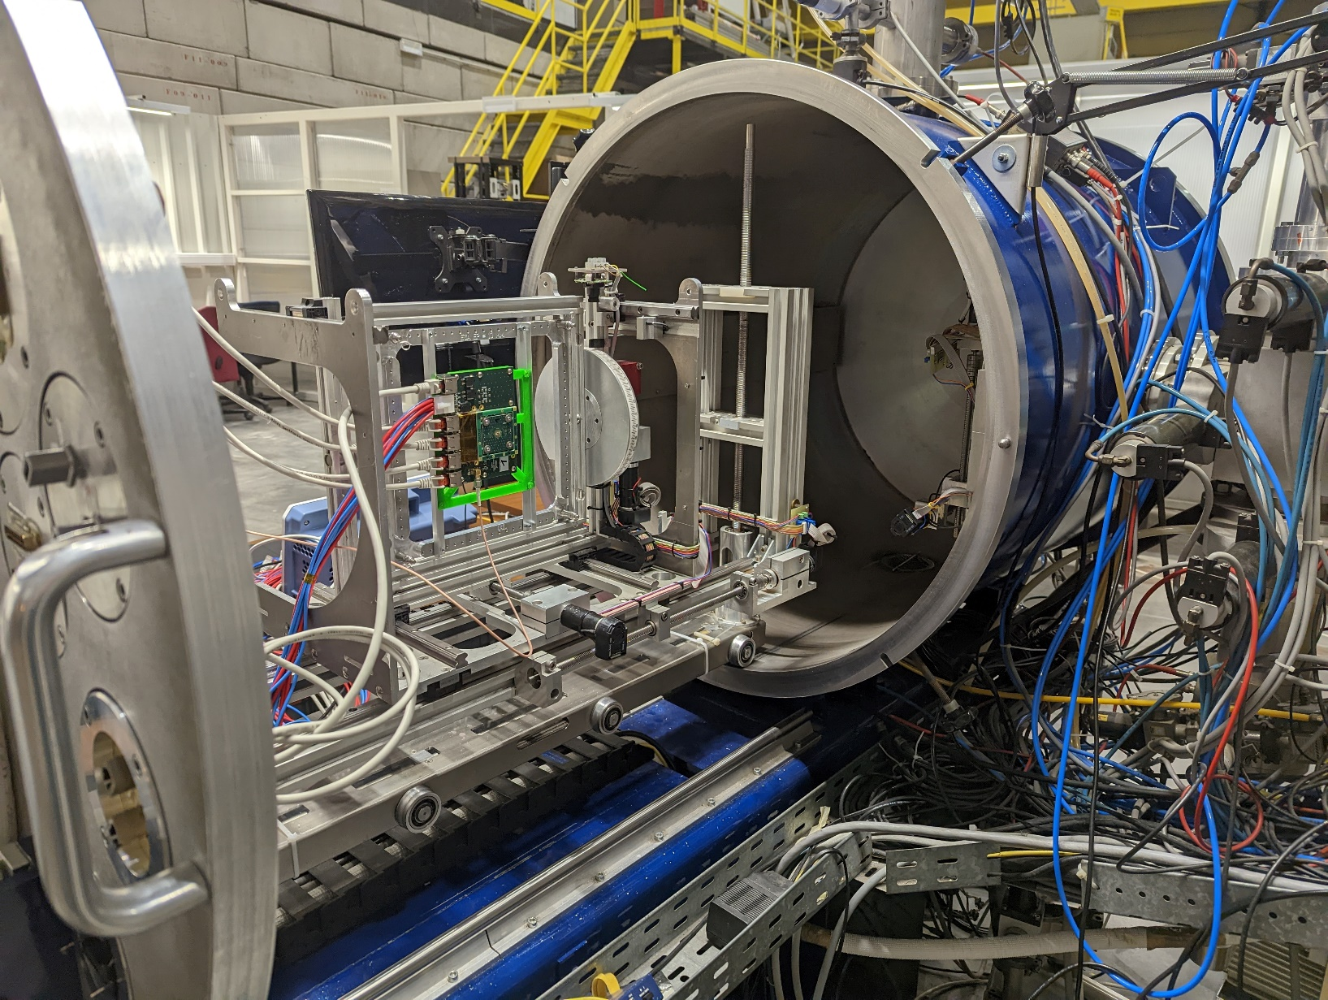
Backup | Heavy-Ion Test Setup

Slide 32
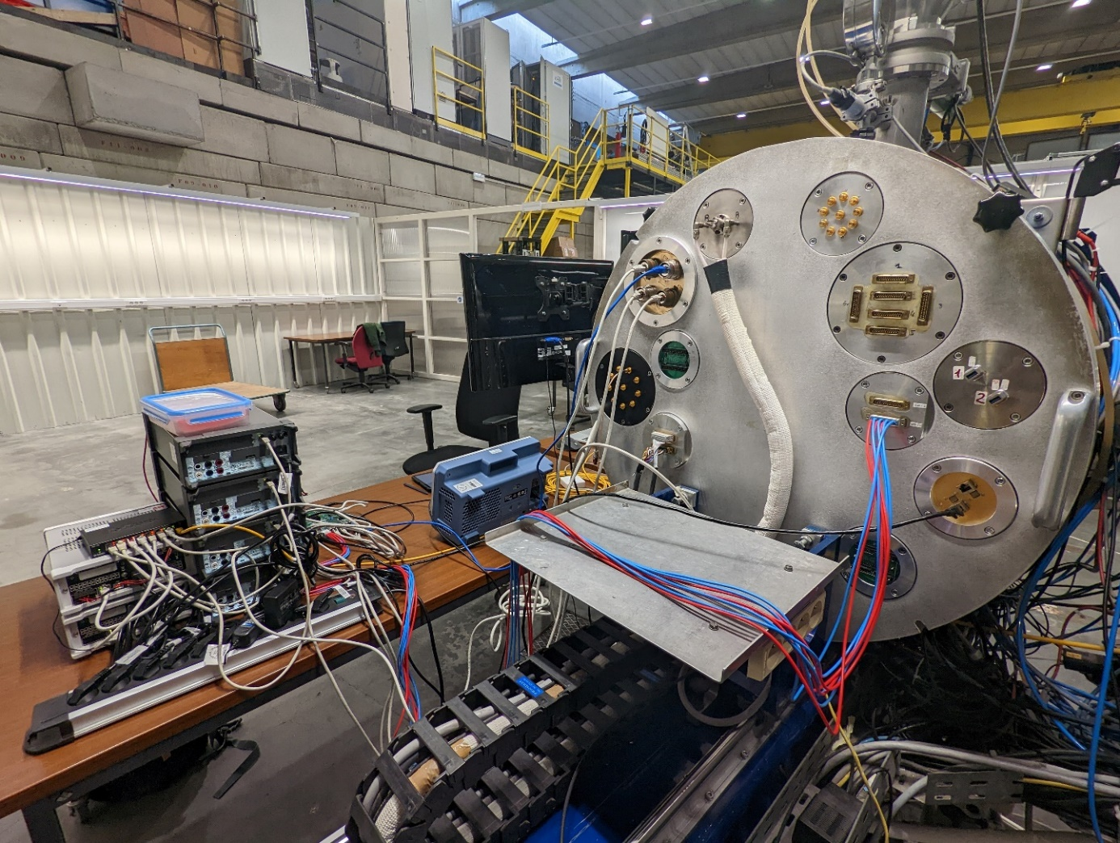
Backup | Heavy-Ion Test System Feedthroughs
Feedthrough:
4x RJ45 (Ethernet)
  LVDS DUT
1x RJ45 (Ethernet)
  Sense
  Supply + Temperature
1x DSUB25
  Supply
  3x 1,2V DUT
  1x 3,3V DUT Carrier

Slide 33
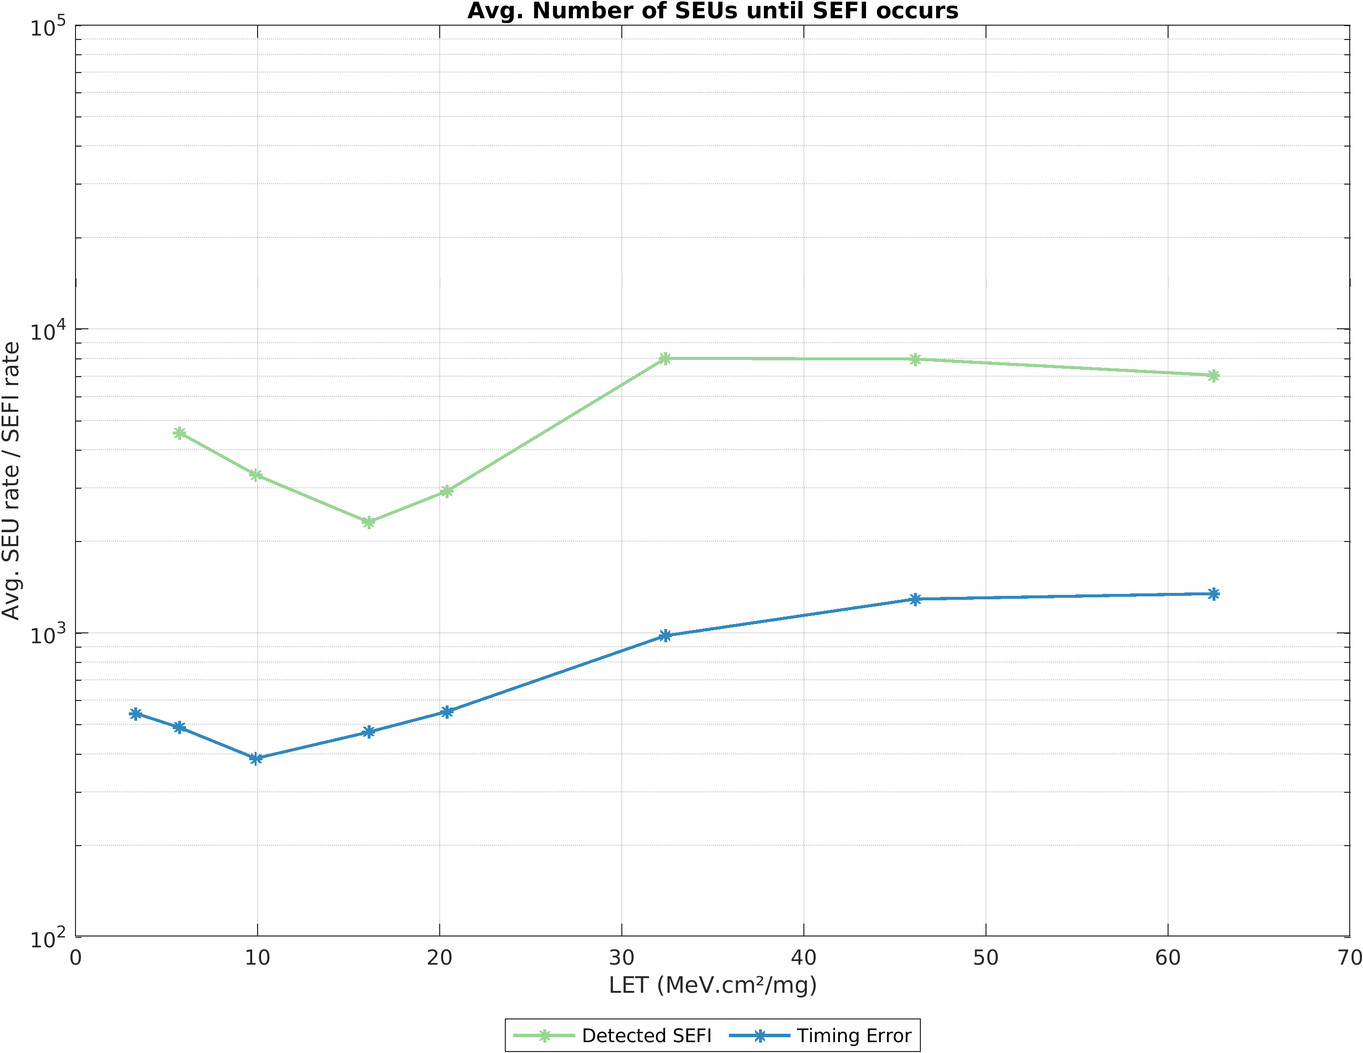
Backup | Heavy-Ion SEFI vs. SEU

