Slide 1
Plasma Density Evolution Background to the Ion-motion Recovery in a Beam-driven Plasma-wakefield Accelerator
Judita Beinortaitė | FTX General Group Meeting | 21.02.2023
Judita Beinortaitė

Slide 2
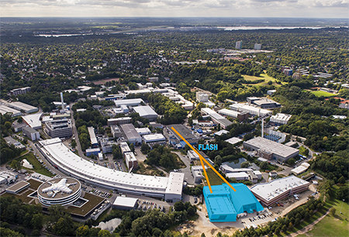
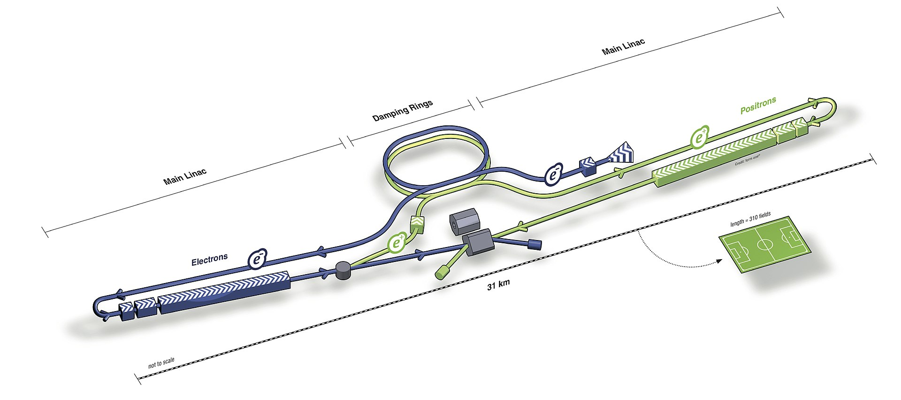
Limits of conventional accelerator cavities
Radio-frequency cavities - material breakdown limitation beyond O(100) MV/m.
Accelerators today & plans for higher energies – size and cost issues.
Example: Conventional accelerating cavity (TESLA SRF).
B. Aune et al. Physical Review Special Topics – Accelerators and Beams 3.092001 (2000).
315 m
31 km
FLASH Free-Electron Laser.
DESY
International Linear Collider design.
ILC (2012).

Slide 3
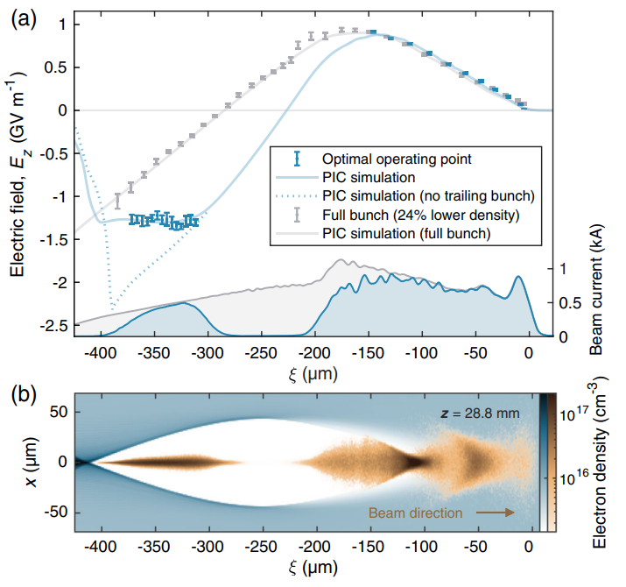
Beam-driven PWFA
Plasma allows for GV/m fields.
Energy doubling of 42 GeV electrons in 85 cm, 2007 (I. Blumenfeld et al., Nature, 445, 741-744).
42% energy transfer efficiency and per-mille energy spread, 2021 (C. A. Lindstrøm et al. Phys. Rev Let., 126.014801).
Example - FLASHForward:
Discharge-capillary plasma target.
Electron bunch divided to:
Driving bunch, creates wakefield in the plasma.
Trailing bunch, accelerated by fields in the plasma.
50 mm and 100 mm discharge capillary plasma targets at FLASHForward.
Trailing
bunch
Driver
Acceleration in plasma wakefield
Image courtesy: Sarah Schröder
Wakefield in the plasma.
C. A. Lindstrøm et al. Phys. Rev Let., 126.014801 (2021).

Slide 4
Meeting future facility standards: high repetition rate
High-repetition-rate operation standards.
Example: luminosity in colliders.
Existing PWFA facilities - far from these repetition rate requirements.
number of bunches per macro-pulse
$$ℒ∝n_{b}f_{p}$$
the rate of macro-pulses per second
Facility | Bunch separation within a macro-pulse | Macro-pulse repetition rate | Number of bunches per macro-pulse | Average repetition rate
ILC¹ | 500 ns | 5 Hz | 1000-5400 | 5-27 kHz
CLIC² | 0.5 ns | 50 Hz | 312 | 16 kHz
FLASH³ | 1000 ns | 10 Hz | 800 | 8 kHz
State-of-the-art PWFA | 100 ms | 10 Hz | 1 | 0.01 kHz
¹ILC. arXiv:0712.1950v1 (2007).
²CLIC. CERN-2012-007 (2012).
³FLASH. New J. Phys. 18 062002 (2016).

Slide 5
Long-term ion motion
Previous work on ion motion:
Post-wakefield ion motion observed.
Ions carry most deposited energy on 1 ns timescale.
How long does it last?
Cannot simulate with PIC.
Need measurements.
Wakefield dissipation
Ion Motion onset
Experiment
Simulation
Energy transport channels in PWFA.
R. Zgadzaj et al. Nature Communications 11.4753 (2020).
Ion-channel formation from a plasma wakefield
M. F. Gilljohann et al. Physical Review X 9.011046 (2019).

Slide 6
Probing long-term ion motion at FLASHForward‣‣
Trailing bunch
Driving bunch
Probe bunch-pair
Unperturbed dataset
Perturbing bunch
Perturbing bunch alone
Probe bunch-pair
Perturbing bunch
Perturbed dataset
Trailing bunch
Driving bunch
Time
Bunch separation, 0.77 ns – 600 µs in 0.77 ns steps
Probe-bunch technique for observing the long-term ion motion.
R. D’Arcy, et al. Nature 603, 58 62 (2022)
Long-term Ion-motion is caused by the perturbing bunch.
The effects of ion motion are observed on the probe bunch.
Comparison between Unperturbed and Perturbed datasets:
Evolution of ion motion,
Time of ion motion recovery.
$$t=t_{recovery} if \left\{\begin{aligned}\frac{E_{gain}^{pert} −E_{gain}^{unpert}}{E_{gain}^{unpert}}=0, witness, \\ \frac{E_{loss}^{pert} −E_{loss}^{unpert}}{E_{loss}^{unpert}}=0, driver.\end{aligned}\right.$$

Slide 7
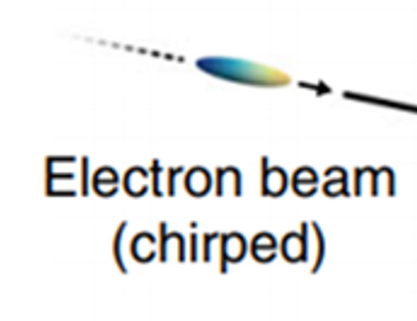
The FLASHForward‣‣ facility
1 GeV, 1 nC, up to 10 Hz electron beams from FLASH linac.
0.77 ns two-bunch separation:
Stems from 1.3 GHz RF frequency.
Allows FF>> to study high-repetition-rate operation in PWFA.
Separated in multiples of 0.77 ns

Slide 8
The FLASHForward‣‣ facility
Bunches are dispersed by a dipole, and their energy spectra are imaged on scintillation screens.
trailing bunch
Dispersing dipole
Screen
driver
Energy-dispersed probing bunch-pair images
Energy projection

Slide 9
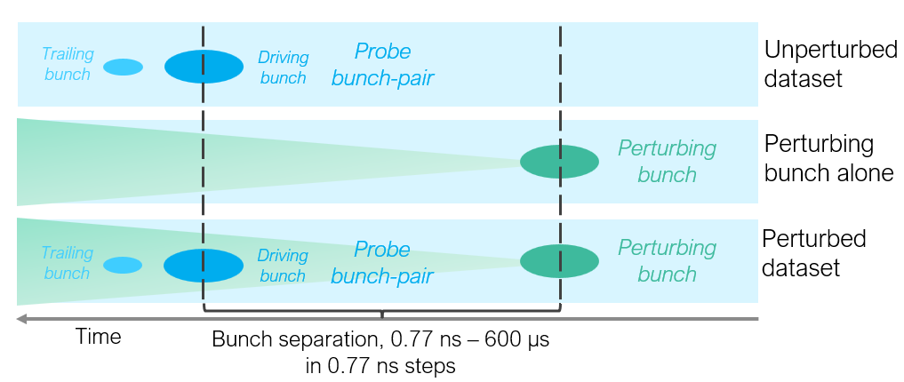
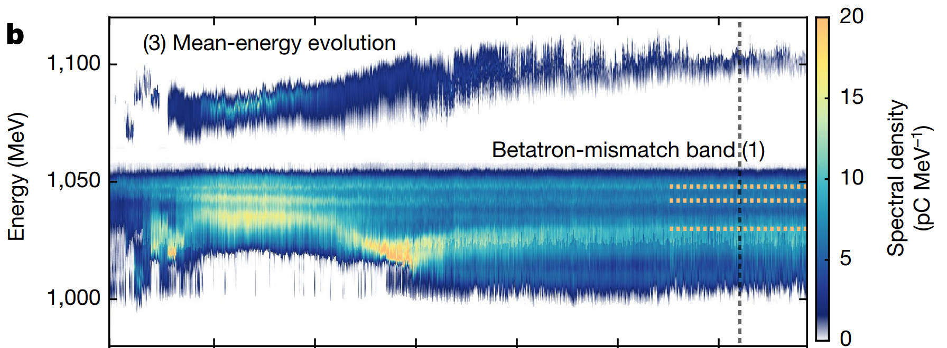
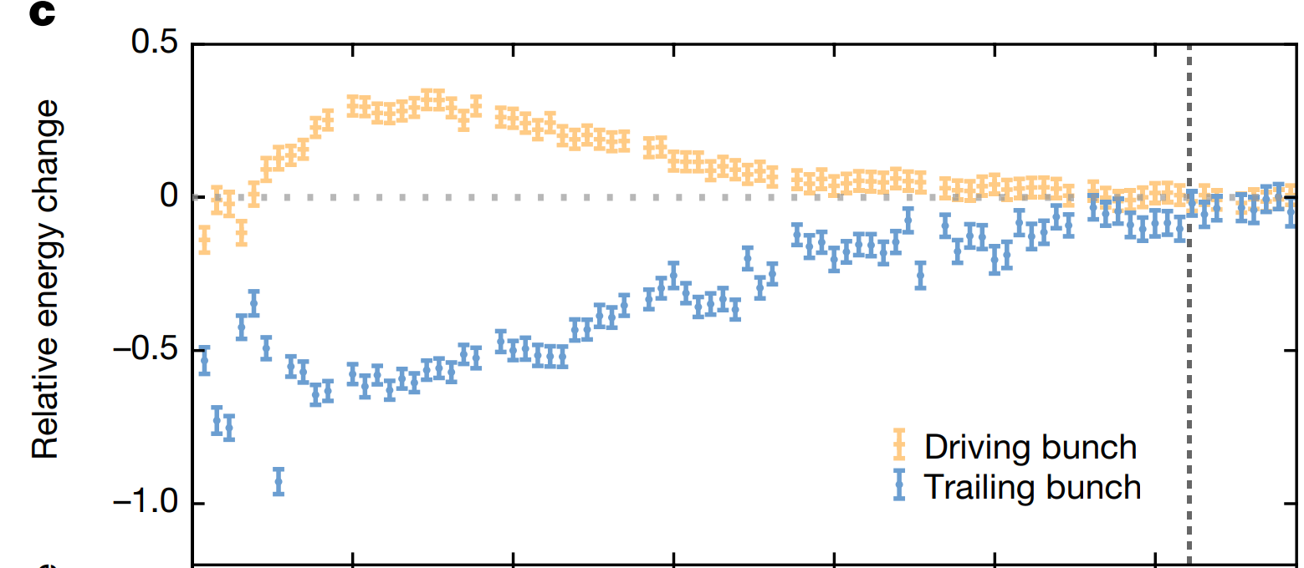
Recovery time measurement
Recent results from FLASHForward:
Recovery time is 63 ns
$$t=t_{recovery} if \left\{\begin{aligned}\frac{E_{gain}^{pert} −E_{gain}^{unpert}}{E_{gain}^{unpert}}=0, witness, \\ \frac{E_{loss}^{pert} −E_{loss}^{unpert}}{E_{loss}^{unpert}}=0, driver.\end{aligned}\right.$$
Recovery time of a beam-driven plasma wake.
R. D’Arcy, et al. Nature 603, 58–62 (2022).

Slide 10
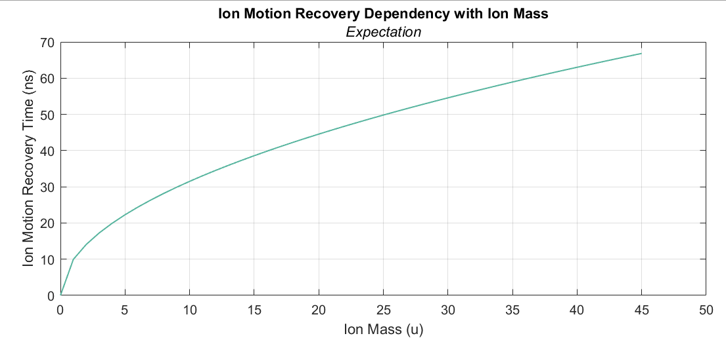
Modelling long-term ion motion perturbation
Perturbation effects could depend on many experimental parameters at various timescales.
Perturbation evolution is as follows:
On-axis density peak at t < 0.77 ns,
On-axis density minimum at t = 10 ns,
Recovery process up to t = 63 ns.
We expect that the recovery process is dominated by ion acoustic wave dynamics¹.
$$v \sim \sqrt{\frac{k_{B}T_{e}}{m_{i}}}$$
Reduced ion mass should increase the speed and thus reduce the recovery time.
Implying: recovery time in Hydrogen could be on the order of 10 ns.
$τ_{H}=τ_{Ar}\sqrt{\frac{m_{H}}{m_{Ar}}},τ_{H}=63\sqrt{\frac{1}{40}}≈10 ns$.
Neon
Argon
Hydrogen
Nitrogen
Result deviating from 10 ns – different dynamics.
Compare recovery time vs ion mass, keep all else consistent:
Wakefield strength
Temperature
Plasma density
Neutral gas density
…
¹Chen, F. F. (2016). Introduction to Plasma Physics and Controlled Fusion (3rd ed.). Springer.

Slide 11
Equivalent parameters in argon vs hydrogen
Keep all other parameters consistent, especially plasma density $n_{e}$ and plasma electrons to atomic density ratio: $R_{n}=\frac{n_{e}}{n_{a}}$.
Measure $n_{e}$ with Optical Emission Spectroscopy: Argon doped with 3% Hydrogen → spectral H-alpha line broadening → plasma density value.
Estimate neutral gas density: FLASHForward gas supply system – measurements and simulations.
Equivalent plasma density timings:
Argon: 3.6 µs – 5.6 µs.
Hydrogen: 0.9 µs – 1.5 µs.

Slide 12
Summary
Plasma-wakefield acceleration is a promising avenue for future facilities in high-energy physics and photon science.
kHz - MHz-level repetition rate is needed to achieve required luminosity.
FLASHForward have measured a recovery time of O(100) ns in a plasma accelerator.
A scaling estimation suggests that $τ_{rec}^{H_{2}}\sim$ O(10) ns.
Need to understand plasma density evolution background: OES plasma density measurements.
This allows making a comparative measurement of long-term ion-motion recovery in Hydrogen.
Outlook
Beam-based measurements will be undertaken this year after the FLASH and FLASHForward re-comissioning.
These are essential steps to realizing high-repetition-rate operation in PWFA.
High-luminosity PWFA – viable alternative for future accelerator facilities.

Slide 13
Thank you!

Slide 14
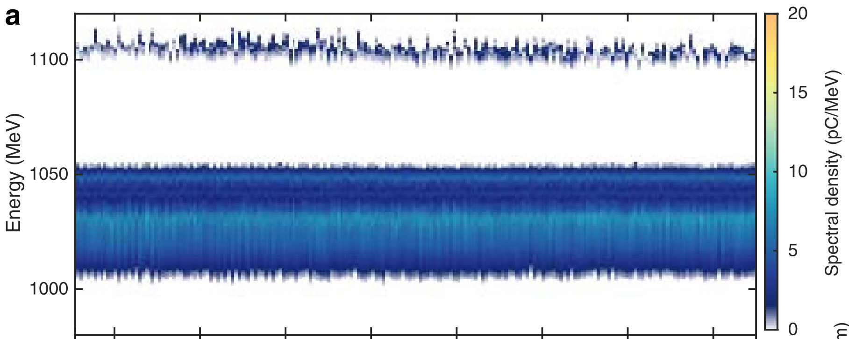
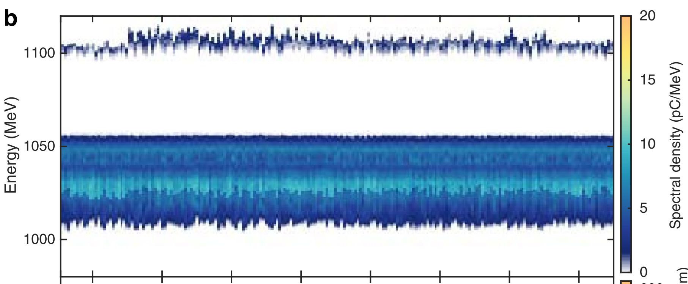
Recovery time measurement – beyond 63 ns
Recent results from FLASHForward:
Probing recovering ion motion with electron bunch-pair,
Observing the recovery time.
Recovery time is 63 ns.
Energy spectra same for Unperturbed and Perturbed beyond 63 ns.
Continued recovery time scan.
R. D’Arcy, et al. Nature 603, 58–62 (2022).

