Slide 1
Beam-Tracking and position of the BPMs in the TL/T20 beamline (up to the IP)
1
DENIAUD Marin - 20/02/2023
Notes:
1

Slide 2
Objectives of this study
Tracking and Correlation
Singular Value Decomposition
Resolution at the IP
Next Objectives
2
DENIAUD Marin - 20/02/2023
Notes:
2

Slide 3
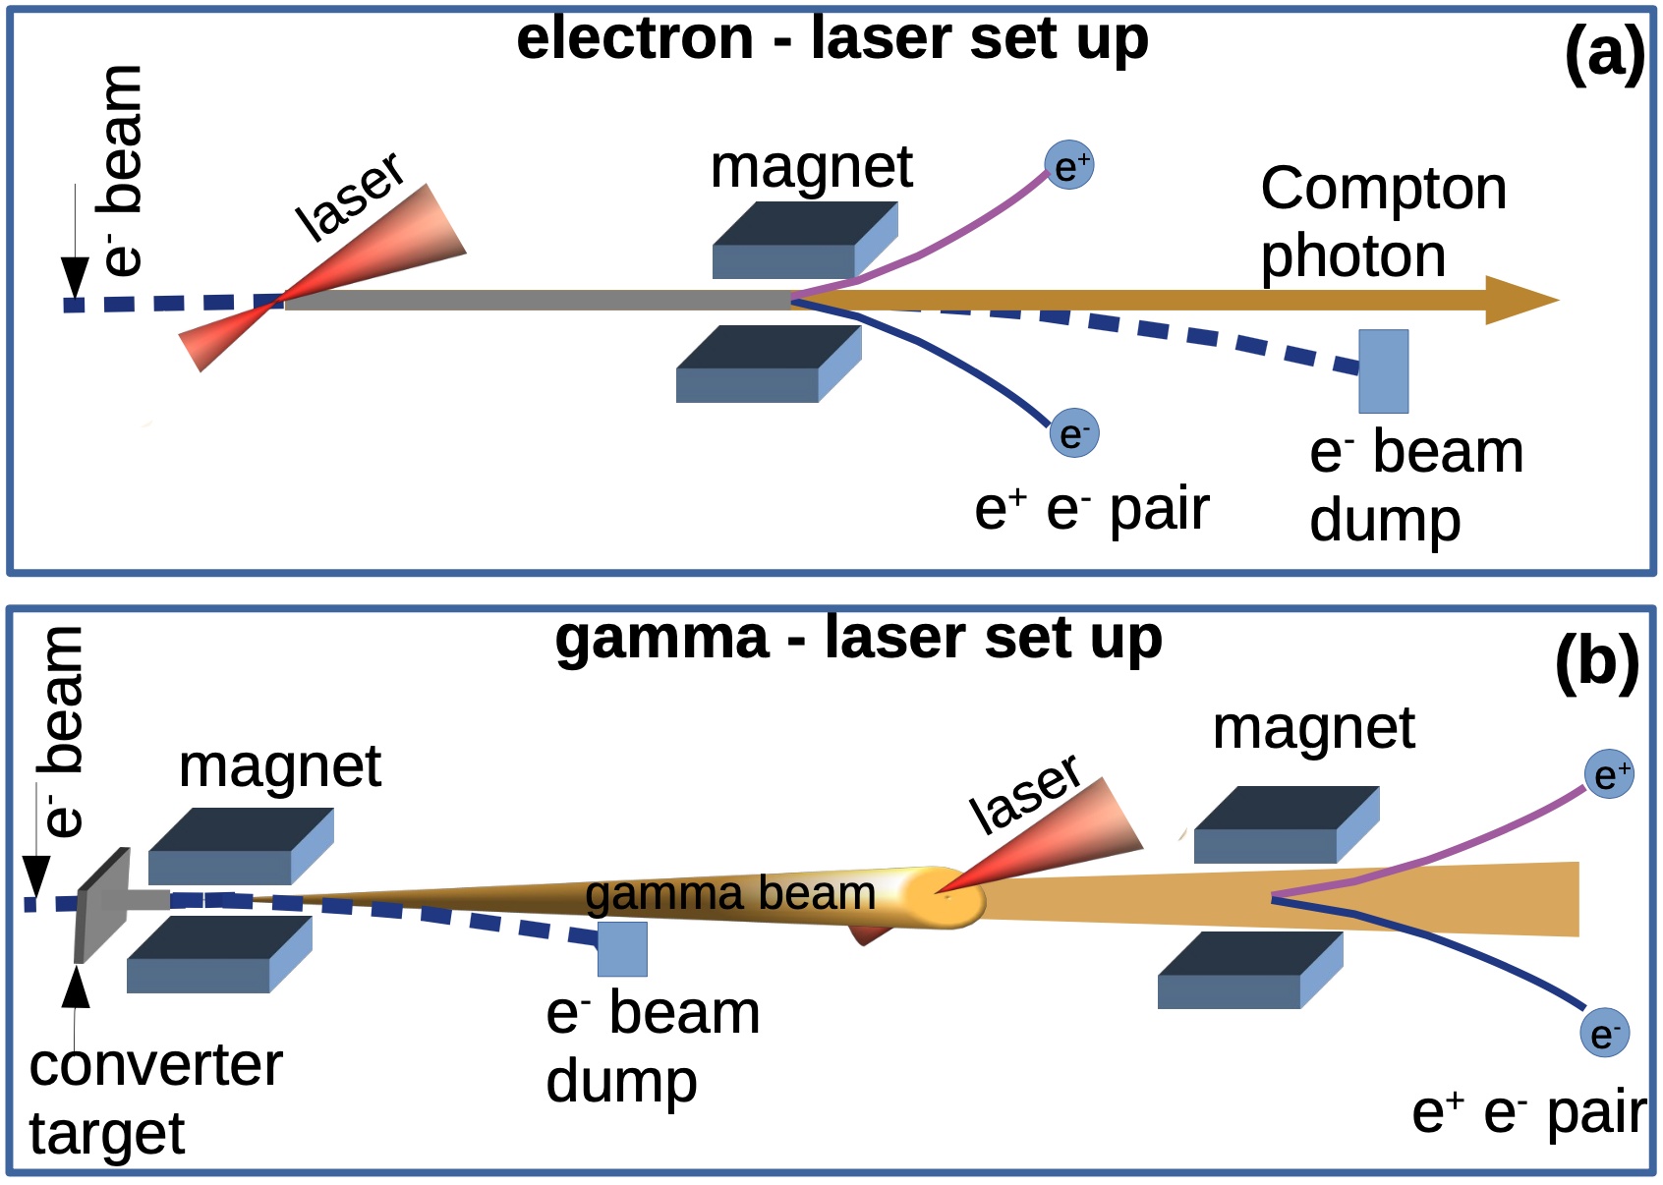
3
DENIAUD Marin - 20/02/2023
1. Objectives of this study
Transverse view of the beams at the IP
ded
fr
Y
Electron/photon beam
Relative position
Laser
X
The goal of LUXE in both configurations is to make 2 beams interact
The smaller the relative position, the higher is the number of interactions
We can’t put some position measurements at the IP so we have to search for correlation points upstream
ded
fr
Notes:
3

Slide 4
4
DENIAUD Marin - 20/02/2023
1. Objectives of this study
How can we put BPMs upstream to measure the positions and angles at the IP ?
d
fr
And what resolution can we get at this IP ?
d
fr
Notes:
4

Slide 5
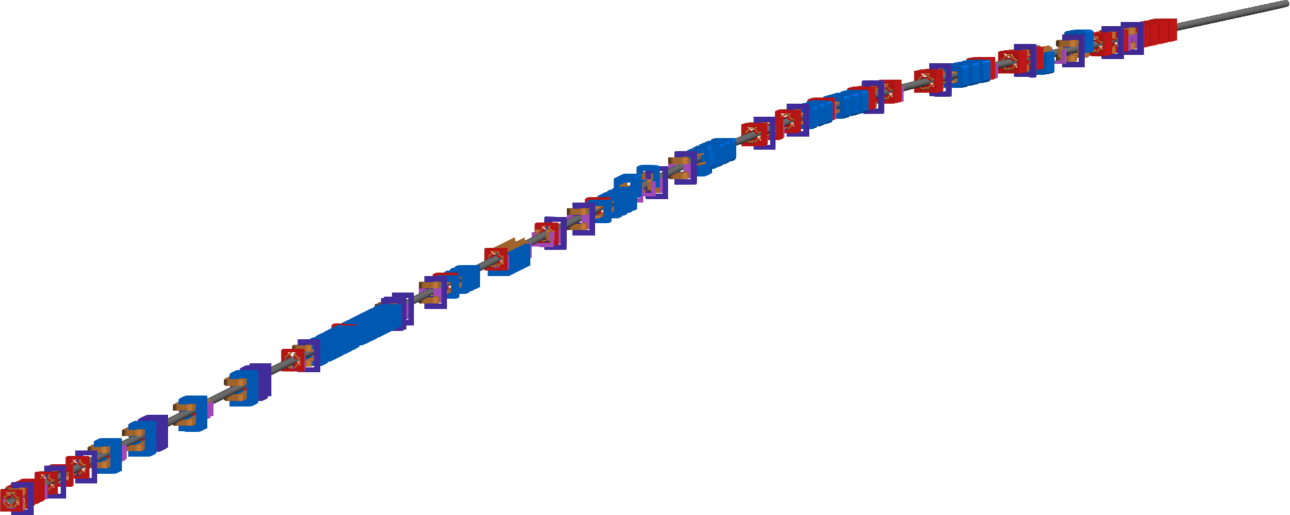
5
DENIAUD Marin - 20/02/2023
1. Objectives of this study
Septa for TD20
End of Collimation section
TD20
LUXE’S IP
TL
The lattice simulated is composed of the TL and the TD20
This lattice TWISS and RMAT files come from Mad8 and all the beam tracking is done using custom python tools
Notes:
5

Slide 6
Objectives of this study
Tracking and Correlation
Singular Value Decomposition
Resolution at the IP
Next Objectives
6
DENIAUD Marin - 20/02/2023
Notes:
6

Slide 7
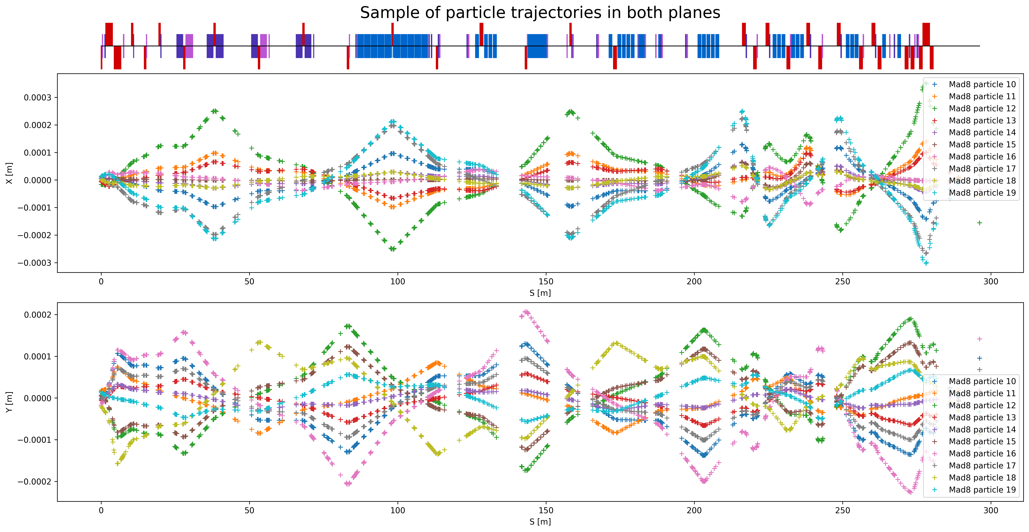
7
DENIAUD Marin - 20/02/2023
2. Tracking and Correlation
INITIAL BEAM :
10 000 particles
X/Y = 10e-6 m std
X’/Y’ = 10e-6 rad std
Z = 30e-6 m std
DE = 3 MeV std
In this study there is no X/Y coupling
We want to extract the position data to identify correlation points :
d
fr
Notes:
7

Slide 8
8
DENIAUD Marin - 20/02/2023
2. Tracking and Correlation
Mathematically, in x for example, a point at position s is correlated if :
From Hill’s equations we know that :
Then using both equations above we can show that we have correlation when :
ded
fr
$$x_{IP}=a\left(s\right)x\left(s\right)$$
$$x\left(s\right)=\sqrt{ε_{x}β_{x}(s)}cos⁡(μ_{x}(s)+φ)$$
$$x_{IP}=a\left(s\right)x\left(s\right)⇒\sin\left(μ_{IP}−μ\left(s\right)\right)=0⇒μ\left(s\right)=μ_{IP}−nπ$$
All the correlation positions can be predicted using the phase advance data which is already given by our Mad8 simulations.
ded
fr
Notes:
8

Slide 9
9
DENIAUD Marin - 20/02/2023
2. Tracking and Correlation
$$|\sin\left(μ_{IP}−μ\left(s\right)\right)|≪0$$
Plotting this value along the lattice, we can see and fit a list of S positions that are in theory good candidates for a BPM
ded
fr
Notes:
9

Slide 10
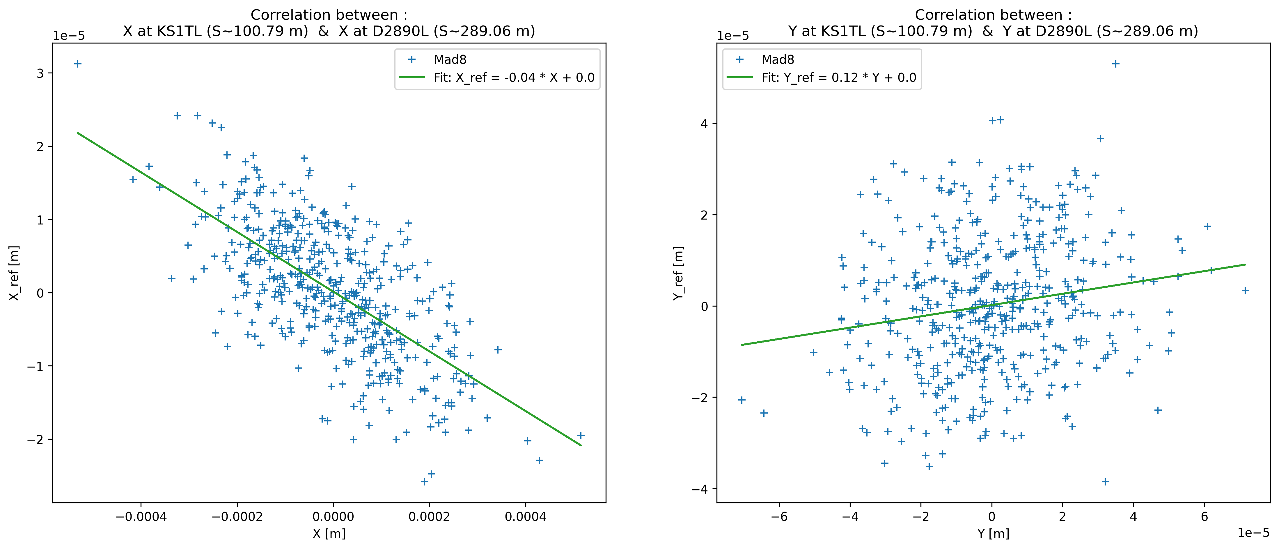
DENIAUD Marin - 20/02/2023
2. Tracking and Correlation
Using the tracking data we can plot the correlation between the IP and any point along the lattice
Each of these correlation plots can be linearly fitted, for a particle i :
ded
fr
$$x_{ref,i}=ax_{i}−b$$
10
Notes:
10

Slide 11
DENIAUD Marin - 20/02/2023
2. Tracking and Correlation
Scanning along the lattice we can find correlation points in both planes
ded
fr
11
Notes:
11

Slide 12
DENIAUD Marin - 20/02/2023
2. Tracking and Correlation
Scanning along the lattice we can find correlation points in both planes
ded
fr
12
Notes:
12

Slide 13
DENIAUD Marin - 20/02/2023
2. Tracking and Correlation
Scanning along the lattice we can find correlation points in both planes
ded
fr
13
Notes:
13

Slide 14
DENIAUD Marin - 20/02/2023
2. Tracking and Correlation
$$χ^{2}=\sum_{i=1}^{N}{{(x_{ref,i}−ax_{i}−b)}^{2}}$$
Those qualitative curves are matching pretty well on the S positionsded
fr
14
Notes:
14

Slide 15
DENIAUD Marin - 20/02/2023
2. Tracking and Correlation
Previously used equations for the position
We can use the same reasoning for the angle correlation
$$\left\{\begin{aligned}x_{IP}=a\left(s\right)x\left(s\right) \\ x\left(s\right)=\sqrt{ε_{x}β_{x}(s)}cos⁡(μ_{x}(s)+φ) \end{aligned}\right.⇒\sin\left(μ_{IP}−μ\left(s\right)\right)=0⇒|\sin\left(μ_{IP}−μ\left(s\right)\right)|≪0$$
$\left\{\begin{aligned}{x′}_{IP}=a\left(s\right)x\left(s\right) \\ x′\left(s\right)=\sqrt{\frac{ε_{x}}{β_{x}\left(s\right)}}(α_{x}\left(s\right)\cos\left(μ_{x}\left(s\right)+φ\right)\text{+}\text{sin}\text{(}μ_{x}\left(s\right)+φ\text{))} \end{aligned}\right.$ $$⇒\sin\left(μ_{x, IP}−μ_{x}\left(s\right)+arctan⁡(\frac{−1}{α_{x,IP}})\right)=0⇒|\sin\left(μ_{x, IP}−μ_{x}\left(s\right)+arctan⁡(\frac{−1}{α_{x,IP}})\right)≪0$$
We are then able to extract correlation data for X, Y, X’ and Y’ at the IP
15
Notes:
15

Slide 16
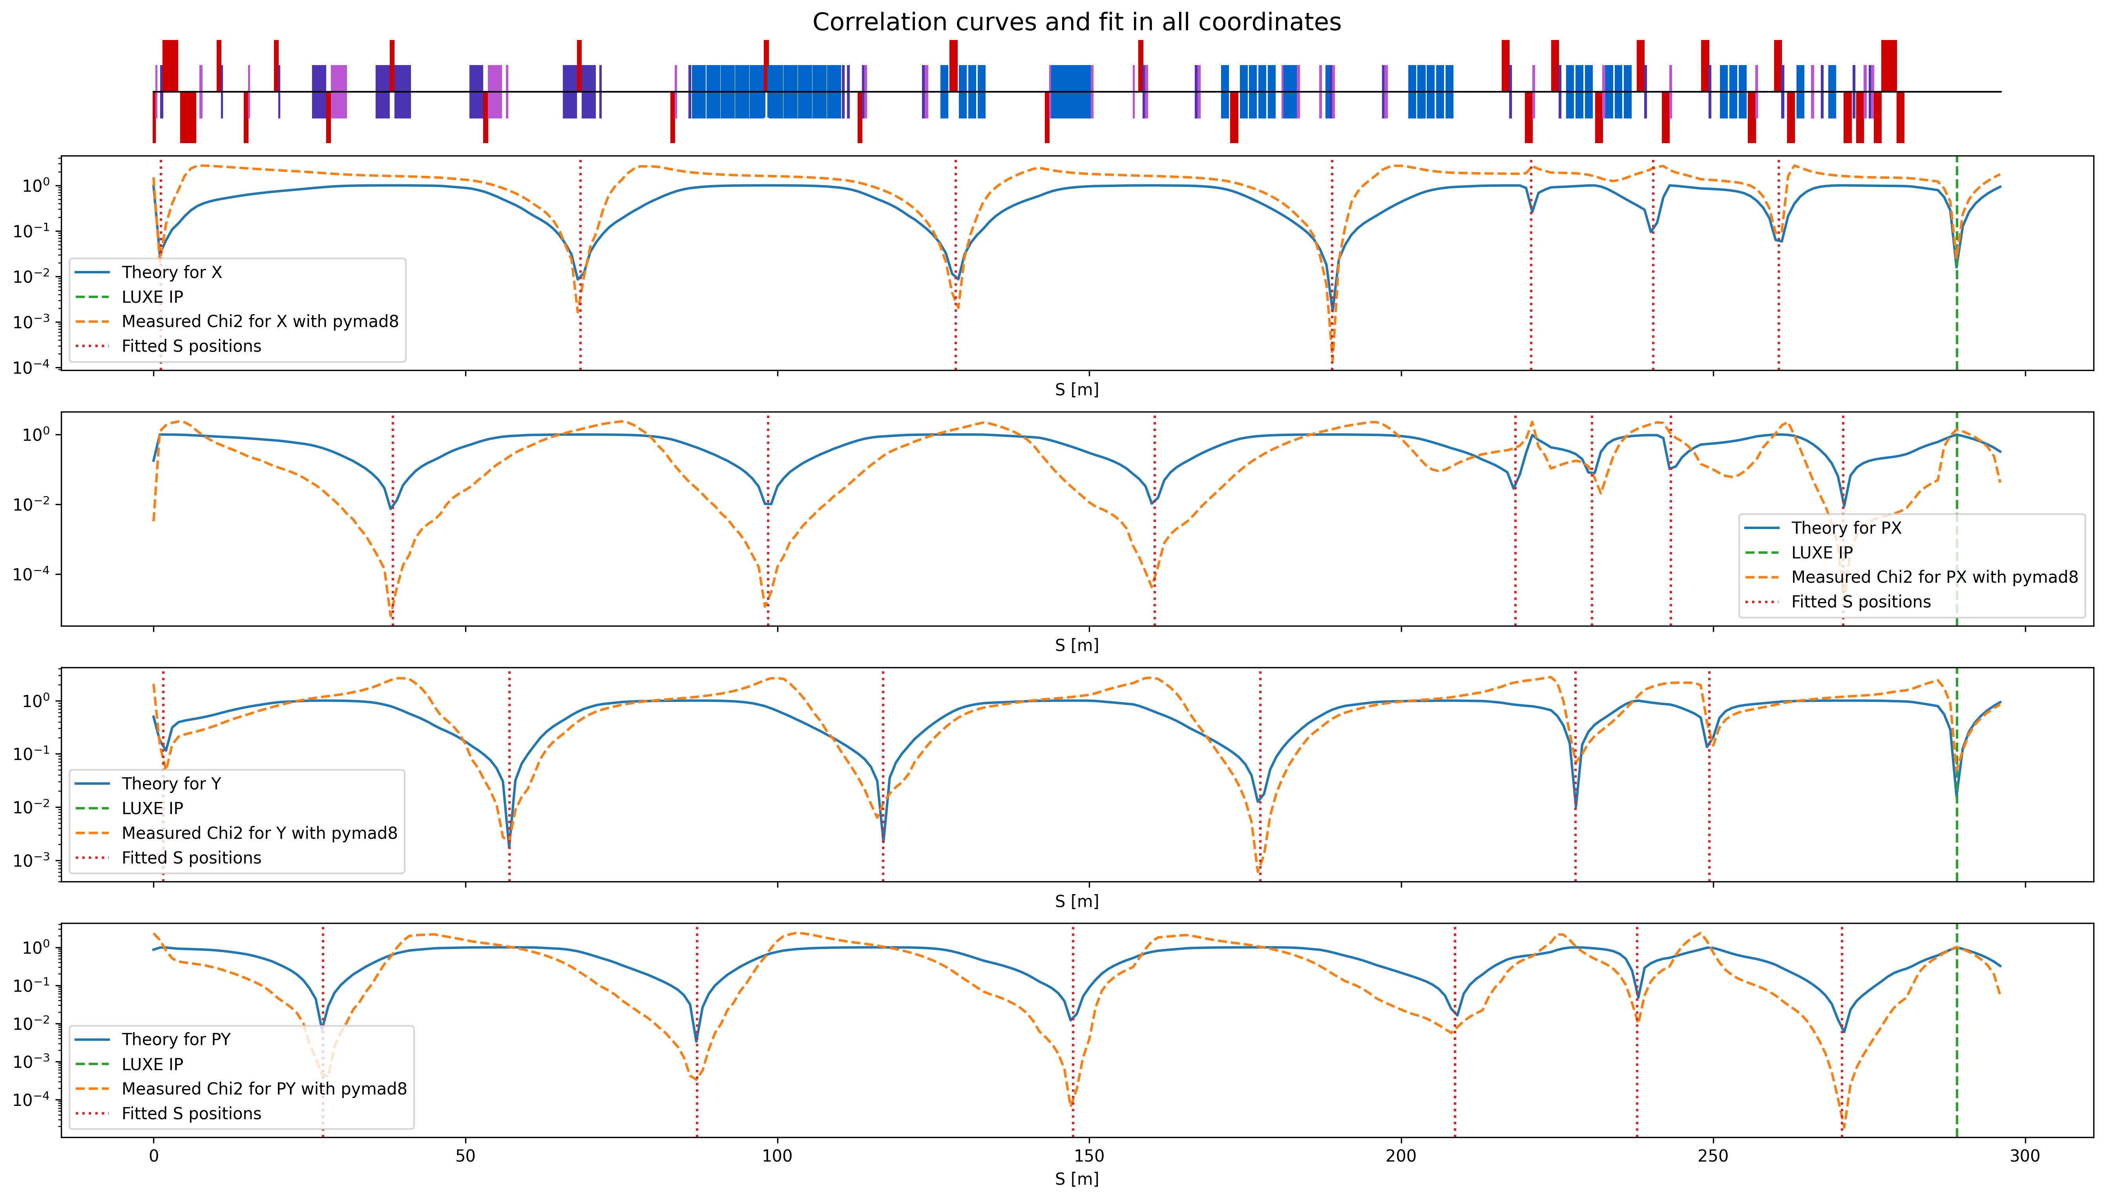
DENIAUD Marin - 20/02/2023
2. Tracking and Correlation
X
X’
Y
Y’
For each coordinates we found 7 possible locations for BPMs (except in Y where we found only 6)
But we need a quantitative method to find what are the most efficient BPMs if we take the given S positions !
16
Notes:
16

Slide 17
Objectives of this study
Tracking and Correlation
Singular Value Decomposition
Resolution at the IP
Next Objectives
17
DENIAUD Marin - 20/02/2023
Notes:
17

Slide 18
3. Singular Values Decomposition
The previous method only shows the position of high correlation and not the correlation coefficients.
We want to extract, from all these positions, the corresponding coefficients $c_{s}$ to measure the beam coordinates at the IP
fr
$$x_{IP}=\sum_{s≠s_{IP}}^{S}{x_{s}c_{s}}$$
We can resolve this problem with a matrix formulation in which $X_{IP}$ contain all the positions information at each BPM and for each particle
$$\underline{x_{IP}}=\underline{\underline{X_{IP}}}.\underline{c_{IP}}⇒\underline{c_{IP}}=\underline{\underline{{X_{IP}}^{−1}}}.\underline{x_{IP}}$$
Inverting the matrix $\underline{\underline{{X_{IP}}^{−1}}}$ require that we use a SVD !
18
DENIAUD Marin - 20/02/2023

Slide 19
DENIAUD Marin - 20/02/2023
3. Singular Values Decomposition
The Singular Value Decomposition is a method that allow the inversion of a non trivial matrix by decomposing it into 3 matrices
fr
$$\underline{\underline{X_{IP}}}≝\underline{\underline{U}}.\underline{\underline{D}}.\underline{\underline{V^{T}}} \left\{\begin{aligned}D is diagonal \\ U,V are unitary\end{aligned}\right.$$
These matrices are easily invertible or transposable so we can re-arrange our previous equation to get the correlation coefficients
fr
$$\underline{c_{IP}}=\underline{\underline{V}}.\underline{\underline{D^{−1}}}.\underline{\underline{U^{T}}}.\underline{x_{IP}}$$
WARNING : This method works here because in this beamline the relationship between two positions is linear or quasi-linear (we don’t have any sextupole)
fr
19
Notes:
19

Slide 20
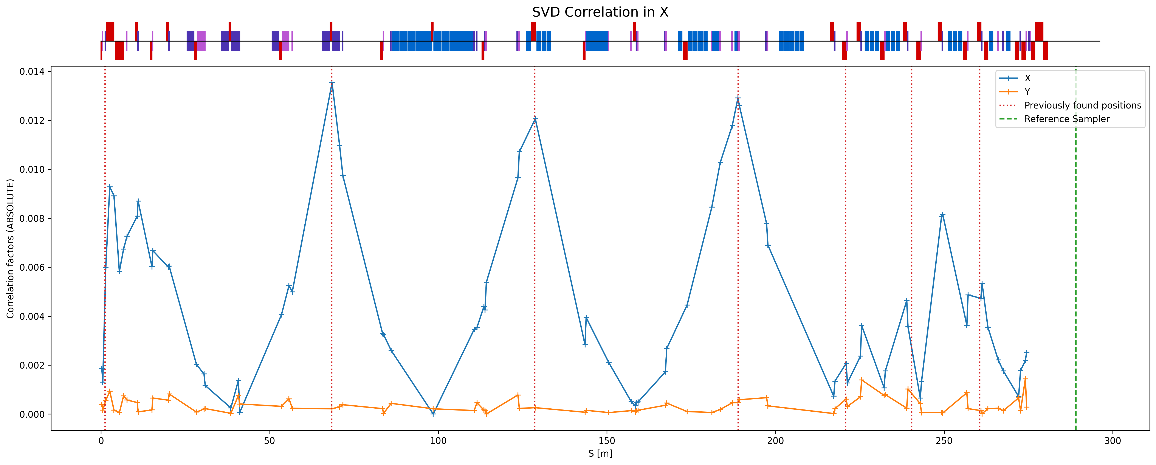
DENIAUD Marin - 20/02/2023
3. Singular Values Decomposition
Attempt to find the same S position that we found with Chi2 method
Only the QUADs and KICKs are registered as samplers
20
Notes:
20

Slide 21
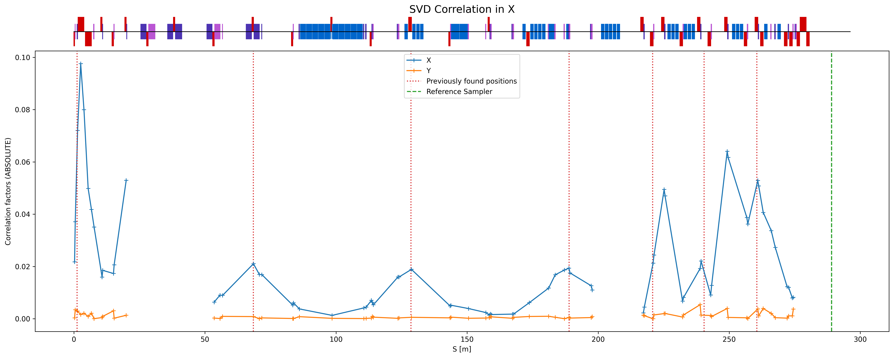
DENIAUD Marin - 20/02/2023
3. Singular Values Decomposition
Easier when doing SVD on less elements. Just a qualitative check.
21
Notes:
21

Slide 22
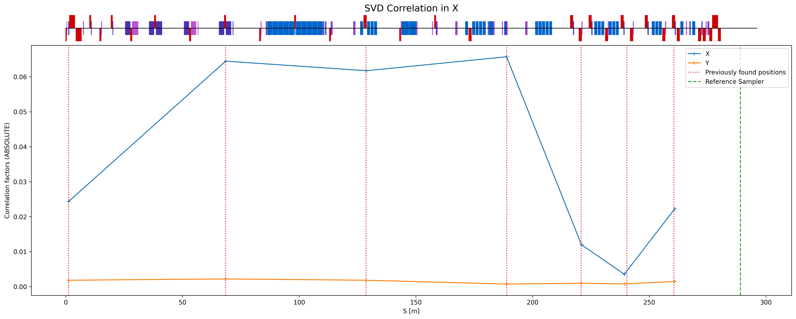
DENIAUD Marin - 20/02/2023
3. Singular Values Decomposition
Now we want to extract the coefficients for each previously found S position
We can now use them to simulate a measurement of the beam at the IP !
22
Notes:
22

Slide 23
Objectives of this study
Tracking and Correlation
Singular Value Decomposition
Resolution at the IP
Next Objectives
23
DENIAUD Marin - 20/02/2023
Notes:
23

Slide 24
4. Resolution at the IP
Now we have all the coefficients $c_{s}$ and we can flip the calculation in order to get a “measure” of a given coordinate at the IP
fr
$$x_{IP,meas}=\sum_{s≠s_{IP}}^{S}{x_{s}c_{s}}$$
Doing this with all 10 000 particles, we can now get a histogram of the resolution at the IP :
$$x_{IP,real}−x_{IP,meas}$$
To have an accurate simulation, we put 10 um of noise at each BPM
24
DENIAUD Marin - 20/02/2023

Slide 25
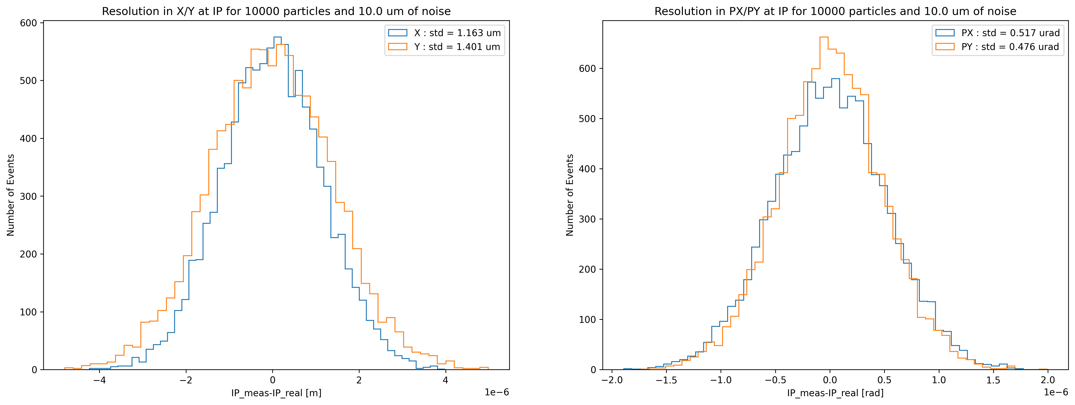
4. Resolution at the IP
In X/Y we have ~1-1.5 um of resolution
In X’/Y’ we have ~0.5 urad of resolution
25
DENIAUD Marin - 20/02/2023

Slide 26
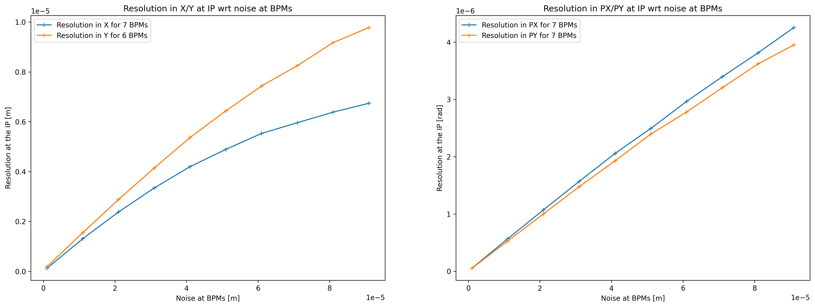
4. Resolution at the IP
We can look at how this resolution vary w.r.t. the BPM noise
26
DENIAUD Marin - 20/02/2023

Slide 27
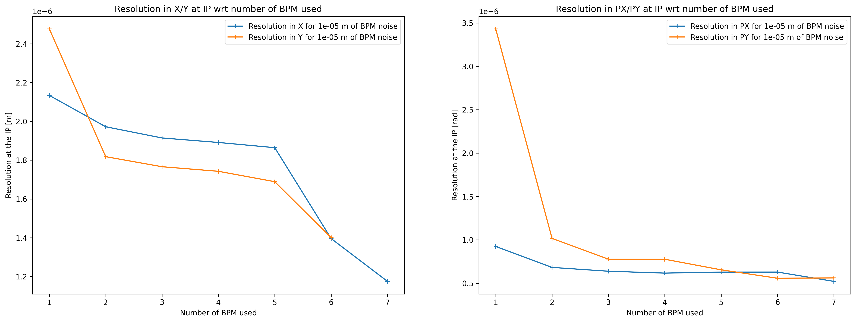
4. Resolution at the IP
Or w.r.t the number of BPMs used for the SVD (by order of coefficients)
27
DENIAUD Marin - 20/02/2023

Slide 28
Objectives of this study
Tracking and Correlation
Singular Value Decomposition
Resolution at the IP
Next Objectives
28
DENIAUD Marin - 20/02/2023
Notes:
28

Slide 29
DENIAUD Marin - 20/02/2023
5. Next objectives
To get the correlation coefficients from the SVD we need the positions and angles at the IP :
fr
$$\underline{c_{IP}}=\underline{\underline{{X_{IP}}^{−1}}}.\underline{x_{IP}}$$
Since we can’t put a BPM at this point, we need to think about another method to make this measurement.
Then after we’ve calculated the coefficients once, we only need the BPM data to calculate the beam coordinates at the IP.
fr
29
Notes:
29

Slide 30
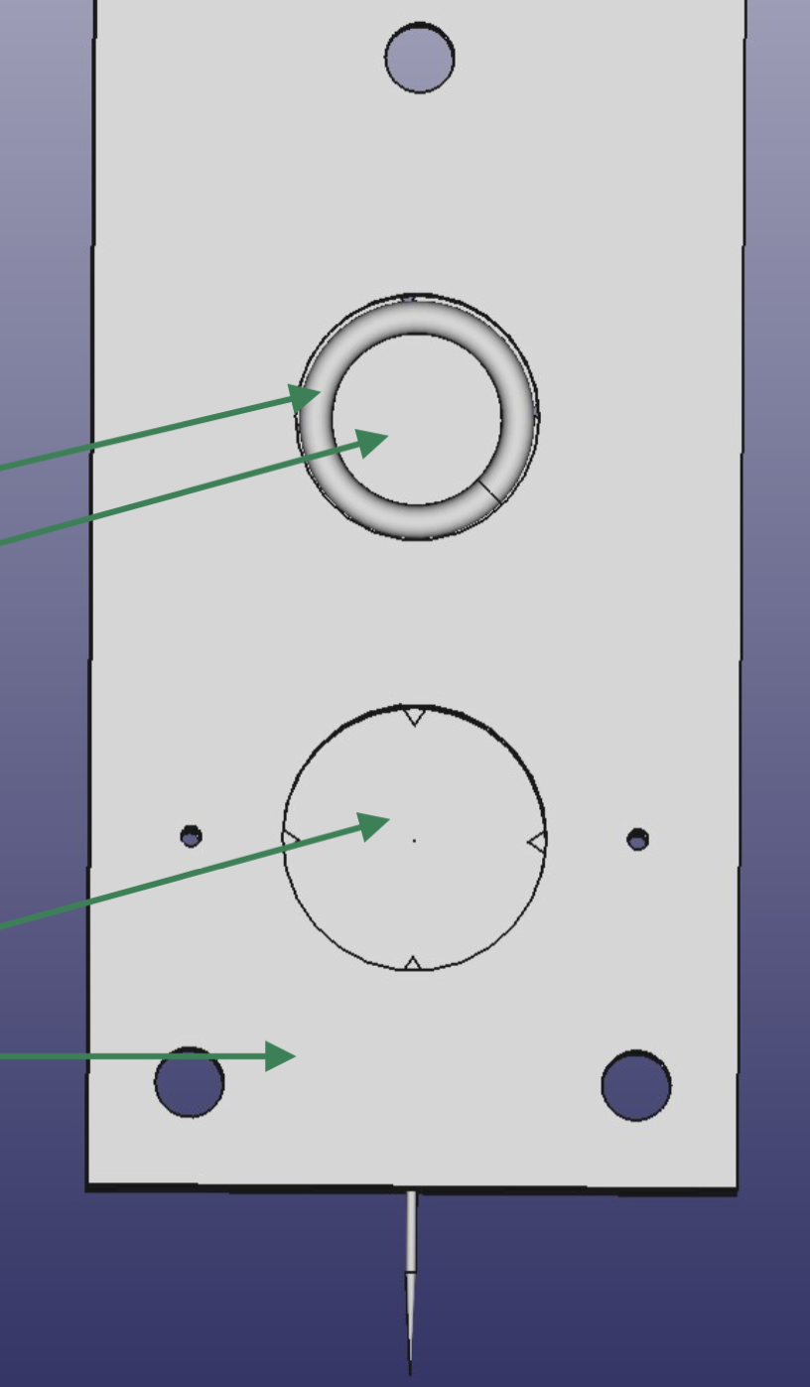
DENIAUD Marin - 20/02/2023
5. Next objectives
We could move a tiny needle in front of the beam.
When in contact with the electron beam it will produce some photons
These photons could be detected with a photodetector
fr
YAG:Ce ?
Pinhole : Al ?
Frame : Al ?
Needle
30
Notes:
30

Slide 31
DENIAUD Marin - 20/02/2023
5. Next objectives
TO SUMMARIZE :
Mad8 tools for tracking studies in TL/TD20
Chi2 method to confirm the theoretical analysis on correlation points in the lattice
The SVD can find the corresponding coefficients in order the do a measurement at the IP
1-1.5 um res in X/Y
0.5 urad res in X’/Y’
We need some measurement device at the IP for the initial calculation of the coefficients
31
Notes:
31

Slide 32
Thank you for your attention !
32
DENIAUD Marin - 20/02/2023
10
10
Notes:
32

Slide 33
Notes:
33

Slide 34
Notes:
34

