Slide 1
Rotated Showers
Weekly Softwear Meeting
David Moisă
Hamburg, 16th of February 2023

Slide 2
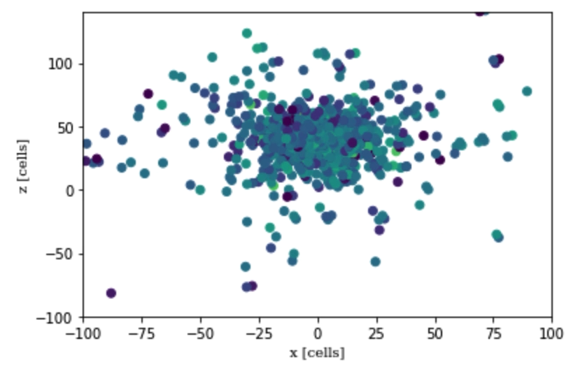
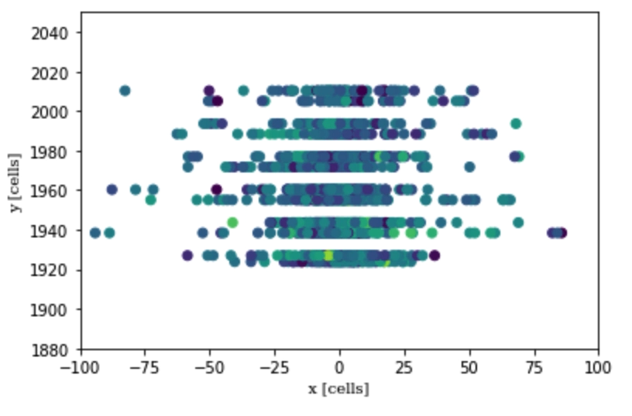
Rotation around origin point (0;40)
Granularity: x4

Slide 3
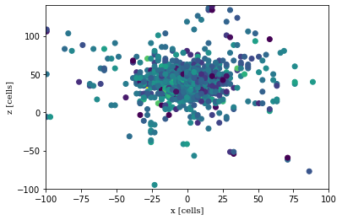
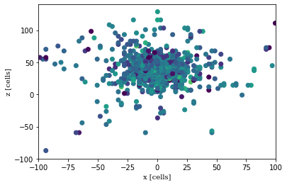
Granularity: x4
Rotation around origin point: 90 degrees
Rotation: 0 degrees
Rotation: 90 degrees

Slide 4
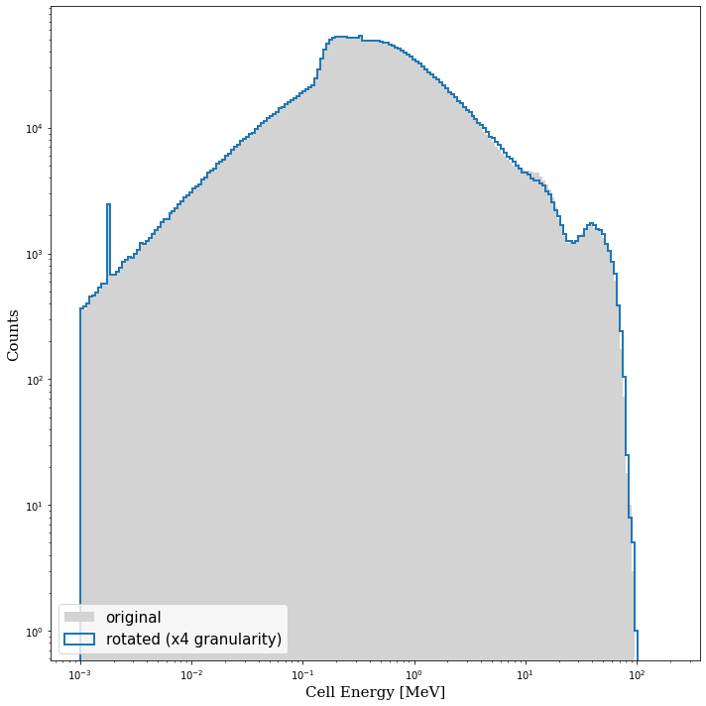
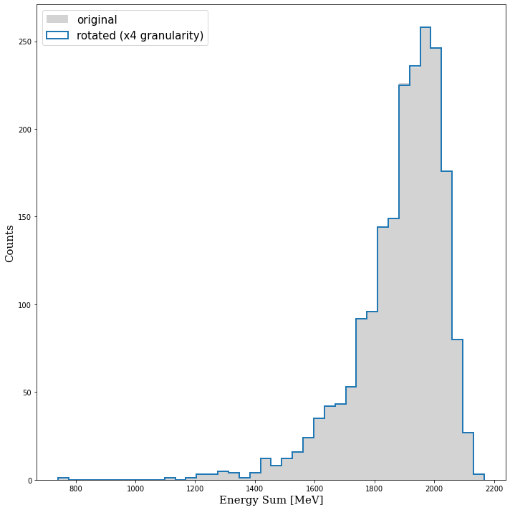
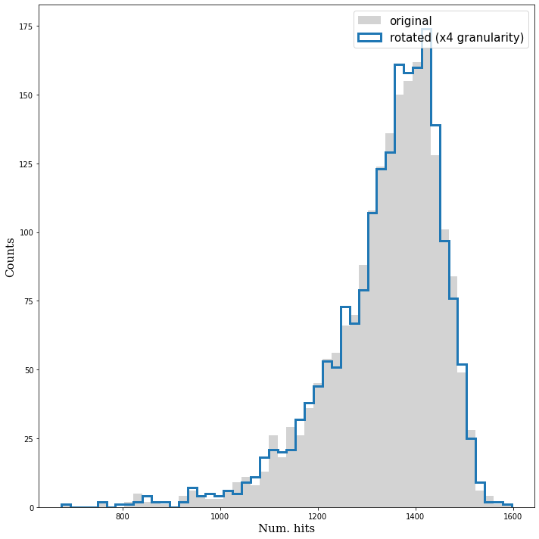
Granularity: x4
Rotation around origin point: 90 degrees

Slide 5
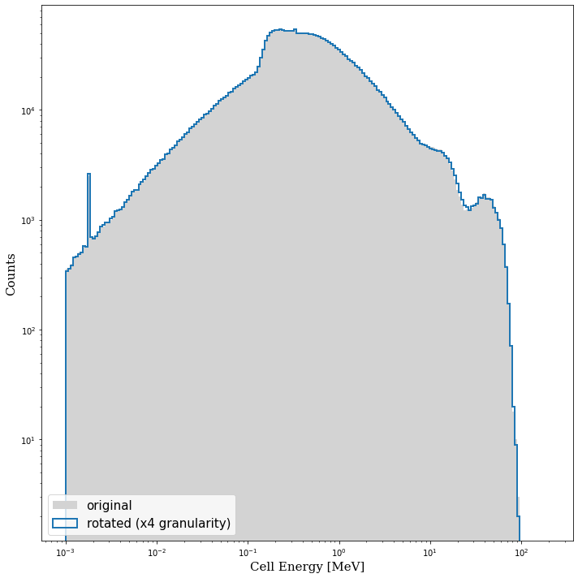

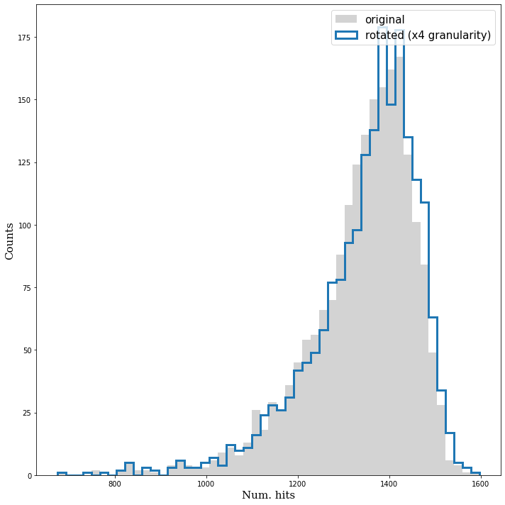
Granularity: x4
Rotation around origin point: 5 degrees

Slide 6
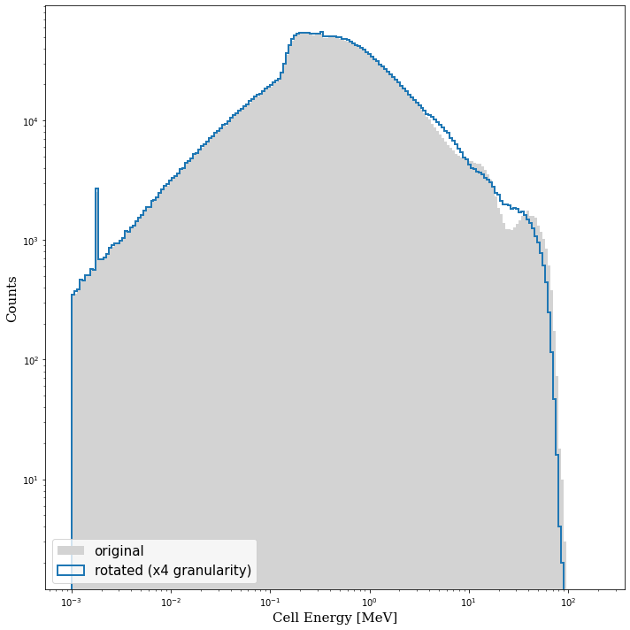

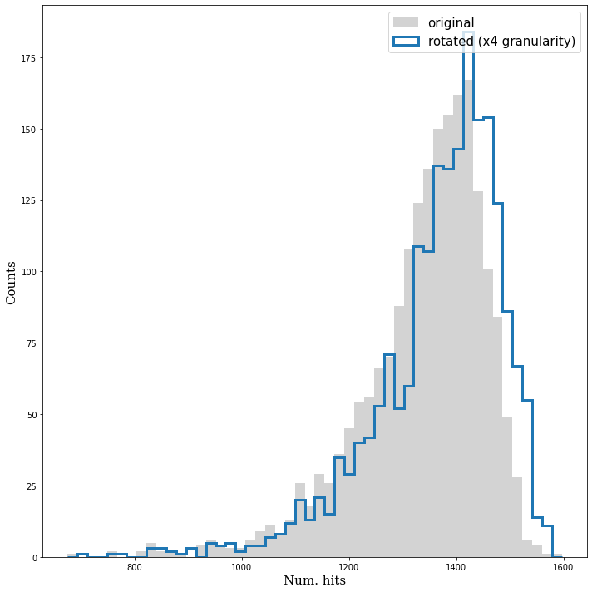
Granularity: x4
Rotation around origin point: 45 degrees

Slide 7
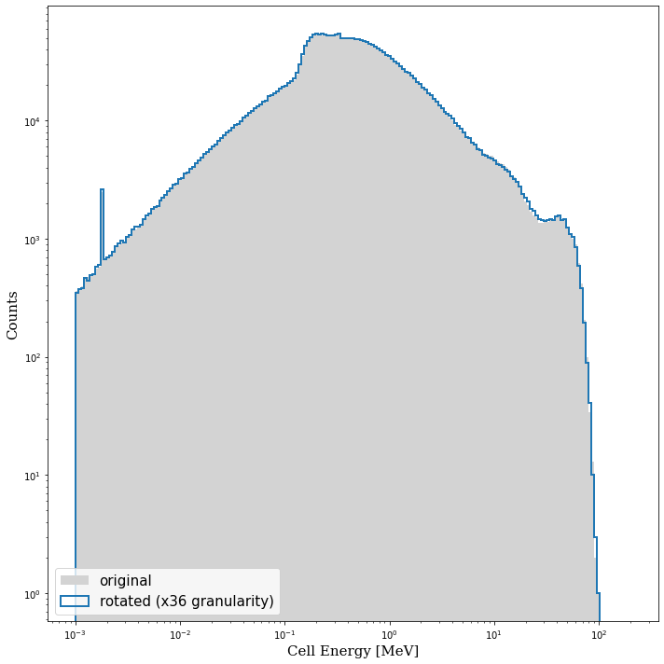

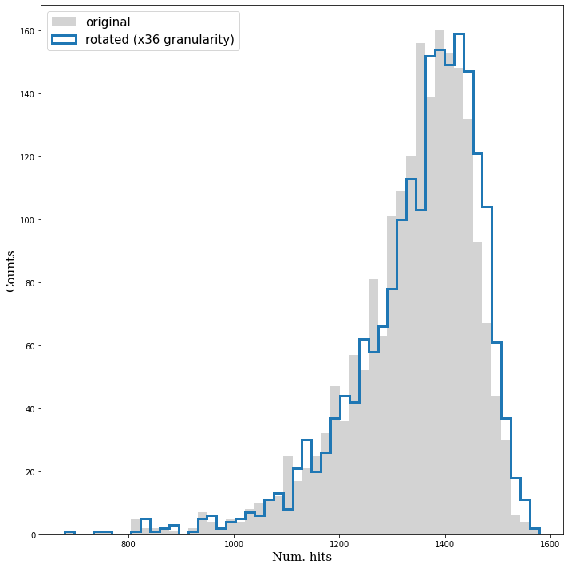
Granularity: x36
Rotation around origin point: 5 degrees

Slide 8


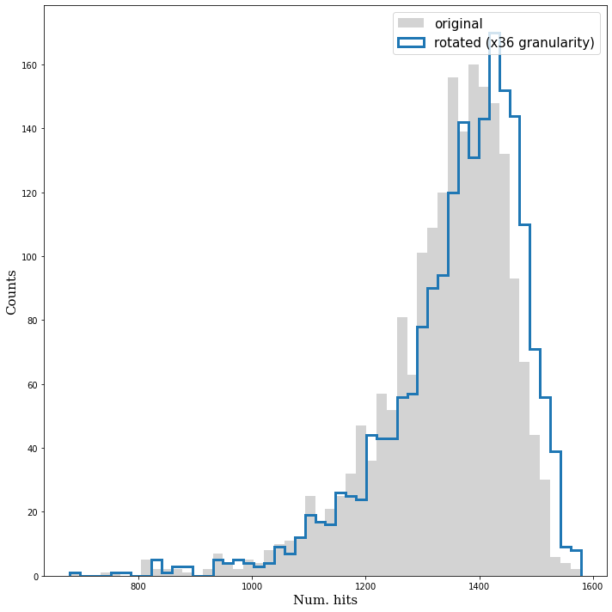
Granularity: x36
Rotation around origin point: 45 degrees

Slide 9
Thank you

Slide 10
David Moisă
FTX
moisad@mail.desy.de
004915780864137

