Slide 1
High-speed optical links and processors for the ATLAS Level-1 Calorimeter Trigger upgrade
B.Bauss, V.Büscher, R.Degele, A.Ebling, W.Ji, C.Meyer, S.Moritz,
U.Schäfer, C.Schröder, E.Simioni, S.Tapprogge
- Mainz -
The ATLAS L1Calo collaboration
Argonne, Birmingham, Cambridge, Heidelberg, Mainz, MSU, QMUL, RAL, Stockholm
14.02.2011 08:39:32

Slide 2
Outline
Current Level-1 Calorimeter Trigger
Latency…
Upgrade for higher luminosity: Phase 1
Towards Phase 2
Mainz R&D activities

Slide 3
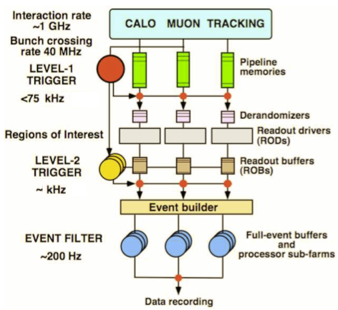
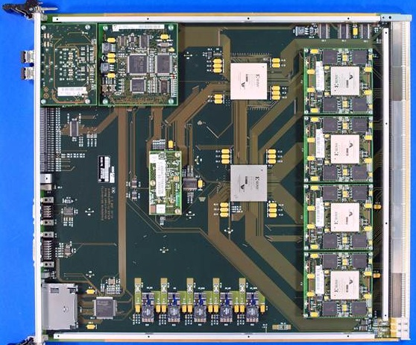
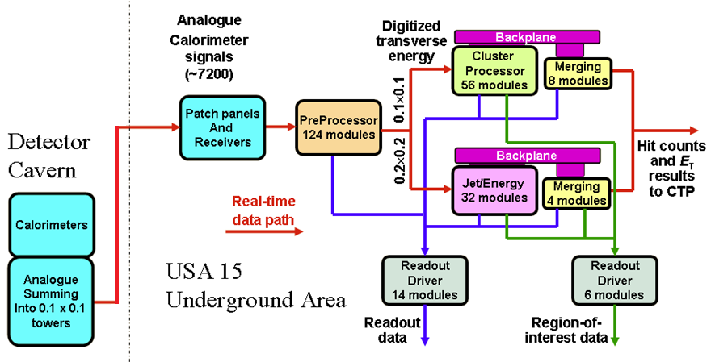
ATLAS Trigger / current L1Calo
L1
Jet/Energy module
µ
calo
CTP

Slide 4
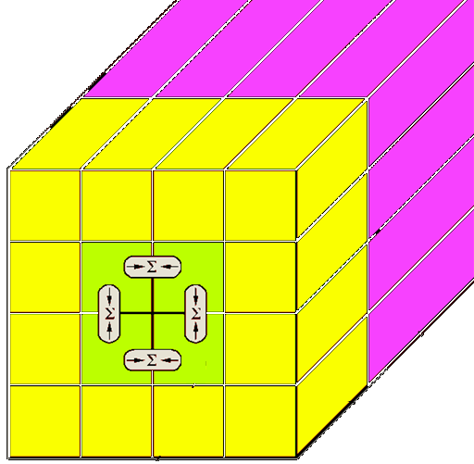
Current L1Calo
Analog signal chain on- and off-detector
Mixed-signal Pre-Processor with discrete analog and ASIC-based digital circuitry : digital filtering / gain control / bunch crossing ID
Digital processing:
Sliding windows algorithms for jet and em cluster detection on processor modules at granularity ≥ .1×.1 (η×φ)
Data consolidation by thresholding and counting objects
Data transmission on parallel backplane to mergers (CMMs)
Global results determined by summation trees on daisy-chained merger modules
Final results of electromagnetic and hadronic object count (at given thresholds), and total and missing transverse energy reported to Central Trigger Processor
Topological information (Regions of Interest – ROIs – basically energy sums per window) sent to 2nd level trigger only for all level-1 accepted events
sliding window

Slide 5
Latency, algorithms, data paths …
Total latency limited to c. 2.5 microseconds (cables!)
Sliding windows algorithms require duplication of data across processor module and crate boundaries
→ All real-time data transmitted electrically
Analogue off the detector
480 Mb/s differential into digital processors, data replication at source
80 / 160 Mb/s single ended data replicated over a custom backplane
40 Mb/s to, between & from merger modules (CMMs)
→ System works well, latency limits met. Complicated and expensive processor backplane (18 layers) and considerable cable plant

Slide 6
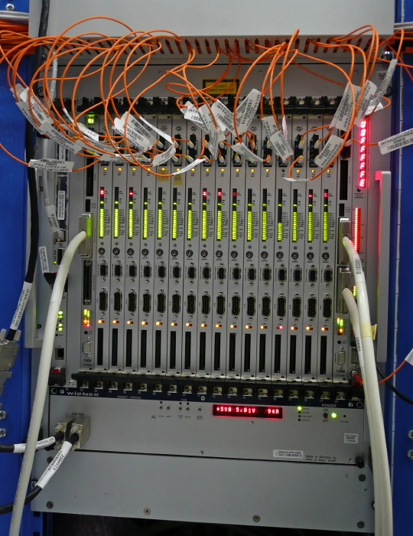
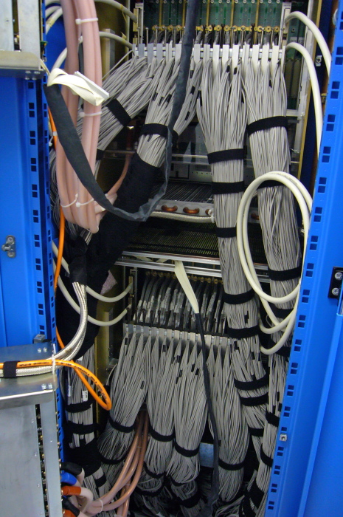
The horror lurks behind…
Jet/En. processor
Jet/Energy processor
Pre-processor

Slide 7
Upgrade : Re-think connectivity
Upgrade will require additional connectivity
System density will rule out additional electrical cabling
Latency might get even more critical
Go for optical connections
Increase system density by use of FPGA-internal Multi-Gigabit Transceivers (MGTs)
Accept inherently higher latency per high speed link
Partition the system such that excessive de-serialization/re-serialization is avoided
Optimize the data replication scheme
Explore options for latency reduction on the FPGA

Slide 8
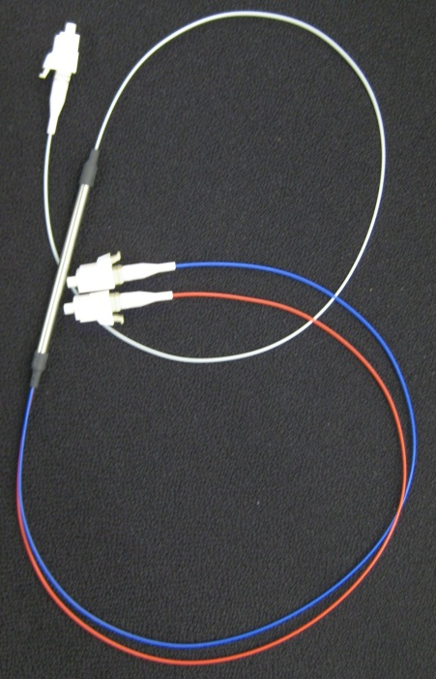
Data replication
source
Do not share any data between modules of same subsystem to avoid additional SerDes latency
sink
Forward data replication only:
Duplication at source
Mirror a link
Assemble a different stream optimised for the replication
Optical splitter (fibre coupler)

Slide 9
L1Calo upgrade steps
Due to expected increase in pile-up of events at rising luminosities, the current algorithms will be degraded. ➔ Improve L1Calo in distinct phases
Phase 0 :
Some improvements on the FPGA based algorithms have been made and will be in use for 2011 running
Further optimizations might follow
No hardware being added / replaced at this stage
Phase 1 :
Improve digital signal processing on Pre-Processor ( ASIC → FPGA )
Add topological processing with limited hardware changes
Phase-2 :
Improve of granularity of L1Calo algorithms in η, φ, and depth
Replace Level-1 Calorimeter Trigger
Probably distinguish Level-0 and Level-1 trigger
NB :
This is a snapshot of current thinking only. Level-1 technical proposal being written
Stages are related to, but not strictly dependent on the LHC machine upgrade steps
L1Calo will attempt to stage the installation of new hardware (sub-phases)
Phase-1 is mainly internal to L1Calo, no strict need for mods of external interfaces
Phase-2 is dependent on calorimeter readout electronics upgrade

Slide 10
Phase 1: Topology
So far topology of identified objects not propagated through 1st level trigger real-time data path for bandwidth reason
Increase RTDP bandwidth and send (almost) full ROI information to a single processor stage where topology cuts are applied and double counting is suppressed by jet/electron/... matching :
Increase backplane bandwidth of existent processor modules 4-fold (40Mb/s→160Mb/s) with modification to FPGA code only
Replace the CMM merger modules by “CMM++” modules
Single FPGA processor
64Gb/s backplane input capability
Possibly up to ~400Gb/s optical I/O
Star-couple all CMM++s into topological processor
Include Muon processing capability on topological processor
Backward compatible to current scheme (for staged installation) : CMM++ daisy-chain (electrical / optical)

Slide 11
New merger module: CMM++
VME --
VME
CPLD
Legacy DAQ, ROI readout
(Glink)
SNAP12
Topological processor links:
12-fiber bundles,
6.4/10 Gbit/s/fiber
LVDS merger links
Virtex 6
HX565T
SNAP12
SNAP12
SNAP12
Backplane
data from
JEM/CPM
modules
(160 MHz)
Legacy
LVDS outputs
to CTP
SNAP12
SNAP12
9U × 40 cm

Slide 12
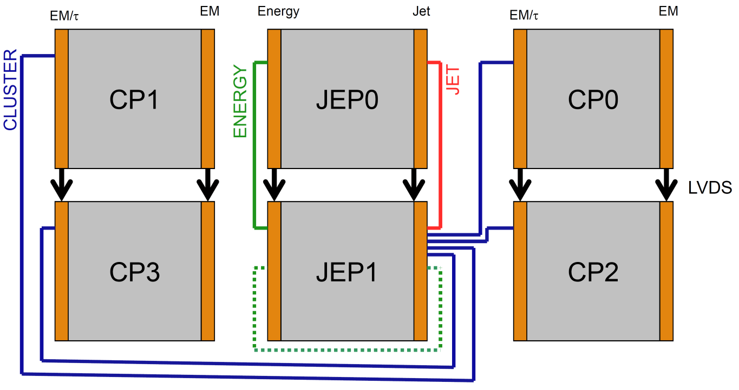
L1Calo Phase-1
Daisy chained
Combination of low-latency LVDS + high bandwidth opto links
CMM++
Full system w. topo processor
single crate

Slide 13
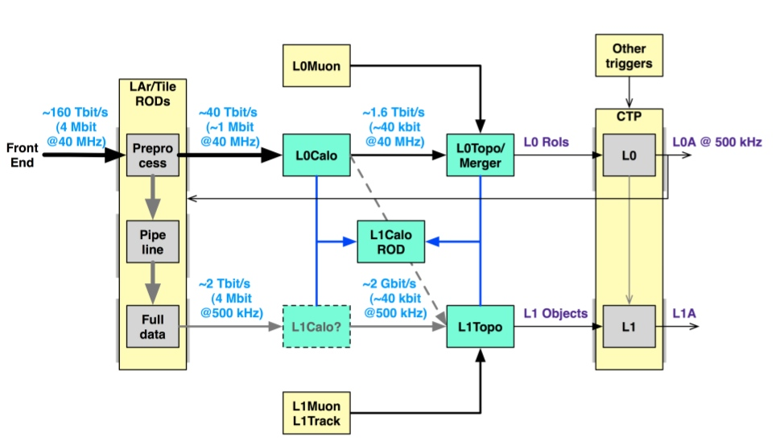
eventually … Phase 2 !
« Once the calorimeter readout is replaced … in 20xx … »
High granularity trigger data provided on optical links
New sliding windows processor with optical interfaces only
Synchronous low-latency L0 plus asynchronous L1

Slide 14
Upgrade activities in Mainz
Simulations of topological algorithms at high luminosities (10³⁴ cm⁻²s⁻¹), high pile-up
Simulation and implementation of the algorithms in VHDL
Improvements on VHDL code for current processors
Design of demonstrator modules for phase 1 and phase 2
Topological processor
Phase-2 Level-0 sliding windows processor
Latency optimization
Data replication schemes
FPGA on-chip MGT operation modes and fabric interfaces

Slide 15
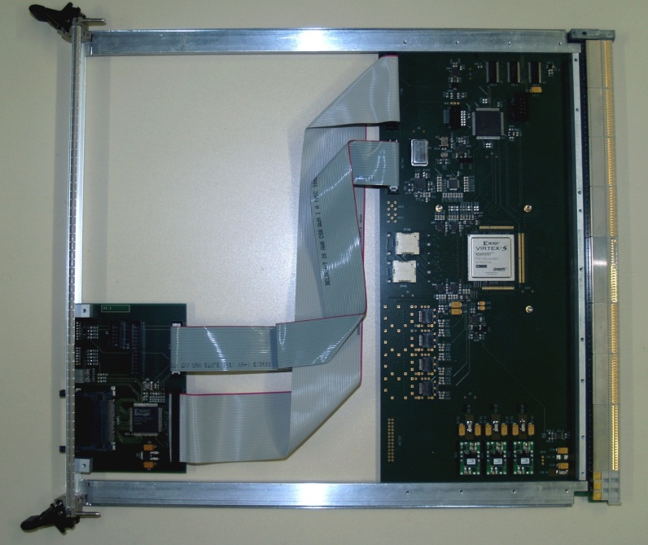
Demonstrators / Prototypes so far…
Work on a CMM++ prototype has started recently at MSU. Currently at specifications stage. Will serve as data input for the topological processor
“GOLD” demonstrator (not just) for a topological processor currently being developed in Mainz Latency → data replication schemes Density → processing power, connectivity
Mainz-built “BLT” backplane and link tester, equipped with Avago opto-link interface (12-channel, 6.4Gb/s) and LHC bunch clock jitter cleaning hardware. Successfully verified backplane data reception (160Mb/s) and opto link operation.

Slide 16
GOLD – Generic Opto Link Demonstrator
RTM
«data concentrator» scheme: many in – few out
Advanced TCA form factor
Limited connectivity on front panel
Input links via optical connectors in zone 3
12-channel 10Gb/s opto modules on daughter card
Electrical connectivity up to 10Gb/s in zone 2
Power budget ~400W
front
Z3
back
Z2
ATCA

Slide 17
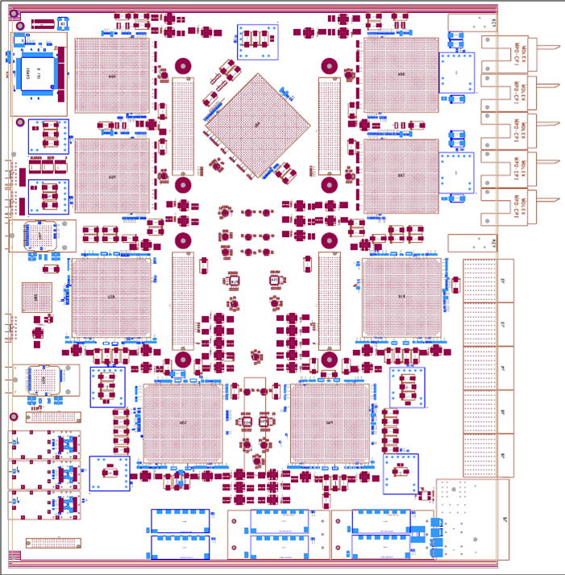
GOLD
Z3
5 * XC6VLX FPGAs (Input L, main M) up to 36 links each
Two pairs of XC6VHX FPGAs (H) 72 links
Up to 12 12-channel optos on mezzanine
Clock generation
144 multigigabit links in zone 2 (equiv. 22300 bit / BC)
L
L
M
Opto
L
L
H
H
Z2
890Gb/s
total
H
H
Z1

Slide 18
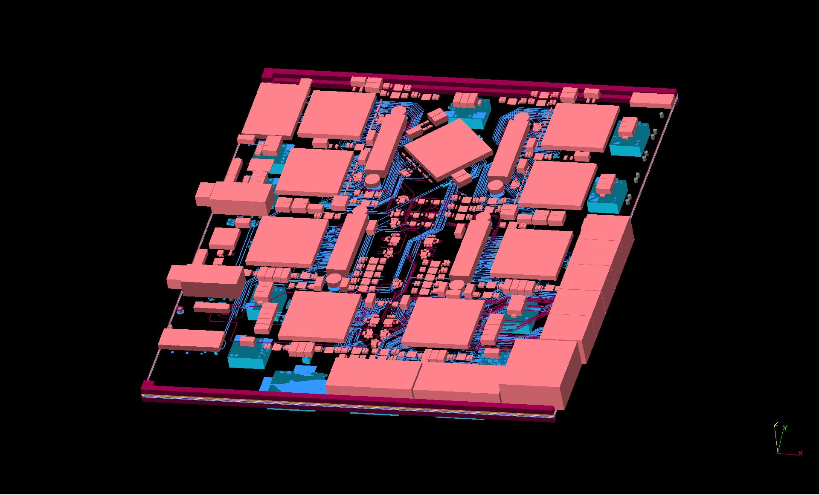
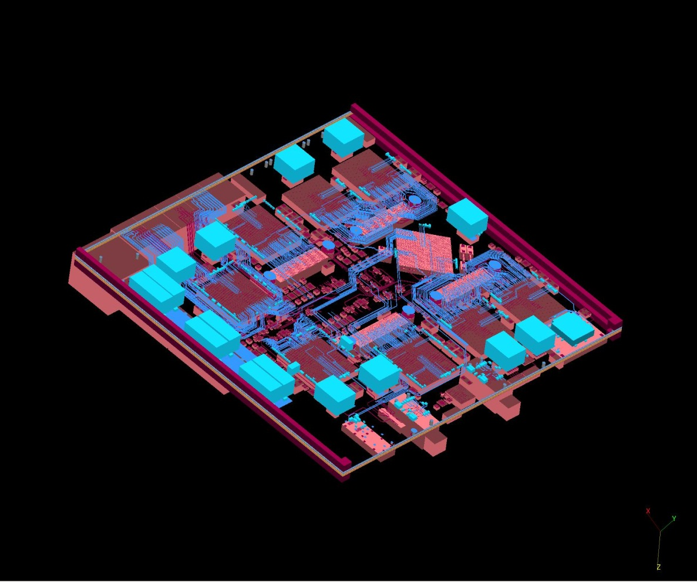
3-d model

Slide 19
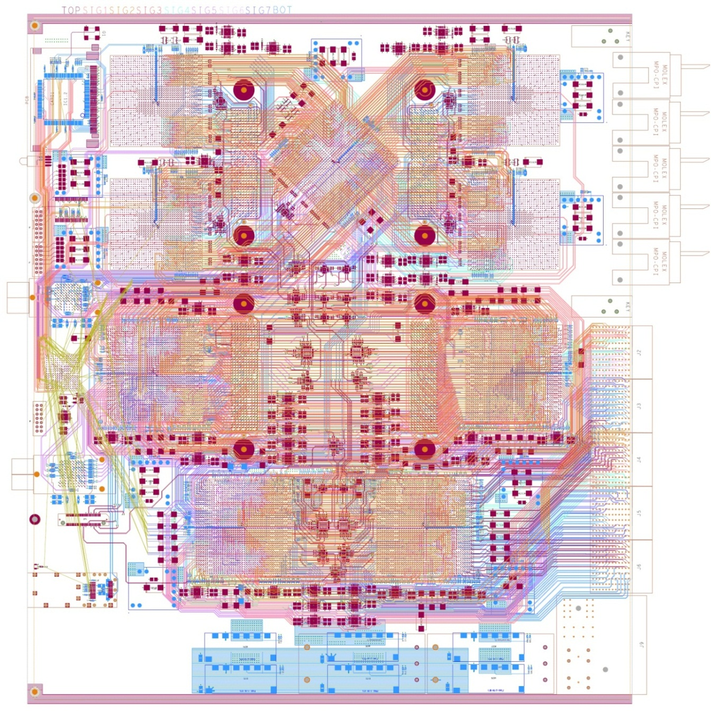
Module status
Main board finished
Carefully hand-routed (~ 400 differential pairs per FPGA, line rates 1.0/6.5/10 Gbps)
Daughter modules almost done
Will have several incarnations of daughter modules
L1Calo-internal review soon
Components available …

Slide 20
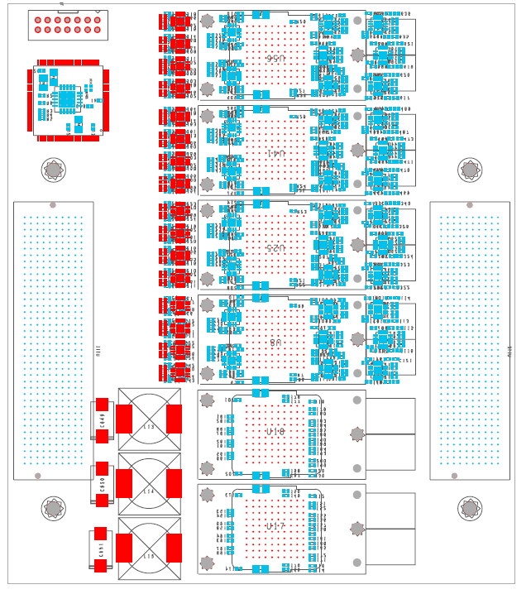
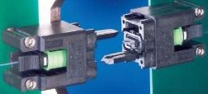
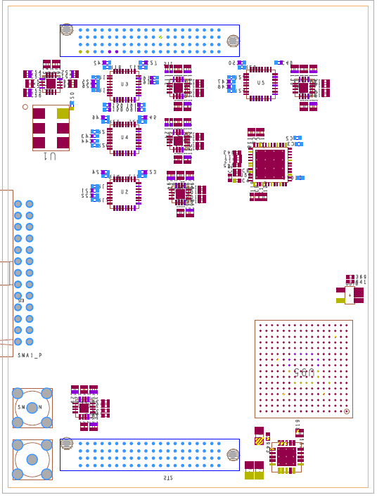
Components…
opto mezzanine
data replication at CML level
12 to 72 fibres per backplane connector (MPO/MTP)
10Gb/s Opto
clock mezzanine

Slide 21
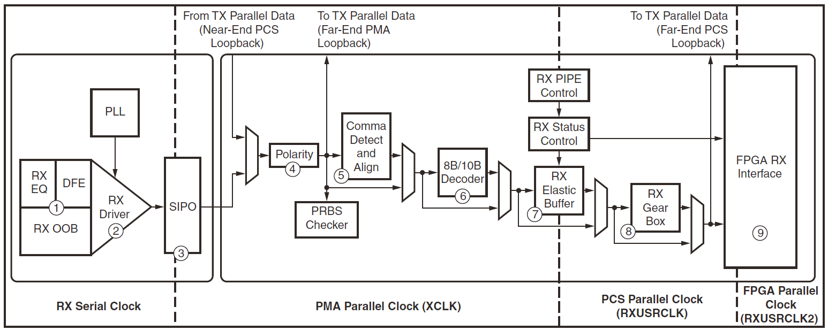
Current activities: h/w, f/w
Main focus on GOLD hardware design / production
First module tests spring 2011, further hardware development for phase1 Topo-processor and phase2 (Virtex-7, up to 28Gb/s)
Characterize 6.5/10Gbps optical link chipsets (Avago)
Work on latency minimization for Xilinx MGTs operated synchronous to LHC bunch clock, with phase alignment
GTX receiver
Received clock | LHC clock

Slide 22
Some current activities
Default encoding (for phase 1 topo) 8b/10b, 80% payload
Successfully tested a variant for latency critical paths:
Transmit raw data, alternating normal and inverted representation
50% payload, latency reduction by c. 1 LHC bunch tick
Suppression of elastic buffer
Works out of the box with Xilinx IP core for small channel count
Fails for large channel count due to insufficient global routing resources
Will probably require to devise specific scheme for re-synchronisation to global LHC bunch clock

Slide 23
Summary / outlook
Need for substantial improvement of trigger algorithms
Topological processor (phase-1) and new sliding windows processor (phase 2) require high-density processors with high-speed, low latency optical interconnect
For phase 1 explore 6.5/10 Gbps opto-links
For phase 2 explore 10/13/28 Gb/s technology
Work on conceptual designs and demonstrators for upgrade phases 1 and 2 has started
Mainz active on hardware / firmware / simulation for both upgrade phases, with particular interest in low latency optical data transmission
Commission GOLD demonstrator in 2011
Use as a starting point for phase-1 and phase-2 prototype development
Benefit from similar requirements on phase 1 and 2

