Slide 1

ATLAS experiences in optical links
T. Flick
Bergische Universität Wuppertal
1st Readout Link Workshop of the Helmholtz Alliance
14.-15. Feb. 2011
Wuppertal

Slide 2
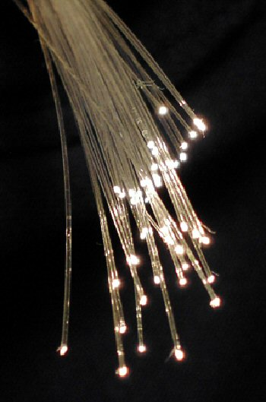
Outline
Optical datatransmission in ATLAS
  LArg calorimeter
  Inner Detector (silicon detectors)
  Other systems like muon spectrometer and
  TRT use optical transmission
Experiences during the first year
of running
Requirements on updated links
Ongoing investigations
Summary / Outlook

Slide 3
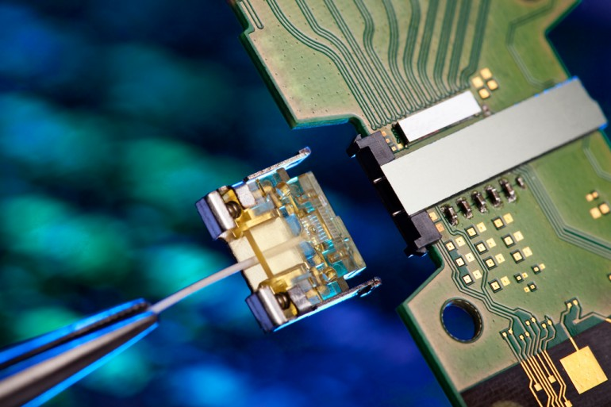
Requirements
Requirements are certainly
detector dependent:
  Occupancy / granularity
  Close distance to beam pipe
  Trigger contribution
  Material budget
Speed: high bandwidth contra
material, granularity, radiation
tolerance
Radiation: inner detector for sure have higher constrains as outer ones (70 MRad for current pixel, up to 200 MRad for HL LHC pixel)
Reliability: error checking, redundant links, hardware lifetime
Low mass: small radiation length to be introduced in the detector
…

Slide 4
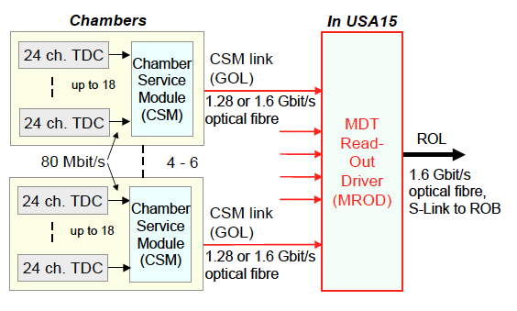
Optical data transmission in ATLAS
ATLAS detector has ~10⁹ channels to be read out
Readout is done subdetector wise
Different strategies and technologies are in use depending on the subdetector location
  LArg Calorimeter uses GB/s optical transmission of multiplexed input channels
  SCT and Pixel have single module optical connections at up to 160 Mb/s bandwidth
  Outer systems use GOL standard
Mostly custom made
components in use
  Radiation aspects
  Space and power
R&D work has to be done for
size (mass), power consumption
and radiation hardness of the
on-detector components
Muon optical link scheme

Slide 5
LArg Calorimeter optical link

Slide 6
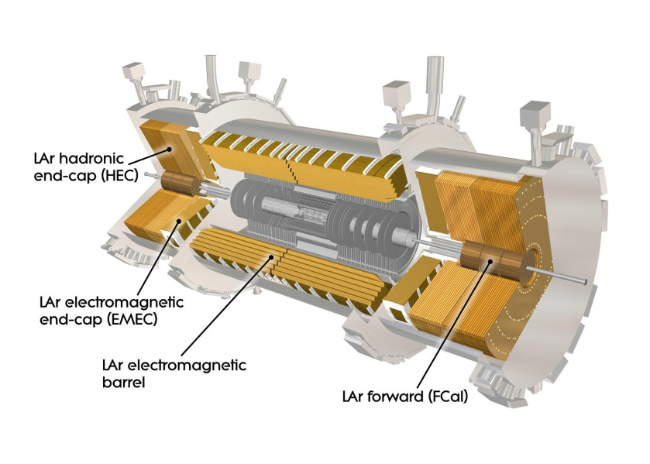
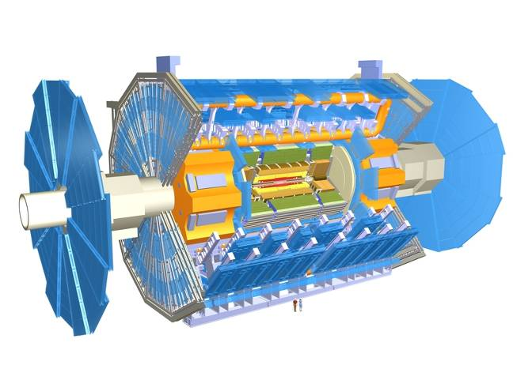
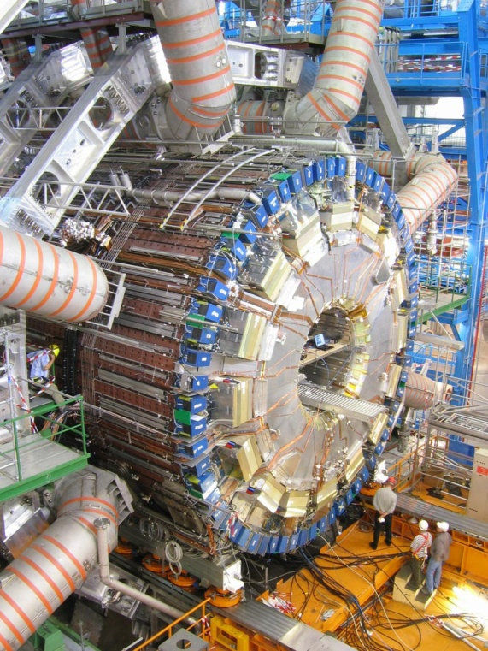
ATLAS Liquid Argon Calorimeter (LArg)
T. Liu (SMU)
~180,000 detector channels
Front-end Electronics on the detector
  58 Front End Crates
  1524 Front End Boards (FEB)
  128 channels per FEB
Back-end Electronics (150 meters away)
  16 Back End Crates
  192 Read Out Driver (ROD) Boards
Fiber optical links between FE and BE
  1524 links, 1.6 Gbps per link
  1 fiber per FEB (128 channels)
Front End Crate

Slide 7
ATLAS LAr optical links overview
50/125 μm Multimode
Developed by a collaboration of 5 institutions: CPPM, IPAS, ISN, KTH and SMU.
Lasted for 6+ years: 1998 - 2004
32 LVDS
16 TTL
1.6 Gbps PECL
ADC
data
SMUX
G-Link TX
OTX
40 MHz
delay
GRIN fibers
ST connectors
80 MHz
40 MHz
QPLL
Front End - FEB
TTCrx
G-Link: commercial serializer/deserializer, specially ordered from Agilent, operating outside of specifications
SMUX: an ASIC fabricated in DMILL, interface between Glink TX and ADC data
OTX, ORX: custom assembled optical interface modules, commercial VCSEL, PIN, laser driver, and TIA
All front-end components qualified for 3.6 kGy(SiO₂)
back End -- ROD
ORX
G-Link RX
To FPGA
8 channels
ORX
GLink RX
To FPGA

Slide 8
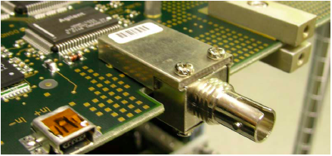
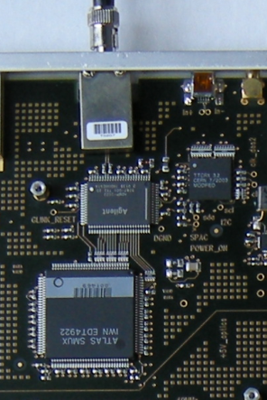
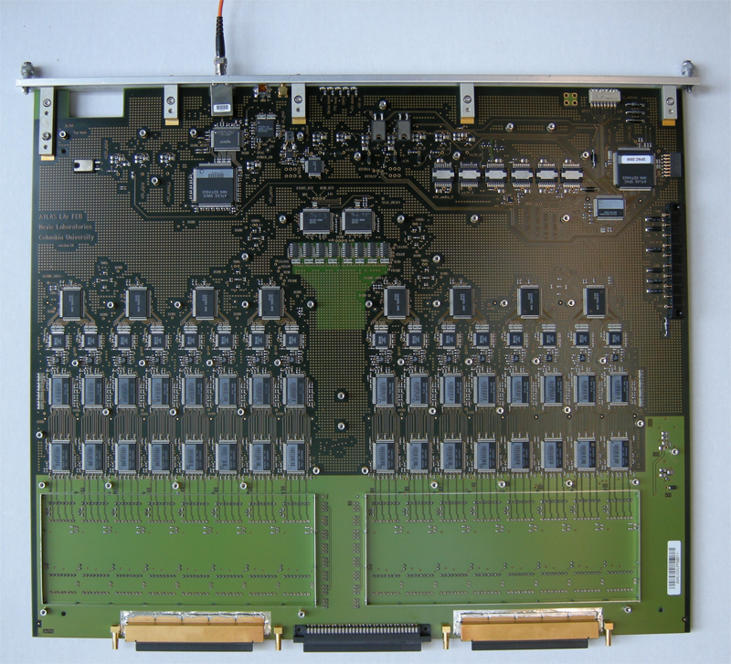
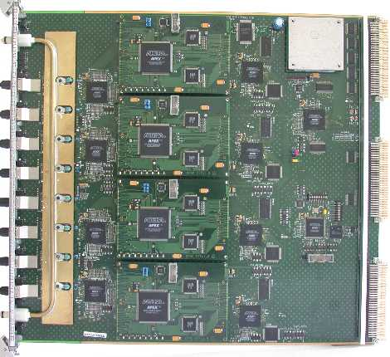
LAr optical links
OTX
G-link TX
FEB
ORX
G-Link Rx
SMUX
ROD
~ 400 mm
~ 400 mm

Slide 9
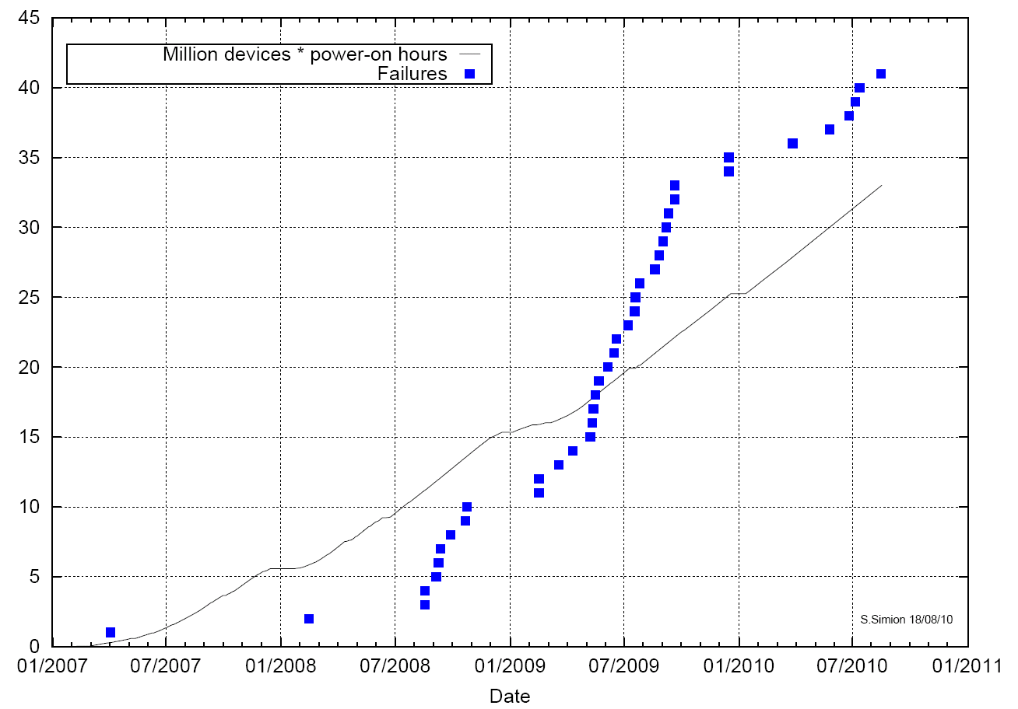
VCSEL failure
The loss of one link means the loss of data of 128 channels. There are 1524 links in total.
Visually all OTX failures are either confirmed VCSEL failures when the parts were accessible and replaced or consistent with VCSEL failures
# of failures
All failed devices were replaced in 2008-2009 shutdown. No access since May 2009
Million devices * power-on hours
Long time before failures started to appear
LAr OTX became an issue in 2008 after first short run
Date

Slide 10
Optical Spectrum versus ESD
In June 2009, from literature¹, it was realized that optical spectrum of a VCSEL becomes narrow after ESD damage. An experiment at SMU verified.
Light Power (dBm)
Light Power (dBm)
Wavelength (nm)
Wavelength (nm)
We know ESD produces narrow optical spectrum, but we are not sure whether narrow optical spectrum is caused only by ESD
¹ T. Kim et al, ETRI Journal, Vol. 30(6), Dec 2008, pp.833-843

Slide 11
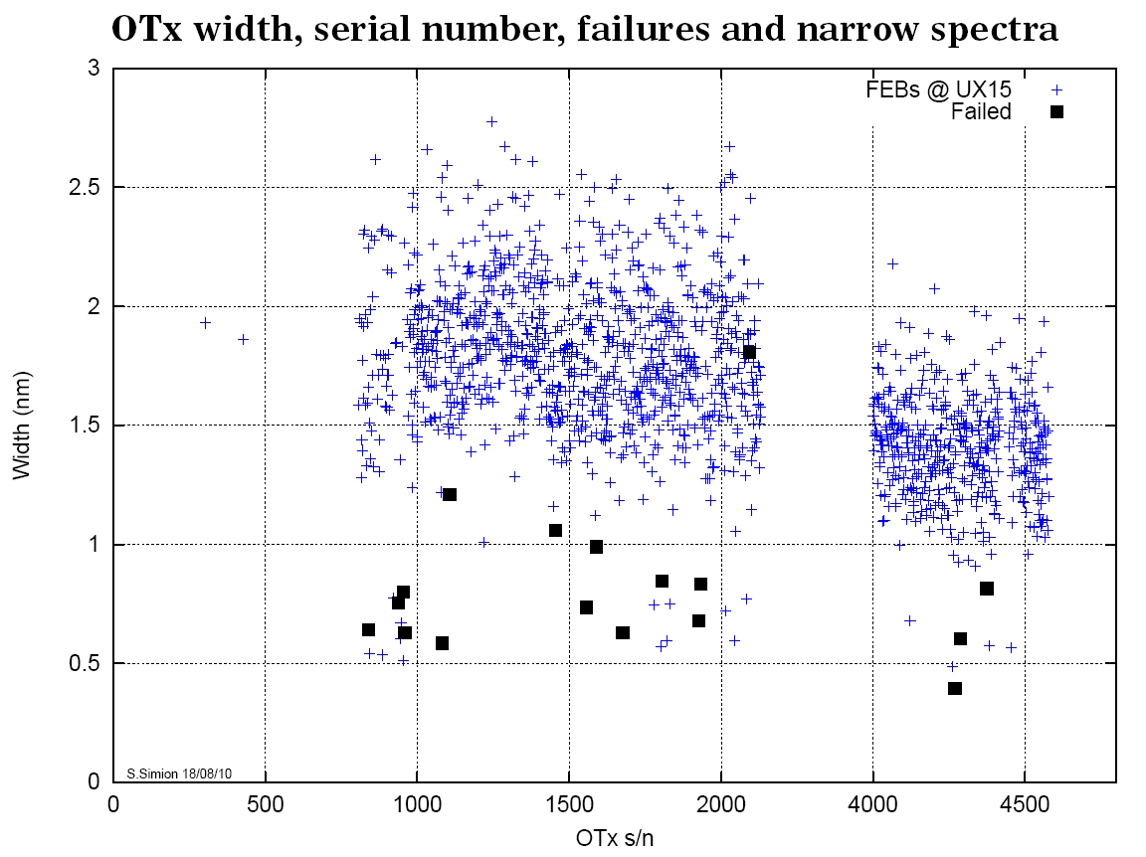
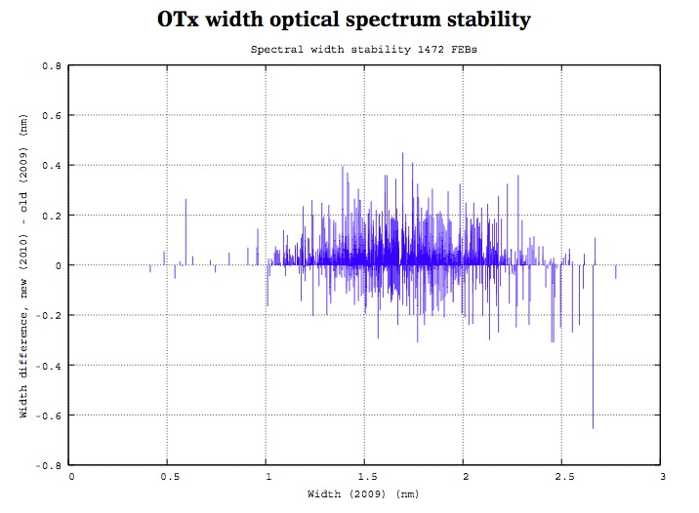
Optical Spectrum stability
The optical spectrum seems effective at predicting which OTX is likely to fail.
All optical spectra at the end of fibers have been measured three times (2009/7, 2009/10, 2010/2). Optical spectrum seems stable.
Width diff (2010/2 – 2009/7) (nm)
Width (nm)
OTX serial number
Width in 2009/7 (nm)
Optical link off on July 13, 2010
we suspect it is not the VCSEL but other component in the FEB/OTX, but we cannot know for sure until we get the board out

Slide 12
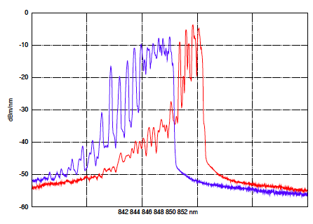
LArg VCSEL failures
Failure rising started in 2008.
Changed I-V curve for death lasers has been observed.
Used optical spectrum measurements for indicating damaged lasers → Exchange them.
From investigation of the VCSEL surfaces (EL, TEM, …):
  Hint that the failed VCSELs had a processing defect (irregular growth of oxide aperture → stress in the active region?).
  Attempts to trace the propagation of the defect from the oxide aperture down to the active region were not successful until now.

Slide 13
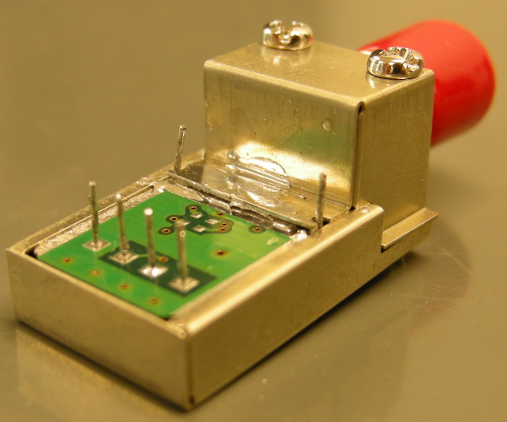
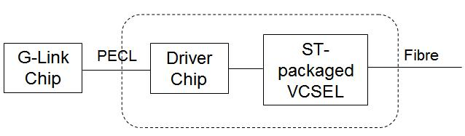
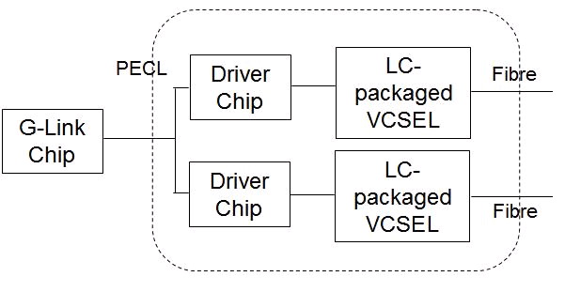
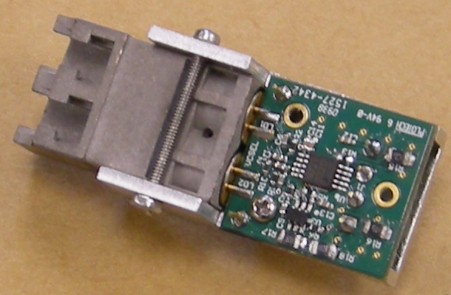
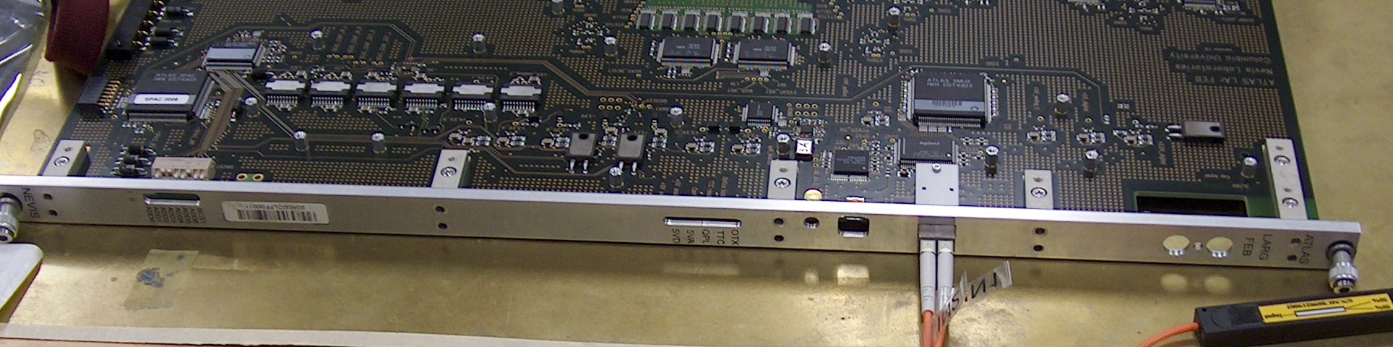
Replacement: Redundancy
The present OTX:
present
The proposed dual-VCSEL OTX:
T. Liu (SMU)
Plan B2

Slide 14
Lessons learned
In the R&D phase
  No system specification was studied in the beginning of R&D. In particular, no jitter requirement on the reference clock was realized until an issue occurred.
  The importance of redundancy was not realized in the R&D. A dual channel redundancy scheme was developed in R&D, but declined in the final implementation due to the cost.
In the integration phase
  All components of optical links were soldered on FEB or ROD boards. The replacement of OTX may damage a whole FEB. A pluggable module containing OTX or a mezzanine board containing an optical link will definitely help.
In the production and quality assurance phase
  We spent a lot of time to learn the OTX burn-in process.
  We performed a reliability test on OTX, but the total device hours were too small to catch the VCSEL failure.
T. Liu (SMU)

Slide 15
SCT & Pixel Optical Links

Slide 16
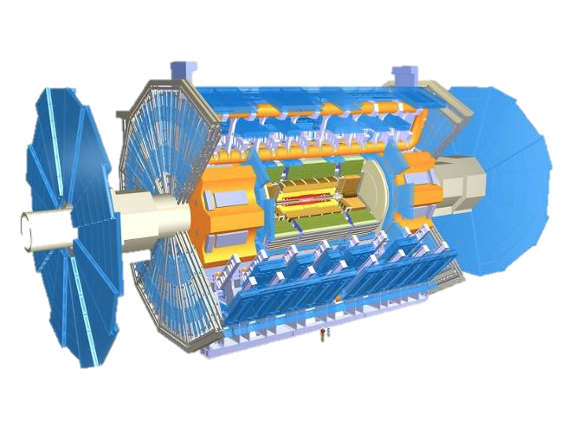
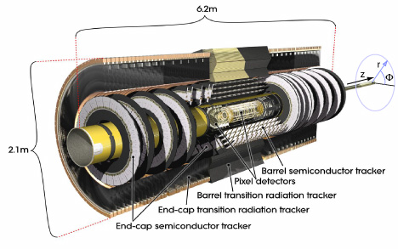
Silicon Detector Links
SCT:
  6*10⁶ channels grouped in modules
  4088 modules each with 1 control and 2 readout links
  each link has a single VCSEL/Pin diode on-detector connected to a 12-way array off-detector connected with 70m optical fibres (12-way)
Pixel:
  8*10⁷ channels grouped in modules
  1744 modules each with 1 control and 1(2) data links
  8-way arrays used on- and off-detector connected with 75m of optical fibres (8-way ribbons)

Slide 17
ATLAS Silicon Detector Links
Combined development of SCT and Pixel groups
Off-detector hardware the same, fibers similar, on-detector different
Used modularity differs slightly
Transmission using 850 nm VCSELs via multi mode(MM) fibers
Speed: 40 Mb/s as baseline
  Pixel has 80 Mb/s or 2*80Mb/s bandwidth for some detector parts
Need to bring out data without having the detector dead for too long:
  LV1 decision within 2.5 us.
  Occupancy (driven by strip/pixel size) O(10⁻⁵)
  Bandwidth need to fit the accumulated data

Slide 18
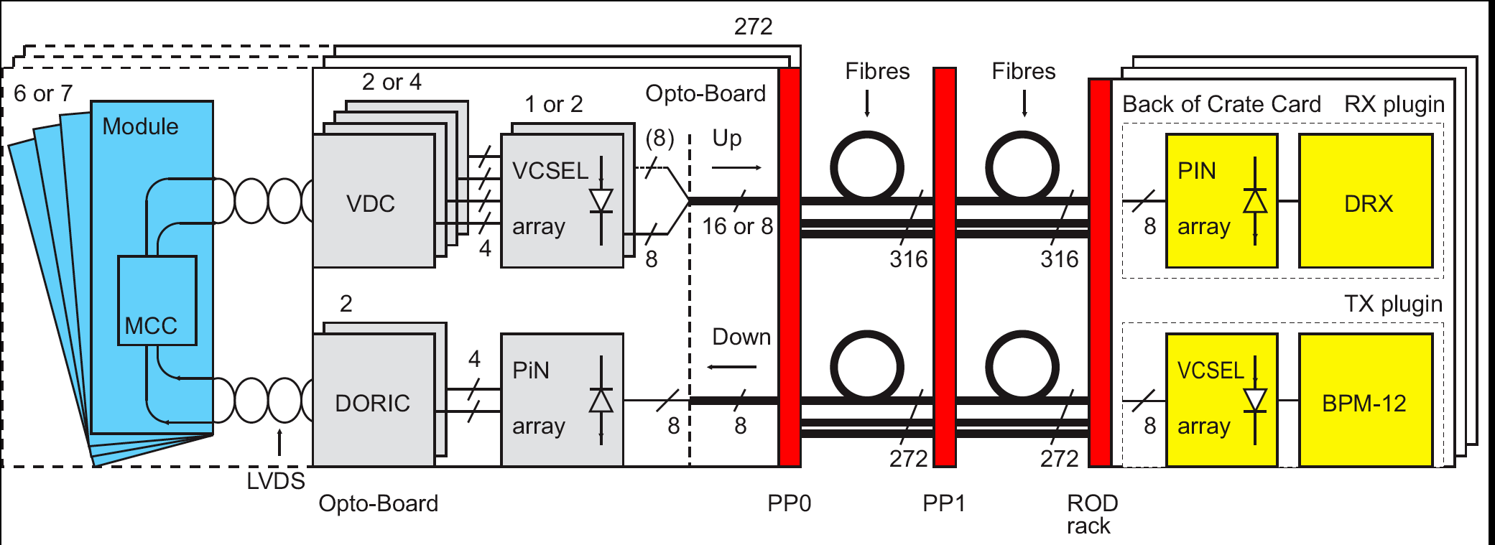
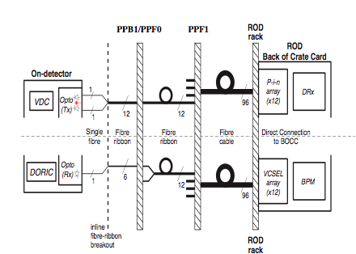
Optical Link for the ATLAS SCT and Pixel Detektor
Pixel
SCT

Slide 19
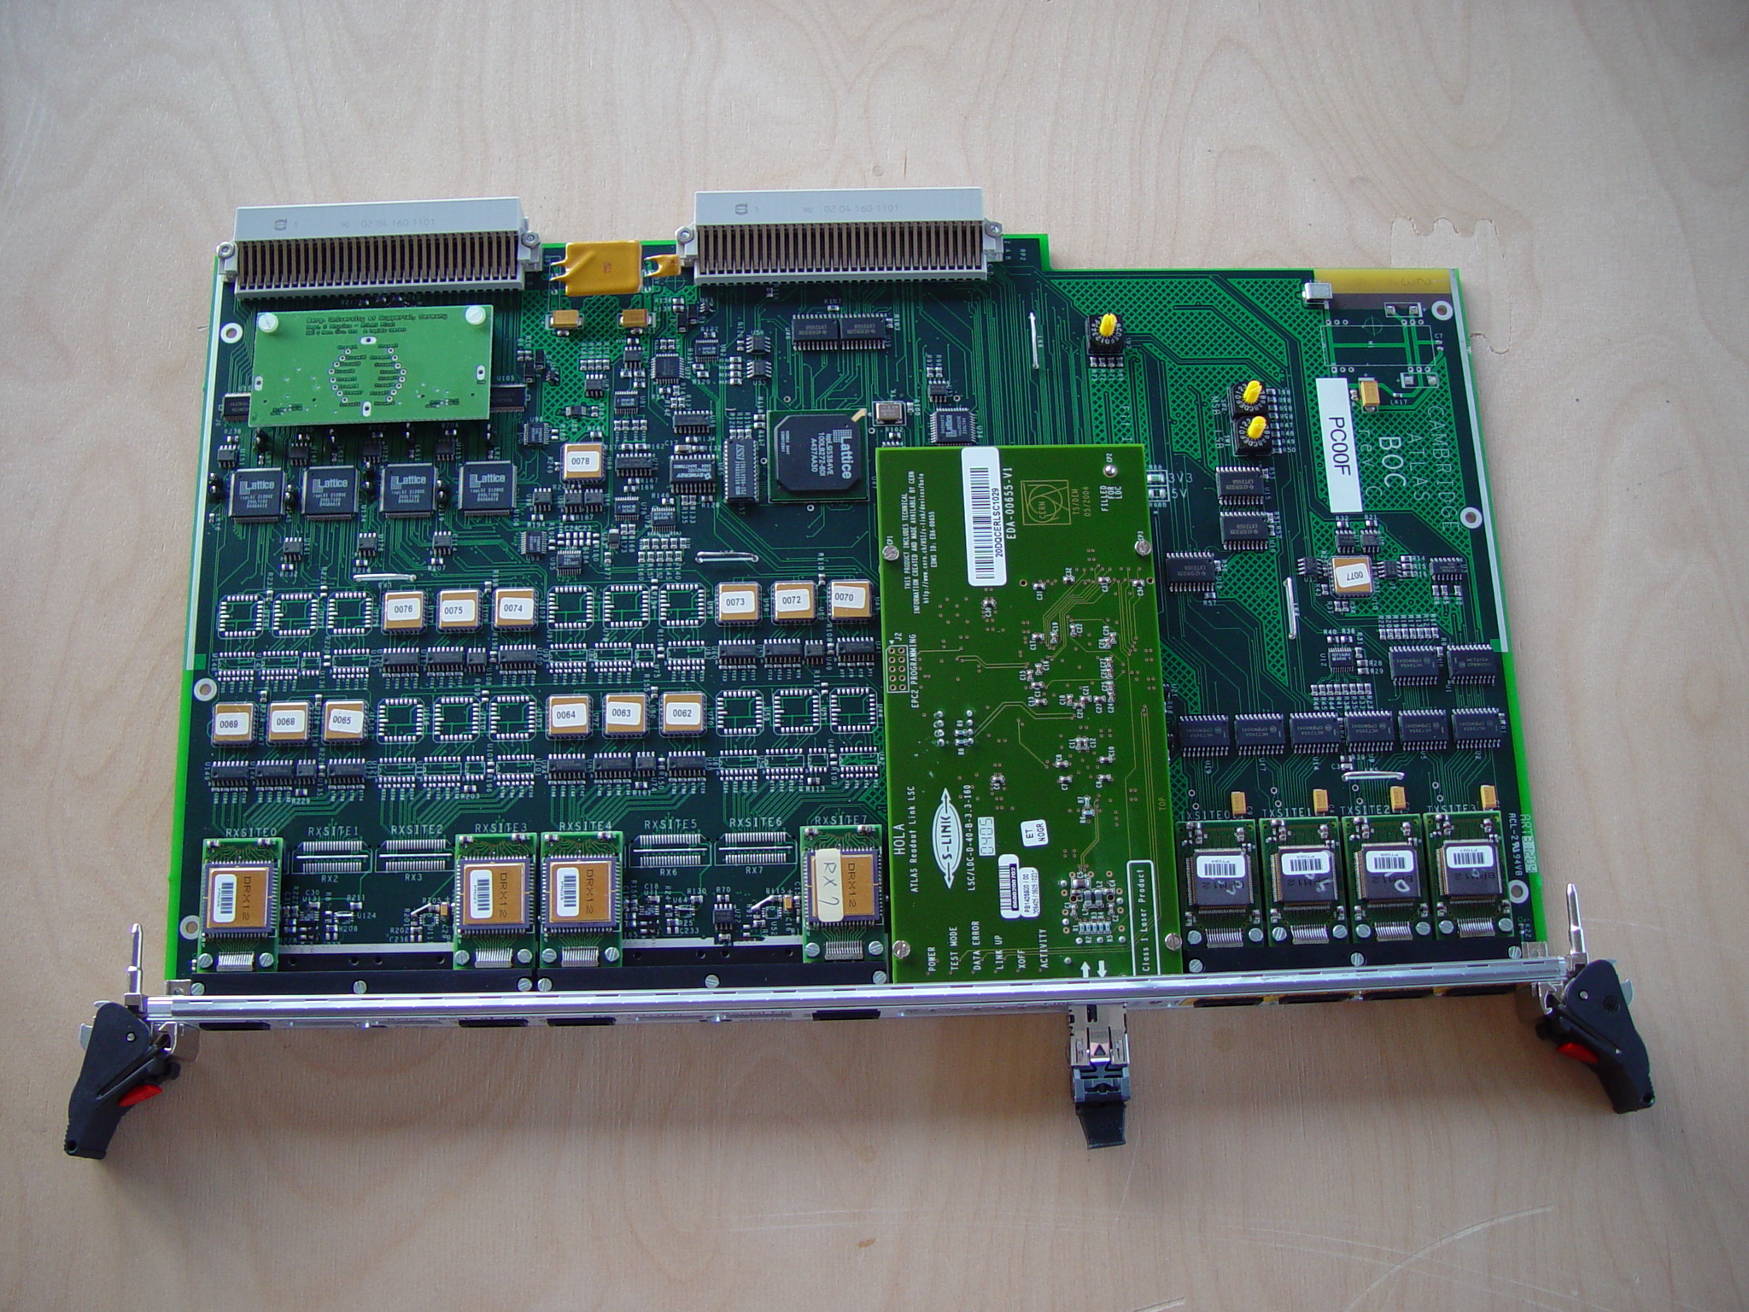
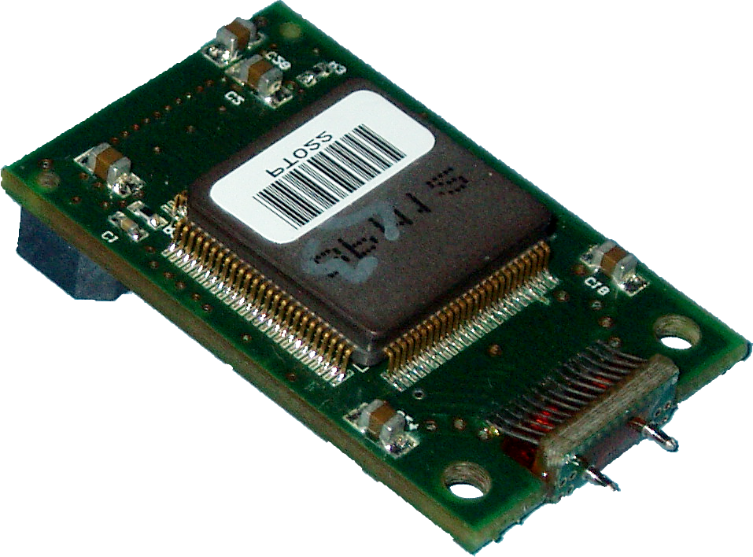
Off-Detector Hardware (SCT&Pixel)
Off-detector optical interface: Pixel Back of Crate Card
Optical component:
Tx-Plugin
BPM
Chip
2x3cm²
9U VME card
VCSEL array

Slide 20
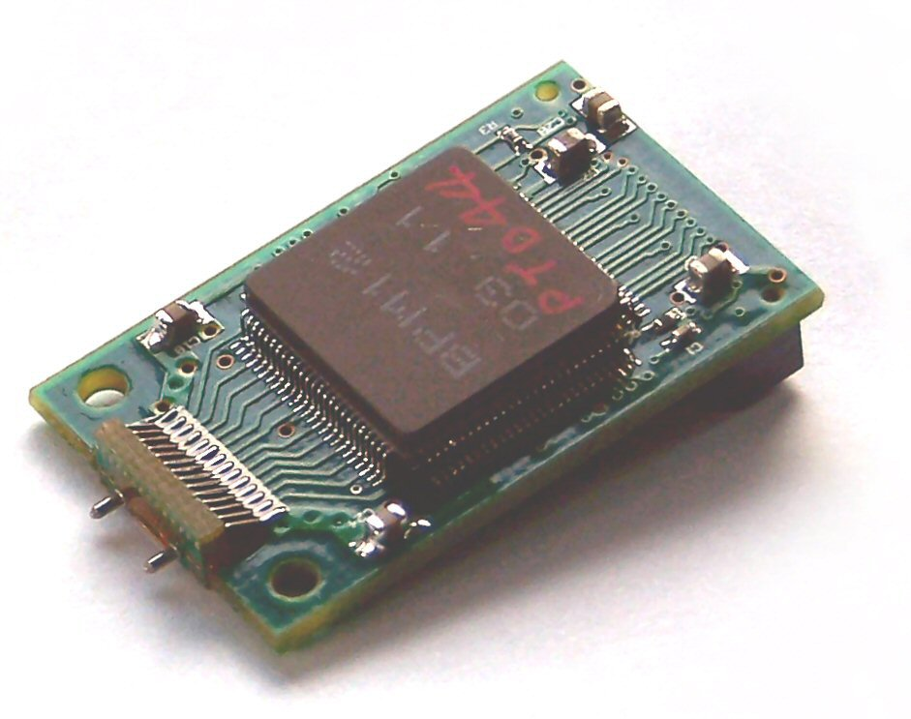
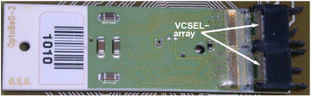
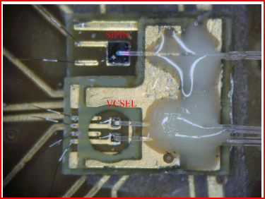
Link Structure (Pixel and SCT)
Pixel and SCT have a very similar optical link. Off-detector components are the same, on-detector differ.
The off-detector components (Tx Plugins) are equipped with a VCSEL array (12 channels) and a driving chip
The Pixel on-detector components (optoboards) are also array based (8 channels / 2* 8 channels)
SCT on-detector components are single laser based, realized as redundant links.

Slide 21

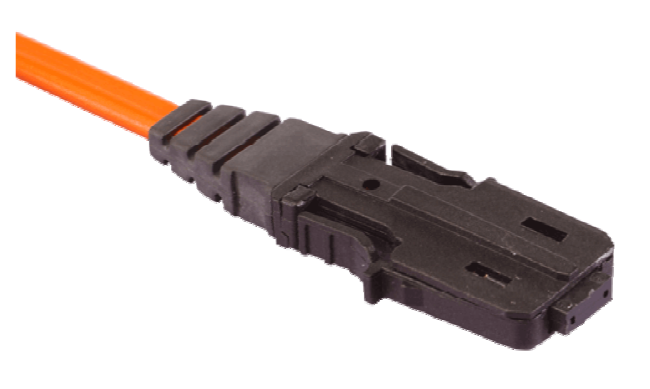
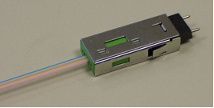
On-Detector Hardware and Fibers (Pixel)
2x6 cm²
1-2 VCSEL arrays
1 PiN diode array
(on backside)
Pixel detector optoboard
Optoboard as on-detector optical interface serves 6 or 7 modules
Pixel fiber connection always with 8 way ribbons down- and upwards (SIMM + GRIN)
SCT fiber are 12-way ribbons (SIMM)

Slide 22
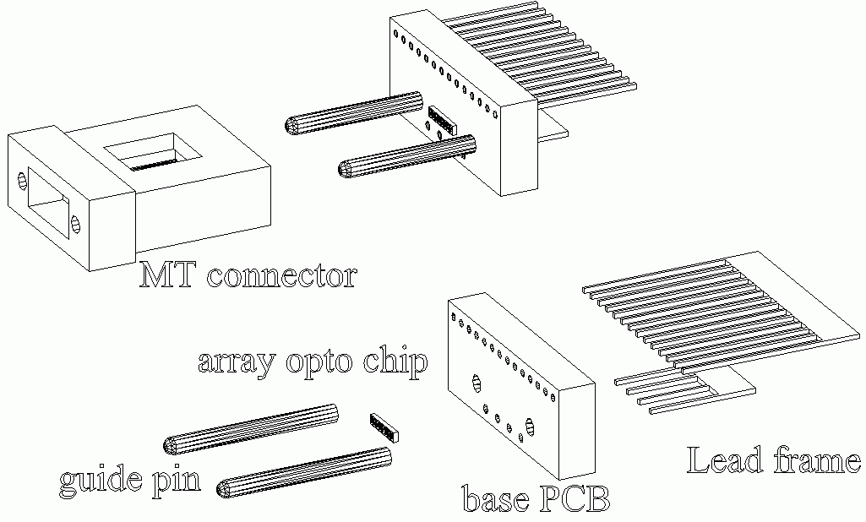
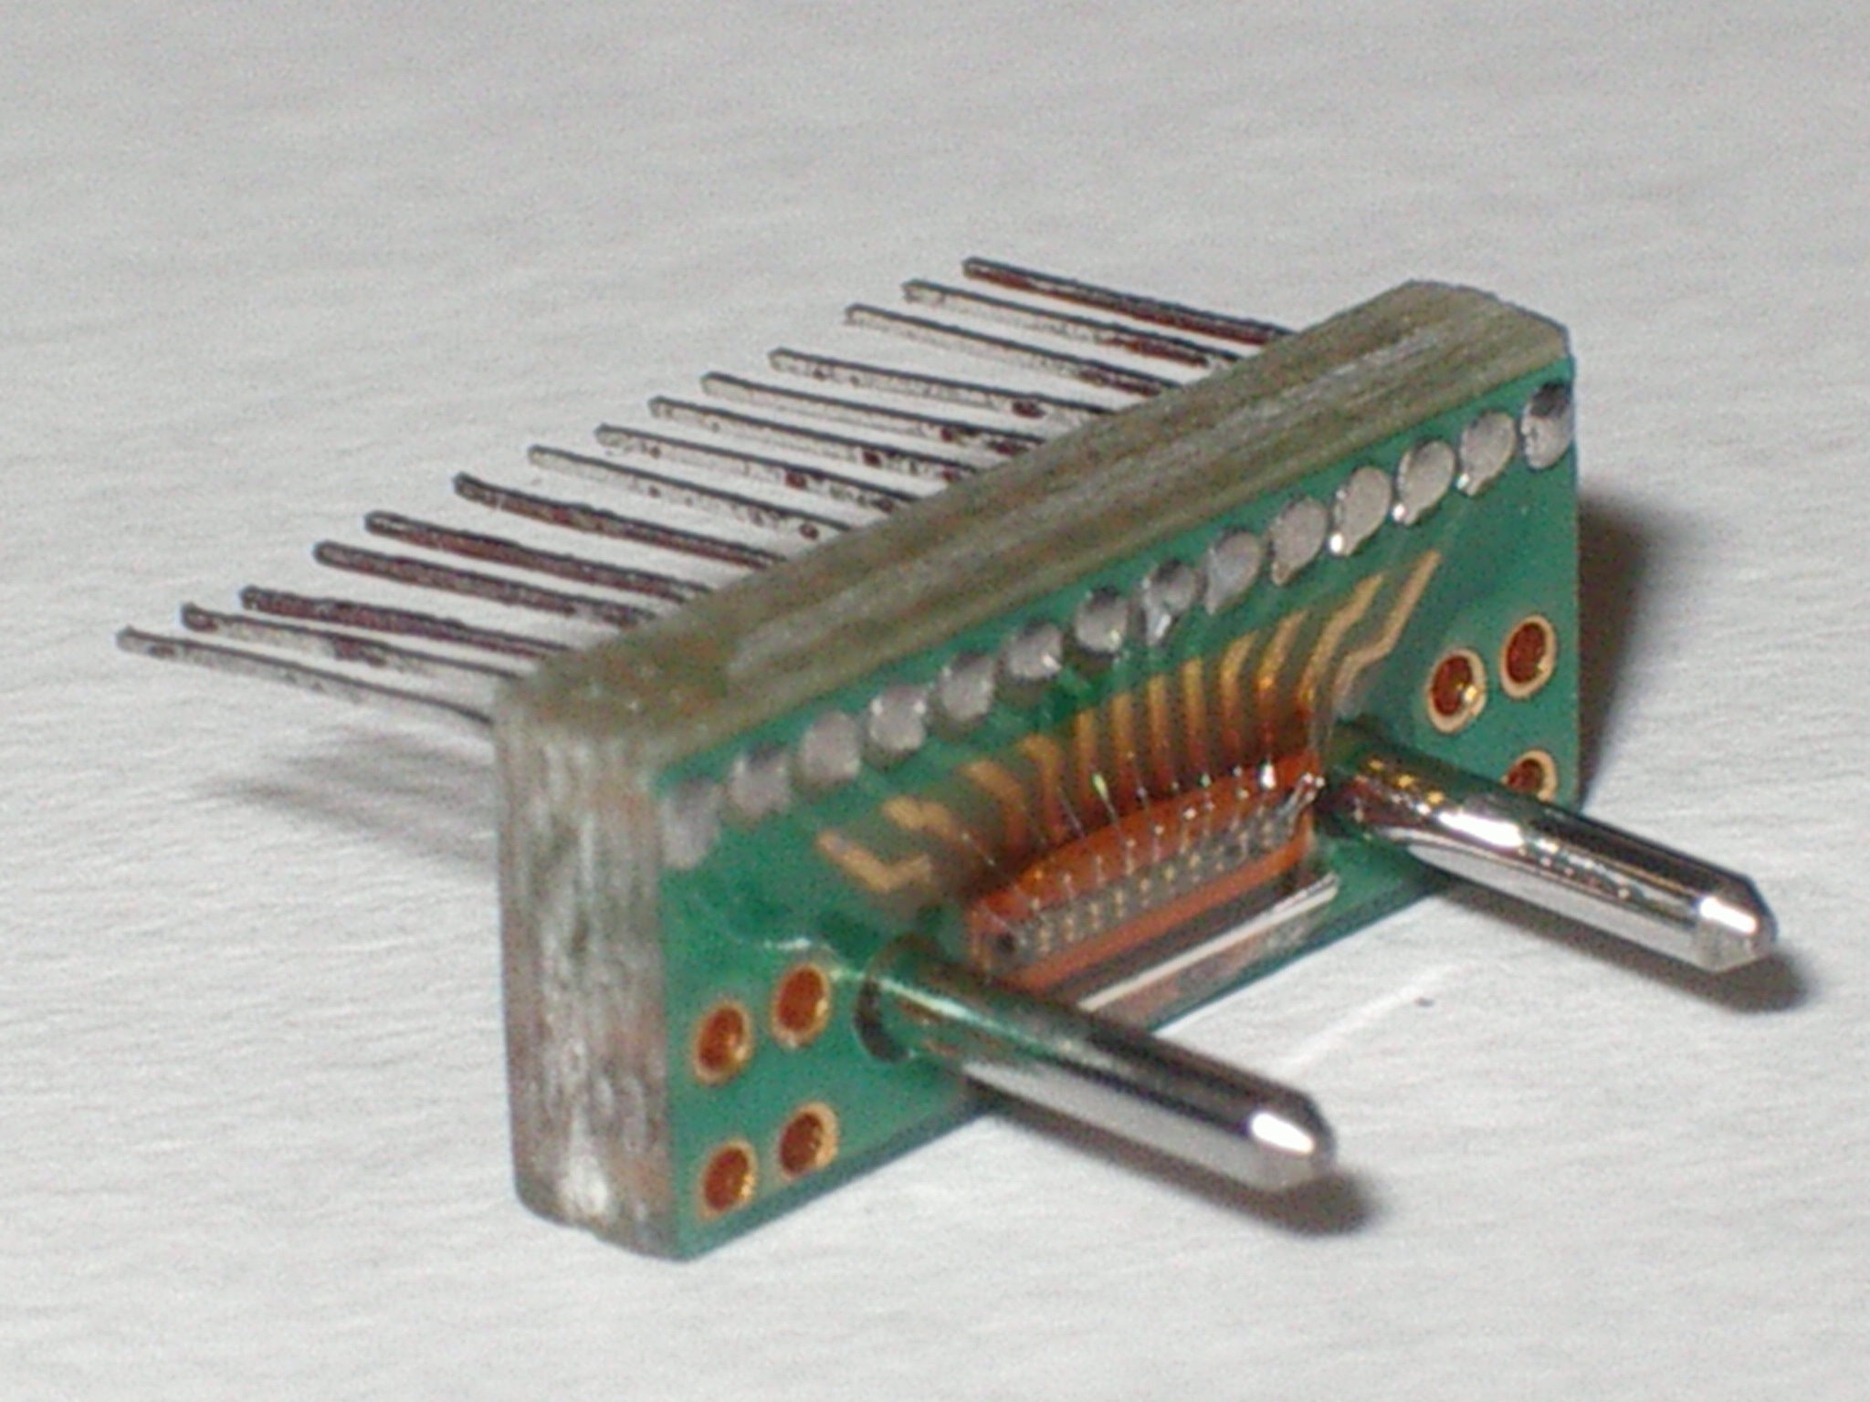
The opto package
Epoxy Epo-Tek 353ND over active surface of VCSEL
Jig used for precision placement of array wrt guide pins ➔ purely passive alignment
MT-connector inside Infineon housing with spring

Slide 23
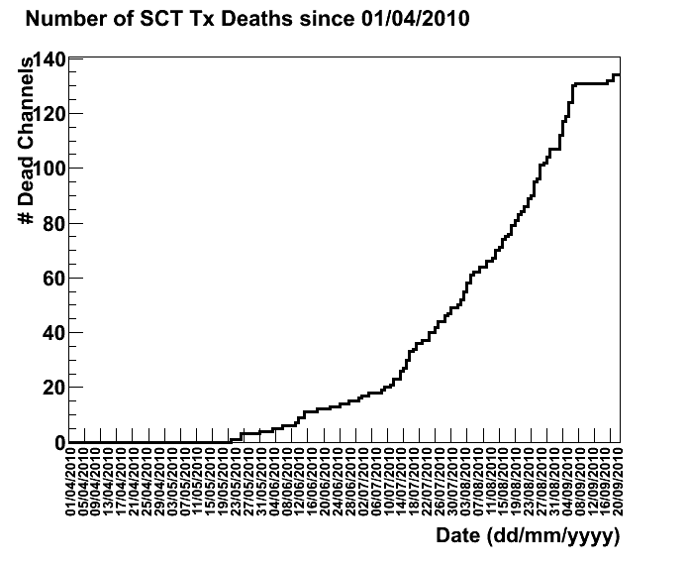
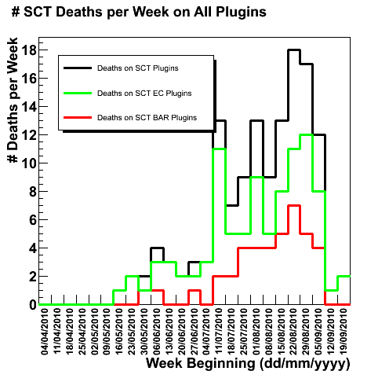
SCT off-detector VCSEL Failure Rates
~135 failed channels
Rate is ~15/week
May 19, 2010
Notes:
Neuer Plot

Slide 24
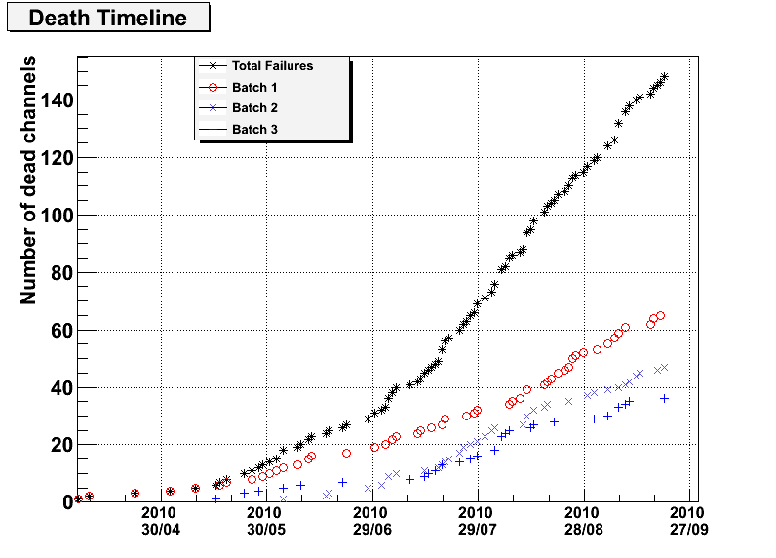
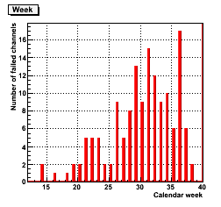
Pixel off-detector VCSEL Failure Rates
~145 failed channels
Rate is ~13/week
April 08, 2010
Notes:
Neuer Plot

Slide 25

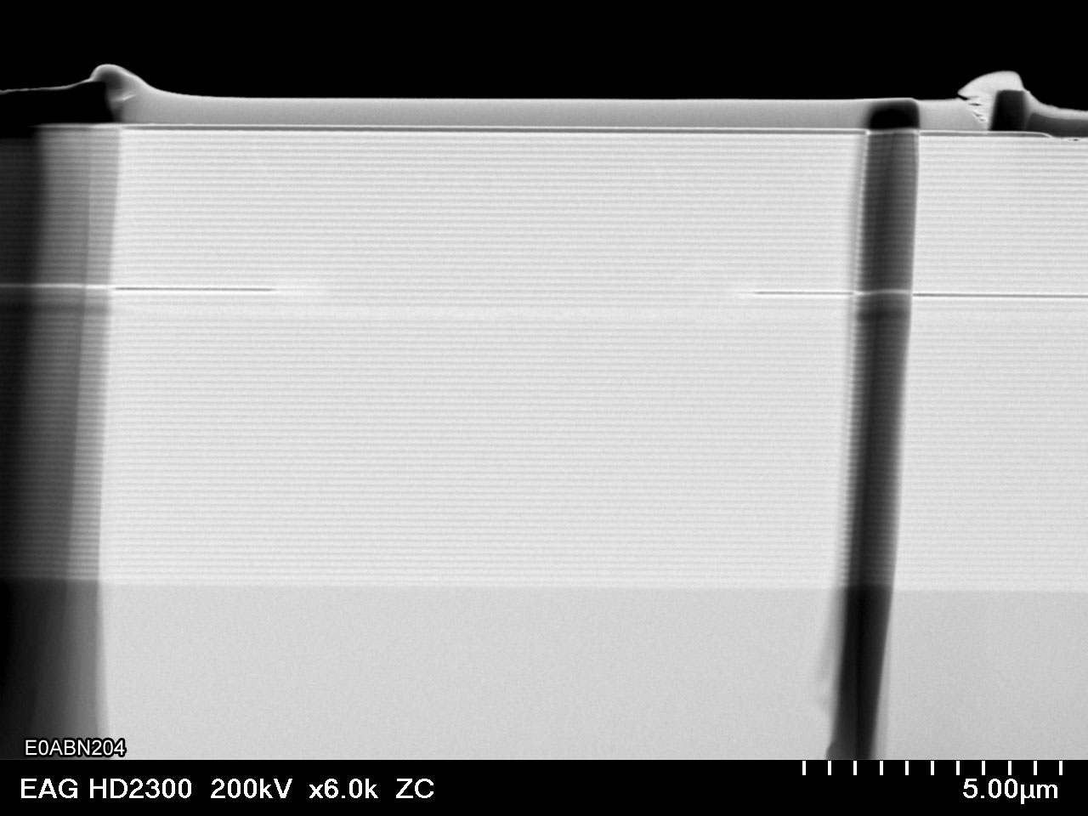
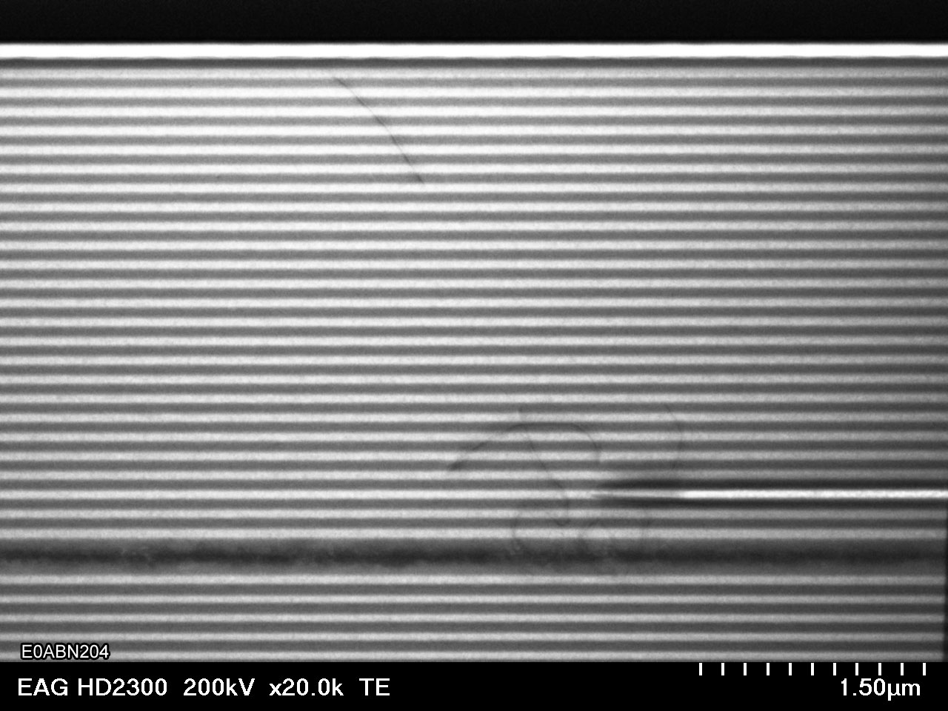
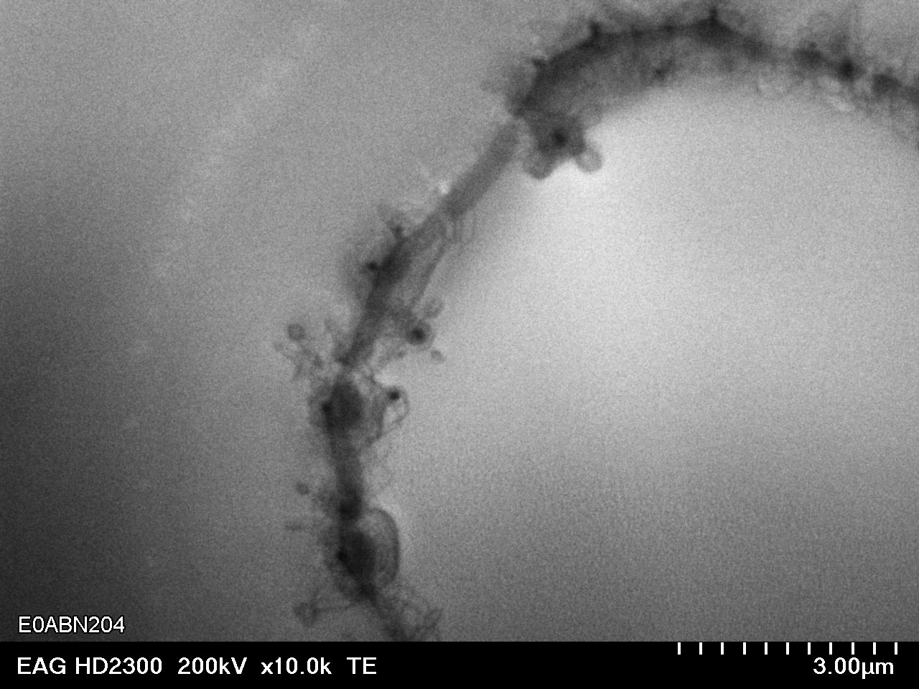
Failure investigation
Off-detector lasers fail, exchange possible
and being done
Failure reason not yet clear completely
  Indication by spectrum measurement if lasers are affected
  (narrowing)
  Laser Bulk investigations show defects inside the bulk and the aperture opening →kind of short?
  Most likely reason today is humidity, VCSELs covers by epoxy which seesm to seak humidity
50 μm

Slide 26
Phase I Upgrade

Slide 27
New innermost layer for Pixel
Insertable B-Layer (IBL) will be installed (most likely) in 2013. Gives higher physics performance and spatial precision.
Additional 448 chips holding 1.2*106 pixel channels
Closer to the beam pipe (33 mm instead of 55 mm)
Smaller pixel size to avoid too high occupancy
Read out per chip at 160 Mb/s, 8b/10b encoded
Optical components to be placed outside the pixel detector volume → needs electrical transmission on the first 6-8 m. But cables need to be as light as possible

Slide 28
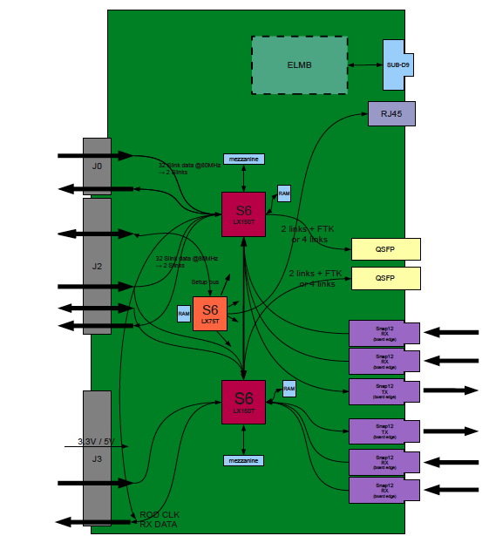
New Off-detector hardware
A new design of the off-detector optical interface needs to be done to account for transmission bandwidths and clock speeds
Commercial components usable (counting room installation), design and layout on the way
Implement monitoring capabilities for the data stream to be able to error check
Uplink needs most action: sample threshold adjustment, phase adjustment, error checking

Slide 29
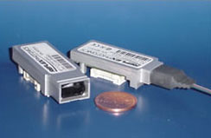
New optical components
Several investigations ongoing.
Humidity issue need to be investigated
Off-detector components off the shelf possible(?)
  Testing SNAP12 devices
  Investigating different lasers and manifacturors
On-detector components not yet clear too.
Are the existing ones still save due to dry environment?
Different lasers under study
New laser packaging under
investigation

Slide 30
Towards High Lumi LHC

Slide 31
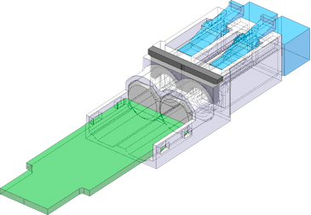
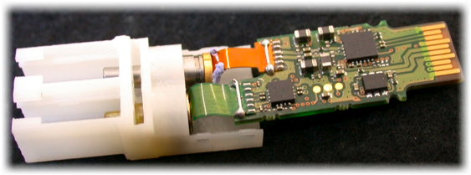
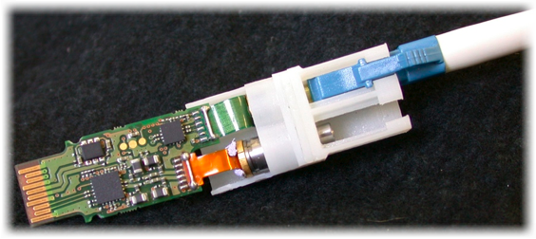
VCSEL packaging
In context of the ATLAS/CMS versatile link project a test stand for measuring the thermal resistance of VCSEL packages is set up
Radiation destruction and heating up the device effect the light power output in nearly equal parts
Since radiation damage can not be prevented, the heat coupling can be optimized
Determine internal thermal resistance of a laser device by measuring the shift of the optical spectrum in dependence of temperature

Slide 32
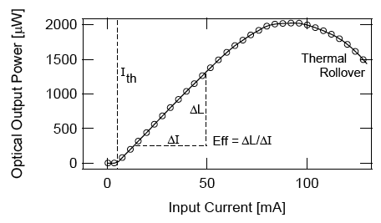
Thermal Rollover
Heating of the VCSEL through introduced power (current)
The measured optical power drops down at a certain power value
→ thermal rollover
Solution: Get the heat out
M. Axer, Jülich

Slide 33
Plans
Giga Bit Transceiver (GBT) under development at CERN is a good candidate for ATLAS optical link drivers for HL LHC
The versatile link project is developing a radiation hard optical link to be used with 3.6 Gb/s plus bandwidth for error checking etc.
  For ongoing R&D work see Tonys talk tomorrow
This is not enough for a track trigger using the tracker‘s data
Different strategies have to be implemented to achieve this (on-detector presampling or –computing of data, special hit data, ...)

Slide 34
Conclusion
The experience of the ATLAS data transmission shows a nice performance in all subdetectors.
The links basically work, but we have observed lifetime issues on some off-detector components so far.
To provide a working link in the future detector setups careful R&D on laser components need to be done:
  Humidity stability
  Radiation hardness (up to 200 Mrad)
  Size / Mass as low as possible
  Power consumption
  Optical power output and bandwidth

Slide 35
Backup

Slide 36
Thermal Properties
Thermal resistance:
Measurement of the change in wavelength depending on the temperature or on the input power determines resistance:
For a know temperature dependance:

Slide 37
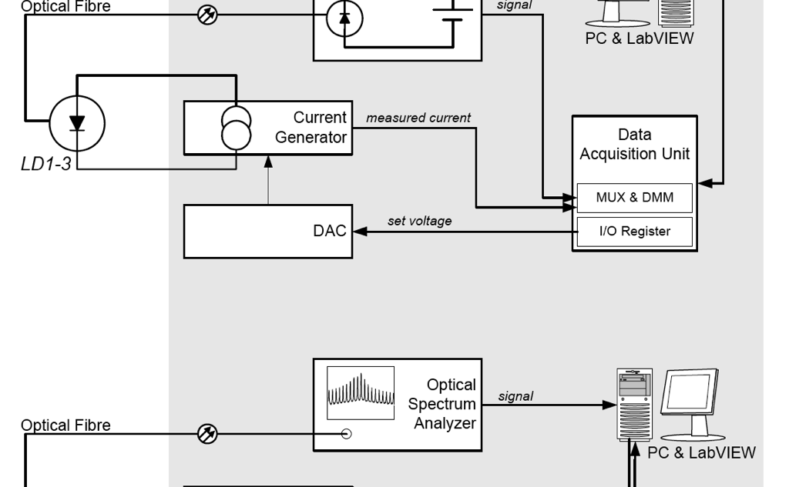
How we want to measure
From:
M. Axer et al: First High Fluence Irradiation Tests of Lasers for Upgraded CMS at SLHC

Slide 38
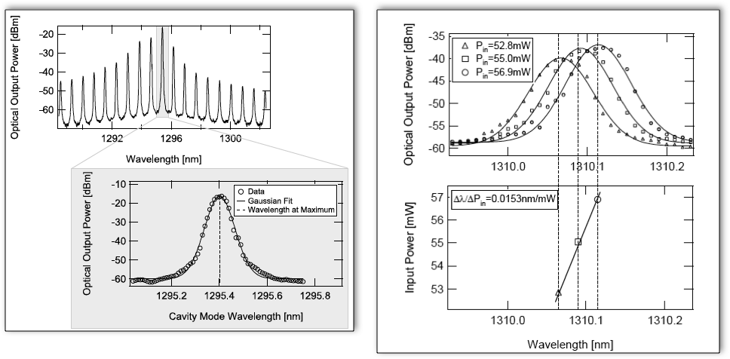
Measurements at CERN
From:
M. Axer et al: First High Fluence Irradiation Tests of Lasers for Upgraded CMS at SLHC

