Slide 1
ARES Operation Meeting
Summary of week 07 / 2023
Frank Mayet, on behalf of the ARES crew

Slide 2
Summary of week 07
Mon. 13th February | Tue. 14th February | Wed. 15th February | Thu. 16th February | Fri. 17th February
EA DOOCS servers restared and tested (incl. timing setup) | Visit in the morning; restart at 13:40 Triple on-crest, ballistic WP setup Stability measurement over night (position oscillations) | ACHIP Stage 0 WP established with stable 20% transmission; all subsystems tested MDI shift (testing charge-dependent readings on all monitors, especially FC1 vs T-ICT and difference between the two Toroid types) Toroids now calibrated according to the FC1/T-ICT | Stability measurements with the PDE (pointing jitter to momentum jitter transfer) | PDE field measurements in the tunnel (ZZ) Stability measurements with the PDE (pointing jitter to momentum jitter transfer)
 | DIOs could not be switched on; had to be fixed on-site in the tunnel TWS modulators were not supplied with cooling water | Logbook printing | Willi’s image acquisition notebook does not work anymore (Python update?) SL.S1 camera saving distorted images using the camera server panel Logbook printing | Significant position drift at TWS1 +70 deg off-crest and TSW2 -90 deg off-crest
Tunnel open
Achievements
Difficulties
Notes

Slide 3
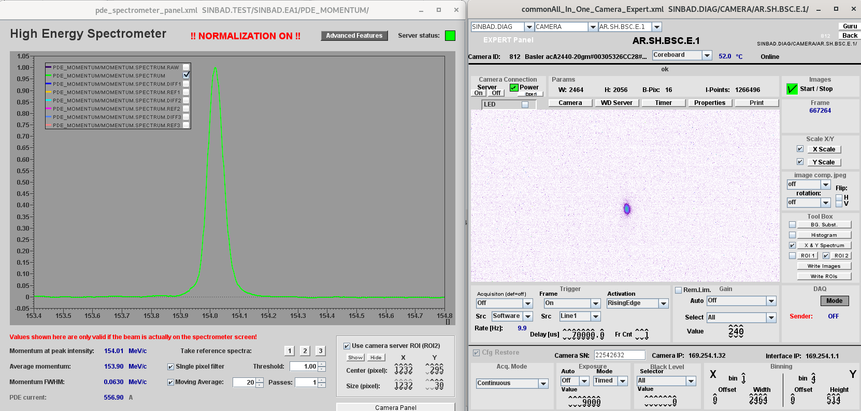
ACHIP – Transmission
~20% Transmission → 110 fC

Slide 4
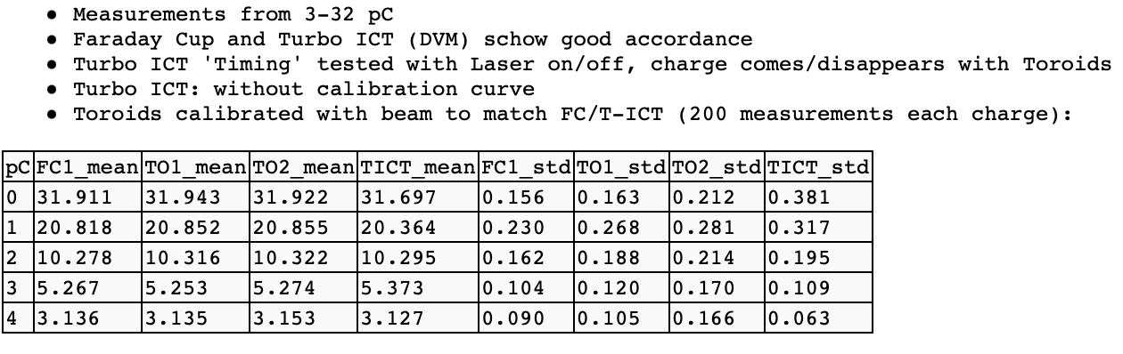
MDI – Charge Monitors – After Calibration

Slide 5
Work in the Tunnel
TDS water cooling
Cathode box removed
MIN cabling
MPC grounding network in the SH region

Slide 6
Schedule
Week 08
Date | Shift Leader
20.02. | -
21.02. | Willi
22.02. | Willi
23.02. | Max
24.02. | Thomas
If you want to learn or join the shift: please give the shift leader a call (BKR 2840 / SINBAD Box 2454)

