Slide 1
Neural network calculation of Energy reconstruction with noise
We will show how we calculated the reconstruction of the Energy spectrum with noise
We will also show the dependence on the physical layers and how the N.N. manages to get nice results with lower and lower number of physical layers
Showing the difference between the results for each case

Slide 2
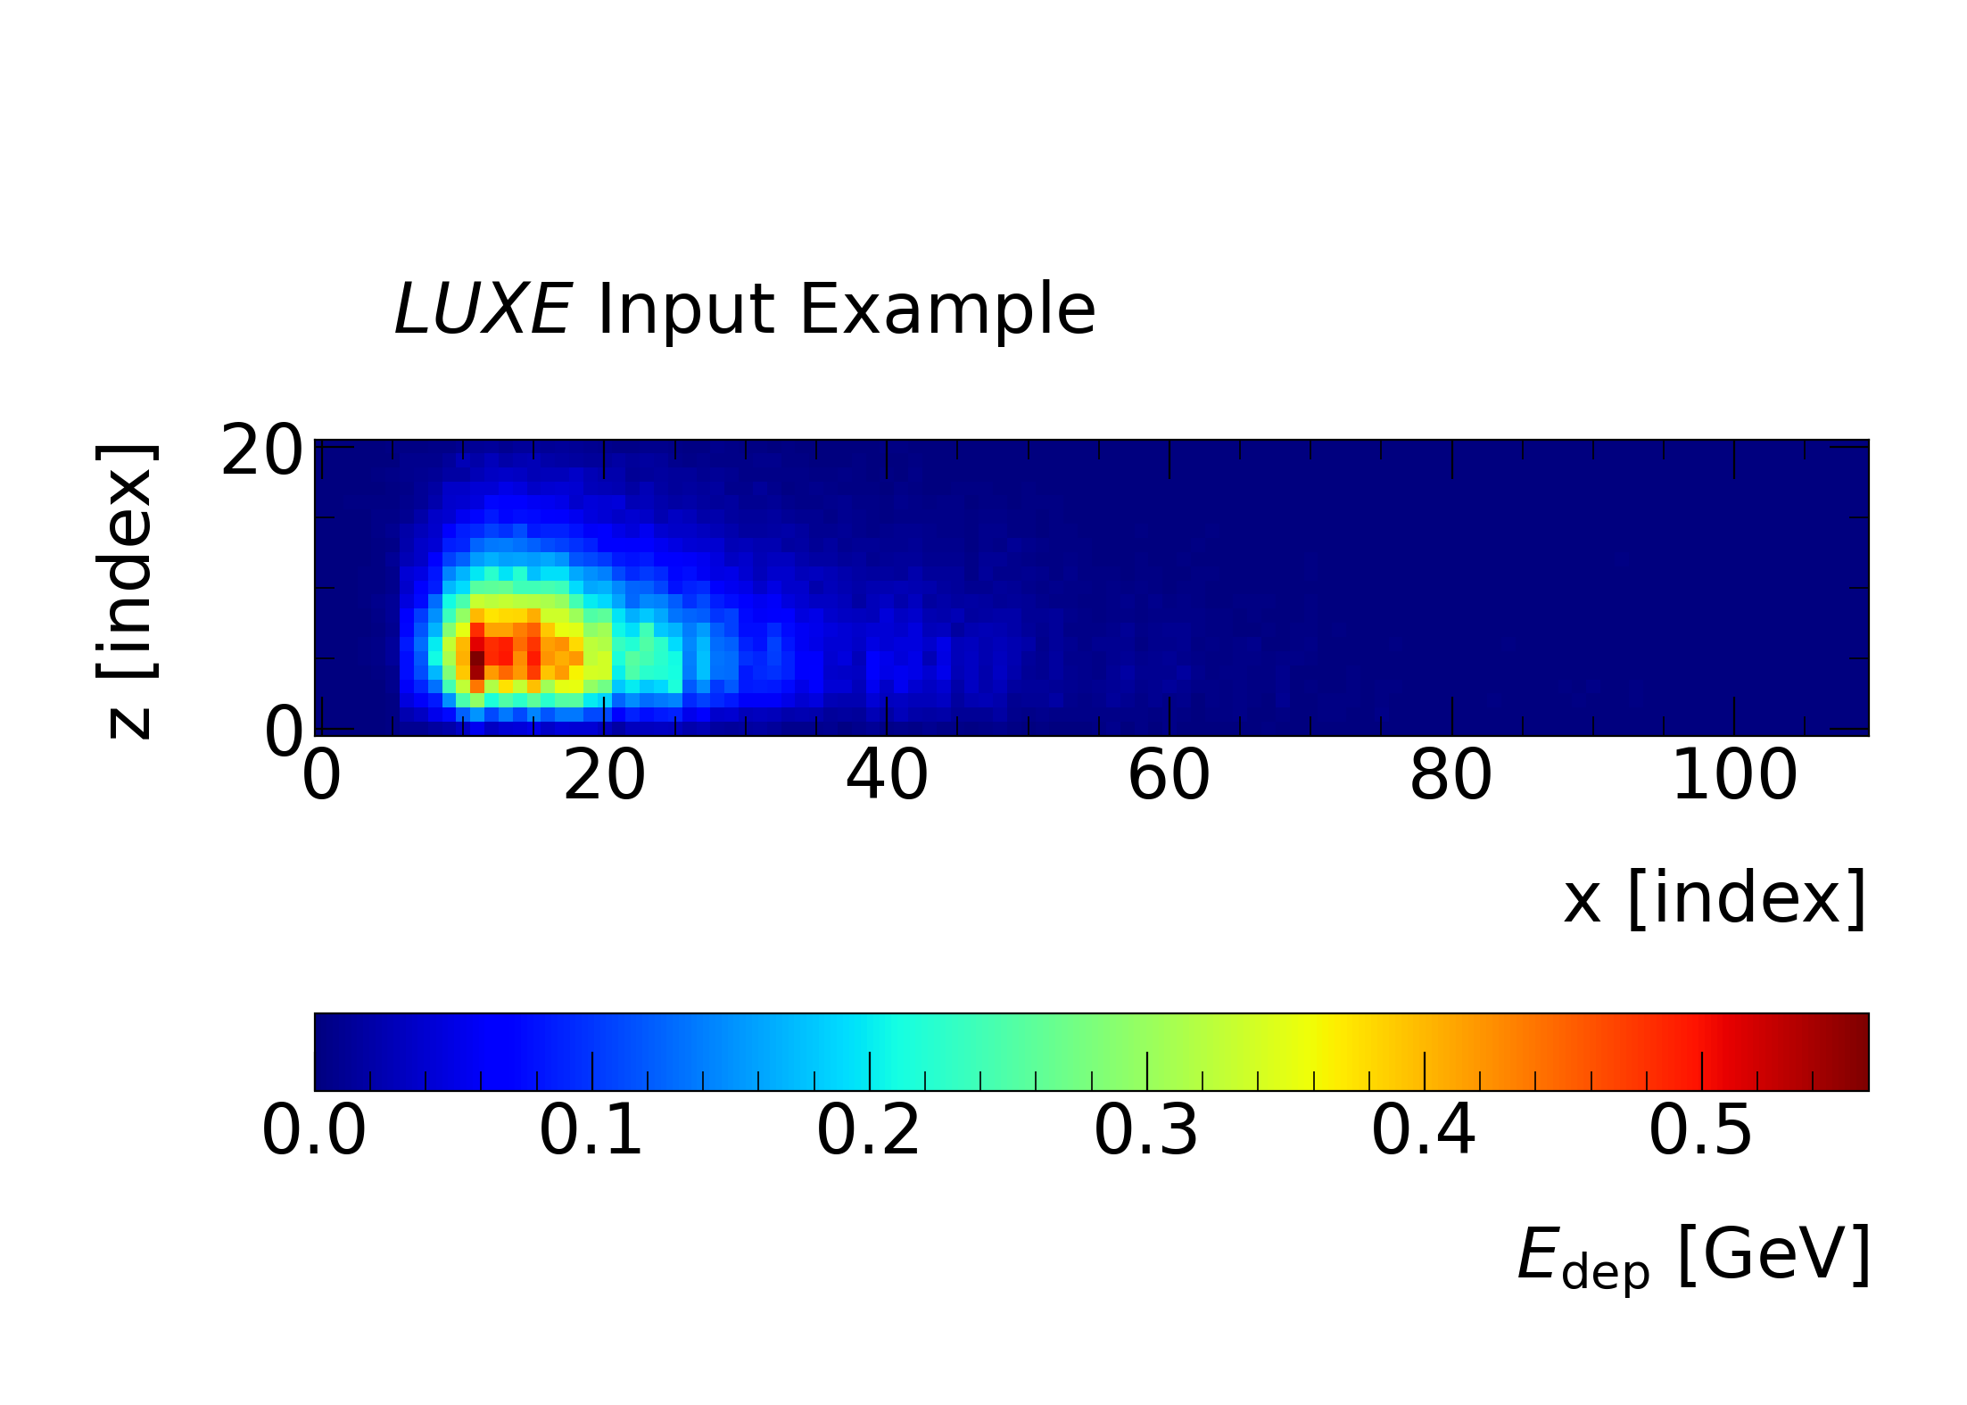

Slide 3
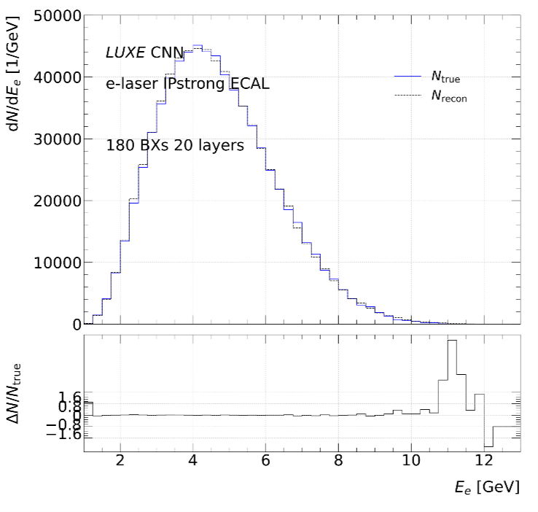
Without Background (WOB) – 20 layers
Showing the histogram of 48 bins of 250[MeV] each for target and output value

Slide 4
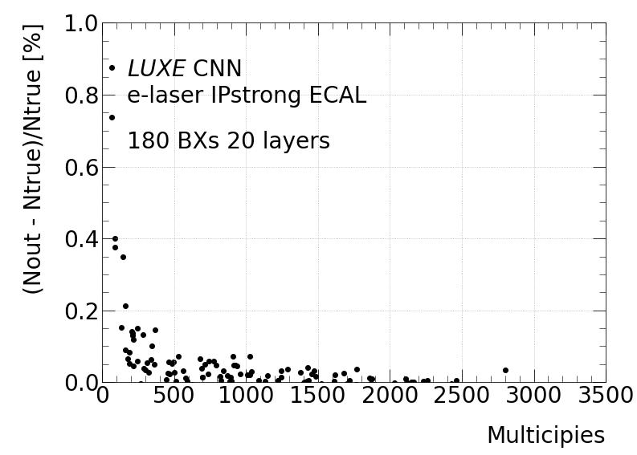
Looking at the error for each multiplicity

Slide 5
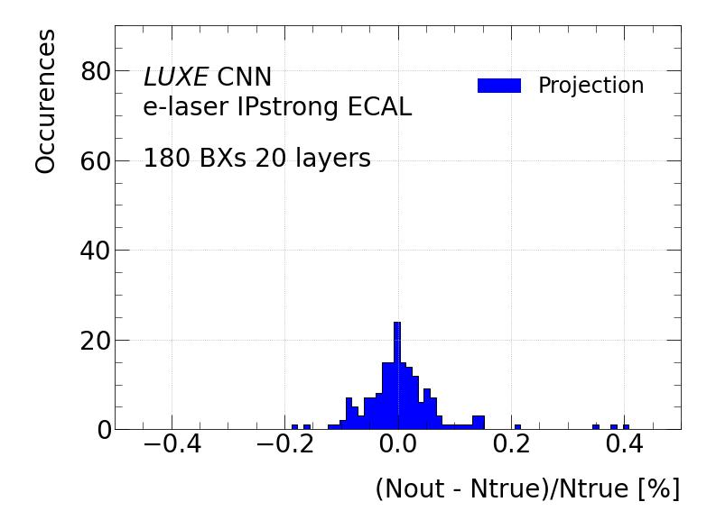
Looking at the projection of the last figure

Slide 6
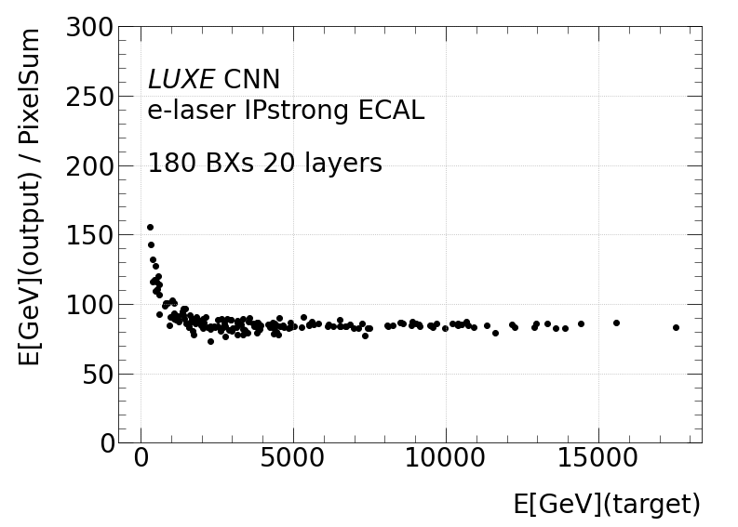

Slide 7
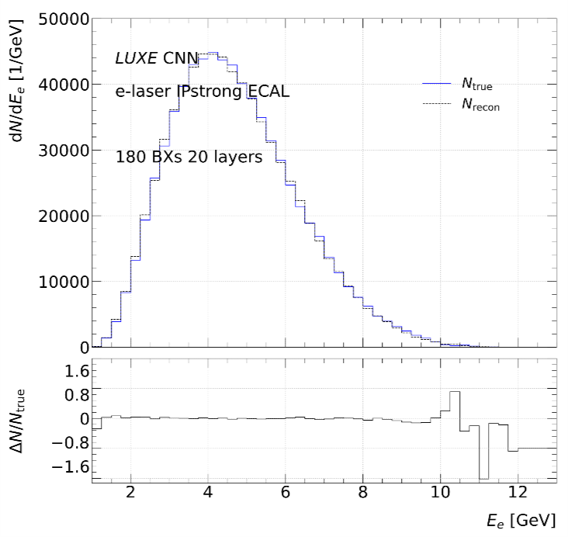
With Background (WB) – 20 layers

Slide 8
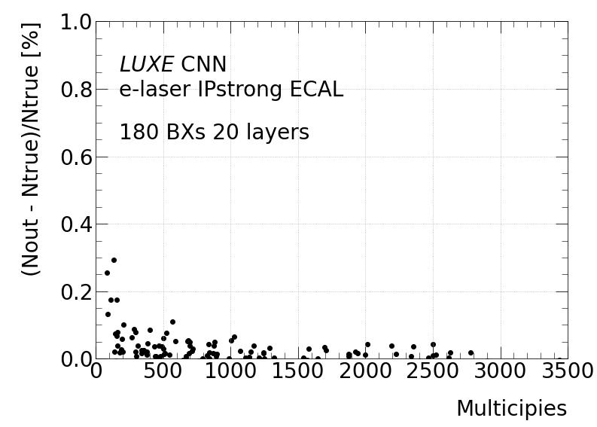

Slide 9
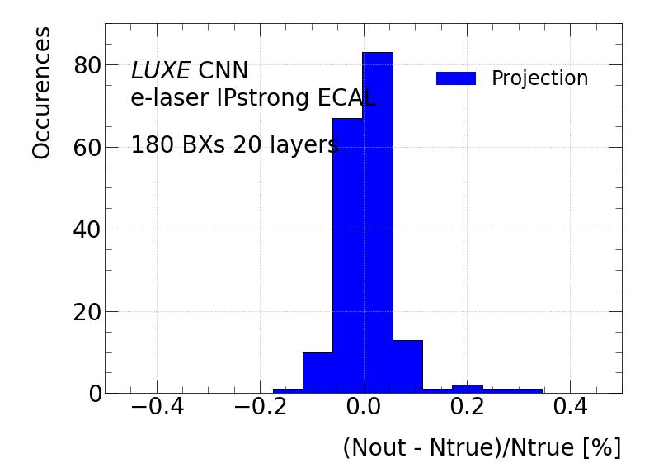

Slide 10
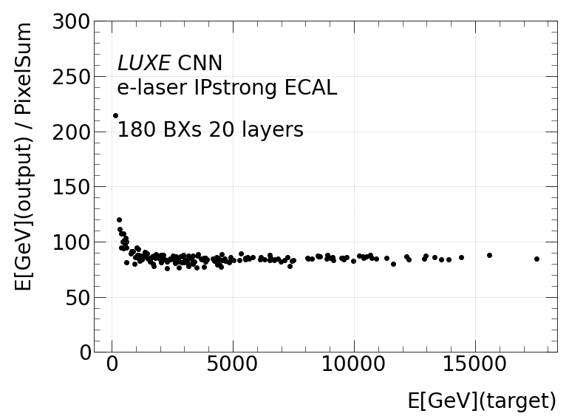

Slide 11
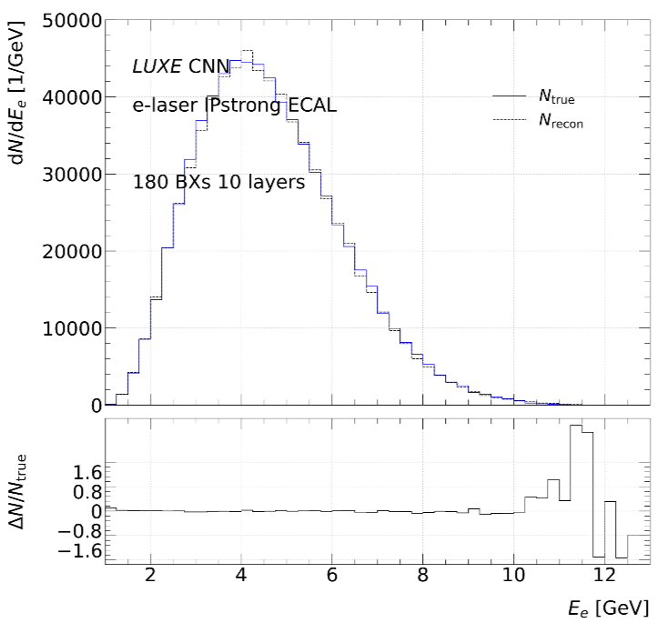
With Background (WB) – 10 layers

Slide 12
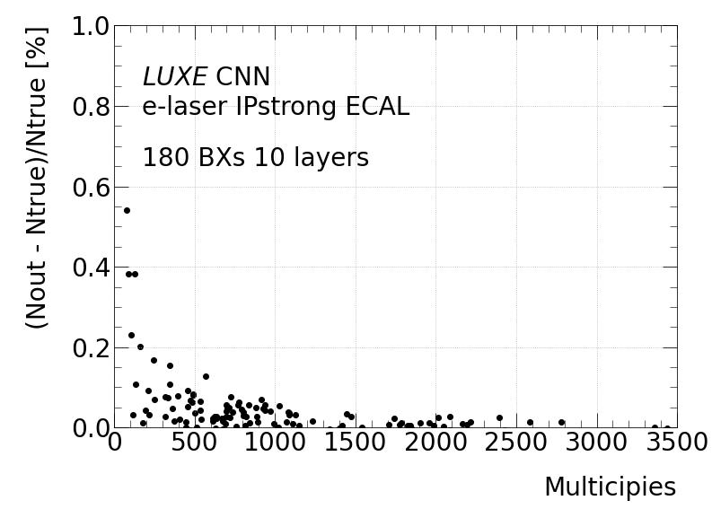

Slide 13
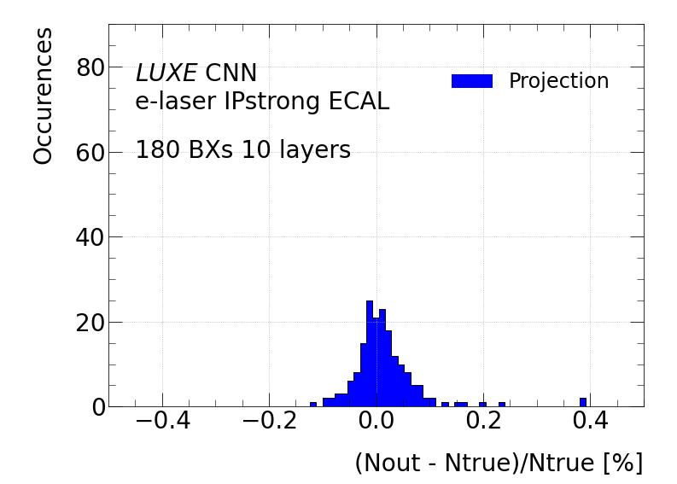

Slide 14


Slide 15
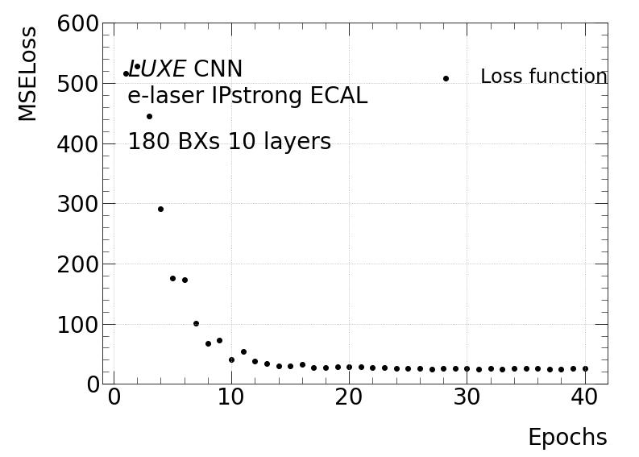

Slide 16
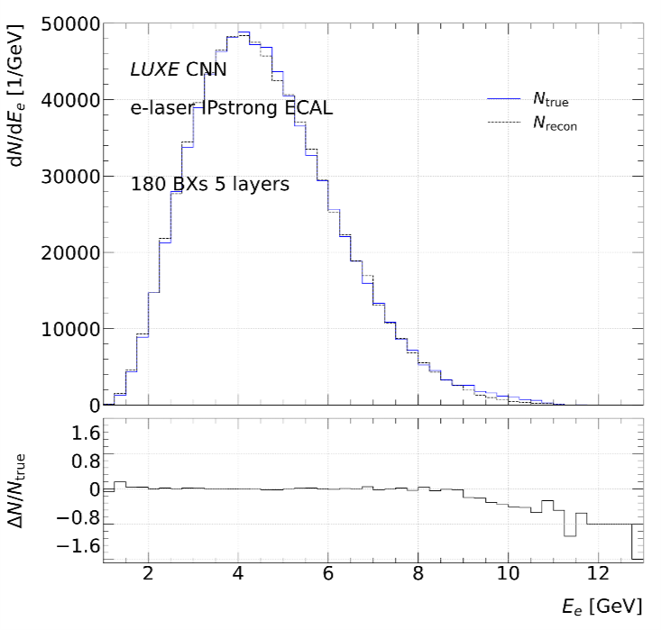
With Background (WB) – 5 layers

Slide 17
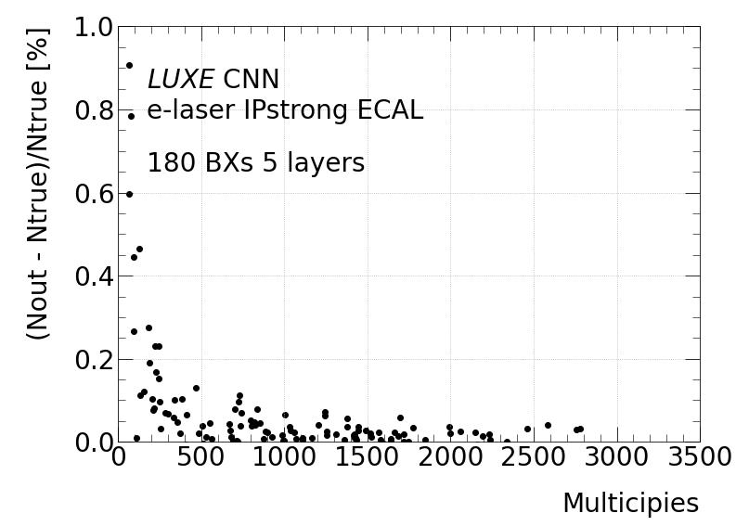

Slide 18
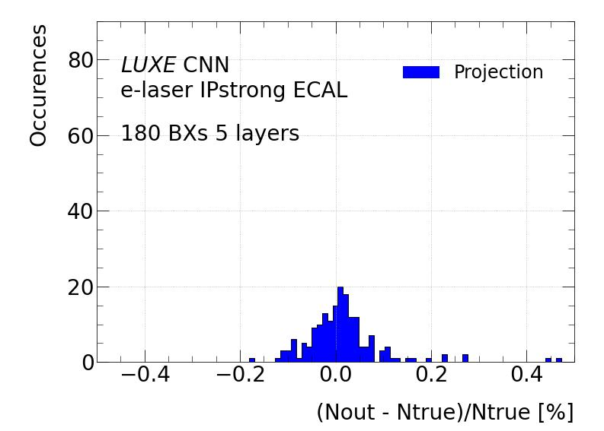

Slide 19
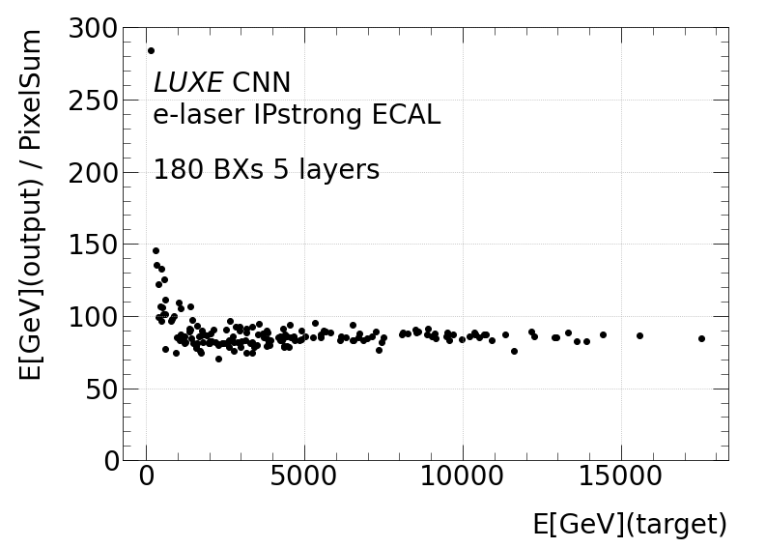

Slide 20
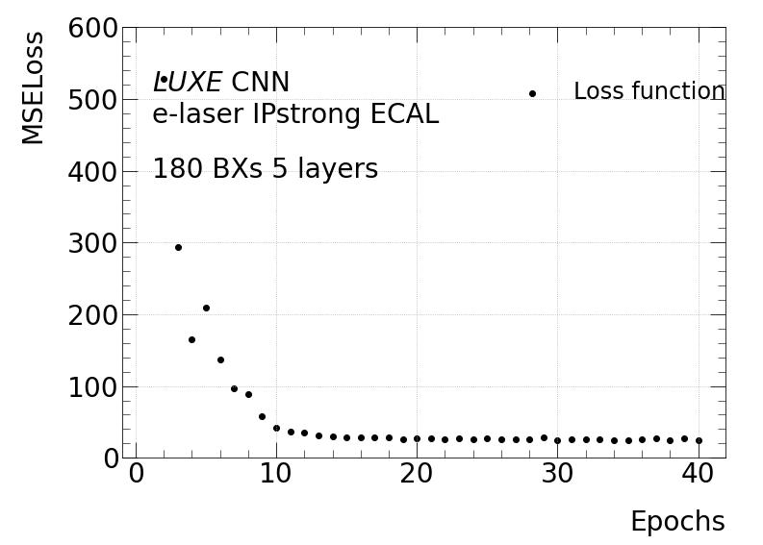

Slide 21
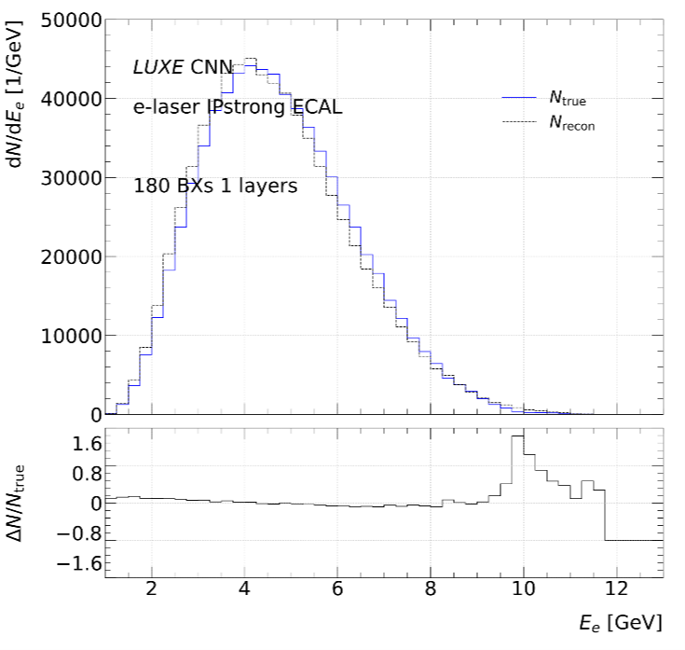
With Background (WB) – 1 layers

Slide 22
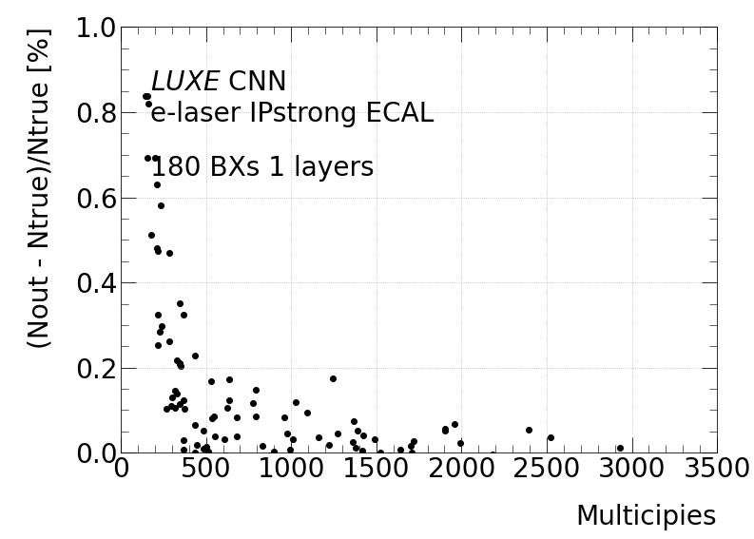

Slide 23
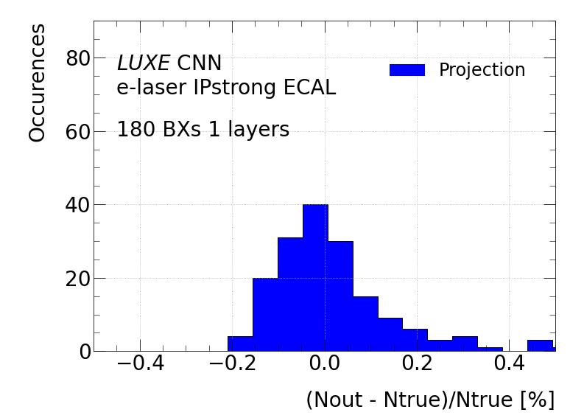

Slide 24
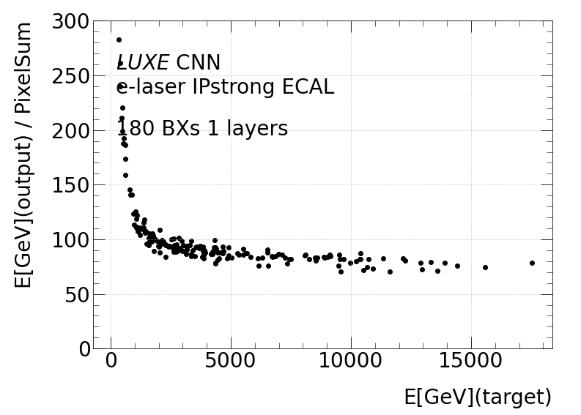

Slide 25
