Slide 1

Organization of Detector Research and Development for future HEP projects
D. Contardo IP2I-CNRS/N2P3

Slide 2
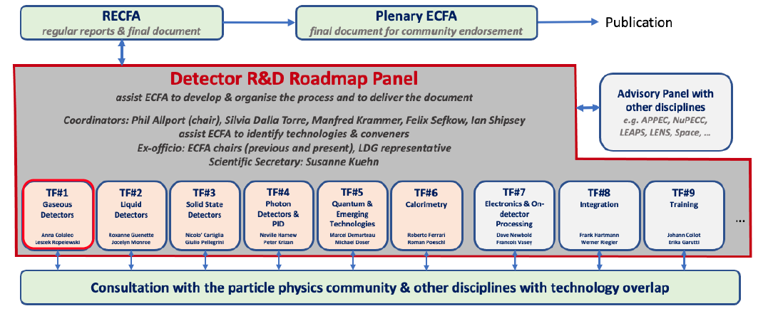
ECFA Detector R&D Roadmap
ESPP 2020 update: ECFA mandated to prepare a Detector R&D roadmap for future HEP projects
Roadmap Panel: define Detector Research and Development areas & organise wide community consultation
  establish strategic project performance requirements and their criticality to the physics program
  assess potential of technology options and studies needed to fulfil the requirements in due time
Roadmap was approved by Plenary ECFA in Nov. 2021
10 General Strategic Recommendations
GSR4: international coordination & organization of R&D activities
GSR6: establish long term strategic funding program
ECFA implementation proposal to form DRD collaborations hosted at CERN
was endorsed by Council Sep. 2022
P. Allport chair - ex-officio ICFA-IIDP chair I. Shipsey

Slide 3
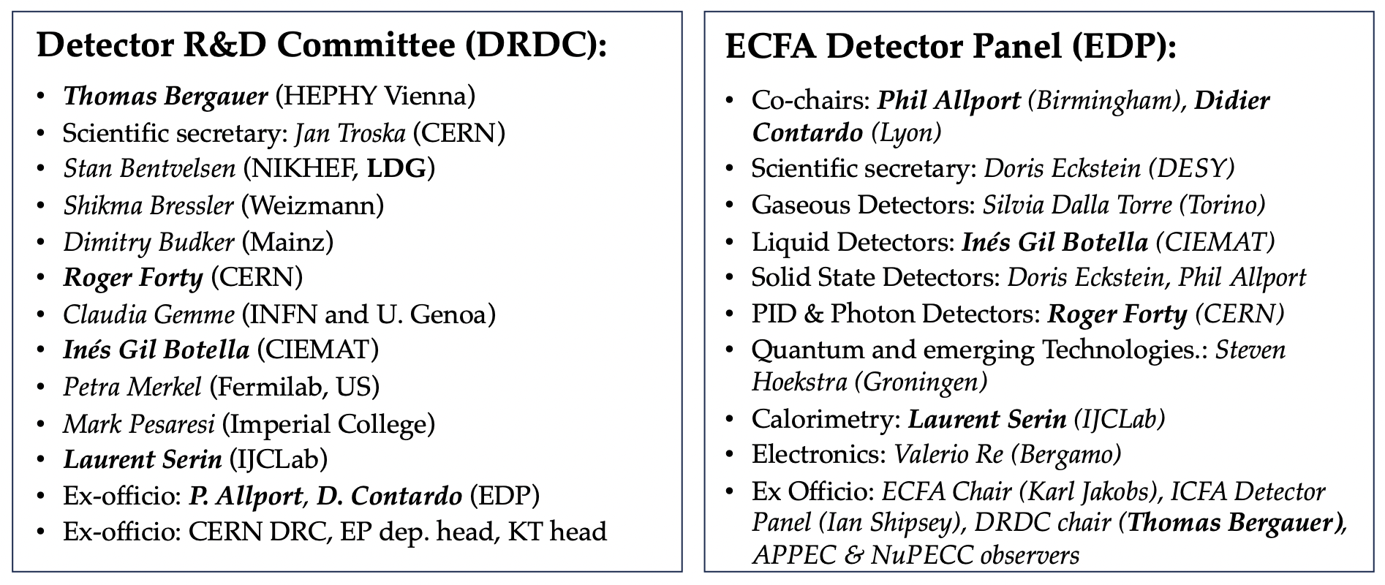
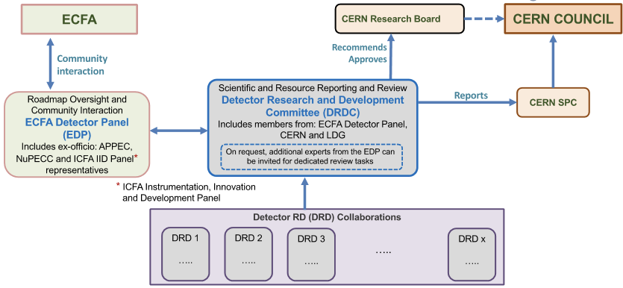
Framework for hosting DRD collaborations at CERN
general conditions for execution of experiments with Funding Agencies resource MoUs
Same teams as for the roadmap have prepared proposals with the community*
  DRD1, DRD2, DRD3, DRD4, DRD6 proposals submitted to DRDC in Aug.
    review ongoing with target approval at CERN Research Board meeting Dec. 6
    collaborations to become active Jan. 2024 and prepare resources MoUs for summer 2024
  DRD5 white paper and DRD7 LoI documents submitted in Aug.
    proposals expected this winter, targeting approval at Mar. RB Meeting
  DRD8 being investigated with the community (workshop Dec. 6)
  Training will be covered by newly created ECFA Training Panel
* also involving leaders of existing R&D programmes CERN RD50 (rad. hard semiconductors), RD51 (MPGDs), RD42 (diamond), RD18 (crystals)*, CALICE, AIDAInnova…

Slide 4
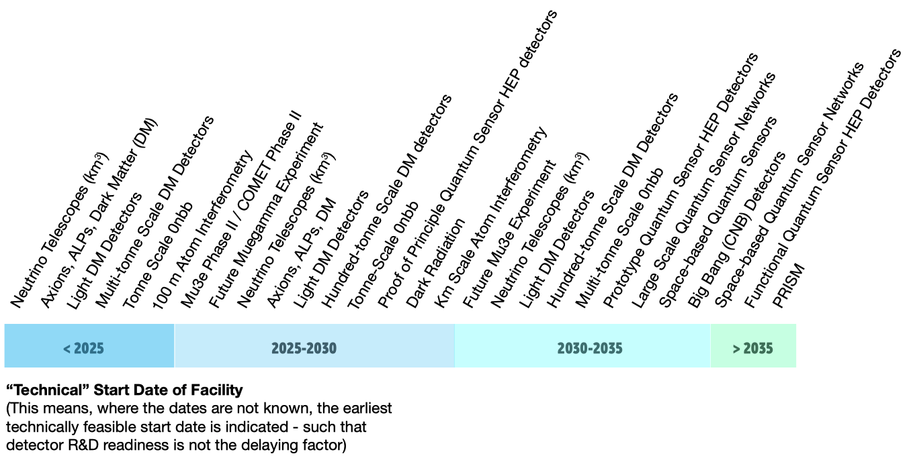
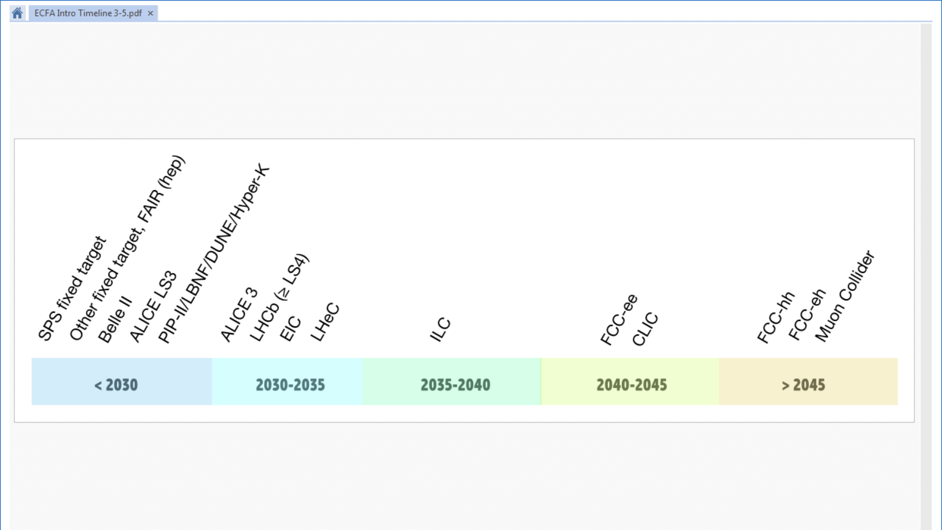
Context of HEP projects for Detector Research & Development
upgrades and future large accelerators projects
small accelerators, nuclear reactors, cosmic rays
second and third generation of experiments
DRD1
gaseous
DRD3
solid state
DRD4
photon & PID
DRD6
calorimeter
DRD2
liquid
DRD5
quantum & emerging techno.
DRD7 electronics and on-detector processing - DRD8 integration (?) - Training Panel
Strategic DRD programmes cover evolving TRLs* between 3 to 6
* Technology Readiness Level defined by NASA, low TRL < 3 also often referred as “blue sky” , TRL > 6 are experiment specific engineering
** Planning of projects is for physics start at the time of the roadmap, end of strategic R&D must consider project engin., constr. and instal. time

Slide 5
DRD proposal content
Scientific programme
  breakdown in Work Packages with Deliverables due to achieve research goals Milestones
  considering development of technologies for other DRDs and/or shared developments of similar components with different specifications or operating conditions
Planning is focused on first R&D period of 3 - 4 years with prospect for longer term
  stepping stone projects on the time scale of HL-LHC LS4
  iterations toward new technologies - new materials - ultimate radiation tolerance for longer term
Human resources and funding at the level of WPs to evaluate feasibility
  in public document
    list of institute wishes to contribute
    estimate of human and funding resources required
    sums of the available/additional expected resources
  confidential to DRDC at the level of institutes
    human and funding resources expected to be available/prolongated
    new resources being requested to achieve the strategic scope
Basis to establish Funding Agency commitments to WP deliverables in MoUs

Slide 6
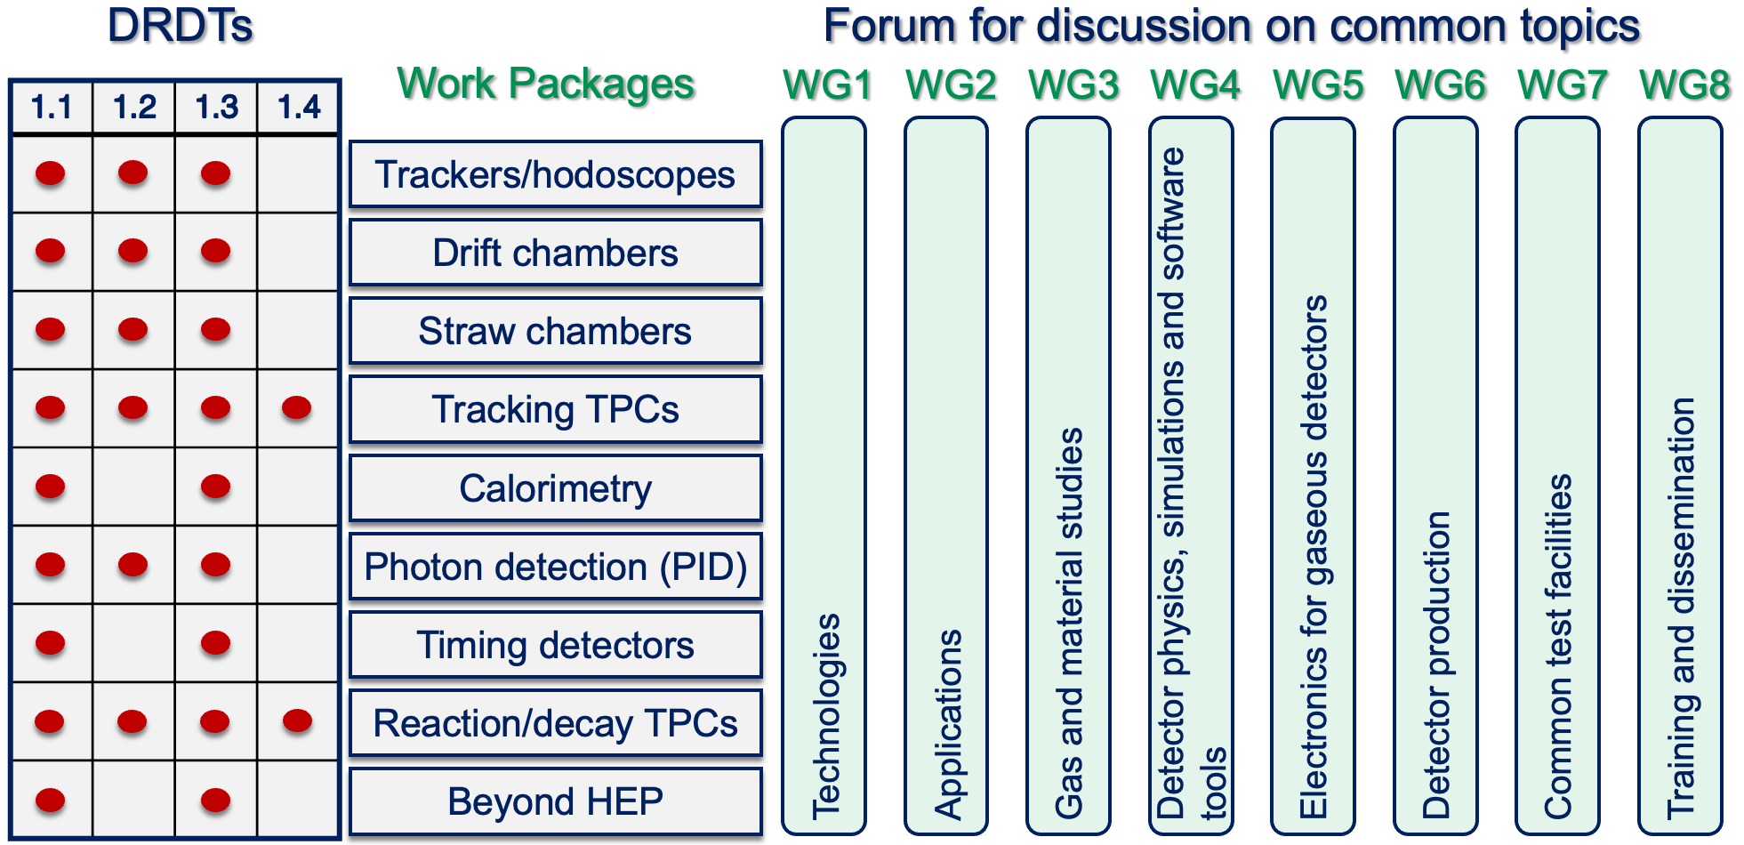
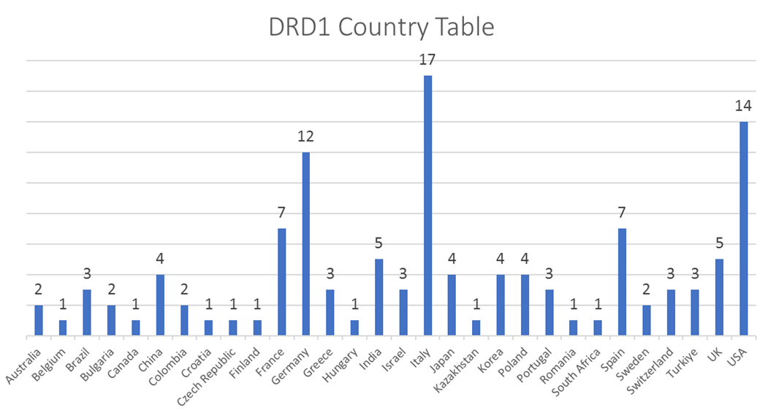
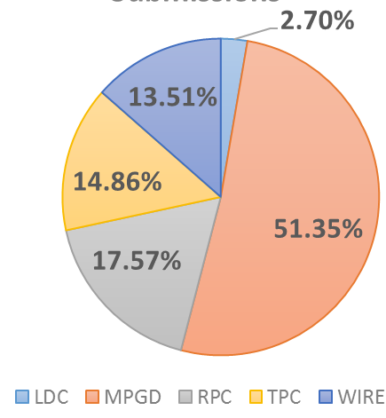
DRD1: Gaseous Detectors
time & spatial precision of MPGD, MWPC, RPC
precise tracking in large volumes,
DCH and TPC with dE/dx - dN/dx PID & low X/X₀
for central tracking at e-e colliders
Eco-friendly gas
MPGD & RPC for High Calorimetry (DRD6)
time & spatial precision of MPGD for gas RICH (DRD4)
MPGD for ToF PID in Timing Layers at colliders
increased sensitivity MPGD for TPC readout (DRD2)
154 institutes in 31 countries
building on RD50, new community beyond MPGDs
technology interests
initial resource estimates*
3(3) MCHF/y available(additional)
270(100) FTE available(additional)
T. Bergauer Plenary ECFA, 17 Nov.

Slide 7
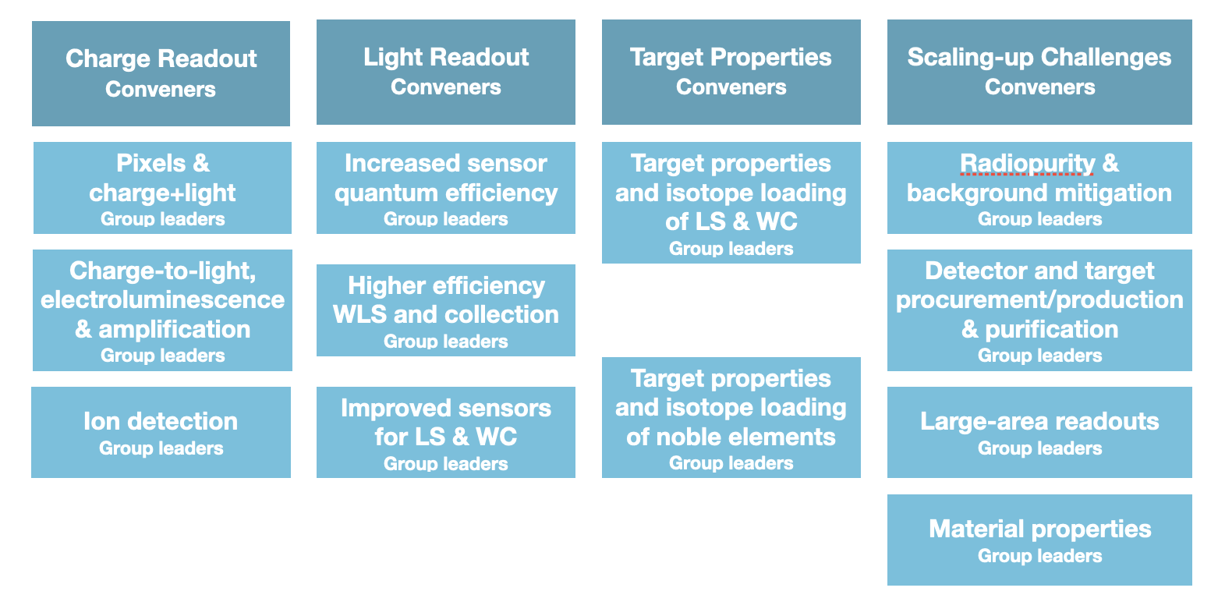
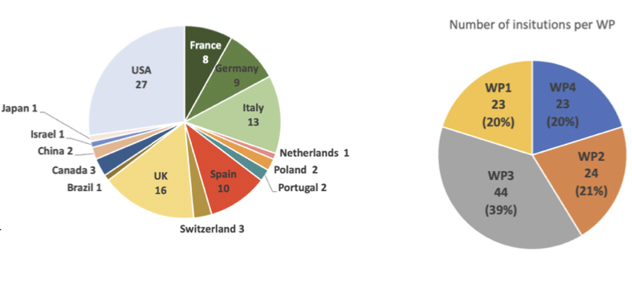
DRD2: Liquid Detectors
Water Cerenkov, Noble Liquids, Liquid Scintillators for DM, Neutrino & rare process (ex. 0𝜈ββ)
several experiments, medium term projects
Work Packages
improve spatial & energy resolution, reduce thresholds
CMOS pixels + photocathodes
SiPM/SPAD VUV efficiency (DRD4)
Photocatode & MPGD amplification structures (DRD1)
improved wave length shifting material (DRD4)
improve material sensitivity, heterogen Cerenkov & scintillation, new scintillators ex. opaque
new community building
99 institutes in 15 countries
technology interests
initial resource estimates*
2.6(5,2) MCHF/y available(additional)
148(157) FTE /y available(additional)
* T. Bergauer Plenary ECFA, 17 Nov.

Slide 8
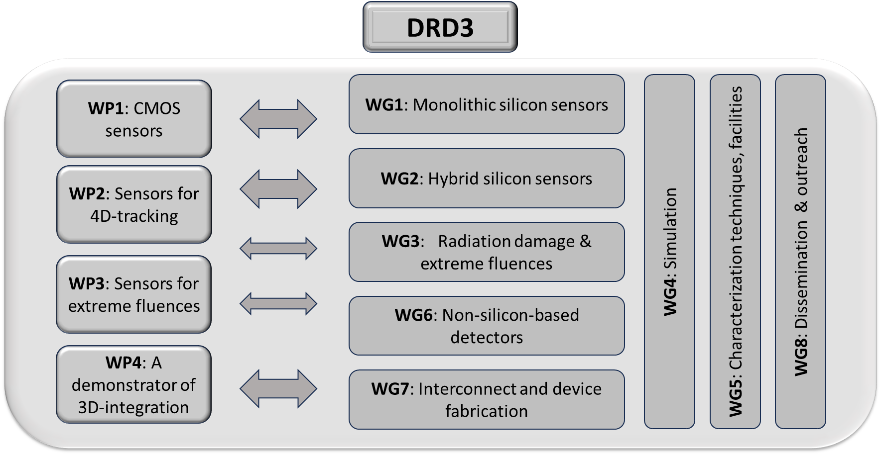
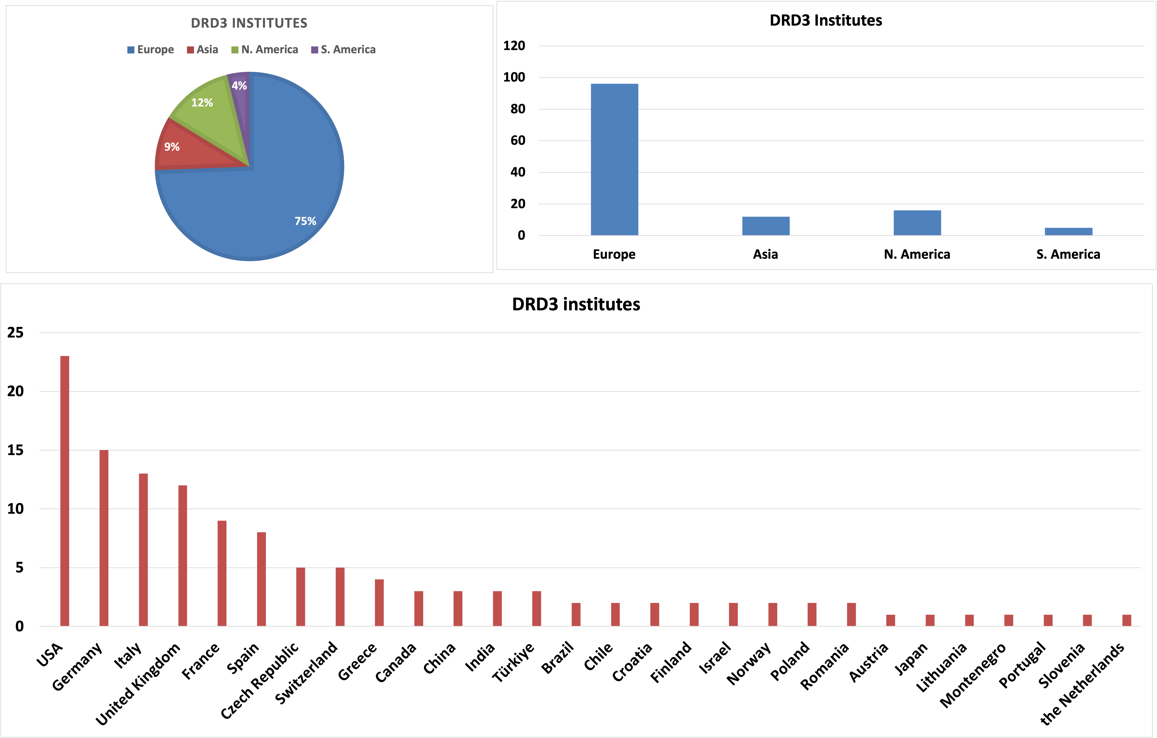
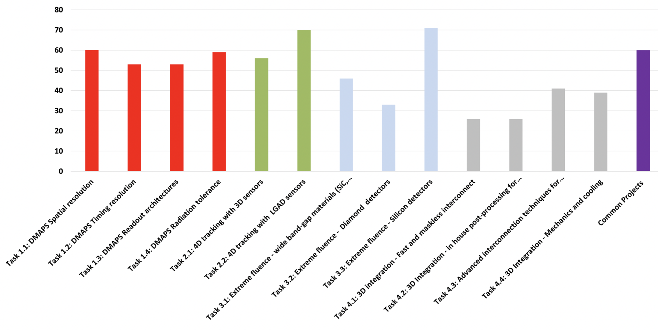
DRD3: Solid State Detectors
stepping stone projects in HL-LHC LS4 and links to DRD6
improve spatial resolution in large size sensors,
Monolithic CMOS in several processes,
extend from VD to CT/Calo., implement σ_{t}
collapse propert ies
high time and spatial resolution for 4D tracking, ToF PID layers, LGAD and 3D sensors
increase radiation tol., Silicon and WBG materials
longer term projects
3D integration of electronics
129 institutes in 28 countries
building on RD50 / RD42 x 2 with MCMOS
MCMOS
LGAD/3D
rad. tol. new mat.
3D integ.
initial resource estimates*
5(8) MCHF/y available(additional)
327(170) FTE/y available(additional)
* T. Bergauer Plenary ECFA, 17 Nov.

Slide 9
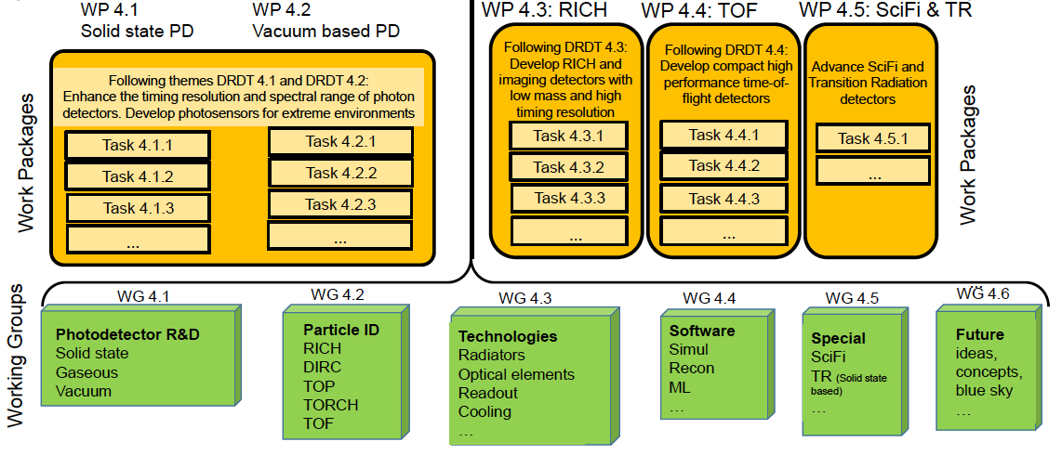
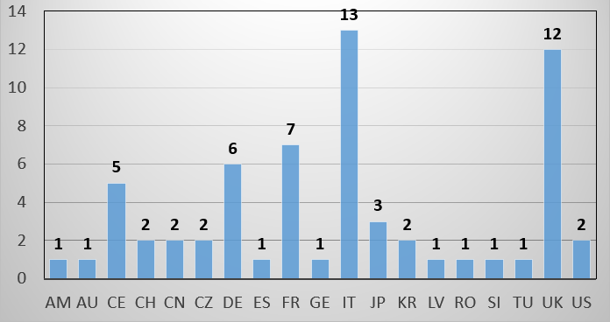
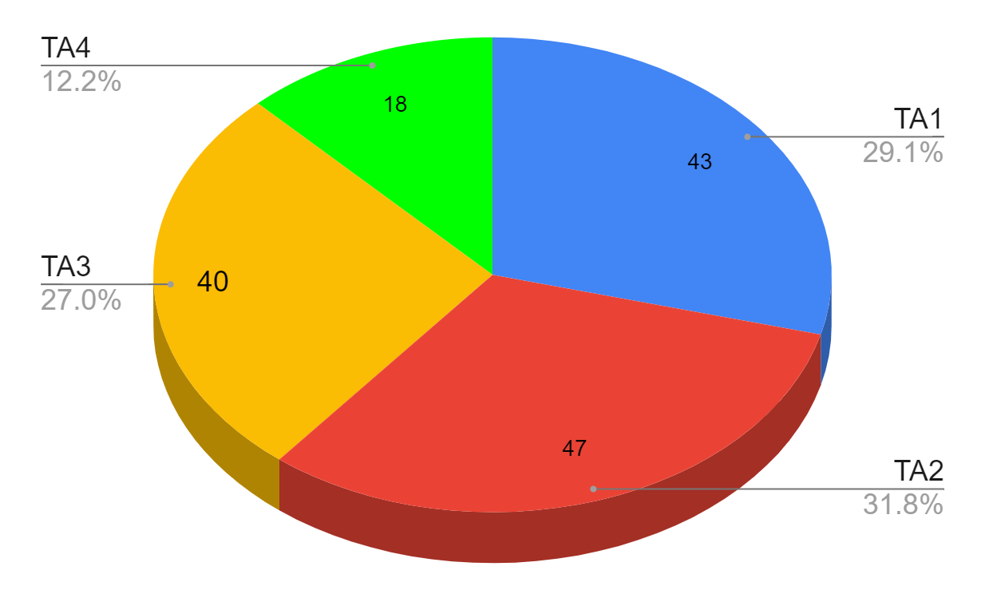
DRD4: Photon detectors and PID
improve resolution and timing in RICH with new radiator materials, link to DRD1 for eco-friendly gas
new hetrogenous and light concepts for large momentum range
improve time resolution in ToF layers, link to DRD6 for scintillating materials
improve timing resolution, spectral range, and rad. tol. of Photodetectors: solid state SiPM/SPADs
vacuum based MCP-PMT
link to DRD2 and DRD6 with focus on single/low photon number (gaseous PD in DRD1)
new community building
DRD4 74 institutes in 19 countries
initial resource estimates*
1.5(1.8) MCHF/y available(additional)
100(60) FTE/y available(additional)
* T. Bergauer Plenary ECFA, 17 Nov.

Slide 10
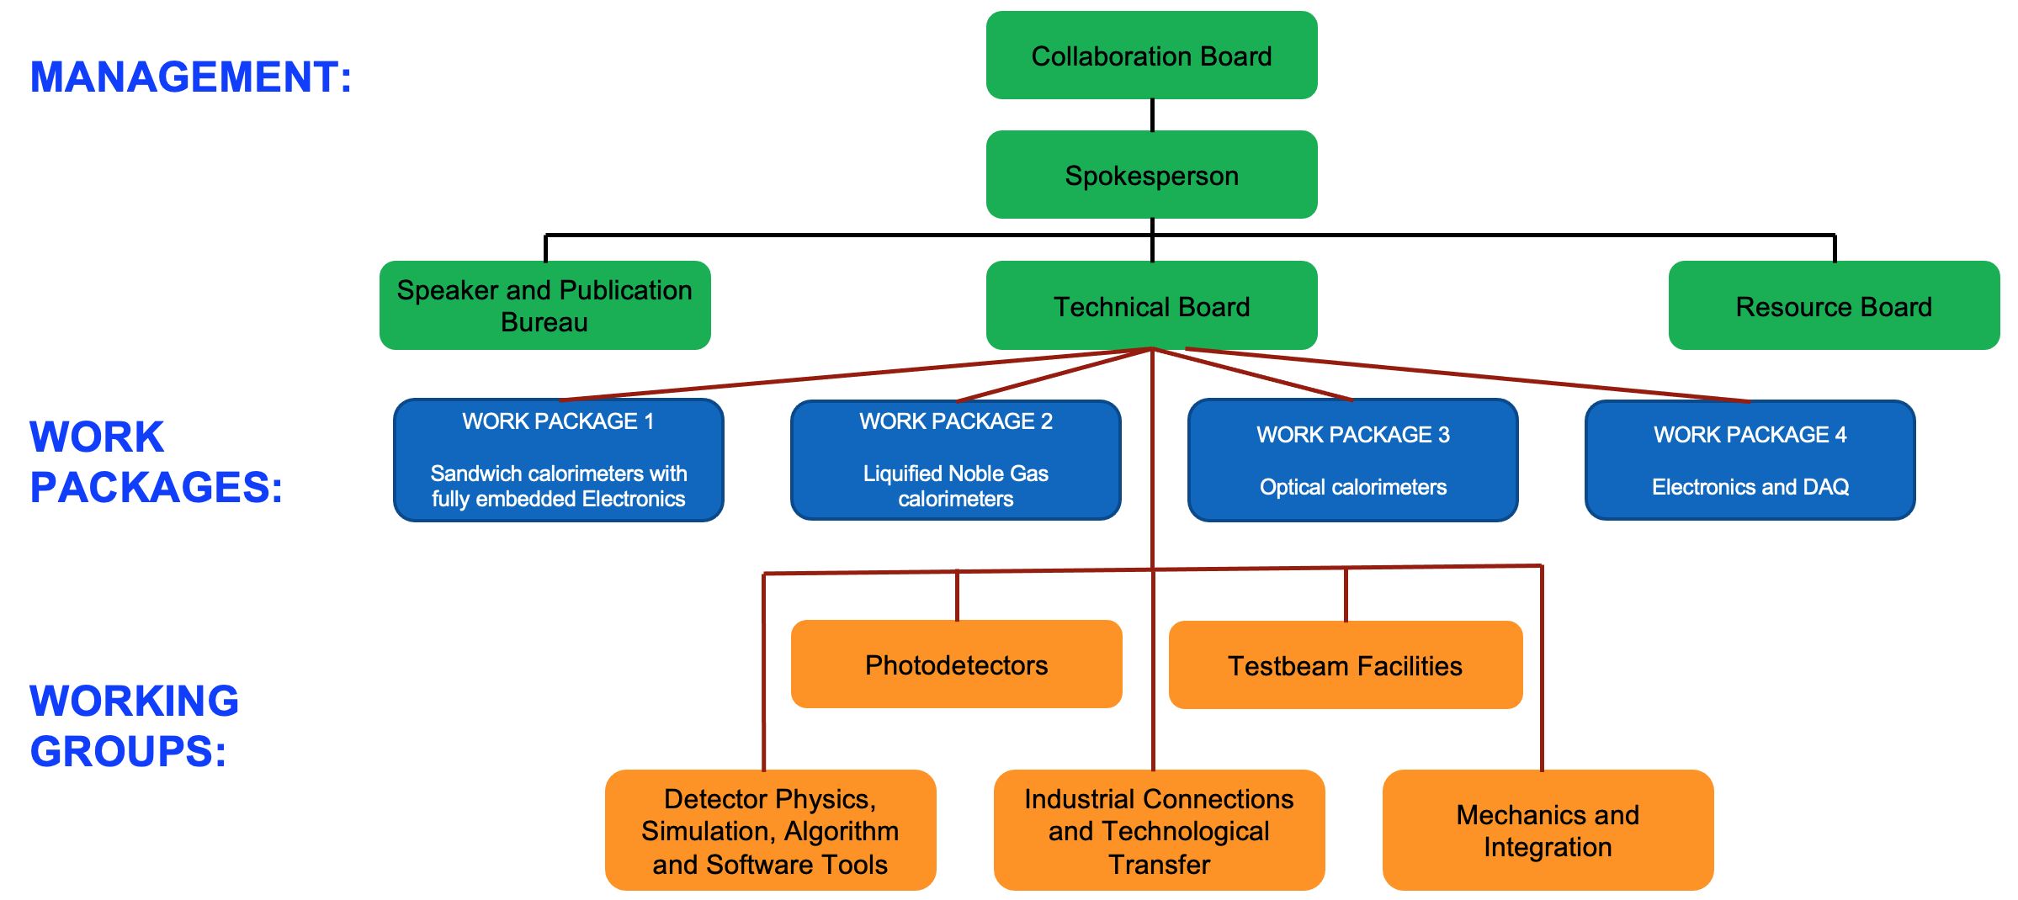
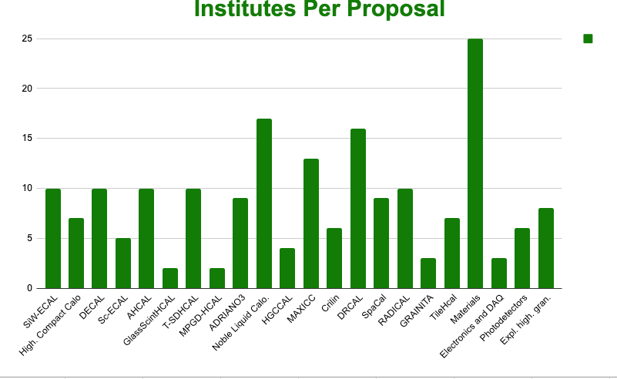
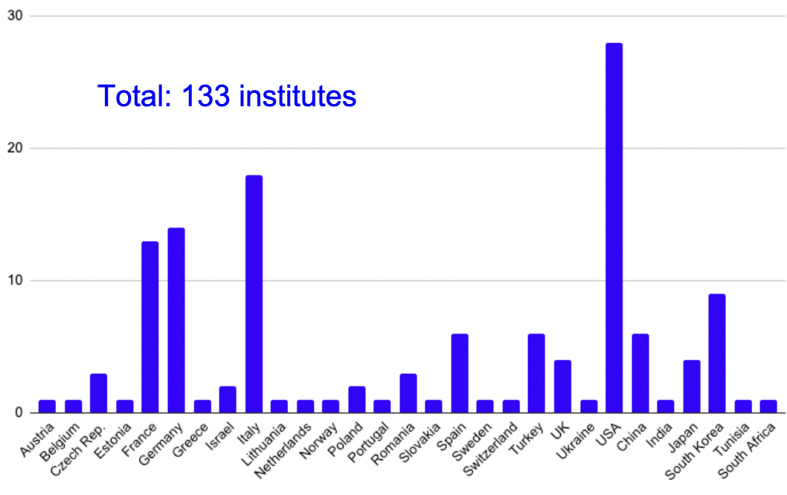
DRD6: Calorimetry
mostly driven by interest for future e-e colliders
particle flow in all concepts evolving to 5D
pre-existing communities in the 3 main class of calorimeters
18 prototype projects to cover options
in configurations of electromagnetic and hadronic segments in all potential technologies
high depth
seg. (CALICE)
LAr/Kr
optical
calorimeter
Working Groups
133 institutes from 29 countries
DRD1 MPGD, RPCs
DRD3 Si-sensors
new optical materials
RD18 – link to DRD5
initial resource estimates*
3.2(2.4) MCHF/y available(additional)
188(100) FTE/y avail.(requested)
DRD2 cold electronics
* T. Bergauer Plenary ECFA, 17 Nov.
DRD2 and DRD4 PhotoDetectors
new concepts digital MCMOS/RPC,
opaque scint., depth seg. with precision timing, homogenous HCAL, Quantum Dots

Slide 11
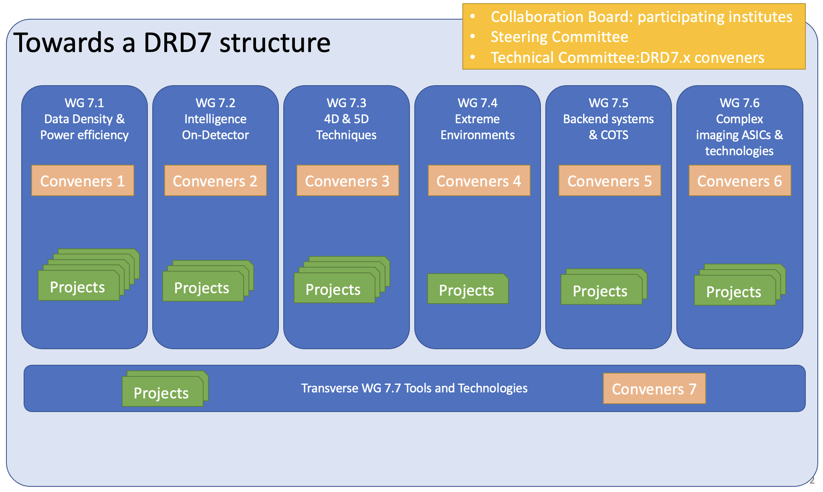
DRD7: Electronic systems
Letter of Intent
Advance the state-of-the-art in performance of electronics and data processing
Improve and develop further common standards, methodologies, and IP
Build expertise, increase efficiency and decrease duplication of effort
Provide facilities and tools for R&D in the community, with long-term continuity
ultra-low
power ADC
& TDC
Calibration
timing
disribution
Photonics
powering
wireless
eFPGA
RISC-V
virt. elec.
rad. tol. of
adv. nodes
cyro. PDK
cooling
cots, tools
& IP
no BE from
FE to DAQ
access to
techno. & IPs
access to 3D
integration
16 projects received from 50 institutes in 18 countries

Slide 12
DRD5: Quantum sensors and emerging technologies
sensors with high sensitivity and precision; nano/meta/heterogenous materials
so far applications in EDM, DM, neutrino, 0𝜈ββ searches, fundamental forces, …
White Paper
Technology Areas
clocks and clock network
Relatively low TRL and transverse to other DRDs for quantum materials
Considering community building
to promote developments and investigate adaptations to HEP
Possibly platform/hub organization
WP1 : atomic, nuclear & molecular systems in trap & beam, TA1 and TA5 (TA4)
WP2 : quantum materials, TA2, TA3, TA4, TA6
WP3 : large ensembles of quantum sensors (multi-modal)
WP4 : scaled-up “quantum for HEP”, (TA2), TA3, (TA4),TA5
WP5 : quantum techniques for sensing, TA1-5
    WP6 : networking, training, shared expertise and infrastructure (all TAs)
kinetic Detectors
spin based and superconducting sensors
optomechanical sensors
atomes/molecules/ions
interferometry
metamaterials,
0/1/2D materials
25 projects received from 40 institutes in 15 countries

Slide 13
Summary of contributions and resources
North Am.
(115)
Europe
(344)
566 institute contributions
sum of participating insitutes in DRD1-2-3-4-6 (same intstitutes can contribute in different DRDs)
Asia
(69)
Other
(38)
preliminary
FTE/y available/additional
funding/y available/additional (MCHF)
Expected FTE/y & funding/y
≃ average over 3 first years
available ≃ current funding
additional ≃ requested to fulfil progr.
based on a survey
(uneven answers from institutes)
not a commitment
need consolidation for MoUs

Slide 14
Outlook
Through preparation of new DRD proposals important progress has been made to :
  build new communities
    large world wide contributions
  prepare a global scientific programme to execute the ECFA roadmap
  assess resource needs and availability
The DRD collaborations will soon become active to :
  form their organization structure
  consolidate the scientific programme and the resource needs in preparation of MoUs with FAs
    substantial ramp-up of resources appears needed
  common work on availability of infrastructure and beam test facilities is on-going with LDG
  fields outside HEP can join the collaborations as full members or partners
  rules for industrial/semi-public partnerships are being prepared for MoUs with CERN guidance
thanks to P. Allport ECFA Roadmap Panel Chair and K. Jakobs ECFA chair
to DRD preparation team leaders
A. Colaleo, L. Ropeleweski (DRD1); R. Guenette, J. Monroe (DRD2); N. Cartiglia, G. Pellegrini (DRD3); C. Joram ,
P. Krizan (DRD4); M. Demarteau, M. Doser (DRD5); R. Ferrari, R. Poeschl (DRD6); D. Newbold, F. Simon, F. Vasey (DRD7)

Slide 15
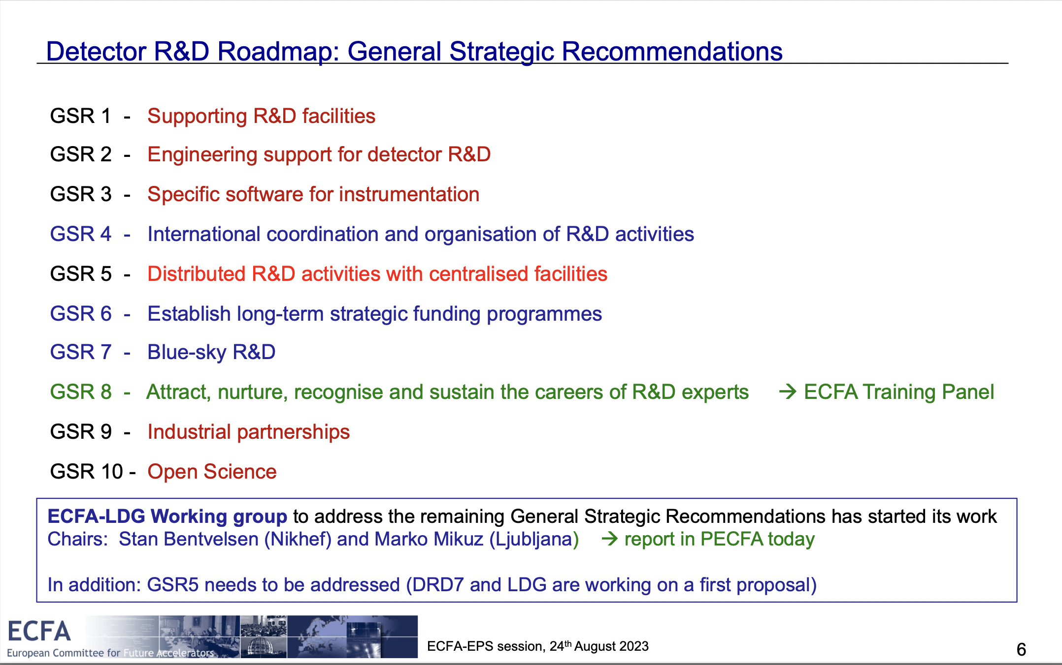
K. Jakobs at ECFA-EPS plenary session 24 Aug. 2023

Slide 16
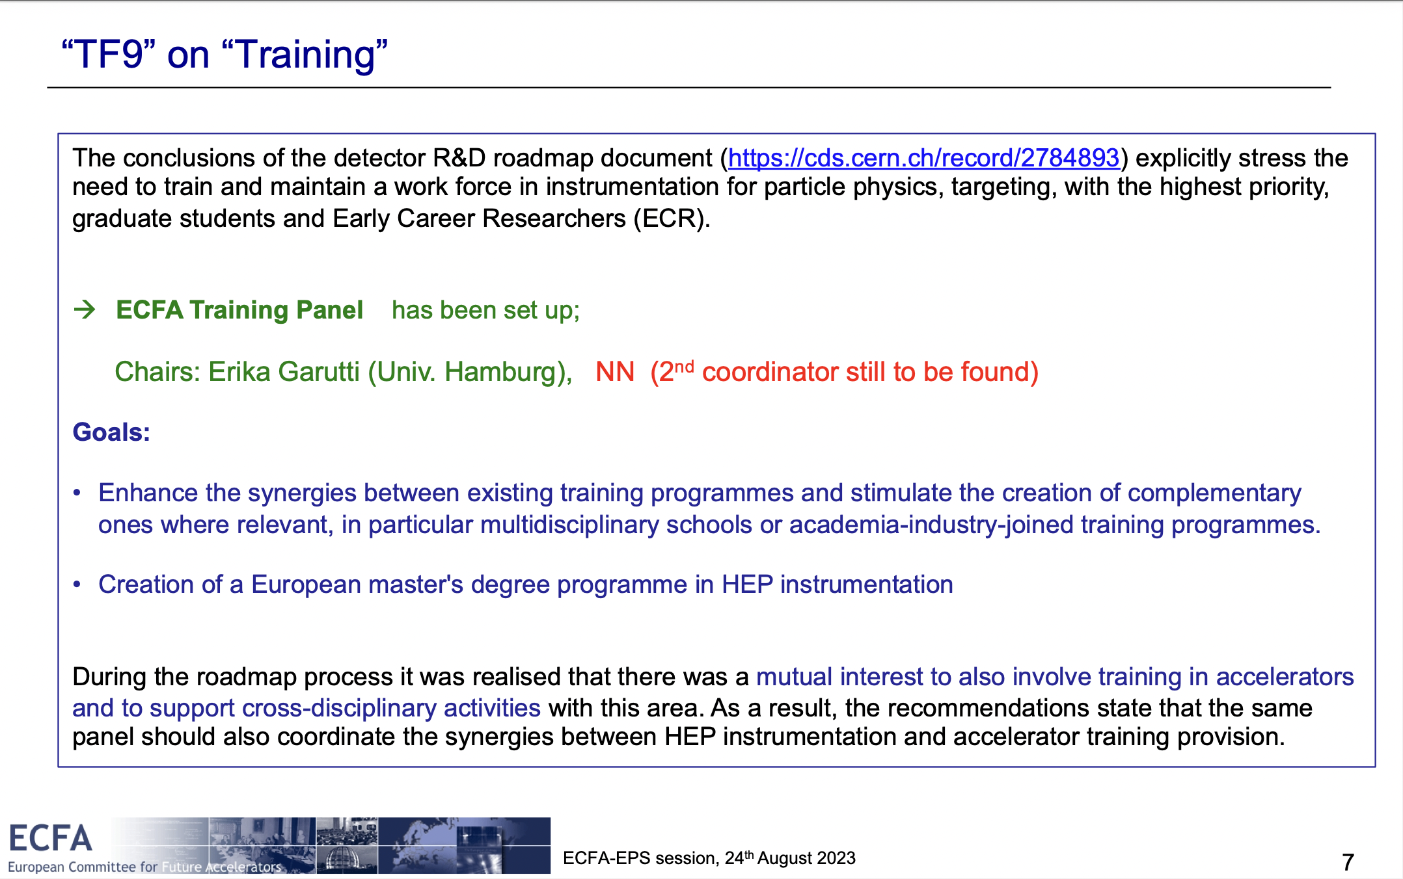
K. Jakobs at ECFA-EPS plenary session 24 Aug. 2023

