Slide 1
ARES Operation Meeting
Summary of week 08 / 2023
Willi Kuropka, on behalf of the ARES crew

Slide 2
Summary of week 08
Mon. 20.2. | Tue. 21.2. | Wed. 22.2. | Thu. 23.2. | Fri. 24.2.
TDS water cooling Cathode box removed MIN cabling MPC grounding network in the SH region | Looking for sources of beam position oscillations and momentum measurement deviations 25Hz main rep. rate test Gun and TWS1 ramped to recent nominal amplitudes without major issues No 10Hz interference from FLASH modulators wad noted Except screen stations and Tubro ICT - all diagnostic devices worked! | Firmware update on intensity monitor rack (MDI) ZZ to check some dimensions on the X-band RF stations in the tunnel (MIN) New BPM doocs server version installed (MDI) Main rep rate restored to 10Hz | Beam position feedback optimization (with AutoAcc colleagues) Corrector ramping speeds have been adjusted | Restart ARES Checking intensity monitor plausibility Checking beam position stability at LIR1 vs. PCB correctors in low energy section Position stability measurement at DLBPMG2 without low energy section correctors TWS1 and 2 momentum measurements
 | Gun/TWS1 DCM needs to be configured for 25Hz operation – deactivated TWS2 took a bit of conditioning at 25Hz Screen station camera delay is very large…we are looking at least at the “next pulse” |  | Fault in 20degC cooling water system halted operation abruptly – was repaired by MKK | Cathode laser reset and locked after cooling water fault (FS-LA, MSK)
Tunnel open
Achievements
Difficulties
Notes

Slide 3
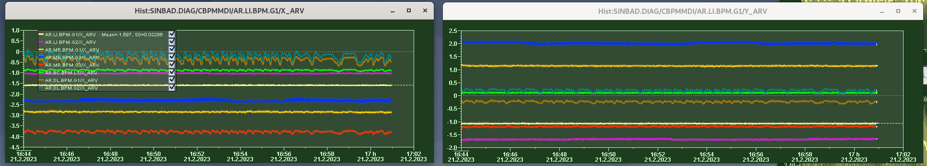
Position oscillations - BPMs
“ballisitic” working point – no quads, only correctors after TWS2 and before TDS are active
All BPMs correlate nicely, amplitude gets larger at the end of the machine – pointing component
Oscillation at LI section BPMs is probably smaller than BPM noise
Amplitude in the SH section at the end of the machine is up to half a millimeter…

Slide 4
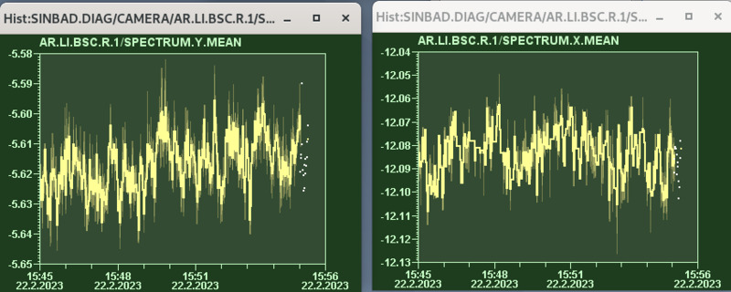
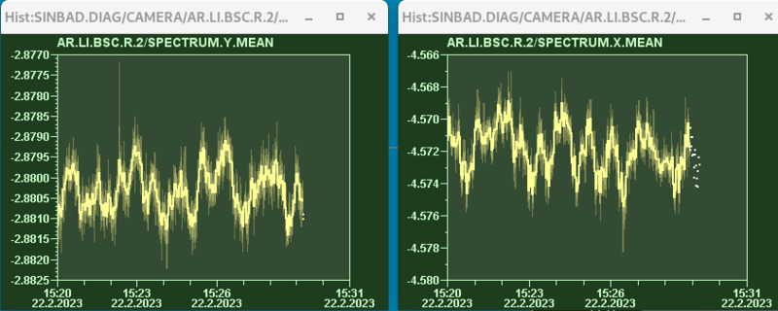
Position oscillations – LI section screens
Less noise in beam position
But gaussian fit is less accurate in beam center
Only one screen at a time – beam position correlation cannot be shown like that
Hard to tell if it is actually there…
Probably we also have to look at the spectrum

Slide 5
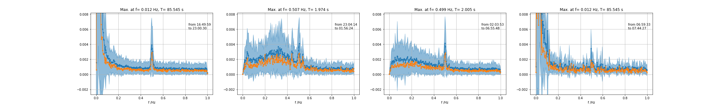
Beam position feedback
Using BPMs and PCB correctors
0.5Hz component..?

Slide 6
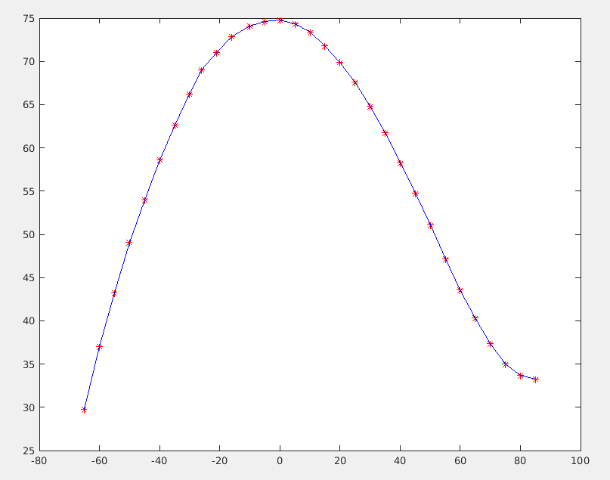
TWS2 PDE mean momentum vs. phase
A few MeV/c are missing compared to measurement with both TWS on-crest
PDE mean momentum [MeV/c]
TWS2 phase [deg]

Slide 7
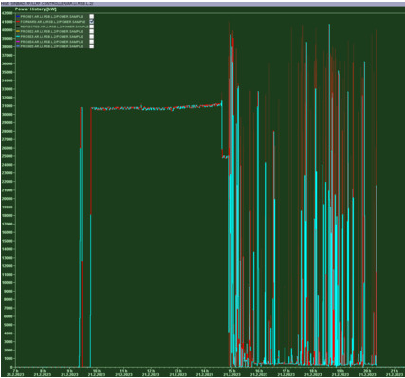
TWS2 forward power reading
Probably broken damping element in the LLRF chain
Probe power readings are ok

Slide 8
Work in the Tunnel, plan for the week
Monday
  TDS water cooling
  MIN cabling
  MSK check on TWS2 forward power reading
Operation
  Investigate position oscillation
  Investigate beam momentum measurement inconsistencies
  Dosimetry beam time for D3 and UKE
  Laser lab: restore 2um laser

Slide 9
Schedule
Week 09
Date | Shift Leader
27.02. | -
28.02. | Frank
01.03. | Max (D3 and UKE)
02.03. | Willi
03.03. | Thomas
If you want to learn or join the shift: please give the shift leader a call (BKR 2840 / SINBAD Box 2454)

