Slide 1
Jet propagation and shocks in the ejecta
Ehud Nakar
Tel Aviv university
Ready, set, go! Preparing for the O4 LIGO-Virgo-KAGRA observing run
Humboldt University of Berlin, June 8-9, 2023

Slide 2
Jet Propagation in expanding media
(Gottlieb & Nakar 2021)
See also: Murguia-Berthier et al. 2014, 2017, 2021; Duffell et al. 2018; Margalit et al. 2018; Matsumoto & Kimura 2018; Gill et al. 2019; Lazzati & Perna 2019; Nakar 2020; Beniamini et al. 2020; Lyutikov 2020; Hamidani et al. 2020; Hamidani & Ioka 2021

Slide 3
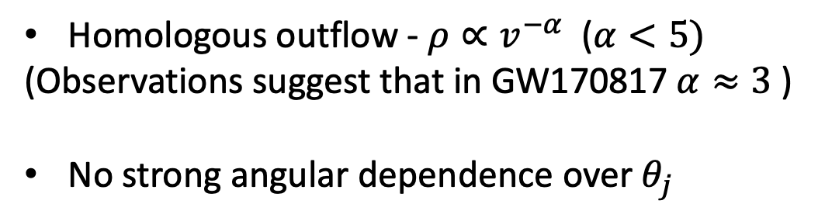

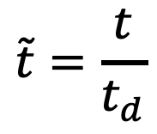
r=vt
Homologous outflow - $ρ∝v^{−α}$ ($α<5)$
(Observations suggest that in GW170817 $α≈3$ )
No strong angular dependence over $θ_{j}$
$$ρ∝v^{−α}$$
Weakly magnetized
or Unmagnetized jet
t=0 – merger time
t_{d} – jet launch starts (delay time)
$$\tilde{t}=\frac{t}{t_{d}}$$

Slide 4
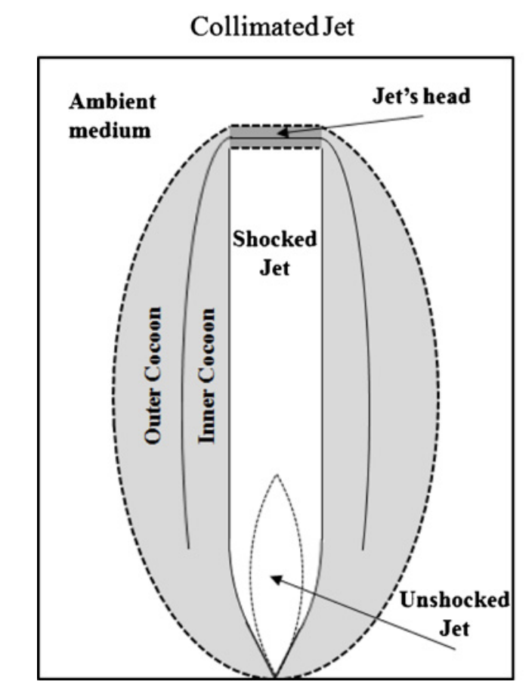
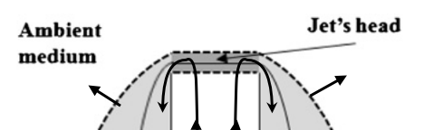
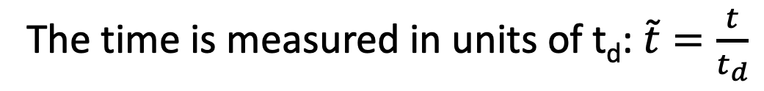
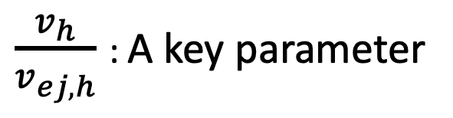


$$v_{ej,h}$$
$$v_{h}≲0.6c$$
$\frac{v_{h}}{v_{ej,h}}$ : A key parameter
Bromberg et al 2011
The time is measured in units of t_{d}: $\tilde{t}=\frac{t}{t_{d}}$

Slide 5
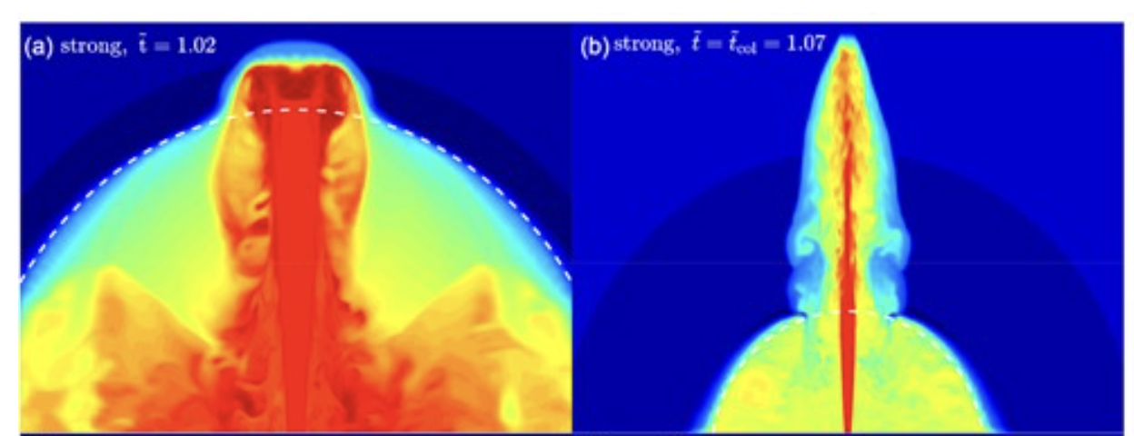

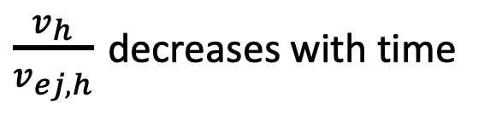
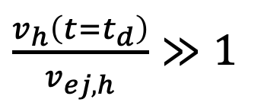

Strong jet
$\frac{v_{h}\left(t=t_{d}\right)}{v_{ej,h}}≫1$
$$r_{ej,min}=1.02 r_{ej,min,0}$$
$$r_{ej,min}=1.07 r_{ej,min,0}$$
$\frac{v_{h}}{v_{ej,h}}$ decreases with time

Slide 6
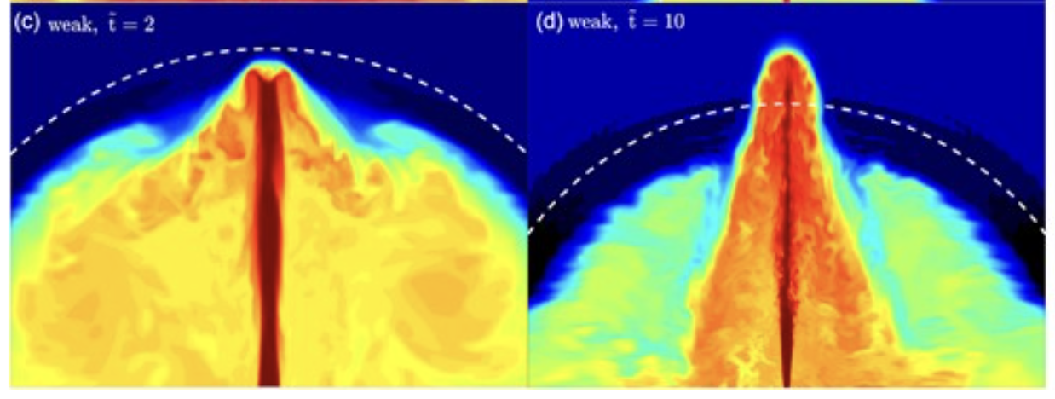


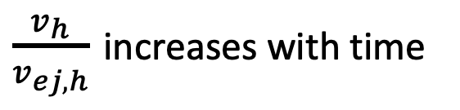
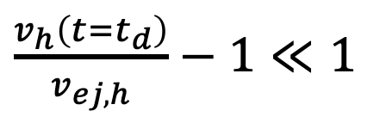
Weak jet
$\frac{v_{h}\left(t=t_{d}\right)}{v_{ej,h}}−1≪1$
$$r_{ej,min}=2 r_{ej,min,0}$$
$$r_{ej,min}=10 r_{ej,min,0}$$
$\frac{v_{h}}{v_{ej,h}}$ increases with time

Slide 7
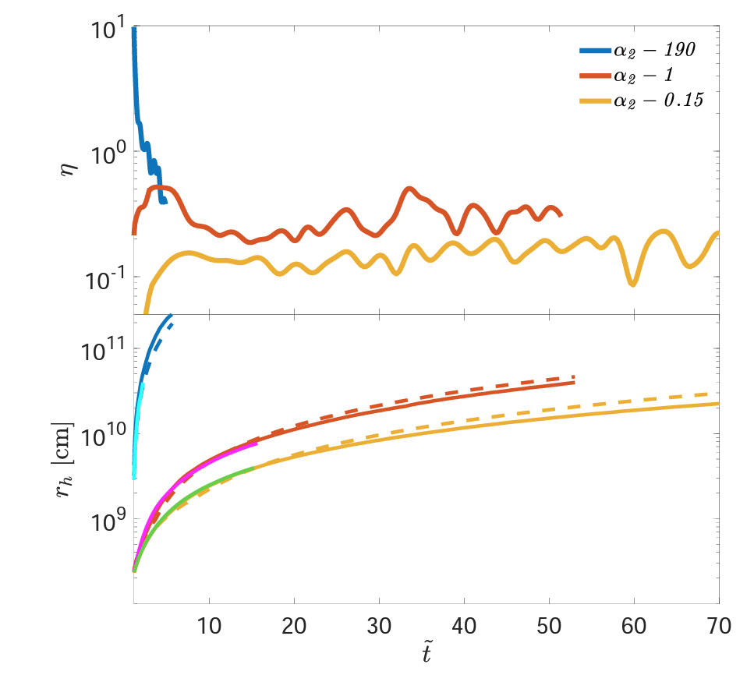
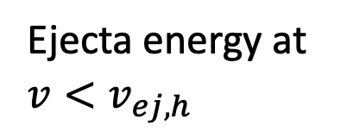
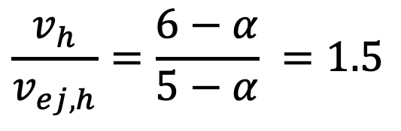

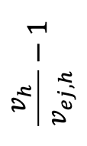

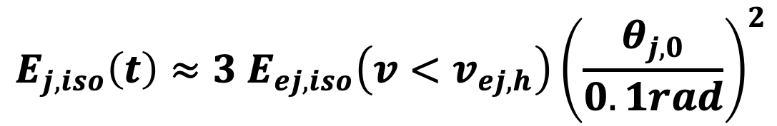
All jets reach the same asymptotic solution
During the asymptotic phase
$$α=3$$
$$\frac{v_{h}}{v_{ej,h}}−1$$
$$\frac{v_{h}}{v_{ej,h}}=\frac{6−α}{5−α} =1.5$$
$$t/t_{d}$$
$$E_{j,iso}\left(t\right)≈3 E_{ej,iso}\left(v<v_{ej,h}\right){\left(\frac{θ_{j,0}}{0.1rad}\right)}^{2}$$
Energy injected into the jet up to time t
Ejecta energy at $v<v_{ej,h}$

Slide 8
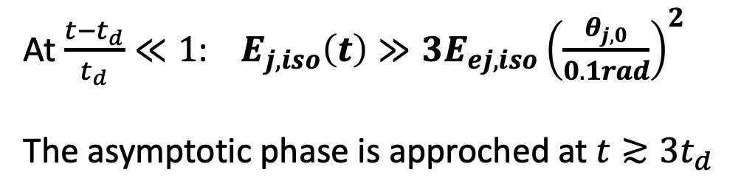
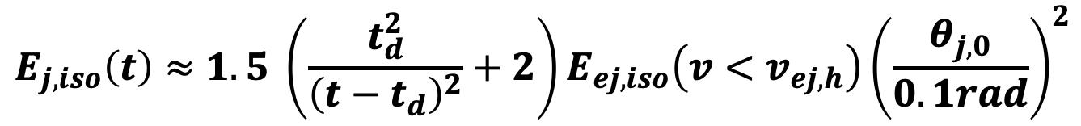
Strong jets
$$E_{j,iso}\left(t\right)≈1.5 \left(\frac{t_{d}^{2}}{{\left(t−t_{d}\right)}^{2}}+2\right)E_{ej,iso}\left(v<v_{ej,h}\right){\left(\frac{θ_{j,0}}{0.1rad}\right)}^{2}$$
At $\frac{{t−t}_{d}}{t_{d}}≪1$: $E_{j,iso}\left(t\right)≫3E_{ej,iso}{\left(\frac{θ_{j,0}}{0.1rad}\right)}^{2}$
The asymptotic phase is approched at $t≳3t_{d}$

Slide 9
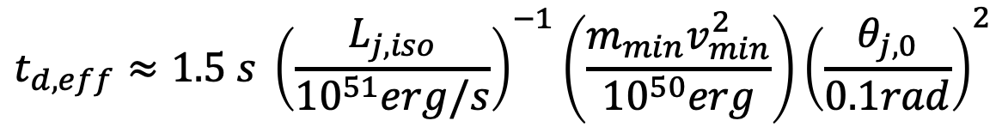
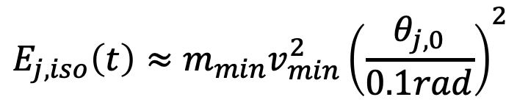
Weak jets
$$E_{j,iso}\left(t\right)≈{m_{min}v}_{min}^{2}{\left(\frac{θ_{j,0}}{0.1rad}\right)}^{2}$$
The jet is stalled until
After that the jet propagation converges to the asymptotic phase
Weak jets have an effective delay time:
$$t_{d,eff}≈1.5 s {\left(\frac{L_{j,iso}}{{10}^{51}erg/s}\right)}^{−1}\left(\frac{{m_{min}v}_{min}^{2}}{{10}^{50}erg}\right){\left(\frac{θ_{j,0}}{0.1rad}\right)}^{2}$$

Slide 10
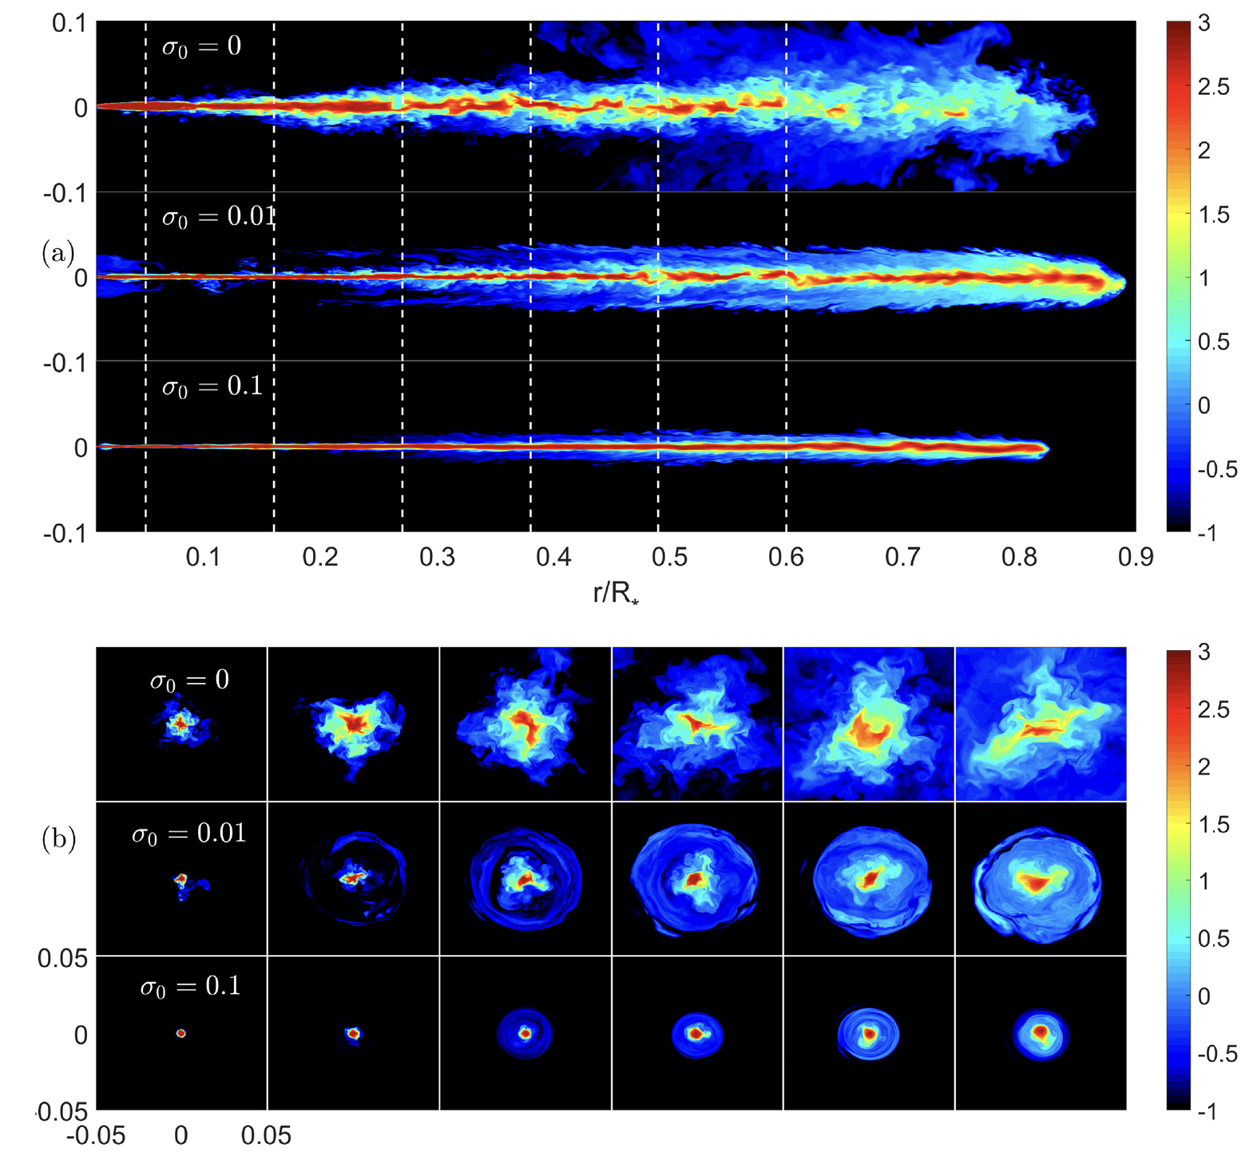
Weakly magnetized jets ($0.01≲σ≲1$) propagates faster than unmagnetized jets
Gottlieb et al 2020

Slide 11
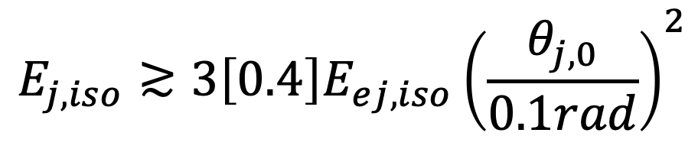
Breakout criterion
(necessary but insuficient)
Total energies
$$E_{j,iso}≳3\left[0.4\right]E_{ej,iso}{\left(\frac{θ_{j,0}}{0.1rad}\right)}^{2}$$
Weakly magnetized jets
For GW170817 observations suggest $E_{j,iso}≳10E_{ej,iso}{\left(\frac{θ_{j,0}}{0.1rad}\right)}^{2}$

Slide 12
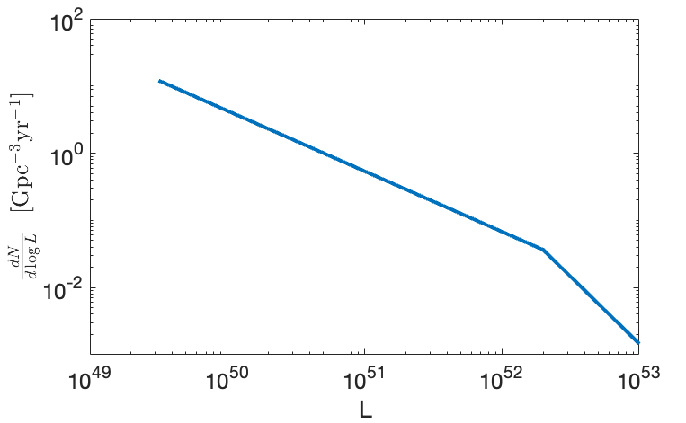
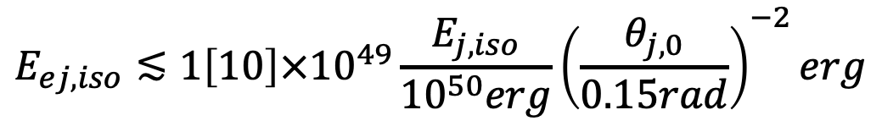
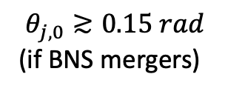
Breakout criterion
(necessary but insuficient)
$$θ_{j,0}≳0.15 rad$$
(if BNS mergers)
For a succesful jet:
$$E_{ej,iso}≲1\left[10\right]×{10}^{49}{\frac{E_{j,iso}}{{10}^{50}erg}\left(\frac{θ_{j,0}}{0.15rad}\right)}^{−2}erg$$
e.g., Wanderman & Piran 2015
(and many others)
iso
[erg/s]
Successful jets in faint sGRBs imply one of the following:
The ejecta in a large fraction of BNS merger is less massive than in GW170817
or
The ejecta in GW170817 was highly aspherical (c.f. Snappen et al 2023)
or
A short delay time – jets are launched before most of the polar ejecta

Slide 13
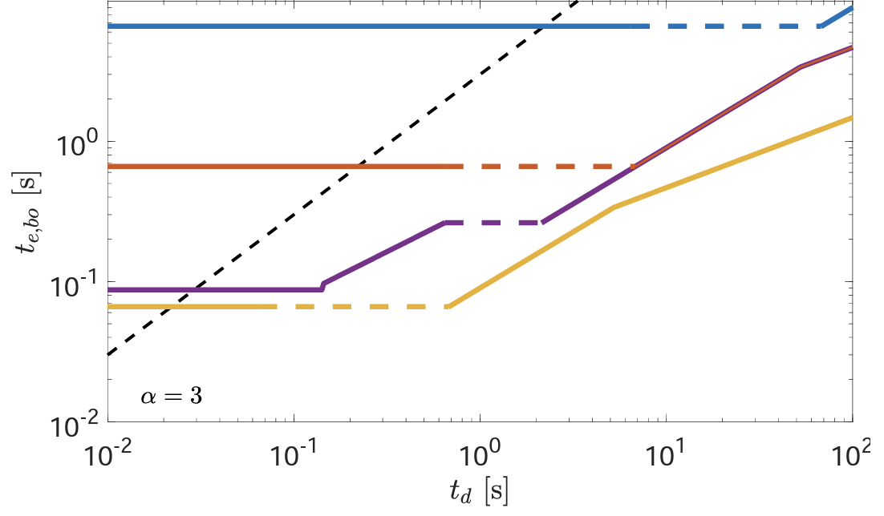
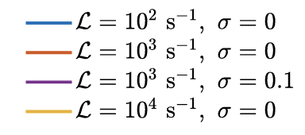


Breakout time
GW170817: $ℒ∼{10}^{3}−{10}^{4}$
In GW170817 the propagation may have taken up to 1sec

Slide 14
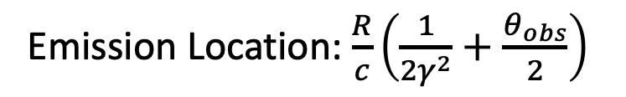
The delay between the merger and the γ-rays
delay between the merger and jet launching
+
Jet propagation time
+
Emission Location: $\frac{R}{c}\left(\frac{1}{2γ^{2}}+\frac{θ_{obs}}{2}\right)$
The sum of three time scales
In GW170817 each of these scale may have dominated the observed delay

Slide 15
The effect of shocks on the ejecta composition
Granot, Levinson & Nakar in prep
See also Derishev 2018; Levinson 2020; Vanthieghem et al. 2022

Slide 16
Some, and possibly most, of the ejecta is shocked after ejection:
  Jet propagation: shocked ejecta dominates the early emission
  Collisions between different part of the ejecta
  Energy injection from the central merger remnant
The shocks, at velocities of 0.1-0.3 c, may affect the ejecta composition

Slide 17
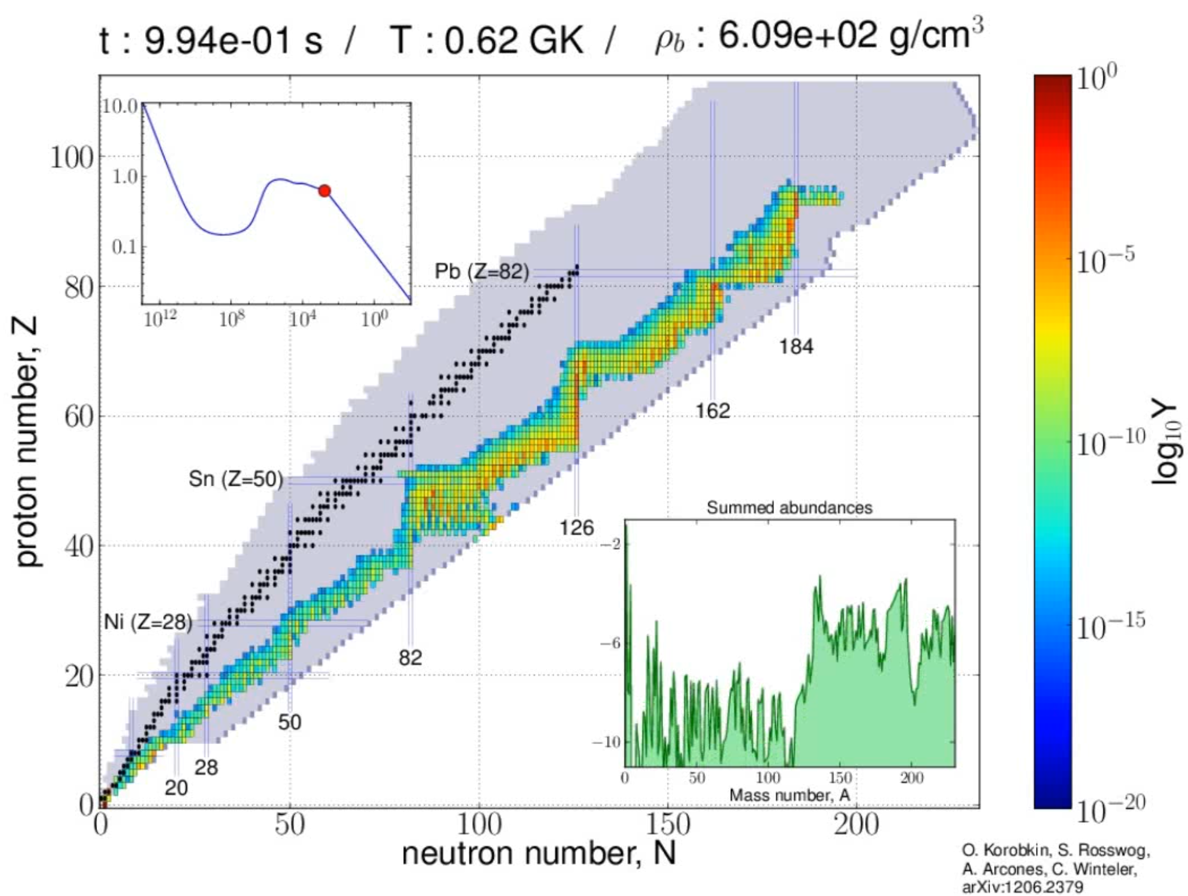
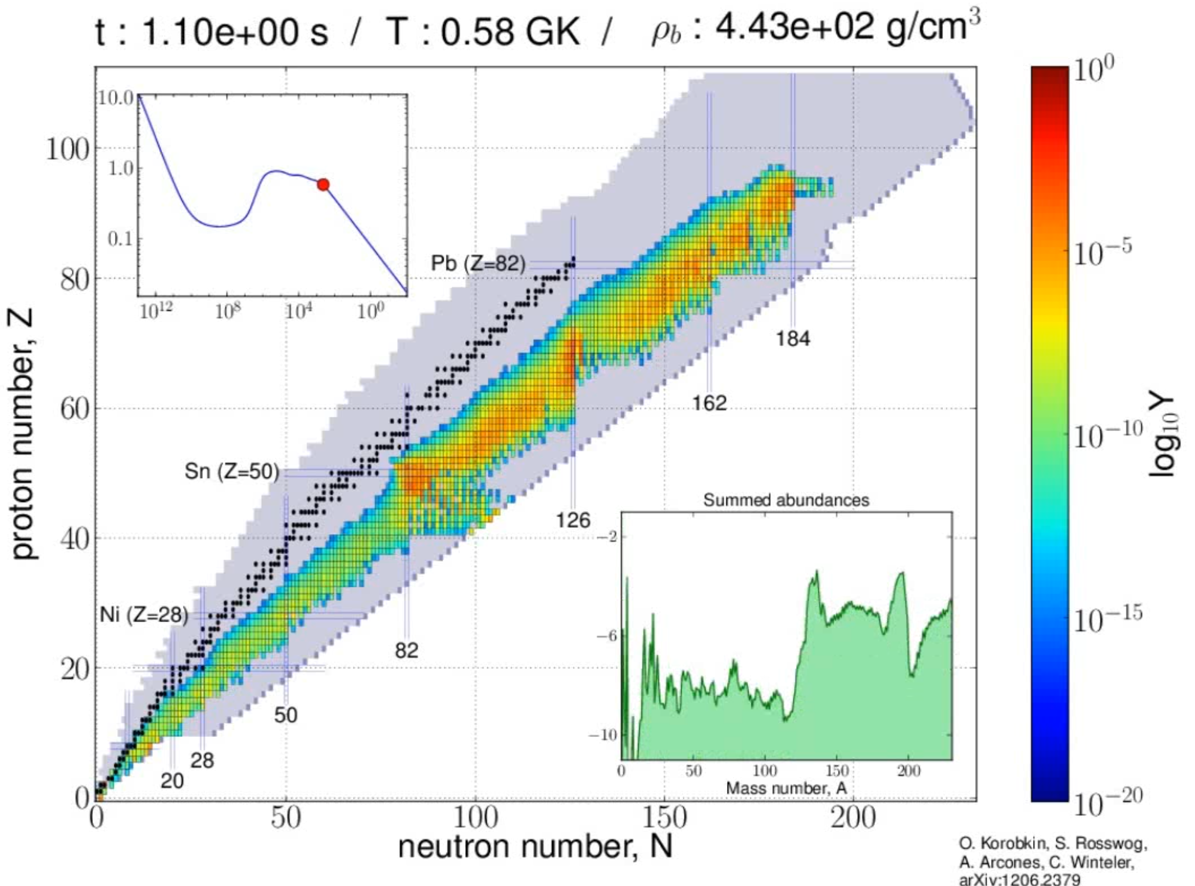
Free neutrons
Number density dominated by free neutrons
Free neutrons are negligible
The energy of a free neutron behind the shock: $20{\left(\frac{β_{s}}{0.2}\right)}^{2}MeV$

Slide 18
Radiation mediated shocks
Downstream
shock
Upstream

Slide 19




Radiation mediated shocks
$$\vec{E}$$
$${\vec{F}}_{E}$$
$${\vec{F}}_{E}$$
$${\vec{F}}_{rad}$$
Downstream
shock
Upstream
Radiation apply
force on electrons
Electrons decelerate
Charge separation
Electrostatic field
Decelerates the ions

Slide 20
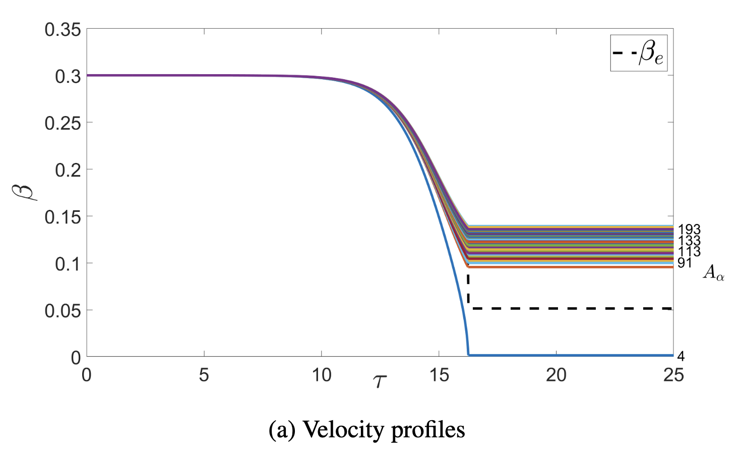
The deceleration in the electrostatic field depends on the charge-to-mass ratio
Relative velocity ➔ inelastic collisions ➔ change in composition

Slide 21
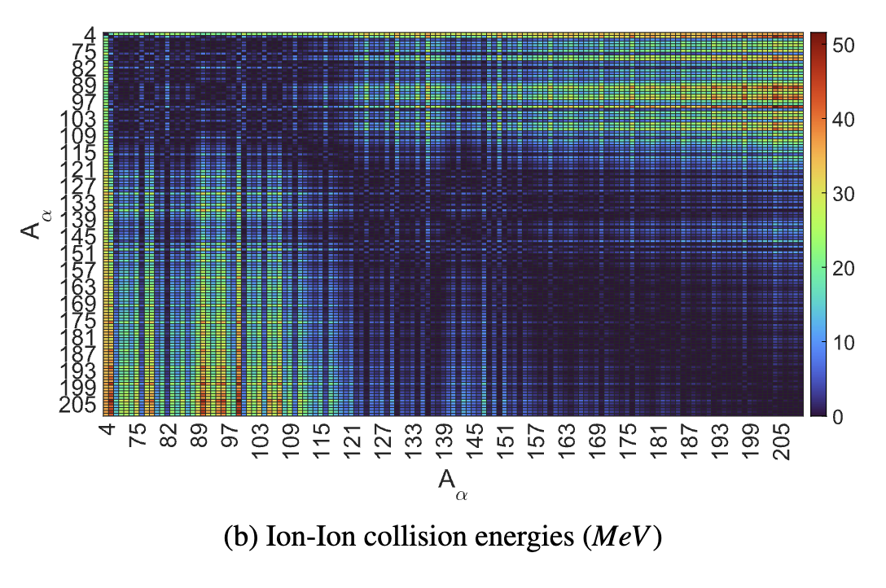

$$β_{s}=0.3$$
For $β_{s}≳0.2$ many collisions are above the Coulomb barier

Slide 22
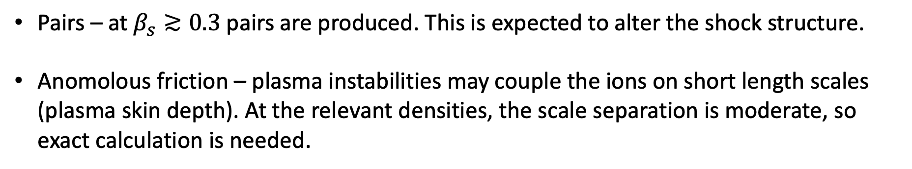
Caveiats
Pairs – at $β_{s}≳0.3$ pairs are produced. This is expected to alter the shock structure.
Anomolous friction – plasma instabilities may couple the ions on short length scales (plasma skin depth). At the relevant densities, the scale separation is moderate, so exact calculation is needed.

Slide 23
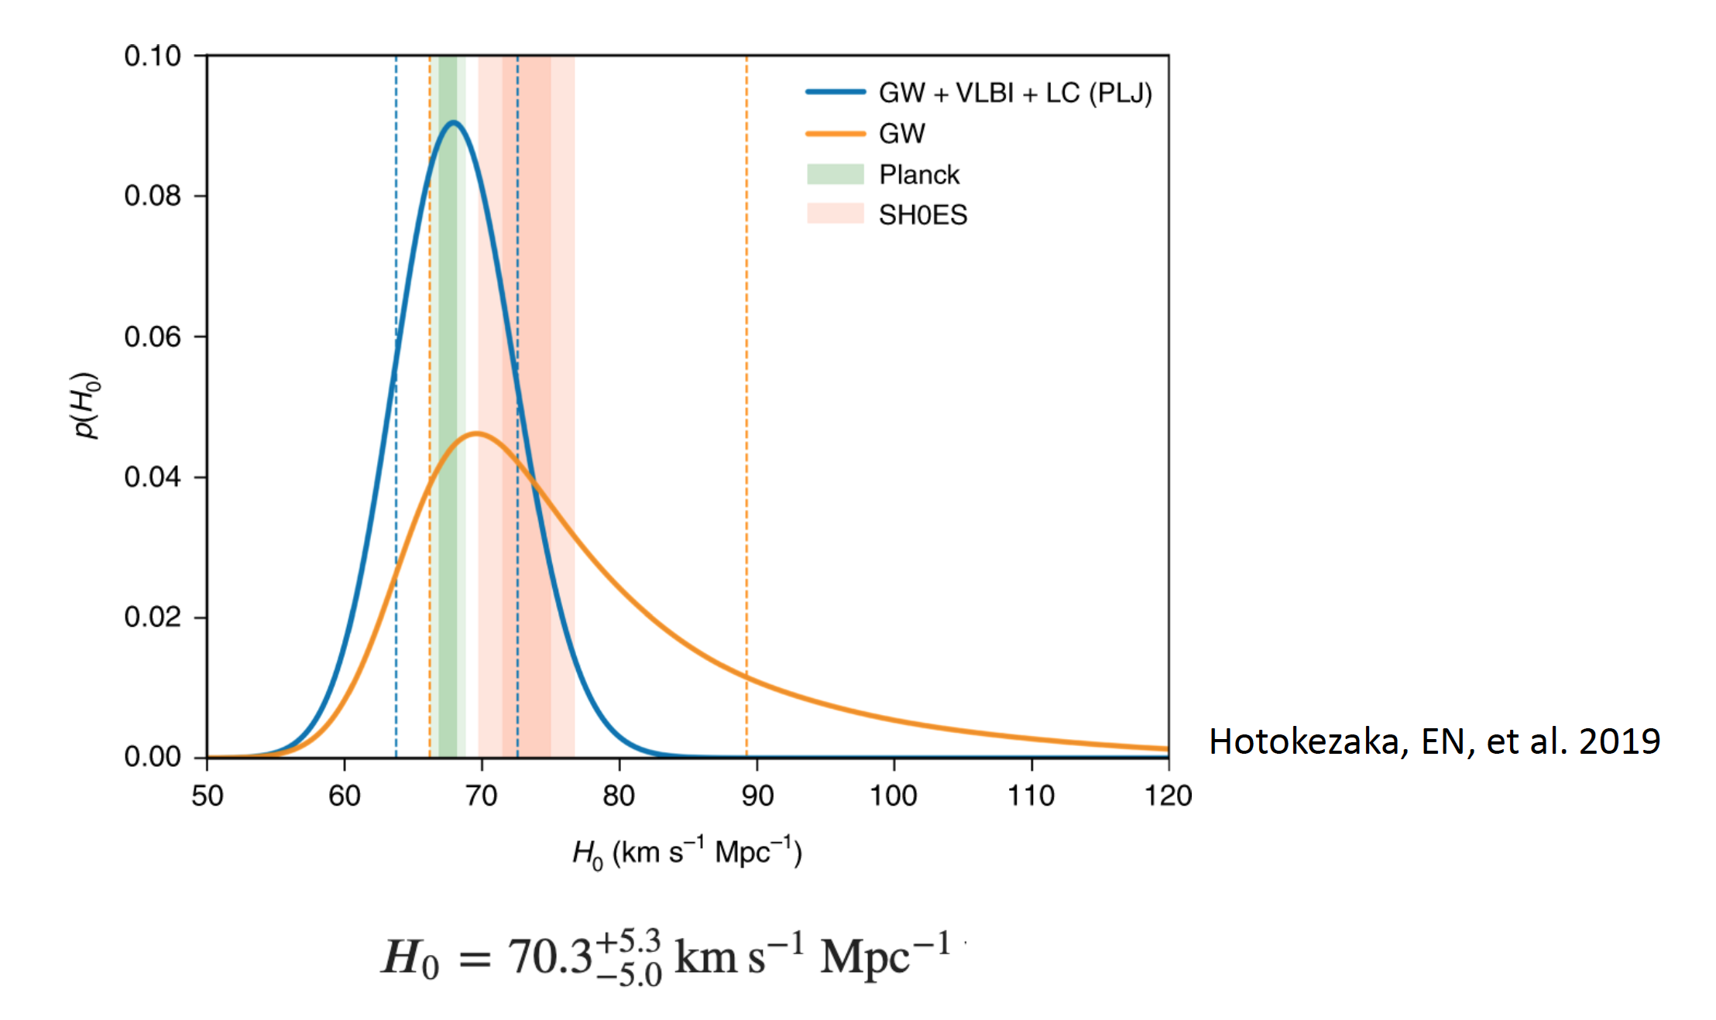
A note on measuring H₀
Constraining the viewing angle improves the constraints
Light curve + VLBI images constraints can be largely insensitive to the jet structure (Govreen-Segal & Nakar 2023)

Slide 24
Take home messages
Jet Propagation
There is a simple (necessary but insuficient) breakout criterion for jets in merger ejecta, which depends only on the jet and ejecta total energy and the jet opening angle
Jet propagation may be delayed for a long time before the jet starts propagating
Lower luminosity sGRBs are probably acomponied by less massive ejecta than GW170817 (at least along the poles)
Shocks in the ejecta
The composition of shocked ejecta may be significantly different than the one predicted by current models

Slide 25
Thanks!

Slide 26
Determining the ejecta mass with the Katz integral

Slide 27
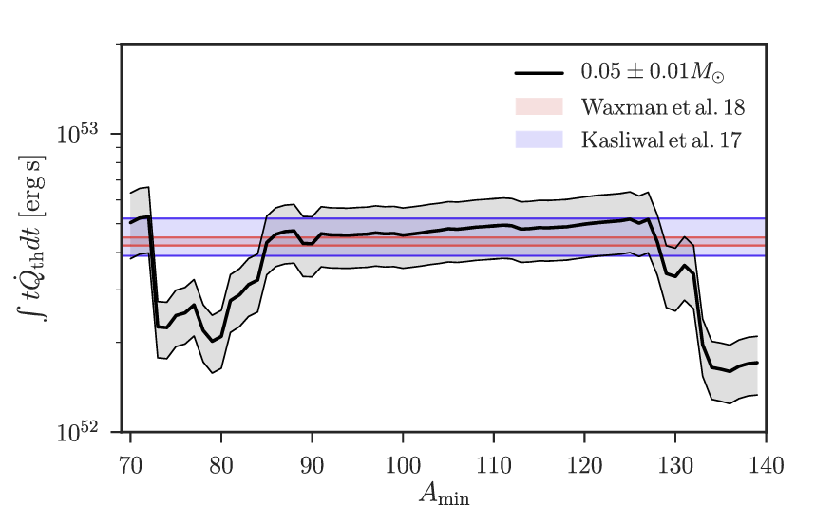


Slide 28
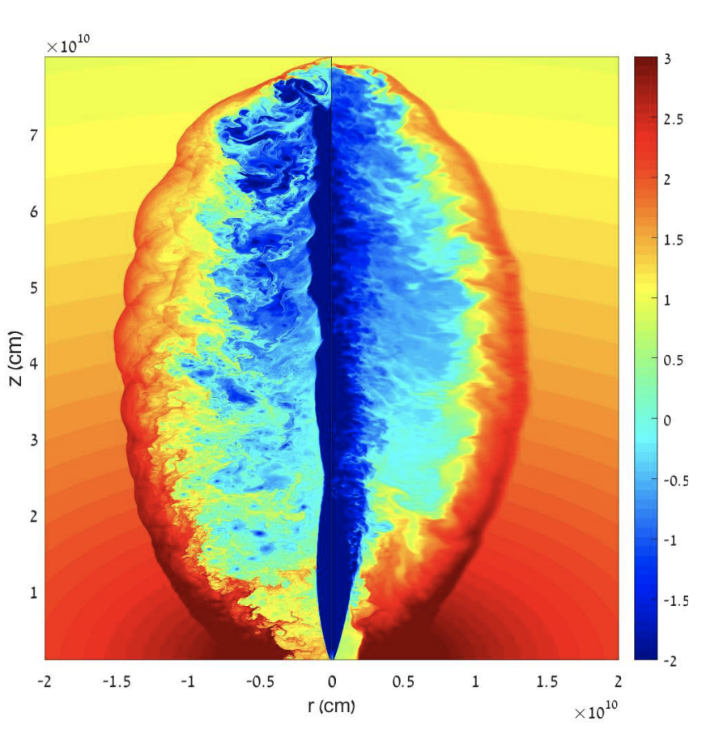
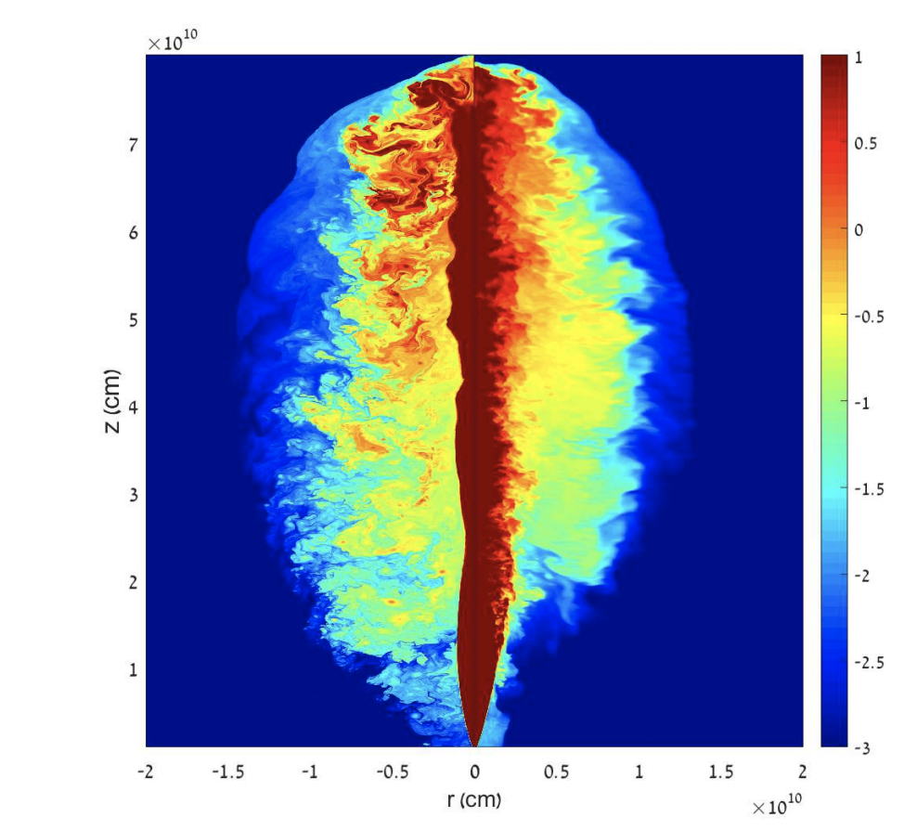
Head
10
10³
Inner
cocoon
10²
1
10
Energy per baryon [mc²]
Jet
Density [gr/cm³]
0.1
1
0.01
Outer
cocoon
0.1
Collimation
shock
0.001
0.01
Harrison et al 2018
Bromberg et al 2011

Slide 29
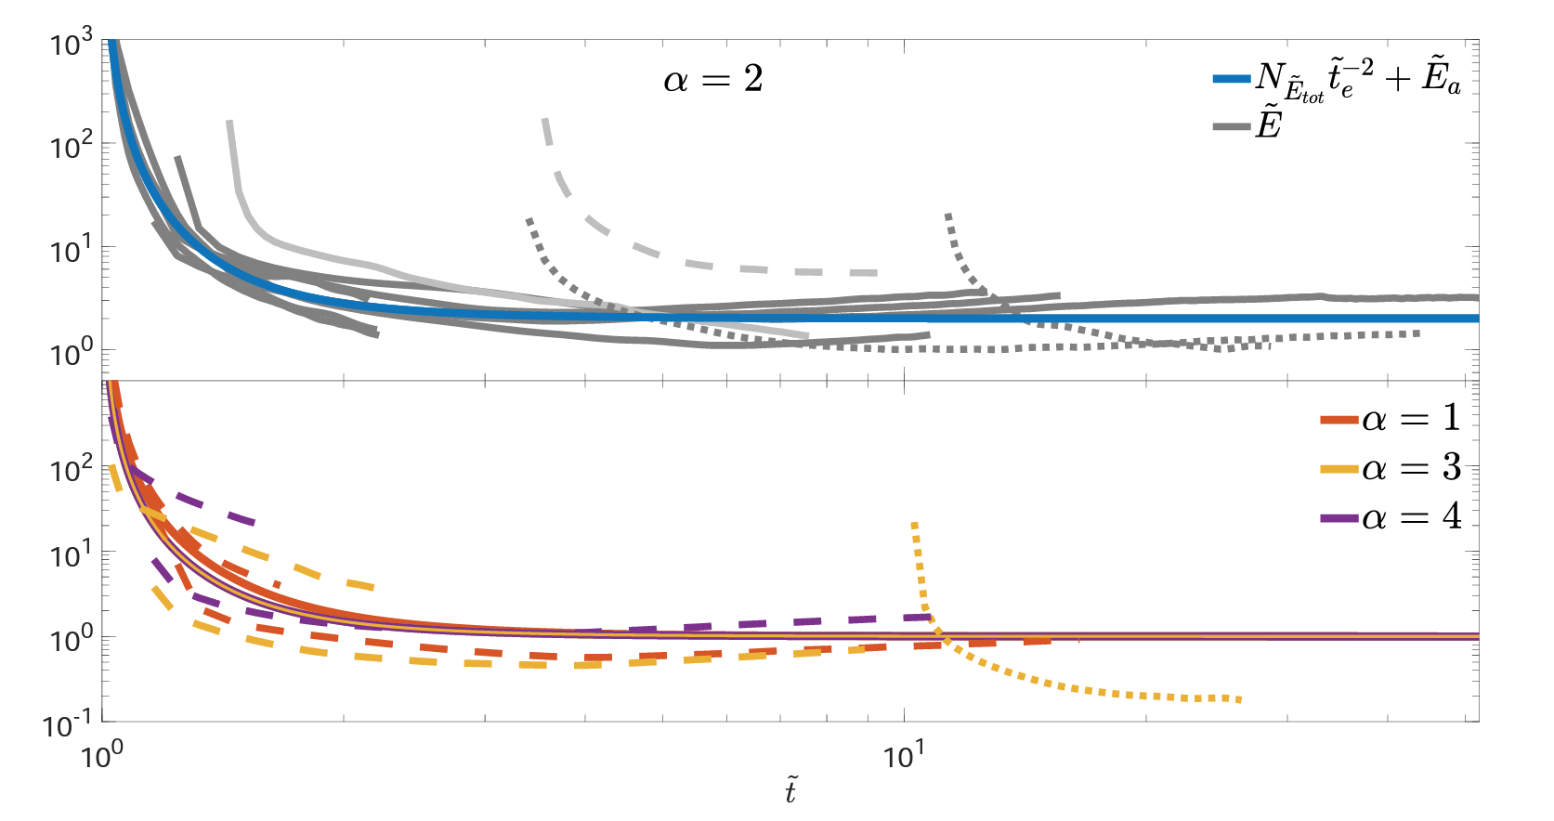
Numerical test and calibration

