Slide 1
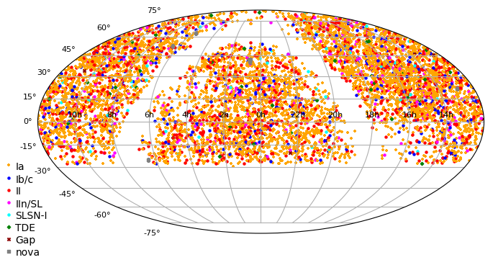
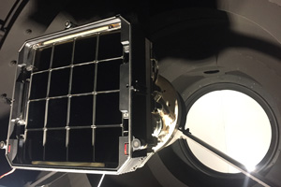
Zwicky Transient Facility:
Surveys in a GW Context
Daniel Perley
(Liverpool John Moores University)
Skymap of 7671 classified extragalactic transients
(m<19 mag) from the ZTF Bright Transient Survey

Slide 2
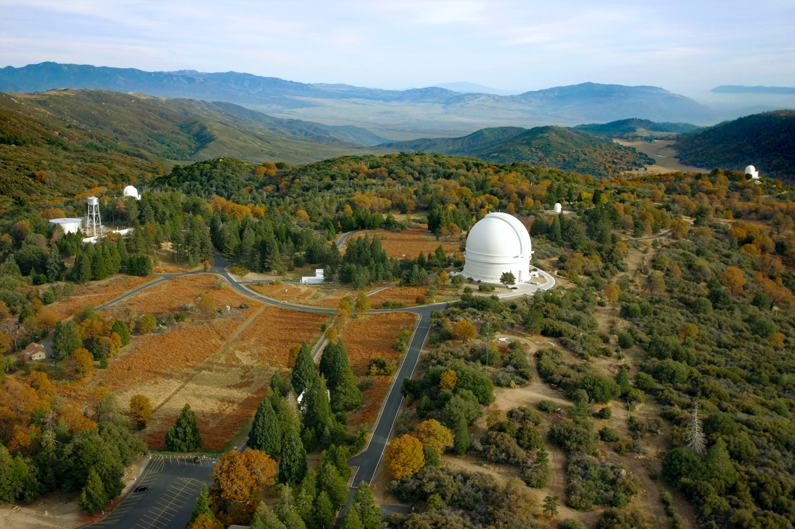
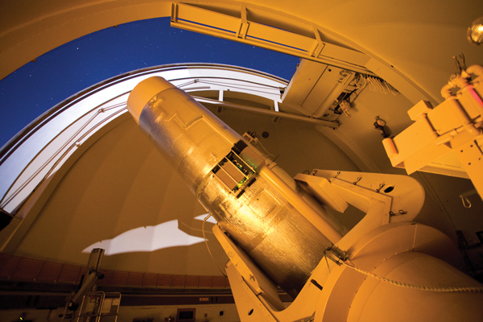

ZTF: An Unprecedented Discovery Machine
P48
1.2m: limit ~ 20.5 mag (30s)
47 deg² FOV
Notes:
And so the next step in the exploration of the dynamic universe has been to increase the power of our surveys yet again. The project that I'll be talking about is the Zwicky Transient Facility, a wide-area survey of the transient night sky. The core of the survey is the 47 square degree camera equipped on the 1.2 meter telescope telescope – the same telescope, in fact, that Zwicky initially used to conduct his pioneering supernova survey. While this is neither the biggest telescope nor the best site, a 30-second exposure is enough to reach well below 20th magnitude, which as I'll show later is more than enough for our aims.

Slide 3
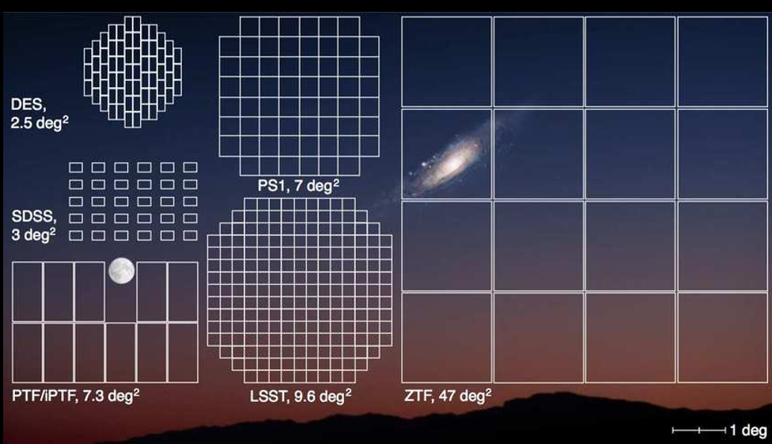

Slide 4
ZTF Surveys
Public extragalactic survey
  40% of time (~3 hours/night)
  Entire observable sky every two nights in g and r
  Likely to continue in similar form throughout O4
Galactic plane survey
Twilight NEO survey
High-cadence surveys

Slide 5
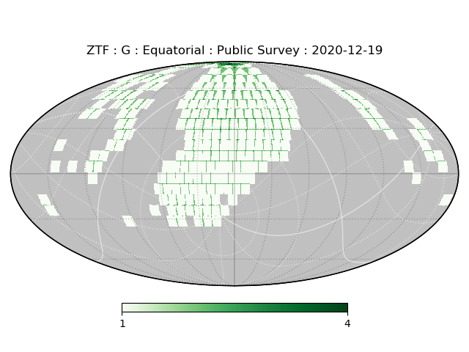
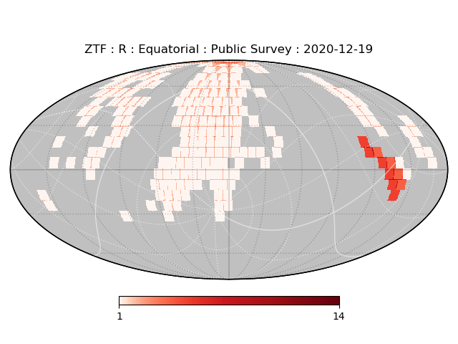
ZTF Public Northern Sky Survey
("MSIP survey")
~6000-10000 deg² surveyed in both g+r filters every clear night
Notes:
ZTF's primary public legacy product is the northern sky survey. Every night, about half the observable sky is imaged in two different filters – g-band and r-band.

Slide 6
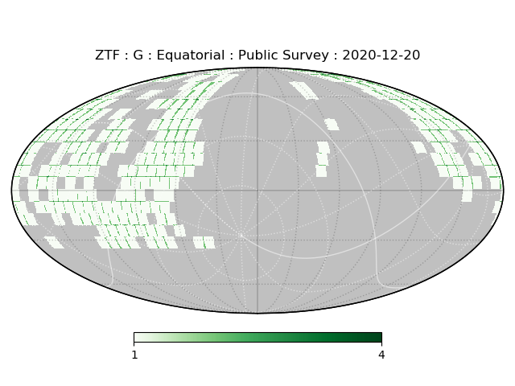
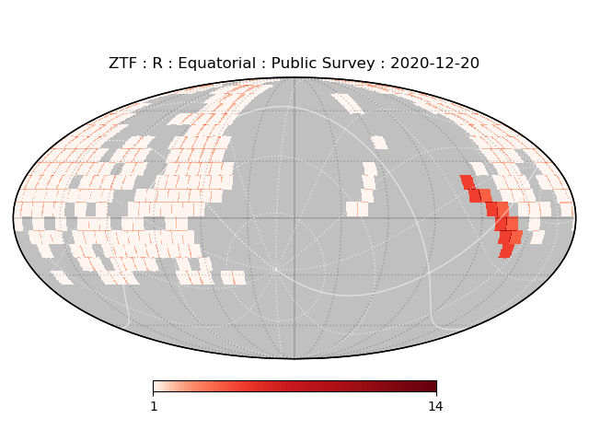
ZTF Public Northern Sky Survey
("MSIP survey")
~6000-10000 deg² surveyed in both g+r filters every clear night
Notes:
The next night, the other half of the observable sky is imaged.

Slide 7
ZTF Public Northern Sky Survey
("MSIP survey")
~6000-10000 deg² surveyed in both g+r filters every night;
~12000-20000 deg² surveyed every two nights (¼ to ½ entire sky!)
Notes:
And so every two nights, almost the entire night sky visible from the Northern hemisphere is recorded in two different filters – depending on season and weather, between 12 and 20 thousand square degrees.

Slide 8
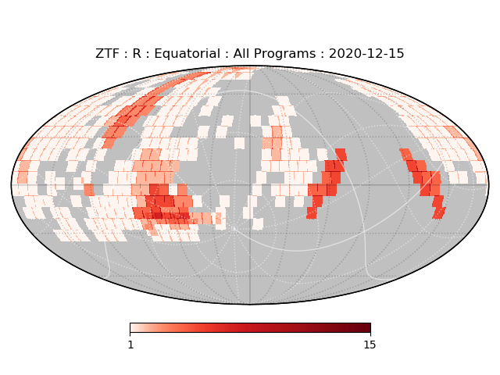
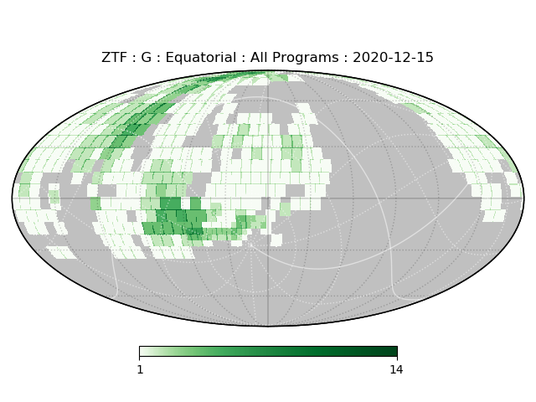
ZTF Public + High-Cadence Surveys
("MSIP survey")
Nightly Galactic
survey
High-cadence extragalactic survey
NEO
twilight survey

Slide 9
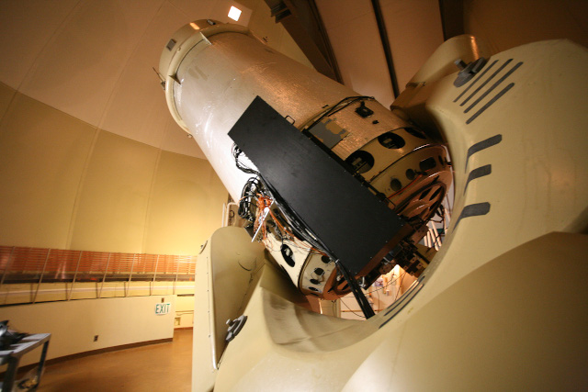
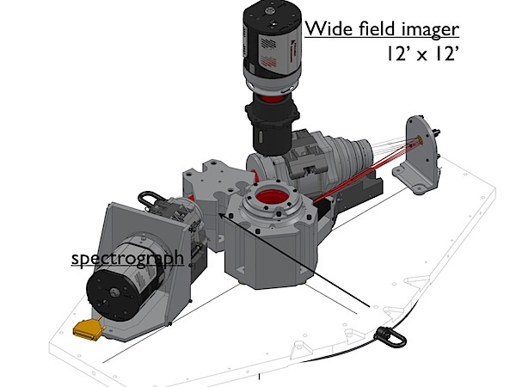

Dedicated Spectroscopic Follow-up
P60
P48
1.8m: spec limit ~ 19 mag (1 hr)
SED Machine
47 deg² FOV
Blagorodnova+2018

Slide 10
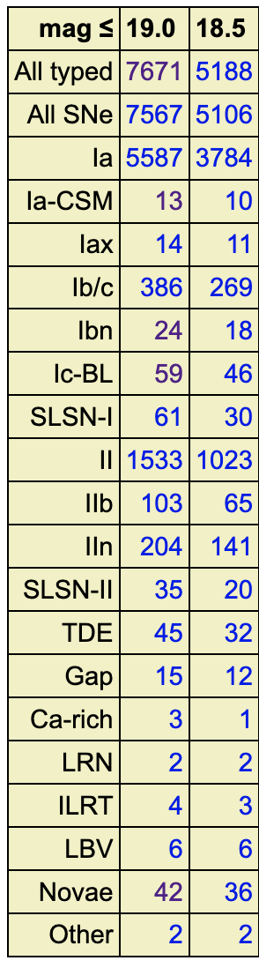
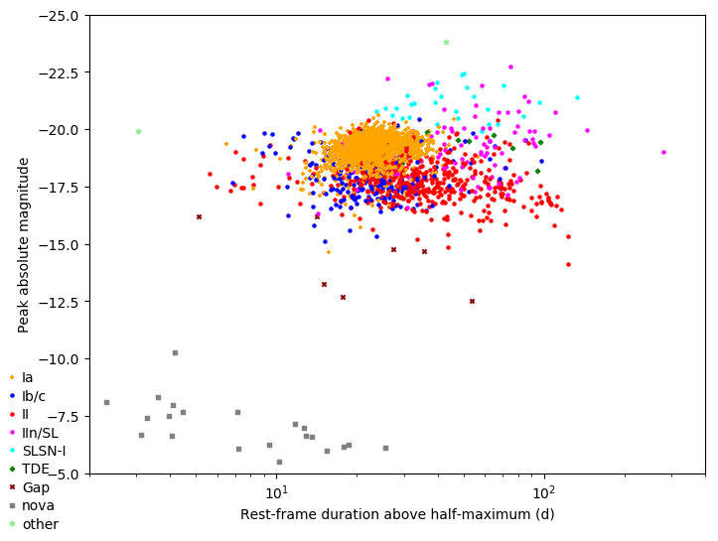
Bright Transient Survey
Record every transient to <19.8 mag;
classify every transient to <18.5 mag
(in public data)

Slide 11
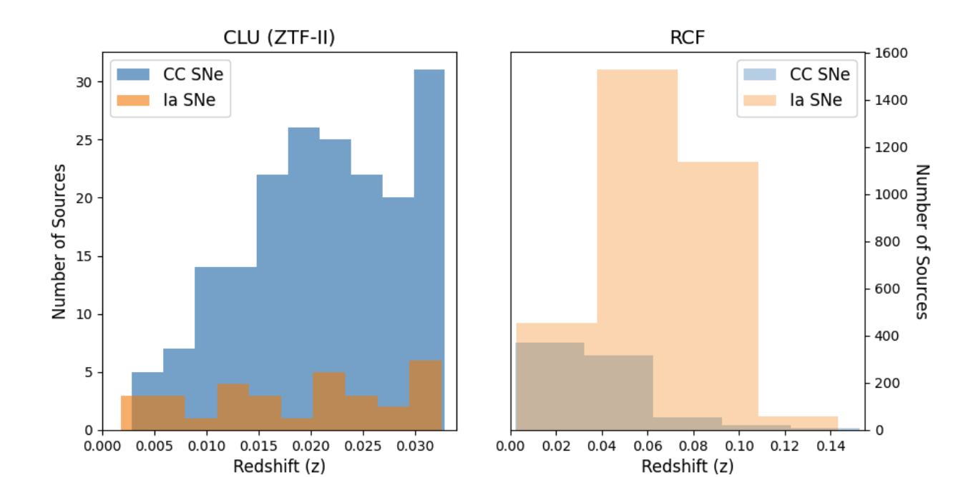
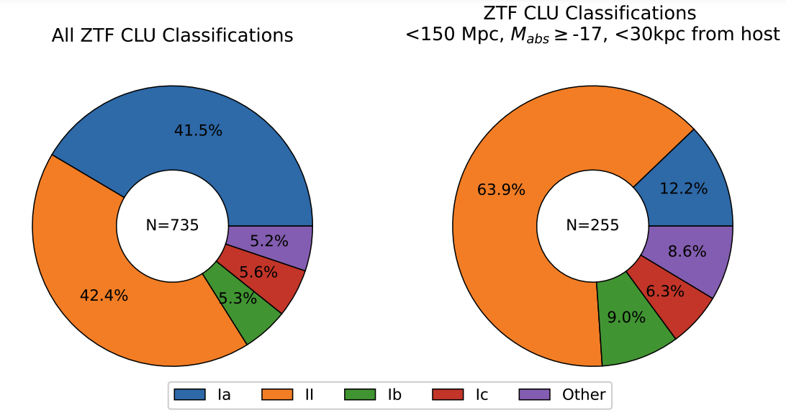
Census of the Local Universe
Record every z<0.03 transient (via crossmatch)
Classify every z<0.03 transient (unless M < -17)

Slide 12
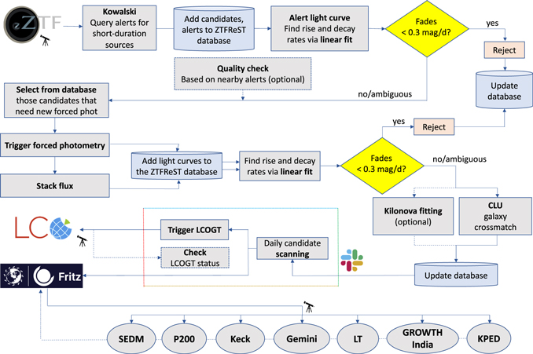
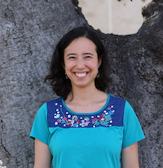


Fast Transients in Real Time
Use timescale, crossmatch, and color to isolate fast transients from new SNe and flare stars
Igor Andreoni
Michael
Coughlin
Anna Ho
Spectroscopy needed: have to act fast and be confident of candidates!

Slide 13
ZTF Surveys in O4
ZTF will be a powerful follow-up machine in O4...
but it is also critical in other ways!
Continuous, deep pre-imaging
Very slow counterparts (AGN disk flares)
The transient landscape (false positives & oddballs)
"Blind" kilonova/afterglow searches (rates, beaming)

Slide 14
Pre-imaging
(and incidental post-imaging)
Most of the observable sky north of δ > -28° will have been imaged to g~r~20 within 2 nights of any future GW trigger [some gaps]
Most unassociated transients and variables in GW error boxes can be ruled out immediately via pre-merger detections
  (Reported to TNS, or accessible via public brokers)
  + forced photometry possible

Slide 15
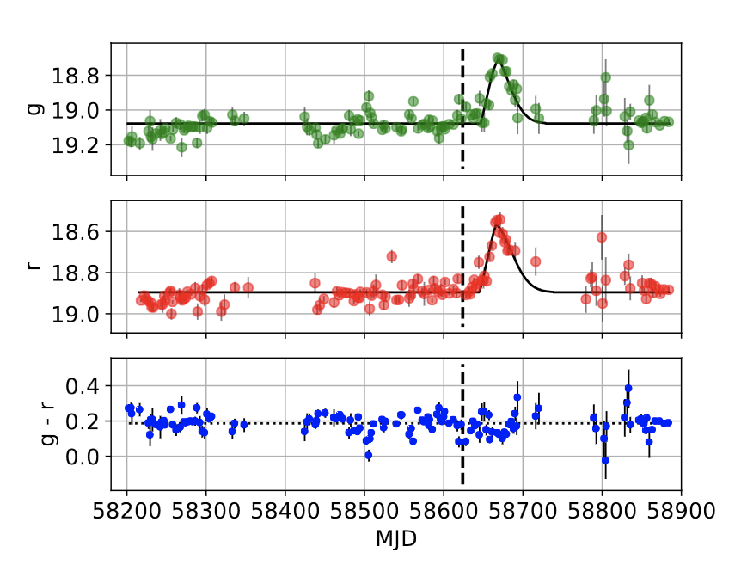
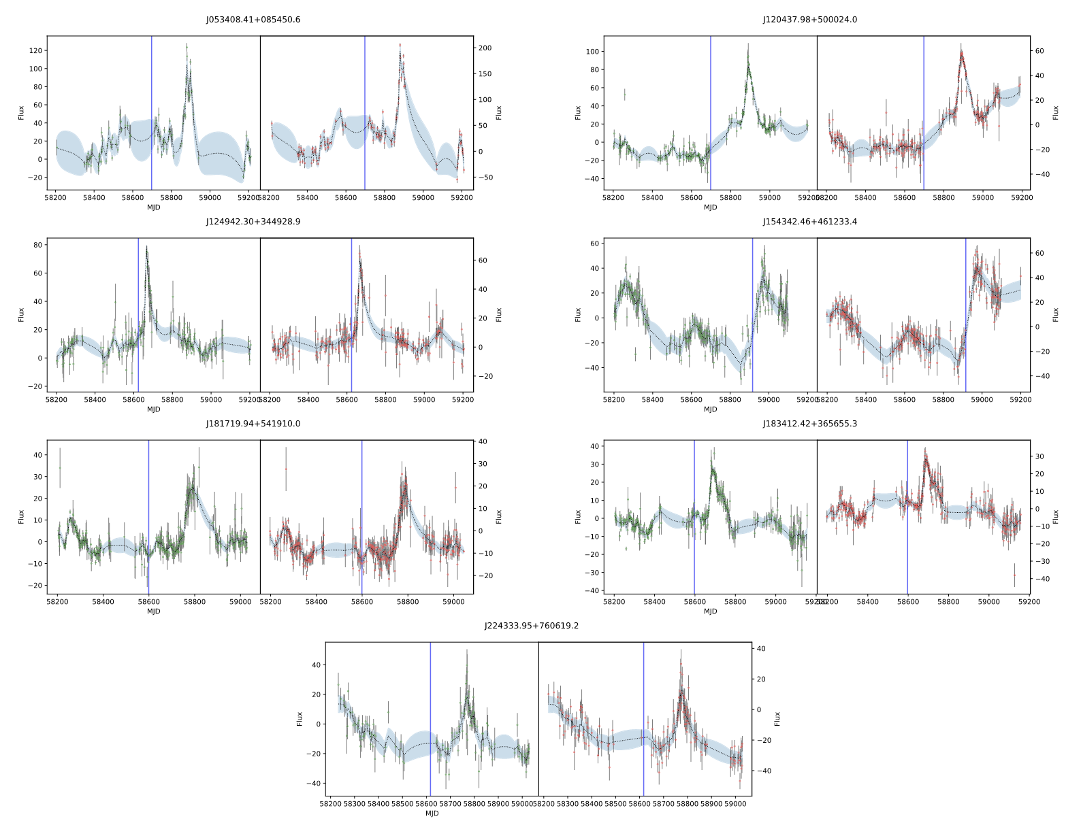
BBH Counterparts?
Graham+2020, 2023

Slide 16
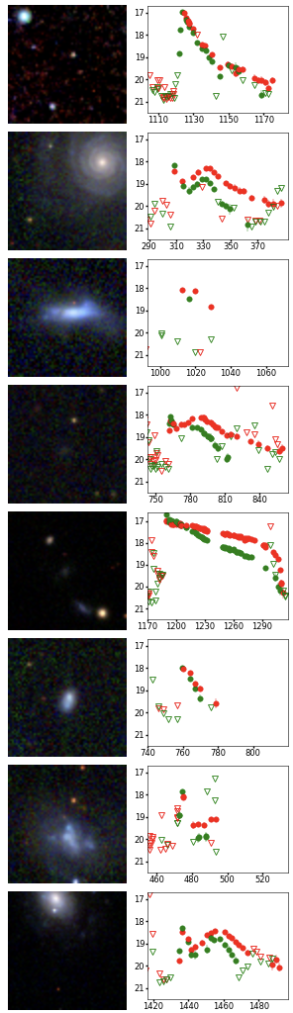
False Positives
M31 nova
IIP
IIb
IIb
II
LBV
IIb
IIb

Slide 17
Oddballs: Orphan Afterglows
Perley+2023

Slide 18
Oddballs: Relativistic TDE
i – 1.0
r
z = 1.19
g+0.5
PS1
Andreoni+2022

Slide 19
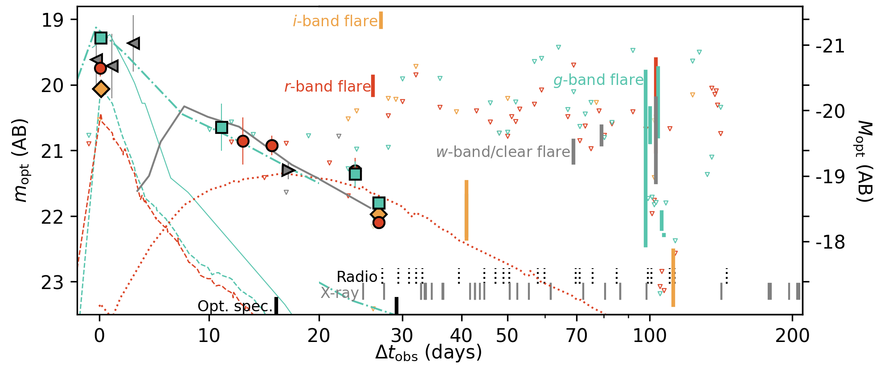
Oddballs: Flashing FBOT
Ho+2023

Slide 20
Transient Parameter Space
m < 18.5
m > 18.5
"Featureless TDE"
SN Ia
SN Iax
SN II
SN IIb
SN IIn
SN Ibn
SN Icn
SN Ibc
SN Ic-BL
SLSN-I
SLSN-II
TDE
LBV
Ca-rich
ILRT/LRN
FBOT
SLSN-I
SLSN-II
FBOT
Ibn
Ia
IIn
II
w/SBO
Ib/c
Ib/c
II
KN:
none yet
Peak absolute magnitude (AB)
ILRT
nova
Rest-frame duration (days)
Perley+2020

Slide 21
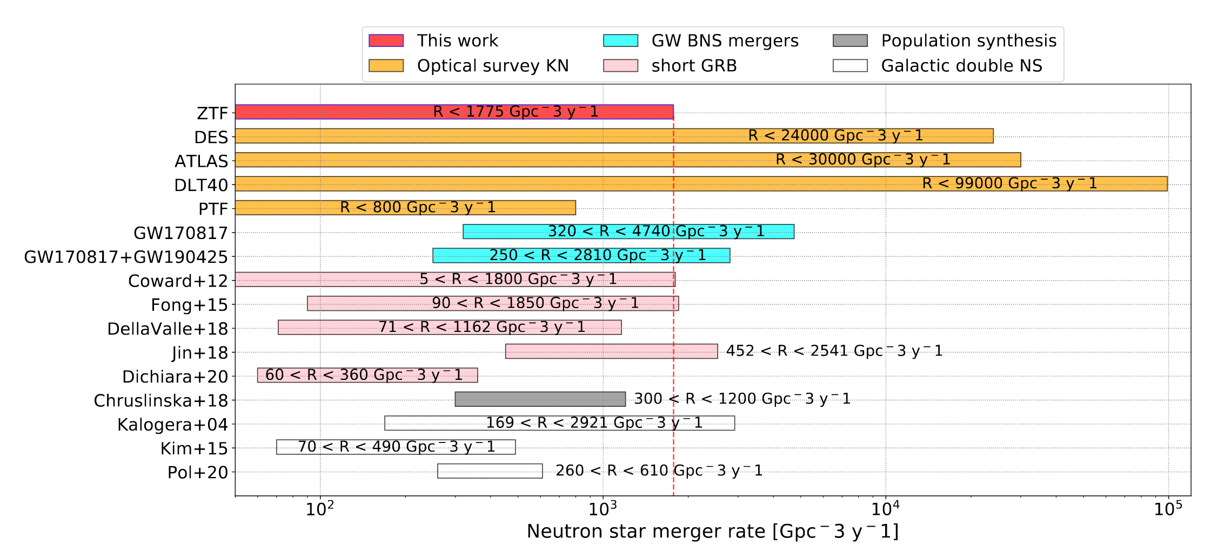
Kilonova Rate Constraints
Abbott+23
Andreoni+2020

Slide 22
Volumetric Supernova Rates
SN Ia: 2.4 × 10⁴ Gpc⁻³ yr⁻¹ (± 10%)
SN CC: 8.0 × 10⁴ Gpc⁻³ yr⁻¹ (± 30%)
SN II: 76% (± 9%) of CCSN
SN Ib/c: 24% (± 9%) of CCSN
SN IIn: 2-4% of CCSN
Ic-BL: 1-5% of CCSN, 4-20% of Ib/c
Ibn: 0.1-0.5% of CCSN
SLSN-I: 0.01-0.05% of CCSN

Slide 23
Public Resources Online
Survey description and statistics:
https://sites.astro.caltech.edu/ztf/bts/
Live catalog with light curves, classifications, pretty host galaxy images, and much more:
https://sites.astro.caltech.edu/ztf/bts/explorer.php
Survey papers: Fremling et al. (2020, ApJ 895:32),
Perley et al. (2020, ApJ 904:35)

Slide 24
Summary
ZTF will be a powerful follow-up machine in O4...
but it is also critical in other ways!
Continuous, deep pre-imaging
Very slow counterparts (AGN disk flares)
The transient landscape (false positives & oddballs)
"Blind" kilonova/afterglow searches (rates, beaming)

