Slide 1
Test-beam Analysis
Wolfgang Lohmann, DESY, BTU and RWTH

Slide 2
ECAL Analysis Meeting
Aim of this meeting
Get an overview on all software activities
Define the next steps
Prepare publication(s)
General informations

Slide 3
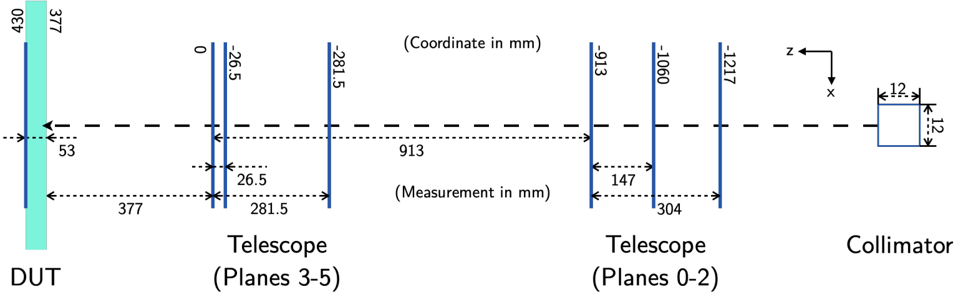
Testbeam data
We used an electron beam of 5 GeV
The track of a beam particle is defined by 5 telescope planes
4 sensors were tested,
Two silicon sensors, thickness 320 μm, denoted as C74 and C75
Two GaAs sensors, thickness 500 μm, denoted as Anton1 and Yan 1.

Slide 4
Testbeam data
We used an electron beam of 5 GeV
The track of a beam particle is defined by 5 telescope planes
Alignment of telescope planes done (thank you, Shan)
Tracking works, sensor alignment in preparation

Slide 5
Testbeam data
Number of triggers
C74 18 x 10⁶ scan over the sensor
7 x 10⁶ at position – 37,5, - 6.5
C75 27 x 10⁶ scan over the sensor
18 x 10⁶ at position – 1.5, - 88.5
A1 46 x 10⁶ scan over the sensor
Y1 44 x 10⁶ scan over the sensor
33 x 10⁶ at position 1, - 94,4

Slide 6
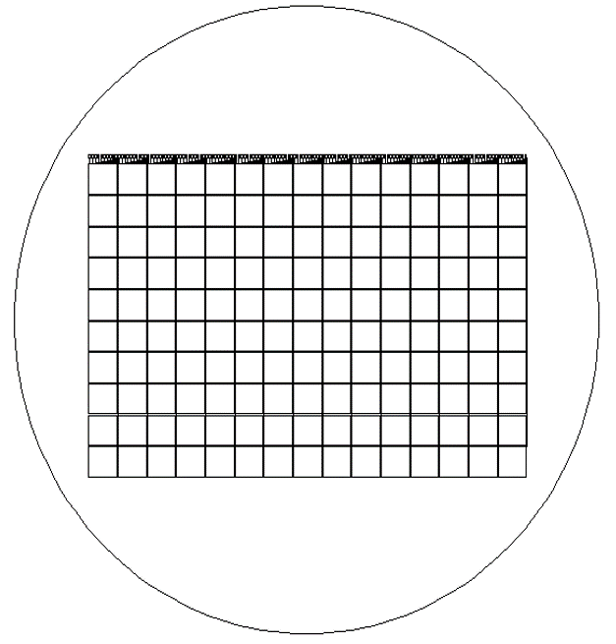
Aim of data analysis
Homogeneity of the response
Take only tracks hitting the central
part of a pad (e.g.the red area
Plot the signal size, determine MPV
of signals in each pad
Use the pedestal width to calculate
S/N
Apply calibration constants

Slide 7
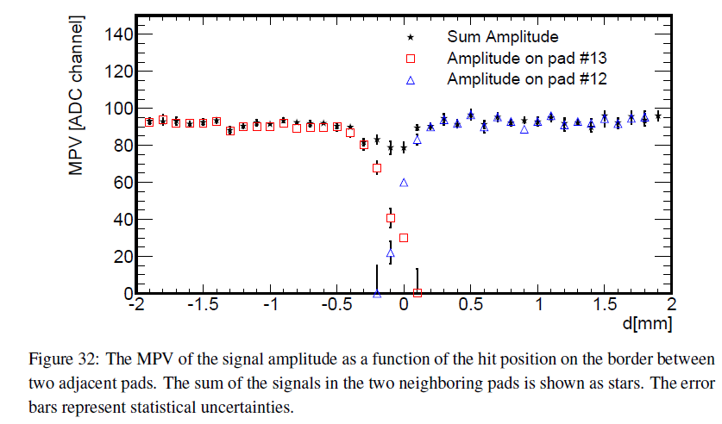
Aim of data analysis
Performance near the edges of the pads
Take tracks hitting a certain strip in x
Plot the signal size of these events, determine MPV of signals in each strip
Plot the MPV as a function of x
(or equivalently y)
Example of such a plot from previous
studies
x

Slide 8
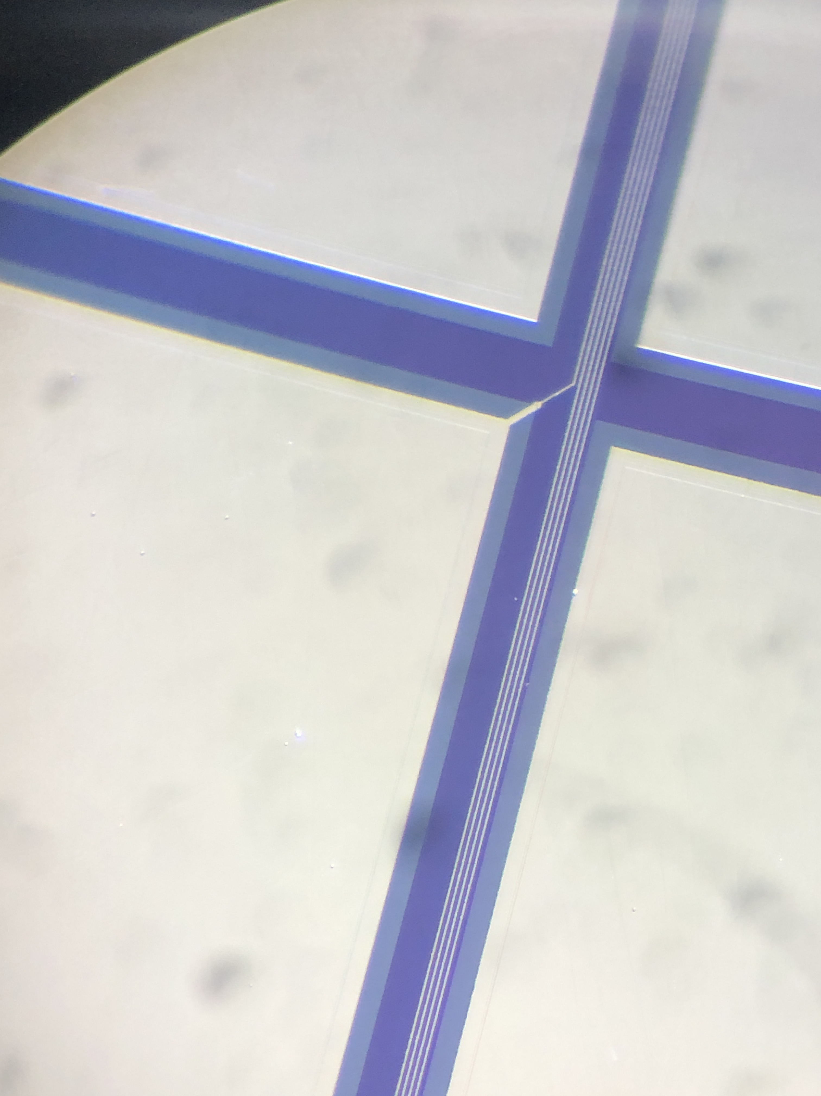
Aim of data analysis
Cross talk 1
At the GaAs sensors, the signals of the pads are routed to the edge via traces in between the pads. Electrons impinging on these traces may induce signals assigned wrongly to the pad where the trace is connected. To study these effects, events with predicted beam positions in between pads should be used.
Select tracks in the orange area, and search for signals in pads to which the traces are connected
Pad connected to Al readout trace

Slide 9
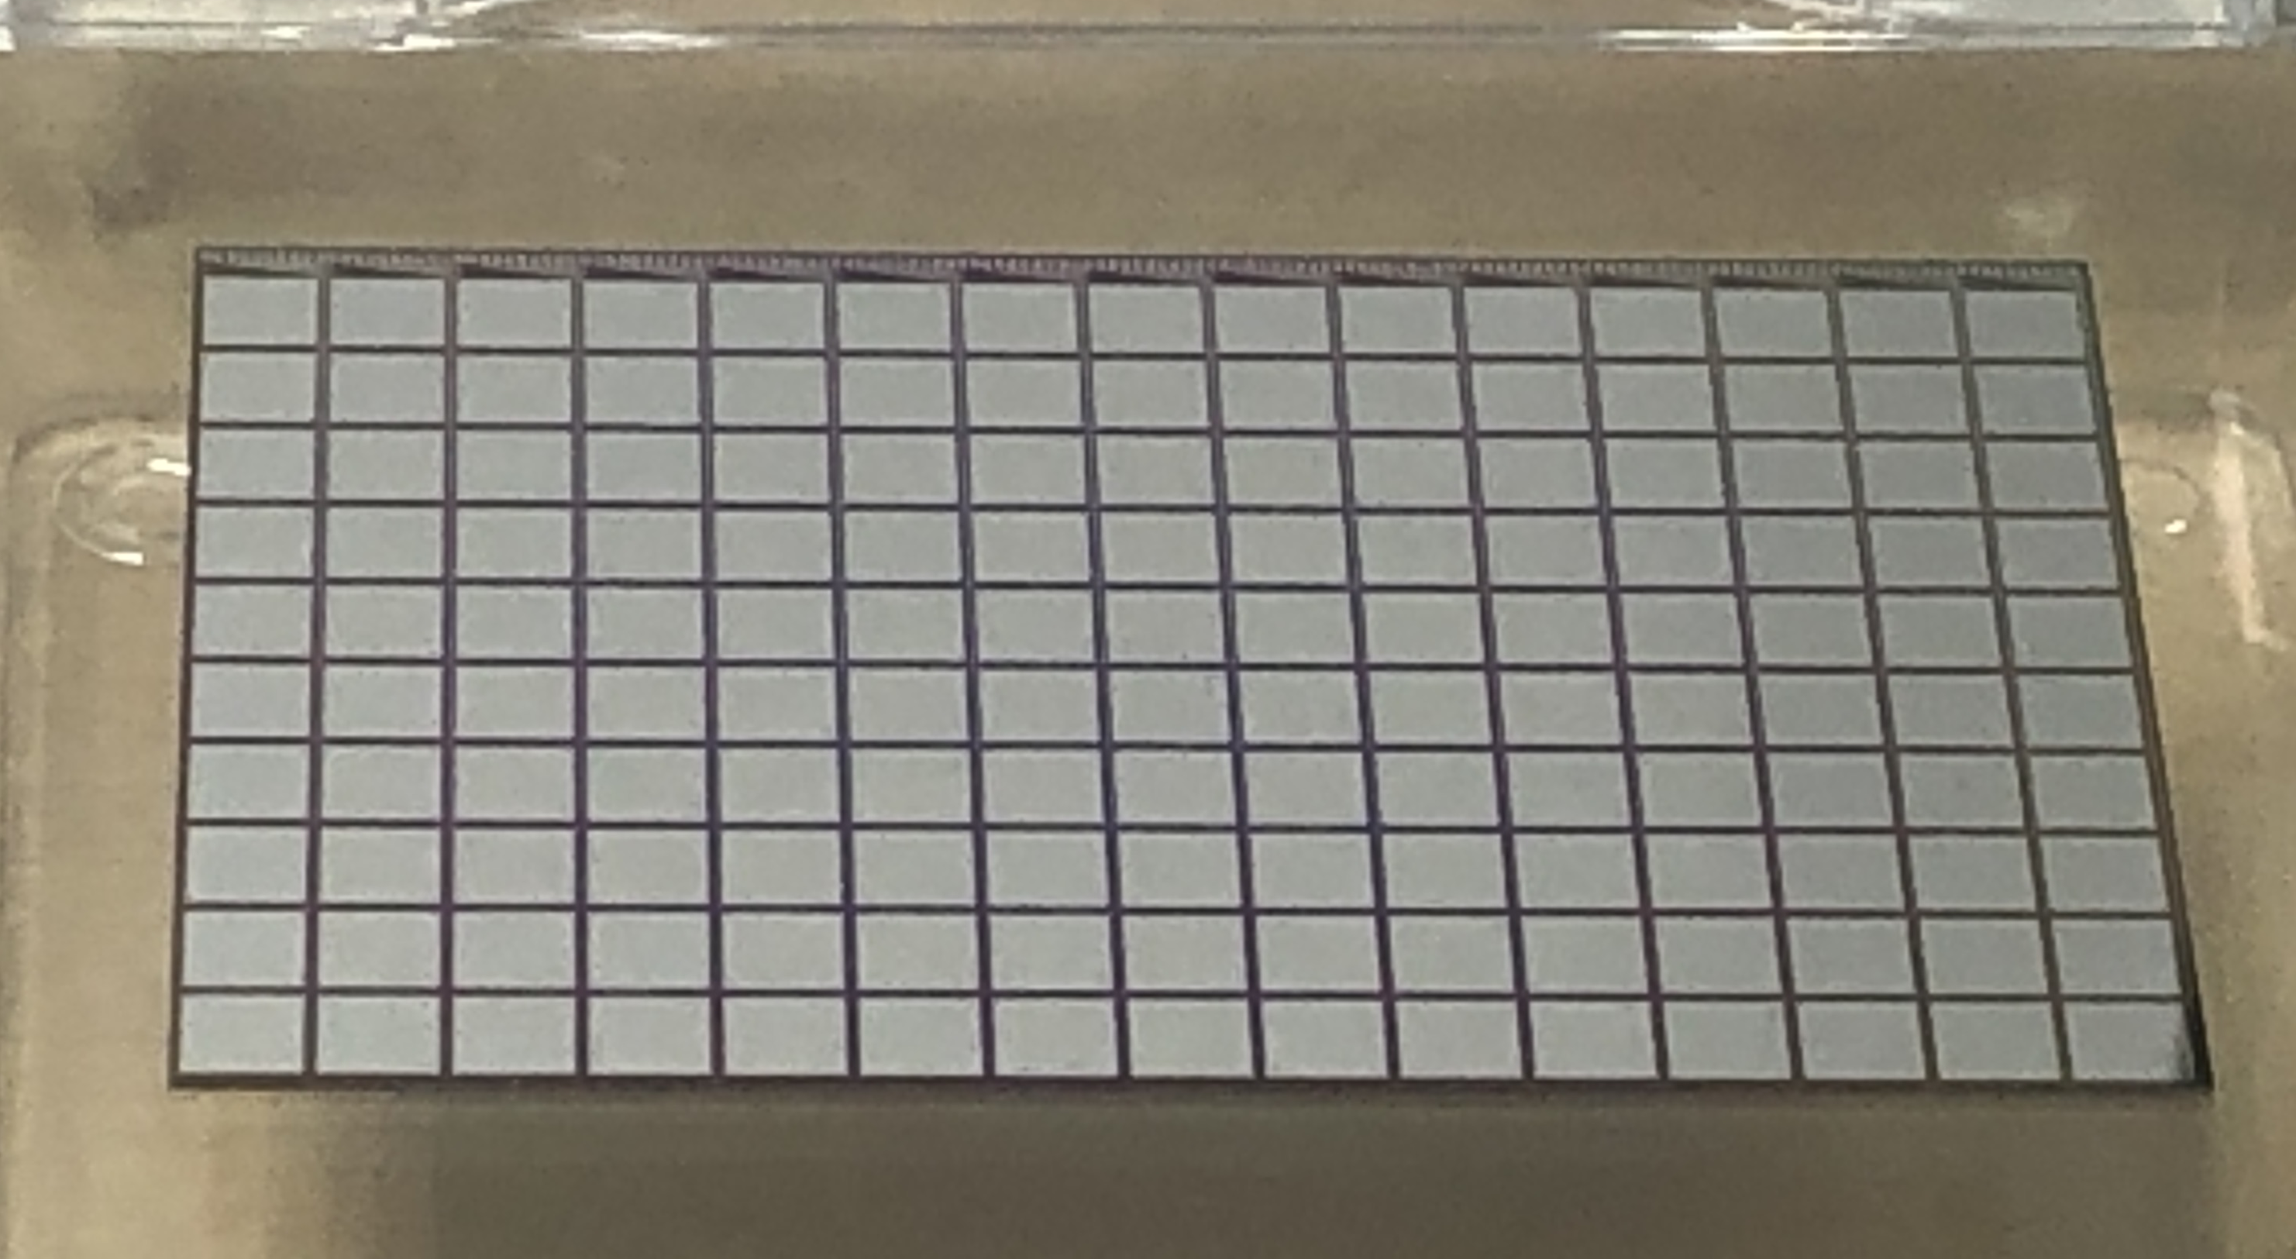
Aim of data analysis
Cross talk 2
Both in Calice and GaAs sensors signal routing traces have a non-zero capacitance to neighbors, resulting in cross talk of signals between traces.
To study this effect runs with the beam spot in the lower part of the sensors should be used. Then, for signals in pads in the upper part, not covered by the beam, should be searched for.
Search for potetial signals here, in addition to signals in the beamspot area
Beamspot here

Slide 10
Goals of data analysis
Analysis of data with tungsten absorber
Understand the response of the readout to larger signals, potential cross talk
Understand the response for “low gain”, define the overlap in amplitudes
Illustrate longitudinal and transversal shower profiles, compare with simulation and previous results (our first measurements of the shower tails)

Slide 11
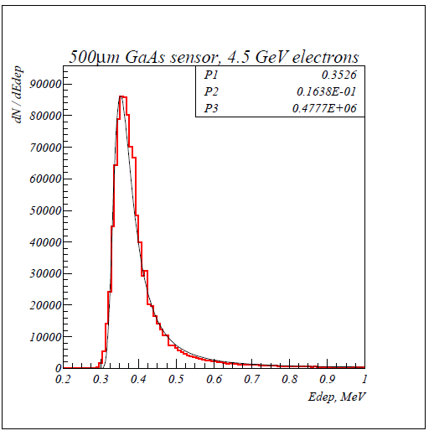
Aim of data analysis
4.5 GeV electron beam,
500 μm sensor thickness
GEANT4 simulation
Estimated number of e/h pairs per μm GaAs for different electron energies,
In a 500 μm thick sensor this corresponds to 41000 electrons

Slide 12
General informtions
IFIC
Preparation of the lab space
Material and structure of the gluing tests
Hiring one postdoc and one Ph.D., potential participation in test beam analysis
IJCLab
Strategy of gluing studies (Technical meeting planned)
Delivery of PCB (for LUXE) in progress
IJCLab kickoff meeting worked well, soon meeting with mechanics department
Status report in April

Slide 13
Goals of data analysis
Auxiliary informations:
Pedestals for all channels in all runs, pedestal width is needed for S/N
Calibration constants for all channels (important for homogeneity plots)
‚zero point‘ of signal distributions (to be done with raw data) at least for a few channles
Signal distribution from raw data without using the FPGA preprocessing algorithm

