Slide 1
Summary of KW 9
 | Monday 27th February | Tuesday 28th February | Wednesday 1st March | Thursday 2nd March | Friday 3rd March
Achievements | * Tunnel open for maintenance day | * Preparing high-charge WP (100 pC), optimizing transmission through TDS * MDI shift (charge comparison DAMON/ICT) | * D3 irradiation tests (50 pC downwards) : TLD irradiation, PANDORA response * UKE irradiation tests (125 pC) | * AA shift: Tuning gains for horizontal position feedback * Overnight position stability data with various feedback settings | * Data acquisition for arrival time jitter measurement vs TWS1 phase
Perturbating events | - | * Cathode laser locking lost, then bucket drifting (stabilized overnight) | * BPM MR.G1 not locked (signal jumping around) | * Missing signal at gun modulator caused RF ramp-down * BPM LI.G1 shows weird signals | -
Notes | - | * TWS2 forward power reading defect | * PETRA magnet ramping does not seem to disturb | - | * Slightly more gun momentum after 25 Hz run

Slide 2
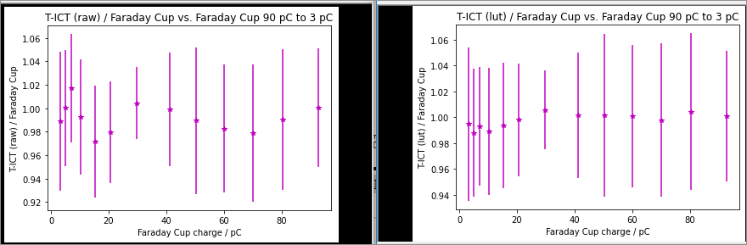
Charge measurement – Devices comparison (MDI)
Turbo-ICT and Faraday Cup are in agreement with each other within the error bars over a large charge range (up to 95 pC). Toroid also in agreement since matched to Faraday Cup.
Signals from the DAMON cavities also acquired for comparison. The outcome needs to be internally discussed before drawing conclusions.

Slide 3
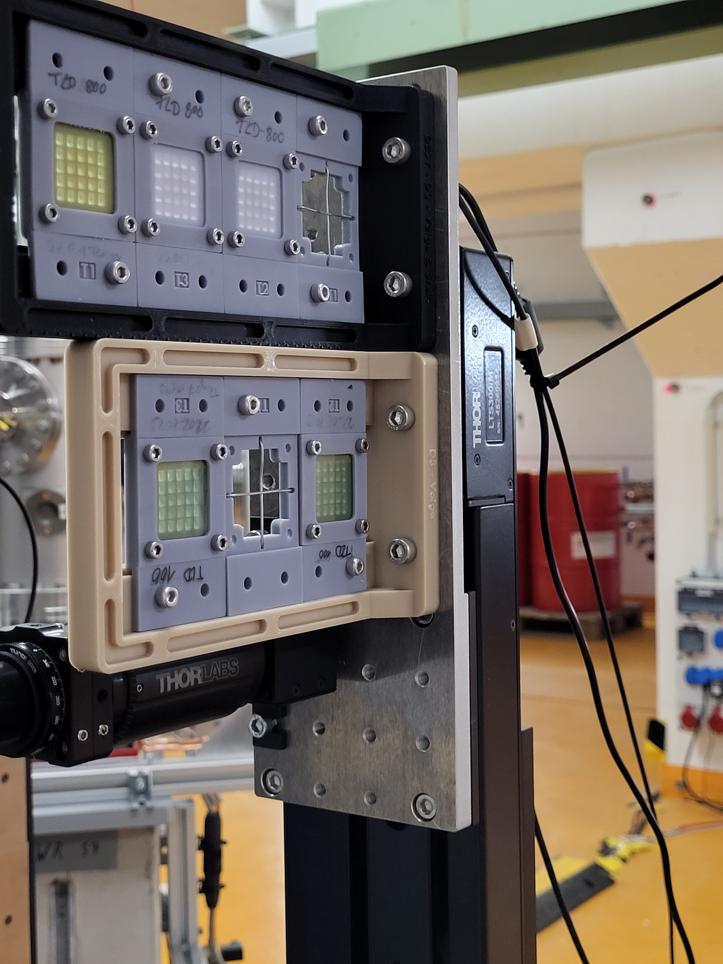
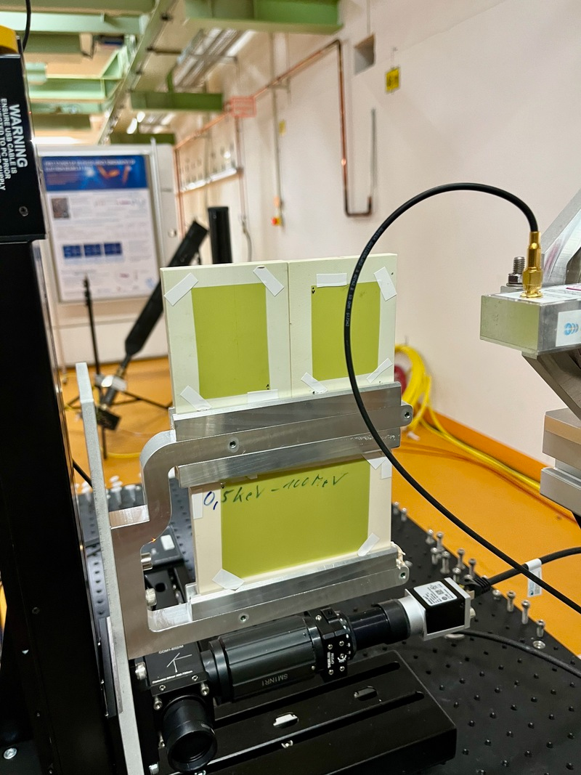
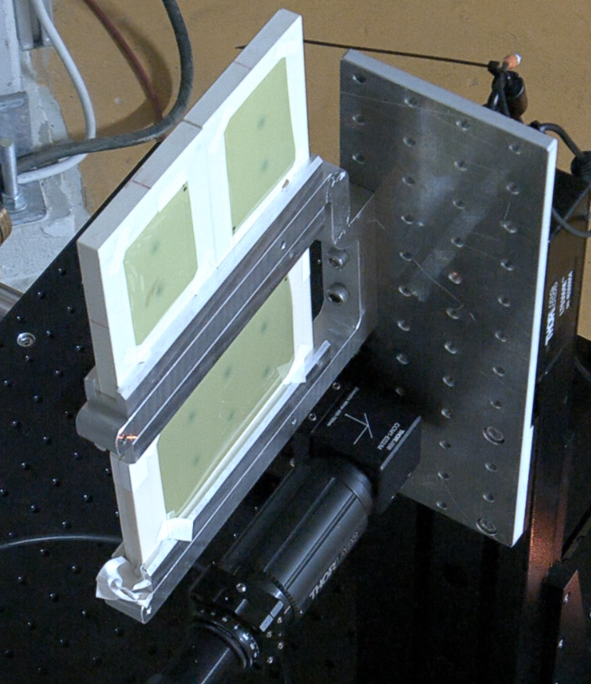
Irradiation tests (UKE & D3)
UKE: Film irradiation
D3: Irradiation of TLD dosimeters

Slide 4
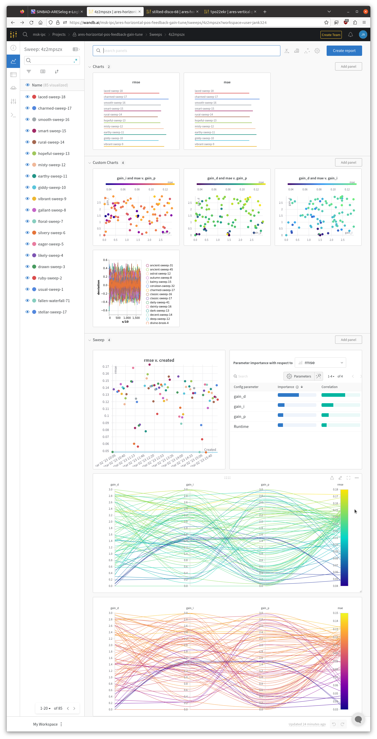
Position feedback gain optimization

Slide 5
Schedule
Week 10
Date | Shift leader
6.3. | Florian (Tunnel open)
7.3. | Thomas, Max
8.3. | Willi, Frank, Blae
9.3. | Willi, Frank, Blae
10.3. | Willi, Frank, Blae
If you want to learn or join the shift: please give the shift leader a call (BKR 2840 / SINBAD Box 2454)

