Slide 1
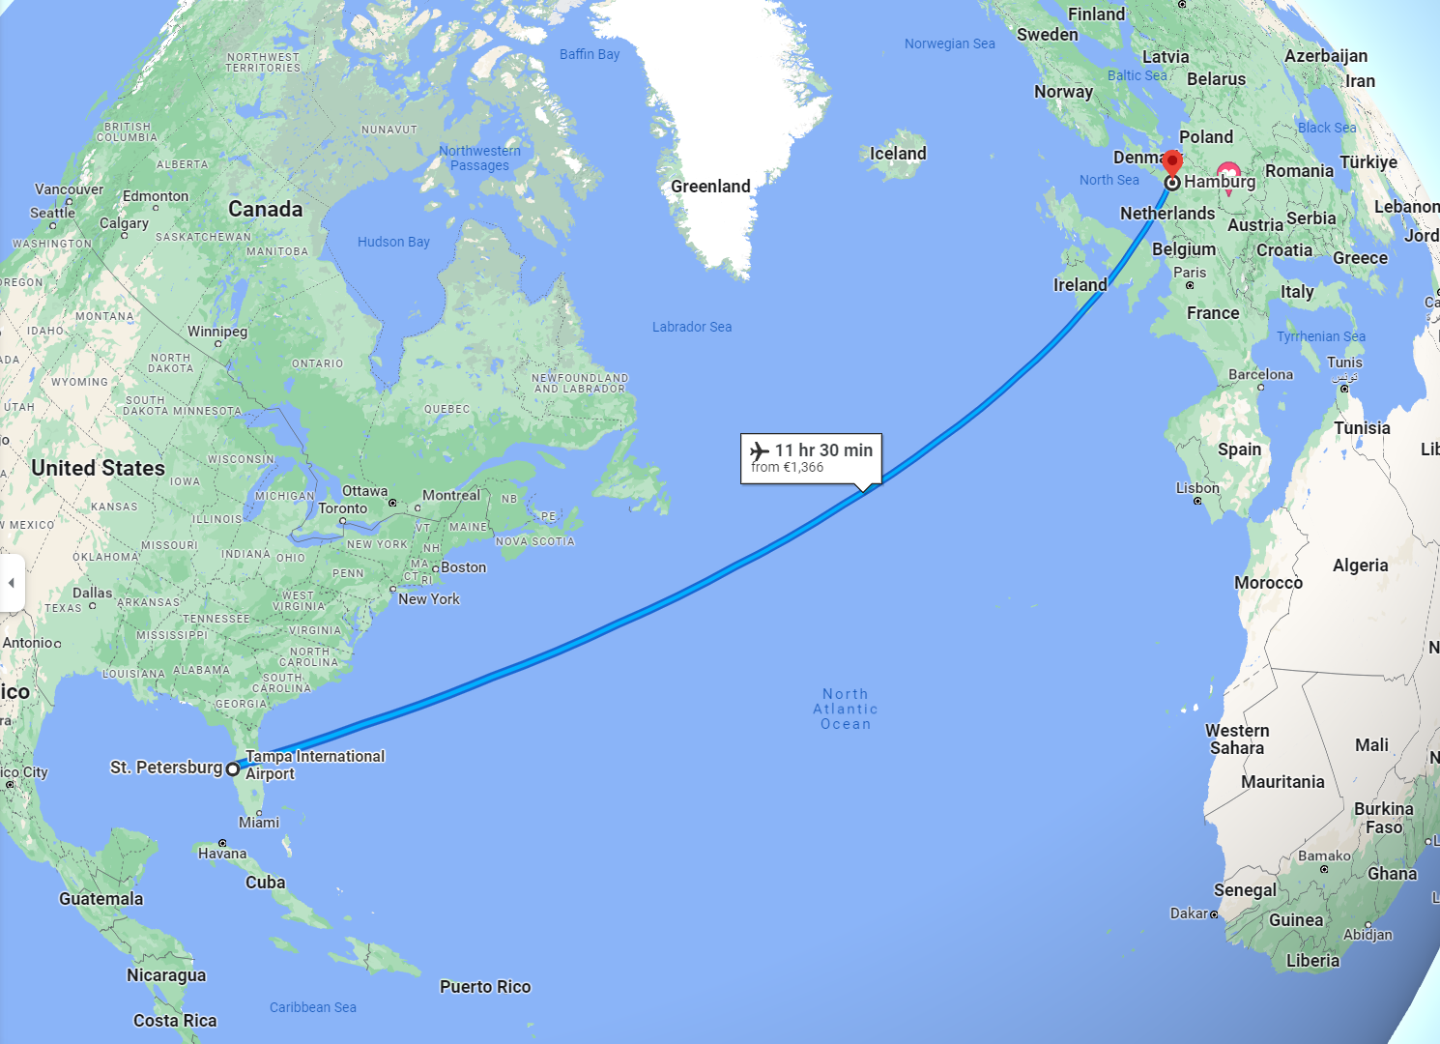
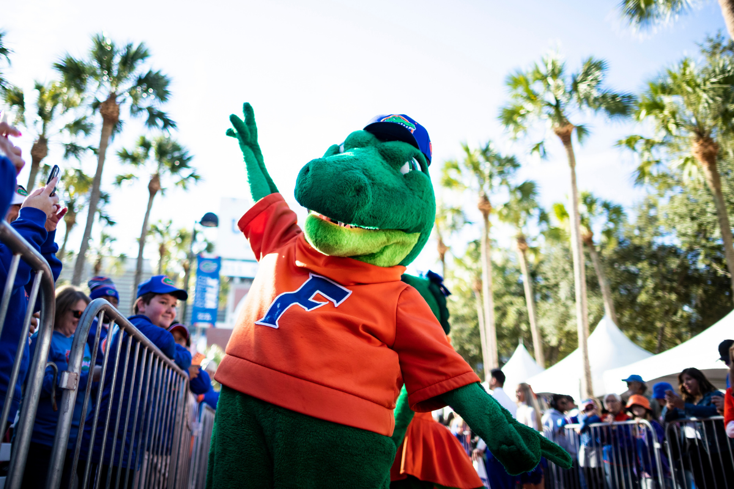
Todd Kozlowski
1992
born, St. Petersburg, FL, USA
2011- 2015
undergraduate education at the University of Florida
2016- 2022
PhD for work on the ALPS II experiment at DESY
2023 - ??
DESY FH Fellow

Slide 2
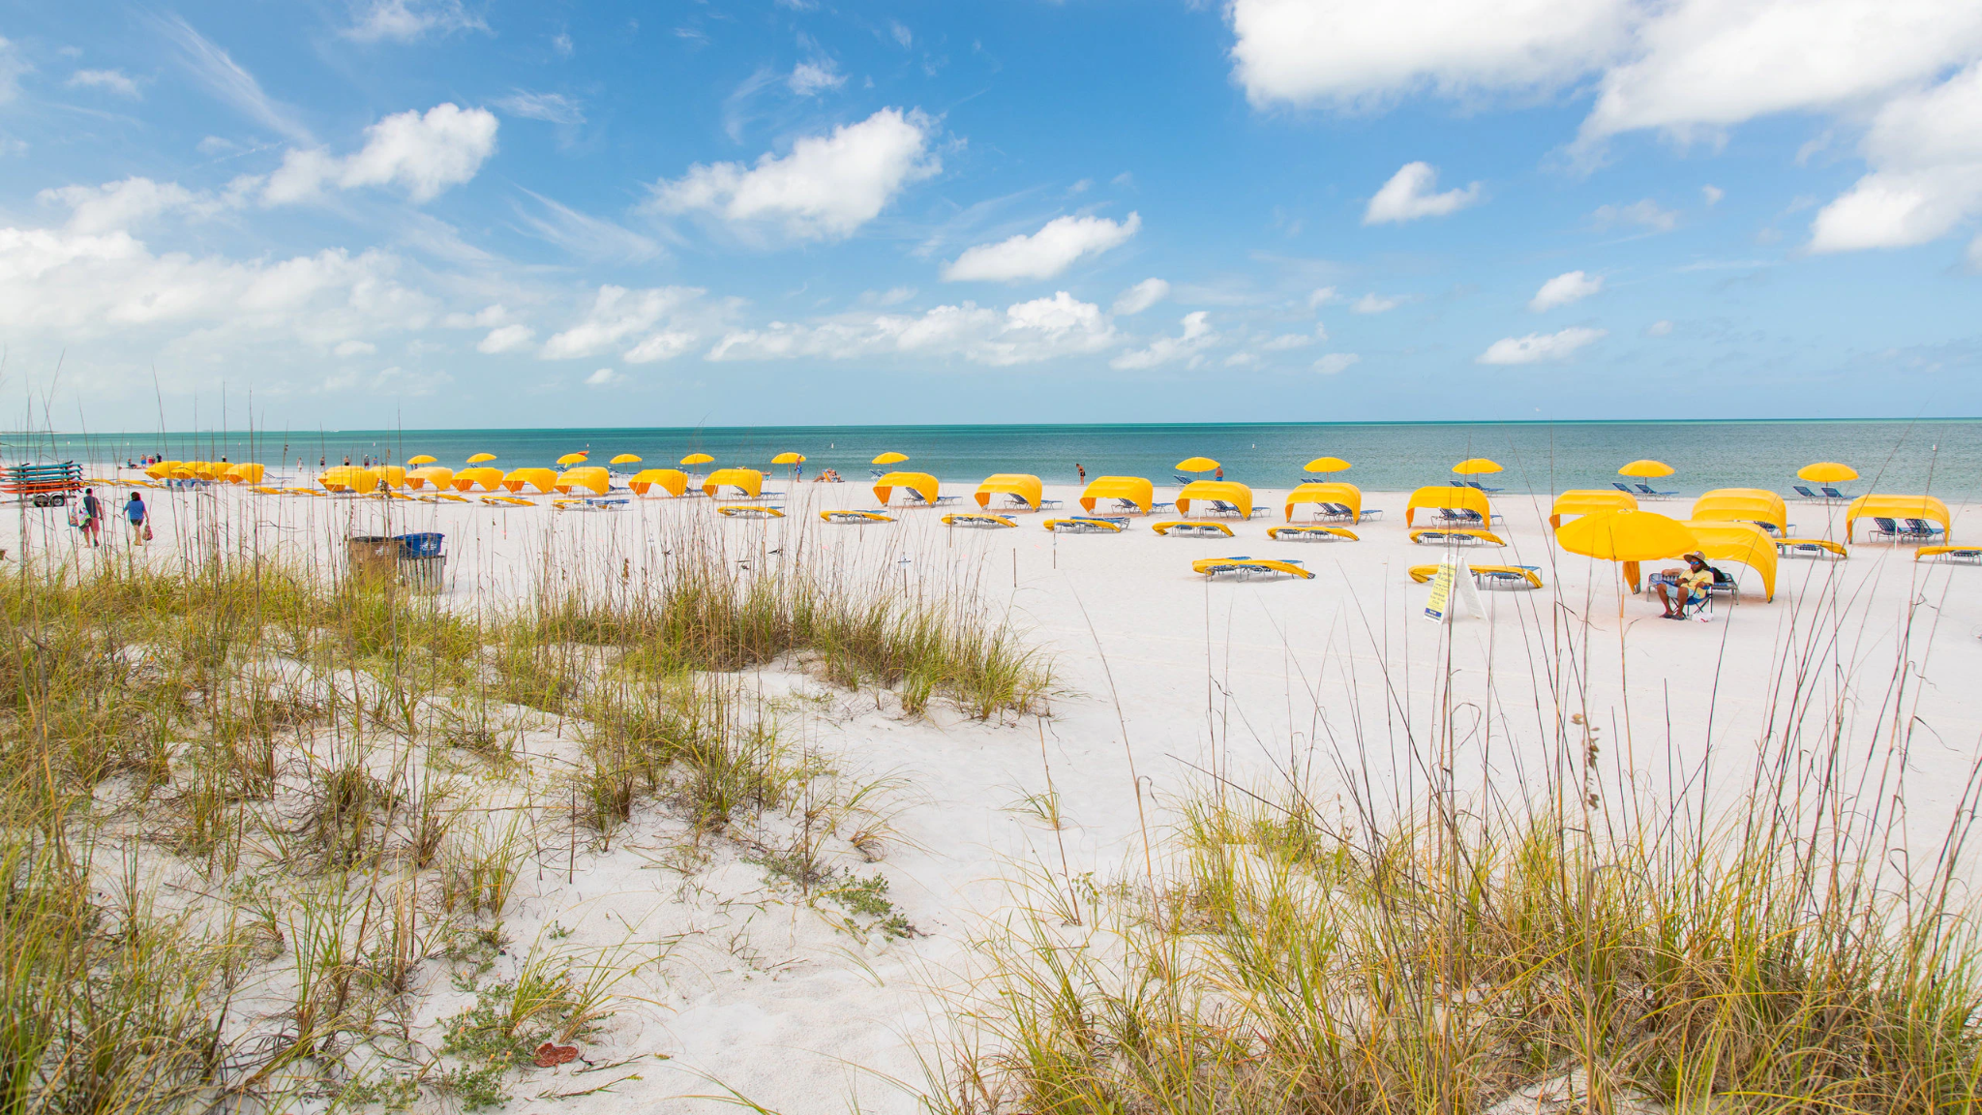
About Me

Slide 3
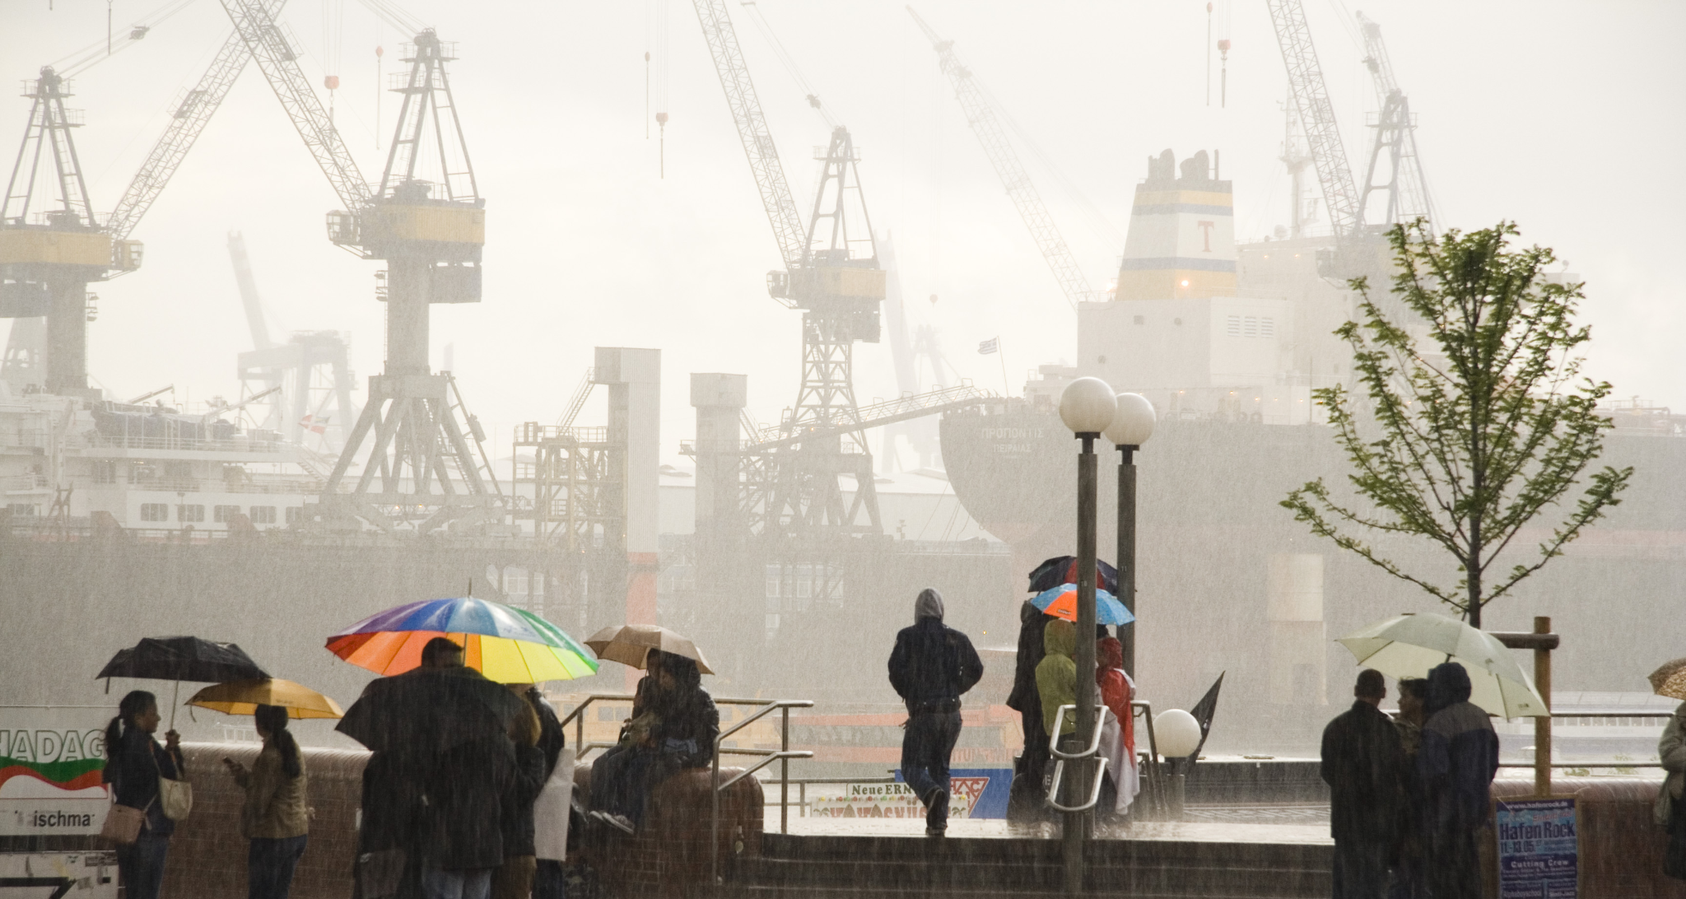
About Me
About Me
Background, past activities

Slide 4
My Current Work
I use high-quality laser optics and techniques in precision interferometry to boost the sensitivity of the ALPS experiment to theoretical particles beyond the Standard Model.
Optical cavities “store” circulating light which, on resonance, formed a standing wave. In this way, the power of circulating light can be thousands of times larger than the power of the input laser.
Achieved a world record for the storage time of two-mirror optical cavity: 6.75ms
Will soon use those same techniques to develop a scheme to measure the magnetic birefringence of the vacuum predicted by quantum electrodynamics.

Slide 5
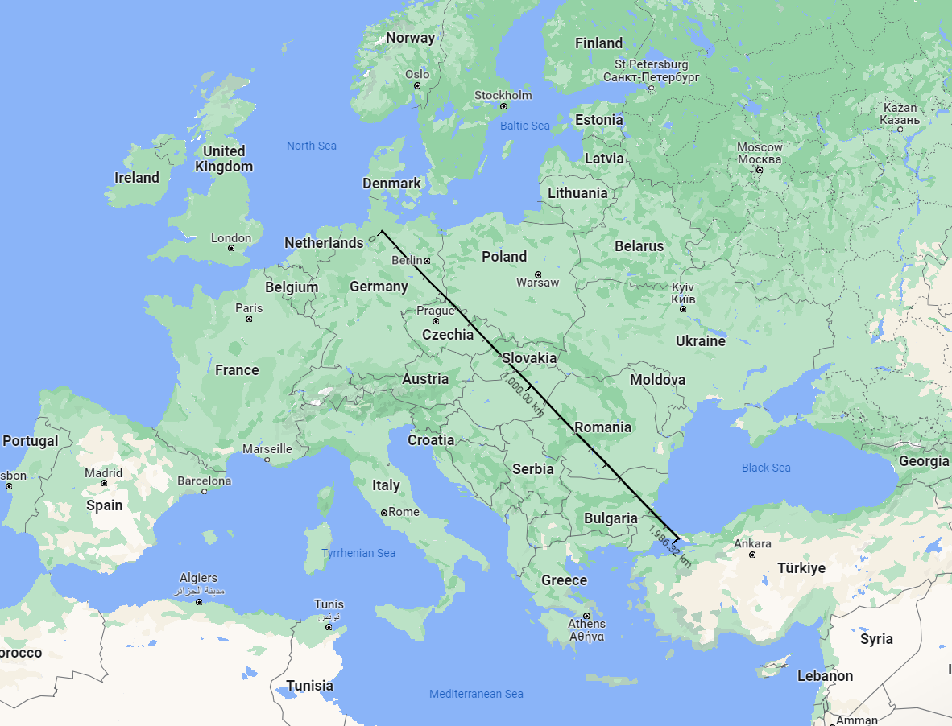
My Current Work
I use high-quality laser optics and techniques in precision interferometry to boost the sensitivity of the ALPS experiment to theoretical particles beyond the Standard Model.
Optical cavities “store” circulating light which, on resonance, formed a standing wave. In this way, the power of circulating light can be thousands of times larger than the power of the input laser.
Achieved a world record for the storage time of two-mirror optical cavity: 6.75ms
Will soon use those same techniques to develop a scheme to measure the magnetic birefringence of the vacuum predicted by quantum electrodynamics.

Slide 6
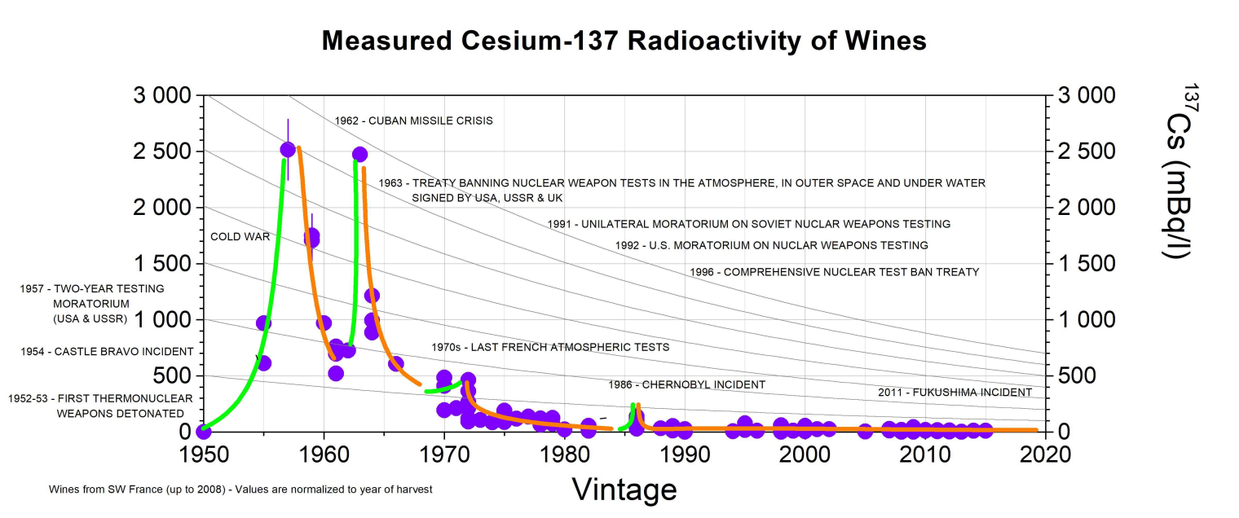
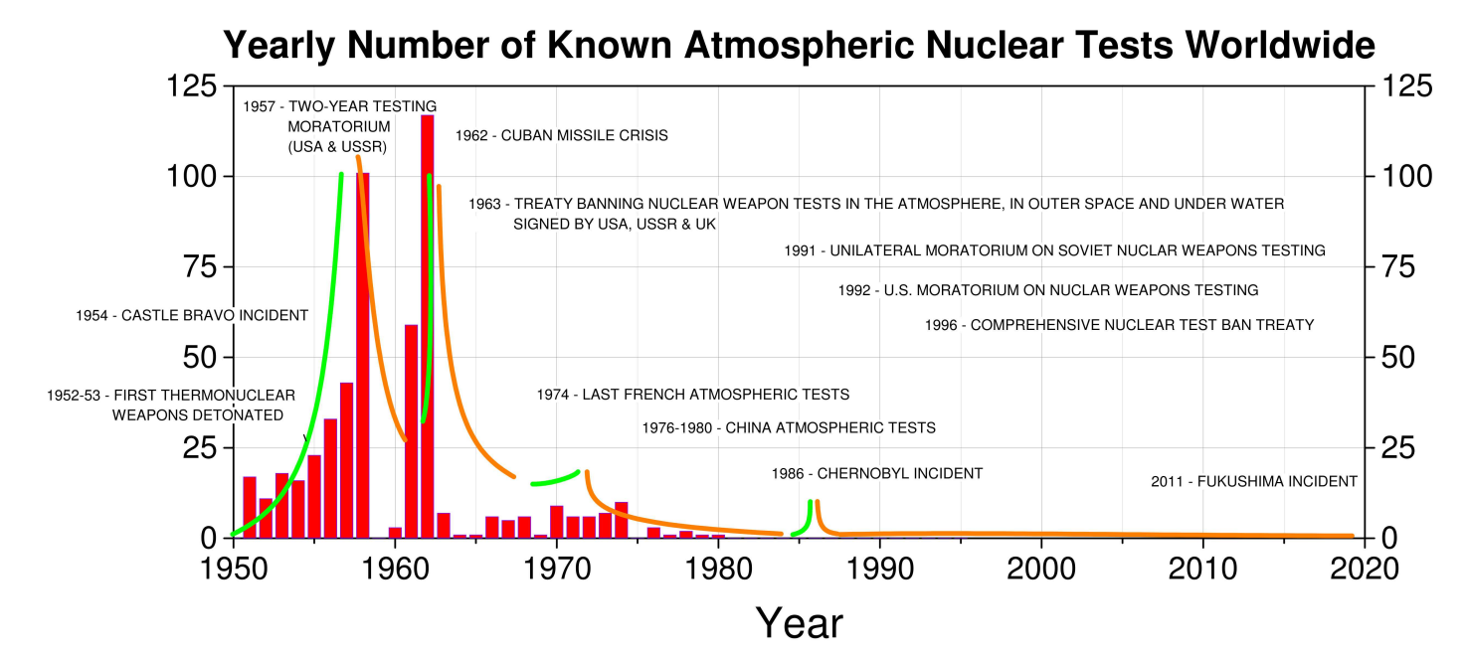
My Favourite Plot

Slide 7
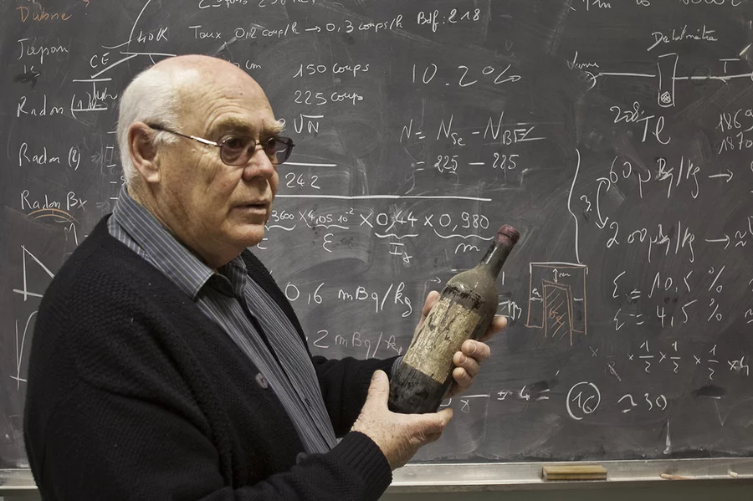
My Favourite Plot
This method is used to check for wine fraud
Including, famously, alleged wine from Thomas Jefferson’s private collection
Sold for $150,000 / bottle to Republican super-donor Bill Koch
by Schlager music manager Hardy Rodenstock

