Slide 1
New tools for precision collider physics
Aditya Pathak
FH Fellow Meeting
21/28 April 2023

Slide 2
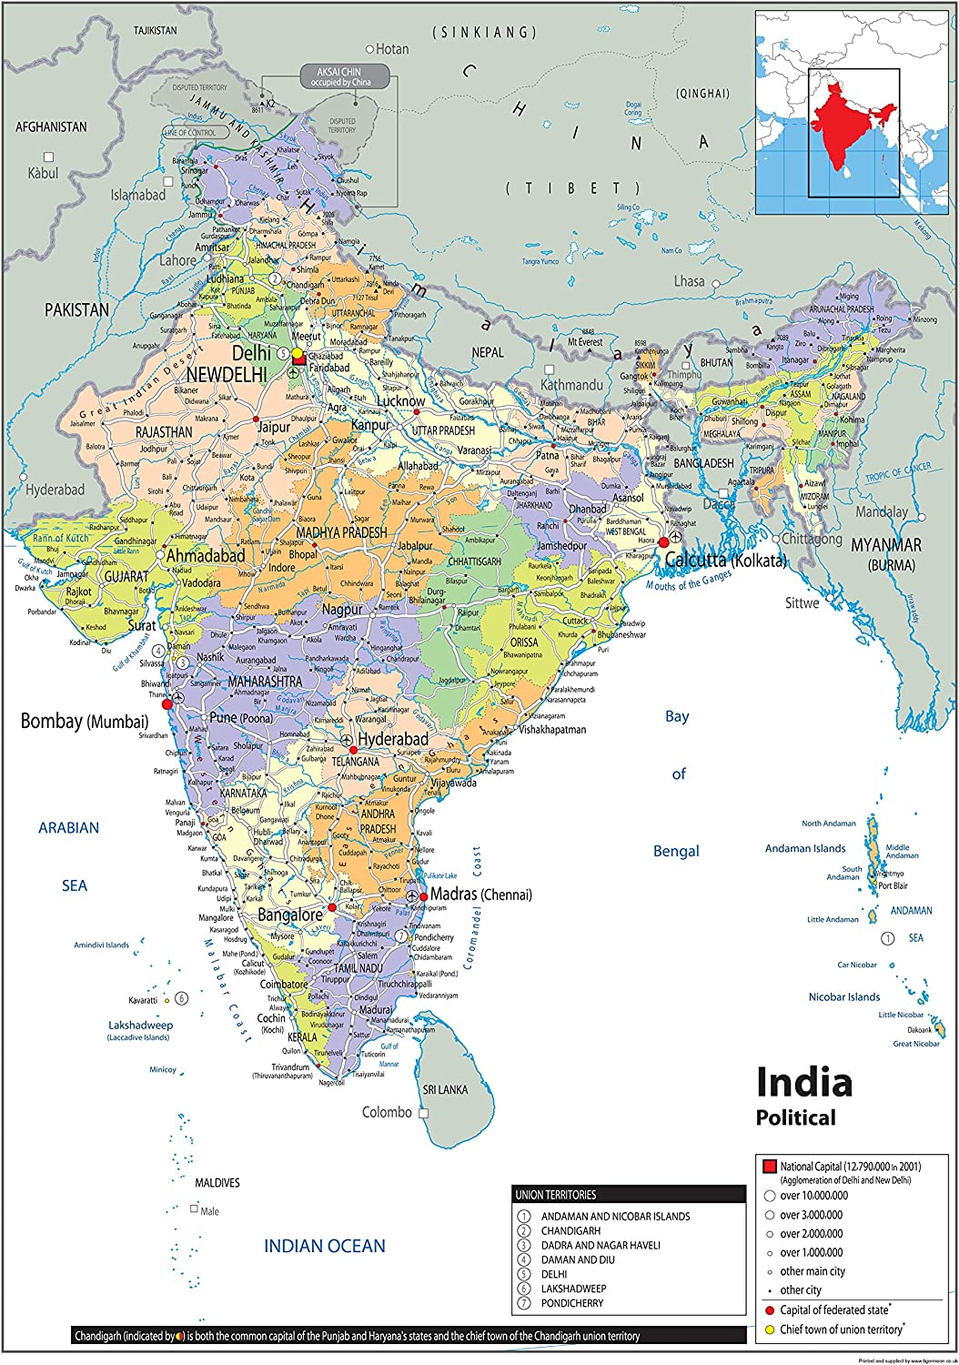
About Me
My journey across the globe …
Born: Ujjain, India

Slide 3
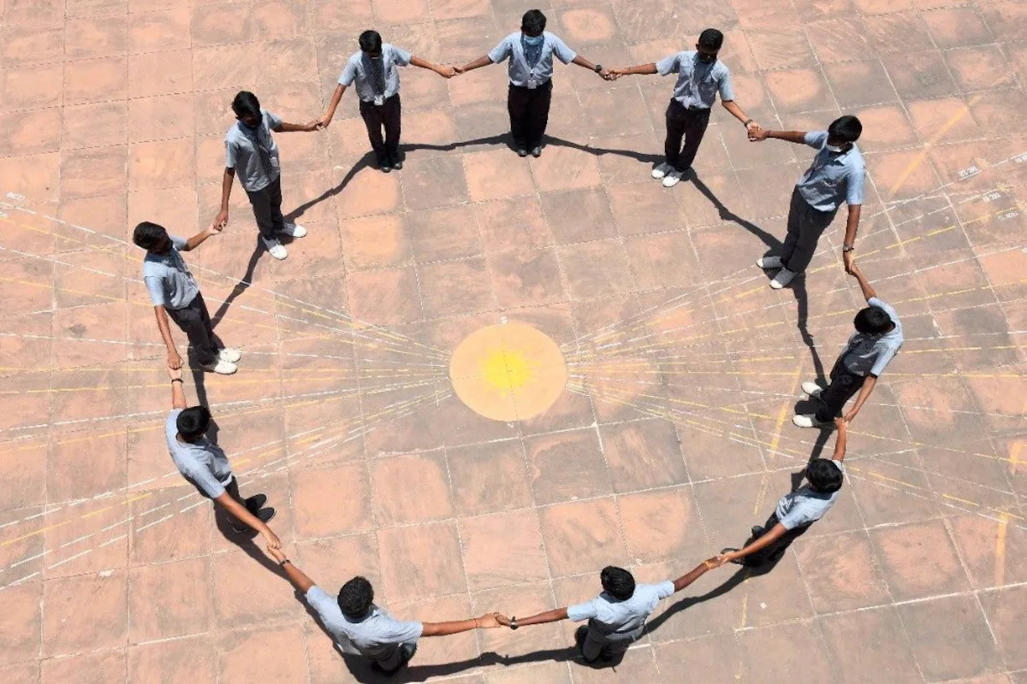
About Me
My journey across the globe …
Born: Ujjain, India (right below the tropic of cancer)

Slide 4
About Me
My journey across the globe …
Born: Ujjain, India (right below the tropic of cancer)

Slide 5
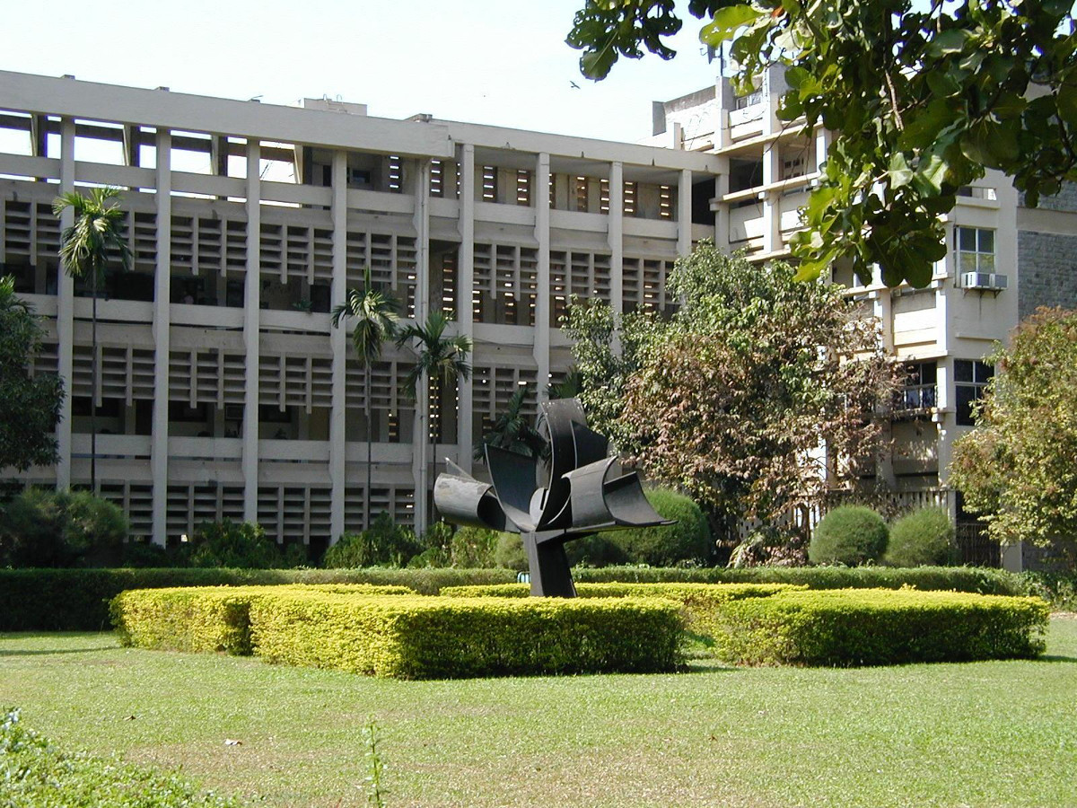
About Me
My journey across the globe …
Born: Ujjain, India
Undergrad: Indian Institute of Technology Bombay (IIT Bombay)

Slide 6
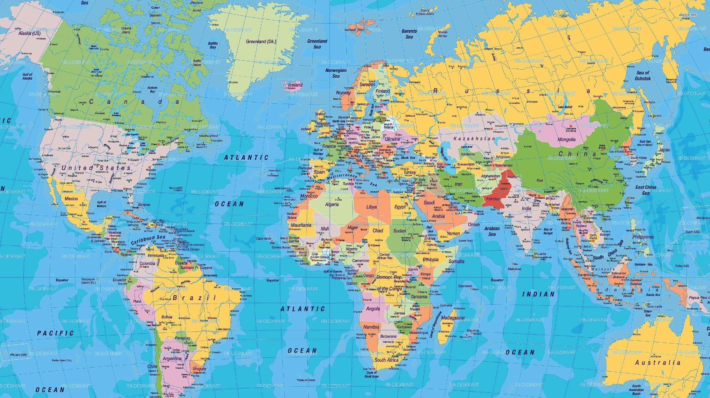
About Me
My journey across the globe …
Born: Ujjain, India
Undergrad: Indian Institute of Technology Bombay (IIT Bombay)

Slide 7
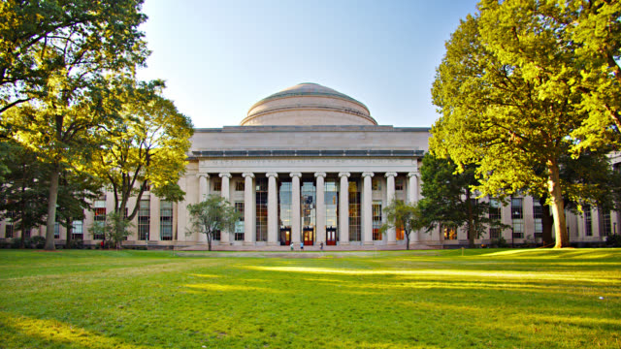
About Me
My journey across the globe …
Born: Ujjain, India
Undergrad: Indian Institute of Technology Bombay (IIT Bombay)
PhD: MIT

Slide 8
About Me
My journey across the globe …
Born: Ujjain, India
Undergrad: Indian Institute of Technology Bombay (IIT Bombay)
PhD: MIT

Slide 9
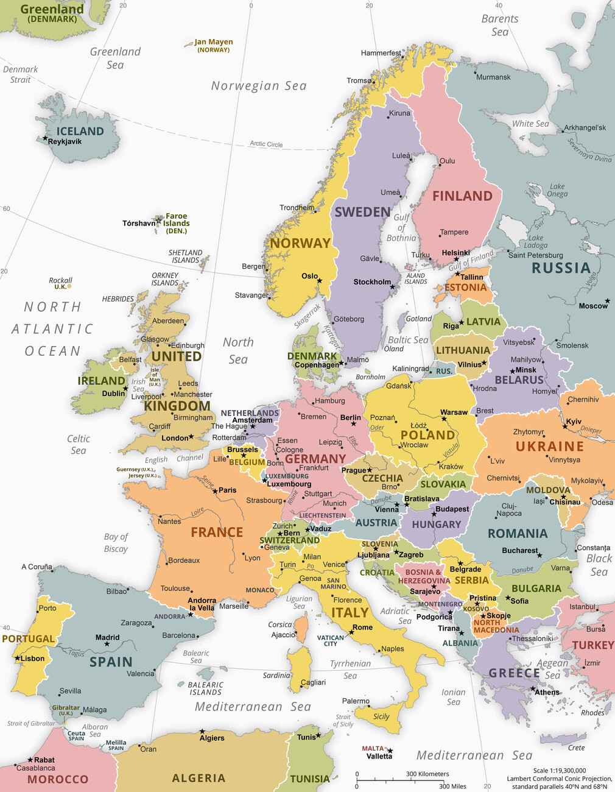
About Me
My journey across the globe …
Born: Ujjain, India
Undergrad: Indian Institute of Technology Bombay (IIT Bombay)
PhD: MIT

Slide 10
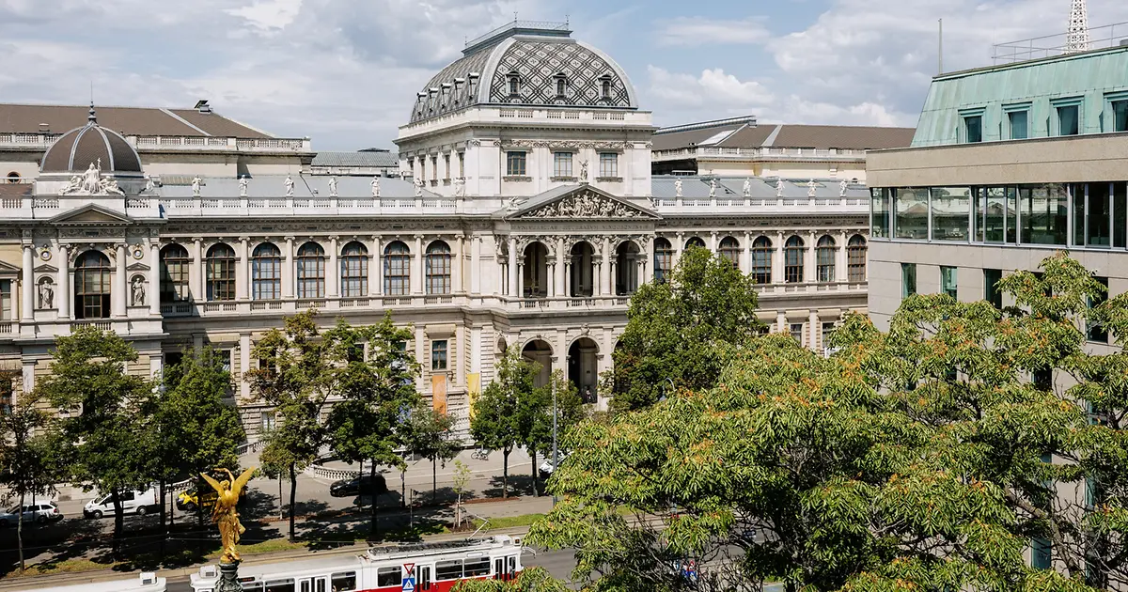
About Me
My journey across the globe …
Born: Ujjain, India
Undergrad: Indian Institute of Technology Bombay (IIT Bombay)
PhD: MIT
Postdoc: University of Vienna

Slide 11
About Me
My journey across the globe …
Born: Ujjain, India
Undergrad: IIT Bombay
PhD: MIT
Postdoc: University of Vienna

Slide 12
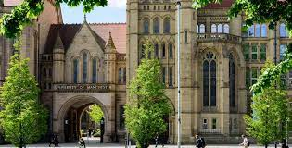
About Me
My journey across the globe …
Born: Ujjain, India
Undergrad: IIT Bombay
PhD: MIT
Postdoc: University of Vienna
Postdoc: University of Manchester

Slide 13
About Me
My journey across the globe …
Born: Ujjain, India
Undergrad: IIT Bombay
PhD: MIT
Postdoc: University of Vienna
Postdoc: University of Manchester

Slide 14
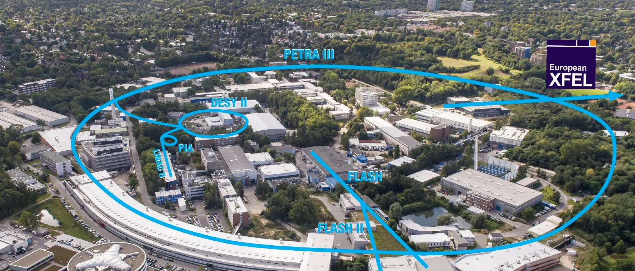
About Me
My journey across the globe …
Born: Ujjain, India
Undergrad: IIT Bombay
PhD: MIT
Postdoc: University of Vienna
Postdoc: University of Manchester
FH Fellow, DESY

Slide 15
My Research
Research interests
I am broadly interested in analytical QCD calculations for collider physics and how they can be used to achieve precision mesurements and improving Monte Carlo simulations.
Effective field theory methods (SCET, HQET, …) in QCD
Precision top quark mass and strong coupling constant
Hadronization corrections in jet observables
Forward scattering and BFKL dynamics
Subleading power corrections in TMD cross sections

Slide 16
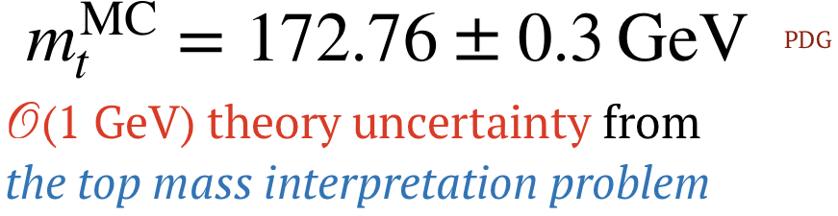
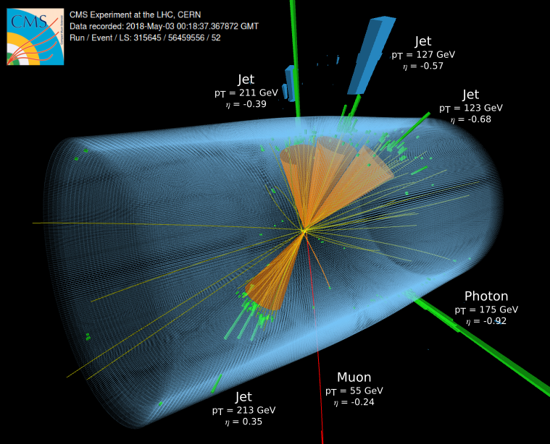
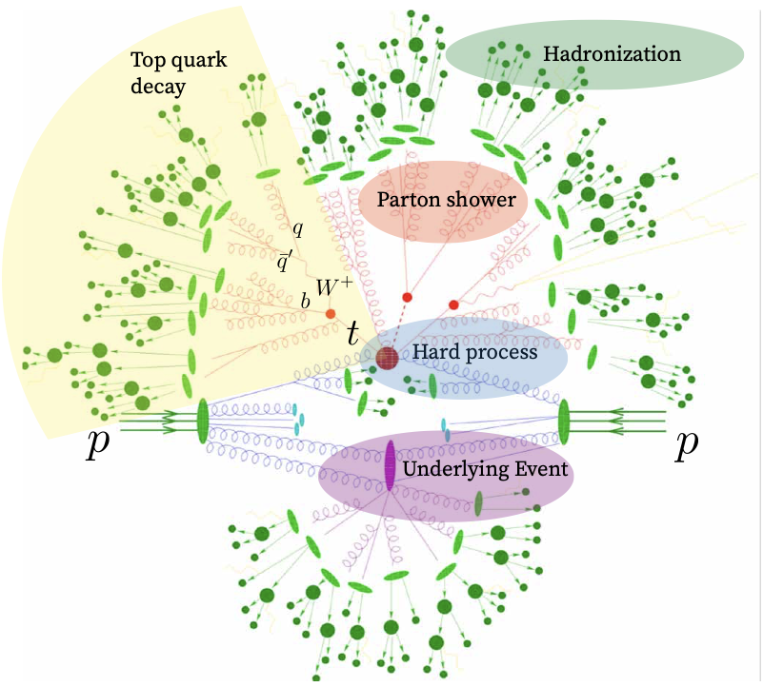
My Research
Top quark mass measurement
To resolve the theory ambiguity in the Monte Carlo top mass we need a direct comparison of (unfolded) data with accurate theory prediction.

Slide 17
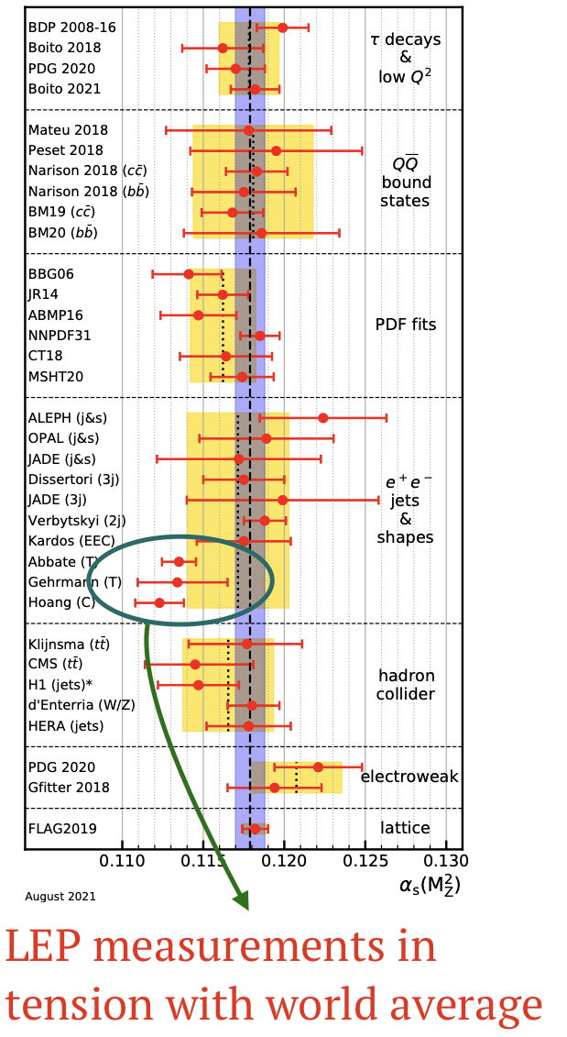
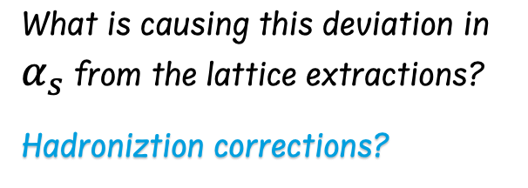
My Research
Strong coupling constant measurement
What is causing this deviation in $α_{s}$ from the lattice extractions?
Hadroniztion corrections?
Soft QCD effects make these measurements challenging

Slide 18
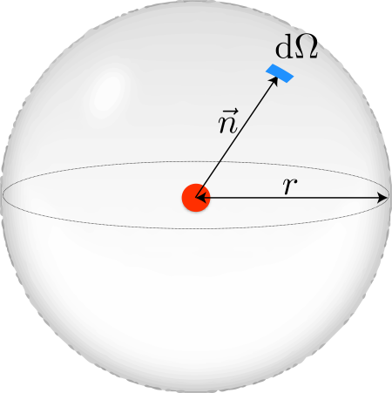
My Research
Energy correlators for precision physics
Correlation functions of energy flow operators are powerful tools for precision physics
QFT definition of a calorimeter:
Hoffman, Maldacena 2008
Energy weighting suppress soft contributions
Inclusive cross sections simpler to calculate

Slide 19
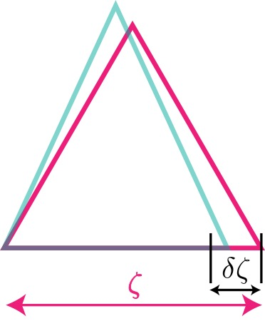
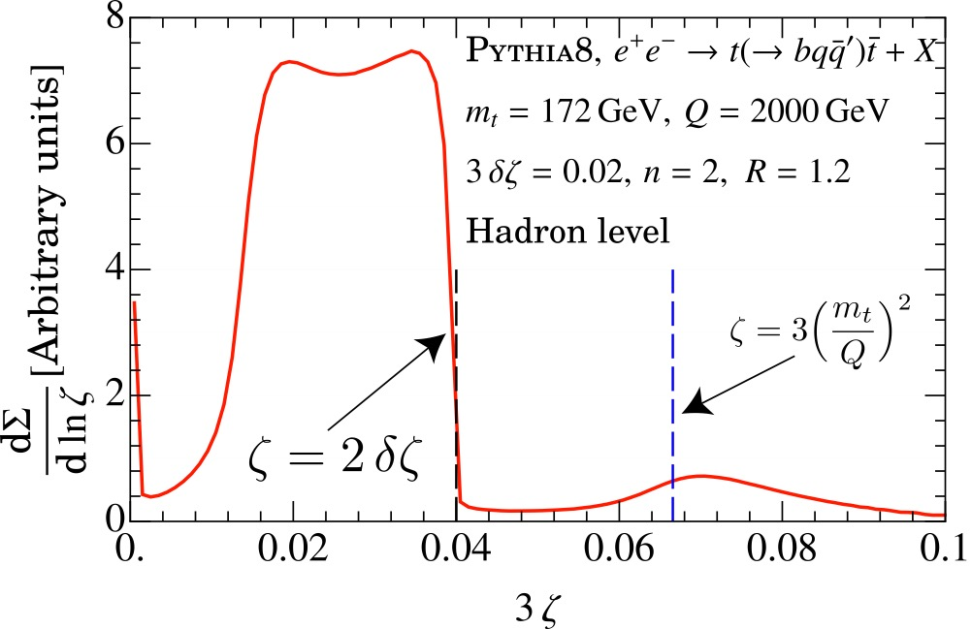
My Research
Energy correlators for top quark mass
Peak dominated by hard decay of the top
Holguin, Moult, AP, Procura 2022
Many more such exciting applications of EECs!

Slide 20
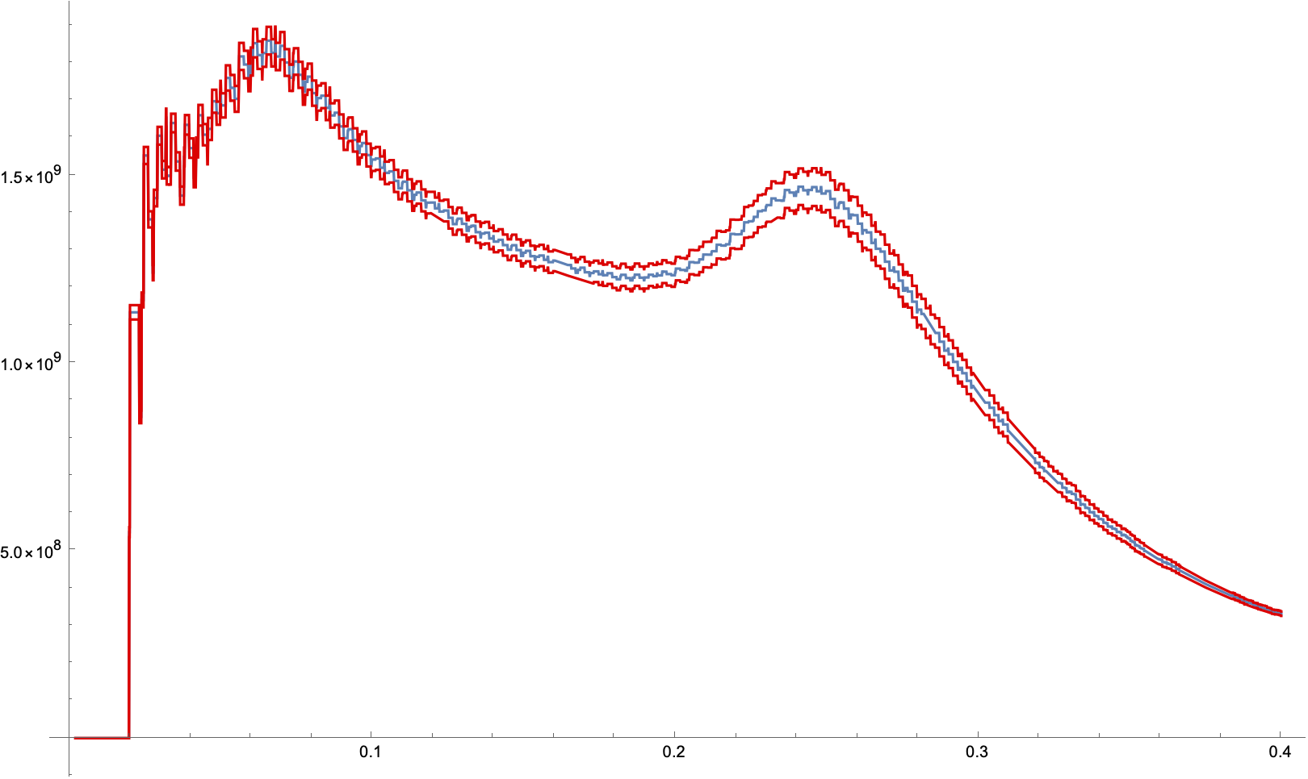
My Research
Energy correlators for top quark mass
New: Can exploit the two body W decay in the top jet to eliminate top velocity dependence
Another projection
Many more such exciting applications of EECs!

Slide 21
My Favourite Plot
Thank you!

