Slide 1
FH Detector Task Force meeting
Ties Behnke
Detector task force, 28.3.2023

Slide 2
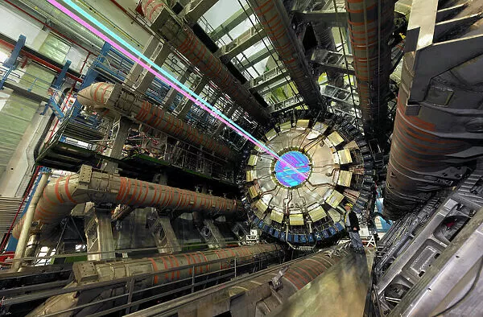
Detectors and Particle Physics

Slide 3
Detectors and particle physics
Helmholtz
International Photon Science/ Science at Synchrotrons
International Particle and Astroparticle Physics
DESY
DESY FH ATLAS/ CMS/ Belle/ FTX/ local
AP-FH-FS-M
Matter and Technologies

Slide 4
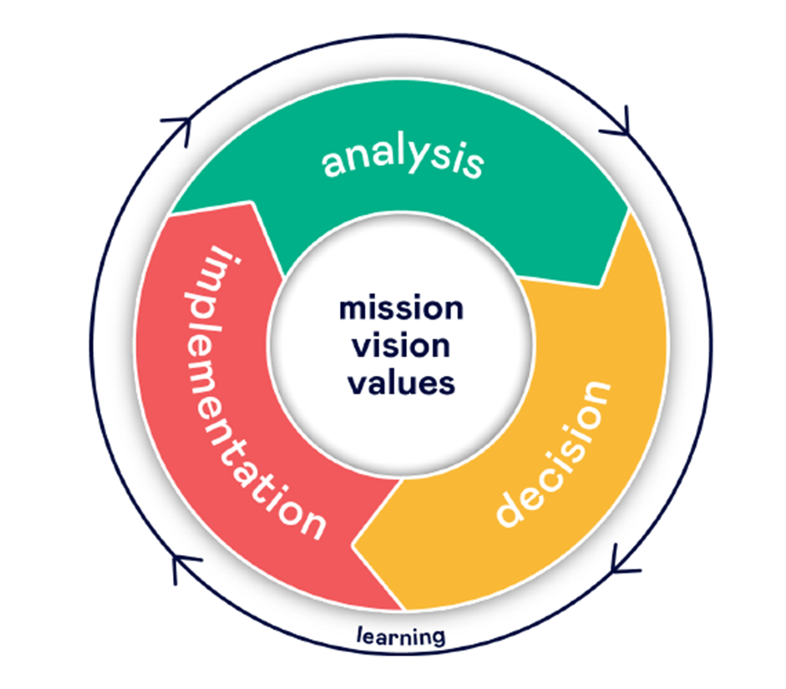
Detector R&D taskforce
Ties Behnke, Ingo Bloch, Doris Eckstein, Ingrid-Maria Gregor, Karsten Hansen, Friederike Januschek, Felix Sefkow, Marcel Stanitzki
Our Ambition:
Outstanding competence in our capability to design and build complex detector systems (60%)
Leadership in selected technological areas which are needed to address our science program (30%)
Retain a level of agility in the technologies and system aspects we work on to be able to identify quickly newly emerging areas of technologies and science relevant for detectors. (10%)
Our Uniqueness:
Demonstrated system competence
Access to technologies and services
Access to unique infrastructures: testbeam, DAF, …
Our Strategy:
Monolithic active Silicon Pixel Detectors: technological priority
Technological lead in SiPM – on – tile Systems
Detector integration center
Fast Data transfer: Silicon photonics
Expertise in key interconnect technologies
Expertise in other detector technologies: cryogenic detectors, others

Slide 5
FH Detector Platform I
Global charge
FH Platforms for Detector R&D (DetRD)
(Draft, March 26nd 2023)
Within FH, the activity “Detector R&D” is of high relevance for the scientific research done within the division, connects to most of the FH groups, offers large synergies with the other DESY science divisions, and has great promise for technology development for society at large. This activity will benefit from a new horizontal structure across the FH groups - henceforth called “platform for detector R&D” - to foster the development of ideas and solution of problems through sharing of expertise.
The overarching goal of the platform is to foster communication and strengthen the technological development in the areas of detector development across the boundaries of the FH groups and to foster stronger connections to scientists in the other divisions. All activities that could aid to achieve this should be considered.
The success of the platforms depends crucially on a close integration and cooperation with the different FH groups, who contribute to the platforms.

Slide 6
News
Regular monthly common meeting on detector development (used to be “competence team detector meeting) every last Monday in the month at 9am
Hybrid event, open to everyone interested, not restricted attendance
We will advertise this shortly and then turn the current meeting into a more open one
Discussions are starting to organize a “FH detector day” to get everyone on board and informed
Workshop on detector development at the Bahrenfeld Campus: PIER workshop on future perspectives for detector development, on June 1

Slide 7
Questions
How can communication in a Platform like the Detector R&D Platform work? What communication channels are most efficient?
How can we increase the visibility a fellow can have at DESY, to recognize his/her work on “technical” work like detector development or detector construction?
Do you feel that as a fellow you can follow new and innovative ideas? Do you feel restricted by the “FH strategy” on detectors?

