Slide 1
Data Management & Analysis
Michael Bussmann, Volker Gülzow
Topic Speakers

Slide 2
Research Field Matter
Looking forward
„Targeted challenge-driven access“ enabled by „intelligent, autonomous, integrated facilities“
Focus on data-driven science across user communities, taking up challenges, enabling discoveries
Frontier science through use of frontier technologies (AI, Exascale, Quantum, Edge, Cloud)
Intelligent, target-driven facility operation enabled by AI-integration of Machines, Experiments & Simulations

Slide 3
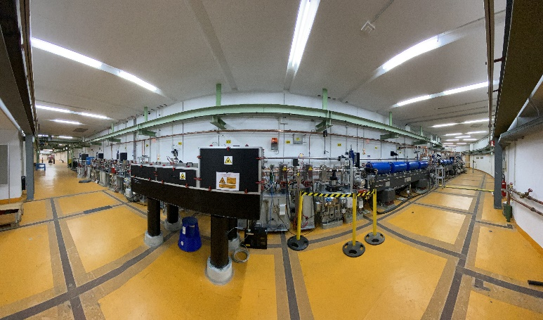
Research Field Matter
What we do
Autonomous accelerators
Prototypes towards fully autonomous, self-optimizing accelerators using machine learning.

Slide 4
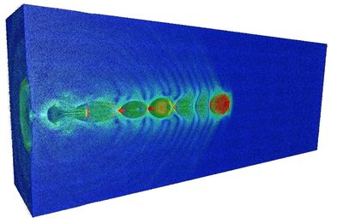
Research Field Matter
What we do
PLASMAPEPSC Center of Excellence
One of 4 European Centers of Excellence for Exascale Computing on Plasma Simulations for next generation supercomputers in Europe. Close collaboration between laser plasma and fusion community.

Slide 5
Research Field Matter
What we do
Quantum Computing for Particle Physics
Quantum Generative Adverserial Networks for fast detector simulations in Particle Physics.

Slide 6
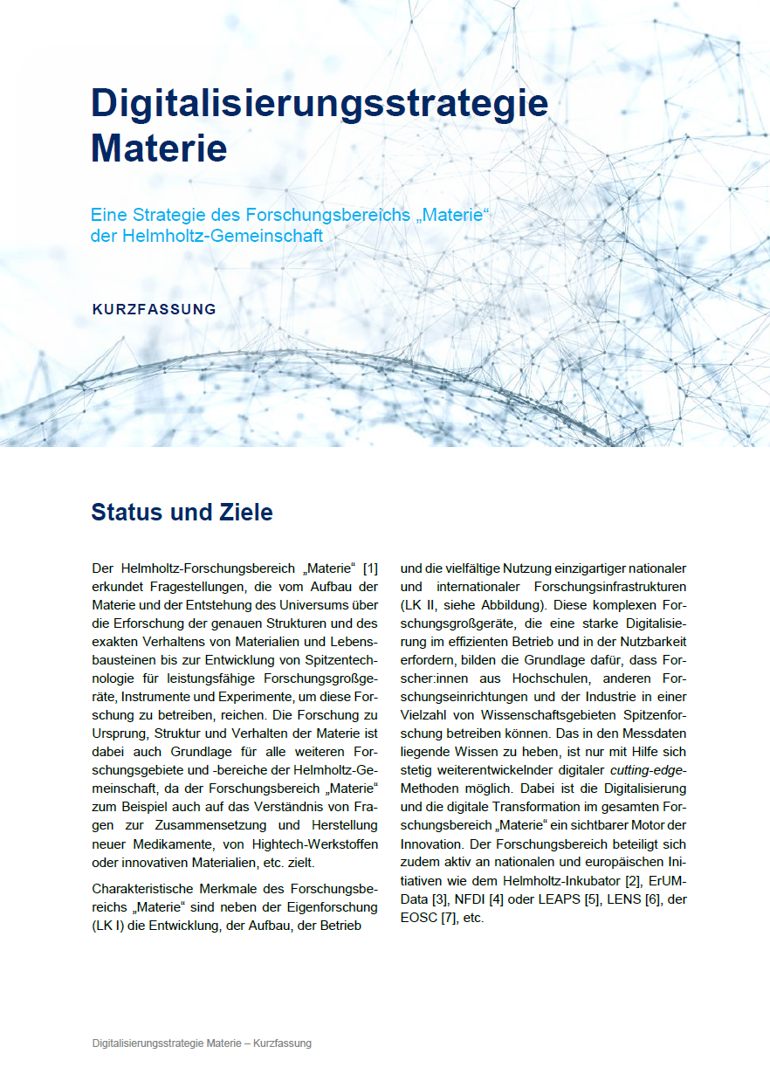
Research Field Matter
Digitalisation Strategy
A digitalisation strategy aligned with all Helmholtz centers in Matter for the whole Research Field.
Set up for cross research field collaboration
Fitting to the strategic position paper “Digitalisierungsstrategie der Helmholtzgemeinschaft”
Concrete measures to reach the goals of the strategy

Slide 7
Research Field Matter
Digitalisation Strategy
Enabling frontier science through federated compute, data and service infrastructures across centres and communities
Sustaining technological leadership in scientific simulation, data analytics and machine/experiment control through cutting edge technologies such as AI, Exascale and Quantum Computing
Providing an integrated support infrastructure for the diverse user communities of our research infrastructure
Supporting user communities in disseminating and using scientific data in an open, sustainable and F.A.I.R. way (Open Science!)
Developing and building large-scale research infrastructures using modern IT technologies
Developing and using intelligent and autonomous systems for maintenance/operation of machines, instruments & experiments
Using resources sustainably, from energy to materials, from data to software
Fostering the careers of young researchers in computer, information and data science
Cooperating with industry partners on applied research
Growing transfer of knowledge and technologies to industry and society both nationally and internationally

Slide 8
Research Field Matter
Status 2023
In general
DMA is smallest topic in MT.
Many activities funded by third party funding such as Innopool (DATA-X, ACCLAIM, …), Pakt (ROCK-IT, …), Inkubator (Helmholtz.AI, HIFIS, HIP, HMC, HIDA), NFDI (PUNCH, DAPHNE, BASE, …), ErUM(-Data), EuroHPC (PlasmaPEPSC, …) and more.
Only part of these activities will be sustainable (Inkubator, NFDI?, …)
Many of these activities include both Helmholtz Centers in Matter and the scientific community (mainly the German communities, universities)
Data-driven science seen as important, yet often still implemented as IT-centered topic
Very fast pace in technologies (AI4Science, LLMs, Quantum Computing, Exascale Computing, Robotics and autonomous systems, …)
RF Matter has clear digitalization strategy that now needs focus and prioritization with respect to resources

Slide 9
Research Field Matter
Status 2023
ST1:
Strengths:
A common goal towards a unified data lifecycle approach
Weaknesses:
Creating a strong engagement with scientific communities not yet visible
A common strategy between centers and scientific communities not yet in place
Opportunities:
Data is a „treasure“ of research facilities, make optimum use of it
Taking up excellent existing projects (EOSC, NFDI, …)
Use synergies with NFDI, ErUM and Inkubator and make RF Matter a strong partner
Define clear interfaces between facilities and user communities
Make research in Matter data-centric
Threats:
Focus in ST1 (management of data vs data-driven science)
Inhibiting further growth of data-driven science at facilities due to missing funding / talents

Slide 10
Research Field Matter
Status 2023
ST2:
Strengths:
Excellency in methods (AI, Exascale, Quantum Computing) with many applications
Sharing of solutions (ESCAPE OSSR)
Weaknesses:
DMA enabling science must become more prominent, engagement of domain scientists
Opportunities:
Stronger engagement of domain scientists
Sustainability and reuse of solutions
Access to frontier technologies
Threats:
Software not seen as critical infrastructure the same way we recognize hardware as infrastructure
Talents with algorithmic expertise go to industry because of opprotunities, salary and interest

Slide 11
Research Field Matter
Status 2023
ST3:
Strengths:
Strong integration with experiments and targeted challenge-driven access
Clear concept of digital twins of experiments, machines, systems
Well-funded demonstrators and pilots
Weaknesses:
Pace of development not in line with technology development
Opportunities:
Autonomous facilities, intelligent steering of experiments for challenge-driven science
Threats:
Lack of base funding support, many successes are driven by third-party funding
Highly different pace between „small-scale experiment“ and „large-scale experiment“ communities

Slide 12
Research Field Matter
Towards POF V
First thoughts on outcomes of April 2023 DMA strategy meeting
The Matter digitalization strategy is a forward looking approach towards data-driven science in Matter
Third-party funded initiatives have helped to support an otherwise underfunded topic
Since 2019 funding of AI, Exascale computing, data-driven science has taken up pace
DMA has to adjust to this new landscape, must define interfaces between facilities and user communities
DMA has to leverage synergies with the third-party funded activities and invest in new technologies
DMA has to set priorities for realising the Matter digitalisation strategy

Slide 13
Research Field Matter
Data
Towards POF V
First thoughts on outcomes of April 2023 DMA strategy meeting
Adjust topic DMA to a radically changed landscape
Focus on excellent data-driven science that is sustainable
  Intelligent data reduction for science
  Integrated infrastructure from edge to data center
  F.A.I.R., open data, synergies with communities
Algorithms for frontier technologies as science drivers
  AI, Exascale, Quantum, Edge, Cloud, federated, …
  Intelligent algorithms (analysis, control, …)
  Sustainable, reusable solutions
Autonomous, intelligent, integrated systems
  Combine machines, experiments, simulations and human users to steer towards discoveries
  Enable targeted, challenge-driven access
  Connect facilities and user communities
  Optimize usage of facilities (discovery, impact, challenges, energy, …)
Autonomous, intelligent facilities for data-driven science
Algorithms
Systems

