Slide 1
IDAF — Strategy for PoF V
Strategy Meeting MT for PoF V
Christian Voß (presented by Yves Kemp)
Kassel Wilhelmshöhe, 28th June 2023

Slide 2
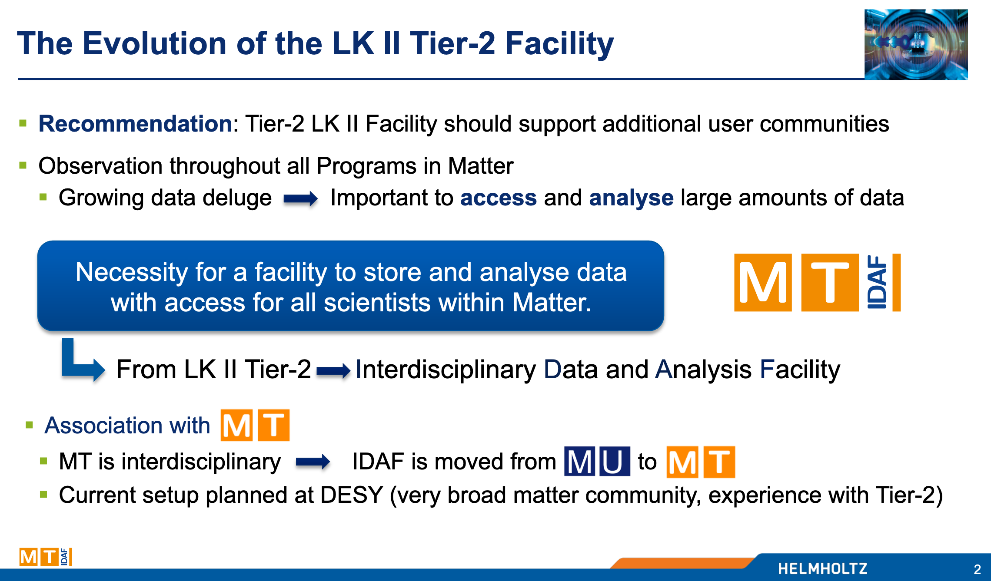
Start with Review of PoF IV Proposal
Goal of the IDAF

Slide 3
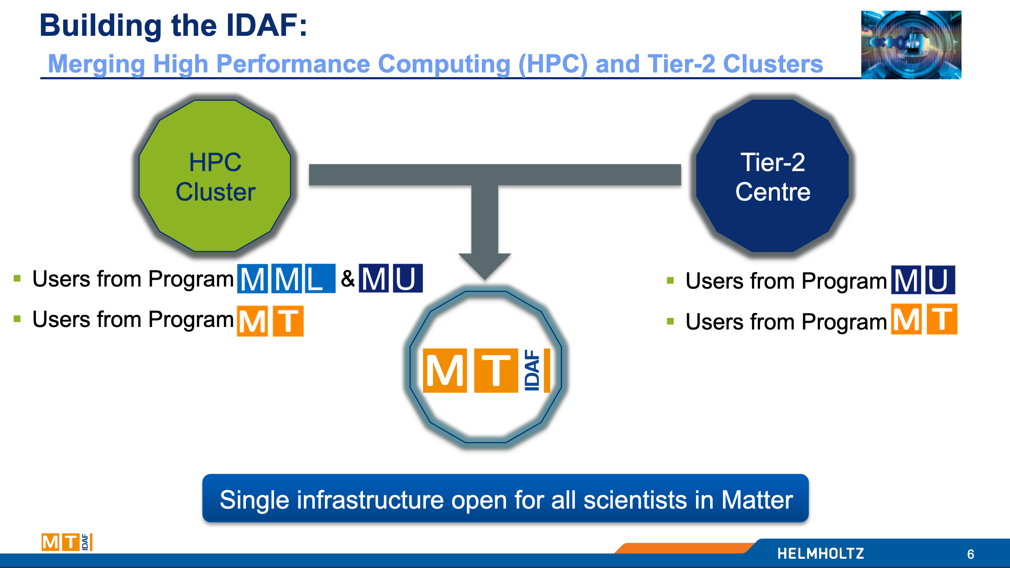
Start with Review of PoF IV Proposal
Plans for the IDAF

Slide 4
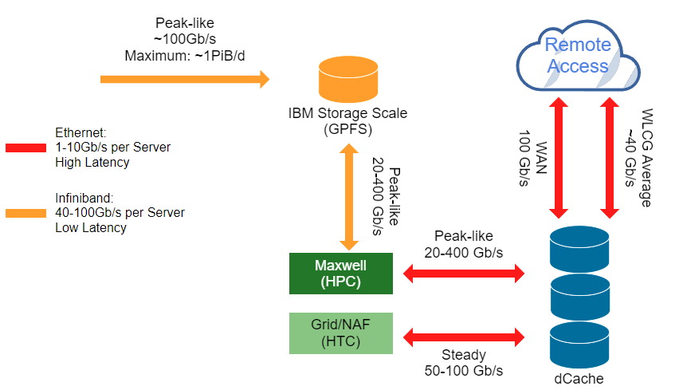


Paradigm: Scientific Analyses are Data Driven
Strategy: Keep the Paradigm that Made the Tier-2 Successful
Example: Traffic pattern in IDAF, approximate numbers from 2023H1
EuXFEL / P-III /
FLASH…
… approximate numbers
from past 6 month

Slide 5

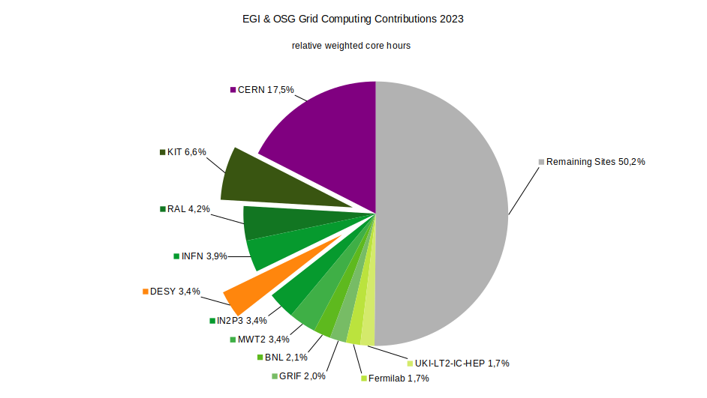
Continued International & new National Commitments
IDAF Inherited Previous MU Commitments for the (Astro-)Particle Physics Experiments from Tier-2
IDAF contributed around 4% to (Astro-)Particle Physics in 2019
2022: share ~3.4% (IDAF still largest contributing Tier-2 centre)
Expanded responsibilities
  Raw Data Centre (Tier-1 equivalent) for Belle II
  Offer tape storage to LHC experiments
  (compensate affected Russian Tier-1 sites)
Take over storage share from German universities
  KET: University Tier-2 centres to be discontinued
  CPU shares to be taken over by some NHR sites
  Storage to be split among Helmholtz Sites (KIT/DESY)
  Investment in part covered by the BMBF (Verbundantrag)
  Some additional investment expected in kind by DESY past 2025
  New workflows expected. Will need research, and support. Close eye on network, might need expansion

Slide 6
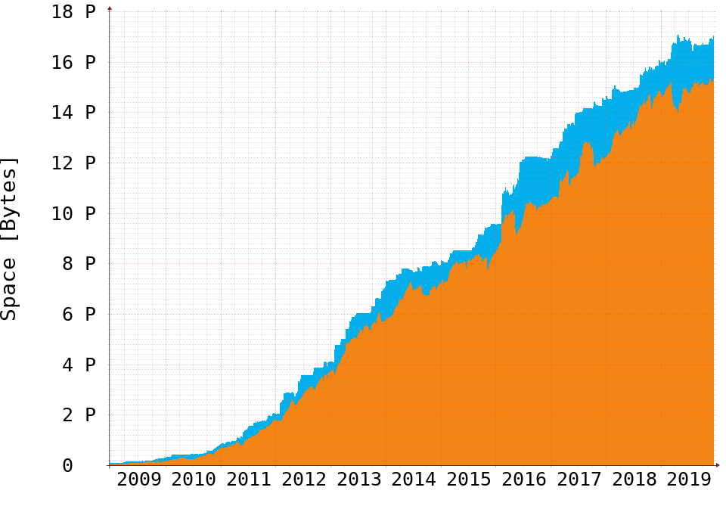
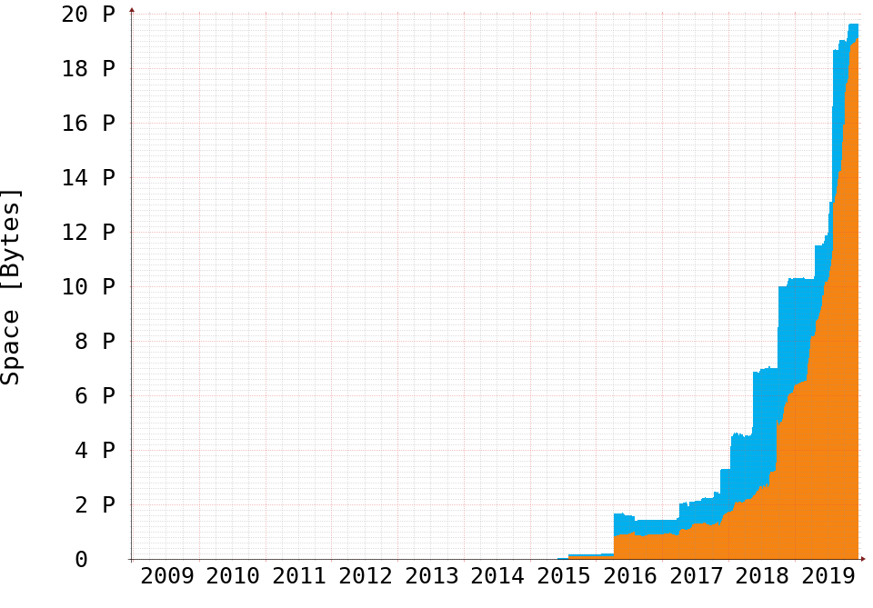
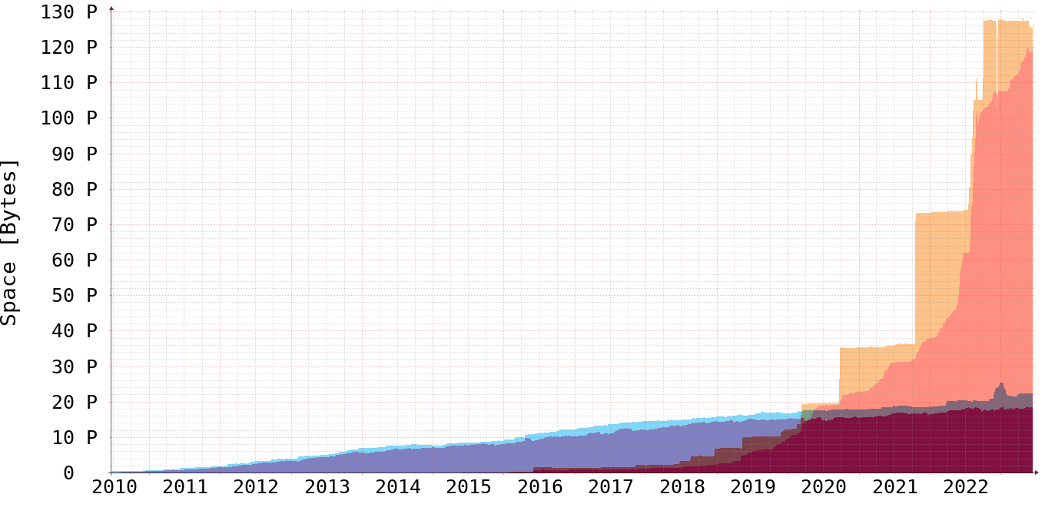
Challenges: Data Deluge in Photon Science
Photon Science and Especially European XFEL Continued to Grow Exponentially
End of 2019
Date stored since beginning of PoF IV more than doubled
Accelerator division starts to contribute
HPC cluster storage similarly increased
Capacity growth slow down/halt during end of 2022 due to funding situation
Alternative usage of existing capacity
More heavy involvement of tape storage
(as done by ATLAS in the WLCG)
European XFEL still expects to collect 50PiB in 2024
Data reduction on the horizon?
Observe scaling issues for the IDAF
(Astro-) Particle
Photon Science
Summer 2023
(Astro-)
Particle
Photon Science

Slide 7
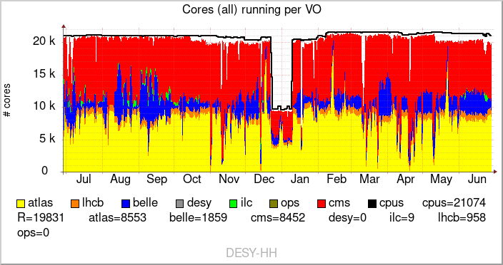
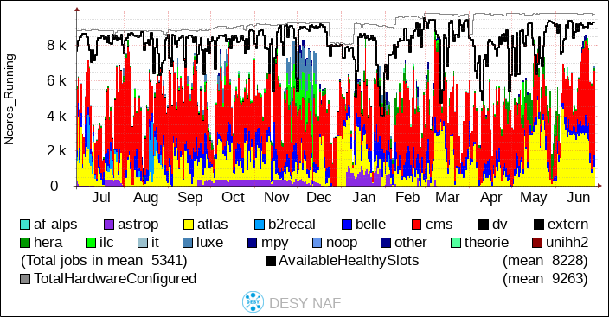
Ressource and usage status IDAF
High Performance Cluster: Maxwell
  ~900 nodes (inkl. ~250 GPU), ~50k Cores. 2700 users (~1000 active in past 3 month)
  Storage: GPFS, dCache, (BeeGFS). InfiniBand, SLURM scheduler
High Throughput, Production: Grid
  400 nodes, 20.000 cores
  Storage: dCache, CVMFS. Ethernet, HTCondor Scheduler – Integration in WLCG/Experiment frameworks.
High Throughput, Interactive: NAF
  350 nodes, 8.000 cores.
  Storage: dCache, DUST (GPFS/NFS), CVMFS, AFS. Ethernet, HTCondor Scheduler.
→ Planning for consolidation, unification

Slide 8
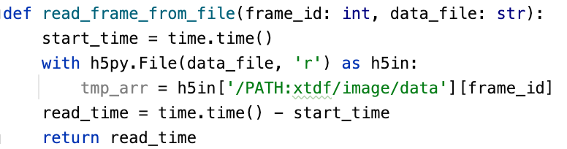

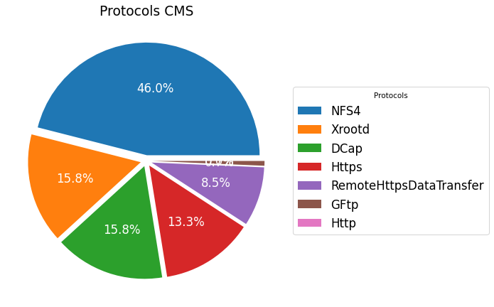


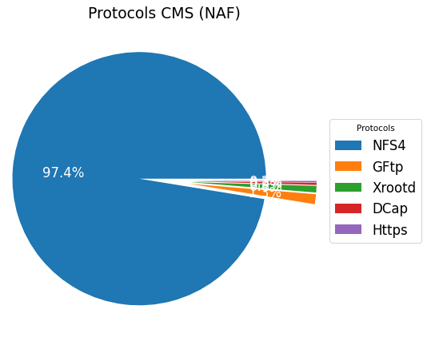
Challenges: Accessing Data
Users Prefer to Use POSIX — IDAF Needs to Adapt to that Fact
Data Access CMS May 2023
Continued trend to access data ‘directly’
Usually only option for and
Trend includes HEP despite remote read capabilities
Poses the challenge of having uniform name-space across the IDAF
  I would need to change my analysis depending on the cluster I’m on
worldwide
local/NAF
HPC
[vossc@max-display008] ~ $ md5sum /gpfs/dust/belle2/user/vossc/stage-rest-api.out
0108f37dbbb38103bba6d836f356d7b7 /gpfs/dust/belle2/user/vossc/stage-rest-api.out
[vossc@naf-belle12] ~ $ md5sum /nfs/dust/belle2/user/vossc/stage-rest-api.out
0108f37dbbb38103bba6d836f356d7b7 /nfs/dust/belle2/user/vossc/stage-rest-api.out
HTC

Slide 9
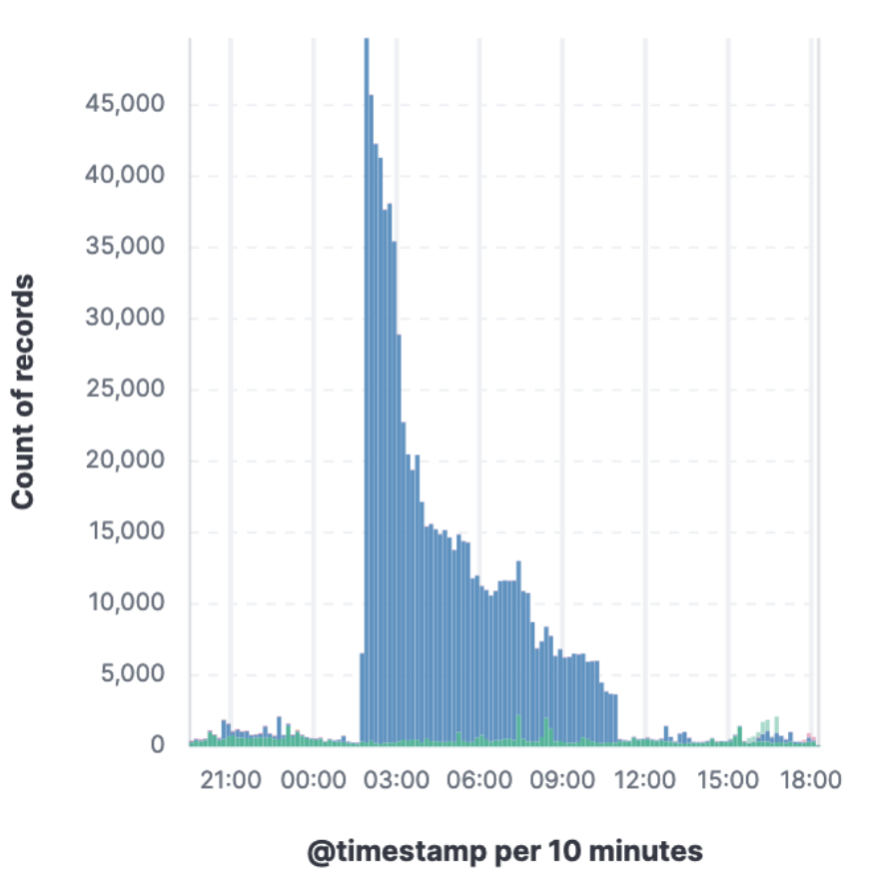
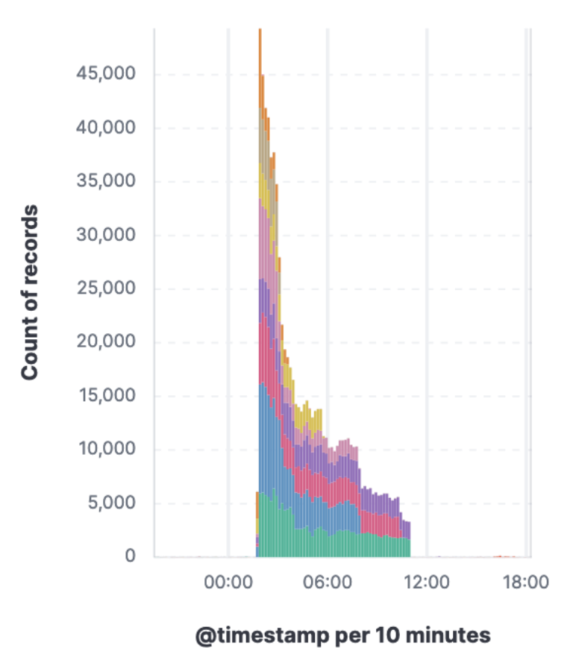



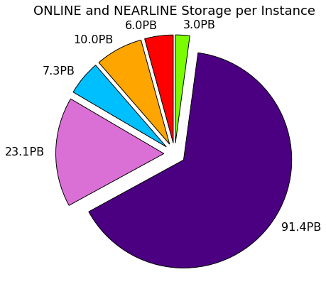
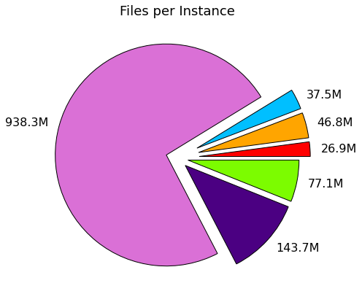
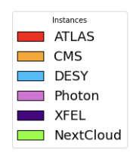
Challenge: Improved Monitoring and Analytics
Managing and Understanding the Change User Access Patterns
Increasing capacity found to manageable
➜ read/write patterns found to be more challenging
Departure from classic C/C++ or FORTRAN driven batch analysis
Ease-of-Use of Python leads to higher memory footprint and excessive, repetitive data access (open files to read <1MiB)
Increased WAN/Tape access will escalate this further
Profit from research in :
  Self adapting systems (e.g. Smart file replication)
  Improved I/O pattern, e.g. through portals (Coffea-Casa)
Profit from research in /
  Reasonable file sizes/numbers
  Streaming/Online Analysis

Slide 10
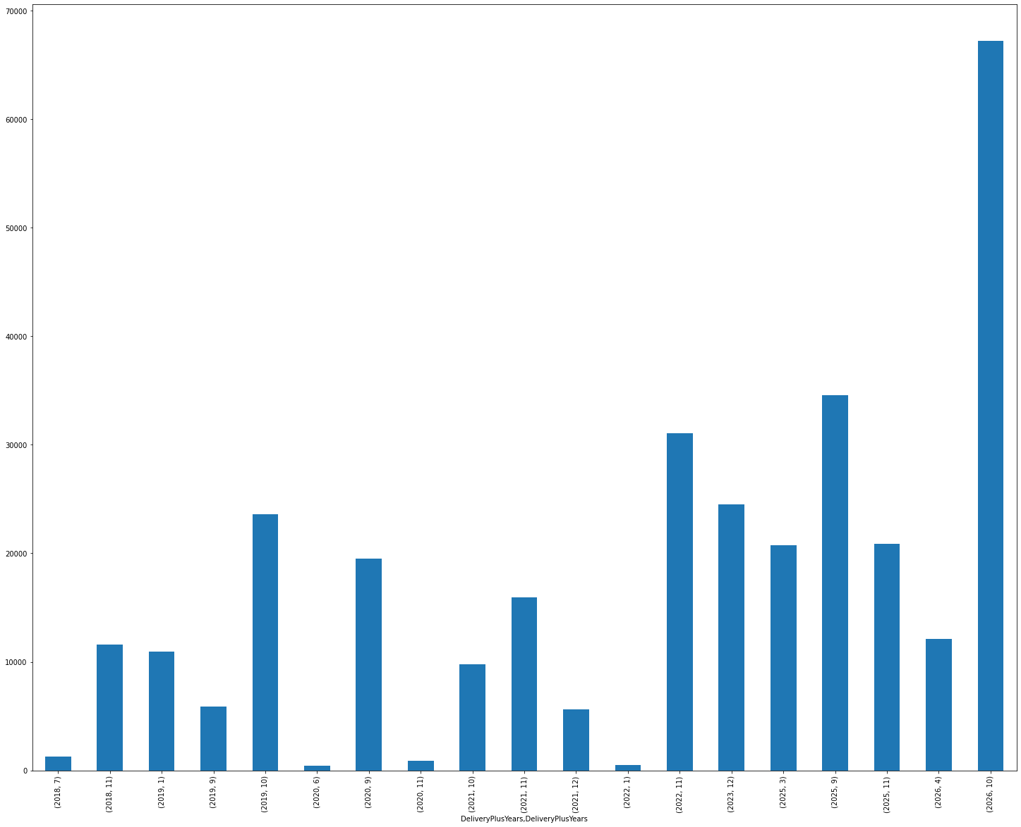
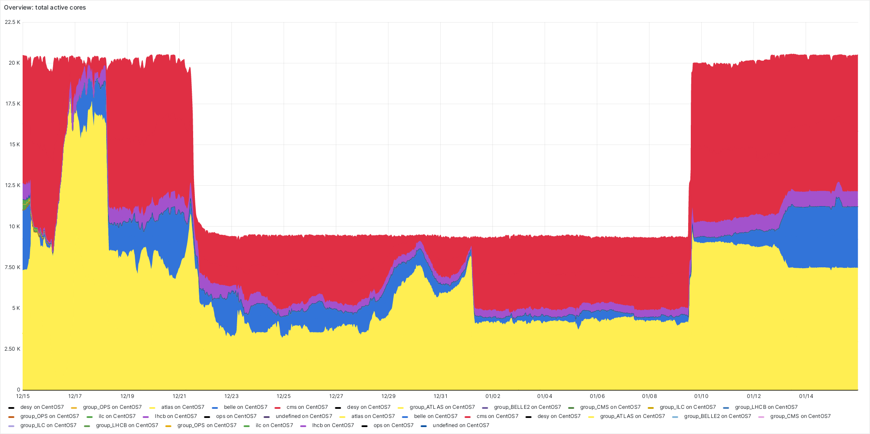
Challenges: Sustainability
CPU pledges in warranty with high efficiency
How to Make the Infrastructure more Sustainable
CPU Buffer with low efficiency
Constant improvement on PUE in DESY CC and infrastructure on DESY Campus … ongoing since years
Hardware life cycle under close watch
Compute: Adapt hardware availability to power availability and/or user needs
Storage: Unused data on tape → Tape?
Raising awareness of users
Train users on most efficient use of IDAF
Train users on tooling and optimal algorithms
Interactivity and fast reaction come with inefficiencies:
Re-evalute how much is needed
Eventually tax users
Work on scheduling and availability
Shutdown of low efficiency cluster over Christmas ‘22
Provided by T. Hartmann

Slide 11
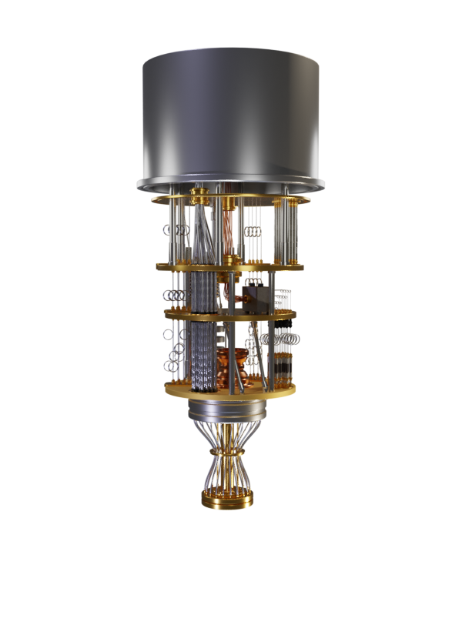
Challenges: Hardware evolution and Person Power
Difficulty Acquiring Hardware and Filling Open Positions
Hardware evolution
Short-term: Supply chains have still not returned to full capacity after end of pandemic
Short/mid-term: GPU: NVIDIA dominance is not healthy, need combined effort to overcome
  many interesting architectures / accelerator products out there, we should be more open and flexible
Mid/long-term: Cloud providers driving technology … and making it private
  Started to offer tape for ‘ultra-cold storage’ ➜ profound effect on design of tape libraries not well suited to the IDAF
  Some architectures already now only available in commercial clouds
Mid/long-term: First quantum computer commercially available. QC will become an additional IDAF platform
Person Power
More and more difficult to fill open positions
ML/AI can be filled eventually
Regular IT positions often cannot be filled and get cancelled

Slide 12
Thank you, any Questions

