Slide 1
Subsystem Symmetries
Andreas Karch, UT Austin
@ “New Perspectives in Conformal Field Theoy and Gravity”
DESY, Hamburg, Sep 27, 2023

Slide 2
Why Subsystem Symmetries?
Field theories with subsystem symmetries violate dearly held notions of decoupling of UV and IR physics.
Peculiarity or Paradigm Shift?

Slide 3
What is a subsystem symmetry?

Slide 4
What is a subsystem symmetry?
Subsystem symmetry = acts only on fields living on a subspace. Symmetry operation can act separately at each point of space.
NOT a gauge “symmetry”!
Gauge “symmetry” = redundancy
Subsystem symmetry = separately conserved charges at each point

Slide 5
Easiest to explain with an example:
This is a free 2+1 dimensional theory, gapless
continuous translations: this is a QFT
90 degree rotations: x→y, y→-x
“The XY Plaquette model”
(Paramekanti, Balents, Fisher; Seiberg Shao)

Slide 6
The simplest Seiberg-Shao theory
Subsystem symmetry:
separately conserved charge
on each line!
x labels lines. Shifting the field
at every point along a line of fixed x
is a symmetry.

Slide 7
The simplest Seiberg-Shao theory
The theory is free!
For a single scalar, all interactions consistent
with symmetries are irrelevant!
Interacting lattice fractons → free field theory
Interacting theories possible if we couple this scalar to other fields (e.g. complex scalar)

Slide 8
Why do we care?
Subsystem symmetries lead to UV/IR Mixing
Fracton Lattice Theories lead to such QFTs

Slide 9
UV/IR Mixing: Dispersion relation
k_{x}=0 gives ω=0 for any k_{y}
UV/IR mixing!
These would-be zero modes are lifted by quantum effects; mass set by lattice scale
will see more signs later …

Slide 10
So why bother?
Field theories with subsystem symmetries arise
as continuum limits of known solvable lattice models.
Many of these lattice models describe fractons

Slide 11
Simplest example: the X-cube model
(Vijay, Haah, Fu)
Lattice model with Ising spins on each lattice link.
Only interactions between near-by spins.
Generalization of Kitaev’s toric code
(“coupled layers of toric code”)

Slide 12
Simplest example: the X-cube model
(Vijay, Haah, Fu)
Summed over all cubes,
and over all crosses (in
all orientations)
Groundstates simultaneous
eigenstates of all A’s and B’s with
eigenvalue -1. Spectrum gapped!
Commuting Projector Hamiltonian:

Slide 13
Fractons in the X-cube model
fracton
lineon
X
Z
planon

Slide 14
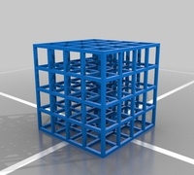
Subsystem symmetry
Standard Ising spins:
Flipping all spins is a symmetry
X-cube:
Flipping all spins on
any given plane is a symmetry

Slide 15
Subsystem symmetry
In fact, every plane has two Z₂ symmetries.
These symmetries take ground states to ground states
$$\#_{GS}=4^{\#_{planes}}=2^{{2L}_{x}+2L_{y}+{2L}_{z}−3}$$
UV/IR mixing!

Slide 16
Field Theory of X-cube
(Seiberg Shao)
This is a 3+1 dimensional theory, gapped
continuous translations
CS type
Z_{N} subsystem symmetry + tensor gauge theory
90 degree rotations
Wilson lines = fractons

Slide 17
Fractons from Wilson lines
Field Theory of X-cube only describes the highly degenerate
ground states.
The finite energy excitations with limited mobility arise as
infinitely heavy external probes → Wilson lines/surfaces
Limited mobility → restricted shape of Wilson line

Slide 18
Fractons from Wilson lines, an example
Gauge invariant
Wilson line
time
the fracton

Slide 19
Applications
Correlation functions and symmetry breaking
Foliated field theories vs exotic field theories
Interactions
Spacetime Subsystem Symmetries

Slide 20
Correlation functions and Symmetry breaking

Slide 21
Coleman-Mermin-Wagner for subsystems:
Batista/Nussinov:
A subsystem symmetry acting on d+1 dimensional defects obeys
the same theorems as a QFT in d+1 dimensions.
In particular, Mermin/Wagner tells us we need at least 2+1
dimensional subsystem symmetries to break continuous symmetries.

Slide 22

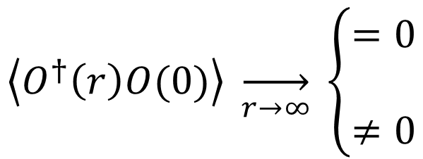
Diagnosing symmetry breaking
A more reliable diagnostic of symmetry breaking are correlators:
$$\left\langle O^{†}\left(r\right)O(0)\right\rangle \overset{→}{r\overset{→}{}∞} \left\{\begin{matrix}=0 \\ \\ ≠0\end{matrix}\right.$$
symmetry unbroken
symmetry broken
O is operator charged under symmetry! Correlator itself charge neutral.
$$\left\langle O^{†}\left(r\right)O(0)\right\rangle \overset{→}{} \left\langle O^{†}(r)\right\rangle \left\langle O(0)\right\rangle$$
by locality
Non-vanishing correlators indicates non-vanishing vev.

Slide 23
Results on symmetry breaking
simplest correlation function here is 4-pt function on plaquette
for basic Seiberg-Shao like theories symmetry NOT broken, even if allowed
continuum theory UV divergences can not be regulated locally (UV/IR); lattice gives unambiguous results
modified Seiberg-Shao theory gives symmetry breaking, when allowed
(Seiberg, Shao; Distler, AK, Raz)
(Distler, AK, Raz)

Slide 24
Foliated Field Theories

Slide 25
Two basic approaches
(Slagle, ….)
Continuum QFT
with discrete
rotation symmetry
Lattice
(Paramekanti, Balents, Fisher)
Foliated Field theory
(Seiberg-Shao, …..)
each layer: 2+1d QFT,
subsystem symmetry acts on layers
retain some sensitivity
to lattice scale!

Slide 26
Two basic approaches
Can formally write as 3+1 continuum theory by introducing “foliation field”
Can easily be generalized to “non-isotropic” cases.
Explicit equivalence to “exotic field theory” recently demonstrated
Formalism provides novel exotic theories
Foliated Field theory
(Spieler)

Slide 27
Interactions

Slide 28
Adding interactions – more fields
Examples:
Fracton-Yukawa-theory
(Distler, Jafry, AK, Raz)
marginal coupling preserving subsystem symmetry
non-relativistic fermion
Fermion loops tame UV/IR mixing
Novel non-renormalization theorem

Slide 29
Adding interactions – more fields
Examples:
Large N complex vector theory
(Pretko; Jensen, Raz)
intrinsically strongly coupled (kinetic term quartic in fields)
Can be solved in vector large N limit using standard techniques
Map out phase diagram; displays symmetry breaking

Slide 30
Spacetime subsystem Symmetries
(Baig, Distler, AK, Raz, Sun)

Slide 31
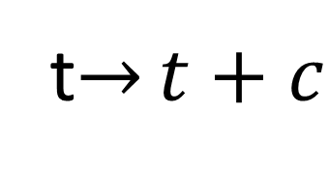
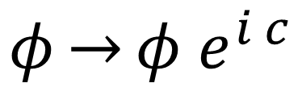
Spacetime vs Internal Symmetries
Standard global symmetries:
Internal
Spacetime
$$φ\overset{→}{}φ e^{i c}$$
t$\overset{→}{}t+c$
Conserved Charge
Conserved Energy

Slide 32
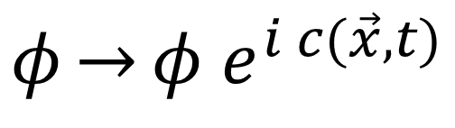
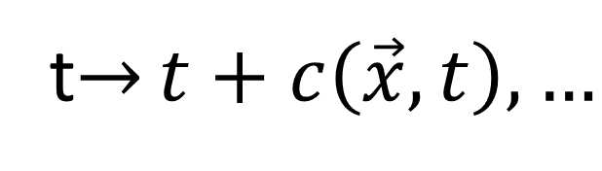
Spacetime vs Internal Symmetries
Gauge Redundancies:
Internal
Spacetime
t$\overset{→}{}t+c\left(\vec{x},t\right), …$
Gauge Theory:
Maxwell, Standard Model
Einstein Gravity

Slide 33
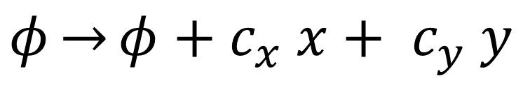
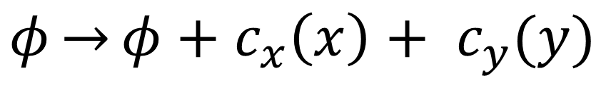
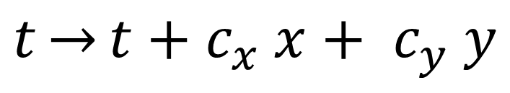
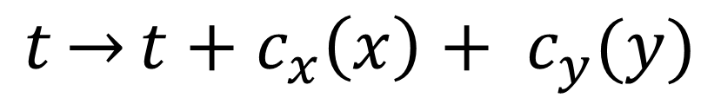
Spacetime vs Internal Symmetries
Subsystem Symmetries:
Internal
Spacetime
$$φ\overset{→}{}φ+c_{x}\left(x\right)+ c_{y}(y)$$
$$t\overset{→}{}t+c_{x}\left(x\right)+ c_{y}(y)$$
$$φ\overset{→}{}φ+c_{x} x+ c_{y} y$$
$$t\overset{→}{}t+c_{x} x+ c_{y} y$$
?
Charges conserved on submanifolds
Conserved dipole moments
Potentially Fractons

Slide 34
Questions for today:
Can we write non—trivial continuum field theories with spacetime subsystem symmetries?
What are the physical consequences?

Slide 35
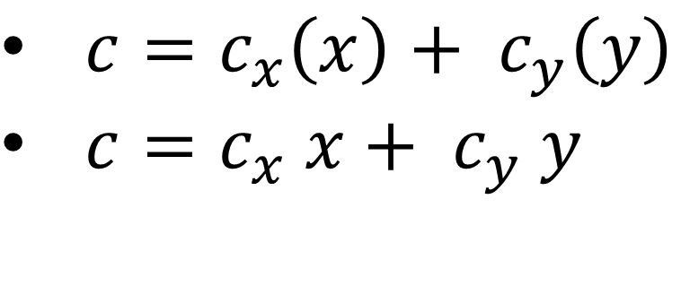
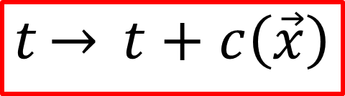
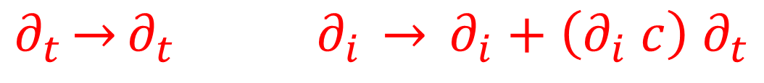
What are we aiming for?
$$t\overset{→}{} t+c\left(\vec{x}\right)$$
locally conserved energy
${c=c}_{x}\left(x\right)+ c_{y}\left(y\right)$
${c=c}_{x} x+ c_{y} y$
energy conserved on lines
conserved moment
Transformation Rule:
$$∂_{t}\overset{→}{}∂_{t } ∂_{i} \overset{→}{} ∂_{i}+\left(∂_{i} c\right) ∂_{t}$$

Slide 36
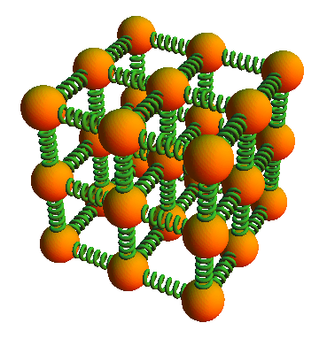
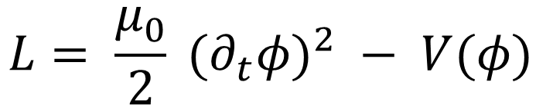
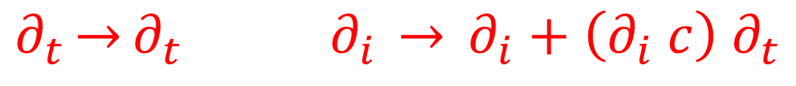
Example 1:
$$∂_{t}\overset{→}{}∂_{t } ∂_{i} \overset{→}{} ∂_{i}+\left(∂_{i} c\right) ∂_{t}$$
time derivative invariant
$$L= \frac{μ_{0}}{2} (∂_{t}φ)^{2} − V(φ)$$
(Birdussi, Hartong, Have, Musaeus, Prohazka;
Chen, Liu, Sun, Zheng)
Balls and Springs
--- without Springs
Obviously energy conserved on site!

Slide 37

“All balls but no springs” = Carrollian limit
Galilean limit: c →ꚙ
Carrollian limit: c → 0
Local time translation = Carroll boost
Relativistic Scalar
“A slow sort of country!” said the Queen. “Now, here, you see, it takes all the running you can do, to keep in the same place. If you want to get somewhere else, you must run at least twice as fast as that.”
Abbns

Slide 38
Do better?
$$∂_{t}\overset{→}{}∂_{t } ∂_{i} \overset{→}{} ∂_{i}+\left(∂_{i} c\right) ∂_{t}$$
Use two scalars:
$$D_{ti}^{12} = \left(∂_{t}φ_{1}\right)(∂_{i}φ_{2})−\left(∂_{i}φ_{1}\right)(∂_{t}φ_{2})$$
is invariant!!
Our theory:
$$L= \frac{μ_{0}}{2} \left[(∂_{t}φ_{1})^{2}+(∂_{t}φ_{2})^{2}\right]+(D_{ti}^{12})^{2}− V(φ_{1},φ_{2})$$

Slide 39
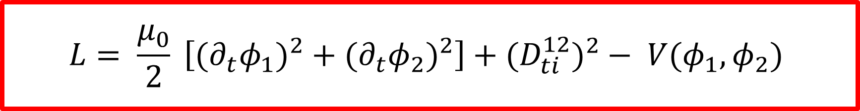
$$L= \frac{μ_{0}}{2} \left[(∂_{t}φ_{1})^{2}+(∂_{t}φ_{2})^{2}\right]+(D_{ti}^{12})^{2}− V(φ_{1},φ_{2})$$
Non-trivial spatial gradients
Local energy conservation
Momentum flows normally
Hamiltonian highly non-linear
Can be deformed to theories with conservation on planes, …

Slide 40
What we didn’t do yet:
Quantization?
Lattice Model?
Integrability?
Experimental Realizations?

Slide 41
Conclusions
Field theories with subsystem symmetries call into question many preconceived notions from standard quantum field theory text books.
We still don’t know the answer to
“What is a quantum field theory?”

